Slide 1

Kelly Sinnapah Mary. “Vagina, Jyoti Singh Pandey” Photography/drawing Variable dimensions 2013- 2015
Shivanee Ramlochan, Everyone Knows I am a Haunting

Slide 2
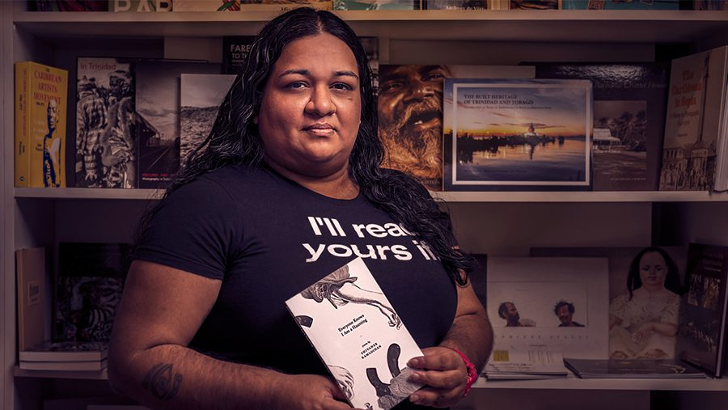

Slide 3
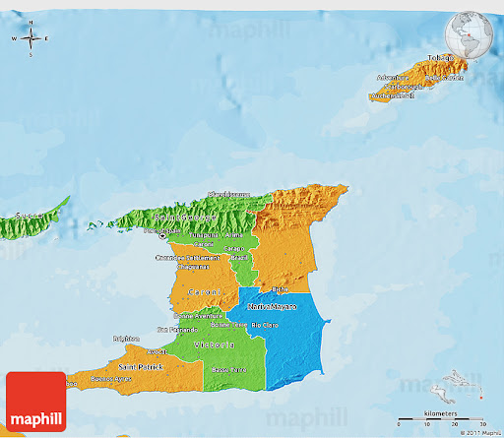
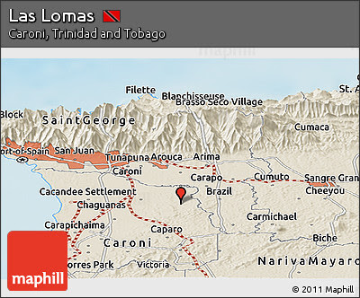

Slide 4

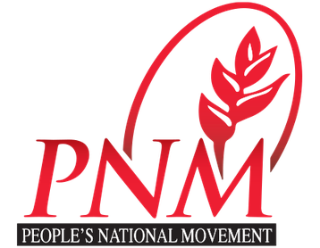
United National Congress Party
vs.
the People’s National Movement

Slide 5
India in the Caribbean
Following the abolition of slavery in 1834/38, the planters sought to resolve what they perceived as a ‘labour shortage’
Turn to another of Britain’s colonial possessions, India
1836 reply from a Calcutta firm engaged in Indian indentureship: “We are not aware that any greater difficulty would present itself in sending men to the West Indies, the natives being perfectly ignorant of the place they go to or the length of voyage they are undertaking.”
May 1838 the first ships carrying Indian indentured laborers arrived in British Guiana

Slide 7
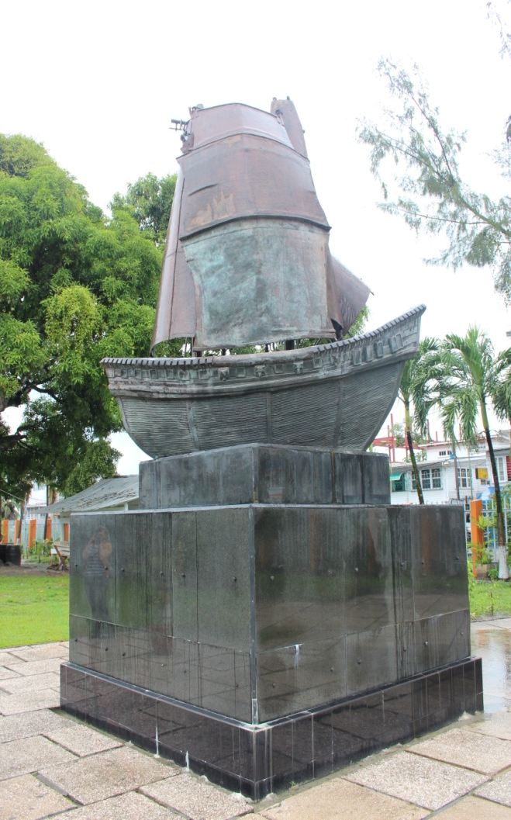
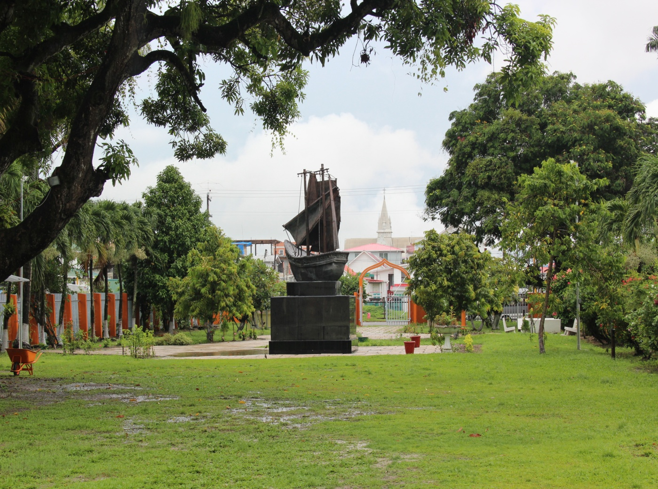
Indenture:
contracts agreed upon by Indian migrants to the Caribbean involved a five-year period of indenture with provision of return passage, free housing, medical attention and standard rations, in return for work of around nine hours per day, six days per week

Slide 8
“Song of the Only Surviving Grandmother”
While I sleep,
you cut through cane
You wash the baby-work from your legs
and turn back to the farm. [. . .]
At night thirty years before I get born,
your lost children whistle through gaps in the farm floor,
culling up from the earth,
ghost-limbs swelling from mapepire snakebite. (55-56)

Slide 9
“Like many Indo-Caribbean women and people of my generation and other generations preceding and following mine, I was raised in a communal culture of Black Suspicion and Indian Superiority. If my parents didn’t dispense this ideology in clear, calculated language (they did not) it was nonetheless all around me. I was not so much *taught*, as I *understood*, that the worst thing (yes, thing) you could bring home was a big black man™. I *understood*, rather than *learned*, that I should be proud of my culture, ‘preserved and intact’ as it was, sailed across treacherous kala pani and the brutalities of indenture. I was led to feel grateful that I had an identity I could wear like a sari, recite like a mantra, cook like dhal.” https://preelit.com/2020/06/07/shivanee-ramlochan/

Slide 10
“My mother is Roman Catholic, the product of an Indo-Caribbean family subject to, and (largely) happily resident in, Christian proselytization. My father’s people are Hindu. With neither parent didactic in their approach to household gods, I found myself positioned reflectively in the grey space between both faiths in my girlhood. I was drawn to but did not understand Hinduism; I understood more of, but was not drawn to Christianity or any of its chambers. This faithful/faithless doubt, rapture, and curiosity I’ve grappled with for two and a half decades has seeped into everything I do, I imagine.”
https://jacket2.org/commentary/coolitude-poetics-interview-shivanee-ramlochan

Slide 11
“A Nursery of Gods for My Half-White Child”
“Ganesh
means some names come before even your mother’s”
“Kali says [. . .] / If you must cry for a man, do it dancing on his skull.”

Slide 12
“Vivek Chooses His Husbands”
Corpus Christi gave his body up between bites of bread,
leavened a Sunday on your tongue so hot
that you chased the burn with olive oil,
sprung from some garden where other men
have fallen to their knees.
You knifed the best sounds of him clean
with eucharist-butter, blessed the back and the sides of the body,
going over catechism scars with tonguepoint,
cock heavy and poised for betrayal. (70)

Slide 13
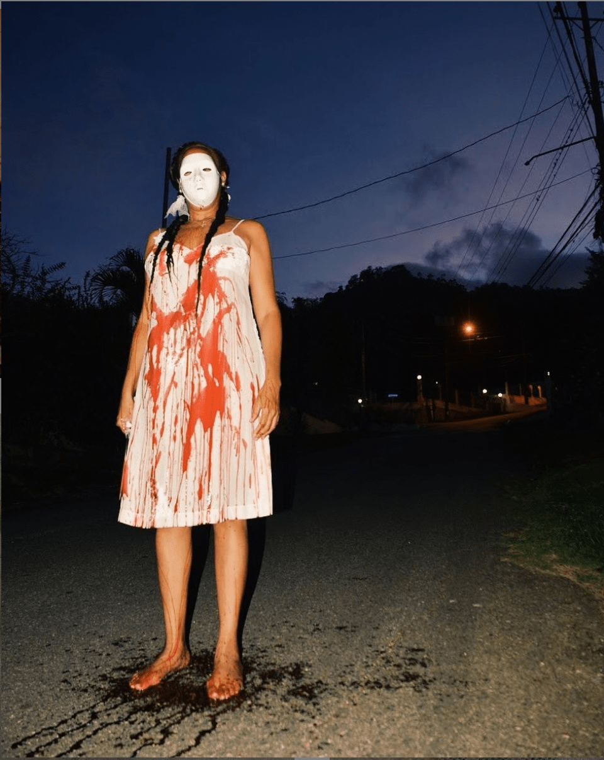
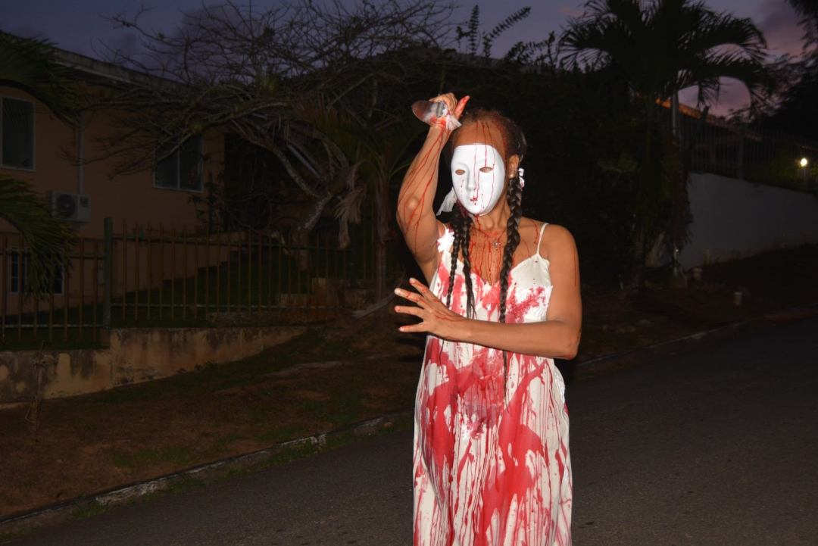
Adele Todd, “Blood Mas” (2021)

Slide 14
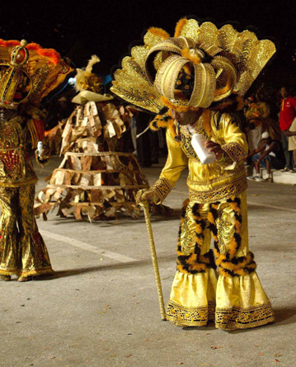
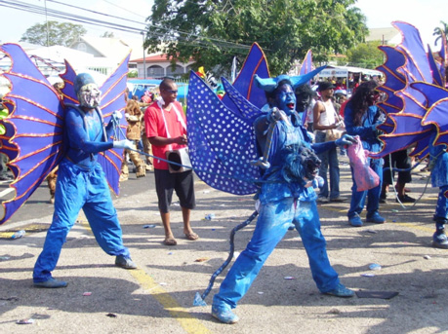
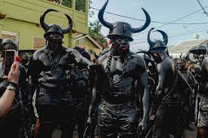

Slide 15
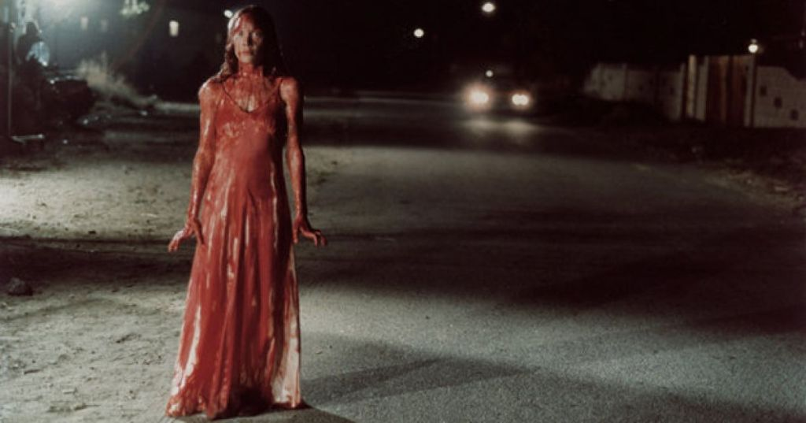
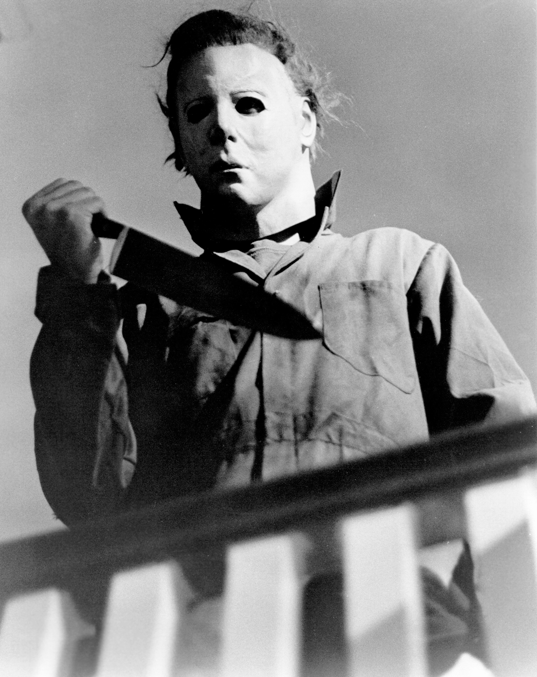

Slide 16
“I See That Lilith Hath Been With Thee Again”
Love,
I saw our daughter in the grocery store again.
This time, she’d discarded the old shoes,
because finally,
her hooves are coming through.

Slide 17
“As of [March 2023], the murder toll across the twin island state of Trinidad and Tobago was on track to overtake last year’s all-time high. As rates rise, more women are being killed than at any point in history. As of May, this year’s death toll was at 280, already overtaking the same period of 2022 – a year which saw 614 violent deaths. The Caribbean nation, with a population of about 1.5 million, now has the sixth-highest crime rate in the world.”
https://www.theguardian.com/global-development/2023/jun/16/the-caribbean-island-of-trinidad-grapples-with-a-national-crisis-of-violence

Slide 18
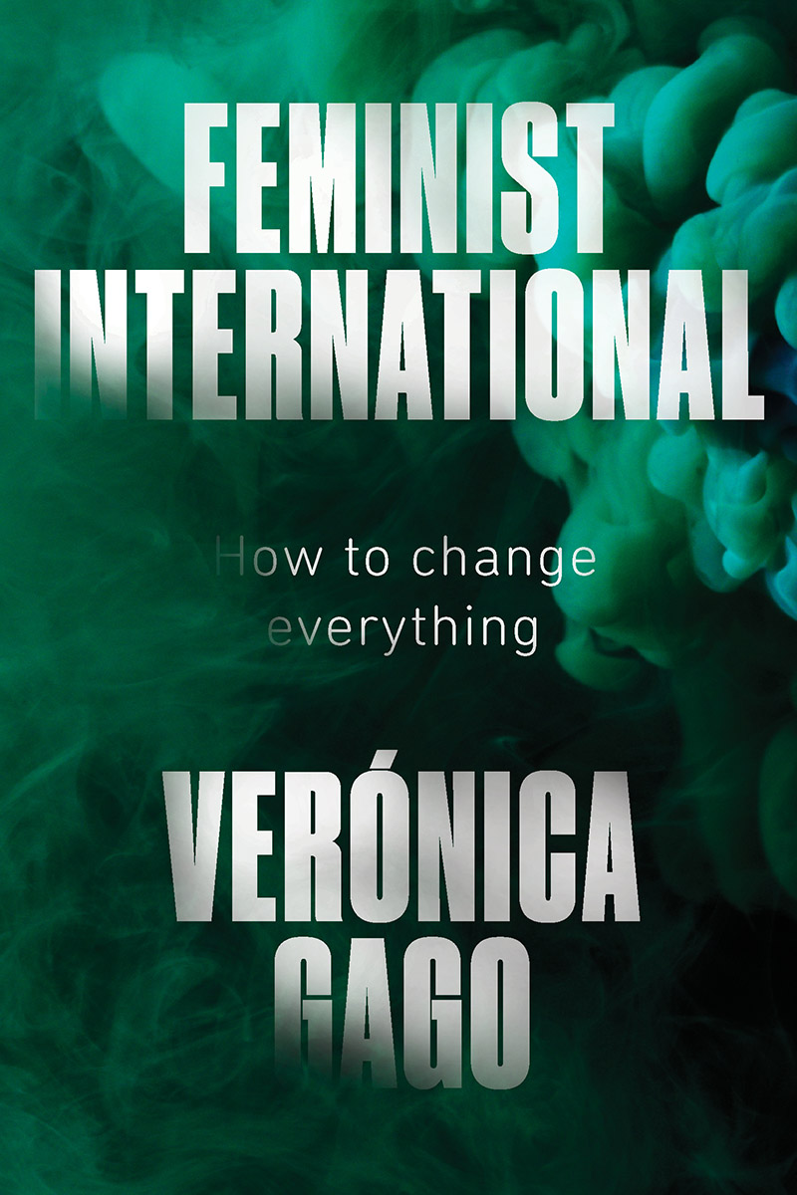

“My hypothesis is that today the war against women is expressed in four special scenes that are the foundation of femicides, that are the underlying layer of their prior production, or paraphrasing Marx, their primitive accumulation, and that there is a logic of connection between them:
The implosion of violence in households as an effect of the crisis of the figure of the male breadwinner…
The organization of new forms of violence as the principle authority in working class neighborhoods based on the proliferation of illegal economies …
The dispossession and looting of the common land and resources that enable communitarian life by transnational corporations… depriving other economies of their material autonomy.
The articulation of forms of exploitation and extraction that share the common element of the financialization of social life, and particularly the apparatus of debt.”

Slide 19
Gago: “The war against women, as [Silvia] Federici characterizes it, is an ‘original’ moment that is repeated in each new phase of ‘primitive accumulation’ of capital: in other words, that which is deployed over the social field, prior to a time of extreme instability of the relations of command-obedience and exploitation. The idea that there are historical moments when violence becomes a productive force for the accumulation of capital [. . .] is fundamental for understanding the current phase of dispossession at various scales.” (Feminist International)

Slide 20
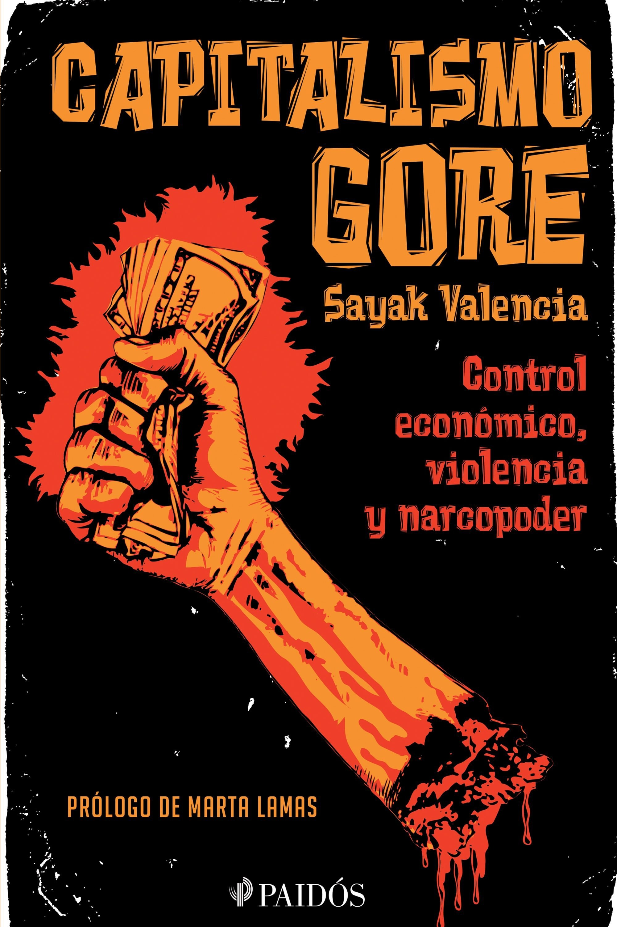
We take the term “gore” from a genre of films characterized by extreme, brutal violence. Thus, “gore capitalism” refers to the undisguised and unjustified bloodshed that is the price the Third World pays for adhering to the increasingly demanding logic of capitalism. It also refers to the many instances of dismembering and disembowelment, often tied up with organized crime, gender and the predatory uses of bodies, [which are now central to capital accumulation]. (12)
In this context, “the force of work is replaced by gore practices, understood as the systematic and repeated use of the most explicit forms of violence to produce capital.” (45)

Slide 21
“Public Holiday”
“His breath was molasses. He chewed my spine, snapped cervical
wires, suckling
marrow and electricity under his sweet tongue. [. . .]
His clean shoulders disappeared into the drink, steady with my neck
in his molars, ground down to pink dust and spit.” (44)

Slide 22
“Feminist Manifesto Against Mega-Mining and the Colonial Patriarchal Extractivist Model”
“The deepening of extractivist policies does nothing more than reinforce the historical oppression of women. This form of labour exploitation relegates women to two ‘destinies’: to precarious and overexploited work and/or to the role of ‘family caregivers,’ undertaking invisible work” (2013).

Slide 23
“Materna”
“Let her struggle each night in a
mangrove thicket; let her wince at the
deforester’s blade on her back,
probing,
testing three canals filled with raw hurt.” (27)
“Nail It to the Barn Door Where It Happened”
“This is how you survive it.
When the doctor stitching the torn seam of your sex
pauses to tend a text message,
spit on him.” (37)

Slide 24
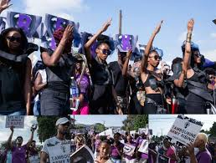
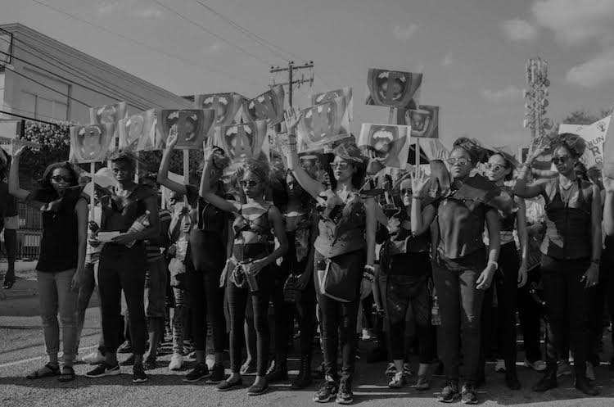

Slide 25
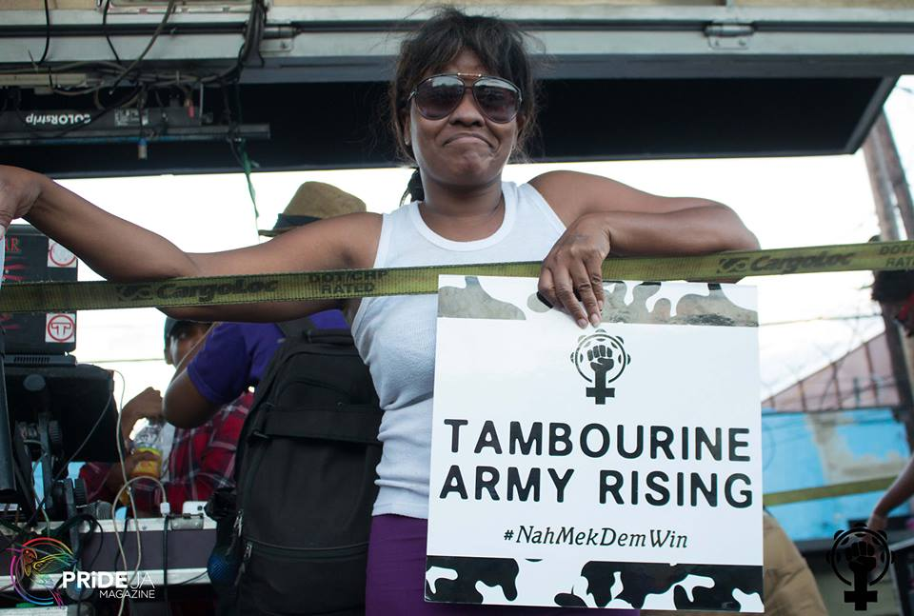

Slide 26

Patricia Joan Saunders: “Equal Rights” became a de facto anthem for many rude gyals during the watershed moment of the Tambourine Army [. . .] and the Jamaica’s Survivor Empowerment March. All these utterances of women’s political, social, and sexual freedom found their amplification by reverberating against heterosexist, patriarchal institutions that systematically threatened and even shamed women into silence not only in Jamaica but also globally. The sexually explicit lyrics in “Equal Rights” called, without apology, for women’s sexual and political needs to be addressed head-on (all puns intended)” (Buyers Beware, 19)

Slide 27
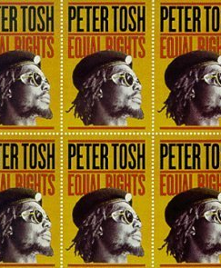
“Everyone is crying out for peace
None is crying out for justice
[. . .]
But there will be no peace
'Till men get equal rights”

Slide 28
Saunders: “Ishawna’s “Equal Rights” both marked a confluence of political crises at the center of Jamaican society and had immediate relevance to Ishawna’s own experience with domestic abuse [. . .]. Her appropriation of Tosh’s 1977 call to political action, in addition to opening Tosh’s song to a gendered critique, links the social and political climate of the late 1970s, when women were very susceptible to physical violence and domestic abuse, to 2017, the year her song was released when the abuse and violence had not abated” (135)

Slide 29


Slide 30
Saunders: “By the time she came to her signature song, which was the closing number, crowds of women rushed to the front of the stage and began to sing along with her. [. . .] Most of the men in the audience had retreated from the front of the stage, the message having been delivered: this space and set were woman centered, women occupied, and unapologetically aimed at women’s sexual empowerment. In this last regard, Ishawna had torn a page from Peter Tosh’s call for equal rights and justice in his song by the same name but had used it to create another social and political watershed moment in Jamaican popular culture.” (141)

Slide 31
Bounty Killer:
“So, if Ishawna think she as go come here and talk about bumpa pon forehead, you ah go let Ishawna tell unno bout bumpa to badman forehead? No bumper to badman forehead!”
Ishawna is “mi daughter and mi love her, but we need to guide her.”

Slide 32
“I’ve been in love with nasty women long before that term acquired currency as a trending battle cry. This is the reason Kali is the god of my household of one – no sanitised version, but Kali in her black-skinned, murderous, protectorate ire and grace. It’s my honour to write about women who bleed, fuck, dance, cuss, transact and thief without apology, be they gentle or garrotte-hearted.” (https://wasafiri.org/content/interview-shivanee-ramlochan-monique-roffey/)

Slide 33
“All the Dead, All the Living”
Play yuhself.
Clay yuhself.
Wine en pointe and wine to the four stations of the cross,
dutty angel,
bragadang badting,
St. James soucouyant,
deep bush douen come to town
to make a killing in mud and mudder-in-law
on fresh doubles, after. (49)

Slide 34
Play all the dead and all the living in you,
in yuh shortpants,
in yuh badjohn drawers,
in yuh ragged fishnets and curry-gold battyriders,
in yuh half-top, in yuh no-top,
breasts swinging under electric-tape nipples. (49)

Slide 35
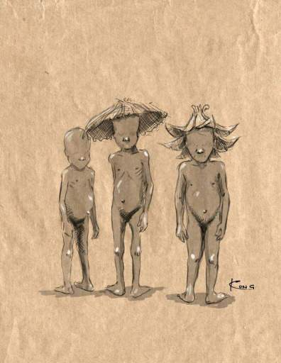
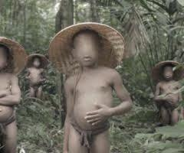

Slide 36
“Duenne Lorca”
“Darling son, the dark is here. Take your father’s bois and skirt
to the eyelid of forest edge.
[. . .]
Darkling son, neither female nor filial
[. . .]
Dreadling son, I am but one mother, tail and all.
Tell your sisters I am sorry.
Tell the woods you will make a faithful bride.”
“Nothing the forest raises is a monster.”

Slide 37
Coolie, Coolitude, Qoolitude
“The concept of Coolitude was coined by Indo-Mauritian poet Khal Torabully in 1992, redefining “India” and the Coolies’ relationship to India—and to other cultures—in the setting of their adoptive homelands by [. . .] foregrounding past struggles and migrancy rather than looking backward to an imagined homeland. Theoretically, a “cross-cultural vagabondage [cultural vagrancy] is at its heart”. India is no longer at the center of understanding the diasporic self; the trauma of passage and plantation is embraced rather than disavowed, becoming the heart of Coolitude.” (Rajiv Mohabir, "The Haunted Cane Fields of Queer Indo-Caribbean Poetry and Qoolie Poetics“ in The Oxford Handbook of Modern Indian Literatures)
the ideas of “Qoolie” and “‘qoolieness …’ as methods of pursuing transgressive Indo-Caribbean means of doing nonnormative gender and sexuality, offering us important vocalities that speak through genealogies of (post)indentureship chutney feminisms … [and show] how such embodied articulations of qoolieness generate alternative forms of Indo-Caribbean citizenships, masculinities and strategies of remaking the self that move us beyond hegemonic ontological paradigms. (Ryan Persadie, “ʻMeh Just Realize Iʼs Ah Coolie Baiʼ: Indo-Caribbean Masculinities, Chutney Genealogies, and Qoolie Subjectivities.” Middle Atlantic Review of Latin American Studies 4.2 (2020): 56)

