Slide 1
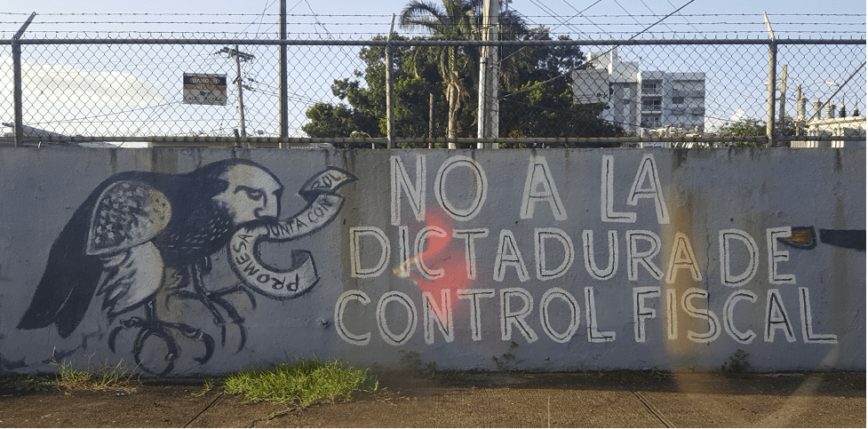
Week 9:
Unnatural Disasters

Slide 2
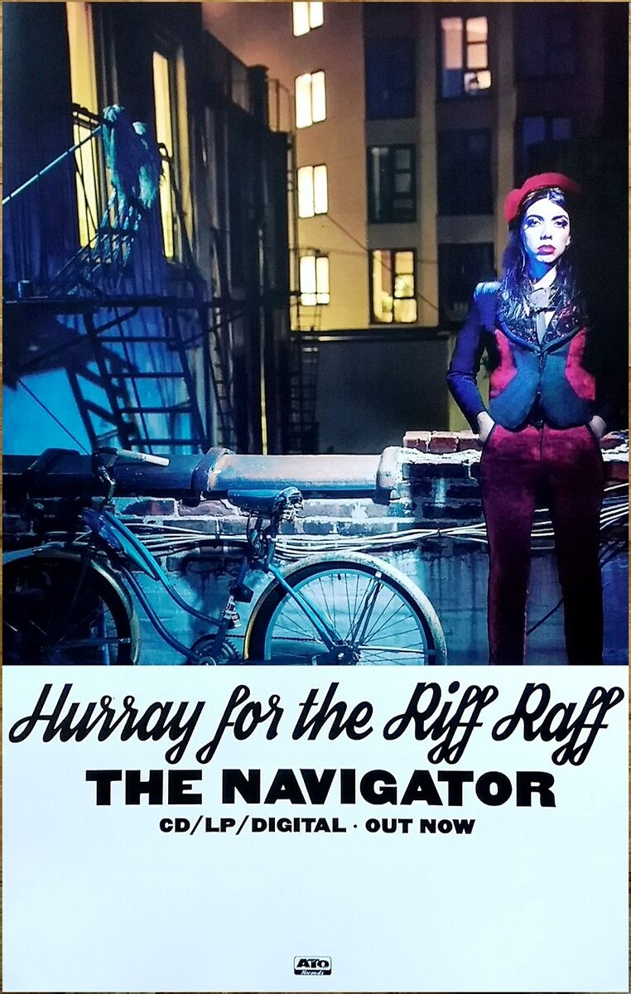
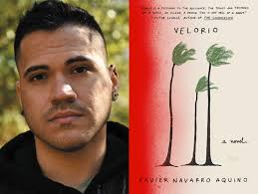

Slide 3
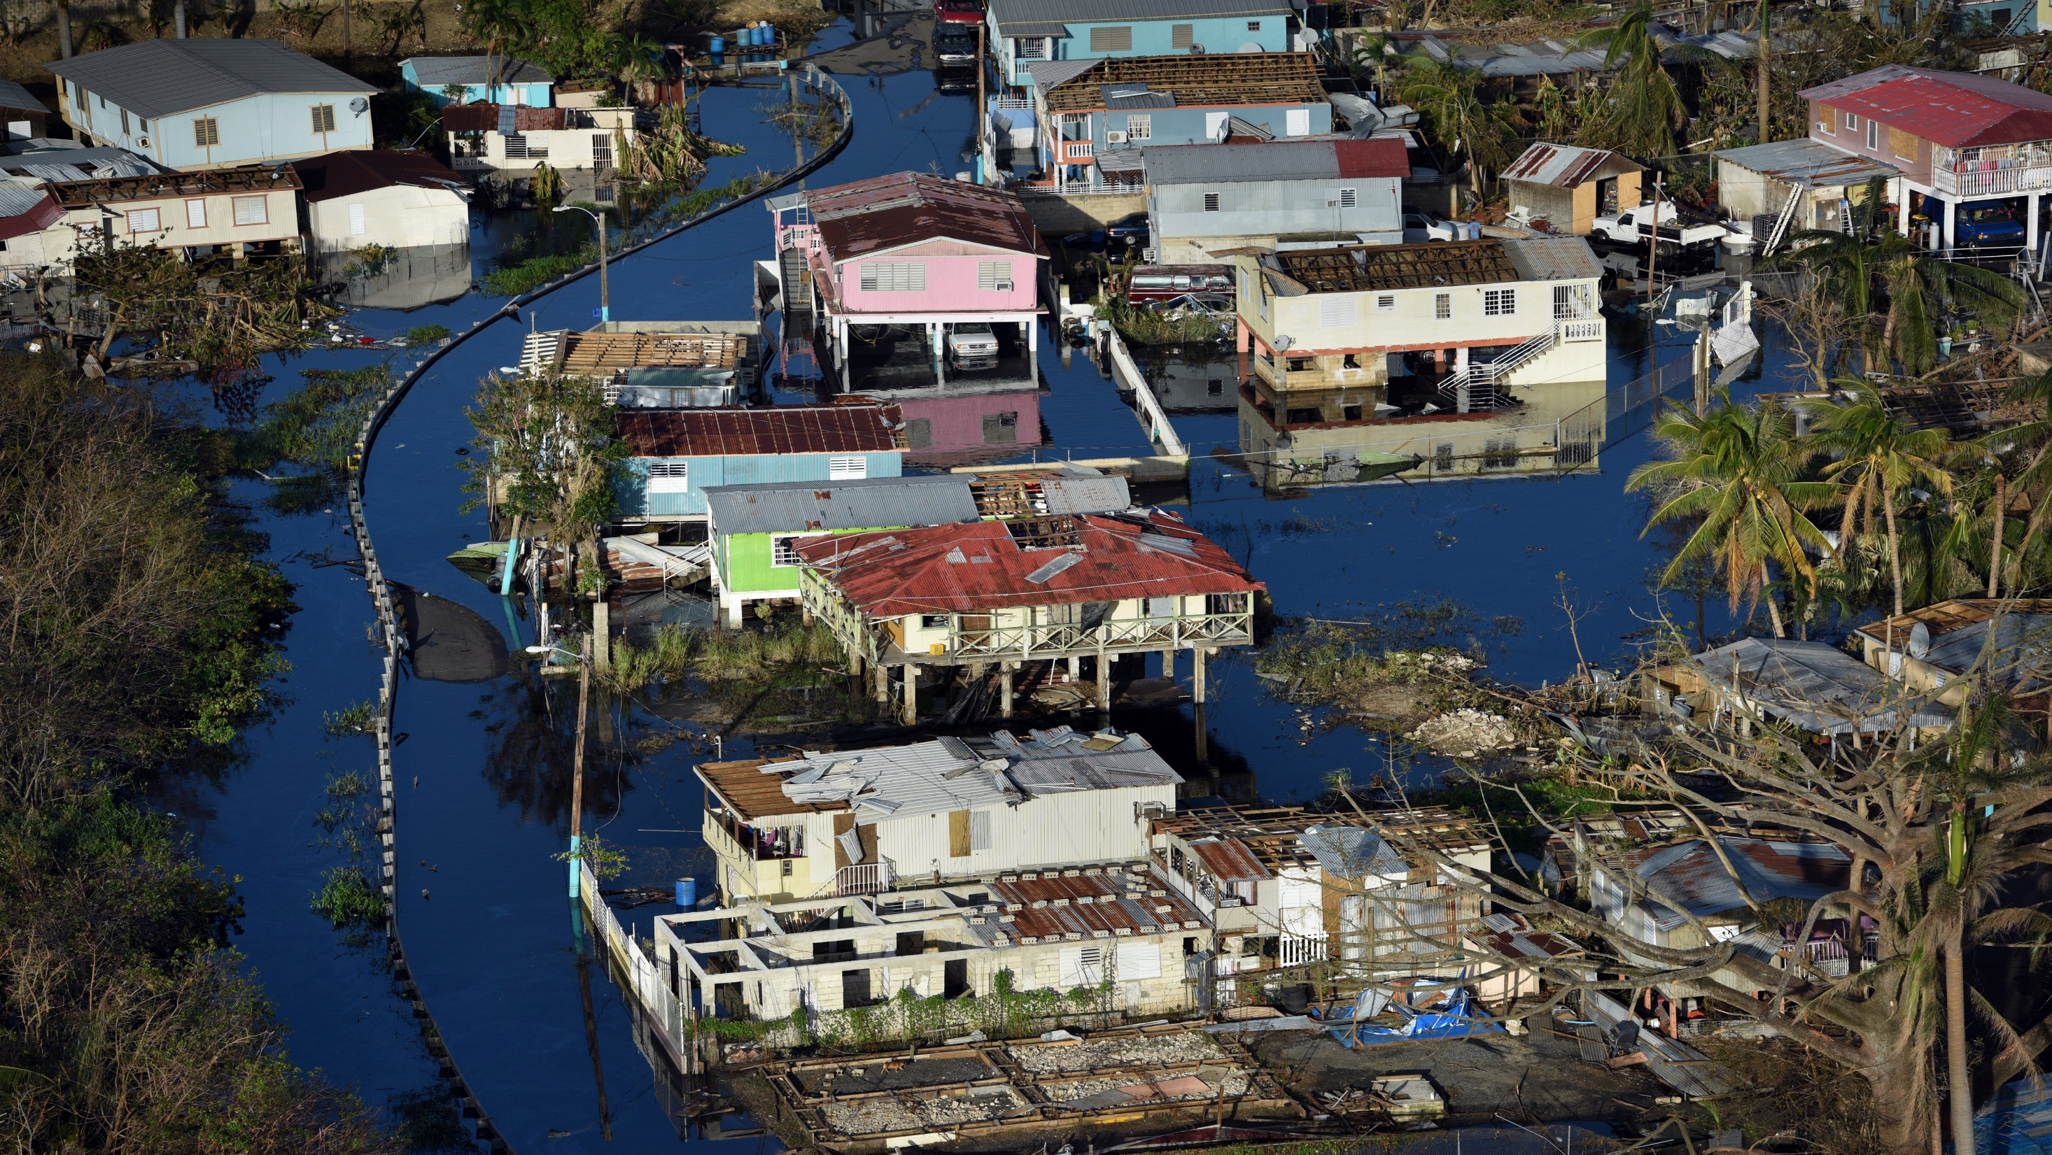

Slide 4
Natural disasters?
“It is generally accepted among environmental geographers that there is no such thing as a natural disaster. In every phase and aspect of a disaster – causes, vulnerability, preparedness, results and response, and reconstruction – the contours of disaster and the difference between who lives and who dies is to a greater or lesser extent a social calculus.” (Neil Smith, “There’s no such Thing as a Natural Disaster”, http://understandingkatrina.ssrc.org/Smith/)

Slide 5
Yarimar Bonilla and Marisol LeBrón, “Introduction” in Aftershocks of Disaster:
“We now know that the great majority of those who lost their lives to María perished not because of the storm but because of the structural failures that followed it: uncleared roads that did not allow ambulances to arrive, lack of water distribution that led residents to contaminated water sources, lack of generators in hospitals, and more than half a year without electricity to power medical equipment, refrigerate lifesaving medications such as insulin, and provide public lighting and traffic lights to prevent deadly accidents. Lives were not lost to the wind and the rain, or even to Trump’s disrespect; instead, residents drowned in bureaucracy and institutional neglect.” (16-17)

Slide 6
Bonilla and LeBron:
“It is difficult to predict when the disaster associated with Hurricane María will actually end since each aftershock creates a new series of problems that ripple out far and wide. Nor is it even clear when this disaster began. Long before María, Puerto Rico was already suffering the effects of a prolonged economic recession, spiraling levels of debt, and deep austerity cuts to public resources. This was preceded by over five centuries of colonialism (first Spanish, then American) and a long history of structural vulnerability and forced dependency.” (17)

Slide 7
Graffiti reading, “El desastre es la colonia” (“The disaster is the colony”), on a light meter six months after
Hurricane Maria, 9 March 2018. Photograph by Lorie Shaull.

Slide 8
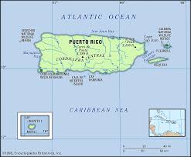
Puerto Rico
Colonized by Spain in the early 16th c.
Became a ‘possession’ of the U.S. following the latter’s victory in the Spanish-American war in 1898
“A new colonial structure was instituted through the Foraker Act of 1900. Puerto Rico was to be a "possession" of the United States, with no assurance of a future as either an independent republic or a state of the Union. The Puerto Rican possessing classes were not admitted as equal partners into the Union but rather turned into colonial subjects.” (César J. Ayala and Rafael Bernabe, Puerto Rico in the American Century: A History Since 1898, p. 52)

Slide 9
“Beginning in 1901, unimpeded trade was established between the island and the United States, while Puerto Ricans were made U.S. citizens in 1917. Thus, while determining that Puerto Rico was a possession but not part of the United States, Washington imposed on it much of the framework that had normally led to statehood. From the start, installed in what we may call the orbit of nonincorporation, the island was thus pushed and pulled in opposite directions: increasingly tied to the United States and insistently defined as not part of it.” (Ayala and Bernabe, 78).

Slide 10
“When the United States admits a new state [. . .] two things happen simultaneously that are nevertheless distinct: Congress approves legislation enabling a territory to constitute itself as a state, and the new state is admitted into the Union. In the case of Puerto Rico, Congress had enabled it to constitute itself as a state by drafting its own constitution, but then, instead of proposing to admit it into the Union, it had offered to enter into a "compact" with it. Puerto Rico had ceased to be a territory of the United States, but it had not become a state or a republic. Instead, in the process of becoming a self-governing entity, it had entered into the aforementioned ‘compact.’” (Ayala and Bernabe, 164)

Slide 11
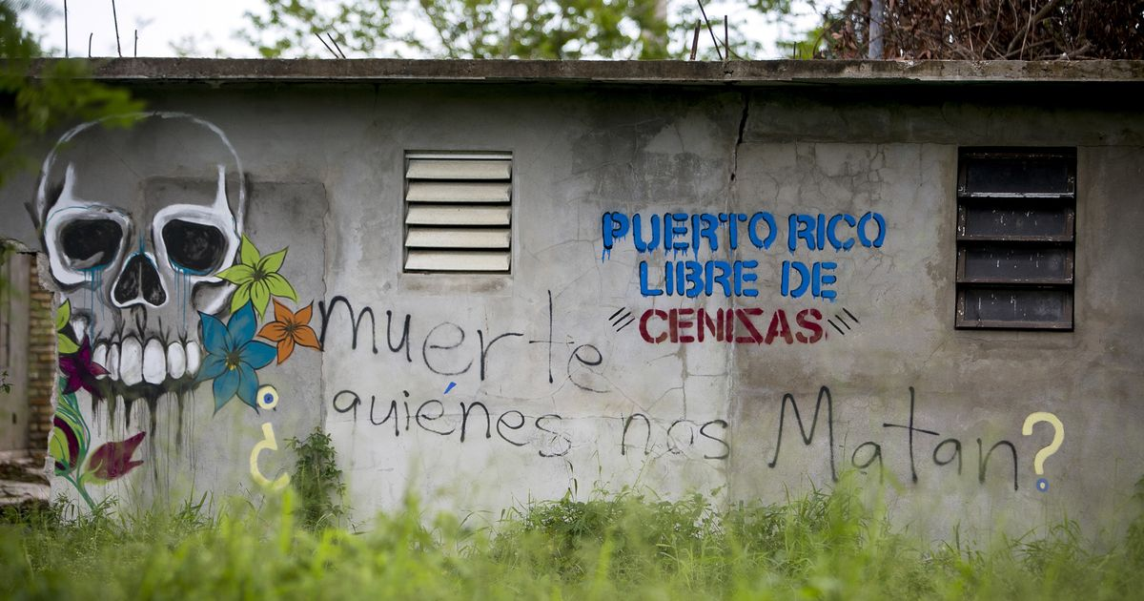
velorio = ‘wake’ / vigil for the dead

Slide 12
Aquino: Urayoán is “trying to create a society that is independent, that is trying to rebuild in its own vision a world that does not carry some of the similar scars and historical legacies of colonization or those legacies of mismanagement of government.” (https://www.npr.org/2021/12/26/1068063634/the-novel-velorio-tells-one-story-of-rebuilding-after-hurricane-marias-destructi

Slide 13
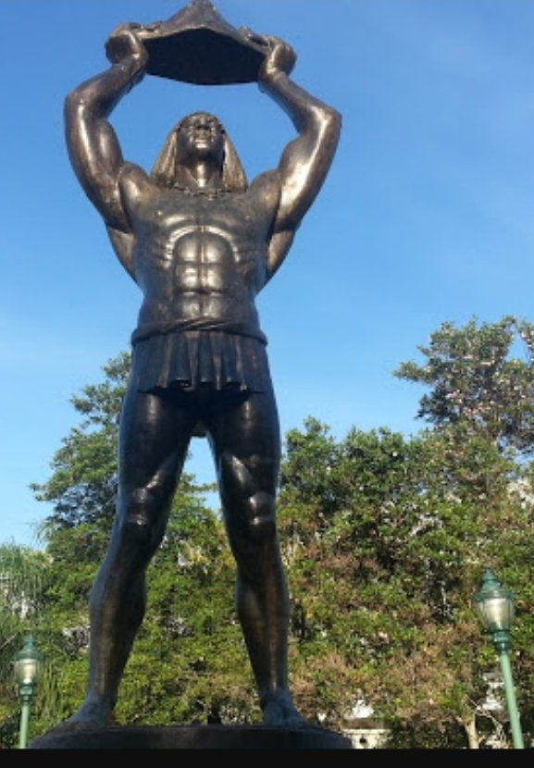
““I’m not sure what Memoria is really. I’m afraid. Afraid that Ura only sees a past and that he too is mimicry” (118).

Slide 14
“Interesting how Ura orbited around the gasoline and diesel as the only essential” (120).

Slide 15
Trump, tweeting in 2018: “3000 people did not die in the two hurricanes that hit Puerto Rico. When I left the Island, AFTER the storm had hit, they had anywhere from 6 to 18 deaths. As time went by it did not go up by much. Then, a long time later, they started to report really large numbers, like 3000 … This was done by the Democrats in order to make me look as bad as possible when I was successfully raising Billions of Dollars to help rebuild Puerto Rico. If a person died for any reason, like old age, just add them onto the list. Bad politics. I love Puerto Rico!”

Slide 16
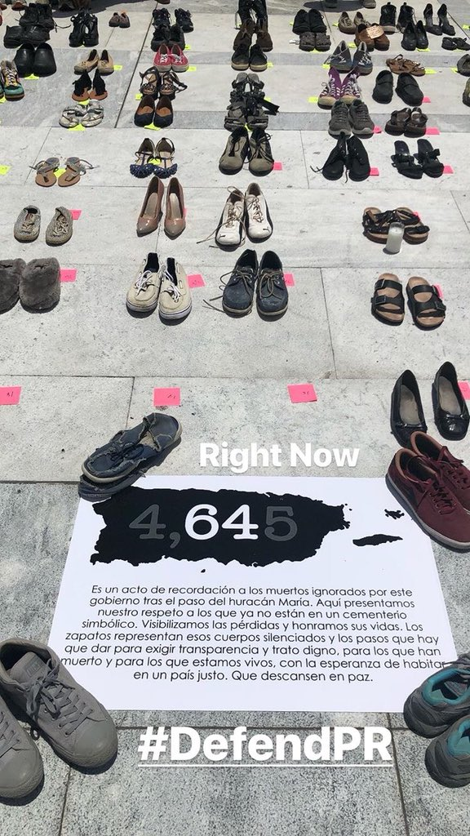
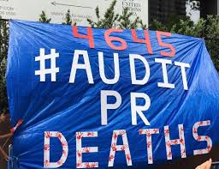

Slide 17
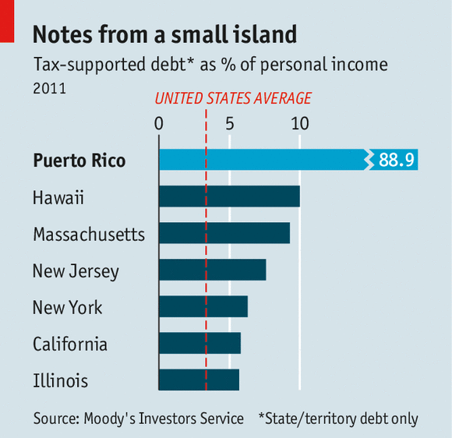
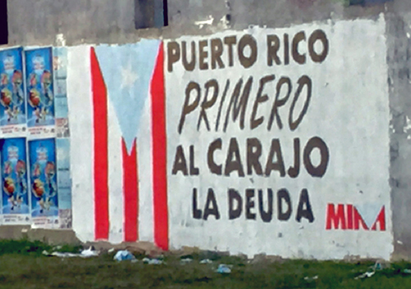

Slide 18
Ed Morales:
“Puerto Rico’s massive debt was caused primarily by its colonial relationship with the United States, which, by refusing to consider its incorporation as a state after acquiring it as war booty after the 1898 war with Spain, used it as a laboratory for the excesses of unfettered capitalism. Following a pattern of indebting or speculating on the debt of several Caribbean island nations, including Cuba, Haiti, and the Dominican Republic, Puerto Rico was established as a place where US corporations could set up shop without being taxed. Because the island had no national sovereignty, it was restricted from making trade pacts with neighbors, unable to develop a national economy that repatriated profits, and forced to go into deep debt in the form of bond issuances that were needed just to maintain operating expenses for governmental agencies and essential services.” (“Puerto Rico’s Unjust Debt” in Aftershocks of Disaster, eds. Yarimar Bonilla and Marisol LeBrón, 2019, pp. 212-213)

Slide 19
“…the deregulation of the financial sector, unleashing massive Wall Street speculation, the creation of financial instruments that bundled risky debts to be bought and sold, and unscrupulous behavior by big banks and financial institutions, which restructured debts and charged exorbitant underwriting fees. These actions caused Puerto Rico’s debt load to increase sevenfold from the year 2000 to present; it has sold $61 billion in bonds to Wall Street since 2006, the final year of the section 936 tax breaks.” (Morales, 213)

Slide 20
“Under the current fiscal plan orchestrated by the congressionally appointed Federal Oversight and Management Board—created by the 2016 Puerto Rico Oversight, Management, and Economic Stability Act, or PROMESA (meaning “promise” in Spanish)—it will take the people of Puerto Rico approximately forty years to pay over $120 billion in debt. In reality, this debt will likely never be paid in its entirety. Despite the rhetoric and all appearances to the contrary, creditors do not actually expect Puerto Rico to pay off this debt. What investors expect and desire is for Puerto Ricans to continue paying interest on this debt, which has been inflated through speculation in financial markets. In other words, for the people of Puerto Rico the future holds the dreaded promise of more debt service, more payments to pay what cannot be paid.”
Adriana María Garriga-López, "Debt, crisis, and resurgence in Puerto Rico." Small Axe: A Caribbean Journal of Criticism 24.2 (2020): 122-132.

Slide 21
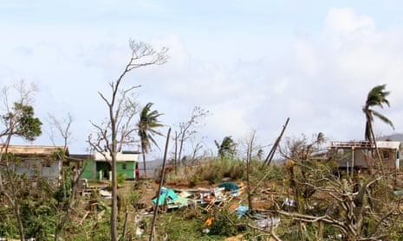
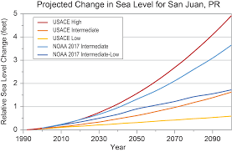

Slide 22
Naomi Klein, The Battle for Paradise: Puerto Rico takes on the Disaster Capitalists:
“It’s hard to imagine an energy system more vulnerable to climate change–amplified shocks than Puerto Rico’s. The island gets an astonishing 98 percent of its electricity from fossil fuels. But since it has no domestic supply of oil, gas, or coal, all of these fuels are imported by ship. They are then transported to a handful of hulking power plants by truck and pipeline. Next, the electricity those plants generate is transmitted across huge distances [. . .]. The whole behemoth is monstrously expensive, resulting in electricity prices that are nearly twice the U.S. average.
And just as environmentalists [. . .] had warned, Maria caused devastating ruptures within every tentacle of Puerto Rico’s energy system: The Port of San Juan, which receives so much of the imported fuel, was thrown into crisis, and some 10,000 shipping containers full of much-needed supplies piled up on the docks, waiting to be delivered. Many truck drivers couldn’t make it to the port, either because of obstructed roads, or because they were struggling to get their own families out of danger. With diesel in short supply across the island, some just couldn’t find the fuel to drive. The lines at gas stations stretched out by the mile. Half of the island’s stations were out of commission altogether.” (16-17)

Slide 23
“The people that brought the Energy my entire life warned that if something were to happen to the roads, the Energy would be difficult to repair” (5)
“The Shell station was swarmed with metal – a line of cars wrapped around the station and disappeared long into the stretch of road” (19)
“One day, Damaris and I stood at a Gulf station again, waiting on the gasoline to come from the old government, But the trucks never came” (43)

Slide 24
Operation Bootstrap (or, industrialization by invitation)
inaugurated in 1947
predicated on: foreign (U.S.) direct investment; tax breaks; lower wages in Puerto Rico
“In twenty years, the island was transformed from a largely agricultural district into an export-oriented manufacturing platform with decaying agricultural activity. This inversion bypassed the possibility of a more balanced and complementary relation between industry and agriculture. The adoption of the North American model of an automobile-centered life meant a rapid passage from rural and semirural settlement to suburban sprawl. By 1970, photographs of pre-194O and even pre-195O Puerto Rico had acquired the aura of images from a distant past, and the lived experience of the younger generations felt a world apart from that of their grandparents and even their parents, who had reached adulthood as Operation Bootstrap picked up pace in the 1950s. (p. 180)
César J. Ayala and Rafael Bernabe, Puerto Rico in the American Century: A History Since 1898

Slide 25
“Another twentieth century policy that continues to haunt Puerto Rico is Operation Bootstrap. Beginning in the 1940s, this industrialization-by-invitation initiative implemented loopholes and tax incentives, thus positioning Puerto Rico as a destination for wealthy investors and corporate polluters, including the pharmaceutical and fossil fuel industries. This form of “petrochemical colonialism” targets precarious communities that are in contemporary times exploited not by slave owners but “by the petrochemical industry executive as the new ‘master’ and ‘overseer’”. Puerto Rico’s current energy mix continues to be shaped by this heavy carbonization initiative. According to the Puerto Rico Energy Commission (PREC, 2016), petroleum, natural gas, coal, and renewables constitute 62, 18, 17, and 3 percent of Puerto Rico’s energy mix, respectively. Those numbers translate into a reliance on imported fossil fuels for 97 percent of the Big Island’s energy needs, causing residents to pay two to three times more than the average US household on their electricity bills.”
Catalina M. de Onís, “Energy Colonialism”

Slide 26
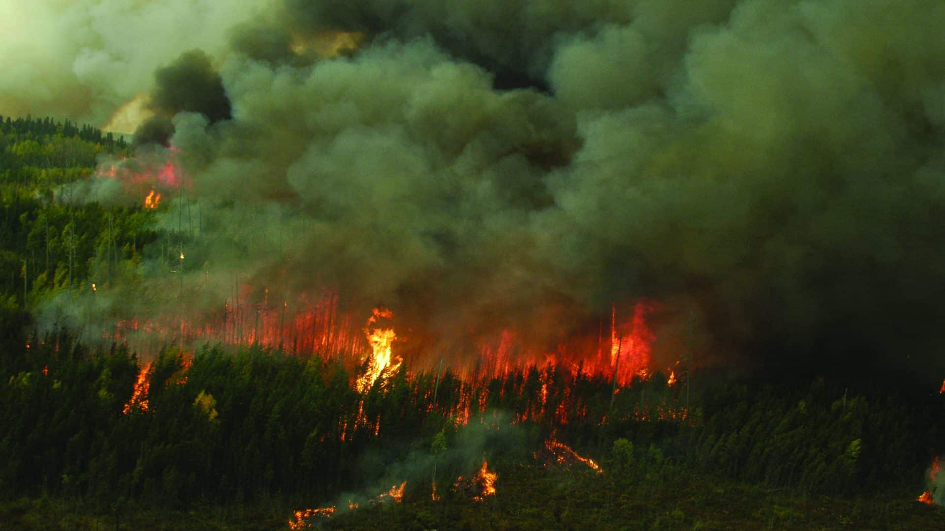
“Interesting how Ura orbited around the gasoline and diesel as the only essential” (120).

Slide 27
Klein: “…in the coastal community of Jobos Bay, near Salinas. This is one of the areas coping with a slew of environmental toxins, much of it stemming from antiquated fossil fuel-burning power plants. [. . .] Residents here have seized on the post-Maria electricity failures to advance solar power [. . .]. Working with local academics, they have developed a plan that would not only produce enough energy to meet their needs, but would also keep the profits and jobs in the community as well. [. . .] When I visited the area, Mónica Flores, a graduate student in environmental sciences at the University of Puerto Rico who has been working with communities on renewable energy projects, told me that truly democratic resource management is the island’s best hope. People need to have a sense, she said, that “this is our energy. This is our water, and this is how we manage it because we believe in this process, and we respect our culture, our nature, everything that is supporting us.”
Months into the rolling disaster set off by Maria, dozens of grassroots organizations are coming together to advance precisely this vision: a reimagined Puerto Rico run by its people in their interests. [. . .] In the myriad dysfunctions and injustices the storm so vividly exposed, they see opportunities to tackle the root causes that turned a weather disaster into a human catastrophe.” (15)

Slide 28
For the next month or so we share our collard greens, which is the only vegetable in the garden not destroyed by Hugo, along with the food, supplies and care-packages sent to us from the mainland by our families, friends, and strangers, all of whom respond to our plight with heartwarming acts of generosity and support. These gifts of food help sustain many worse off than we are. Since not one visible banana tree survived the storm here, the Caribbean island of St. Lucia sends the gift of a boatload of ripe bananas to the people of St. Croix. On Saturday the wharf at Gallows Bay is filled with people picking up their bunches of bananas, many seeing each other for the first time since Hugo.
Audre Lorde, “Of Generators and Survival—Hugo Letter,” Callaloo 14.1 (1991): 75

Slide 29
Ryan Cecil Jobson: “For Lorde, Hugo inaugurates a temporal rupture. Postdisaster time is defined less by the contours of the capitalist working day than by repertoires of solidarity and care. She does not romanticize the latter. Care is accompanied by pain and desperation. “Remembering how that first yellow banana from St. Lucia tasted, three weeks after Hugo,” she adds, “still brings tears to my eyes.” In this moment, the sharing of supplies, foodstuffs, and first aid serves as a model for a different form of living. Submarine unity is articulated in the form of emergency relief. Locally cultivated collard greens and a barge loaded with bananas are charged with the quintessential spirit of the gift as gestures that eclipse the arbitrary confines of the bourgeois family and nation-state alike.” ("States of crisis, flags of convenience: An introduction." Small Axe: A Caribbean Journal of Criticism 24.2 (2020): 67-77)

Slide 30
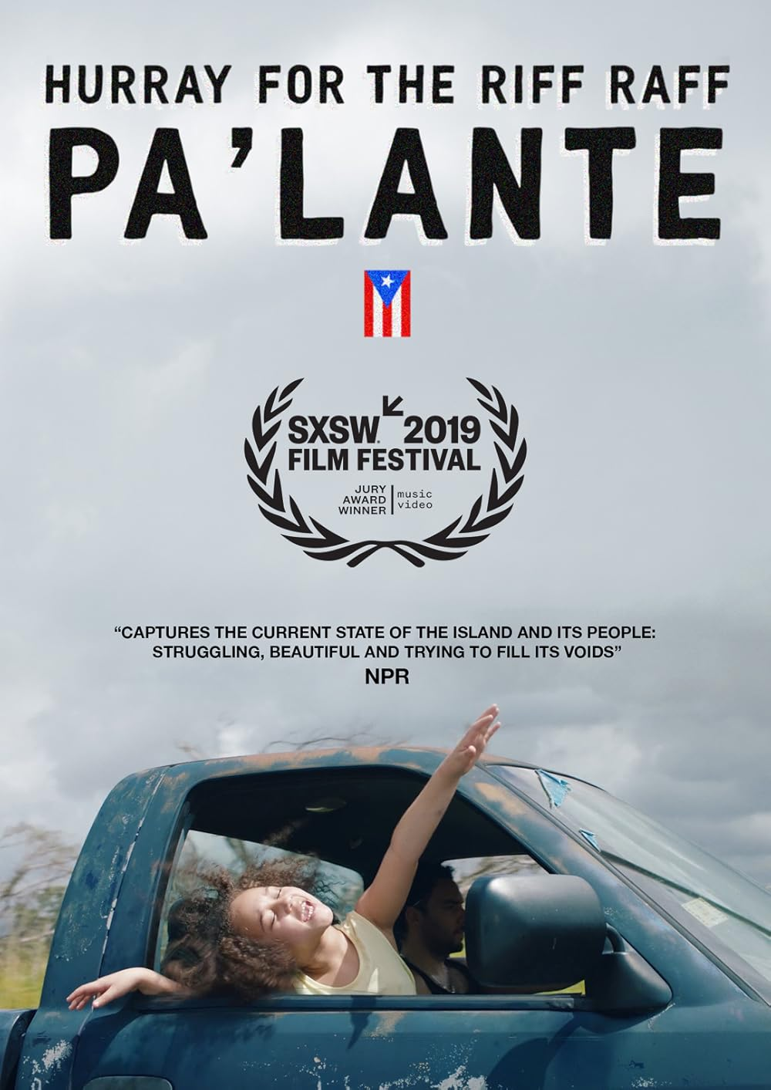
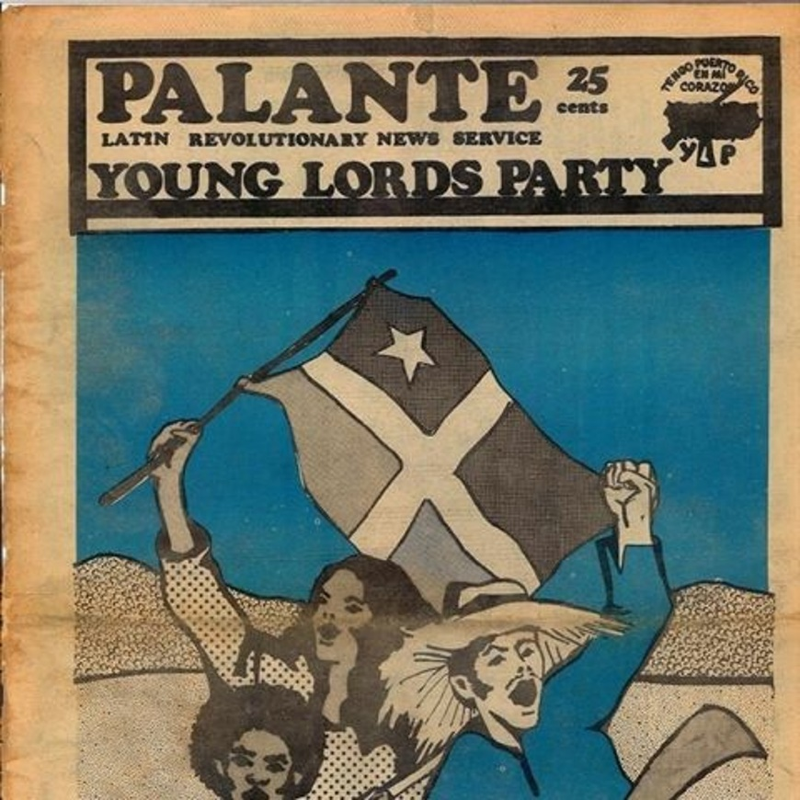
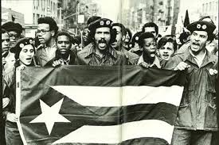

Slide 31
The Young Lords:
In the summer of 1966, the killing of Puerto Rican youth Aracelis Baez by the Chicago police led to three days of rioting, remembered as the Division Street Uprising. These protests accelerated the politicization of the Young Lords street gang, led by Jose "Cha Cha" Jimenez. The Chicago Young Lords joined the Black Panthers and other groups in community initiatives and protest actions.
A New York branch of the Young Lords Organization emerged; organized in 1969, it had a stronger student component than its Chicago counterpart.
By 1970, the New York group separated from Chicago and became the Young Lords Party. The Lords embraced the ideas of Third World anticolonialism and socialism; drew on the ideas of the Black Panthers, Fanon, Che Guevara (especially "Socialism and Man in Cuba“) and work of Mao Tse-tung.
By the early 1970s; the Lords staged marches and sit-ins, blocked streets and organized community actions, raising issues such as garbage collection, inadequate health services, lead poisoning, police harassment, abuses by landlords, and the right to bilingual education.
They published the tabloid Pa’lante; perhaps most spectacular actions, attracting wide media attention, were the eleven-day takeover of the First Spanish Methodist Church of East Harlem, the commandeering of a Department of Health X-ray truck to provide services in El Barrio, and the occupation of the Lincoln Hospital School of Nursing in the Bronx to demand adequate health installations.

Slide 32
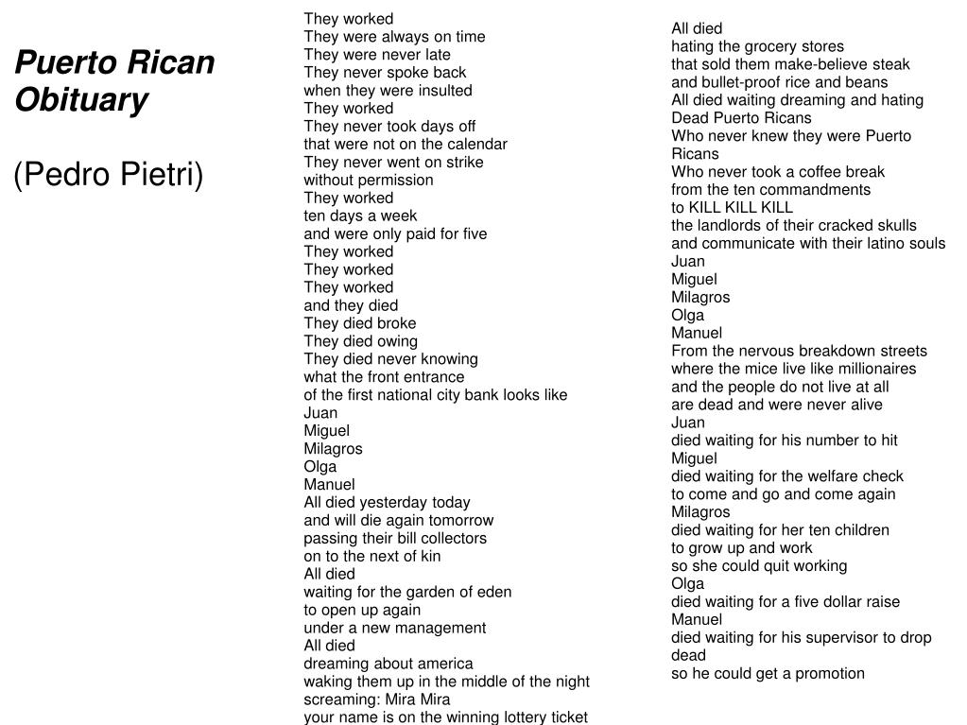
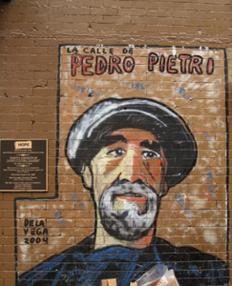

Slide 33
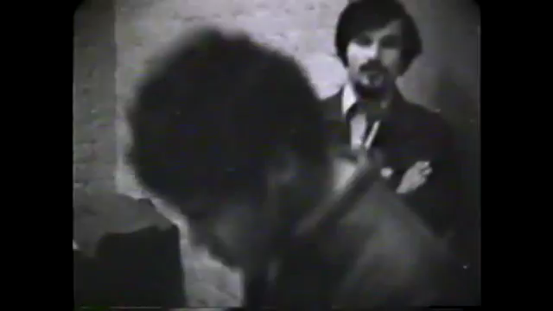

Slide 34
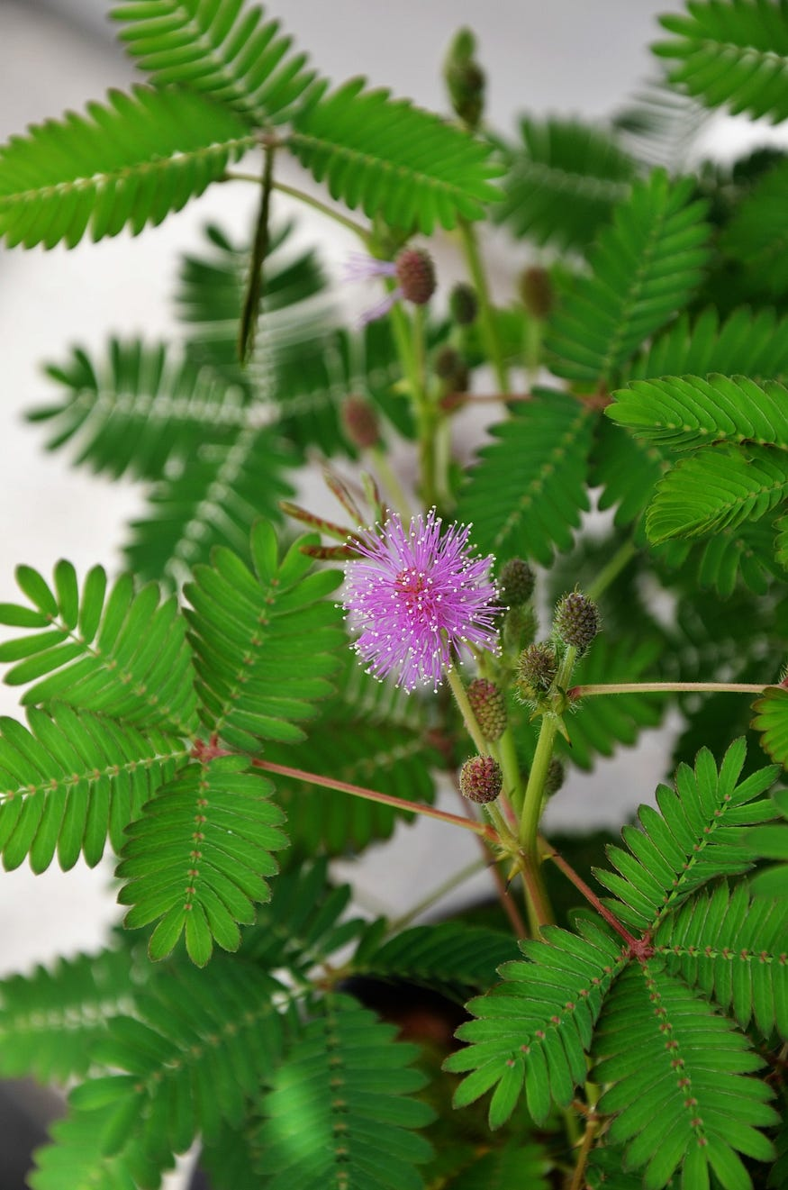
Moriviví (Mimosa Púdica)
a perennial flowering plant that closes its leaves when touched
Its name translates as ‘dielive’ or ‘I died, I lived’

