Slide 1
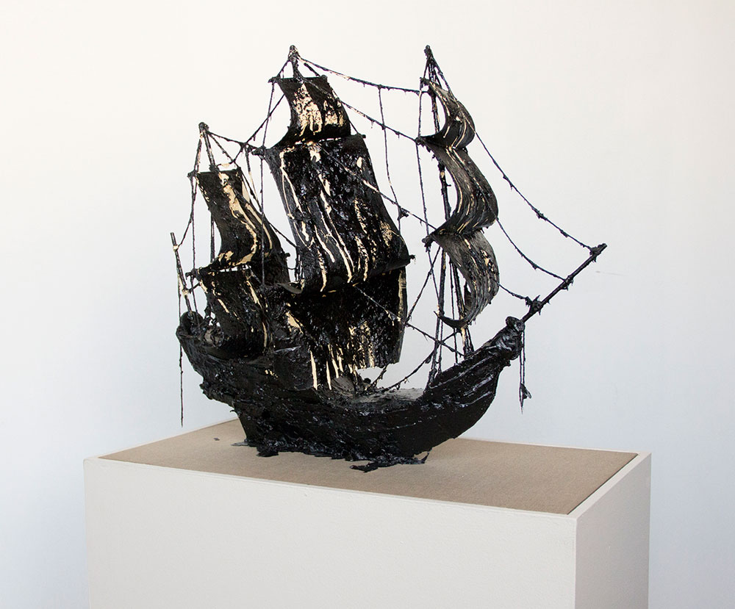
RACE:
POLITICS, PHILOSOPHY, HISTORY
Jonathan Schroeder
22 October 2019
Image Credit: Christine Tarkowski, San Dominick (tar model)

Slide 2
INTRODUCTION
Formation of the concept of race: sovereignty, race, biopolitics
  Texts: Charles Mills + Michel Foucault
Formation of the meaning of blackness: slavery
  Texts: Walter Johnson
Anti-slavery and its genres
  Texts: Karen Halttunen + William Wells Brown

Slide 3
RACE IN THE 1850s
Model 1 (Emergent): Race as visible skin difference, justified by biology
Model 2 (Dominant): Racial difference as the product of climate and environment, justified by medicine, geography, and history.
Think about when “Benito Cereno” employs one or both of these models. When and where? To which kinds of “natures” do these models correspond?

Slide 4
HIERARCHIZING MATTER
Divine
Fully human (aspirational)
Partially human (civilized)
Less human (savage)
Even less human (barbarian)
Animal (from more complex to less)
Plants (ditto)
Inorganic Matter (ditto)
The Enlightenment catalogued and classified animate and inorganic matter according to a hierarchy that runs from the divine to the simplest form of inorganic matter.

Slide 5
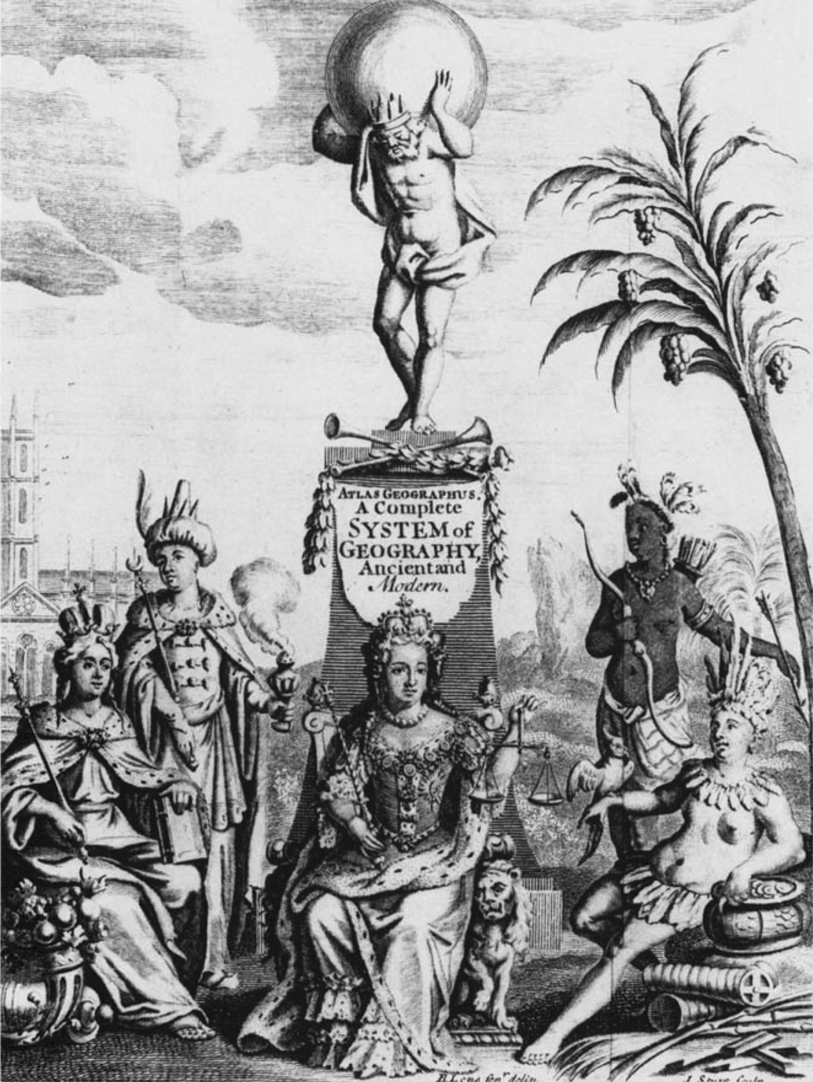
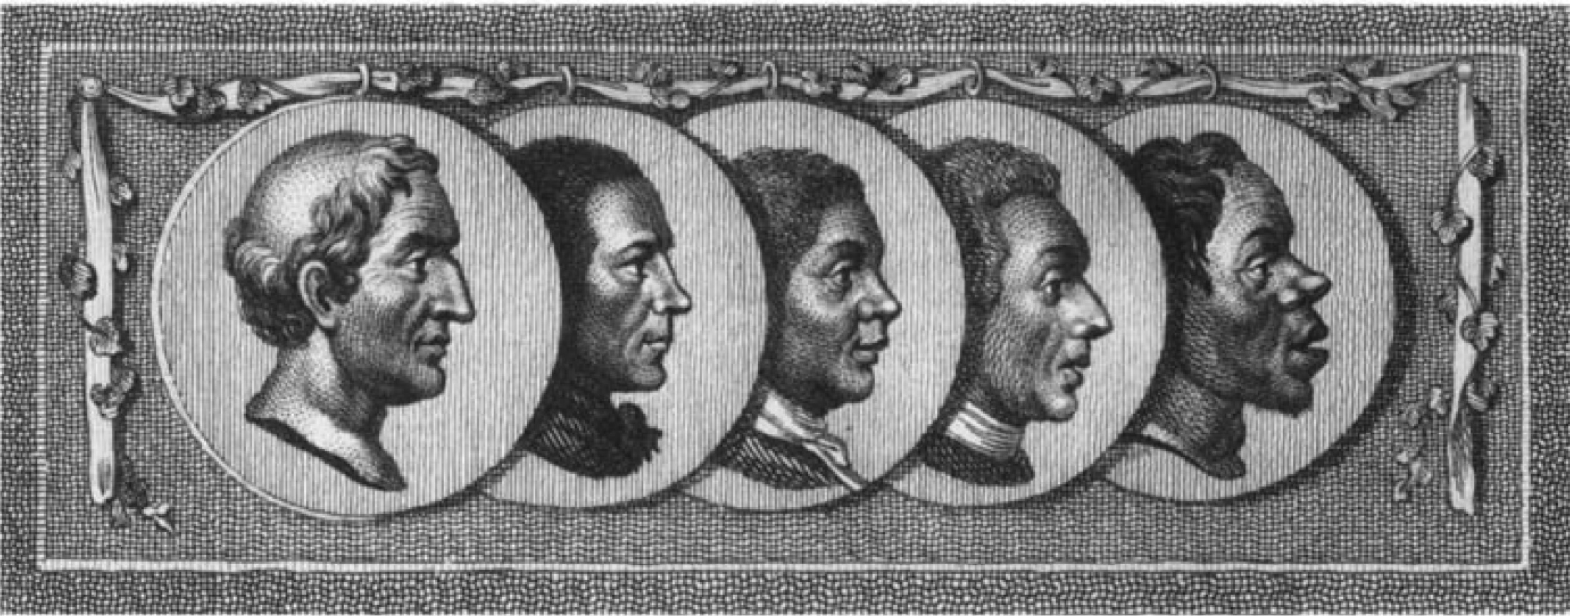
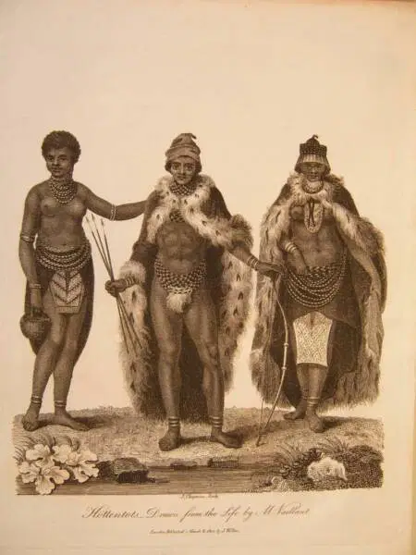
HIERARCHIZING HUMANS
The Complexion of Man (1789-98)
Early c19 engraving of Khoi/Hottentot people
Atlas Geographicus (1711)

Slide 6
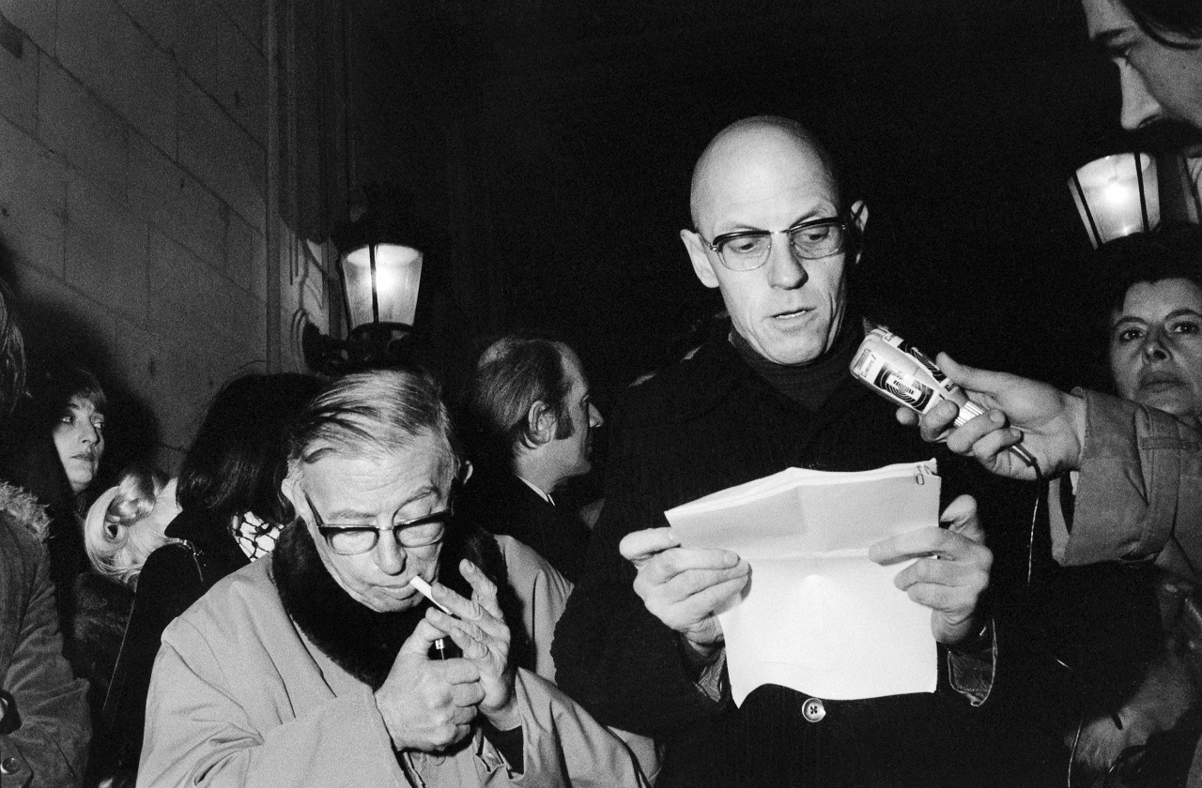

BIOPOLITICS + RACISM
Lecture 11 in

Slide 7
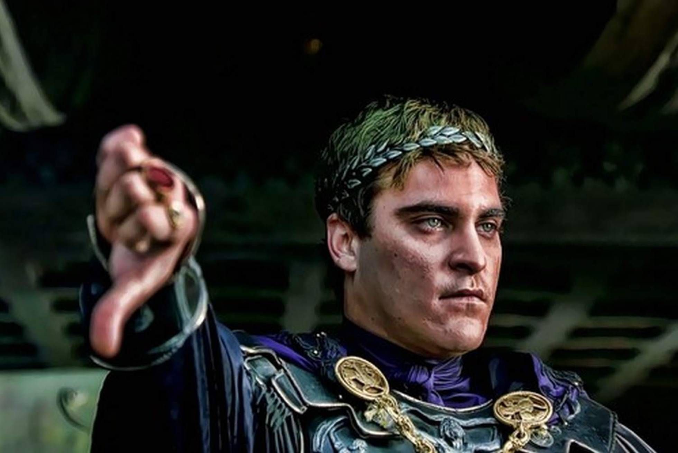
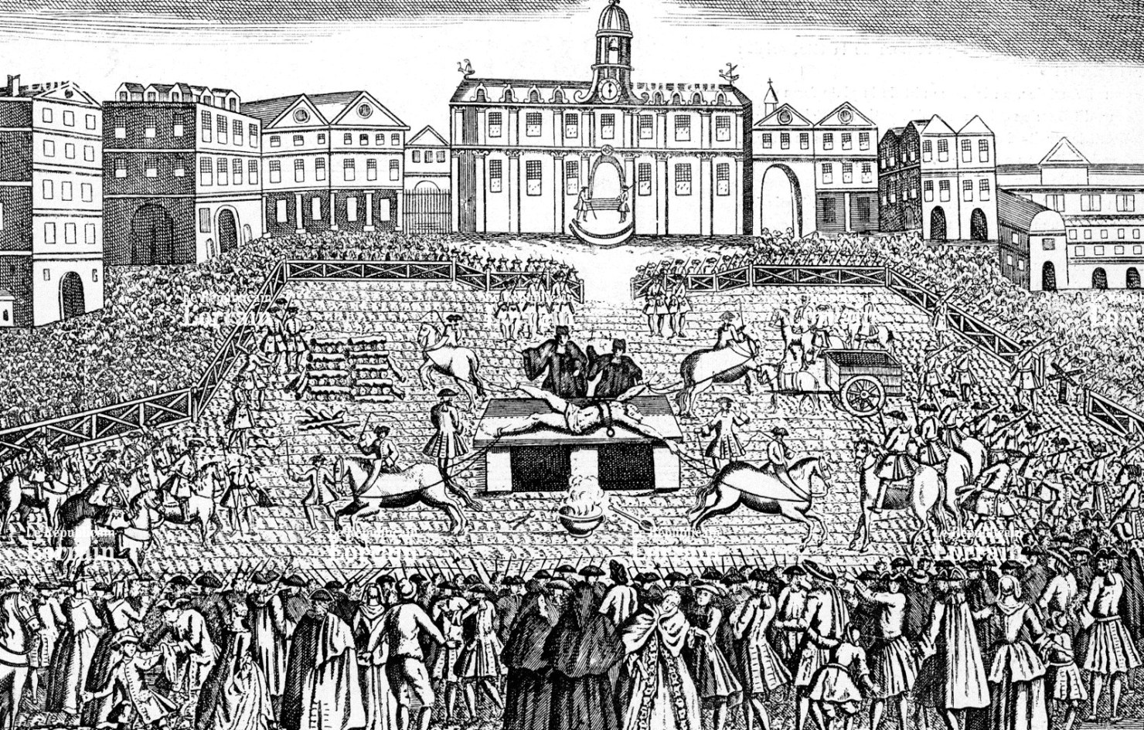
SOVEREIGNTY OF KINGS
Joaquin Phoenix as Emperor Commodus (161-191) in Gladiator (2000)
The Execution of Damiens, 1757

Slide 8


MODERN SOVEREIGNTY
Old: The right to make die and let live
New: The right to make live and let die
Q1: How does the new state power make life?
A1: Studying populations, treating groups of humans as a series of natural processes, designing ways of modifying these natural processes
Q2: Why would the new state power let things die if the whole point is increasing life? How?
A2: State racism . . .

Slide 9
STATE RACISM
[Racism] is primarily a way of introducing a break into the domain of life that is under power’s control: the break between what must live and what must die. The appearance within the biological continuum of the human race of races, the distinction among races, the hierarchy of races, the fact that certain races are described as good and that others, in contrast, are described as inferior: all this is a way of fragmenting the field of the biological that power controls. It is a way of separating out the groups that exist within a population (Foucault, 254-5)
A logic of division—installing divisions within the biological continuum of humanity.
Rationale of state racism: the overall health of the population justifies the elimination or removal or segregation of a segment of the population.
Thus National Socialism is not egregiously unique, but the extreme outcome of a biopolitical logic of normalization, regularization, and purification.

Slide 10
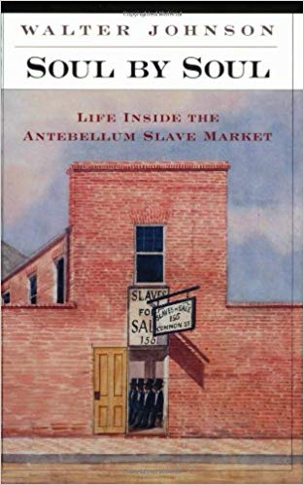
RACE AND SLAVERY
The rituals of the slave pens taught the inexperienced how to read black bodies for their suitability for slavery, how to imagine blackness into meaning, how to see solutions to their own problems in the bodies of the slaves they saw in the market. Gazing, touching, stripping, and analyzing aloud, the buyers read slaves’ bodies as if they were coded versions of their own imagined needs—age was longevity, dark skin immunity, a stout trunk stamina, firm muscles production, long fingers rapid motion, firm breasts fecundity, clear skin good character. The purposes that slaveholders projected for slaves’ bodies were thus translated into natural properties of those bodies—a dark complexion became a sign of an innate capacity for cutting cane, for example. Daily in the slave market, buyers ‘discovered’ associations they had themselves projected, treating the effects of their own examinations as if they were the essences of the bodies they examined. Passed on from the experienced to the inexperienced, from the examiners to the on-lookers, the ritual practice of the slave pens animated the physical coordinates of black bodies with the purposes of slavery (Johnson, 149).

Slide 11
RACE AND SLAVERY II
  [stream of consciousness of a poor southern white] You knew that you could hit them . . . and they would not hit back or even resist . . . [Y]ou knew when you hit them you would just be hitting a child’s toy balloon with a face painted on it, a face slick and smooth and distended and about to burst into laughing, and so you did not dare strike it because it would merely burst and you would rather let it walk on out of your sight than to have stood there in the loud laughing.
  – William Faulkner, Absalom, Absalom!
  Some near-equivalencies to consider:
The language of projection // the black body as screen (Johnson)
Treating non-normative bodies as members of a population rather than individuals (Foucault)
The epistemology of ignorance (Mills)
Amasa Delano’s “good nature” (Melville)

Slide 12
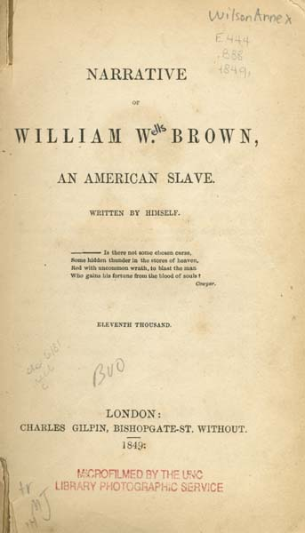
HUMANITARIANISM
The [whip] handle was about three feet long, with the butt-end filled with lead, and the lash, six or seven feet in length, made of cow-hide, with platted wire on the end of it. This whip was put in requisition very frequently and freely, and a small offence on the part of a slave furnished an occasion for its use. During the time that Mr. Cook was overseer, I was a house servant -- a situation preferable to that of a field hand, as I was better fed, better clothed, and not obliged to rise at the ringing of the bell, but about half an hour after. I have often laid and heard the crack of the whip, and the screams of the slave. My mother was a field hand, and one morning was ten or fifteen minutes behind the others in getting into the field. As soon as she reached the spot where they were at work, the overseer commenced whipping her. She cried, "Oh! pray -- Oh! pray -- Oh! pray" -- these are generally the words of slaves, when imploring mercy at the hands of their oppressors. I heard her voice, and knew it, and jumped out of my bunk, and went to the door. Though the field was some distance from the house, I could hear every crack of the whip, and every groan and cry of my poor mother. I remained at the door, not daring to venture any further. The cold chills ran over me, and I wept aloud. After giving her ten lashes, the sound of the whip ceased, and I returned to my bed, and found no consolation but in my tears. Experience has taught me that nothing can be more heart-rending than for one to see a dear and beloved mother or sister tortured, and to hear their cries, and not be able to render them assistance. But such is the position which an American slave occupies.
— Narrative of William W. Brown, an American Slave, Written by Himself (1847)

Slide 13
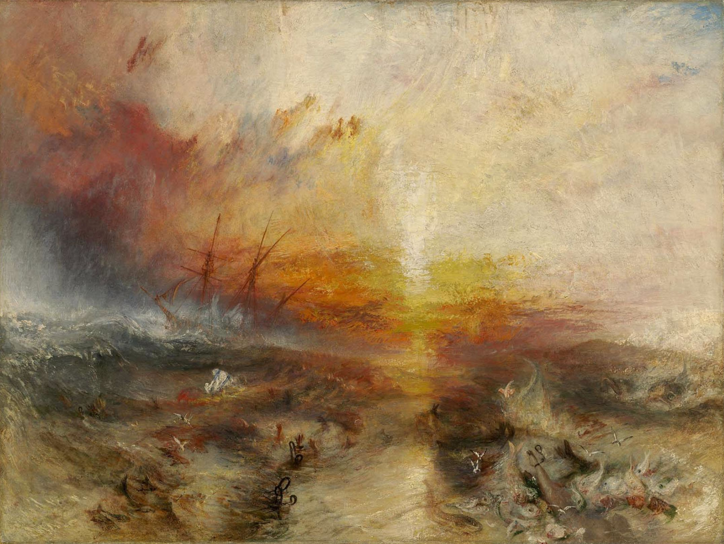
RACE: POLITICS, PHILOSOPHY, HISTORY
Image Credit: JMW Turner, Slavers throwing overboard dead and dying slaves (typhoon coming on) (1840)

