Slide 1
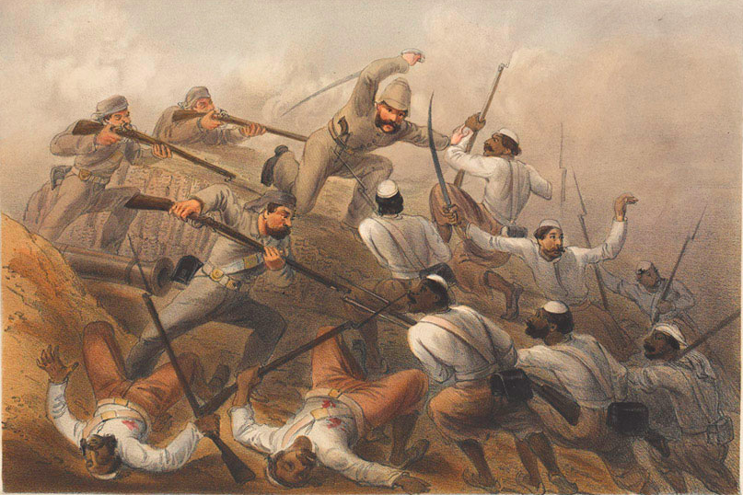
EN2J9 Writing History
Unit 2: India in 1857
Week 7:
Introduction and ‘Eyewitness’

Slide 2
Two senses of ‘history’
Michel-Rolph Trouillot’s two senses of ‘history’ –
Historicity 1 - history as ‘what happened’, or ‘the socio-historical process’
Historicity 2 – history as ‘that which is said to have happened’, or our knowledge of the socio-historical process.
Michel-Rolph Trouillot, Silencing the Past:
Power and the Production of History (1995), 2-3

Slide 3
Problems of the ‘events’ of 1857-8 in India
Suggests that there was a single, cohesive ‘event’ – rather than a fragmentary, disaggregated series of conflicts
Events of 1857-8 ‘in India’ not actually nationwide, nor primarily centred on the nation as we generally understand it
Implies that conflicts of 1857-8 were somehow exceptional to a norm of ‘profoundly tranquil’* colonial rule – whereas ‘In fact armed revolt was endemic in all parts of colonial India.’**
*This phrase was used in Lord Dalhousie’s final Minute as Governor-General, 28 Feb. 1856
(quoted in Gautam Chakravarty, The Indian Mutiny and the British Imagination (Cambridge, 2005), 36
**C.A. Bayly, Indian Society and the Making of the British Empire (Cambridge, 1988), 180

Slide 4
Our concern in this unit
The governing question for ‘Writing History’: where does history as a meaningful account of the past come from?
The operation of power in the production of historical knowledge (by both British and Indian writers)
What constitutes an historical ‘event’, and is there a common historical ‘reality’ underlying textual representations of the uprising?
How do we read sources without assuming that their primary function is to represent ‘what happened’?

Slide 5
Today’s lecture
Background: the British in India, 1608-1856
Knowledge and power in colonial India
The uprising, 1857-8
The uprising as text(s)
Eyewitness: three readings

Slide 6
Today’s lecture
Background: the British in India, 1608-1856
Knowledge and power in colonial India
The uprising, 1857-8
The uprising as text(s)
Eyewitness: three readings

Slide 7
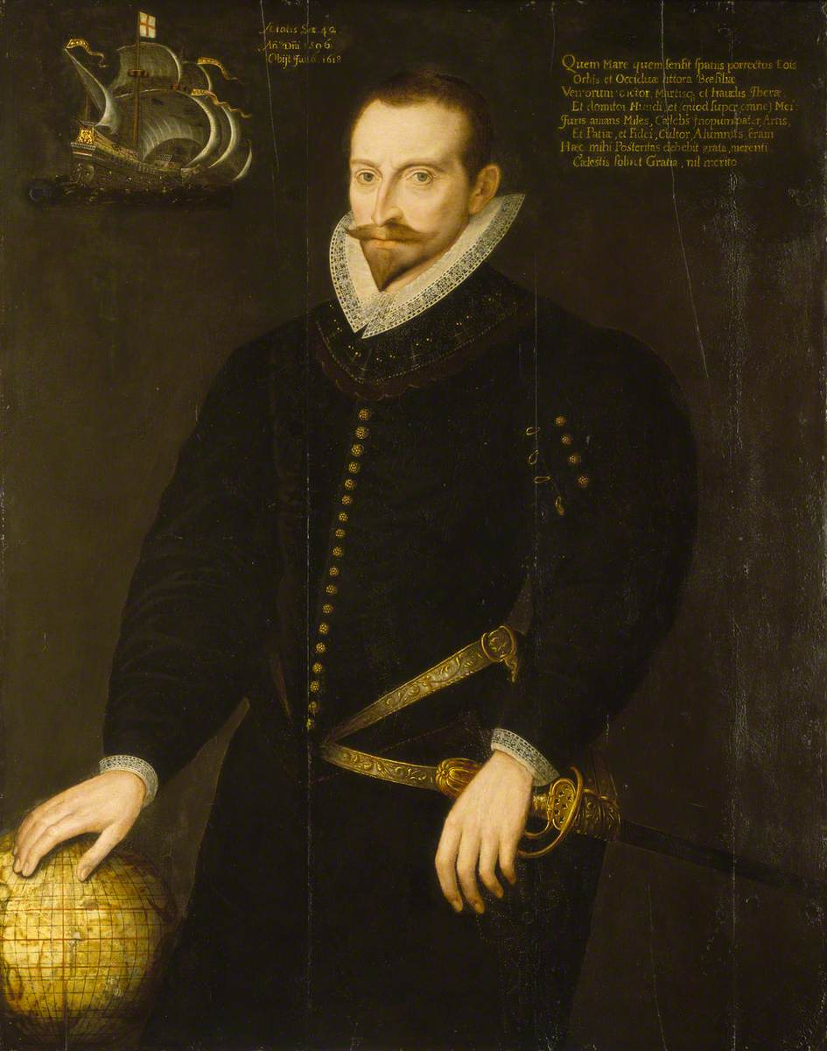
The East India Company
East India Company formed by Royal Charter 31 Dec. 1600, with monopoly of English trade with Asia
Lands in India 1608, sets up first ‘factory’ (trading post) at Surat in Gujarat, by permission of the Mughal Emperor
Company remains dependent on goodwill of the emperor throughout C17 and (at least nominally) C18
Principal English trading post the Fort St. George, Madras from 1639
Sir James Lancaster (c.1554-1618), commander of the first English ship to reach the ‘East Indies’

Slide 8
Origins of British power in south Asia
Anglo-French conflict in India as extension of the War of Austrian Succession (1740-8)
India also a theatre of the global Seven Years War (1756-63)
1756: Nawab of Bengal expels East India Company from its most economically valuable province
1757: Battle of Plassey - British forces under Robert Clive defeat Nawab of Bengal
Robert Clive and Mir Jaffar (Bengali commander, supported the British at Plassey) after the Battle of Plassey (painting by Francis Hayman)

Slide 9
Development of British imperialism, 1757-1818
1765 – East India Company granted power to collect revenues in Bengal
Maratha States remain predominant territorial power in India during second half of C18 – but East India Company extends its power through ‘subsidiary alliances’ with local Indian rulers
Governor-Generalship of Richard Wellesley (1798-1805) marks new phase in British imperialism, based on powerful state; British racial superiority; and the right to conquest
1818 – British victory in Third Anglo-Maratha War establishes Britain as leading territorial power in India – although the Company still technically a vassal of the Mughal Emperor
Richard Wellesley
Governor-General of Bengal, 1798-1805

Slide 10
Development of British imperialism, 1818-1856
British rule in India remains inherently unstable after 1818
  intersects with forms of local power
  search for expanded revenue → further territorial acquisitions, the cost of which worsens the problem of revenue*
  economic difficulties exacerbated by falling prices, 1830s & -40s
Territorial acquisition remains crucial to Company’s economic viability – thus use of ‘doctrine of lapse’ under Lord Dalhousie (Gov.-Gen. 1848-1856), whereby kingdoms without direct male heir automatically ‘revert’ to the Company – used to gain control of Satara (1848), Jhansi (1853), and Nagpur (1854)
1856 annexation of Awadh (‘Oudh’) – worth another £5m in revenue, but a source of discontent and questioned by some British officials
*See Bayly, Indian Society, 120ff

Slide 11
Today’s lecture
Background: the British in India, 1608-1856
Knowledge and power in colonial India
The uprising, 1857-8
The uprising as text(s)
Eyewitness: three readings

Slide 12
Narratives of Indian decline
British imperialism also a system of knowledge post-1757, in which south Asia is situated within the teleological framework of Enlightenment ‘science of man’
Master narrative: Indian decline, a once-great ‘civilisation’ locked in the past and unable to progress:
[I]n beholding the Hindus of the present day, we are beholding the Hindus of many ages past; and are carried back, as it were, into the deepest recesses of antiquity.
Whoever travels in Asia […] must naturally remark the superiority of European talents […] although we must be conscious of our superior advancement in all kinds of useful knowledge, yet we ought not therefore to contemn the people of Asia, from whose researches into nature, works of art, and inventions of fancy, many valuable hints may be derived for our own improvement and advantage.
James Mill, History of British India (1817, repr. 1975), 248
[William Jones,] ‘The Second Anniversary Discourse, Delivered 24th February, 1785, by the President’, Asiatick Researches vol. 1 (5th edn., London, 1806), 406-7

Slide 13
Knowledge/ power in British imperialism in India
Representation of India as a timeless land somehow locked in the past a central component of the discourse of ‘Orientalism’ defined by Edward Said: how European societies have known and thus exercised power over non-European societies, particularly in Asia
Backwardness of India a justification of British rule: the ‘civilising’ mission
Underpins the objective of ‘improvement’ or ‘progress’ pursued from 1828 under Governor-General Lord William Bentinck – India as a kind of testing-ground for liberal administrative reforms also being pursued in Britain
But India still constructed as fundamentally alien: e.g. suppression of sati (sacrificial immolation of Hindu widows on husbands’ funeral pyre) and campaign against Thuggee (wandering gangs) – reinforces view of Indians as unpredictable, inscrutable, and dangerous: the ‘other’ of the liberal subject. (See Thomas R. Metcalf, Ideologies of the Raj, ch.2.)

Slide 14
Today’s lecture
Background: the British in India, 1608-1856
Knowledge and power in colonial India
The uprising, 1857-8
The uprising as text(s)
Eyewitness: three readings

Slide 15
India in 1857-8: a bare narrative
10 May 1857 – sepoys (Indian troops in British service) mutiny at Meerut and march to Delhi, where they forcibly acclaim the Mughal Emperor Bahadur Shah II as sole lawful authority in India and leader of the rebellion
Followed by mutinies at >40 military stations and breakdown of British authority elsewhere
Other Indian rulers emerge as leaders of rebel forces, especially Nana Sahib (adopted son of the last Peshwa of the Maratha Confederacy, who’d been denied the Peshwa’s pension by the British), and the Rani (Queen) of Jhansi, whose son had been disinherited by the East India Company under the ‘doctrine of lapse’
Bahadur Shah II, Mughal Emperor 1837-57; acclaimed as leader of the rebellion in Delhi, 11 May 1857

Slide 16
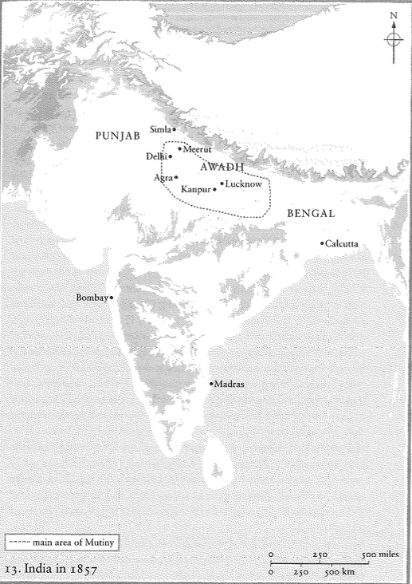
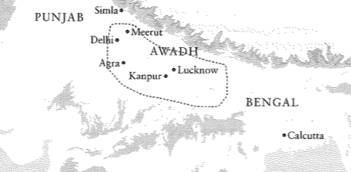
India in 1857-8: a bare narrative
Uprising mostly concentrated in northern India, particularly Delhi and Awadh; our texts mostly concerned with the three main urban centres of Delhi, Kanpur, Lucknow
Map from John Darwin, Unfinished Empire: The Global Expansion of Britain (2012), 249

Slide 17
Kanpur, June-July 1857
4 June 1857 – troops at Kanpur mutiny and besiege British troops and administrators
27 June – British surrender in return for promise of peaceful passage to Allahabad; but on attempting to board boats are attacked and many killed
Women and children taken to a room, ‘the Bibighur’, and on 15 July killed by executioners armed with swords and knives, and their bodies thrown into a well
‘Cawnpore’ (British name) thereafter a major site of memorialization and quasi-pilgrimage
The well at Kanpur, and (background) the ‘Bibighur’ house
Photograph by John Murray, 1858

Slide 18
Kanpur, June-July 1857
‘House at Cawnpore, the Scene of the Massacre’, Illustrated London News 1865

Slide 19
Kanpur, June-July 1857
Memorial to British women and children killed at Kanpur in 1857

Slide 20
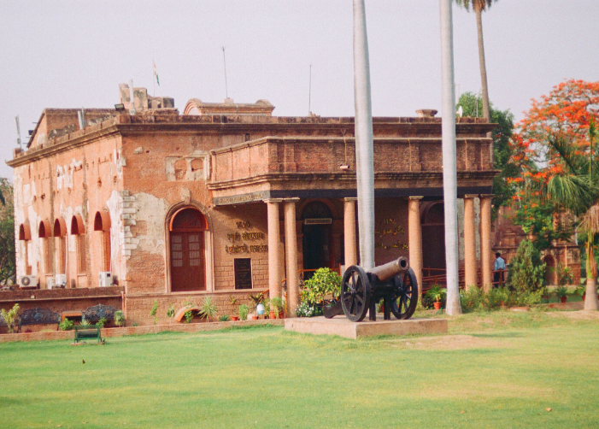
Siege of Lucknow, May – November 1857
British soldiers, administrators, women and children—and some Indians—besieged in Residency complex
Relief force led by Gens. Havelock and Outram arrives September 1857 but can only add reinforcements; Residency finally relieved by Gen. Campbell (British c-in-c in India) November 1857
Havelock dies shortly after Campbell’s arrival
City of Lucknow not re-taken by British forces until March 1858
The Residency, Lucknow

Slide 21
British counter-insurgency
British forces instigate brutal and indiscriminate violence against Indians from the outbreak of the uprising
British dead (in action and from disease) c.10,000; Indian dead unknown, but certainly >100,000
Some British soldiers and officials (e.g. Sir John Lawrence, Chief Commissioner of the Punjab) shocked by the scale and ferocity of British violence and steps taken to restrain it – although these measures also served to re-establish the ‘legitimacy’ of British rule
Execution of mutineers in the Bengal Army
(painting by Orlando Norie)

Slide 22
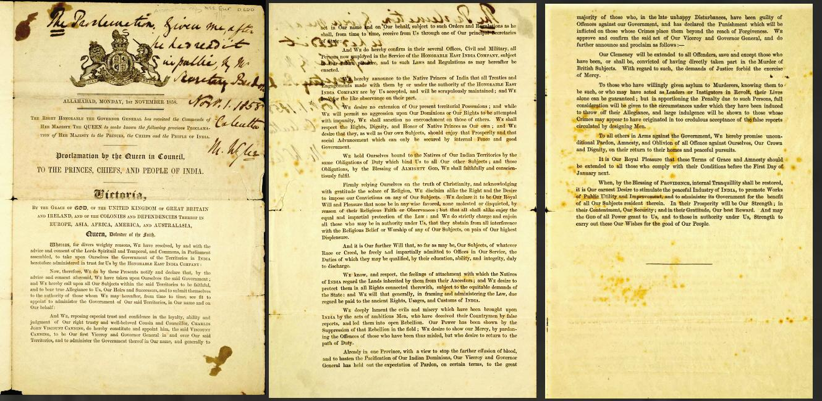
The end of the uprising & of the East India Company
The Proclamation of November 1858, announcing a general amnesty for all involved in the uprising except those guilty of murdering British subjects

Slide 23
Today’s lecture
Background: the British in India, 1608-1856
Knowledge and power in colonial India
The uprising, 1857-8
The uprising as text(s)
Eyewitness: three readings

Slide 24
Naming and narrative
I attribute the existing disturbances in India to a mutiny in the Bengal army, and to that cause alone; I mean that the exciting and immediate cause of the revolution is to be found in the mutiny. That we have in many parts of the country drifted from mutiny into rebellion, is all too true; but I repeat my assertion, that we have to deal now with a revolt caused by a mutiny, not with a mutiny growing out of a national discontent.
Charles Raikes, Notes on the Revolt in the North-Western Provinces of India (London, 1858), 156
quoted in Gautam Chakravarty, The Indian Mutiny and the British Imagination (Cambridge, 2005), 23

Slide 25
Early British narratives of the ‘mutiny’ [sic]
Focus on causes – constructing the uprising as something out of the ordinary that required an explanation – and thus tacitly affirming the fundamental legitimacy of British colonial rule
‘Mutiny’ as Muslim conspiracy – thus (e.g.):
The Hindoo Sepoys were made the dupes and instruments of their more crafty Mussulman comrades.
It appears to be now accepted as a fact that it was the result of a vast Mahomedan conspiracy long organized, and having for its object the re-establishment of its ancient dominion.
Westminster Review, January 1858, 197
Bentley’s Miscellany 43 (February 1858), 122

Slide 26
Today’s lecture
Background: the British in India, 1608-1856
Knowledge and power in colonial India
The uprising, 1857-8
The uprising as text(s)
Eyewitness: three readings

Slide 27
William Howard Russell
Russell a sort of celebrity journalist following his reports on the Crimean War (1853-56); often identified as the first war correspondent
Arrived in Calcutta January 1858, after the sieges of Kanpur and Lucknow and the re-taking of Delhi, but while insurgency was still underway
Wrote thirty dispatches for the Times, criticizing British violence and hardening of racial divisions (in language we’d still regard as heavily racialized)
His dispatches also propagate key narratives of British colonial rule – e.g. Indian immobility and Mughal decline
William Howard Russell, 1855
Victoria & Albert Museum

Slide 28
Russell’s dispatches (for reading this week)
March 29 1858 – his first (published) dispatch from India – description of the Indian landscape and visit to Kanpur (‘Cawnpore’), commenting on the myths and memorialization of the massacres
May 31 1858 – report on plunder by British soldiers
July 19 1858 – report on violence by British troops, and criticisms of its severity
August 20 1858 – his encounter with the imprisoned Emperor Bahadur Shah II in the Red Fort in Delhi

Slide 29
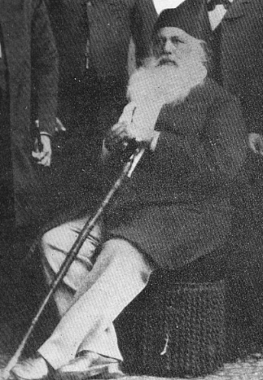
Sir Syed Ahmad Khan
Arguably the most influential Indian Muslim leader of the nineteenth century – founded Aligarh Muslim University 1877
Protected British from violence during the uprising in Bijnor (north-east of Meerut and Delhi), but lost several members of his own family
Causes of the Indian Revolt (1858; 1873) – rejects what he identifies as false accounts of the causes of the uprising (esp. the ‘Mahomedan conspiracy’ thesis) and claims its true cause was lack of understanding between governors and governed
Doesn’t question legitimacy of British authority in India, and adopts some of the tropes of British constructions of the uprising
Sir Syed Ahmad Khan
Late C19

Slide 30
The Narrative of Mainodin
Mainodin Hassan Khan – kotwal (chief of police) in Parhaganj, appointed through patronage of the prominent Anglo-Indian Metcalfe family. During uprising in Delhi saved the life of Sir John Metcalfe, but was appointed Colonel in rebel army
Fled after British re-conquest of Delhi, then returned and gave himself up for trial, at which—with assistance of the Metcalfe family—he was acquitted of murdering Europeans, and pardoned for his role in the uprising in Delhi
Handed manuscript of Two Native Narratives to British official Charles Theophilus Metcalfe, which Metcalfe translated & prepared for publication after Mainodin’s death in 1885
C.T. Metcalfe: ‘… the great value attaching to these records lies in the fact that they are from purely native sources, and are, so far as I know, the first trustworthy contribution, from the native side, to the history of the Indian Mutiny.’

Slide 31
The Narrative of Mainodin
Mainodin Hassan Khan – kotwal (chief of police) in Parhaganj, appointed through patronage of the prominent Anglo-Indian Metcalfe family. During uprising in Delhi saved the life of Sir John Metcalfe, but was appointed Colonel in rebel army
Fled after British re-conquest of Delhi, then returned and gave himself up for trial, at which—with the assistance of the Metcalfe family—he was acquitted of murdering Europeans, and pardoned for his role in the uprising in Delhi
Handed manuscript of ‘two native narratives’ to British official Charles Theophilus Metcalfe, which Metcalfe translated & prepared for publication after Mainodin’s death in 1885
C.T. Metcalfe: ‘… the great value attaching to these records lies in the fact that they are from purely native sources, and are, so far as I know, the first trustworthy contribution, from the native side, to the history of the Indian Mutiny.’

Slide 32
The Narrative of Mainodin
Mainodin Hassan Khan – kotwal (chief of police) in Parhaganj, appointed through patronage of the prominent Anglo-Indian Metcalfe family. During uprising in Delhi saved the life of Sir John Metcalfe, but was appointed Colonel in rebel army
Fled after British re-conquest of Delhi, then returned and gave himself up for trial, at which—with the assistance of the Metcalfe family—he was acquitted of murdering Europeans, and pardoned for his role in the uprising in Delhi
Handed manuscript of ‘two native narratives’ to British official Charles Theophilus Metcalfe, which Metcalfe translated & prepared for publication after Mainodin’s death in 1885
C.T. Metcalfe: ‘… the great value attaching to these records lies in the fact that they are from purely native sources, and are, so far as I know, the first trustworthy contribution, from the native side, to the history of the Indian Mutiny.’
So: an account of the uprising ‘from purely native sources’? Or written in the gaze of colonial power?

