Slide 2
(Un-)Making Masculinity
Shakespeare’s Baffled Lovers: Othello, Othello, and the rest …
‘What a piece of work is a man. How noble in reason, how infinite in faculty, in form and moving how express and admirable, in action how like an angel, in apprehension how like a god – the beauty of the world, the paragon of animals. And yet to me what is this quintessence of dust?’
(Hamlet 2.2.293-97)
‘What is a man / If his chief good and market of his time /Be but to sleep and feed? -- a beast, no more’ (Hamlet, 4.4.9.23-25)
A play about race? A play about masculinity? A play about misogyny? Yes.

Slide 3
RECAP:
‘“It’s a boy!”
may be a statement of biological fact, but it is also a ‘performative utterance’ – the first in a long series of repetitions of gender norms which ‘create’ the male’ (Steve Purcell).
For Judith Butler, gender identities are ‘a kind of impersonation and approximation…a kind of imitation for which there is no original’ (Inside/Out, 1992).
Question: Given this ‘imitation game’, how did early modernity construct masculinity?

Slide 4
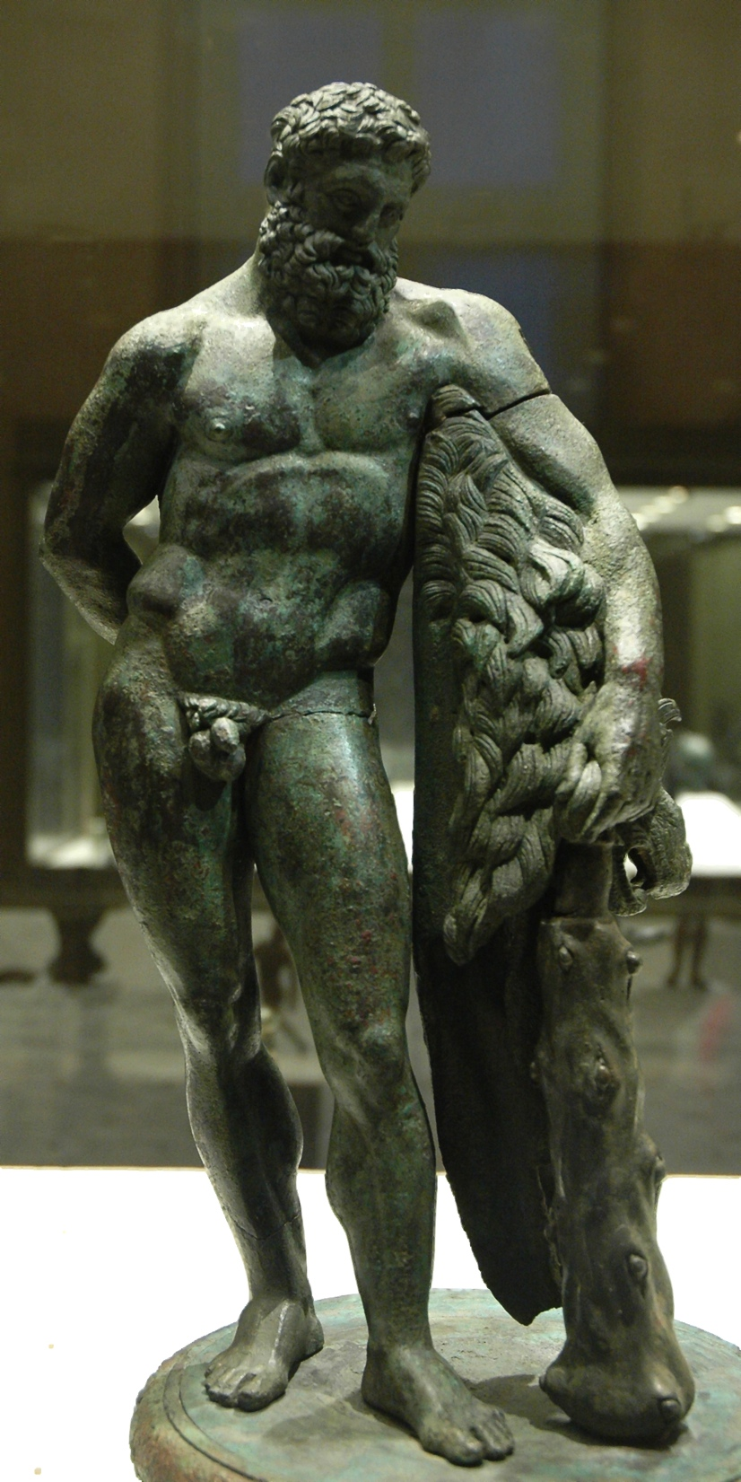
[M]asculinity is something quite different from biological maleness, and … different cultures define masculinity in markedly different ways …. What remains constant across these differences, however, is the fact that masculinity must be achieved. It is not a natural given, something that comes with possession of male sexual organs, but an achievement, something that must be worked toward and maintained. Masculinity … is not an essence but a construction (Bruce Smith, Shakespeare and Masculinity (CUP, 2000), p. 2).
‘Those his goodly eyes / … o’er the files and musters of the war / Have glowed like plated Mars /… His captain’s heart / … in the scuffles of great fights hath burst / The buckles on his breast’ (Antony and Cleopatra, 1.1.2-8).
‘Look, prithee, Charmian, / How this Herculean Roman does become / The carriage of his chafe’ (Antony and Cleopatra, 1.3.83-85)
The Farnese Heracles

Slide 5
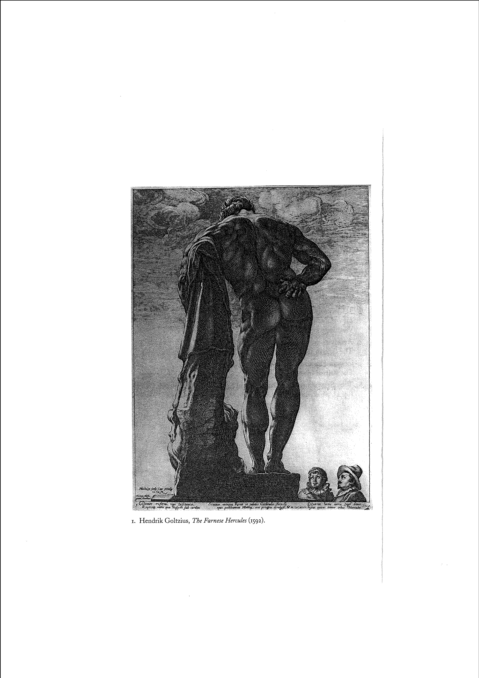
Among most of the peoples that anthropologists are familiar with, true manhood is a precious and elusive status beyond mere maleness, a hortatory image that men and boys aspire to and that their culture demands of them as a measure of belonging …. Its vindication is doubtful, resting in rigid codes of decisive action in many spheres of life: as husband, father, lover, provider, warrior. A restricted status, there are always men who fail the test.
(David Gilmore, Manhood in the Making: Cultural Conceptions of Masculinity [1990, p. 17]).
‘[She] married with mine uncle / My father’s brother, but no more like my father than I to Hercules’ (Hamlet, 1.2.151-53).
The Farnese Heracles (1592) engraved by Hendrik Goltzius

Slide 6
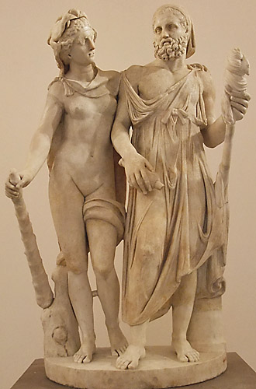
‘If masculine identity is something that men give each other, they do so under a complicated system of rules whereby they alternately abet and oppose each other’ (Smith, Masculinity, p. 66).
If masculinity is something men ‘give each other’, logically, then, it is something that men can take from each other. It is not just winnable but losable, not just achievable but reversible. A man can be emasculated. He can be ‘boyed’ – or worse, ‘girled’.
Cleopatra: Why should not we / Be [in these wars] in person?
Enobarbus: … Your presence needs must puzzle
Antony, / Take from his heart, take from his brain, from’s time / What should not then be spared. He is already / Traduced for levity; and ’tis said in Rome that Photinus, an eunuch, and your maids manage the war. (Antony and Cleopatra, 3.7.5-15)
Canidius: …our leader’s led, / And we are women’s men.
(3.7.68-69)
Antony: O thy vile lady,
She has robbed me of my sword. (4.15.22-23)
Omphale with cross-dressed Heracles: ‘the noble ruin of her magic’

Slide 7
The role of women in male ‘ruin’: Troilus? Angelo? Antony? Vincentio?
Macbeth: I dare to all that may become a man;
Who dares do more is none.
Lady Macbeth: What beast was’t then
That made you break this enterprise to me?
When you durst do it, then you were a man;
And to be more than what you were, you would
Be so much more the man. (1.7.46 - 51)
* * * * *
Coriolanus: Shall I be tempted to infringe my vow…?
….I will not… [Enter Virgilia, Volumnia, Valeria, Young Martius]
Let it be virtuous to be obstinate.
What is that curtsy worth? Or those dove’s eyes
Which can make gods forsworn? I melt, and am not
Of stronger earth than others…Let the Volsces
Plough Rome and harrow Italy! I’ll never
Be such a gosling to obey instinct, but stand
As if a man were author of himself
And knew no other kin.
Virgilia: My lord and husband…
Coriolanus: Like a dull actor now
I have forgot my part… O, a kiss … (5.3.20 – 44)
w

Slide 8
Othello: a tale of ‘noble’ men ‘ruined’ by ‘her magic’?
Of a man who could not ‘move from the casque to the cushion’ from soldier to lover, from the martial to the marital?
A tale of wrecked masculinity?
A tale of ‘baffled lovers’?
To begin with, the (back)story of a love affair, an elopement, a stolen love that starts with a story that is continuously retold in re-tellings …
Ocularity vs. Orality Eyes vs. Ears
‘Give me the ocular proof’ vs. ‘Tush, never tell me’
A play built on story-telling? What stories? Whose telling?
Monstrous looking. Monstrous hearing. Monstrous imagining.
A story launched, propelled, managed by ‘honest’ Iago…
we enter this play through the ‘intelligence’ of the man who hates the Moor
A play of a man destroyed by a man

Slide 9

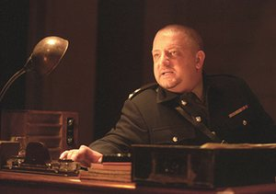
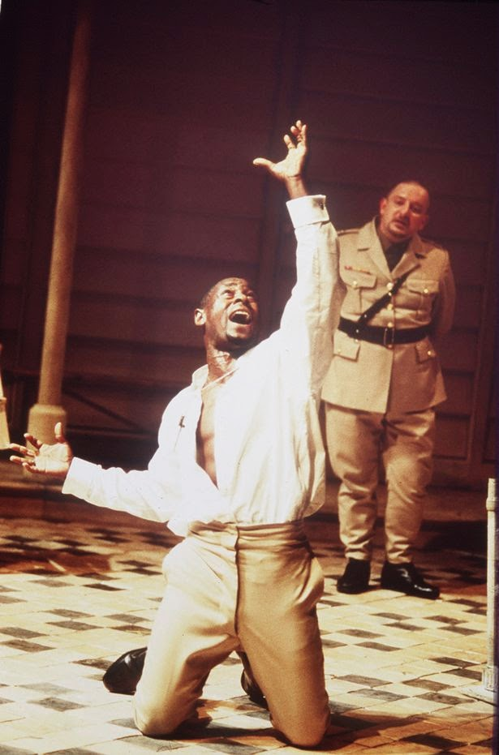
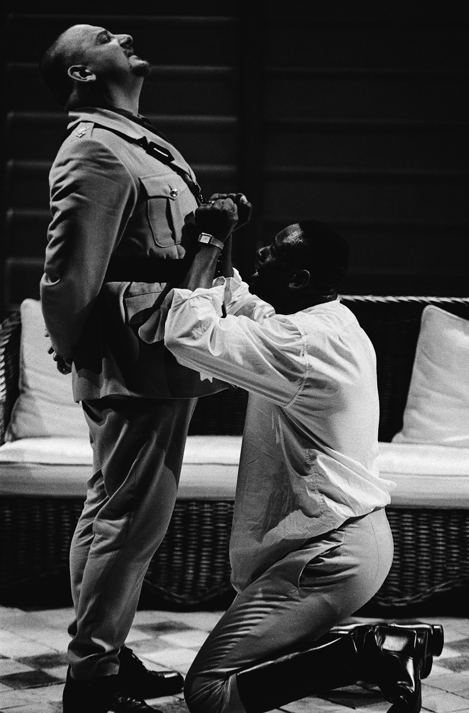
Iago: a corrective?
He is not the ‘dazzling machiavel of critical commonplace’ but ‘The dullest man in Shakespeare’: ‘he has no charm (like Richard Gloucester), no wit (like Thersites). A man whose vocabulary, his use of language, except when he’s talking about sex, is imitative or workmanlike, dull and grey’ (Simon Russell Beale, National Theatre Othello directed by Sam Mendes with David Harewood 1997).
Iago is ‘absolutely without love. He can’t understand it. Has no mental vocabulary to construct love. That’s the hell he lives in – deep in the grain of his soul, a rooted lovelessness, that he needs someone else to experience’ ( Rutter, ‘Simon Russell Beale’ in Brown and Ewert ed., The Routledge Companion to Actors’ Shakespeare, 2012)

Slide 10
A play of binaries: (monstrous doubles?) And oxymorons:
black/white fair warrior
angel/devil fair devil
Venetian/stranger civil monster
helmet/skillet divinity of hell
house/unhoused honourable murderer
city/citadel honest Iago
courtesy/lechery
daughter/wife And paradoxes:
officer/spinster ‘I am not what I am.
Venice/deserts idle ‘Nobody. I myself.’
cannibal/housewife ‘What you know you know.’
obedience/revolt ‘One that loved not wisely but too well.’
Christian/heathen
reason/sensuality And racist slurs:
heaven/hell ‘old black ram’; ‘thicklips’; ‘erring barbarian’;
light/dark ‘extravagant and wheeling stranger of here and everywhere’
‘public commoner’/ ‘chrysolite entire’
And misogynist/pornographic discourse:
A play set mostly at night that stages, ‘she must have change, she must’
repetitively, the trope of men roused ‘She has deceived her father’; ‘she did deceive her father’
from bed; a play that, constantly ‘a maid that paragons description and wild fame’ v.
voyeuristically asking, ‘Who’s in bed with ‘What, a customer?’
Desdemona?’, drives toward the final ‘her eye must be fed’
violated scene of the bed and bedroom. ‘Was this fair paper, this most goodly book,
Made to write ‘whore’ upon? What committed!’

Slide 11

Othello: Her father loved me, oft invited me, / Still questioned me the story of my life / From year to year – the battles, sieges, fortunes / That I have passed. / I ran it through … I spake of most disastrous chances, / Of moving accidents by flood and field, / Of hair-breadth scapes … Of being … sold to slavery … / Wherein of antres vast and deserts idle, / Rough quarries, rocks and hills whose heads touch heaven / It was my hint to speak … / And of the cannibals that each other eat, / The Anthropophagi, and men whose heads / Do grow beneath their shoulders. This to hear / Would Desdemona seriously incline, / But still the house affairs would draw her thence / Which ever as she could with haste dispatch / She’d come again, and with a greedy ear / Devour up my discourse (1.3.129-50).

Slide 12

Desdemona: Let me go with him.
Othello: Let her have your voice.
Vouch with me heaven, I therefore beg it not
To please the palate of my appetite…
But to be free and bounteous to her mind.
And heaven defend your good souls that you think
I will your serious and great business scant
When she is with me. No, when light-winged toys
Of feathered Cupid seel with wanton dullness
My speculative and officed instrument …
Let housewives make a skillet of my helm
And all indign and base adversities
Make head against my estimation. 1.3.260-75
‘She loved me for the dangers I had passed / And I loved her that she did pity them (1.3.168-9).
Othello: O, my fair warrior! It gives me wonder great as my content / To see you here before me! O my soul’s joy, / If after every tempest come such calms / May the winds blow till they have wakened death / And let the labouring bark climb hills of seas, / Olympus-high, and duck again as low / As hell’s from heaven. If it were now to die /’Twere now to be most happy, for I fear / My soul hath her content so absolute / That not another comfort like to this / Succeeds in unknown fate (2.1.180- 91).

Slide 13

Iago (to Cassio): I’ll tell you what you shall do. Our general’s wife is now the general…Confess yourself freely to her, importune her help to put you in your place again … His soul is so enfettered to her love / That she may make, unmake, do what she list, / Even as her appetite shall play the god / With his weak function (2.3.309-15, 340-43).
Othello (to Desdemona): I will deny thee nothing. Wherein I do beseech thee, grant me this, To leave me a little to myself.
Desdemona: Shall I deny you? No /… Be as your fancies teach you: / Whate’er you be, I am obedient (3.3.83-89)
Othello (exit Desdemona): Excellent wretch! Perdition catch my soul /But I do love thee! And when I love thee not, / Chaos is come again.
Iago: My noble lord –
Othello: What dost thou say, Iago?
Iago: Did Michael Cassio, when you wooed my lady, / Know of your love? (3.3.90 – 94)

Slide 14
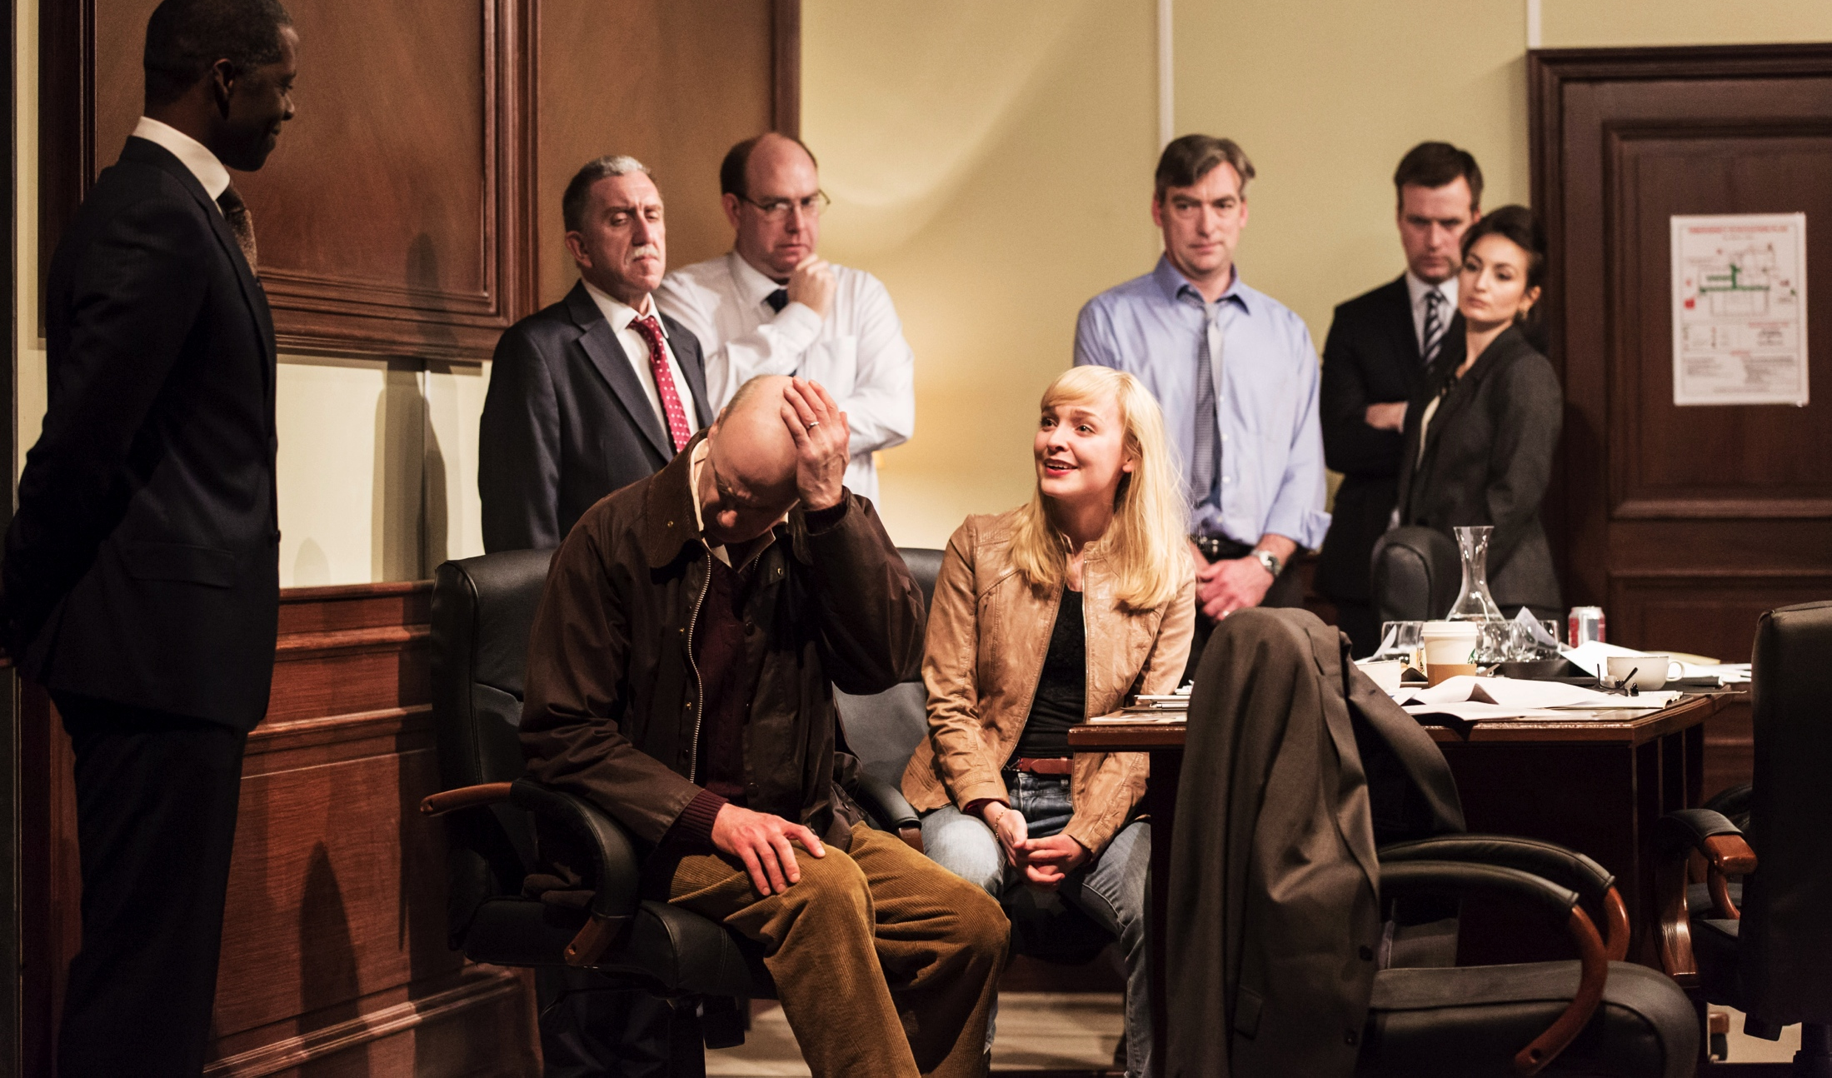
Iago: Now, now very now, an old black ram
Is tupping your white ewe. 1.1.88
Brabantio: What tell’st thou me of robbing? This is Venice:
My house is not a grange.
1.1.104-05
Brabantio: It is too true an evil, gone she is … Who would be a father? … O, she deceives me past thought… O heaven, how got she out? O treason of the blood (1.1.158-67). … a maid so tender, fair and happy, / So opposite to marriage that she shunned / The wealthy, curled darlings of our nation [to] Run from her guardage to the sooty bosom / Of such a thing as thou? (1.2.66-71) She is abused, stolen from me and corrupted / By spells and medicines bought of mountebanks. / For nature so preposterously to err … / Sans witchcraft could not (1.3.61-5). A maiden never bold / Of spirit so still and quiet that her motion / Blushed at herself; and she, in spite of nature / Of years, of country, credit, everything, / To fall in love with what she feared to look on? (1.3.95-9) Come hither, gentle mistress. / Do you perceive, in all this noble company / Where most you owe obedience? (1.3.178-80) Come hither Moor: / I here to give thee that with all my heart / Which, but thou hast already, with all my heart / I would keep from thee (1.3.193-6). Look to her Moor, if thou hast eyes to see. / She has deceived her father, and may thee (1.3.293-4).
Othello: ‘My life upon her faith.’

Slide 15

Roderigo: Tush, never tell me. I take it much unkindly / That thou, Iago, who hast had my purse / As if the strings were thine, shouldst know of this (1.1.1).
Roderigo: I will incontinently drown myself. It is silliness to live when to live is torment…. (1.3.306, 309)
Iago: Put money in thy purse. It cannot be that Desdemona should long continue her love to the Moor – put money in thy purse – nor he his to her…She must change for youth. When she is sated with his body she will find the error of her choice. She must have change. She must. If sanctimony, and a frail vow betwixt an erring barbarian and a super-subtle Venetian be not too hard for my wits…thou shalt enjoy her.(1.3.340 - 350)
Iago: The lieutenant tonight watches on the court of guard.
First I must tell thee this: Desdemona is directly in love with him.
Roderigo: With him? Why, tis not possible.
Iago: … Mark me with what violence she first loved the Moor, but
for bragging and telling fantastical lies …Her eye must be fed, and
what delight shall she have to look on the devil?
Roderigo: I cannot believe that in her, she’s full of most blest
condition.
Iago: Blest fig’s end!...
Roderigo: That was but courtesy.
Iago: Lechery. (2.1.215-passim)
Roderigo: I do not find that thou deal’st justly with me…Every day thou doff’st me with some device…I will no longer endure it…I have wasted myself out of my means. The jewels you have had from me to deliver to Desdemona would half have corrupted a votarist… (4.2.175-90)

Slide 16

Montano: But … is your general wived?
Cassio: … he has achieved a maid
That paragons description and wild fame;
One that excels the quirks of blazoning pens
And in th’ essential vesture of creation
Does tire the inginer …
O, behold,
The riches of the ship is come on shore: You men of Cyprus, let her have your knees! Hail to thee lady…! (2.1.60-85)
[Kisses Emilia] Let it not gall your patience, good Iago,
That I extend my manners; ’tis my breeding That gives me this bold show of courtesy (2.1.97-99).
Iago: That Cassio loves her, I do well believe it.
That she loves him, ’tis apt and of great credit. (2.1.284-5)
Cassio: My reputation, Iago, my reputation.
Iago: … I thought you had received some bodily hurt. There is more of sense in that than in reputation…What, man, there are ways to recover the general again…Our general’s wife is now the general…importune her help…she is of so blest a disposition that she holds it a vice not to do more than she is requested (2.3.260 –215).
Iago: Now if this suit lay in Bianca’s power,
How quickly should you speed…
She gives it out that you shall marry her;
Do you intend it?
Cassio: I marry? What, a customer? (4.1.108-120).

Slide 17
Iago: That Cassio loves her, I do well believe it… / Now, I do love her too, / Not out of absolute lust – though peradventure / I stand accountant for as great a sin … (2.1.284 – 291)
Shakespeare’s Source: ‘The Moor had in his company an Ensign of handsome presence but the most scoundrelly nature in the world. He was in high favour with the Moor, who had no suspicion of his wickedness … This false man had likewise taken to Cyprus his wife, a fair and honest young woman …The wicked Ensign, taking no account of the faith he had pledged to his wife, and of the friendship, loyalty and obligations he owed the Moor, fell ardently in love with Disdemona, and bent all his thoughts to see if he could manage to enjoy her; but he did not dare openly show his passion, fearing that if the Moor perceived it he might straightway kill him. He sought therefore in various ways, as deviously as he could, to make the Lady aware that he desired her. But she, whose every thought was for the Moor, never gave a thought to the Ensign or anybody else. And all the things he did to arouse her feelings for him had no more effect that if he had not tried them. Whereupon he imagined that this was because she was in love with the Corporal [i.e., Cassio] and he wondered how he might remove the latter from her sight. Not only did he turn his mind to this, but the love which he had felt for the Lady now changed to the bitterest hate, and he gave himself up to studying how to bring it about that, once the Corporal were killed, if he himself could not enjoy the Lady, then the Moor should not have her either. Turning over in his mind divers schemes…he determined to accuse her of adultery, and to make her husband believe the Corporal was the adulterer’ (Giraldi Cinthio, Hecatommithi [1565]; French tr. 1583).
Shakespeare’s innovation: to change the target of the Ensign’s ‘bitterest hate’; to use the imputation of adultery to destroy not Desdemona but Othello. (Desdemona ‘naturally’ is destroyed, inter alia, but only as ‘collateral damage’). In Shakespeare’s play the object of male hatred is male, and the route to male destruction is looped through the female, the human terra icognita or space that ‘puzzles’ masculinity and ‘puddle[s]’ his ‘clear spirit’. The exquisite destructive force of Iago’s ‘telling’ is that he tells a story that makes Othello doubt himself by doubting Desdemona while making him doubt Desdemona by doubting himself.

Slide 18

Iago: Look to your wife, observe her well with Cassio…
I know our country disposition well –
In Venice they do let God see the pranks
They dare not show their husbands; their best conscience
Is not to leave’t undone, but keep’t unknown…
She did deceive her father, marrying you,
And when she seemed to shake, and fear your looks,
She loved them most… Why, go to then:
She that so young could give out such a seeming
To seel her father’s eyes up, close as oak,
He thought ’twas witchcraft (3.3.200-14).
Othello: I do not think but Desdemona’s honest…
And yet, how nature erring from itself –
Iago: Ay, there’s the point: as, to be bold with you,
Not to affect many proposed matches
Of her own clime, complexion and degree,
Whereto we see, in all things, nature tends –
Foh! One may smell in such a will most rank,
Foul disproportion, thoughts unnatural… I may fear
Her will, recoiling to her better judgment,
May fall to match you with her country forms,
And happily repent… (3.3.229 – 242).
Iago: My noble lord –
Othello: What dost thou say, Iago?
Iago: Did Michael Cassio, when you wooed my lady, Know of your love?
Othello: He did, from first to last.
Why dost thou ask?
Iago: But for a satisfaction of my thought,
No further harm (3.3.92-8).

Slide 19

Othello: Why did I marry? …
This fellow’s of exceeding honesty
And knows all qualities, with a learned spirit,
Of human dealings. If I do prove her haggard,
Though that her jesses were my dear heart-strings,
I’d whistle her off and let her down the wind
To prey at fortune. Haply for I am black
… or for I am declined
Into the vale of years – yet that’s not much –
She’s gone, I am abused, and my relief
Must be to loathe her. O curse of marriage
That we can call these delicate creatures ours
And not their appetites! (3.3.245-274)
[Enter Desdemona]
Look where she comes:
If she be false, O then heaven mocks itself.
I’ll not believe it. (3.3.281-283)
Desdemona: …Your dinner, and the generous islanders
By you invited, do attend your presence…
Othello: I have a pain upon my forehead, here.
Desdemona: Faith, that’s with watching, ’twill away again.
Let me but bind it hard…
Othello: Your napkin is too little. [Drops the handkerchief]
Let it alone. Come, I’ll go in with you.
Emilia: I am glad I have found this napkin…(3.3.281-94)

Slide 20

Ha!Ha! False to me?...O now for ever
Farewell the tranquil mind, farewell content!
Farewell the plumed troops and the big wars
That makes ambition virtue! O, farewell…:
… Othello’s occupation’s gone.
(3.3.337-36)
Villain, be sure thou prove my love a whore,
Be sure of it, give me the ocular proof…
Her name, that was as fresh
As Dian’s visage, is now begrimed and black
As mine own face…
Give me a living reason she’s disloyal.
3.3.362-412
Iago: You would be satisfied? But how? How satisfied, my lord?
Would you, the supervisor, grossly gape on?
Behold her topped?...What then? How then?
3.3.396-403
Iago: I lay with Cassio lately
And being troubled with a raging tooth
I could not sleep. There are a kind of men
So loose of soul that in their sleeps will mutter
Their affairs – one of this kind is Cassio.
In sleep I heard him say, ‘Sweet Desdemona
Let us be wary, let us hide our loves,’
And then sir would he gripe and wring my hand,
Cry ‘O sweet creature!’, and then kiss me hard
As if he plucked up kisses by the roots
That grew upon my lips, lay his leg o’er my thigh,
And sigh, and kiss …
Othello: O monstrous! Monstrous! 3.3.416-439
Iago: Nay, this was but his dream.
Othello: But this denoted a foregone conclusion.
Iago: Tis a shrewd doubt, though it be but a dream,
And this may help to thicken other proofs
That do demonstrate thinly.
Othello: I’ll tear her all to pieces!
Iago: Nay, yet be wise, yet we see nothing done,
She may be honest yet. Tell me but this,
Have you not sometimes seen a handkerchief
Spotted with strawberries, in your wife’s hand?

Slide 21
Cultural ‘knowledge’ no. 1 : what blackness is
Now, every now, an old black ram / Is tupping your white ewe’
‘Your daughter and the Moor are making the beast with two backs’
‘Your fair daughter [is] / Transported … / To the gross clasps of a lascivious Moor’;’ [she has] made a gross revolt / Tying her duty, beauty, wit and fortunes / To an extravagant and wheeling stranger /Of here and everywhere’
‘O thou foul thief, where hast thou stowed my daughter? Damned as thou art, thou hast enchanted her / [to] Run from her guardage to the sooty bosom / Of such a thing as thou, to fear not to delight’
‘These Moors are changeable in their wills…The food that to him now is luscious as locusts shall be to him shortly as acerb as coloquintida’
‘O gull, o dolt, / As ignorant as dirt!’
‘Do thy worst:
This deed of thine is no more worthy heaven
Than thou wast worthy her’
‘Moor, she was chaste, she loved thee, cruel Moor’
‘O ill-starred wench,
Pale as thy smock. When we shall meet at compt
This look of thine will hurl my soul from heaven
And fiends will snatch at it.’
Cultural ‘knowledge’ no. 2: what women are
‘your daughter … your daughter … your fair daughter … Your daughter … hath made a gross revolt’
‘O, she deceives me past thought…O treason of the blood’
‘Fathers, from hence trust not your daughters’ minds
By what you see them act’
‘My story being done
She gave me for my pains a world of sighs,
She swore in faith twas strange, twas passing strange…
She wished / … That heaven had made her such a man. She… bade me, if I had a friend that loved her,
I would but teach him how to tell my story
And that would woo her. Upon this hint I spake.’
‘It cannot be that Desdemona should long continue her love to the Moor – put money in thy purse – nor he his to her. It was a violent commencement in her, and thou shalt see an answerable sequestration…She must change for youth; when she is sated with his body she will find the error of her choice: she must have change, she must…super-subtle Venetian’.
‘Come on, come on, you [women] are pictures out of doors
Bells in your parlours, wild-cats in your kitchens,
Saints in your injuries, devils being offended,
Players in your housewifery, and housewives in …
Your beds’
‘lewd minx’ ‘monkey’ ‘bauble’
‘Was this fair paper, this most goodly book,
Made to write “whore” upon? What committed?’
‘Villanous whore’; ‘Filth, thou liest’
‘Tis proper I obey him; but not now’

Slide 22
Baffled lovers?
‘O, these men, these men!
Dost thou in conscience think – tell me Emilia –
That there be women do abuse their husbands
In such gross kind?’ (4.3.59-62)
‘But I do think it is their husbands’ faults
If wives do fall. Say that they slack their duties
And pour our treasures into foreign laps;
Or else break out in peevish jealousies,
Throwing restraint upon us; or say they strike us,
Or scant our former having in despite,
Why, we have galls; and though we have some grace
Yet have we some revenge. Let husbands know
Their wives have sense like them; they see, and smell,
And have their palates both for sweet and sour
As husbands have. What is it that they do
When they change us for others? Is it sport?
I think it is. And doth affection breed it?
I think it doth. Is’t frailty that thus errs?
It is so too. And have not we affections?
Desires for sport? And frailty as men have?
Then let them use us well: else let them know:
The ills we do, their ills instruct us so. (4.3.85-102)
Desdemona: This Lodovico is a proper man.
Emilia: A very handsome man.
Desdemona: He speaks well.
Emilia: I know a lady in Venice would have walked barefoot to Palestine for a touch of his nether lip. (4.3.34-37)

Slide 23


Slide 24
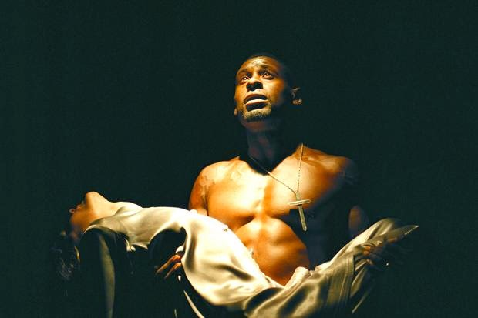

Slide 25
Desdemona: O Lord! Lord! Lord! [smothers her]
Emilia [within] My lord, my lord, what ho, my lord, my lord!
Othello: What noise is this? Not dead? Not yet quite dead? (5.2.83-5)
Othello: She was false as water…Thy husband knew it all.
Emilia: My husband? … My husband?... My husband!
My husband say she was false? … he lies to th’heart…
O gull, O dolt,
As ignorant as dirt!...
I care not for thy sword, I’ll make thee known
Though I lost twenty lives.
Emilia: Disprove this villain…Speak, for my heart is full.
Iago: I told him what I thought, and told no more
Than what he found himself was apt and true…
Emilia: …She false with Cassio? Did you say with Cassio?
Iago: With Cassio, mistress. Go to, charm your tongue.
Emilia: I will not charm my tongue. I am bound to speak…
Iago: What, are you mad? I charge you, get you home.
Emilia: Good gentlemen, let me have leave to speak.
’Tis proper I obey him, but not now.
Perchance, Iago, I will ne’er go home…
Othello: Cassio…I saw it in his hand…It was a handkerchief…
Emilia: O God, O heavenly God!
Iago: Zounds, hold your peace!
Emilia: ’Twill out, ’twill out! I peace?
No, I will speak as liberal as the north….I’ll speak.
Iago: Be wise, and get you home.
Emilia: I will not….
Iago: Villanous whore! Filth, thou liest! …
Emilia: What did thy song bode, lady?..Willow, willow, willow.

Slide 26
Production Credits:
Othello National Theatre 1997. Director: Sam Mendes. Othello:David Harewood. Iago: Simon Russell Beale. Desdemona: Claire Skinner.
Othello National Theatre 2013 Director: Nicholas Hytner. Othello: Adrian Lester. Desdemona: Olivia Vinall. Iago: Rory Kinnear. Emilia: Lyndsey Marshall. Cassio: Jonathan Bailey. Bianca: Rokhsaneh Ghawam-Shahidi. Roderigo: Tom Robertson. Brabantio: William Chubb. Duke: Robert Demeger. Lodovico: Nick Sampson. Montano: Chook Sibtain. Gratiano: Jonathan Dryden Taylor. Senators/Officials: Joseph Wilkins, Rebecca Tanwen, David Carr.. Soldiers: Sandy Batchelor, Gabriel Fleary Scott Karim, Adam Berry, David Kirkbride, Tom Radford.

