Slide 1
Shakespeare and Selected Dramatists of His Time
Love’s Labour’s Lost
24th October 2011

Slide 2
Dates for your Diary
Week 5, Wed 2nd – Sat 5th November 2011, Faustus in Warwick Arts Centre Studio Theatre (7.45 pm)
Week 5, Saturday 5th November, 2011, 11 am. ‘Shakespeare on Film’ season in Warwick Arts Centre, preview of Coriolanus, dir. Fiennes, intr. Tony Howard.
Term 3. Tuesday 1st May 2012, Propeller Winter’s Tale at Belgrade Theatre, Coventry.

Slide 3
Genuine exam question (English Literature Dept, University Glasgow, c. 1987)
If Shakespeare’s comedies aren’t funny, what on earth is the point of them?

Slide 4
Chronology of Shakespeare’s Plays
(according to Oxford Shakespeare)
  The Two Gentlemen of Verona (1589-1591)
  The Taming of the Shrew (1590-1594)
  Henry VI, Part 2 (1590-1591)
  Henry VI, Part 3 (1590-1591)
  Henry VI, Part 1 (1591)
  Titus Andronicus (1591-1592)
  Richard III (1592)
  Edward III (1592-1593)
  The Comedy of Errors (1594)
  Love's Labour's Lost (1594-1595)
  Love's Labour's Won (1595)
  Richard II (1595)
  Romeo and Juliet (1593-1595)
  A Midsummer Night's Dream (1595)
  The Life and Death of King John (1596-1597)
  The Merchant of Venice (1596)

Slide 5
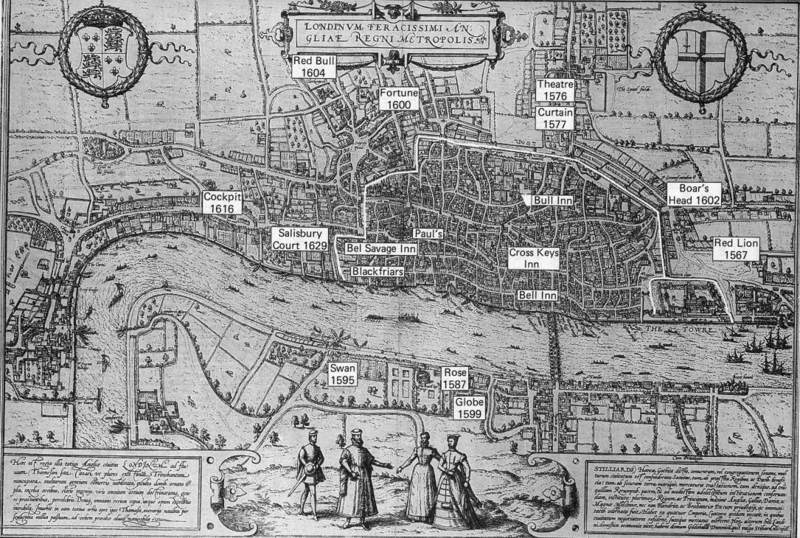

Slide 6
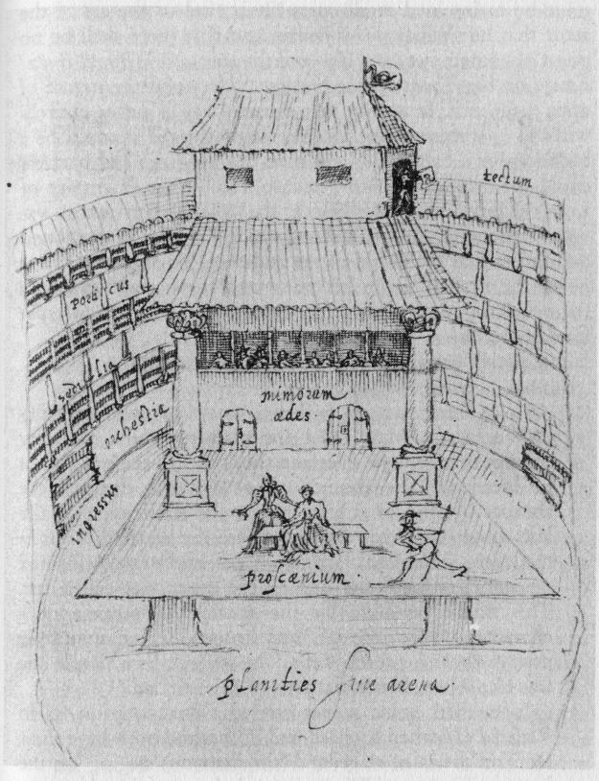

Slide 7
KING
Let fame, that all hunt after in their lives,
Live registered upon our brazen tombs,
And then grace us in the disgrace of death;
When, spite of cormorant devouring time,
Th’endeavour of this present breath may buy
That honour which shall bate his scythe’s keen edge,
And make us heirs of all eternity.
LLL, 1.1.1-7.

Slide 8
Compare to Sonnets 19, 55, 63-5, 100.
SONNET 65
Since brass, nor stone, nor earth, nor boundless sea,
But sad mortality o'er-sways their power,
How with this rage shall beauty hold a plea,
Whose action is no stronger than a flower?
O, how shall summer's honey breath hold out
Against the wreckful siege of battering days,
When rocks impregnable are not so stout,
Nor gates of steel so strong, but Time decays?
O fearful meditation! where, alack,
Shall Time's best jewel from Time's chest lie hid?
Or what strong hand can hold his swift foot back?
Or who his spoil of beauty can forbid?
O, none, unless this miracle have might,
That in black ink my love may still shine bright.

Slide 9
Rosaline
Nay, I have verses too, I thank Berowne;
The numbers true, and, were the numbering too,
I were the fairest goddess on the ground.
I am compared to twenty thousand fairs.
O, he hath drawn my picture in his letter!
Princess
Anything like?
Rosaline
Much in the letters, nothing in the praise.
Princess
Beauteous as ink: a good conclusion.
Katherine
Fair as a text B in a copy-book.
LLL, 5.2.34-42

Slide 10
The Poets deuised to haue many parts played at once by two or three or foure persons, that debated the matters of the world, sometimes of their owne priuate affaires, sometimes of their neighbours, but neuer medling with any Princes matters nor such high personages, but commonly of marchants, souldiers, artificers, good honest housholders, and also of vnthrifty youthes, yong damsels, old nurses, bawds, brokers, ruffians and parasites, with such like, in whose behauiors, lyeth in effect the whole course and trade of mans life, and therefore tended altogether to the good amendment of man by discipline and example.
George Puttenham, The Arte of English Poesie (1589)

Slide 11
But rather, a busy loving courtier; a heartless threatening Thraso; a self-wise-seeming schoolmaster; an awry-transformed traveller. These, if we saw walk in stage names, which we play naturally, therein were delightful laughter, and teaching delightfulness.
Philip Sidney, Defence of Poetry (pr. 1595)

Slide 12
Nathaniel
Where will you find men worthy enough to present them?
Holofernes
Joshua, yourself; this gallant gentleman, Judas Maccabaeus; this swain, because of his great limb or joint, shall pass Pompey the Great; the page, Hercules.
Armado
Pardon, sir, error! He is not quantity enough for that Worthy’s thumb. He is not so big as the end of his club.
Holofernes
Shall I have audience? He shall present Hercules in minority. His enter and exit shall be strangling a snake; and I will have an apology for that purpose.
Moth
An excellent device! So if any of the audience hiss, you may cry, ‘Well done, Hercules! Now thou crushest the snake!’ That is the way to make an offence gracious, though few have the grace to do it.
Armado
For the rest of the Worthies?
Holofernes
I shall play three myself.
Moth
Thrice-worthy gentleman.
LLL, 5.1.116-135

Slide 13
Starveling
I believe we must leave the killing out, when all is done.
Bottom
Not a whit! I have a device to make all well. Write me a prologue, and the prologue seem to say we will do no harm with our swords, and that Pyramus is not kill’d indeed; and for the more better assurance, tell them that I Pyramus am not Pyramus, but Bottom the weaver. This will put them out of fear.
MSDN, III.i.14-22

Slide 14
Bottom
Let me play Thisby too. I’ll speak in a monstrous little voice, “Thisne! Thisne! A Pyramus my lover dear! Thy Thisby dear and lady dear”.
Quince
No, no, you must play Pyramus, and Flute, you Thisby.
…
Bottom
Let me play the lion too. I will roar, that I will do any man’s heart good to hear me. I will roar that I will make the Duke say, “Let him roar again; let him roar again.”
MSND, I.ii.51-56; 70-3.

Slide 15
Theseus
I will hear that play;
For never any thing can be amiss,
When simpleness and duty tender it…
Where I have come, great clerks have purposed
To greet me with premeditated welcomes
Where I have seen them shiver and look pale,
Make periods in the midst of sentences,
Throttle their practic’d accent in their fears,
And in conclusion dumbly have broke off,
Not paying me a welcome. Trust me, sweet,
Out of this silence yet I pick’d a welcome;
And in the modesty of fearful duty
I read as much as from the rattling tongue
Of saucy and audacious eloquence.
Love, therefore, and tongue-tied simplicity
In least speak most, to my capacity.
MSDN, V.i.82-4; 93-105.

Slide 16
King
Berowne, they will shame us. Let them not approach.
Berowne
We are shame-proof, my lord; and ’tis some policy
To have one show worse than the King’s and his company.
King
I say they shall not come.
Princess
Nay, my good lord, let me o’errule you now.
That sport best pleases that doth least know how –
Where zeal strives to content and the contents
Dies in the zeal of that which it presents;
Their form confounded makes most form in mirth,
When great things labouring perish in their birth.
Berowne
A right description of our sport, my lord.
LLL, V.ii.509-19.

Slide 17
Two Gentlemen presents its courtship behavior as an inept sort of playacting, the rote performance of a bad script that has little relation to the living circumstances within which it is played out. In this respect Shakespeare’s characters in Two Gentlemen are all too clearly charactered; they aspire not to independent life, but rather to insertion within a discourse by Castiglione or Capellanus.
Bruce Boehrer, Shakespeare Among the Animals
(Palgrave, 2002), p. 158.

Slide 18
O never will I trust to speeches penned,
Nor to the motion of a schoolboy’s tongue,
Nor never come in visor to my friend,
Nor woo in rhyme like a blind harper’s song.
Taffeta phrases, silken terms precise,
Three-piled hyperboles, spruce affectation,
Figures pedantical: these summer flies
Have blown me full of maggot ostentation.
I do forswear them, and I here protest,
By this white glove – how white the hand, God knows! –
Henceforth my wooing mind shall be expressed
In russet yeas and honest kersey noes.
And to begin: wench, so God help me, law!
My love to thee is sound, sans crack or flaw.
LLL, V.ii.402-415

Slide 19
Princess
There’s no such sport as sport by sport o’erthrown,
To make theirs ours and ours none but our own.
So shall we stay, mocking intended game,
And they well-mocked, depart away with shame.
LLL, V.ii.153-6

