Slide 1
Marlowe, Shakespeare, Jonson
Revision Lecture,
23rd April 2012

Slide 2
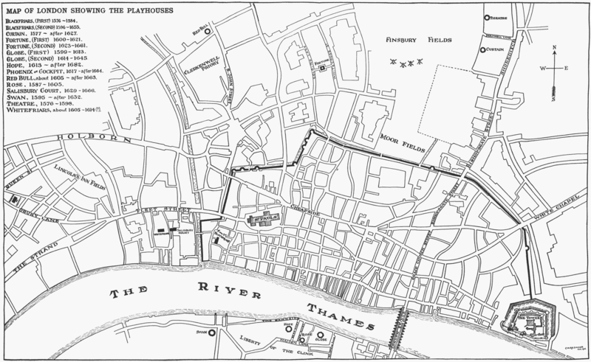

Slide 3
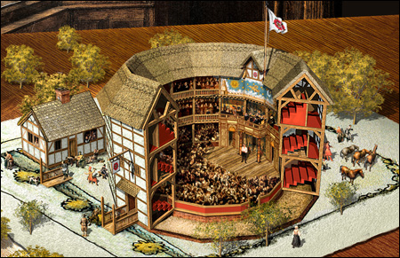
Copyright, Society of Theatre Research at http://www.str.org.uk/events/other/archive/rose2010.shtml

Slide 4
Videna
Here resteth all. But if they fail thereof,
And in the end bring forth an ill success,
On them and theirs the mischief shall befall.
And so I pray the gods requite it them;
And so they will, for so is wont to be
When lords and trusted rulers under kings,
To please the present fancy of the prince,
With wrong transpose the course of governance,
Murders, mischief, or civil sword at length,
Or mutual treason or a just revenge,
When right succeeding line returns again,
By Jove’s just judgment and deserved wrath,
Brings them to cruel and reproachful death
And roots their names and kindreds in the earth.
Sackville and Norton, Gorbuduc (1561), I.i.54-67

Slide 5
Meander
Then, noble soldiers, to entrap their thieves
That live confounded in disordered troops,
If wealth or riches may prevail with them,
We have our camels laden all with gold
Which you that be but common soldiers
Shall fling in every corner of the field,
And while the base-born Tartars take it up,
You, fighting more for honour than for gold,
Shall massacre those greedy-minded slaves;
And when their scattered army is subdued
And you march on their slaughtered carcasses,
Share equally the gold that bought their lives
And live like gentlemen in Persia.
Strike up the drum, and march courageously!
Fortune herself doth sit upon our crests.
Marlowe, Tamberlaine Part 1 (1587), II.ii.59-73

Slide 6
“alchemists of eloquence, who (mounted on the stage of arrogance) think to outbrave better pens with the swelling bombast of bragging blank verse.”
Thomas Nashe, Preface to Greene’s Menaphon (1589).
“From jigging veins of rhyming mother-wits
And such conceits as clownage keeps in pay
We’ll lead you to the stately tent of War,
Where you shall hear the Scythian Tamberlaine
Threat’ning the world with high astounding terms
And scourging kingdoms with his conquering sword.
View but his picture in this tragic glass,
And then applaud his fortunes as you please.
Marlowe, Tamberlaine Part 1 (1587), Prologue.

Slide 7
“[that] the engrafted overflow of some kill-cow conceit that overcloyeth their imagination…commits the digestion of their choleric encumbrances to the spacious volubility of a drumming decasyllabon”
Thomas Nashe, Preface to Greene’s Menaphon (1589).
I’ll have them fly to India for gold,
Ransack the ocean for orient pearl,
And search all corners of the new-found world
For pleasant fruits and princely delicates.
I’ll have them read me strange philosophy
And tell the secrets of all foreign kings.
I’ll have them fill the public schools with silk,
Wherewith the students shall be bravely clad.
I’ll levy soldiers with the coin they bring
And chase the Prince of Parma from our land,
And reign sole king of all the provinces;
Yea, stranger engines for the brunt of war
Than was the fiery keel at Antwerp bridge
I’ll make my servile spirits to invent.
Dr Faustus, B-text, I.i.81-95.

Slide 8
How can you fancy one who looks so fierce,
Only disposed to martial stratagems.
Who, when he shall embrace you in his arms,
Will tell you how many thousand men he slew,
And when you look for amorous discourse
Will rattle forth his facts of war and blood –
Too harsh a subject for your dainty ears.
Tamberlaine Part 1, III.ii.40-6.

Slide 9
When Learning’s Triumph o’er her barb’rous Foes
First rear’d the Stage, immortal Shakespear rose;
Each Change of many coloured Life he drew,
Exhausted Worlds, and then imagin’d new:
And panting Time toil’d after him in vain:
His pow’rful Strokes presiding Truth impress’d,
And unresisted Passion storm’d the Breast.
Then Johnson came, instructed from the School,
To please in Method, and invent by Rule;
His studious Patience, and laborious Art,
By regular Approach essay’d the Heart;
Cold Approbation gave the ling’ring Bays,
For those who durst not censure, scarce cou’d praise.
Samuel Johnson, from ‘The Prologue Spoken by Mr Garrick’, printed in Prologue and Epilogue Spoken at the Opening of the Theatre at Drury Lane 1747

