Slide 1
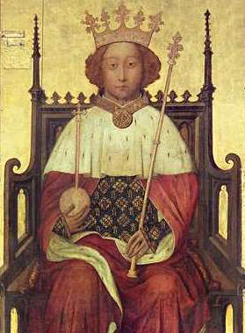
Richard II
-- or --
a tale of two buckets
Give me the crown. Here cousin, seize the crown.
Here, cousin.
On this side my hand, and on that side yours.
Now is this golden crown like a deep well
That owes two buckets, filling one another,
The emptier ever dancing in the air.
The other down, unseen, and full of water.
That bucket down and full of tears am I,
Drinking my griefs whist you mount up on high.
(4.1.181-89)
-

Slide 2
Preliminaries
Richard II, written ca. 1595, belongs to the period of Romeo and Juliet and A Midsummer Night’s Dream
Published in 1597 (First Quarto) without 4.1.154-318, the abdication scene.
Source: Raphael Holinshed’s Chronicles (1587 edition) recently printed by Thomas Vautrollier in the printing house where Shakespeare’s schoolfellow from Stratford, Richard Field, had been apprenticed and was now master.
Q4, 1608, published with (as it is announced on the title page) ‘new additions of the Parliament Sceane, and the deposing of King Richard’.

Slide 3
The play deals with recorded events across only two years:
Henry Bolingbroke and Thomas Mowbray (the ‘appellants’) accused each other before the king on 29 April 1398.
They met at Coventry for the trial by combat on 16 September 1398 where the lists were interrupted and the combatants banished.
John of Gaunt, first Duke of Lancaster, son of Edward III, uncle to King Richard, father to Henry Bolingbroke, died 3 February 1399.
Bolingbroke returned to England in June or July 1399.
Richard resigned his throne / was deposed 30 September 1399
And murdered in Pomfret Castle January 1400.

Slide 4
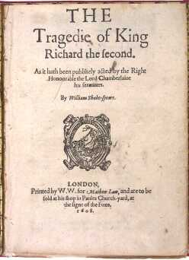
History or Tragedy?
Theatre = events + point of view, bi-focality,
heteroglossia
Shakespeare’s track-record to date, writing history:
The first tetralogy
Opens with the funeral of Henry V; ends with
the death of Richard III and the victory of
Henry Richmond at Bosworth Field, the
beginning of the Tudor dynasty, current reigning
monarch in Shakespeare’s England
-- Henry VI Part 2 1591
-- Henry VI Part 3 1591
-- Henry VI Part 1 1592
-- Richard III 1592-3
Event-driven plots: ‘alarums and excursions’
Iconic scenes: Temple Garden Part I, 2.4
Meditations on kingship: Mole Hill, Part III, 2.5; Tower of London Part III, 5.6
Performance of regicide: Death of York, Death of Henry Part III, 1.4, 5.6
Person-driven plot: inhabiting, exploring, exposing Richard as demon king; developing soliloquy as thinking machine discovering interiority + making character

Slide 5
Richard II opening play in Shakespeare’s second tetralogy, which circles back to events / histories before those he dramatised in the Henry VIs to look at where it all began …
Consider the trajectory from Richard II to Henry V via the two parts of Henry IV …
Memory / Prophecy The Past / The Future
What does divinity have to do with this history? What does politics have to do with it?
What theories / practices of Kingship are being explored in these plays? What is the king’s relationship to law? As an absolute monarch, is he above the law? (‘That which pleases the king has the force of law’.) Or, as God’s deputy, is he himself subject to the law? How do ‘we’ (the English nobility, the English commons) negotiate the ‘bad king’ conundrum? What is our responsibility – and course of action – if we know that the king is implicated in crime, like murder?

Slide 6
Further Preliminaries: Contemporary events in Shakespeare’s London
‘Richard II occupies a special place in Shakespeare scholarship because it represents the most conspicuous and famous example of a Shakespearean play transcending the confines of theatrical production to enter into real-life political drama during the playwright’s own lifetime. Or, at least, it probably does. On the afternoon of 7 February 1601—the day before the so-called Essex Rising—the Lord Chamberlain’s Men certainly staged a play “of Kyng Harry the iiiith and of the kyllyng of Kyng Richard the Second” at the insistence of certain gentlemen who were to be involved in the events of the following day …’
      Paul E.J. Hammer, ‘Shakespeare’s Richard II, the Play of 7 February 1601, and the Essex Rising’, Shakespeare Quarterly (2008) 1 – 36.

Slide 7
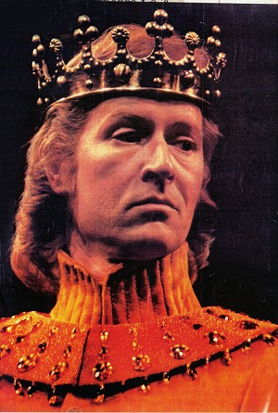
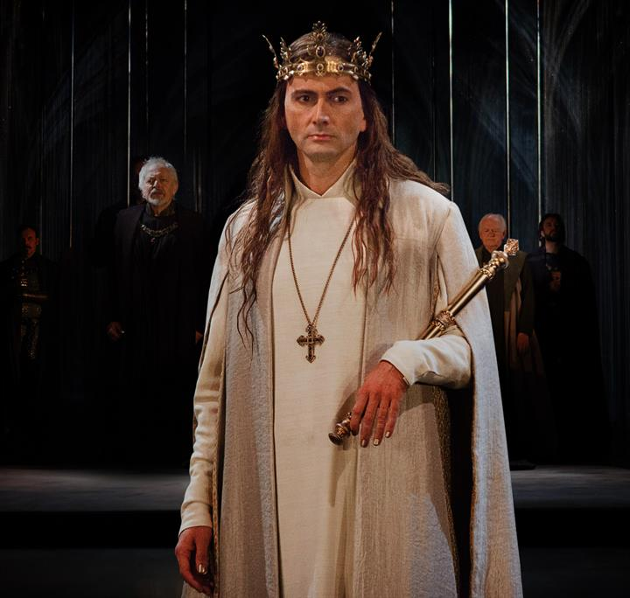
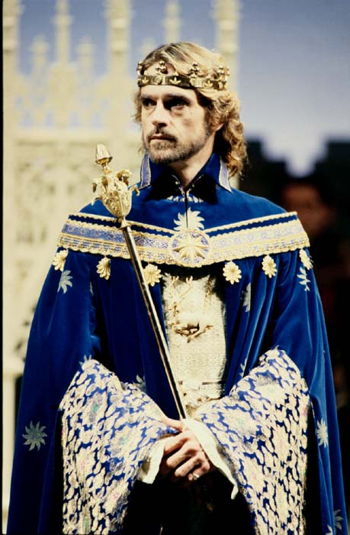
We were not born to sue but to command. (1.1.196)
But: Bolingbroke v. Mowbray
Be ready, as your lives shall answer it,
At Coventry upon Saint Lambert’s day,
There shall your swords and lances arbitrate
The swelling difference of your settled hate…
Since we cannot atone you, we shall see
Justice design the victor’s chivalry. (1.1.198-203
Alan Howard 1981 RSC directed by Terry Hands
Jeremy Irons 1986 RSC directed by Barry Kyle
David Tennant 2013 RSC directed by Gergory Doran

Slide 8
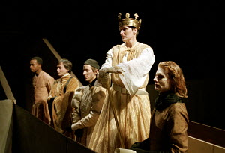
Lists at Coventry 1.3 Trial by Combat Fiona Shaw as Richard, National Theatre 1995 Interrupted. Why?
For that our kingdom’s earth should not be soiled
With that dear blood which it hath fostered,
And for our eyes do hate the dire aspect
Of civil wounds plough’d up with neighbours’ swords …And…And…And…
Therefore we banish you our territories.
But do we believe that? Or is there another reason?

Slide 9
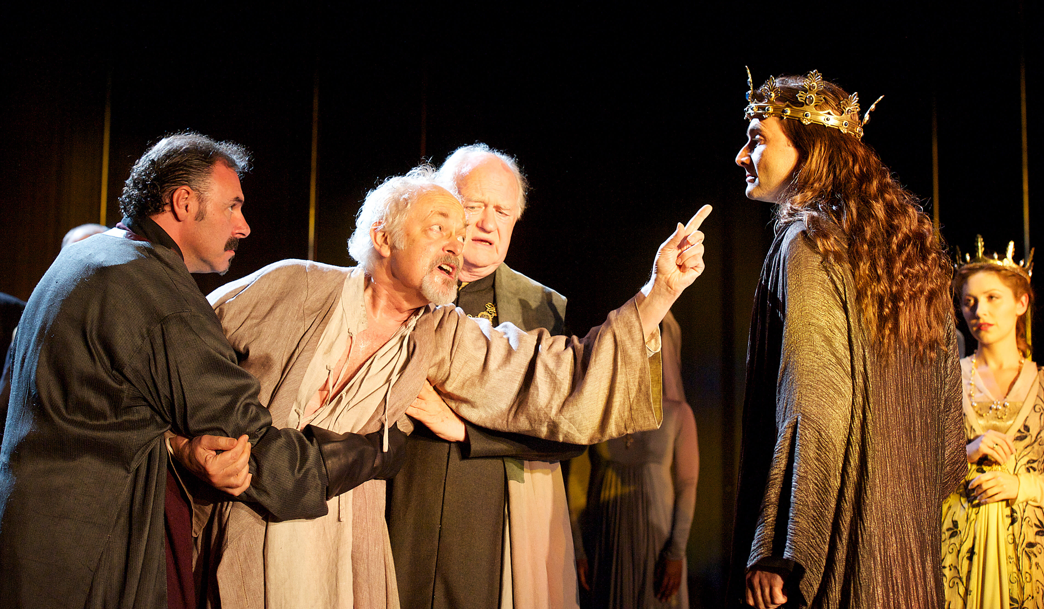
David Tennant as Richard 2013
directed by Gregory Doran
‘A thousand flatterers sit within thy crown,
Whose compass is no bigger than thy head;
And yet, incaged in so small a verge,
The waste is no whit lesser than thy land’ (2.1.100-4)

Slide 10
Richard: … Now for our Irish wars…
And for these great affairs do ask some charge, / … we do seize to us
The plate, coin, revenues, and moveables
Whereof our uncle Gaunt did stand possess’d… […]
York: Seek you to seize and gripe into your hands
The royalties and rights of banish’d Hereford?
Is not Gaunt dead? And doth not Hereford live?
Was not Gaunt just? And is not Harry true?
Did not the one deserve to have an heir?
Is not his heir a well-deserving son?
Take Hereford’s rights away, and take from Time
His charters and his customary rights.
Let not tomorrow then ensue today.
Be not thyself – for how art thou a king
But by fair sequence and succession? …
If you do wrongfully seize Hereford’s rights…
You pluck a thousand dangers on your head…
And prick my tender patience to those thoughts
Which honour and allegiance cannot think.
Richard: Think what you will, we seize into our hands
His plate, his goods, his money and his lands. (2.1.155 – 210)

Slide 11
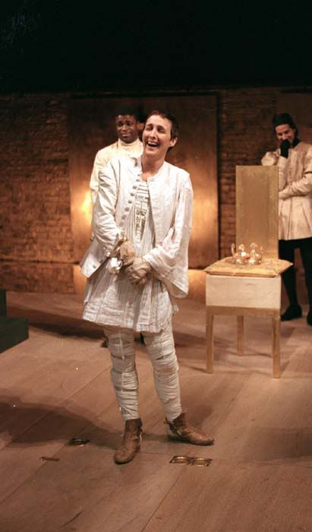
The lining of his coffers shall make coats
To deck our soldiers for these Irish wars 1.4.62-4
King Henry: The skipping king, he ambled up and down
With shallow jesters and rash bavin wits…
Mingled his royalty with cap’ring fools;
Had his great name profaned with their scorns…
Grew a companion to the common streets,
Enfeoff’d himself to popularity. (Henry IV Part I, 3.2.60-69)
* * * *
Gaunt: O, had thy grandsire, with a prophet’s eye,
Seen how his son’s son should destroy his sons,
From forth thy reach he would have laid thy shame,
Deposing thee before thou wert possess’d,
Which are possess’d now to depose thyself…
Landlord of England art thou now, not king.
(Richard II, 104-07, 113)
Fiona Shaw as Richard, National Theatre 1995. Directed by Deborah Warner

Slide 12
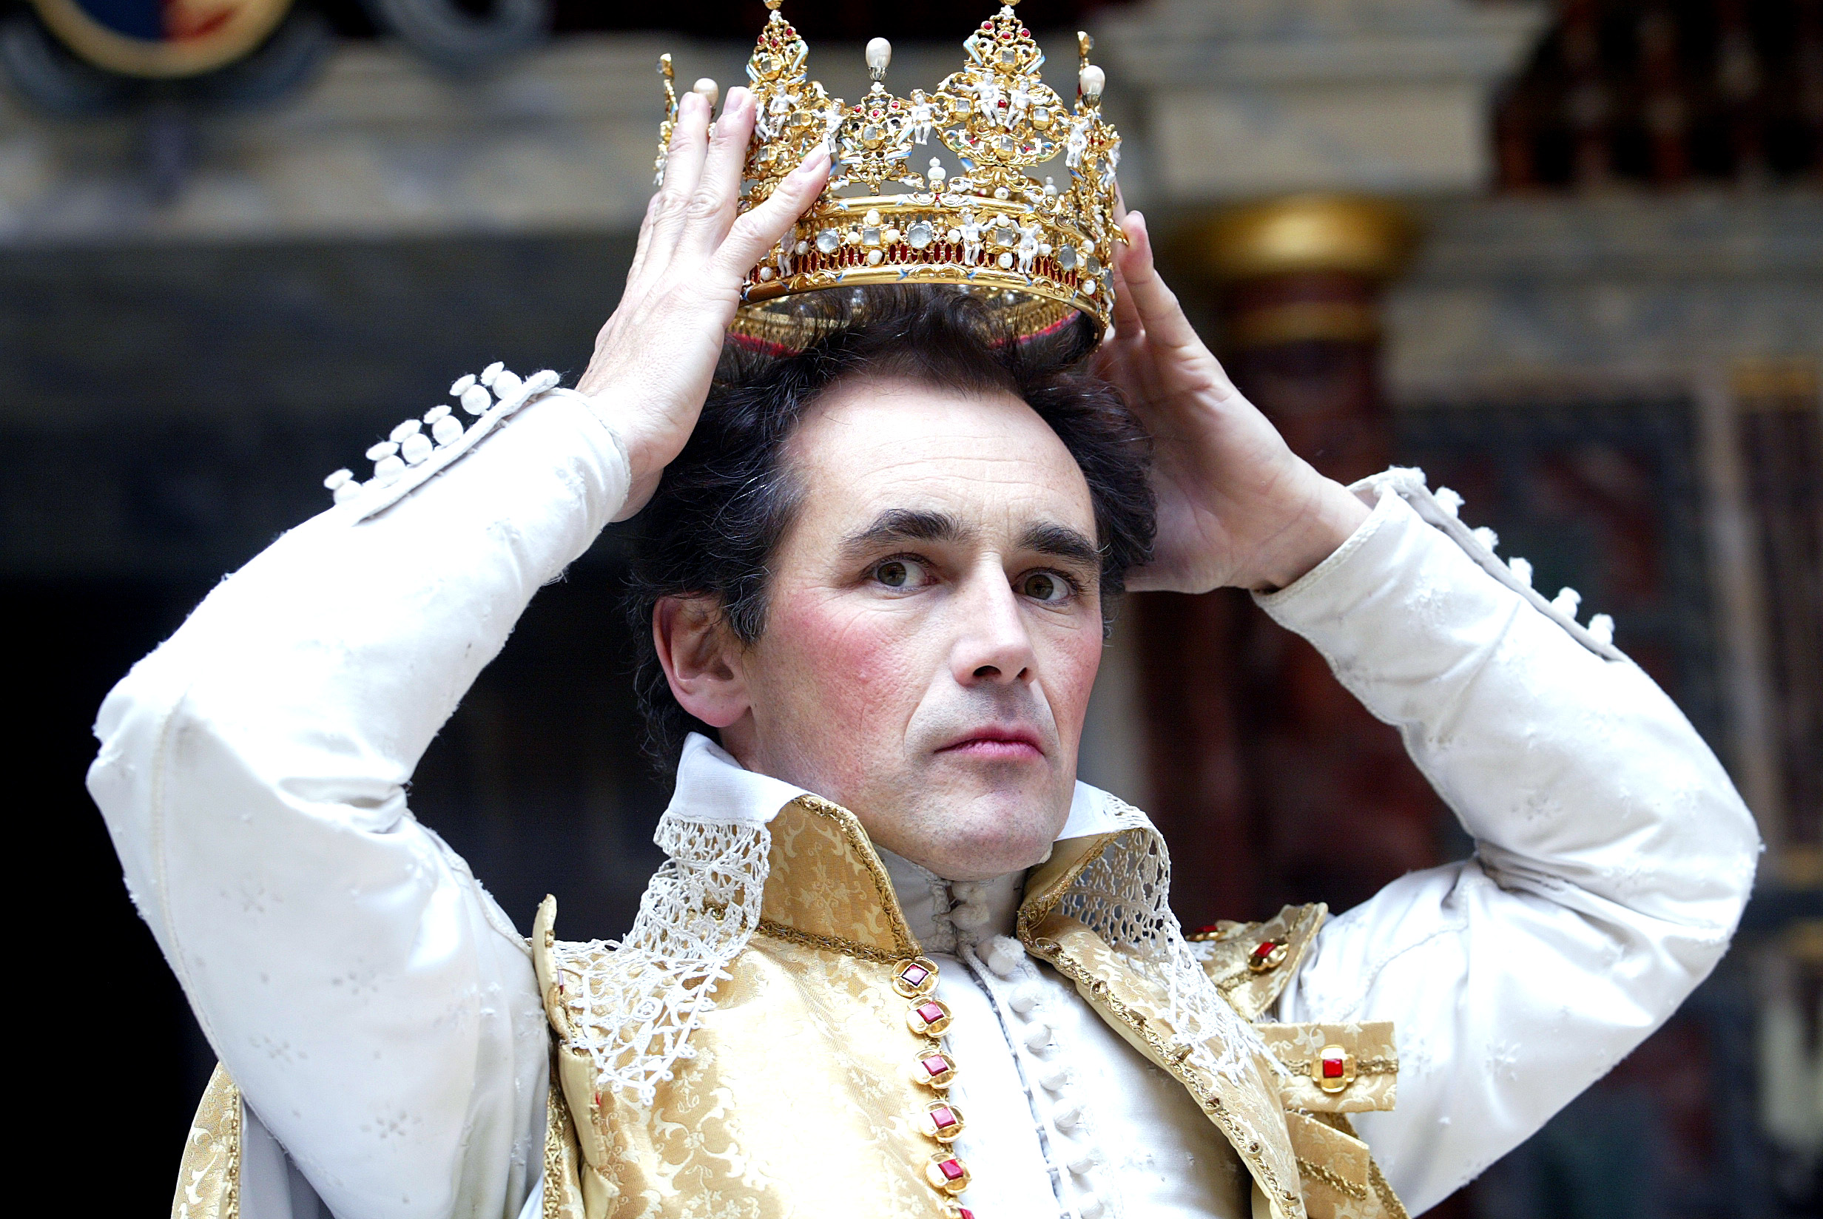
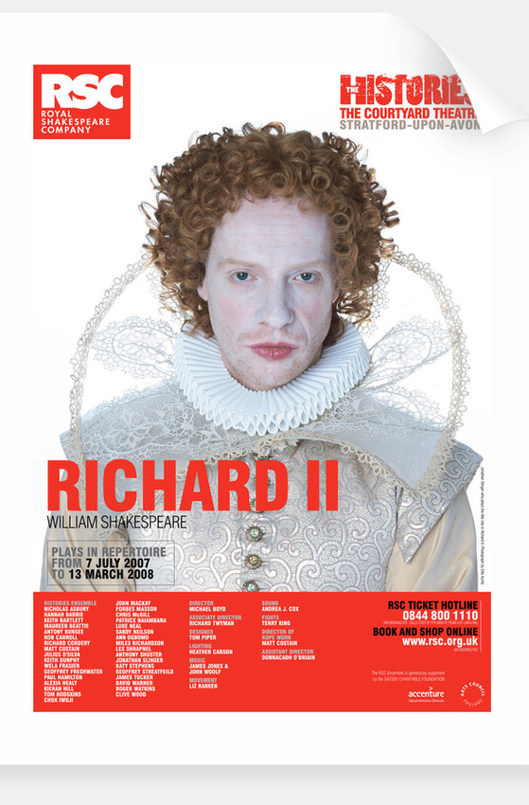
Mark Rylance as Richard, Globe, 2003 directed by Tim Carroll
Jonathan Slinger as
Richard, RSC, 2007 directed
By Michael Boyd

Slide 13
Richard: [… ] [K]now’st thou not
That when the searching eye of heaven is hid
Behind the globe that lights the lower world,
Then thieves and robbers range abroad unseen
In murders and in outrage boldly here?
But when from under this terrestrial ball
He fires the proud tops of the eastern pines
And darts his light through every guilty hole,
Then murders, treasons, and detested sins,
The cloak of night being plucked from off their backs,
Stand bare and naked, trembling at themselves.
So when this thief, this traitor Bolingbroke,
Who all this while hath reveled in the night
Whilst we were wand’ring with the Antipodes,
Shall see us rising in our throne, the east,
His treasons will sit blushing in his face,
Not able to endure the sight of day,
But self-affrighted, tremble at his sin.
Not all the water in the rough rude sea
Can wash the balm off from an anointed king.
The breath of worldly men cannot depose
The deputy elected by the Lord.
For every man that Bolingbroke hath pressed
To lift shrewd steel against our golden crown,
God for His Richard hath in heavenly pay
A glorious angel. Then, if angels fight,
Weak men must fall, for heaven still guards the right. (3.2.36-62)

Slide 14
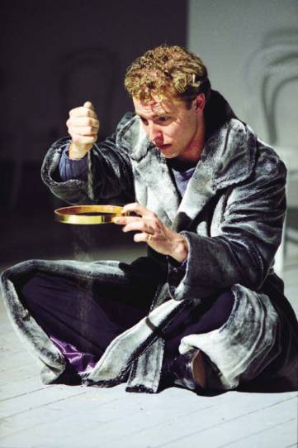
Cover your heads, and mock not flesh and blood
With solemn reverence. Throw away respect,
Tradition, form, and ceremonious duty,
For you have but mistook me all this while.
I live with bread like you, feel want,
Taste grief, need friends. Subjected thus,
How can you say to me I am a king? (3.2.144—77)
Sam West as Richard RSC 2000 directed by
Stephen Pimlott
KING RICHARD […] Of comfort no man speak.
Let’s talk of graves, of worms, and epitaphs,
Make dust our paper, and with rainy eyes
Write sorrow on the bosom of the earth.
Let’s choose executors and talk of wills.
And yet not so, for what can we bequeath
Save our deposèd bodies to the ground?
Our lands, our lives, and all are Bolingbroke’s,
And nothing can we call our own but death
And that small model of the barren earth
Which serves as paste and cover to our bones.
For God’s sake, let us sit upon the ground
And tell sad stories of the death of kings—
How some have been deposed, some slain in war,
Some haunted by the ghosts they have deposed,
Some poisoned by their wives, some sleeping killed,
All murdered. For within the hollow crown
That rounds the mortal temples of a king
Keeps Death his court, and there the antic sits,
Scoffing his state and grinning at his pomp,
Allowing him a breath, a little scene,
To monarchise, be feared, and kill with looks,
Infusing him with self and vain conceit,
As if this flesh which walls about our life
Were brass impregnable; and humored thus,
Comes at the last and with a little pin
Bores through his castle wall, and farewell, king!

Slide 15
Bolingbroke: Go to the rude ribs of that ancient castle…
… and thus deliver:
Henry Bolingbroke
On both his knees doth kiss King Richard’s hand
And sends allegiance and true faith of heart
To his most royal person, hither come
Even at his feet to lay my arms and power,
Provided that my banishment repealed
And lands restored again be freely granted.
If not, I’ll use the advantage of my power
And lay the summer’s dust with showers of blood
Rained from the wounds of slaughtered Englishmen —
The which, how far off from the mind of Bolingbroke
It is …My stooping duty tenderly shall show. (3.3.31-48)
* * * * *
Richard (to Northumberland): We are amaz’d, and
thus long have we stood
To watch the fearful bending of thy knee,
Because we thought ourself thy lawful king.
And if we be, how dare thy joints forget
To pay their awful duty to our presence? …
…though you think…we are barren and bereft of friends,
Yet know, my master, God omnipotent,
Is mustering in his clouds, on our behalf,
Armies of pestilence, and they shall strike
Your children yet unborn and unbegot
That lift your vassal hands against my head … (3.3.72-89)
Northumberland: … Thy thrice-noble cousin,
Harry Bolingbroke, doth humbly kiss thy hand,
And by the honorable tomb he swears
That stands upon your royal grandsire’s bones,
And by the royalties of both your bloods,
Currents that spring from one most gracious head,
And by the buried hand of warlike Gaunt,
And by the worth and honor of himself,
Comprising all that may be sworn or said,
His coming hither hath no further scope
Than for his lineal royalties, and to beg
Enfranchisement immediate on his knees;
Which on thy royal party granted once,
His glittering arms he will commend to rust,
His barbèd steeds to stables, and his heart
To faithful service of your Majesty.
This swears he, as he is a prince and just,
And as I am a gentleman I credit him. (3.3.103-20)

Slide 16

BOLINGBROKE Stand all apart,
And show fair duty to his Majesty.
My gracious lord.
KING RICHARD Fair cousin, you debase your princely knee
To make the base earth proud with kissing it.
Me rather had my heart might feel your love
Than my unpleased eye see your courtesy.
Up, cousin, up. Your heart is up, I know,
Thus high at least although your knee be low.
BOLINGBROKE, My gracious lord, I come but for mine own.
KING RICHARD Your own is yours, and I am yours, and all.
BOLINGBROKE So far be mine, my most redoubted lord,
As my true service shall deserve your love.
KING RICHARD Well you deserve. They well deserve to have
That know the strong’st and surest way to get.—
Uncle, give me your hands. Nay, dry your eyes.
Tears show their love but want their remedies.—
Cousin, I am too young to be your father,
Though you are old enough to be my heir.
What you will have I’ll give, and willing too,
For do we must what force will have us do.
Set on towards London, cousin, is it so?
BOLINGBROKE Yea, my good lord.
KING RICHARD Then I must not say no. (3.3.187-210)

Slide 17
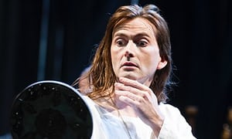
Richard: An if my word be sterling yet in England,
Let it command a mirror hither straight,
That it may show me what a face I have
Since it is bankrupt of his majesty.
BOLINGBROKE Go, some of you, and fetch a looking-glass.
NORTHUMBERLAND Read o’er this paper while the glass doth come.
KING RICHARD Fiend, thou torments me ere I come to hell!
BOLINGBROKE Urge it no more, my Lord Northumberland.
NORTHUMBERLAND The commons will not then be satisfied.
KING RICHARD They shall be satisfied. I’ll read enough
When I do see the very book indeed
Where all my sins are writ, and that’s myself. [Enter one with a glass]
Give me that glass, and therein will I read.
No deeper wrinkles yet? Hath sorrow struck
So many blows upon this face of mine
And made no deeper wounds? O flatt’ring glass,
Like to my followers in prosperity,
Thou dost beguile me. Was this face the face
That every day under his household roof
Did keep ten thousand men? Was this the face
That like the sun did make beholders wink?
Is this the face which faced so many follies,
That was at last outfaced by Bolingbroke?
A brittle glory shineth in this face.
As brittle as the glory is the face, [He breaks the mirror.]
For there it is, cracked in an hundred shivers.—
Mark, silent king, the moral of this sport:
How soon my sorrow hath destroyed my face. David Tennant RSC 2013 directed by Gregory Doran
BOLINGBROKE The shadow of your sorrow hath destroyed
The shadow of your face. (4.1.264-94)

Slide 18
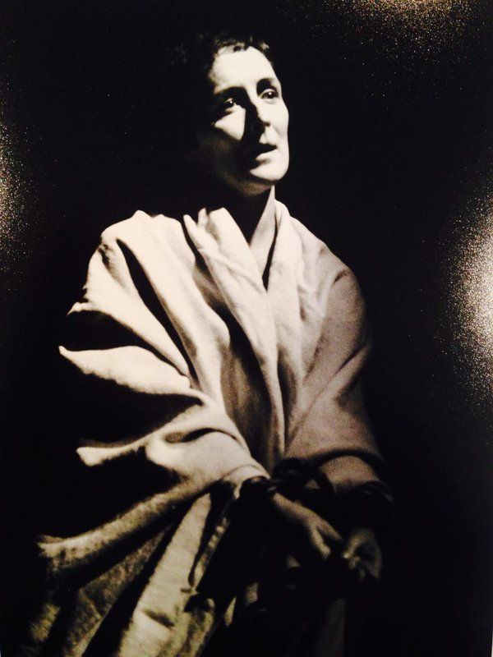
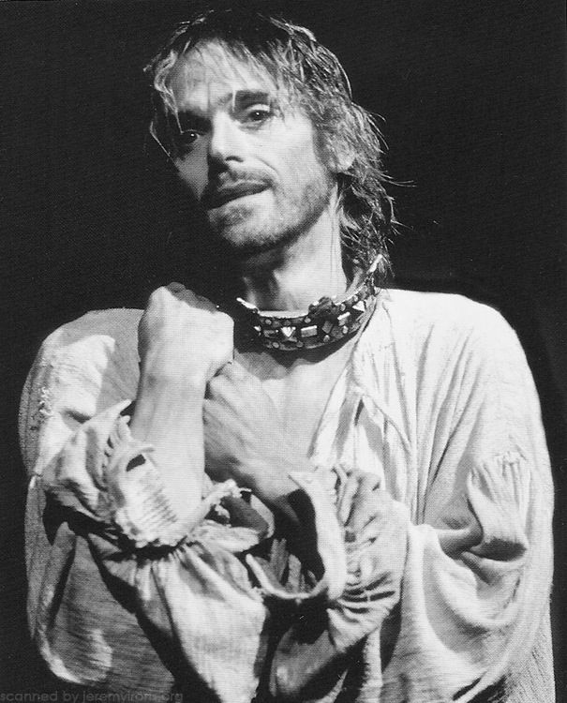
I have been studying how I may compare
This prison where I live unto the world;
And for because the world is populous,
And here is not a creature but myself,
I cannot do it. Yet I’ll hammer it out.
My brain I’ll prove the female to my soul,
My soul the father; and these two beget
A generation of still-breeding thoughts;
And these same thoughts people this little world …
… Sometimes am I a king
Then treasons make me wish myself a beggar.
And so I am. Then crushing penury
Persuades me I was better when a king;
Then am I king’d again; and by-and-by
Think that I am un-king’d by Bolingbroke,
And straight am nothing. But whate’er I be,
Nor I, nor any man that but man in,
With nothing shall be pleas’d till he be eas’d
With being nothing.
I wasted time, and now doth time waste me.
History or Tragedy?
Fiona Shaw NT 1995 directed by
Deborah Warner
Jeremy Irons RSC 1986 directed by
Barry Kyle

