Slide 1
Shakespeare’s (and Marlowe’s) Books
Book as Significant Object
Book and Brain Content
Book and Learning
Reading for Wrighting: Source into Play

Slide 2
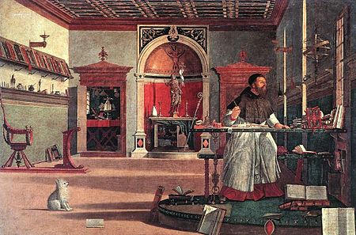
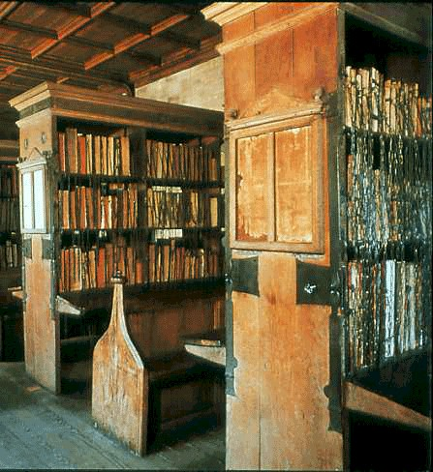
At riper years to Wittenberg he went,…
So much he profits in divinity
That shortly he was graced with doctor’s name,
Excelling all, and sweetly can dispute
In th’heavenly matters of theology;
Till … glutted now with learning’s golden gifts,
He surfeits upon cursèd necromancy;
Nothing so sweet as magic is to him,
Which he prefers before his chiefest bliss.
And this the man that in his study sits.
Victtore Carpaccio, St Augustine in his Study
Books in Duke Humphry’s Chained Library, Bodleian,
Oxford
Settle thy studies, Faustus, and begin
To sound the depth of that thou wilt profess.
Having commenced, be a divine in show, Divinity adieu!
Yet level at the end of every art, These metaphysics of magicians
And live and die in Aristotle’s works… And necromantic books are heavenly…
Bid Oeconomy farewell, and Galen come… O, what a world of profit and delight
Physic, farewell! Where is Justinian?... Of power, of honour, of omnipotence
This study fits a mercenary drudge… Is promised to the studious artisan!...
When all is done, divinity is best. …Emperors and kings
Jerome’s Bible, Faustus, view it well… Are but obeyed in their several provinces
‘Si pecasse negamus, fallimur, But his dominion that exceeds in this
Et nulla est in nobis veritas…* Stretcheth as far as doth the mind of man.
Why then belike me must sin,
And so consequently die…

Slide 3
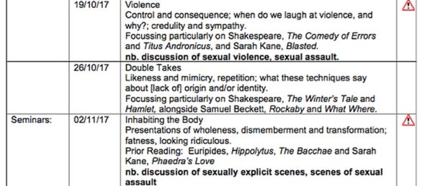

Slide 4
Signifying presence of the book …
Little Lucius’s books. Folio Stage Direction ‘Enter young Lucius and Lauinia running after him, and the Boy flies from her with his bookes vnder his arme. Enter Titus and Marcus’.
Titus: How now, Lavinia … / Some booke there is that she desires to see. / Which is it girl of these? Open them boy. / But thou art deeper read and better skilled / Come and take choice of all my library / And so beguile thy sorrow till the heavens / Reveal the damn’d contriver of this deed. / … Lucius, what book is that she tosseth so?
Lucius: Grandsire, ’Tis Ovid’s Metamorphoses….
Titus: Soft, so busily she turns the leaves / … what would she find? …
This is the tragic tale of Philomel.
Peter Quince: ‘Marry, our play is, The most lamentable comedy, and most cruel death of Pyramus and Thisby’, its source, Ovid’s story from Metamorphoses Book IV. …
Snug: Doth the moon shine that night we play our play?
Bottom: A calendar, a calendar. Look in the almanack; find out moonshine, find out moonshine’:
Gertrude: But look where sadly the poor wretch comes reading…
Polonius: What do you read, my lord?
Hamlet: Words, words, words.
Polonius: What is the matter, my lord?
Hamlet: Between who? … Slanders, sir: for the satirical rogue says here that old men have grey beards …
Polonius: Ophelia, walk you here…/We will bestow ourselves. Read on this book / That show of such an exercise may colour / Your loneliness.
Hamlet [to the Player]: One speech I chiefly loved … ’twas Aeneas’s tale to Dido.
Worcester’s book: ‘Peace cousin … I will unclasp a secret book / And to your quick-conceiving discontents / I’ll read you matter deep and dangerous’. And other actual writing (letter; map; ‘papers’) v. oral report

Slide 5
Books and brain content
What was in Shakespeare’s brain? (natural genius? plagiarist? apish? artless? crafty?)
Robert Greene: ‘ape’; ‘antick’; ‘puppet’; ‘an upstart Crow, beautified with our feathers, that with his Tygers hart wrapt in a Players hyde, supposes he is as well able to bombast out a blanke verse as the best of you: and being an absolute Johannes fac totum, is in his owne conceit the onely Shake-scene in a countrey’ (A Groat’s Worth of Wit, 1592).
Francis Beaumont (1615): his writing was ‘cleere’ from ‘all Learninge’, without any ‘schollershippe’; he was led only ‘by the dimme light of Nature’.
Ben Jonson (1623): He was not of an age, but for all time !
Nature her selfe was proud of his designs,
And joy'd to weare the dressing of his lines ! …
Yet must I not give Nature all: Thy Art,
My gentle Shakespeare, must enjoy a part;
For though the Poets matter, Nature be,
His Art doth give the fashion. And, that he,
Who casts to write a living line, must sweat,
(Such as thine are) and strike the second heat
Upon the Muses anvile : turne the same,
(And himselfe with it) that he thinkes to frame;
Or for the lawrell, he may gaine a scorne,
For a good Poet's made, as well as born.

Slide 6
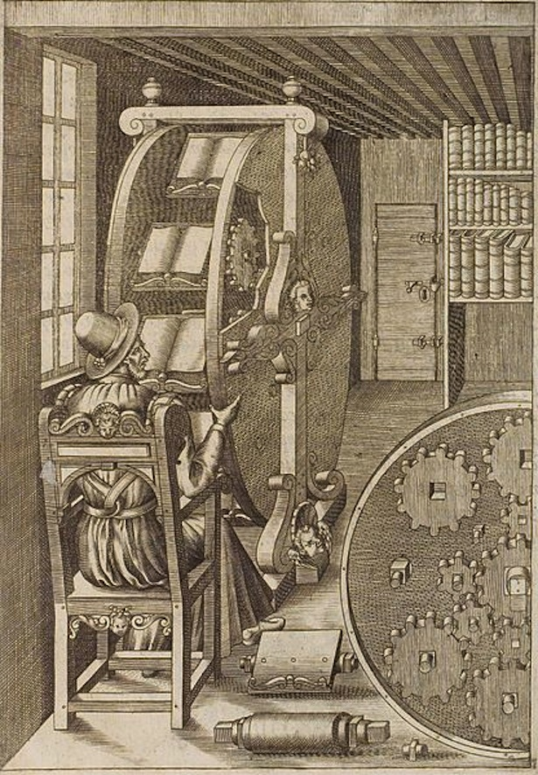
Shakespeare’s Library:
(Richard Field’s print shop?)
Bible (Bishop’s; Geneva)
Book of Common Prayer *
Raphael Holinshed’s Chronicles + Hall
Thomas North’s translation of Plutarch’s Lives of the Noble Greeks and Romans
Chaucer, Canterbury Tales, Troilus and Criseyde
Boccaccio, Decameron
Cicero, de Oratroe, Letters
Ovid Metamorphoses
Virgil, The Aeneid
Plautus, Menaechmi
Terence, Phormio
Seneca, Tragedies
Florio’s Montaigne, Essays Italian dictionaries
Hoby’s Castiglione, The Book of the Courtier
Lewknor’s Contarini, The Commonwealth and Government of Venice
Riche’s Herodotus, Famous History of Egypt
Spenser, The Fairy Queen Sidney, Sonnets
Elyot, The Book of the Governor
Puttenham, The Art of English Poesie
Barrough’s Physick, Gerrard’s Herbal, Topsell’s History of Four Footed Beasts
Greene, Lyly, Peele, Marlowe, Kyd, Dekker, Heywood, Middleton
[If we say that we have no sin we deceive ourselves and the truth is not in us; but if we confess our sins he is faithful and just to forgive us our sins, an to cleanse us from all unrighteousness. John 1.8-9 ]

Slide 7
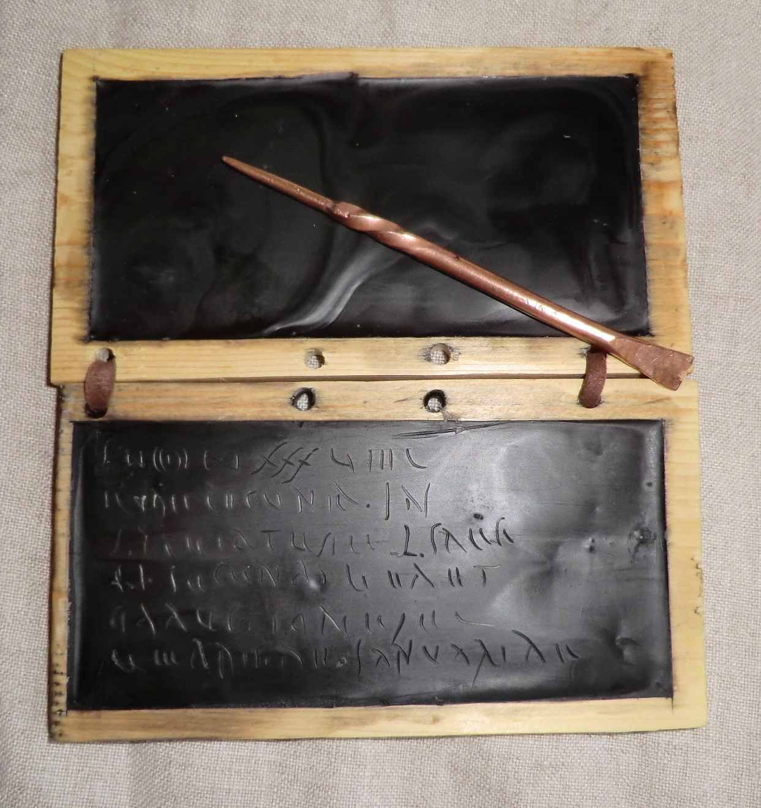
HAMLET: Remember thee?
Ay, thou poor ghost, while memory holds a seat
In this distracted globe. Remember thee?
Yea, from the table of my memory
I’ll wipe away all trivial fond records,
All saws of books, all forms, all pressures past
That youth and observation copied there,
And thy commandment all alone shall live
Within the book and volume of my brain,
Unmix’d with baser matter.
(Hamlet, I.5.95-104
Hamlet: I heard thee speak me a speech once, but it was
ever acted, of it it was, not above once, for the play, I
remember, pleased not the million … One speech in it I chiefly loved; twas Aeneas’ tale to Dido; and thereabout of it especially where he speaks of Priam’s slaughter. If it live in your memory, begin at this line: let me see, let me see: The rugged Pyrrhus, like the Hyrcanian beast – tis not so, it begins with Pyrrhus: -- The rugged Pyrrhus, he whose sable arm …
Technologies of remembering:
Tables
Commonplace books

Slide 8
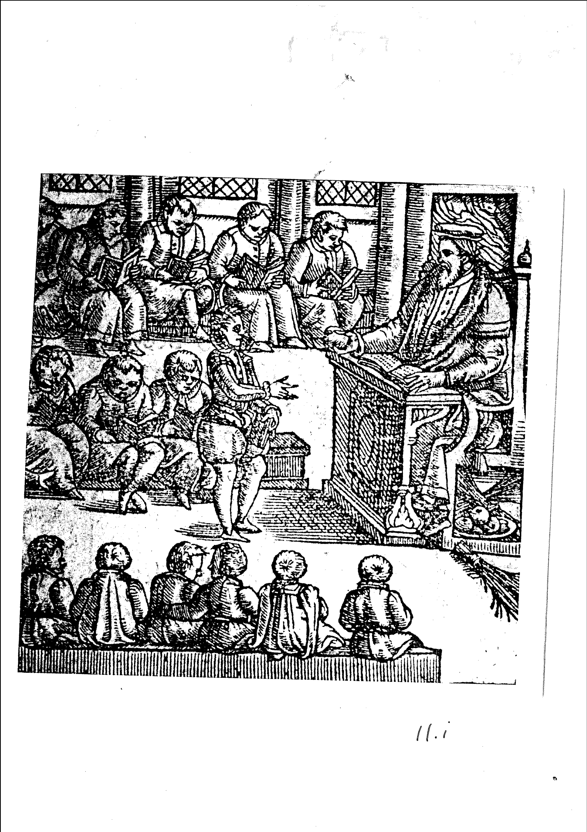

Slide 9
Grammar School Syllabus
Reading Writing Speaking / Imitation Memorisation Invention
‘Erasmus, Sturm, Ascham, Brinsley and the founders of the grammar schools agreed that education served to promote religion, moral virtue, wisdom and eloquence, that these qualities were linked and that the training best suited to produce them was a study of classical languages and literature’ (Peter Mack, Elizabethan Rhetoric: Theory and Practice, p. 12)
‘The grammar school cultivated particular skills in a range of different ways but it also emphasised a range of skills. Moral sentences formed the pupils’ elementary reading matter in the Sententiae pueriles, which they learned by heart as examples of Latin syntax. These sentences crop up again when pupils are expected to extract them from their reading of classical tests and when they are instructed to quote them as components of particular composition exercises…Pupils were also taught how to compose, analyse, and use moral narratives, how to amplify, how to construct different types of text [for use in later life:] letters … memoranda… parliamentary speech’ … sermons (Mack, p. 12). See Hamlet remembering a speech heard once.
‘The grammar school inculcated knowledge as well as skills. The poems and histories pupils read, the maxims and stories they learned and reproduced, provided a shared stock of principles through which persuasion could be articulated’ (Mack, p. 12).

Slide 10
Statutes of Chester grammar school, executed in 1558, the first year of Elizabeth’s reign, recorded that the aim of education was to ‘instruct’ youth ‘to live well’ and to ‘furnish their minds with knowledge and cunning’.
The study of bonae literae aimed not only at individual wisdom and virtue but at a social programme of reform: the eradication of ‘greed and indolence, the taproots of injustice and social disorder’ (M.H. Curtis, ‘Education and Apprenticeship’, Shakespeare Survey 17 p. 53).
For Desiderius Erasmus in De ratione studiii (On the Method of Study, 1512) it was evident that ‘grammar … claims primacy of place’ on the school syllabus and that ‘at the outset boys must be instructed in two – Greek, of course, and Latin’. Why? ‘Because almost everything worth learning is set forth in these two languages.’(See Craig R. Thompson (ed.), Collected Works of Erasmus Vol. 24, ‘On the Method of Study’, tr. Brian McGregor (U. Toronto, 1978), p. 667).
John Brinsley, in Ludus Literarius (1612, reflecting Elizabethan practice): students must ‘pronounce euery matter according to the nature of it … as if they themselues were the persons which did speake… & … imagine themselues to have occasion to vtter the very same thing’. Memorisation was a key skill. Boys who memorized their authors word for word, ‘without book’, wrote Brinsley, made ‘the very phrase and matter of their Author’ ‘their owne to vse perpetually’. A boy literally incorporated those texts into the fabric of his being, into his muscle-memory, by ‘imprinting the originals in his hart’.

Slide 11
Syllabus Harrow 1591 (reflecting earlier practice) A national curriculum?
1. Grammar, Cato, Mimus, etc; Cicero Selected Epistles
2. Aesop, Cato, Erasmus, Colloquia, Mancini, On the Four Virtues
3 Cicero, Epistolae familiares, grammar, Terence, Ovid, Tristia
4. Cicero, De officiis, De amicitia, De senectute, Virgil, Eclogues, Georgics or Horace, Erasmus
De copia, De conscribendis epistolis, Greek grammar
Virgil, Aeneid, Caesar, Cicero, De natura deorum, Livy, Demosthenes, Isocrates,
Hesiod, Heliodorus or Dionysius Halicarnassus
Core handbooks:
Apthonius, Progymnasmata
Erasmus, De copia
Letter writing manuals
Lily’s Brevissima institutio : teaching students to recognize the rhetorical tropes and
figures (among them, metaphor, allegory, irony, hyperbole, synecdoche, metonymy;
anaphora, ploce, anadiplosis, ellipsis, apostrophe), to see them as elements of a writer’s
style, to discriminate their appropriate use in their own writing, and to understand
them not as ‘dry formulae’ or mere ornamentation but ‘pockets of energy’, channels
for re-enacting feeling (Brian Vickers, ‘Shakespeare’s Use of Rhetoric’ in Kenneth Muir
and S. Schoenbaum, A New Companion to Shakespeare Studies (1971), p. 91. As G.K.
Hunter reminds us, ‘rhetoric’ for the Elizabethans was not flattery, insincerity or bombast;
it was ‘a science (or art or techne) of persuasion, an art, that is of public activity’; ‘a science
of doing rather than knowing’ (Hunter in Mack (ed.), Renaissance Rhetoric (1994) p. 103).

Slide 12
Most significantly, grammar school training, writes Robert Miola (in Shakespeare’s Reading, [Oxford, 2000) pp. 2, 3) ‘fostered certain habits of reading, thinking, and writing’ that would have spilled over into students’ writing in English. They ‘acquired extraordinary sensitivity to language, especially its sound.’ Reading aloud and reciting verse viva voce were practices that not only encouraged the performative but helped students develop ‘acute inner ears that could appreciate sonic effects which are lost on moderns.’ Such ‘aural sensitivity led to delight in wordplay of all kinds, repartee, double entendre, puns, and quibbles’, wordplay that ‘exploited the energies of language and intellect’.
The grammar school boy would always in some sense have been working in two languages, and hearing the Latin legacy, its DNA, left in his English. So when Ben Jonson wrote that ‘Art’ gave ‘the Poets matter’ its ‘fashion’, he would certainly have had in mind the Latin root of ‘fashion’, ‘facere’, to make, and the way that verb would play in the line against ‘poet’, the Greek for ‘maker’.

Slide 13
Worcester: He [Hotspur] apprehends a world of figures here,
But not the form of what he should attend. (1 Henry 4, 1.3.207-208)
Polonius: Your noble son is mad.
‘Mad’ call I it, for to define true madness,
What is’t but to be nothing else but mad?
But let that go.
Queen: More matter with less art.
Polonius: Madam, I swear I use no art at all.
That he is mad, ’tis true; ’tis true ’tis pity,
And pity ’tis ’tis true – a foolish figure,
But farewell it, for I will use no art. (Hamlet, 2.2.93-100)
Polonius: …these few precepts … Give thy thoughts no tongue,
Nor any unproportioned thought his act.
Be thou familiar but by no means vulgar…
Neither a borrower nor a lender be…
This above all, to thine own self be true … (Hamlet, 1.4.58 et seq)
Ophelia: He hath … made many tenders / Of his affection to me…
Polonius: Do you believe his ‘tenders’…? / Tender yourself more dearly
Or – not to crack the wind of the poor phrase
Running it thus – you’ll tender me a fool (Hamlet, 1.4.99 et seq)

Slide 14
Ludus literarius and Play
A school exercise called ‘ethopoeia’
ethopoeia: speech for the character
imagining difference
becoming ‘other’
embodying alternative selves
speaking alterity
George Sabinus, commentary on Ovid’s Metamorphoses
[1584]: ‘poetry is nothing other than philosophy arranged in verses and fables’ (Mack, 2002, p. 17)

Slide 15
Julia (as Sebastian): Madam, he sends your ladyship this ring.
Silvia: The more shame for him, that he sends it me;
For I have heard him say a thousand times
His Julia gave it him at his departure.
Though his false finger had profan’d the ring,
Mine shall not do his Julia so much wrong.
Julia/Sebastian: She thanks you.
Silvia: What say’st thou?
Julia/Sebastian: I thank you madam that you tender her:
Poor gentlewoman, my master wrongs her much.
Silvia: Dost thou know her?
Julia/Sebastian: Almost as well as I do know myself.
To think upon her woes, I do protest
That I have wept a hundred several times…
Silvia: Is she not passing fair?
Julia/Sebastian: She hath been fairer, madam, than she is …
Silvia: How tall was she?
Julia/Sebastian: About my stature: for at Pentecost,
When all our pageants of delight were play’d,
Our youth got me to play the woman’s part,
And I was trimm’d in Madam Julia’s gown,
Which servéd me as fit, by all men’s judgments,
As if the garment had been made for me;
Therefore I know she is about my height.
And at that time I made her weep agood,
For I did play a lamentable part.
Madam, ’twas Adriade, passioning
For Theseus’ perjury, and unjust flight;
Which I so lively acted with my tears
That my poor mistress, moved therewithal
Wept bitterly; and would I might be dead,
If I in thought felt not her very sorrow.
Silvia: She is beholding to thee, gentle
youth,
Alas, poor lady, desolate and left.
I weep myself to think upon thy words.
The Two Gentlemen of Verona
4.4.130-74

Slide 16
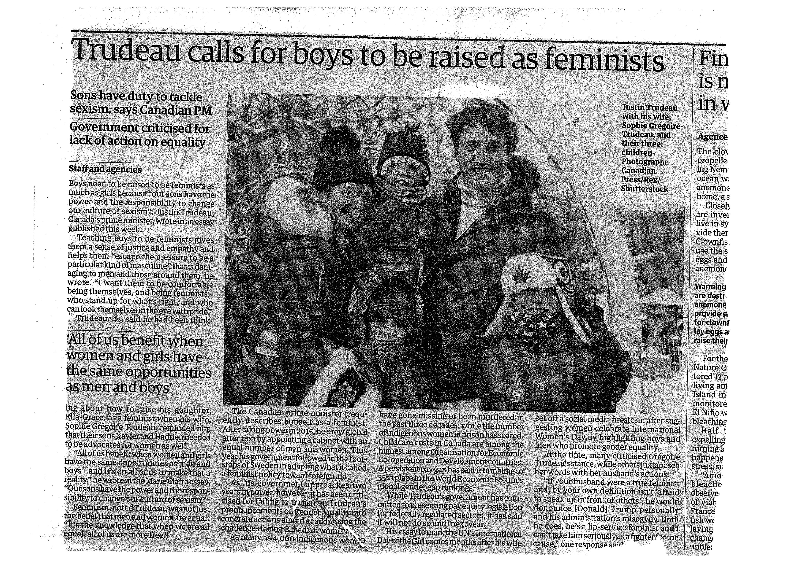

Slide 17
‘The source of Othello is Giraldi Cinthio’s Hecatomithi’, writes Muir; and for Macbeth, ‘when all is said, Shakespeare’s main source was Holinshed.’ [But, argues Daniel Swift, having quoted Muir] ‘Plays are not rivers: they can have more than a single source…To account for Shakespeare’s relation [to his sources] we need a more active understanding of literary influence, one that preserves playfulness and does not seek to dampen down the richness of an encounter between two rival works. We need a messier and more engaged definition of a source. This is not to limit Shakespeare’s creativity or to diminish the texture of the plays. Instead, it is to acknowledge that Shakespeare did not conjure the tensions of his plays from the dust and from the air. This kind of engagement puts work at the center of our reading and sees the plays as carried out between playwright and source, involved with a local world. This will entail a new conception of literary production, in which the writer is perhaps not alone. “In a way that has not been fully recognized or conceptualized by scholars trained to organize material within post-Enlightenment paradigms of individuality, authorship, and textual property, collaboration was a prevalent mode of textual production in the sixteenth and seventeenth centuries,’ writes Jeffrey Masten…[and] according to the stage historian G.E.Bentley, ‘Altogether the evidence suggests that it would be reasonable to guess that as many as half the plays by professional dramatists in the period indorporated the writing at some date of more than one man.” If we seek to see Shakespeare in his own time … we first must learn to see him collaborating, joining sharing. We must learn to see his plays as common work’ (Daniel Swift, Shakespeare’s Common Prayers, 2013).

