Slide 1
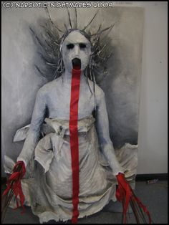
Titus: and the Bodies Politic

Slide 2
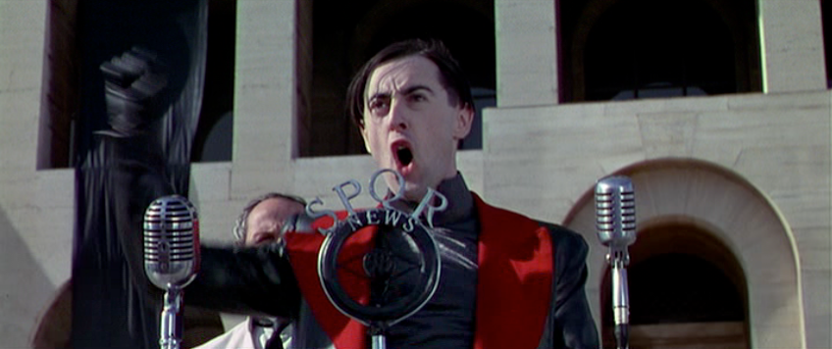
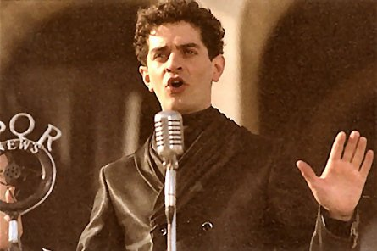
)

Slide 3
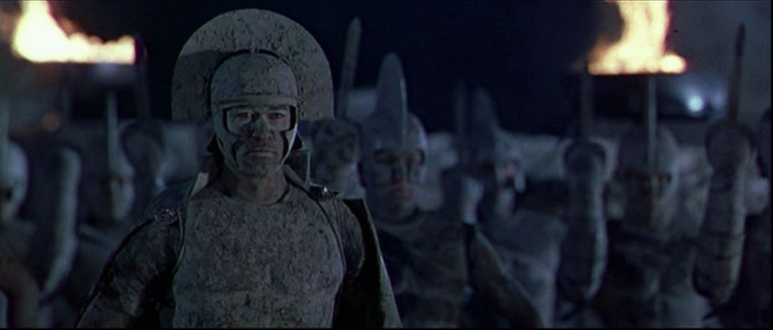
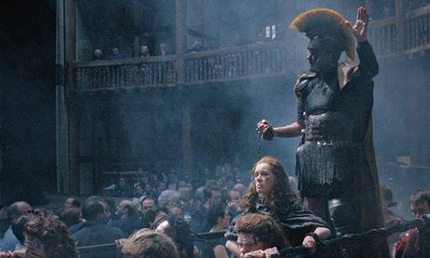
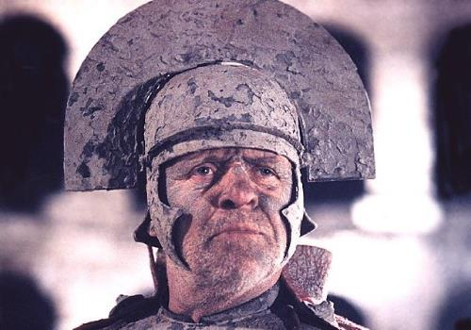
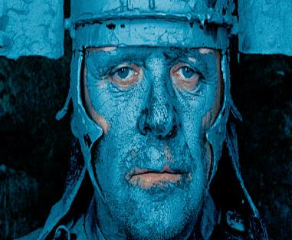

Slide 4
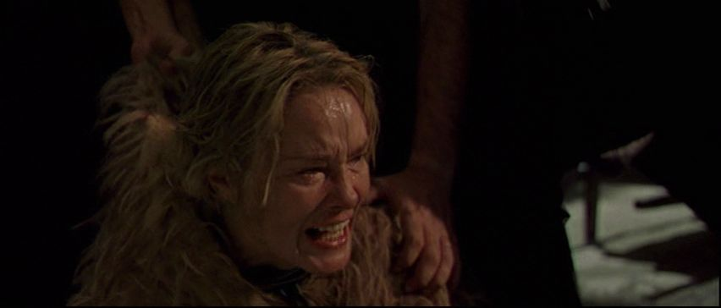
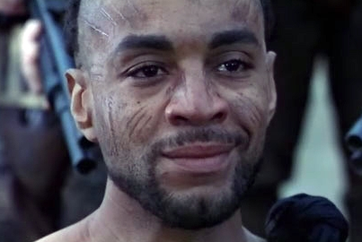

Slide 5
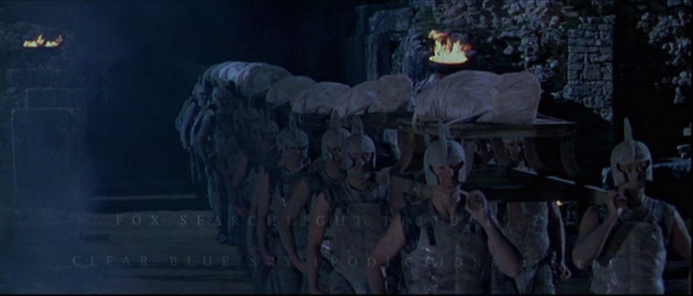
Marcus: He by the Senate is accited home
From weary wars against the barbarous Goths;
That, with his sons, a terror to our foes,
Hath yok’d a nation, strong, trained up in arms.
Ten years are spent since first he undertook
This cause of Rome…five times he hath return’d
Bleeding to Rome, bearing his valiant sons
In coffins from the field. (1.1.27-35)

Slide 6
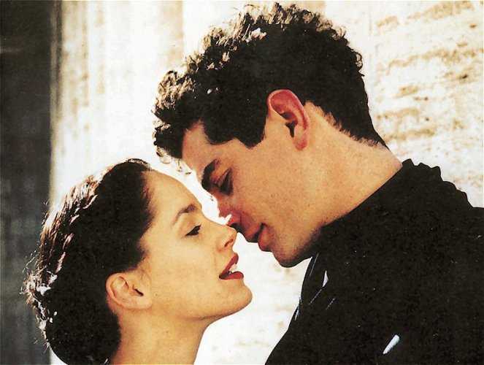

Slide 7

Saturninus:
Noble patricians, patrons of my right,
Defend the justice of my cause with arms,
And countrymen, my loving followers
Plead my successive title with your swords.
I am his first-born that was the last
That wore the imperial diadem of Rome…
Bassianus: Romans, friends, followers …
If ever Bassianus, Caesar’s son,
Were gracious in the eyes of royal Rome,
Keen then this passage to the Capitol,
And suffer not dishonour to approach
The imperial seat, to virtue consecrate…
But let desert in pure election shine…
Marcus: Princes, that strive by factions and by friends
Ambitiously for rule and empery,
Know that the people of Rome, for whom we stand
A special party, have by common voice
In election for the Roman empery
Chosen Andronicus, surnamed Pius …
Titus Andronicus, the people of Rome …
Send thee by me, their tribune and their trust,
This palliament of white and spotless hue,
Be candidatus then and put it on,
And help to set a head on headless Rome.
Titus: A better head her glorious body fits
Than his that shakes for age and feebleness …
Rome, I have been thy soldier forty years…
And buried one-and-twenty valiant sons…
Give me a staff of honour for mine age,
But not a sceptre to control the world. (I.1.1-223)

Slide 8
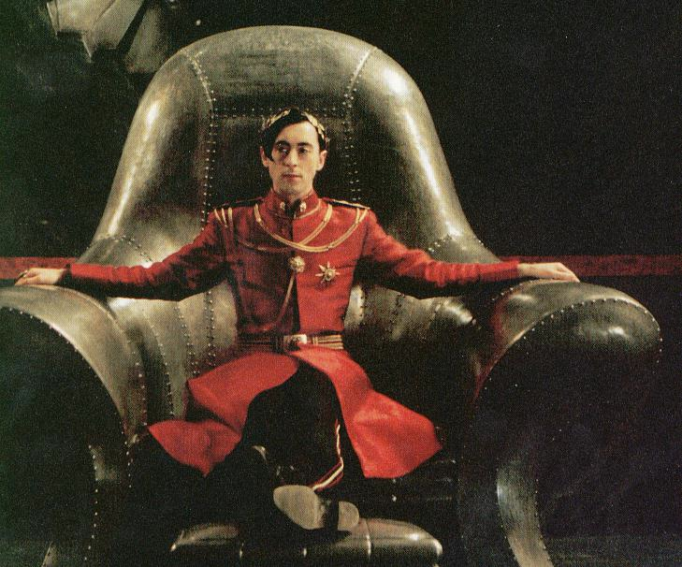

Slide 9
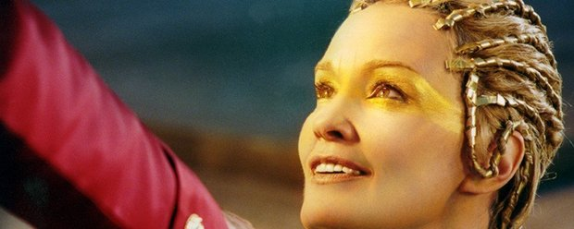
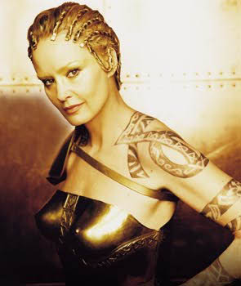
Saturninus: Titus Andronicus, for thy favours done
To us in our election this day,
I…will with deeds…advance
Thy name and honourable family,
Lavinia will I make my empress…doth this motion please thee?
Titus: It doth my worthy lord …
Bassianus: Lord Titus, by your leave, this maid is mine…
Mutius: Brothers, help to convey her hence…
Titus: Barr’st me my way in Rome. [Stabs Mutius] …
Saturninus: …the emperor needs her not,
Nor her, nor thee, nor any of thy stock…give that changing piece
To him that flourish’d for her with his sword…lovely Tamora…
Behold, I choose thee Tamora for my bride…

Slide 10
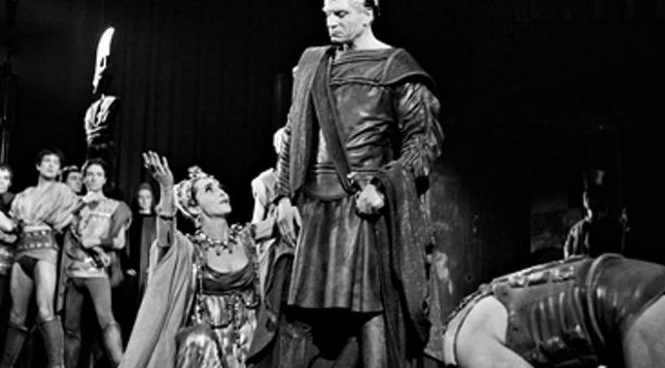
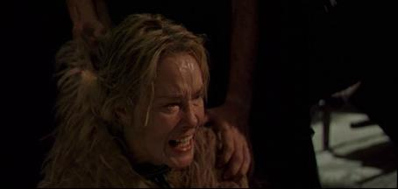
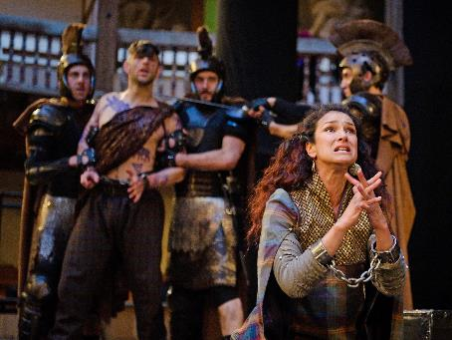
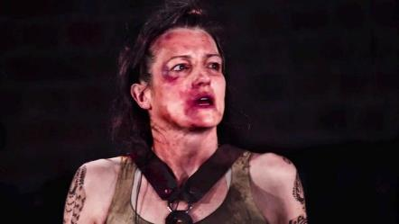

Slide 11
TITUS: Hail Rome, victorious in thy mourning weeds!
Lo, as the bark that hath discharged his fraught
Returns with precious lading to the bay
From whence at first she weighed her anchorage,
Cometh Andronicus, bound with laurel boughs,
To resalute his country with his tears,
Tears of true joy for his return to Rome…
Romans, of five-and-twenty valiant sons,
Half of the number that King Priam had,
Behold the poor remains alive and dead.
These that survive let Rome reward with love;
These that I bring unto their latest home,
With burial amongst their ancestors.
Here Goths have given me leave to sheathe my sword.
Titus, unkind and careless of thine own,
Why suffer’st thou thy sons unburied yet
To hover on the dreadful shore of Styx?
Make way to lay them by their brethren.
They open the tomb.
There greet in silence, as the dead are wont,
And sleep in peace, slain in your country’s wars….
LUCIUS Give us the proudest prisoner of the Goths,
That we may hew his limbs and on a pile,
Ad manes fratrum, sacrifice his flesh
Before this earthy prison of their bones,
That so the shadows be not unappeased,
Nor we disturbed with prodigies on Earth.
TITUS: I give him you, the noblest that survives,
The eldest son of this distressed queen.
TAMORA: Stay, Roman brethern! Gracious conqueror,
Victorious Titus, rue the tears I shed,
A mother’s tears in passion for her son:
And if thy sons were ever dear to thee,
O think my son to be as dear to me.
Sufficeth not that we are brought to Rome
To beautify thy triumphs and return
Captive to thee and to thy Roman yoke,
But must my sons be slaughtered in the streets
For valiant doings in their country’s cause?
O, if to fight for king and commonweal
Were piety in thine, it is in these!
Andronicus, stain not thy tomb with blood.
Wilt thou draw near the nature of the gods?
Draw near them then in being merciful.
Sweet mercy is nobility’s true badge.
Thrice-noble Titus, spare my first-born son.
TITUS Patient yourself, madam, and pardon me.
These are their brethren whom your Goths beheld
Alive and dead, and for their brethren slain
Religiously they ask a sacrifice.
To this your son is marked, and die he must,
T’ appease their groaning shadows that are gone.
LUCIUS Away with him, and make a fire straight,
And with our swords upon a pile of wood
Let’s hew his limbs till they be clean consumed. Exit with Alarbus.
Tamora: O cruel, irreligious piety!...
Lucius: See … Alarbus’ limbs are lopp’d
And entrails feed the sacrificing fire
Whose smoke, like incense, doth perfume the sky. (1.1.70 – 145)

Slide 12
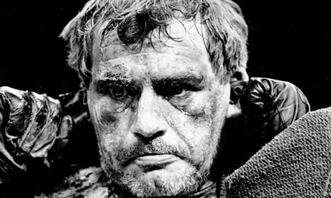
Demetrius: … madam, stand resolv’d; but hope withal…
With opportunity of sharp revenge…
May…Tamora…quit the boodly wrongs upon her foes.
1.1.135-141
Tamora (to Saturninus): My lord, be rul’d by me…
Dissemble all your griefs and discontents:
You are but newly planted in your throne…
Yield at entreats, and then let me alone.
I’ll find a day to massacre them all. 1.1.442-450

Slide 13
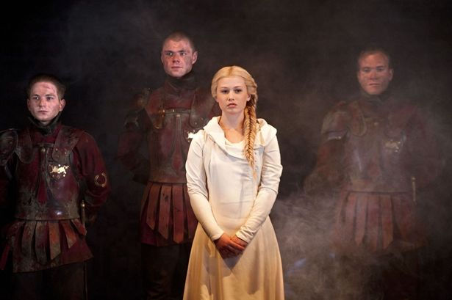
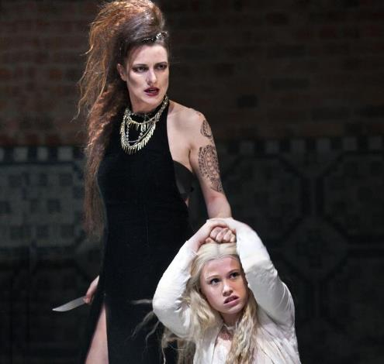
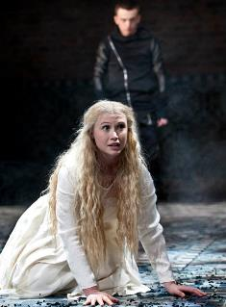
Tamora: Give me thy poinard; you shall know, my boys,
Your mother’s hand shall right your mother’s wrong.
Demetrius: Stay, madam. Here is more belongs
to her:
First thrash the corn, then after burn the straw.
This minion stood upon her chastity
Upon her nuptial vow, her loyalty…
And shall she carry this unto her grave?
Chiron: An if she do, I would I were an eunuch.
Drag hence her husband to some secret hole
And make his dead trunk pillow to our lust…
Come mistress, now perforce we will enjoy
That nice-preserved honesty of yours. 2.3.120-35

Slide 14
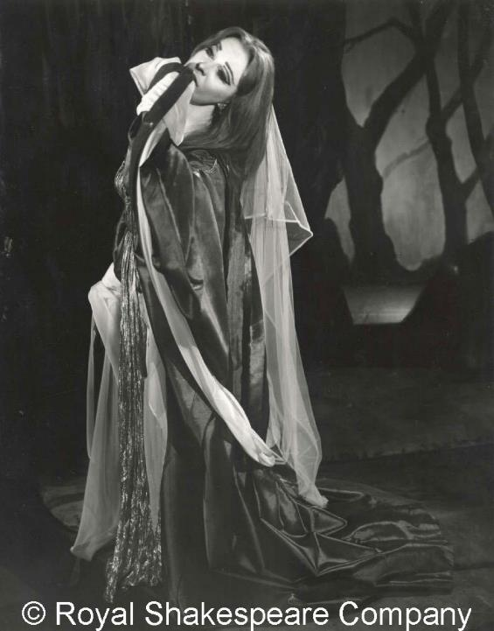
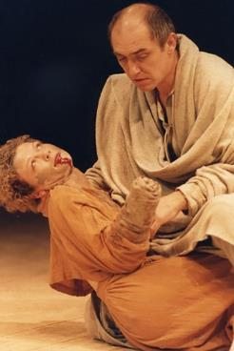
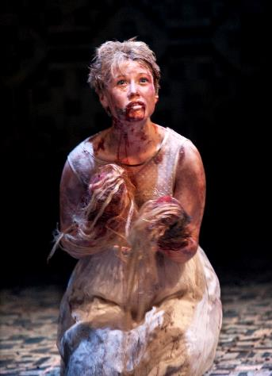
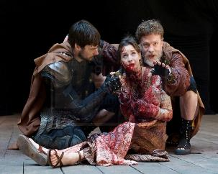
‘pattern, precedent and lively warrant’, 5.3.44

Slide 15
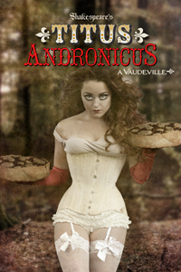
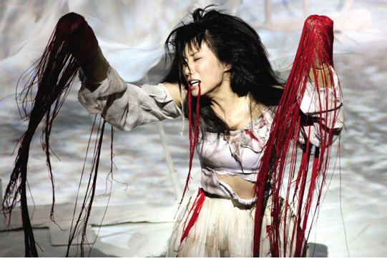
Demetrius: So, now go tell, an if thy tongue can speak,
Who ’twas that cut thy tongue and ravish’d thee.
Chiron: Write down thy mind, bewray thy meaning so:
An if thy stumps will let thee play the scribe.
Demetrius: See, how with sings and tokens she can scrowl.
Chiron: Go home, call for sweet water, wash thy hands.
Demetrius: she hath no tongue to call, nor hands to wash.
And so let’s leave her to her silent walks.
Chiron: An ’twere my case, I should go hang myself.
Demetrius: If thou hadst hands to help thee knit the cord. (2.3.1-10)
TITUS ANDRONICUS, A VAUDEVILLE
is a play for every school child who found the Bard a bit boring.
This Vaudeville inspired Burlesque show won’t put you to sleep, but may encourage you to run away with the circus. Come see Shakespeare’s most gruesome and bloody play, told by a rag-tag group of old-time performers

Slide 16
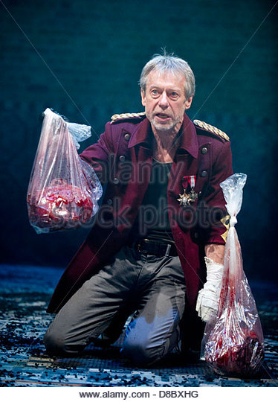
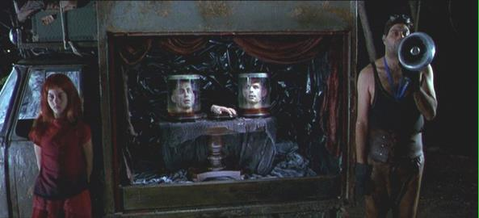
Messenger: Worthy Andronicus, ill art thou repaid
For that good hand thou sent’st the emperor.
Here are the heads of thy two noble sons,
And here’s thy hand in scorn to thee sent back:
Thy grief their sports, thy resolution mocked,
That woe is me to think upon thy woes
More than remembrance of my father’s death….
Titus: When will this fearful slumber have an end?
Marcus: Now farewell flattery…
Thou dost not slumber….
Now is a time to storm. Why art thou still?
Titus: Ha, ha, ha!
Marcus: Why dost thou laugh? It fits not with this hour.
Titus: Why? I have not another tear to shed.
Besides, this sorrow is an enemy
And would usurp upon my watery eyes
And make them blind with tributary tears.
Then which way shall I find Revenge’s cave,
For these two heads do seem to speak to me … (3.1.235-272)

Slide 17
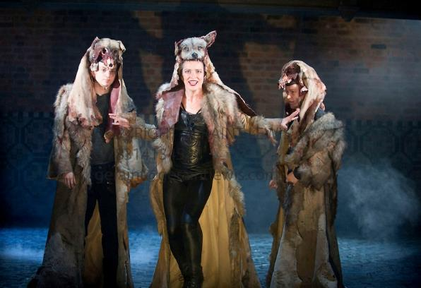
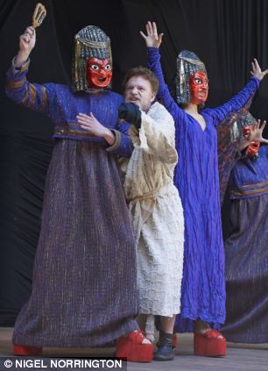
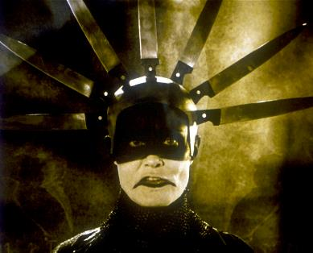
Tamora: I am Revenge, sent from th’
infernal kingdom / To ease the
gnawing vulture of thy mind/ By working wreakful vengeance on thy foes.
Titus: Are these thy ministers?...good Lord, how like the empress’ sons they are, / And you the empress (5.2.30–65)

Slide 18
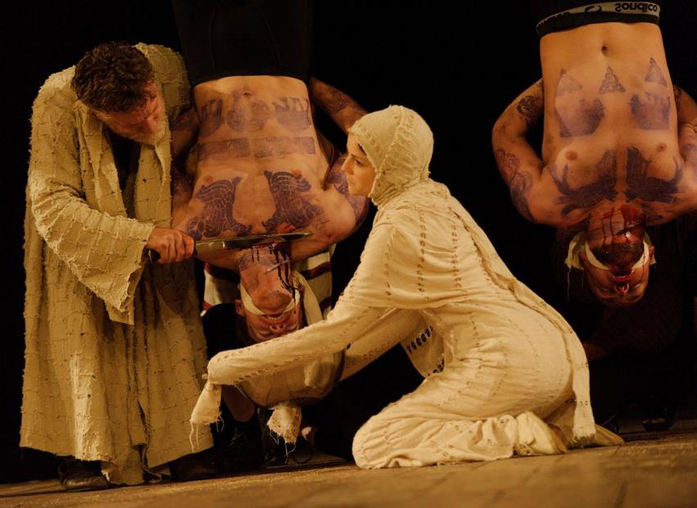
Hark wretches how I mean to martyr you…
Hark, villains, I will grind your bones to dust,
And with your blood and it I’ll make a paste,
And of the paste a coffin I will rear,
And make two pasties of your shameful heads
And bid that strumpet, your unhallowed dam,
Like to the earth, swallow her own increase…
For worse than Philomel you used my daughter,
And worse than Progne I will be revenged.
And now, prepare your throats. Lavinia, come…(5.2.180-95)

Slide 19
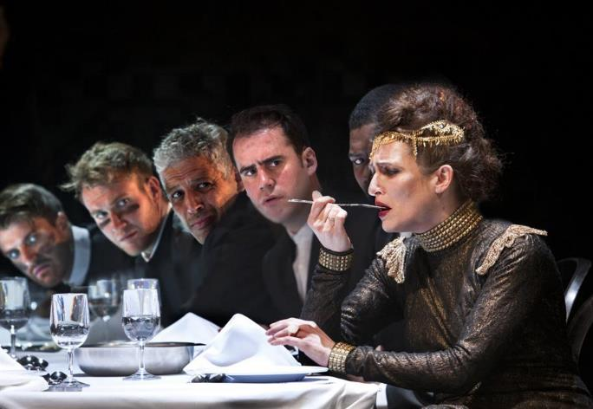
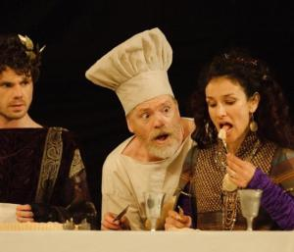
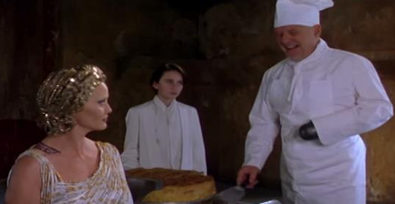
Tamora: Why hast thou slain thine only daughter thus?
Titus: Not I, ’twas Chiron and Demetrius: / They ravished her and cut away her tongue/ And
they, ‘’twas they, that did her all this wrong.
Saturninus: Go, fetch them hither to us presently.
Titus: Why, there they are, both baked in this pie, / Whereof their mother daintily hath fed/ Eating the flesh that she herself hath bred. (5.3.54-61)

Slide 20
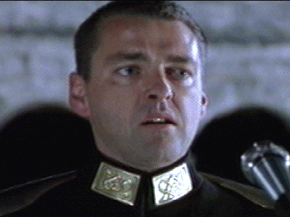
Marcus: You sad-faced men, people and sons of Rome
By uproars severed, as a flight of fowl
Scattered by winds and high tempestuous gusts,
Let me teach you how to knit again
This scattered corninto one mutual sheaf,
These broken limbs again into one body…
* * * *
All Romans: Lucius, all hail, Rome’s gracious governor.
Lucius: Thanks, gentle Romans. May I govern so
To heal Rome’s harms and wipe away her woe….
Come hither boy, bome and learn of us
To melt in showers. Thy grandsire loved thee well:
Many a time he danced thee on his knee,
Sung thee asleep, his loving breast thy pillow,
Many a story hath he told to thee
And bid thee bear his pretty tales in mind
And talk of them when he was dead and gone.
5.2.66-71, 145-165)

Slide 21
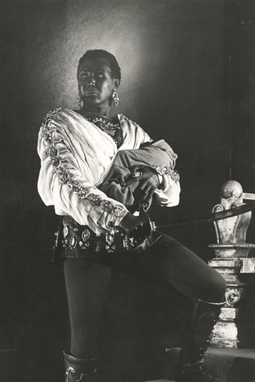
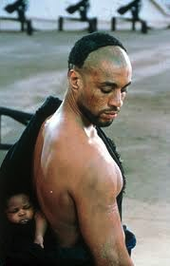
‘Behold this child’
5.3.118

Slide 22
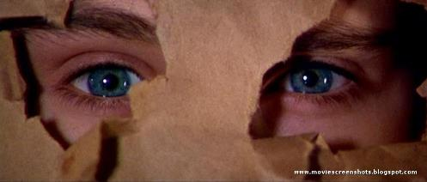
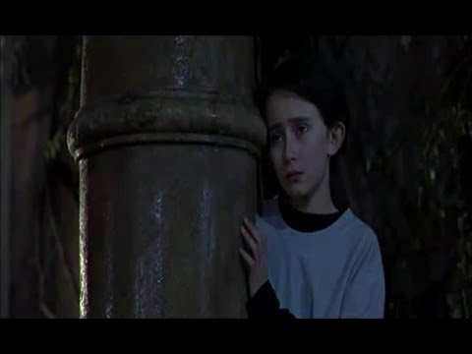
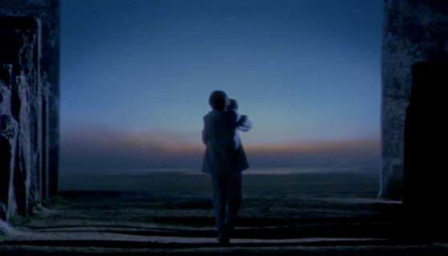

Slide 23
The politic bodies in Hamlet?
Violence, conquest, murder: revenge play
The revanant body: the anachronistic body
The mourning body: the dissident body
The distracted body: the erotic body
The heroic body: the appropriated body
The ‘play-ful’ body: improvising different endings …

