Slide 1
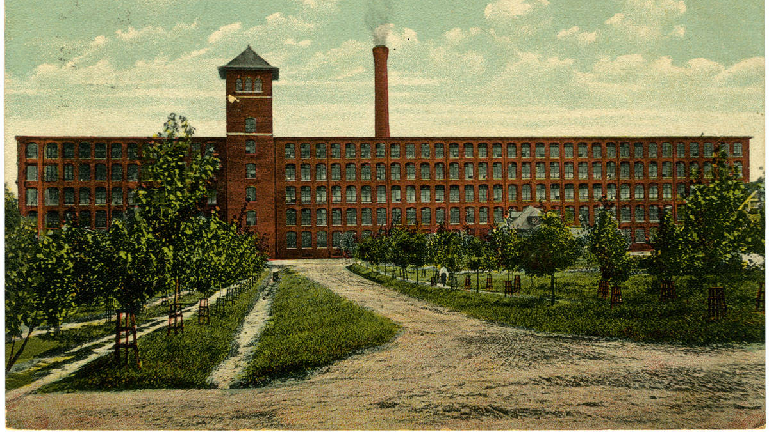
Global Literary Radicalism – Week 8
Gastonia novels and strike ballads

Slide 2
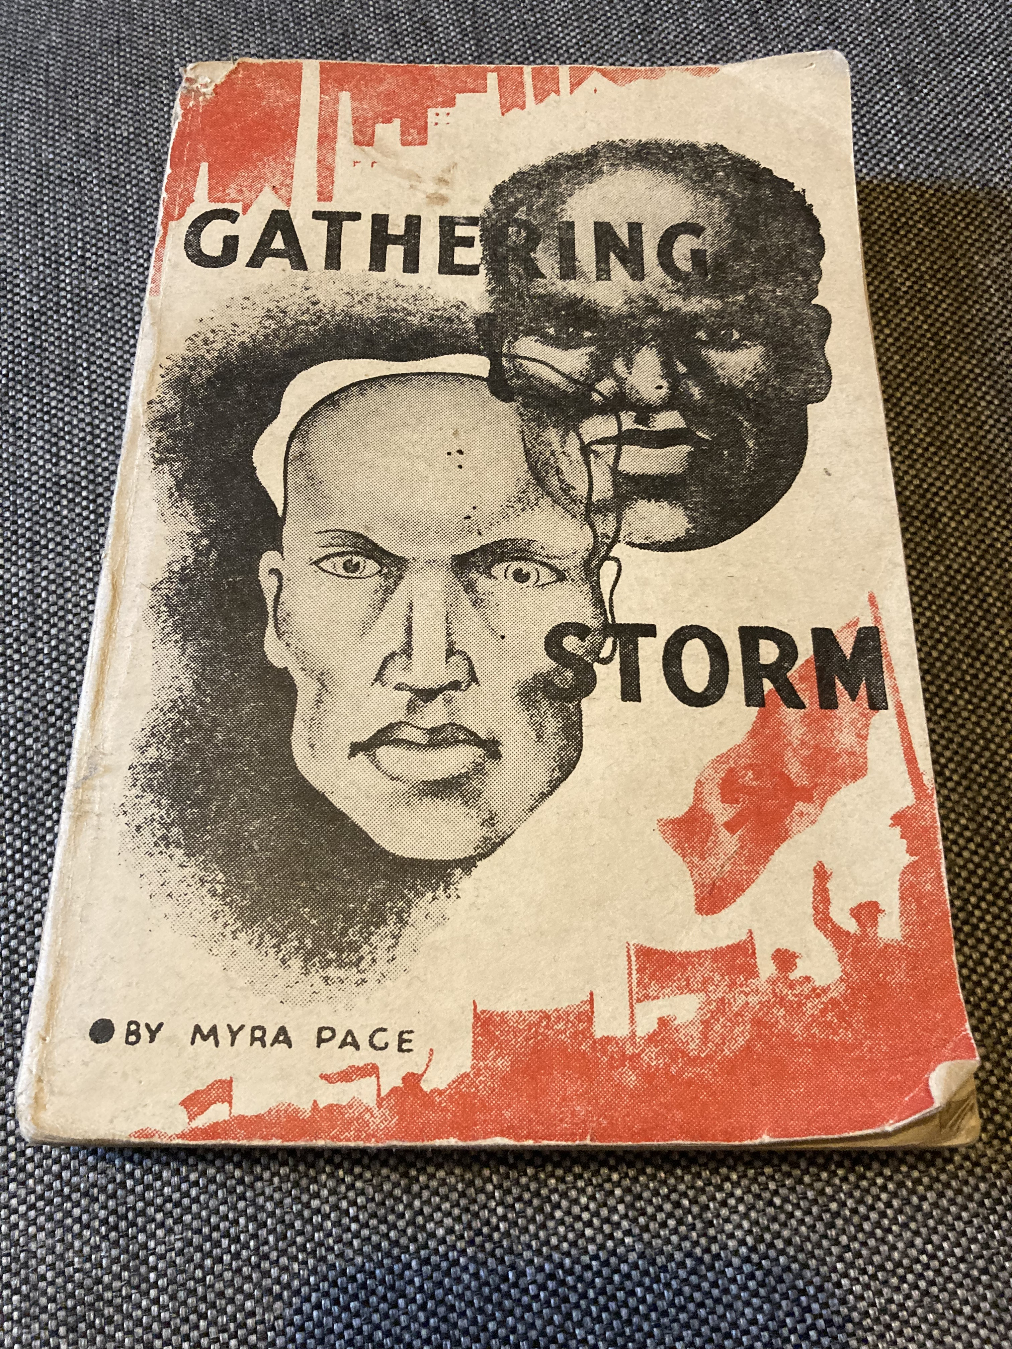
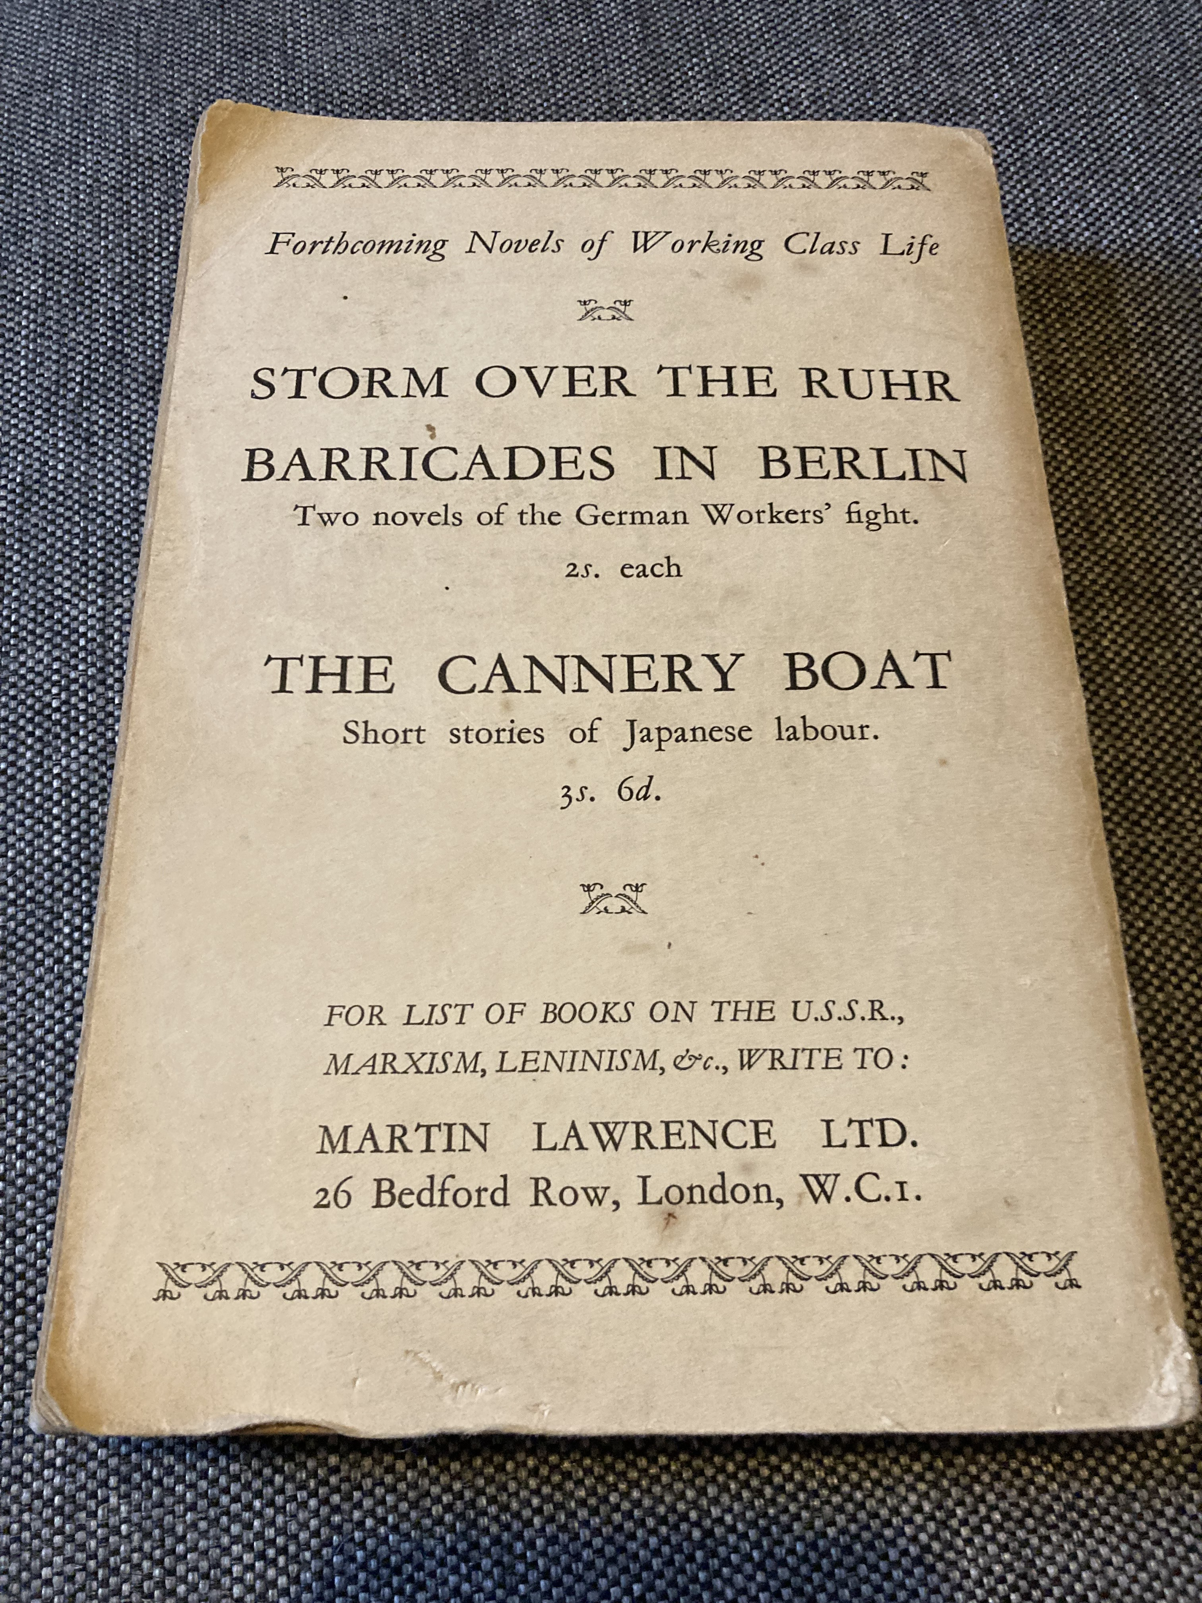

Slide 3
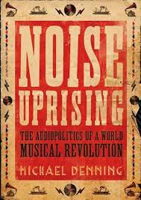
“In a few short years between the introduction of electrical recording in 1925 and the onset of the worldwide depression in the 1930s, a noise uprising occurred in a series of relatively unnoticed recording sessions. In port cities from Havana to Honolulu, Cairo to Jakarta, New Orleans to Rio de Janeiro, commercial recording companies brought hundreds of unknown musicians into makeshift studios to record local musics. Thousands of inexpensive discs made from shellac (a resin secreted by the female lac bug, a colonial product harvested in the forests of South Asia) were released, disseminating musical idioms which have since reverberated around the globe under a riot of new names: son, rumba, samba, tango, jazz, calypso, beguine, dafo, flamenco, tzigane, rebetika, tarab, marabi, kroncong, hula” (Michael Denning, Noise Uprising: The Audiopolitics of a World Musical Revolution, Verso Press, 2018. pp2)
“this noise uprising was prophetic: it not only preceded but prepared the way for the decolonization of legislatures and literatures. These vernacular phonograph musics reverberated across the colonial world, a cultural revolution in sound. Inheriting the harmonies and instruments of colonial musics, they embodied the contradictions of the anticolonial struggles: as ‘modern dance musics’ – a common phrase of the time – they were scarred with the hierarchies of class and spectrums of color that shaped the dance halls and night clubs, shebeens and streets, they inhabited. But […] they also prefigured a new world, a ‘third’ world, culturally as well as politically independent. Music did not simply sustain the soul in the struggle; the decolonization of the territory was made possibly by the decolonization of the ear” (9)
“Unlike modern novels, paintings, theatre, or even film, which ‘represented’ the modern ‘masses,’ these discs circulated the voices of those masses” (4).

Slide 4
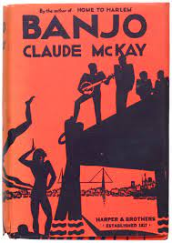
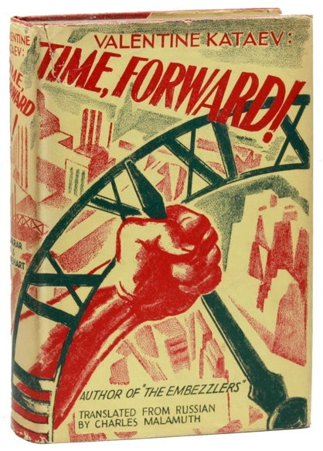
“By evening, the entire car was taking the warmest interest in [Fyenya’s] fate. She was touchingly frank. It was a heroic frankness, bordering on self-flagellation. People consoled her, entertained her. The Germans started the phonograph for her. She listened to barking recitatives of negro choruses, to dull metallic chords of banjos, to shameless moans of Hawaiian guitars – all these sounds and voices from another, mysterious worlds” (Time Forward! 333)
“The customers were colored seamen, soldiers from Martinique and Guadeloupe, a few from Madagascar, and three brown girls. During the dinner a brown, jolly-faced soldier played an accordion while a Martinique guide and sweetman, who was sweet in the ditch for every purchasable thing, was shaking a steel pipe, about the size of a rolling-pin, containing something like beans or sand grains. The curious thing went beautifully with the accordion. They played the ‘beguin,’ which was just a Martinique variant of the ‘jelly-roll’ or the Jamaican ‘burru’ or the Senegalese ‘bombé.’” (Banjo 105)

Slide 5
“In the United States this moment is part of the history of popular music, particularly the explosion of jazz and blues on the ‘race records’ marketed to African-American workers, and the emergence of modern country music in the ‘old-time’ records made and distributed in the mill towns of the Appalachian Piedmont. It also included the recording of European-language ‘foreign’ records in the Great Lakes industrial cities, which begat the hybrid music known as “polka,” the border recordings of Mexican norteño sounds, and the recording of Cajun musics in Louisiana” (4-5)

Slide 6
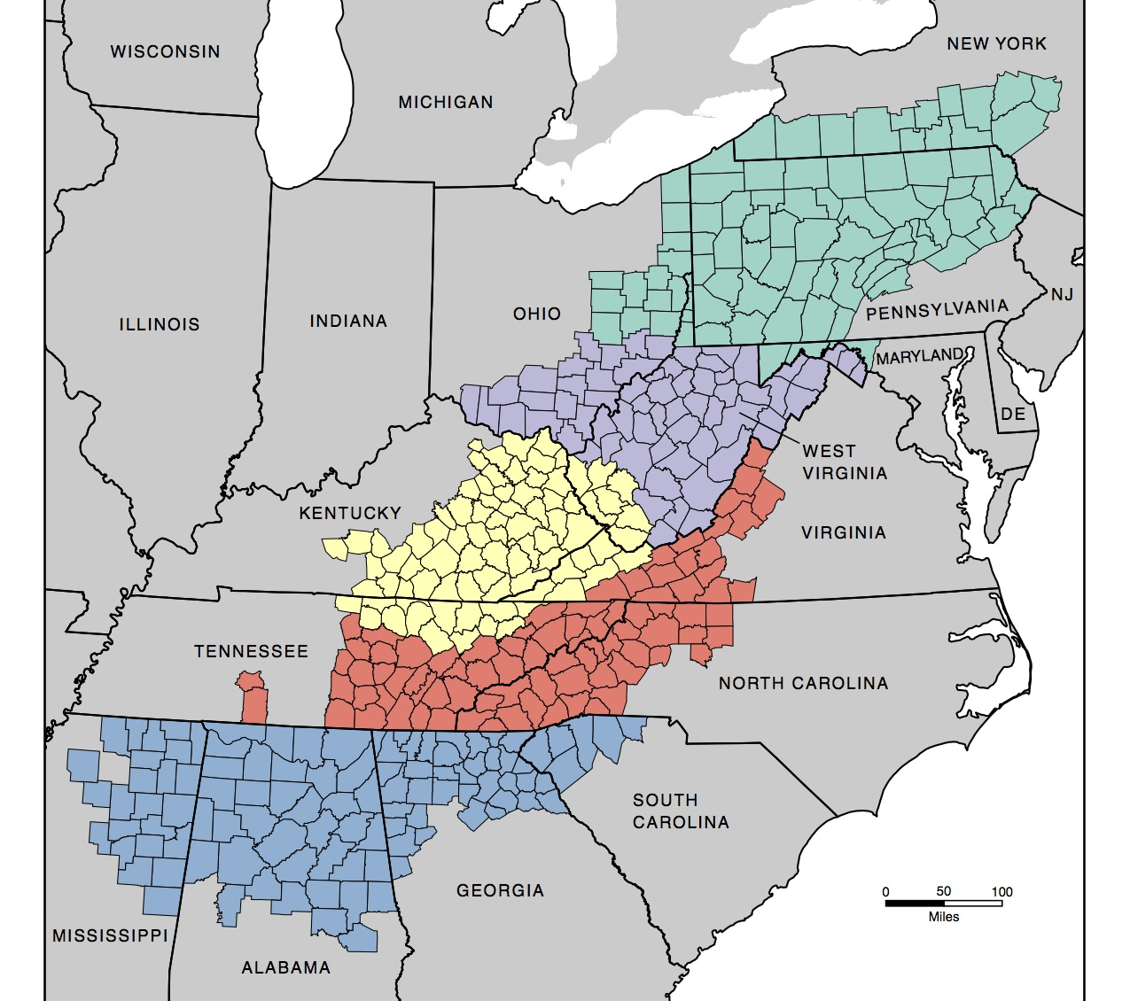
“Outsiders proclaimed that early-twentieth-century Southern Appalachians had ‘worked out their individual existence far removed from the forward march of progress.’ From the late nineteenth century until the 1970s, this area was nostalgically described as the last place in the country where ‘time stood still,’ preserving the vanishing American frontier life. Presuming that the region had not undergone the ‘normal’ linear advance toward modernity, journalists and intellectuals contended that isolation froze Appalachians into ‘a folk world of small, isolated, homogeneous societies’ shaped by the traditions of early settlers. Fascinated with the imagery of a ‘strange land’ and a ’peculiar folk,’ Americans still view Southern Appalachia as one of the most distinct subregions left in the United States” (Wilma Dunaway, The First American Frontier: Transition to Capitalism in Southern Appalachia, 1700-1860, University of North Carolina Press, 1966)

Slide 7
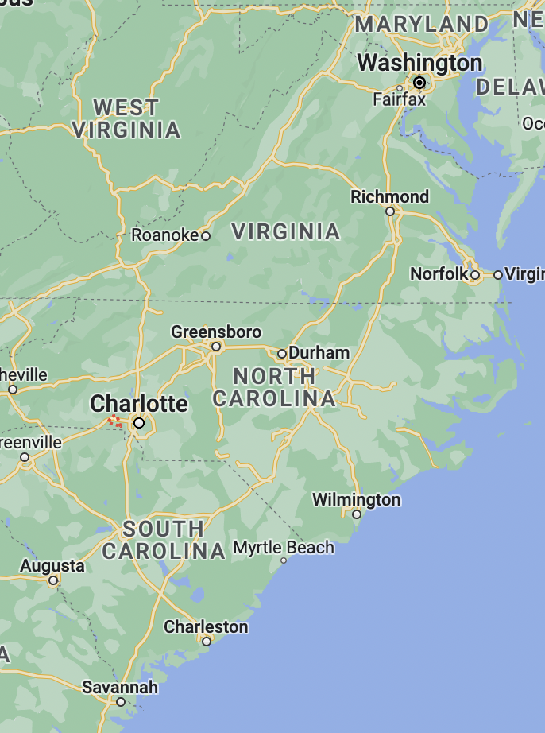
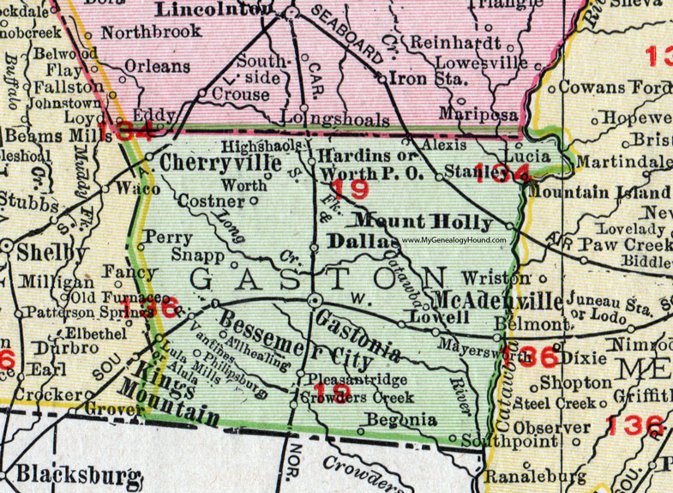
“Southern Appalachia was articulated with the world economy as a support zone for New World plantation economies and for the industrial centers of the American Northeast and western Europe”
(Wilma Dunaway, The First American Frontier)

Slide 8
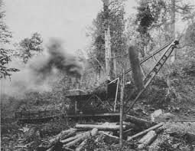
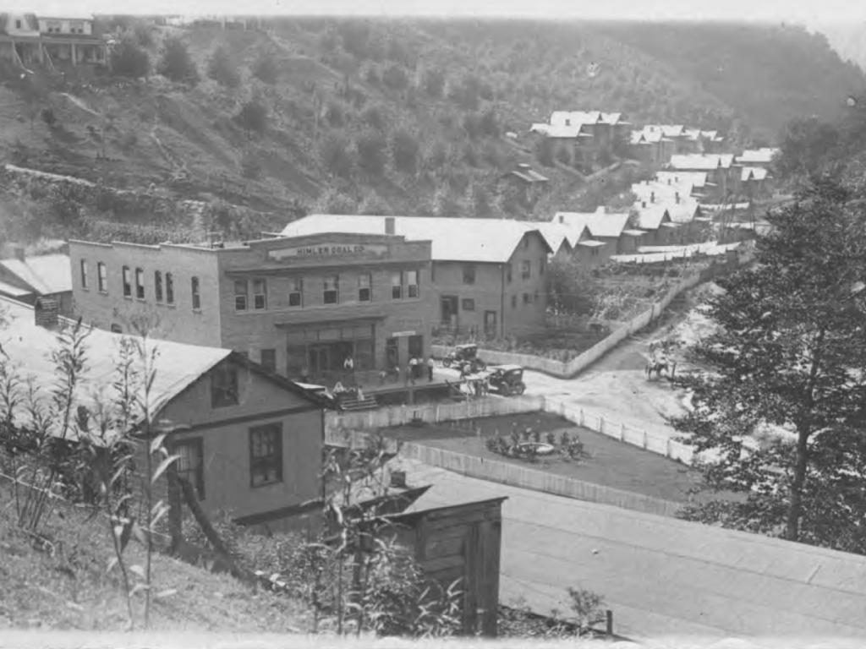
“By 1930, most mountaineers, whether they remained on the farm or migrated to the mill villages, timber towns, or coal camps, had become socially integrated within the new industrial system and economically dependent upon it as well. To say the least, this dependence was not on their terms – that is to say, it was a product not of mountain culture but of the same political and economic forces that were shaping the rest of the nation and the western world” (Ronald D. Eller, Minters, Millhands, and Mountaineers: Industrialization of the Appalachian South, 1880-1930, xxii)

Slide 9
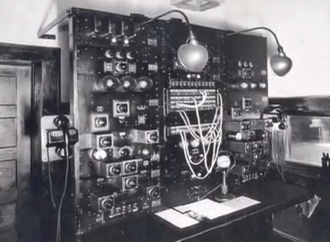
“World War I had ushered in a time of booming prosperity in southern cotton mills, fueled largely by government defense orders for uniforms, tents, and war material. Thousands of new jobs opened in the mills, and wages soared to all-time highs, in some cases tripling between 1915 and 1920. Soon, millhands were purchasing Model T Fords, radios, phonograph records, furniture suites, and myriad other consumer products, often on the instalment plan.” (Patrick Huber, “Mill Mother’s Lament: Ella May Wiggins and the Gastonia Textile Strike of 1929,” Southern Cultures , Vol. 15, No. 3, Music (2009), 83-4)

Slide 10
“On clear nights, Marion workers could pick up Charlotte’s WBT radio over the airwaves or programming out of weaker stations in Asheville and Spindale, North Carolina. The traditional tunes and mill-related songs that became important to the strikers in Gastonia and Marion, it appears, may have been picked up, disseminated, and used by mill workers throughout the region”
(Vincent J. Roscigno, and William F. Danaher, Voice of Southern Labor : Radio, Music, and Textile Strikes, 1929-1934, University of Minnesota Press, 2004), 78.

Slide 11
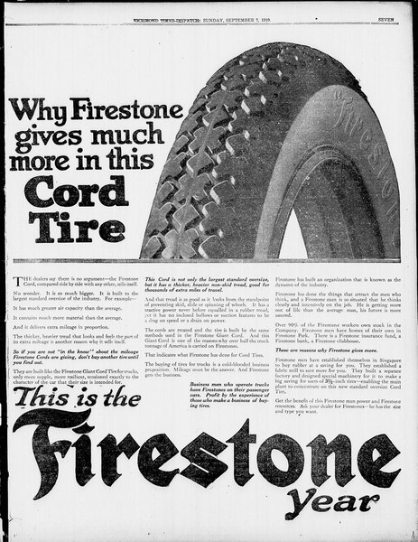

Slide 12
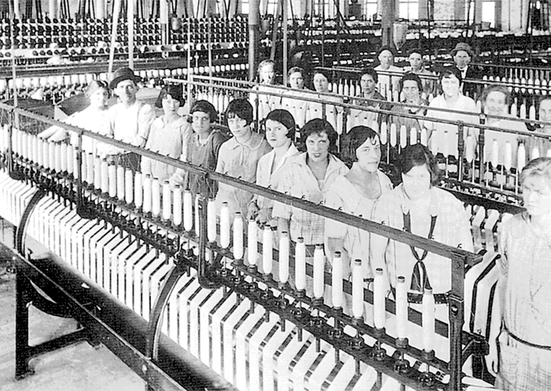
“I used to tend forty-eight looms, while under the stretch-out I have to tend ninety looms, and I couldn’t do it. Three years ago I was makin’ over $19 a week. Now I make $17.70” (qtd in Huber 84)

Slide 13
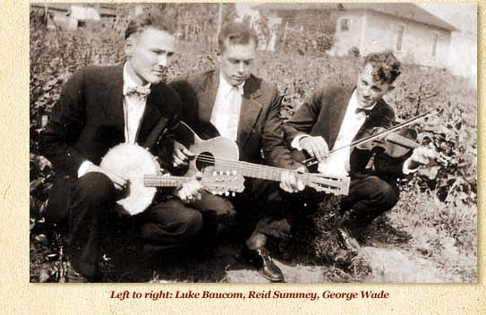
“Musicians like McCarn, Watts, and the members of the Tobacco Tags performed for mill-worker audiences and often sang songs about life in the cotton mills. These songs did not praise the work, but rather pointed out its problems. Poor working conditions, the stretch-out, cotton dust, long hours, low pay, and unreasonable supervisors were key themes. Their songs resonated with other mill workers, partially because of these themes, but also because these musicians themselves were seen as mill workers, with credibly claims, who often met workers face-to-face as they travelled” (Vincent J Roscigno and William F Danaher, Voice of Southern Labour: Radio, Music, and Textile Strikes, 1929-1934, 81)

Slide 14
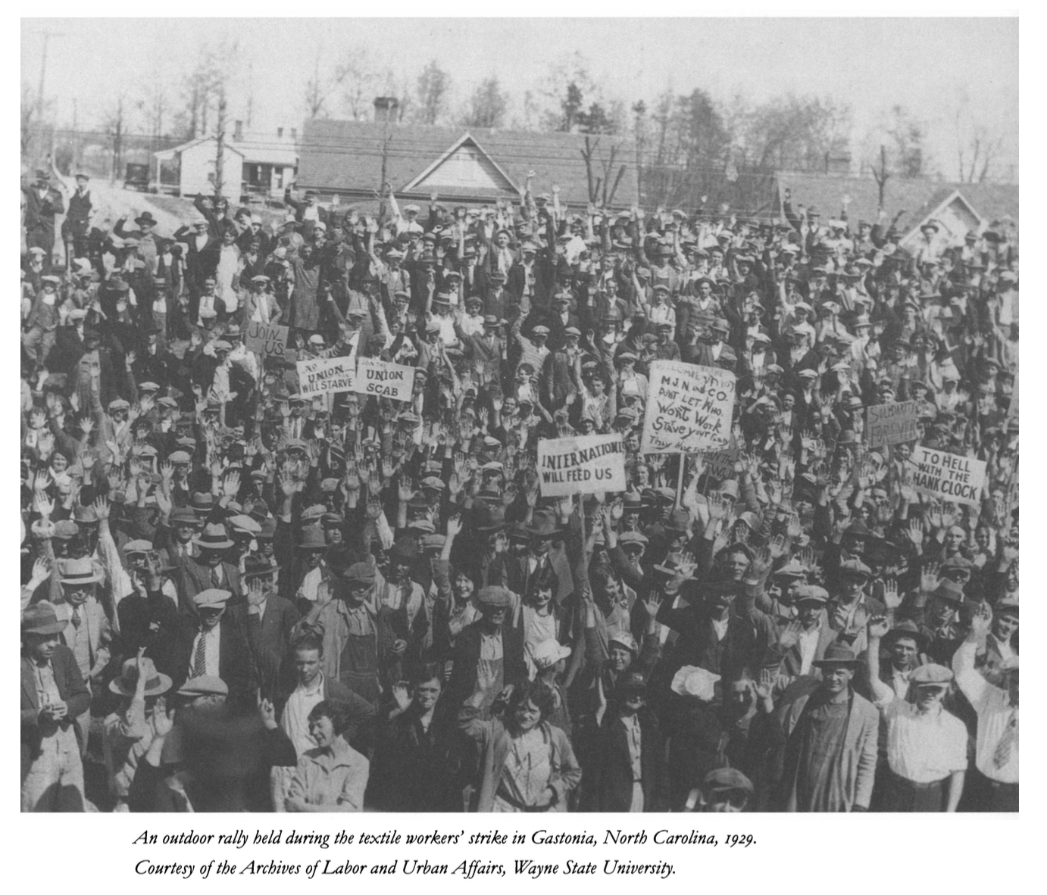
“In Gastonia, as elsewhere across the southern Piedmont that spring and summer, what one newspaper called the strike’s ‘holiday-like atmosphere’ opened new public opportunities s for women to serve in their union locals, perform strike committee work, deliver speeches, distribute food and relief supplies, and march on picket lines. It also offered Gastonia’s young working-class flappers the chance to flout community standards of acceptable dress and behavior” (Huber 89)

Slide 15
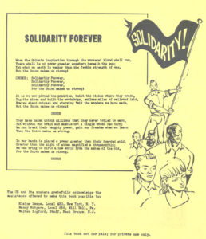
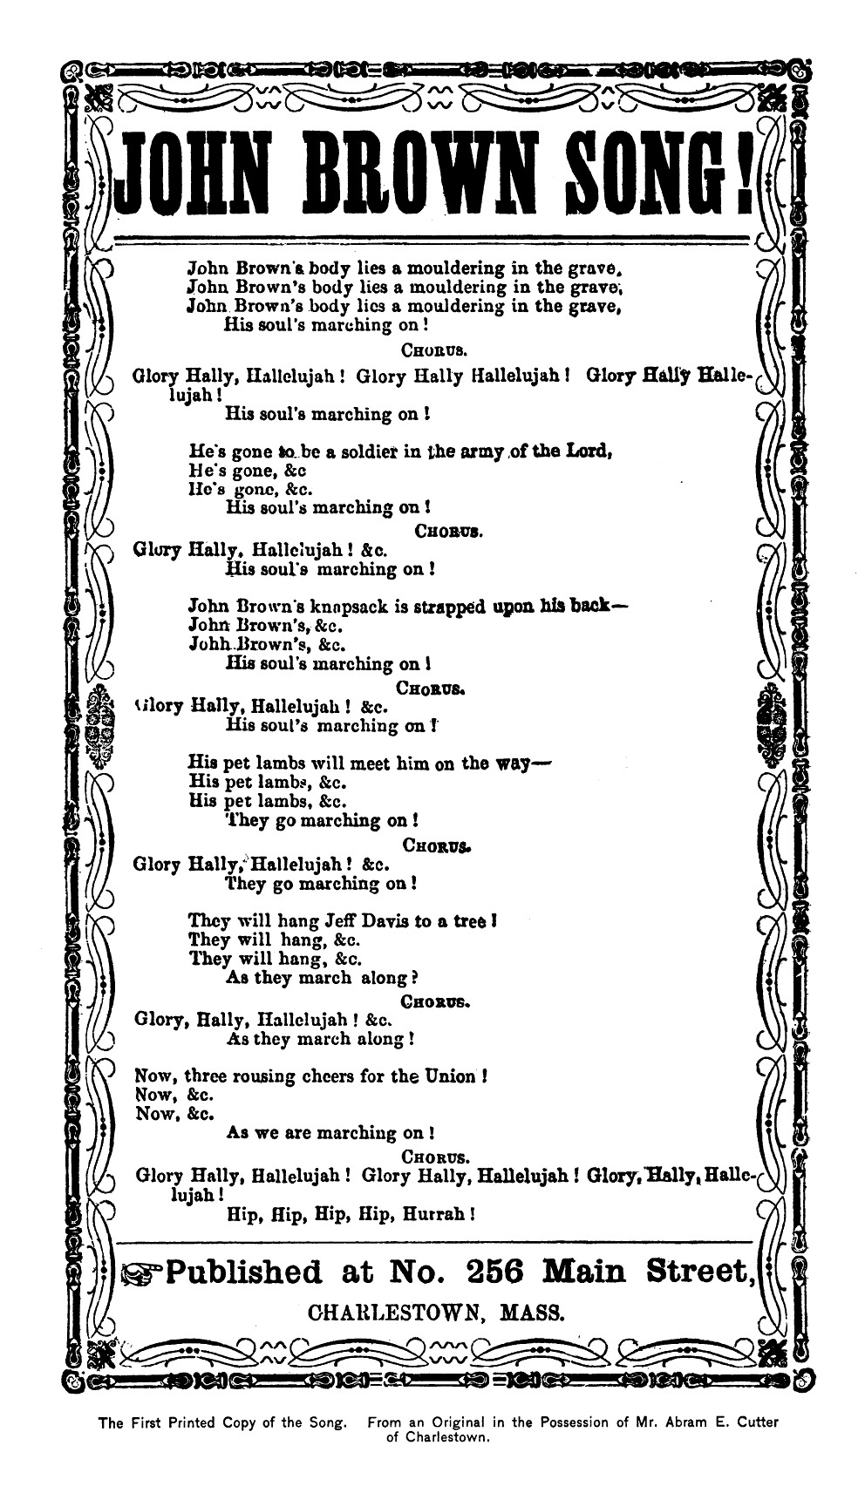

Slide 16
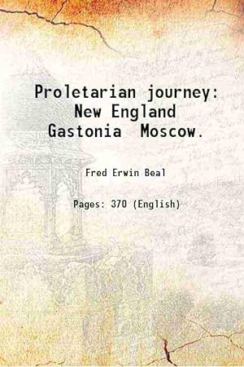
"No evening passed […] without getting a new song from our Ella May, the minstrel of our strike. She would stand somewhere in a corner, chewing tobacco or snuff and fumbling over notes of a new poem scribbled on the back of a union leaflet. Suddenly someone would call for her to sing and other voices would take up the suggestion. Then in a deep, resonant voice she would give a simple ballad The crowd would join in with an old refrain and Ella May would add verse after verse to her song. From these the singers would drift into spirituals or hymns and many a "praise-the-Lord" would resound through the quiet night” (Fred Beal Proletarian Journey: New England, Gastonia, Moscow (1937), qtd in Huber 118)

Slide 17
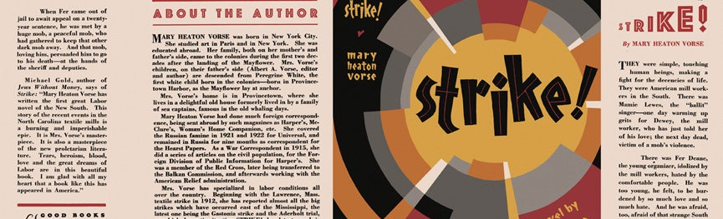
“The strike novels often exhibit common qualities. The clash is described in lavish and often authentic detail. The strike is seen from the inside. The novelists take us into the workers ‘homes and union halls, into the jails, and on the picket lines. Thee struggles capture the natural rhythm of a strike: the first days of elation and the later moments of apathy, boredom, and despair, all leading to the climax of terror and defeat, although the workers retain the memory of their collective strength. The strike also functions a symbolic microcosm of political revolution. The violent conflict advances the workers toward a higher form of class consciousness.” (Dee Garrison, “Introduction,” Strike, University of Illinois Press, 1991, x.)

Slide 18
““ ‘I tell you what we got,’ Walter spoke bitterly. ‘Bob n’ Burke got bad lungs; ‘n me, I got an arm missing’ outta the war. ‘N thar’s a new crop of millionaires out the war. That’s what we got.’
‘The mill-owners sure musta made money. Look at the new papers? ‘N all the new mills what went up.’
‘That’s thar war for democracy,’ Walter continued, ‘it was one rich man’s war ‘n poor man’s fight’” (23)

