Slide 1
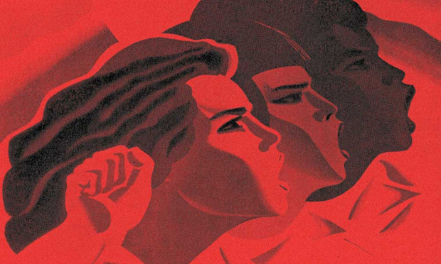
Global Literary Radicalisms
Proletarian Literature from the Russian Revolution to Anticolonial Resistance

Slide 2
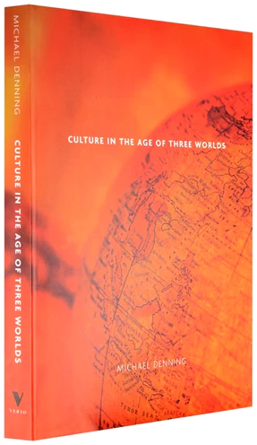
“A history of this literary movement must thus move between two moments: the moment of the breakthrough books, the landmark ‘proletarian novels,’ short, sometimes crude, but electrifying works often written by figures who did not go on to careers as novelists; and the moment of fruition when writers shaped by the radical literary movement produced major works, long after the manifestos and polemics had been forgotten. Thus, if proletarian literature came to world attention in the brief moment in the late 1920s and early 1930s when young writers like [Richard] Wright founded Communist literary circles and magazines, and the fledgling Soviet regime attracted writers to literary congresses and published Literature of the World Revolution in several languages, its roots lay in the first alliances between writers and the socialist movement at the beginning of the twentieth century, and its legacies reach to the magical realisms and postmodernisms of the age of three worlds” (Michael Denning, “Novelists International,” Culture in the Age of Three Worlds, Verso, 2004. pp 54)

Slide 3
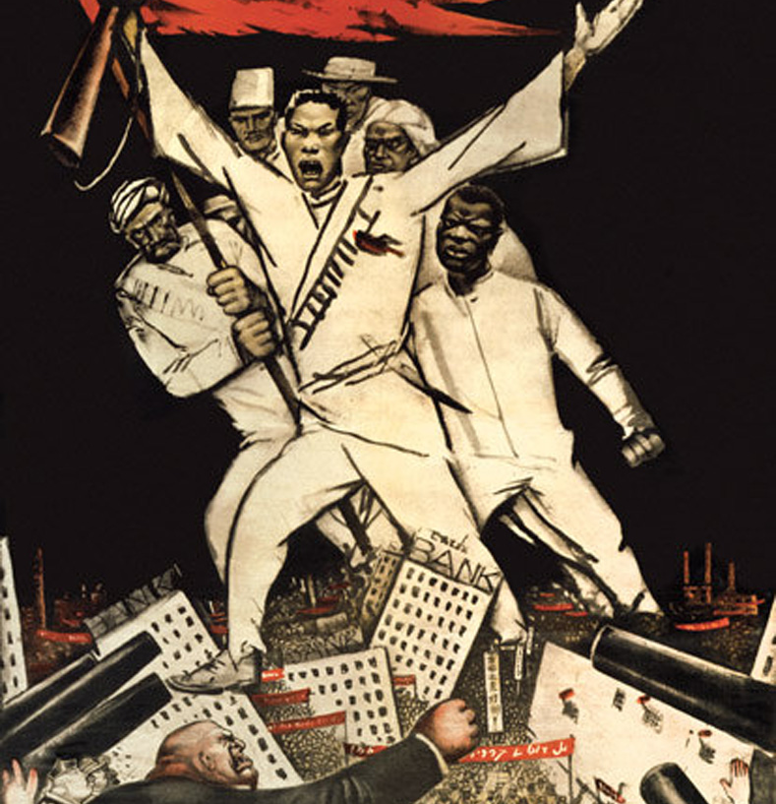
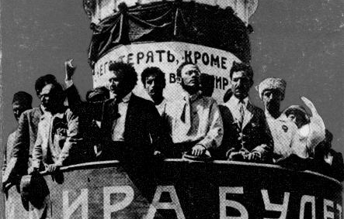
“For all the limitations of Soviet anti-colonialism, which only grew under Stalinism, it is worth remembering that the interwar Bolshevik state was the one (major power) state that not only fought racism and imperialism at home but also took this fight internationally, a fact appreciated by anti-colonial activists world wide” (Rossen Djagalov, From Internationalism to Postcolonialism: Literature and Cinema between the Second and the Third Worlds, McGill Queens Press, 2022. Pp. 12)

Slide 4
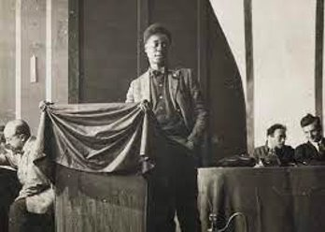
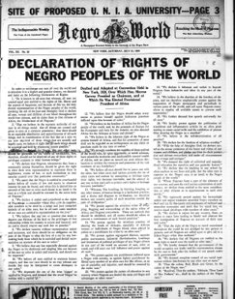
"Every Negro who lays claim to leadership should make a study of Bolshevism and explain its meaning to the colored masses. It is the greatest and most scientific idea afloat in the world today that can be easily put into practice by the proletariat to better its material and spiritual life. Bolshevism...has made Russia safe for the Jew. It has liberated the slave peasant from priest and bureaucrat who can no longer egg him on to murder Jews to bolster up their rotten institutions. It might make these United States safe for the Negro"
-Claude McKay in Negro World, (qtd in Winston James, "To the East Turn," American Historical Review (September 2021), 1003).

Slide 5
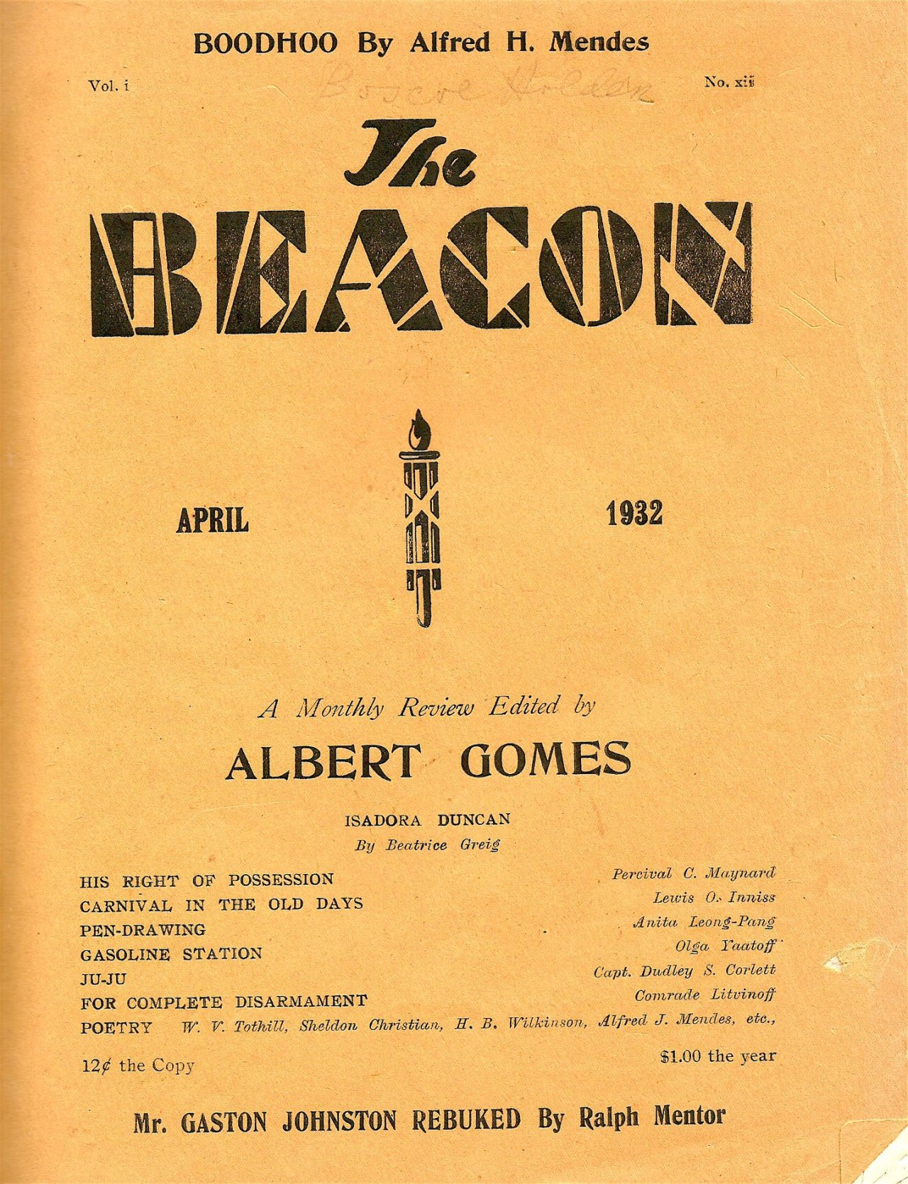
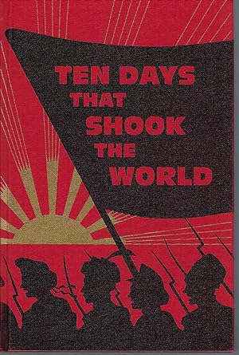
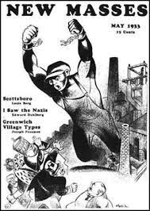
The "socialist global ecumene” was a “far-flung or worldwide community of people committed to a single cause and engaged in discussions, lobbying and writing aimed at working toward some common program.”
-Katerina Clark, Eurasia Without Borders: The Dream of a Leftist Literary Commons, 1919-1943, Belknap Press, 2021. p 22.

Slide 6
Proletarian novels “were experiments in form, attempts to reshape the novel. Several challenges immediately presented themselves: the attempt to represent working-class life in a genre that had developed as the quintessential narrator of bourgeois or middle-class manners, kin structures, and social circles; the attempt to represent a collective subject in a form built around the interior life of the individual; the attempt to create a public agitational work in a form which, unlike drama, depended on private, often domestic, consumption; and the attempt to create a vision of revolutionary social change in a form almost inherently committed to the solidity of society and history.” (59)
“Thus, this emerging novelists’ international and its proletarian novel is neither a sociological entity (all novels written by proletarians) nor a fully formed genre, but is a continuing dialectic between a self-conscious literary movement and the literary forms it developed” (59)

Slide 7
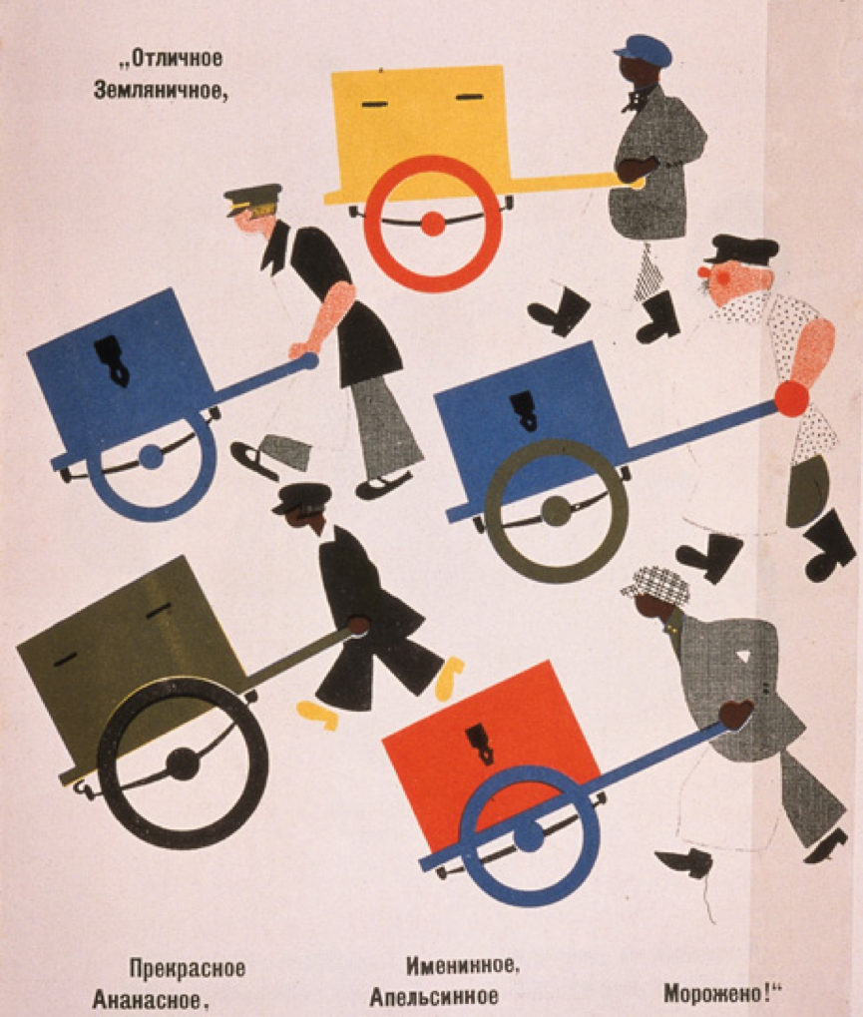
“Like other modernist movements, the proletarian arts movement sought to redefine the form and function of literature and art; and like other modernist movements, it held that capitalism was fundamentally changing the ways that people related to each other and to the world in which they lived. But, in contrast, the proletarian arts movement — no matter how much writers disagreed over the details — held that class-based struggle was necessary because capital was controlled by the few at the expense of the many.” (Heather Bowen-Struyk, “Introduction: Proletarian Arts in East Asia,” positions 14.2 (2006): 252)

Slide 8
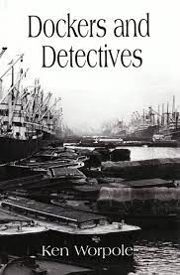
Ken Worpole: “experimentation in cultural forms often went hand in hand with revolutionary ideas in politics [. . .] [That connection has] since the Cold War been completely broken, and revolutionary and radical politics came to be associated with the most dull and unimaginative expectations of what is possible in literature” (Dockers and Detectives, 2008: 124).

Slide 9
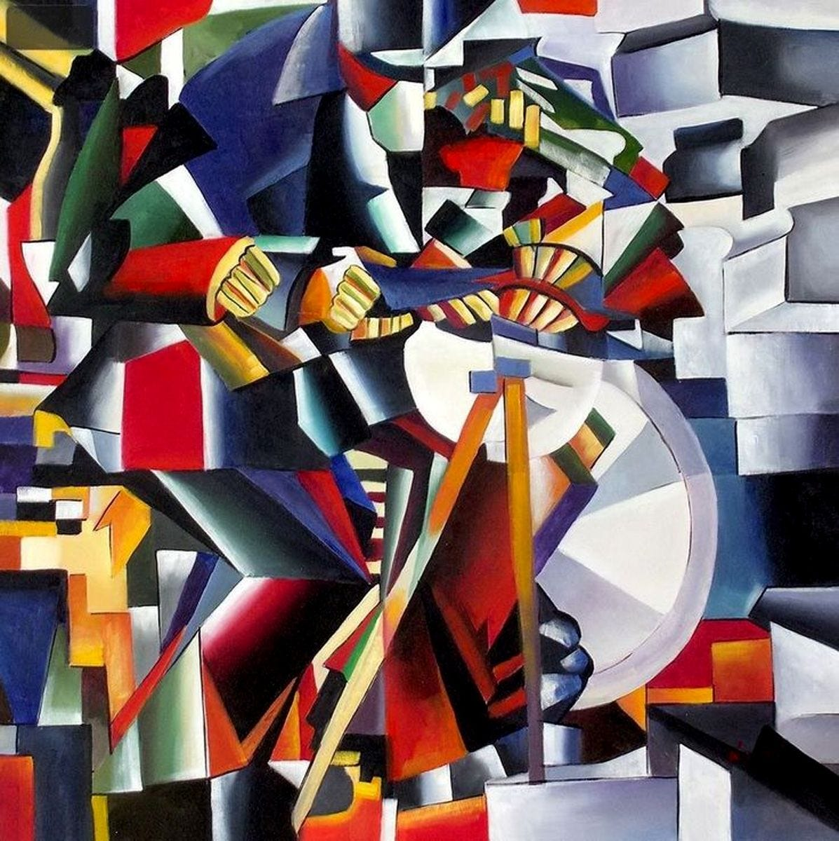
Graham Holderness: “the indispensable function of non-naturalistic discourses in any fiction aspiring to express the full complexity of an industrial working-class community, past and future, oppression and liberation; the enduring nightmare that is, and the dream of justice yet to come” (The British Working-Class Novel in the Twentieth Century (ed. Jeremy Hawthorn, 1984: 25).
John Fordham: proposes a dialectical approach to working-class modernism that “relies on an understanding of modernism as a gradual and emergent discourse within the ‘realist text,’ the effect of which to the latter is to threaten its disruption and breakdown but ultimately not to eradicate it altogether” (James Hanley: Modernism and the Working-Class, 2000: 113).

Slide 10
“Given this diversity of proletarian literary movements, are there any common modes, forms, or genres? At first, it seems unlikely, given the multitude of linguistic, literary, religious, political, ethnic, and national traditions from which the proletarian or progressive writers came. On the other hand, unlike many novelists around the world, these writers held an explicitly internationalist aesthetic ideology; they sought links across continents and translated each other” (65)

Slide 11
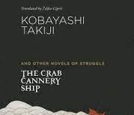
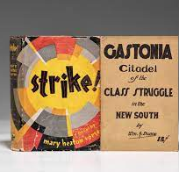
“Two kinds of work quickly emerged: novels of [...] Job and Tenement. Representing the factory and its collective laborer was not only a central formal, and political, challenge, but it offered a microcosm, a knowable community that might found a new realism. ‘There are no heroes in this work - no leading characters or persons such as you would find in works dealing with the lives of individuals,’ Kabayashi Takiji wrote about his Kani Kosen [...] ‘The collective hero is a group of laborers … I have rejected all attempts at depicting character or delving into psychology.’ The narrative is a sequence of incidents in the daily life of the factory ship, culminating in the strike.
The strike narrative becomes, not surprisingly, a core element in these works, representing the interruption in daily life - a festival of the oppressed - that creates a story. Certain actual historical strikes - the 1927 Shanghai strikes and the 1929 Gastonia (US) textile strike, for example - became the subject of a cluster of novels [....] The other formal option was to represent the tenement, the crowded and chaotic collective households of urban workers which spilled out into the street of the proletarian quarter” (65-6)

Slide 12
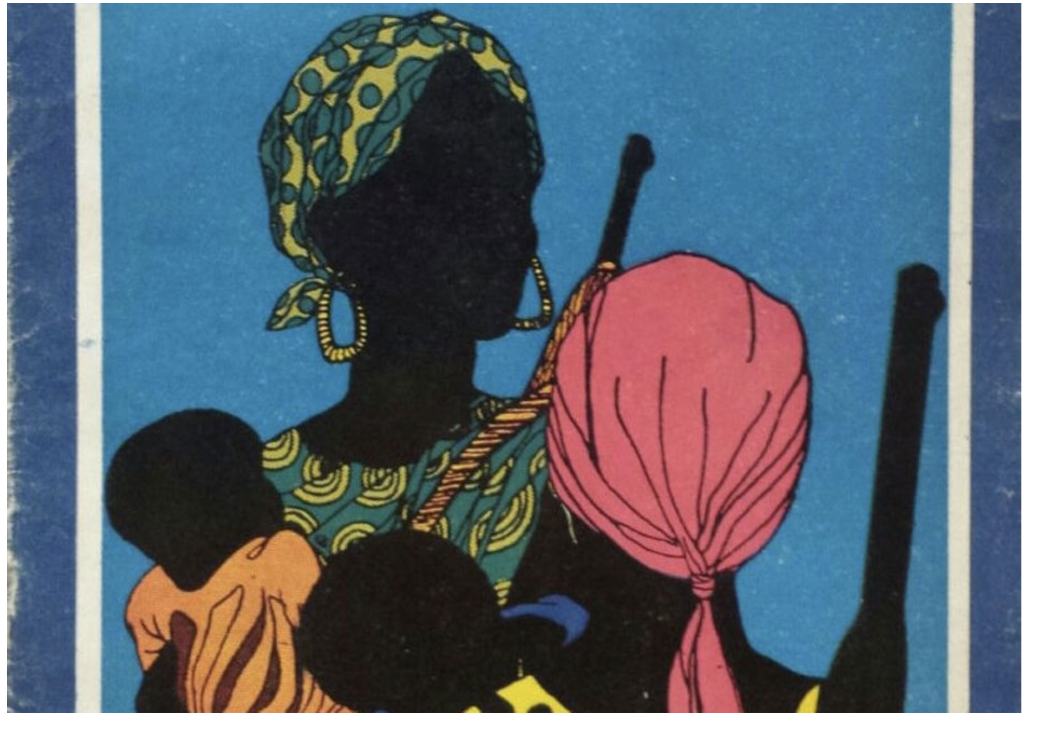
The central concept for the new nations was the Third World. For them, the Third World was not a place; it was a project. Galvanized by mass movements and by the failures of capitalist maldevelopment, leaders in the darker nations looked to one another for an alternative agenda. Politically they wanted more planetary democracy. No more the serfs of their colonial masters, they wanted to have a voice and power on the world stage. What would that voice say? It would speak of three core principles: peace (nuclear disarmament), bread (what they dubbed a New International Economic Order, in which human needs would take precedence over profit) and justice (social development and an end to racism).” -Vijay Prashad “The Third World Idea” The Nation May 17, 2097

Slide 13
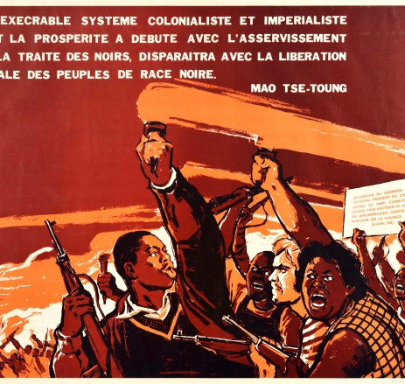
“At that time, decolonization meant not just the overthrow of the European empires but also, crucially, building new developmentalist states in the ex-colonial countries, with a robust public sector and nationalized industries to replace the imbalances of the colonial economy through import-substitution programmes. The contradictions and failures of such strategies were explored in broadly Marxian terms in theories of under-development, debt-dependency and world-system analysis” - Volodomyr Ishchenko “Ukrainian Voices,” New Left Review 138 (Nov/Dec 2022), 1

Slide 14
“Rather than seeing the bread-winning factory worker as the productive base on which a reproductive superstructure is erected, imagine the dispossessed proletarian household as a wageless base of subsistence labour—the ‘women’s work’ of cooking, cleaning and caring—which supports a superstructure of migrant wage seekers who are ambassadors, or perhaps hostages, to the wage economy. [. . .] We must insist that ‘proletarian’ is not a synonym for ‘wage labourer’ but for dispossession, expropriation and radical dependence on the market. You don’t need a job to be a proletarian: wageless life, not wage labour, is the starting point in understanding the free market.” Michael Denning, “Wageless Life,” New Left Review 66 (2010), 81.

Slide 15
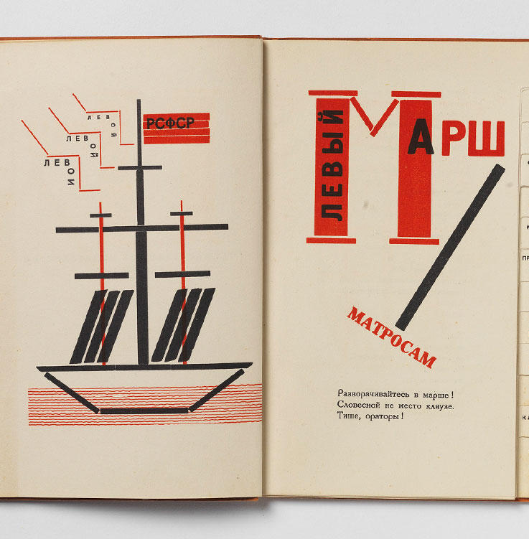

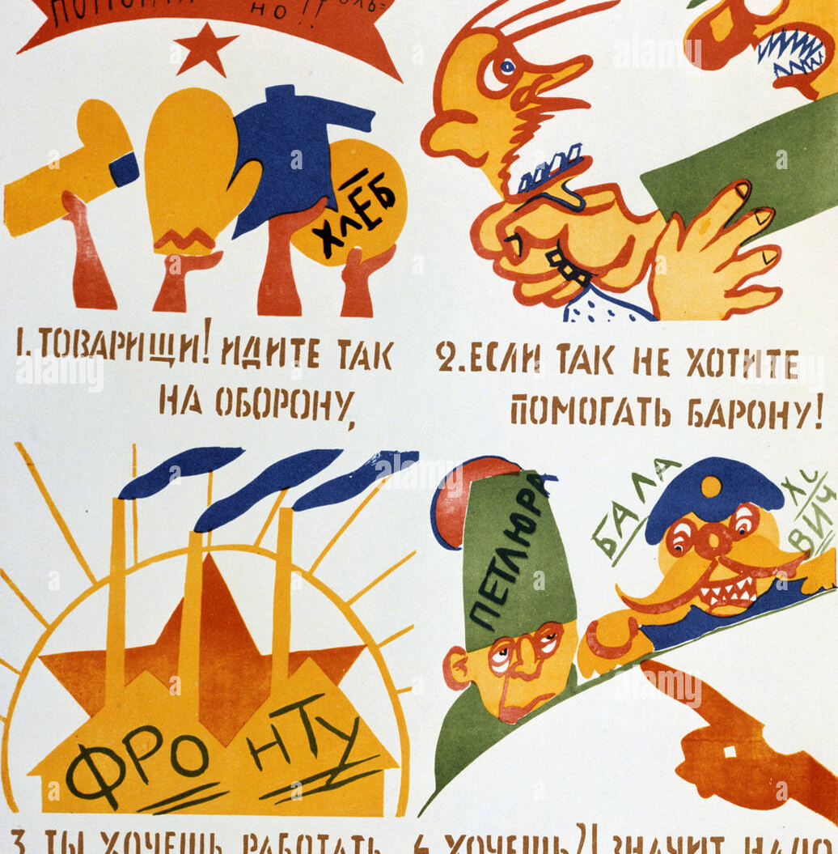
“I was born in the Caucasus, my father is a Cossack, my mother is Ukrainian. My mother tongue is Georgian. Thus three cultures are united in me,” (Prager Presse in a 1927 interview) https://www.futurismo.org/vladimir-mayakovsky

Slide 16
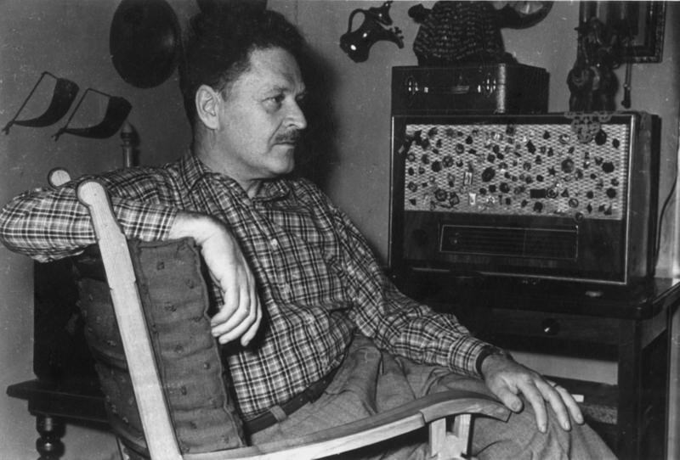
How do these poets either depict proletarians or take up the identity of the proletarian writer?
What is the significance of Mayakovsky’s depiction of material infrastructures and objects (e.g., the Eiffel Tower) as subjects or as having agency?
What are some of the ways that both sets of poems encode a proletarian internationalism – either in terms of content or sound/form?
How else are these writers in conversation with each other (e.g. what are some other similarities?)

