Slide 1

Patricia Galvão Industrial Park
Global Literary Radicalism

Slide 2
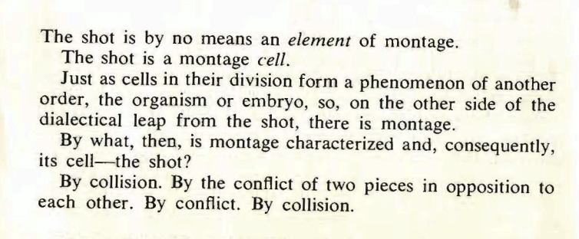
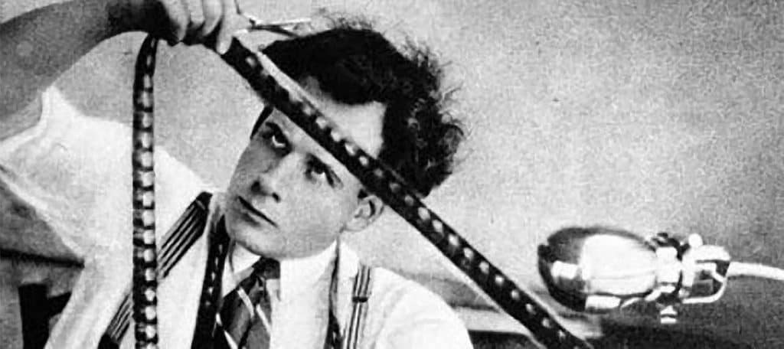
Sergei Eisenstein, “Collision of Ideas” "The Cinematographic Principle and the Ideogram," Film Form, Harcourt, Brace, 1949. Reprinted in paperback by Meridian Books, 1957. Pp. 37--40.

Slide 3
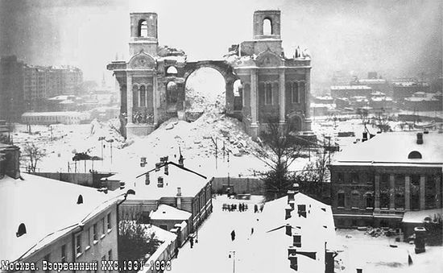
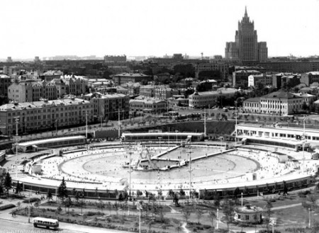
“The dull snow, soiled with soot, flowed into the pile of wood. There had been no antennae over the attics. There had seemed to be many more churches, and actually there had been many more of them then[…] Every quarter of an hour, day and night, it spoke the chromatic language of chiming bells. Like a boyar in a high sable hat, it walked the length of the Kremlin wall, amidst patriotic decorations […] But how Moscow had changed since those vanished days!” (105-6)
“Blazing cauldrons of tar. They belched heat, stung the eye. The repair work had made a purgatory of Moscow. Streetcar routes changed daily. Katya was waiting for ‘A.’ It did not come. Instead of ‘A’ altogether unsuitable, fantastic letters and numbers passed along the steamy, mirror-like river. It was something like a confused game of lotto” (107)

Slide 4
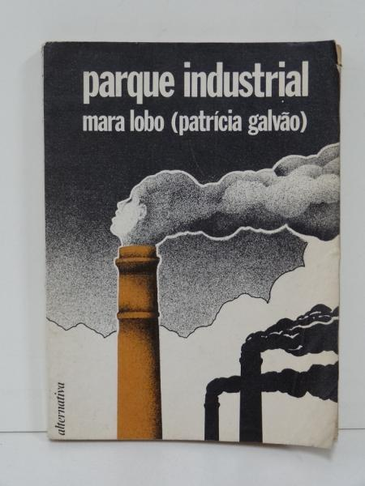
“The neglect or exclusion of Industrial Park from histories of modernism written since the 1930s and 1950s leaves a conspicuous gap in the definition of the period. Unlike regional works, the urban social novel could not be ‘saved’ by picturesque descriptions or by the folkloric or indigenous themes then highly valued in the creation of the idea of a national character. The novel’s female working-class characters, immigrant dialectal language, and urban geography, alongside its propagandistic political slogans calling for communist revolution, did not at the time fit into accepted theories of either artistic prose, social pamphlet, or national character” (Jackson, “Afterword,” 126)

Slide 5
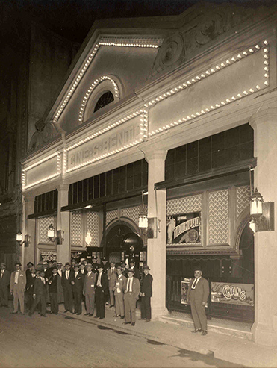
“Parque Industrial engages the problem of how to narrate contemporaneous struggles in a language that takes into account an emergent historical agent: the masses. Cinema, in particular, embodies changes in technology, spectatorship, and collective identities advanced by her contemporaries, including Walter Benjamin, Siegfried Kracauer and Sergei Eisenstein.”
“At the same time, the novel reveals a palpable ambivalence with respect to the cinema, critiquing its close relationship to capitalism and the subjectivities of spectatorship it seems to engender. […] Parque industrial constitutes a laboratory of the problem of writing in Brazil in an emergent media ecology, in which formerly new media such as cinema and the radio are no longer novel opportunities but seemingly unavoidable, contradictory facets of daily life, increasingly brought under the wing of both state and consumer culture. In order to engage with its tumultuous present, the novel suggests, one must confront the languages of these consolidated media”
(Sarah Ann Wells, "Mass Culture and the Laboratory of Late Modernism in Patricia Galvao's Parque Industrial," Luso-Brazilian Review 53.1 (2016): 55-76. 55-56).

Slide 6
“São Paulo is the greatest industrial center of South America: The textile workers read on the imperialist crown of the ‘shrimp’ that rolls by. The Italian girl throws an early morning ‘banana’ at the trolley. She defends the country.
-Don’t believe it! Braz is the greatest” (7)

Slide 7

“The Colombo Theater, opaque and illuminated, indifferent to empty stomachs, receives Braz’s aristocratic petty bourgeoisie that still have money for the cinema.
At the door, the pale enigma of Greta Garbo, in the poorly drawn colors of a poster. Disarrayed hair. Bitter smile. A prostitute feeding the imperialist pimp of America to distract the masses” (78)

Slide 8
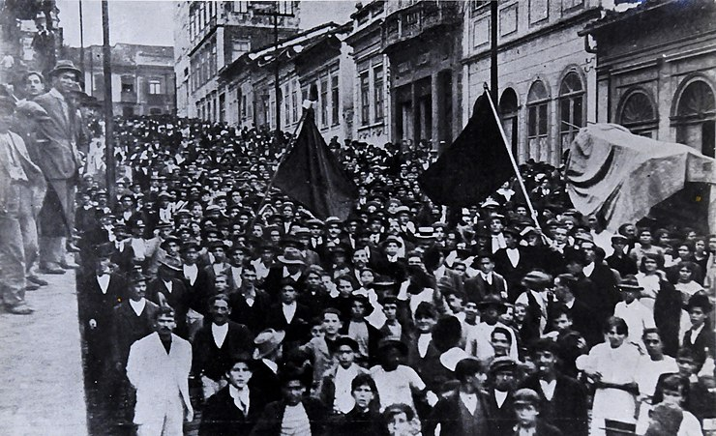
“Industrial expansion had a dramatic impact on life in São Paulo. With the city’s population and number of buildings more than doubling from 1900 (239,820 people and 22,407 buildings) to 1918 (504,278 and 55,356), residents experienced the many problems and frustrations of living in a metropolis. Along with this expansion, São Paulo witnessed the clear demarcation of neighborhoods by social class. The growth of luxury housing and of the city’s commercial center forced an increasing number of workers to move into cortiços in the factory districts of Brás, Mooca, Belemizinho and Cambucí. In 1915 and 1916 Mayor Washington Luís Pereira de Sousa encouraged further high-rise construction in the downtown and attempted to renovate Brás and other working-class neighborhoods. Washington Luís’s plans sought not only to spur further growth but also ‘to uplift [the city] immorally and physically.’ Paulistano elites wanted to cleanse the working-class neighborhoods of their ‘vicious mixture of scum of all nationalities, all ages, all of the dangerous.’ São Paulo’s workers felt the full effects of Washington Luís’s reforms”
(Joel Wolfe, “Anarchist Ideology, Worker Practice: The 1917 General Strike and the Formation of São Paulo’s Working Class” Hispanic American Historical Review 71.4 (1991), 815)

Slide 9
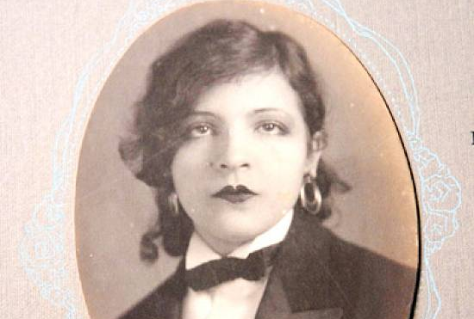
Key dates
1910 – born to a middle-class family
1928 - “discovered” by Oswaldo de Andrade
1931 - Galvão joins the Communist Party and moves to a worker’s district where she acts as an armed guard for Party meetings,
1933 – Industrial Park published in a very limited edition. Quickly goes out of print
1933 - Pagu leaves her infant son with de Andrade and sails to China and then on the Trans-Siberian Railroad to Moscow and to Paris
1935 – arrested and tortured under the dictatorship of Vargas as part of its targeting of leftist leaders which targeted left leaders
1940s and 1950s – continues to work as an artist and activist
1962 – dies of cancer
1981 – Industrial Park comes back into print in Portuguese
1993 – Industrial Park translated into English

Slide 10
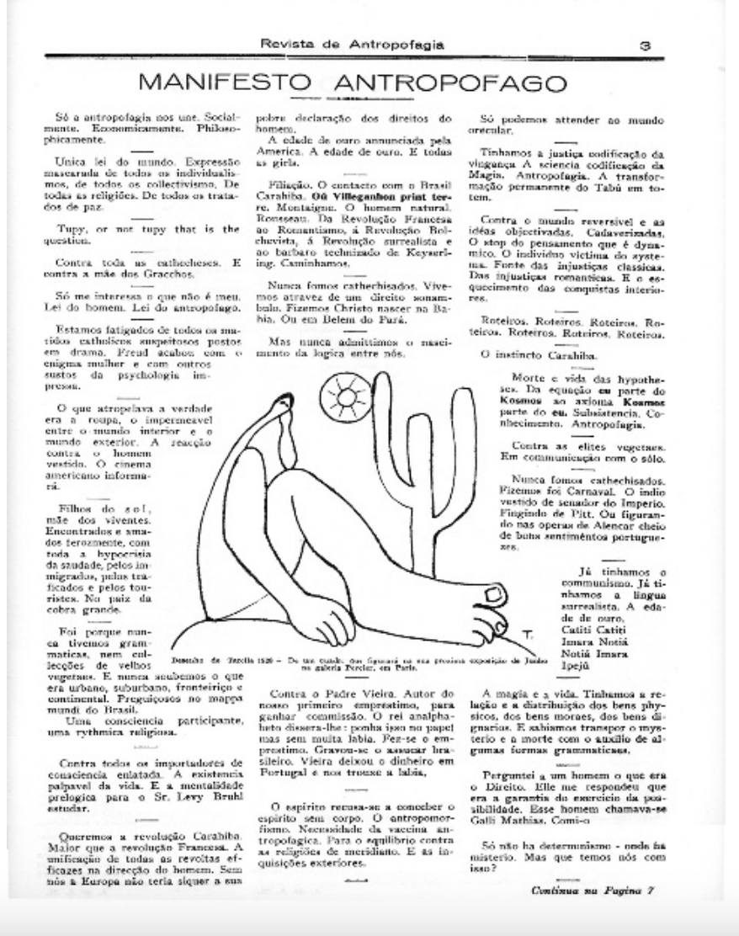
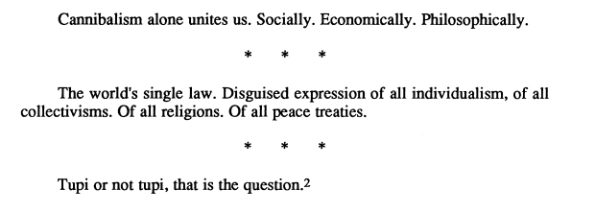
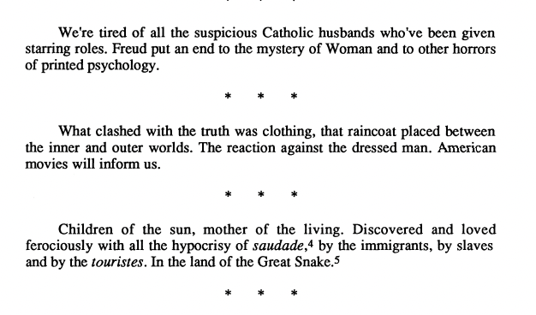

Slide 11

“The Indian sacrifice served as an organic metaphor for the idea that Brazil needed ‘to swallow’ the ‘enemy’ emblems of Western civilization in order to liberate its spirit and conquer its intellectual/cultural autonomy […] The Anthropophagists believed that by seeking the native roots, buried underneath Brazil's masquerade as a colonized society, Christian and civilized, they could cultivate a new cultural synthesis with a deeper national consciousness”
(Jayne H. Bloch, "Patrícia Galvão: the struggle against conformity." Latin American Literary Review (1986): 190)

Slide 12
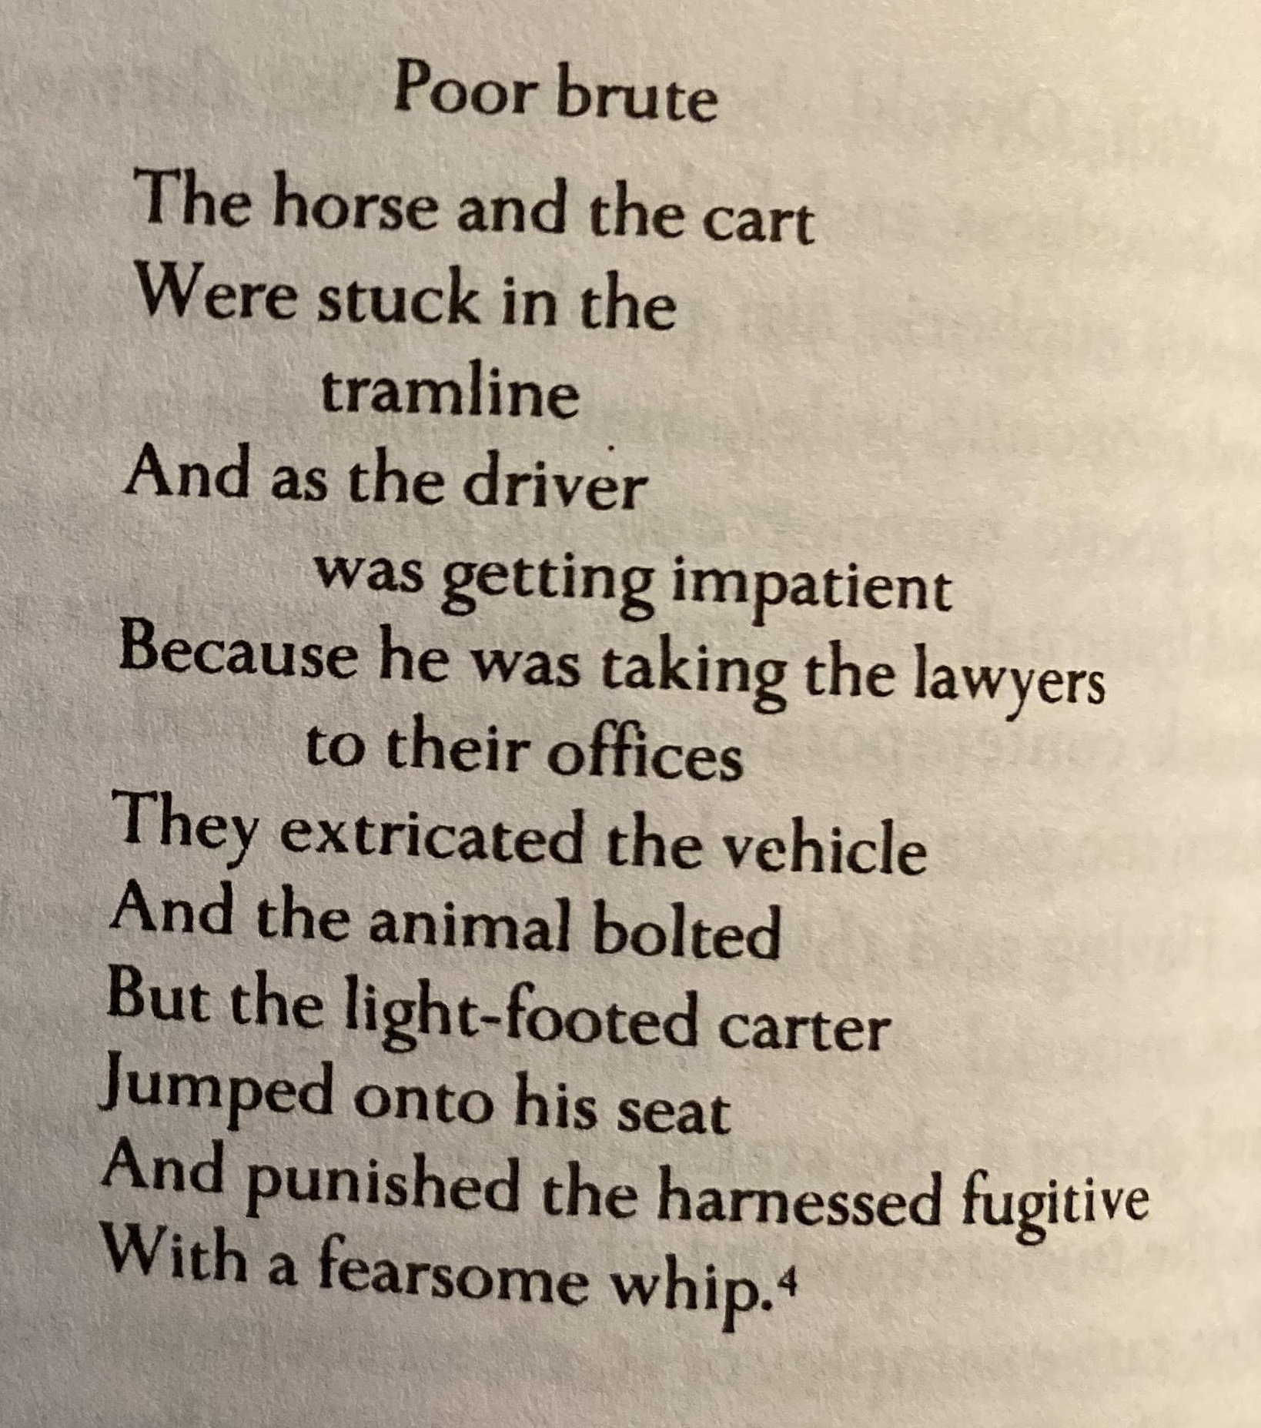
de Andrade’s method works through “superimpose[ing] incongruous coordinates, whose clashes are a direct challenge to historical awareness: avant-garde art versus provincial resentment; cart Brazil versus office Brazil; a rudimentary individualism versus patriotic allegories or the cult of subjectivity” (Roberto Schwarz, “The Cart, the Tram and the Modernist Poet,” Misplaced Ideas, Verso, 1992. Pp. 117)

Slide 13


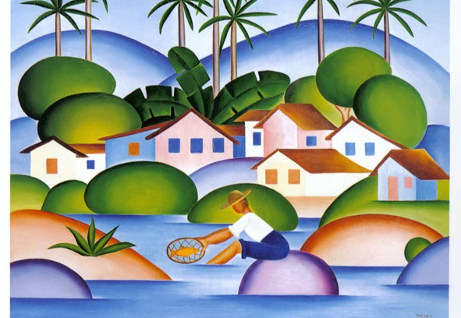
In de Andrade’s work “life looks like one of Tarsila’s drawings, where men, animals and things all move around under an affectionate, tender and diminutive star. This distance, which allows one to pass real conflicts by and envelop the warring sides in the same embrace, is, naturally itself a point of view […] The emptying out of the antagonism between the colonial and (backward) bourgeois elements, along with the disregard for their subjective content, are caused by a distance which is internal to the poem, and which is, in turn, a transposition of the distance between the local and the universal models for progress” (Schwarz 118)

Slide 14
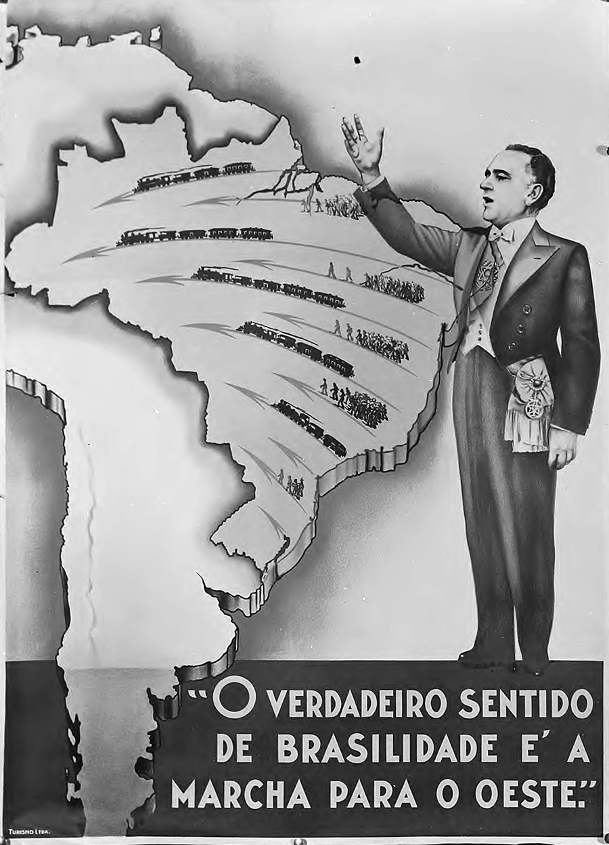

Slide 15
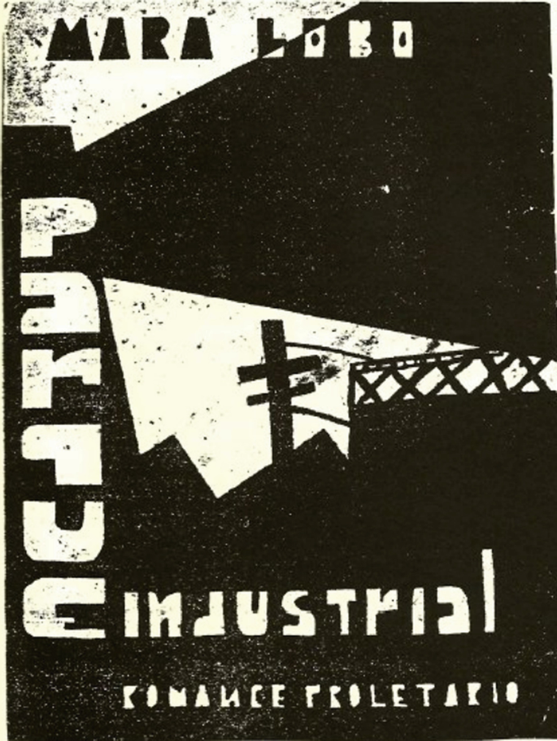
“Corina is the last to return to the atelier. A wide belt of oil-cloth burns red against the same old dress as always.
Her mouth satiated with kisses. The bronze of her head, saturated with joy is even more bronzed. Her legs rise, with runs in the stockings, out of extraordinary heels.
She wears embers on her cheeks and a new, futurist handkerchief around her neck.
The nose of the sewing machines begins again after lunch. In a room darkened by tapestries, twelve hands are paired with a cut piece of pyjamas.
Madame stiffened by elastics smeared with mascara, carelessly smokes her cigarette to the amber of the holder. The women’s working eyes are like hers. Tinged with purple, but from night’s works.” (14)

Slide 16
“Alfredo Rocha reads Marx and smokes a Partagas in the rich apartment of the downtown hotel. His slippered feet injure the furry cushions. Annoying little dogs. Dolls. Bohemian chic. A little Chinese maid to wait on the couple. The disarray.
-Ming! Bring me tea with kisses.
His blue pyjamas flitter and open slightly. The Chinese woman with bangs leaves the cup behind. Obedient. Accustomed. Tiny. She disappears in the cushions. Coldly she receives her boss’s kisses. She’ll take a new banknote to the fat, paralytic Chinaman on Conde Sarzedas Street” (48)
“Corina is the last to return to the atelier. A wide belt of oil-cloth burns red against the same old dress as always.
Her mouth satiated with kisses. The bronze of her head, saturated with joy is even more bronzed. Her legs rise, with runs in the stockings, out of extraordinary heels.
She wears embers on her cheeks and a new, futurist handkerchief around her neck.
The nose of the sewing machines begins again after lunch. In a room darkened by tapestries, twelve hands are paired with a cut piece of pyjamas.
Madame stiffened by elastics smeared with mascara, carelessly smokes her cigarette to the amber of the holder. The women’s working eyes are like hers. Tinged with purple, but from night’s works.” (14)

Slide 17
“The factory owner steals the largest part of the work day from each worker. That’s how he gets rich at our expense!
-Who told you that?
-Are you blind? Don’t you see the automobiles of the people who don’t work and our poverty?
-You want me to smash his car?
-If you do that alone, you’ll go to jail, and the boss will keep riding in another automobile” (11)
*
“-They’re ripping the bread from our mouths! We can’t allow it! They lowered our wages more! Dogs!
The textile workers foam with proletarian hate. The poor ranks thicken in an unexpected protest in front of the factory. Robust hands and skeletal hands advance on the great industrialist’s luxury limousine stopped there. The elegant chauffeur fled. Glass and upholstery crumble in the hands of the avenging masses.
-This gasoline is our blood!” (78)

Slide 18
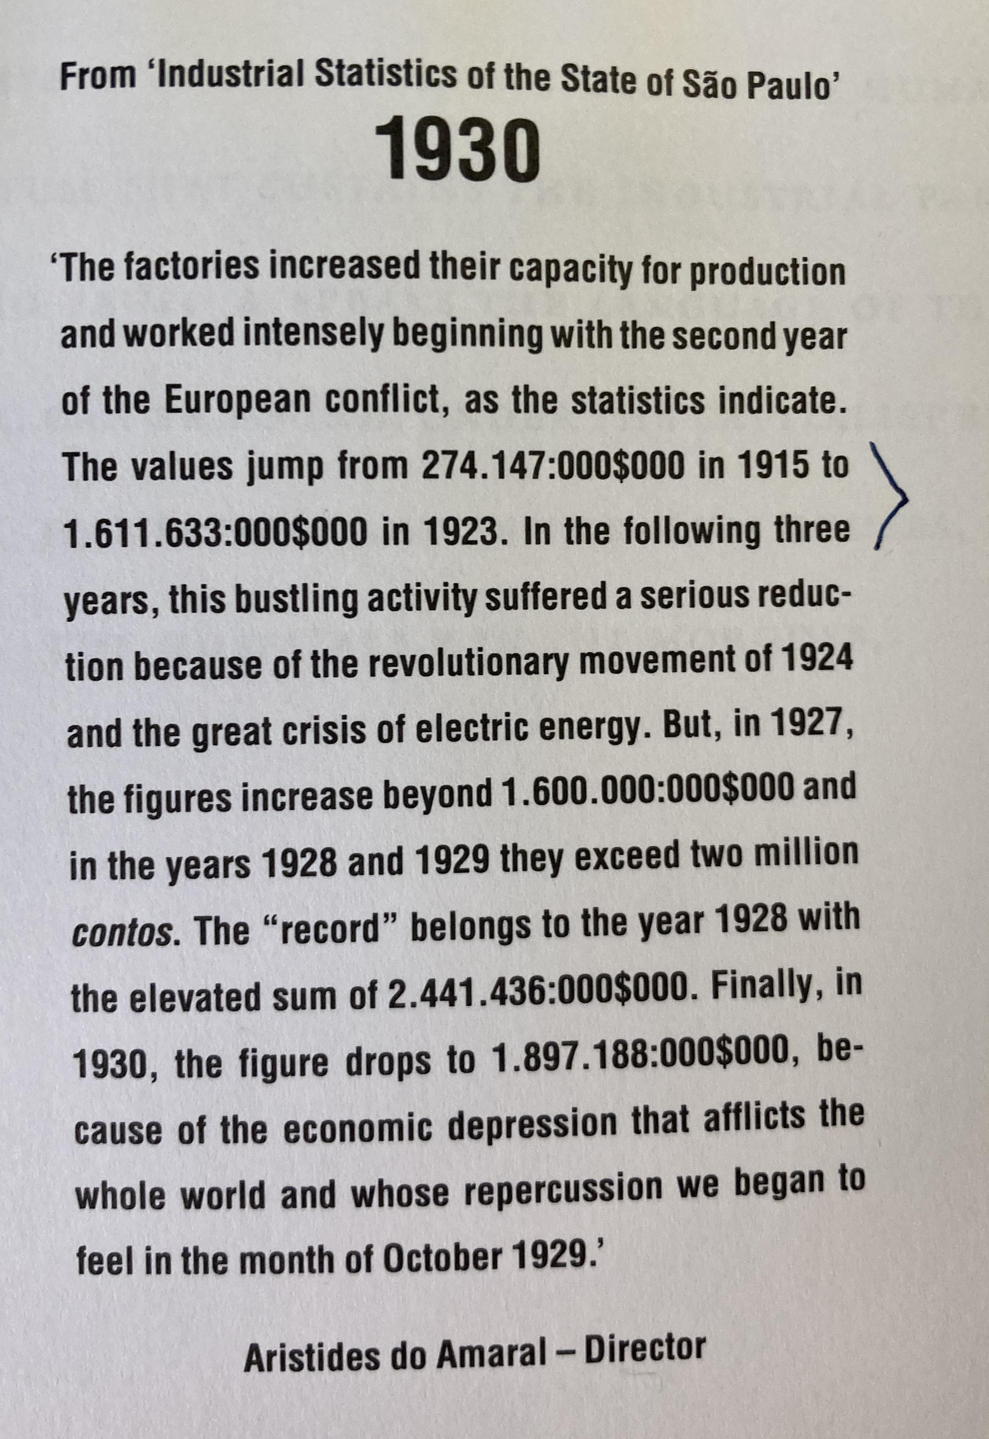
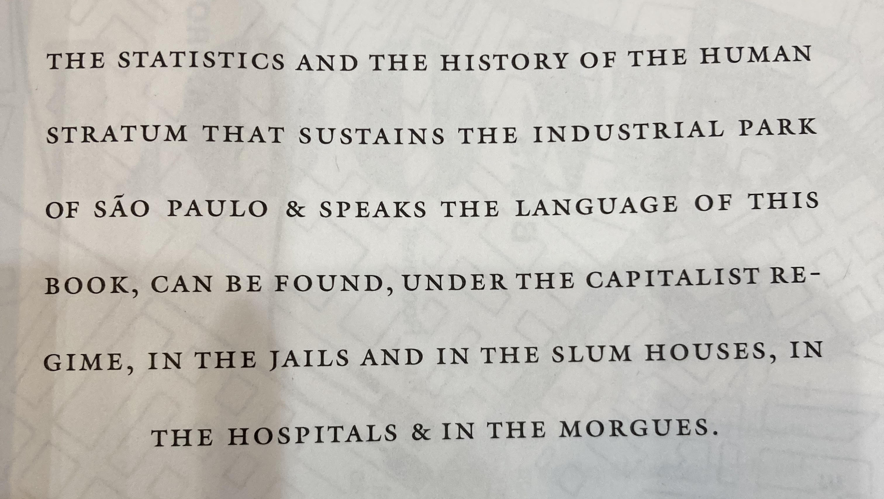

Slide 19
///
“The two, clinging together, victims of the same unawareness, cast on the same shore of capitalist ventures, carry salted popcorn to the same bed” (114)

