Slide 1

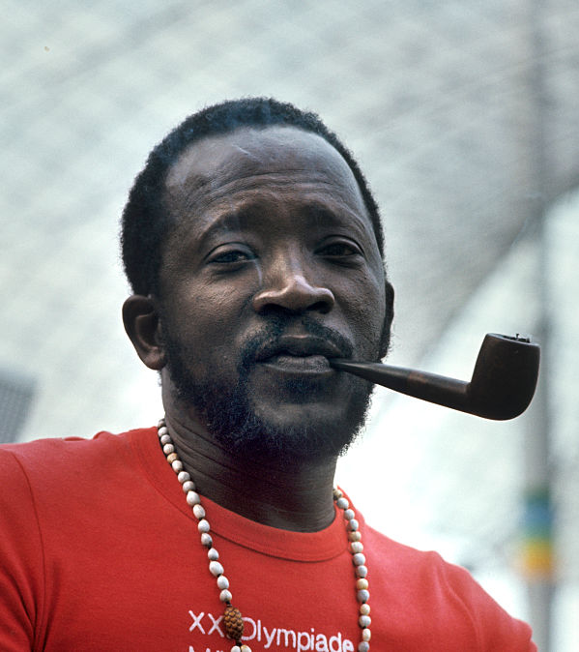

Week 3

Slide 2


Slide 3
Denning in “Globalization and Culture”: certain forms of today’s global culture have “aesthetic roots [that lie] in one of the first explicitly international cultural movements, the worldwide movement of plebian artists and writers to create a proletarian culture, a socialist realism. Though the checkered literary politics of the Soviet Union and the various national Communist parties have often obscured it, much of what emerges as the vital element of a global culture comes out of this internationalism, as it intersected with the national-popular hopes of the anticolonial movements.” (32)

Slide 4
“Only a few years after he had launched his career as a filmmaker, Sembène himself commented on his understanding of what function the author fulfils in the preface to his novel L’Harmattan (1964). He regards himself as an African griot, a person who traditionally figures as a witness and conveyor of events, who meticulously records and transmits historical knowledge. It is this task that Sembène takes upon himself and which he considers to be a form of realism, paraphrasing it as “coming as close to reality and to the people as possible”.10 In essence, Sembène combines the traditional West African concept of the griot with a social, critically motivated occidental understanding of realism aiming at a detailed description of social reality in order to elucidate the problems of those discriminated against most by society.”
Gesine Drews-Sylla, "Ousmane Sembène’s Hybrid ‘Truth’: Social (ist) Realism and Postcolonial Writing Back." Realisms in Contemporary Culture: Theories, Politics, and Medial Configurations (2013): 70-89.

Slide 5
Gesine Drew-Sylla: “In his depiction of the strike, he creatively alters and makes up events: thus, neither did the women’s march from Thiès to Dakar – a central episode in the novel – take place nor did the strike have the immediate success attributed to it in the story. Within the African epic tradition, the narration of events is not required to follow a mimetic description. Instead, the epics aim at presenting a sense of what happened.”
“Sembene does not tell the truth ‘of what happened’ but another truth, the sense of what happened. This sense is, most certainly, the sense of the one who sees it. And this is closely connected to the form of his novel. Therefore, it is important that [God’s Bits of Wood] is situated within the tradition of the epic narrative.” (Eileen Julien, qtd. in Drew-Sylla)
George Lamming: “The novelist does not only explore what has happened. At a deeper level of intention than literal accuracy, he [sic] seeks to construct a world that might have been; to show the possible as a felt and living reality” (“Thirty Years After”, George Lamming Reader, 28).

Slide 6
Born in 1923 in Casamance, southern Senegal

Slide 7
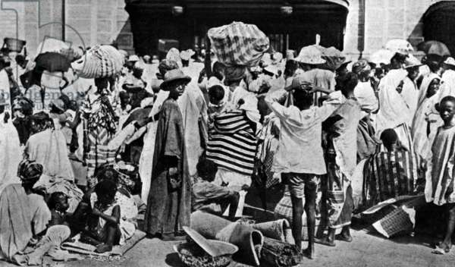
Dakar, 1947
An era of social and political ferment and rising anticolonial activism

Slide 8
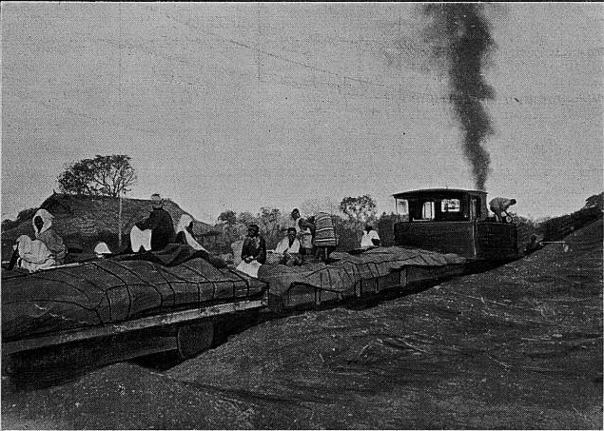
French West African Rail Workers Strike
1947-48
“an event of epic dimensions” (Frederick Cooper)

Slide 9
Sembène in Marseille, speaking with union leader Victor Gagnaire, circa 1950
Sembène joined the CGT (General Confederation of Labour / Confederation generale des travailleurs) in 1950

Slide 10
“In addition to my work as a CGT union leader, I was also the secretary-general of Black workers in France. This enabled me to gain insight into both aspects, race- and class-based, of the situation. The way I saw it, it didn’t make any sense that Africans living in Europe should try to set up a labour organization on the basis of their skin colour. A labour organization is made up of workers from the same corporation fighting to improve their condition. When I arrived in Marseilles, CGT was a major entity [. . .]. I saw in it a tool for self-improvement, for you learn an awful lot through trade unionism, it’s a real school.” (Sembène, qtd. in Samba Gadjigo, Ousmane Sembène : The Making of a Militant Artist, 112)

Slide 11
Samba Gadjigo: “[Sembène] was convinced that the Black worker’s situation was tied to the liberation of Africa” (113)
“We were deep into the colonial era and we were strangers in France, to boot, on account of our culture and our language. It was therefore very difficult for us to create an organization. We had to situate our action within a political context, it was impossible to isolate ourselves. That said, when we returned to our neighbourhood, we found back our roots through cultural activities that imbued us with a real sense of pride” (Sembène, qtd. in Gadjigo, 113)
“In the last analysis, Sembène fought on two fronts, and if he was so intent on acquiring more and more knowledge, it was also to make himself serviceable, as a revolutionary leader, to his African brothers living in France, whether they were Blacks or Arabs. Moreover, in so doing Sembène was also inscribing himself within a firmly established Pan-African political tradition.” (Gadjigo, 113)

Slide 12
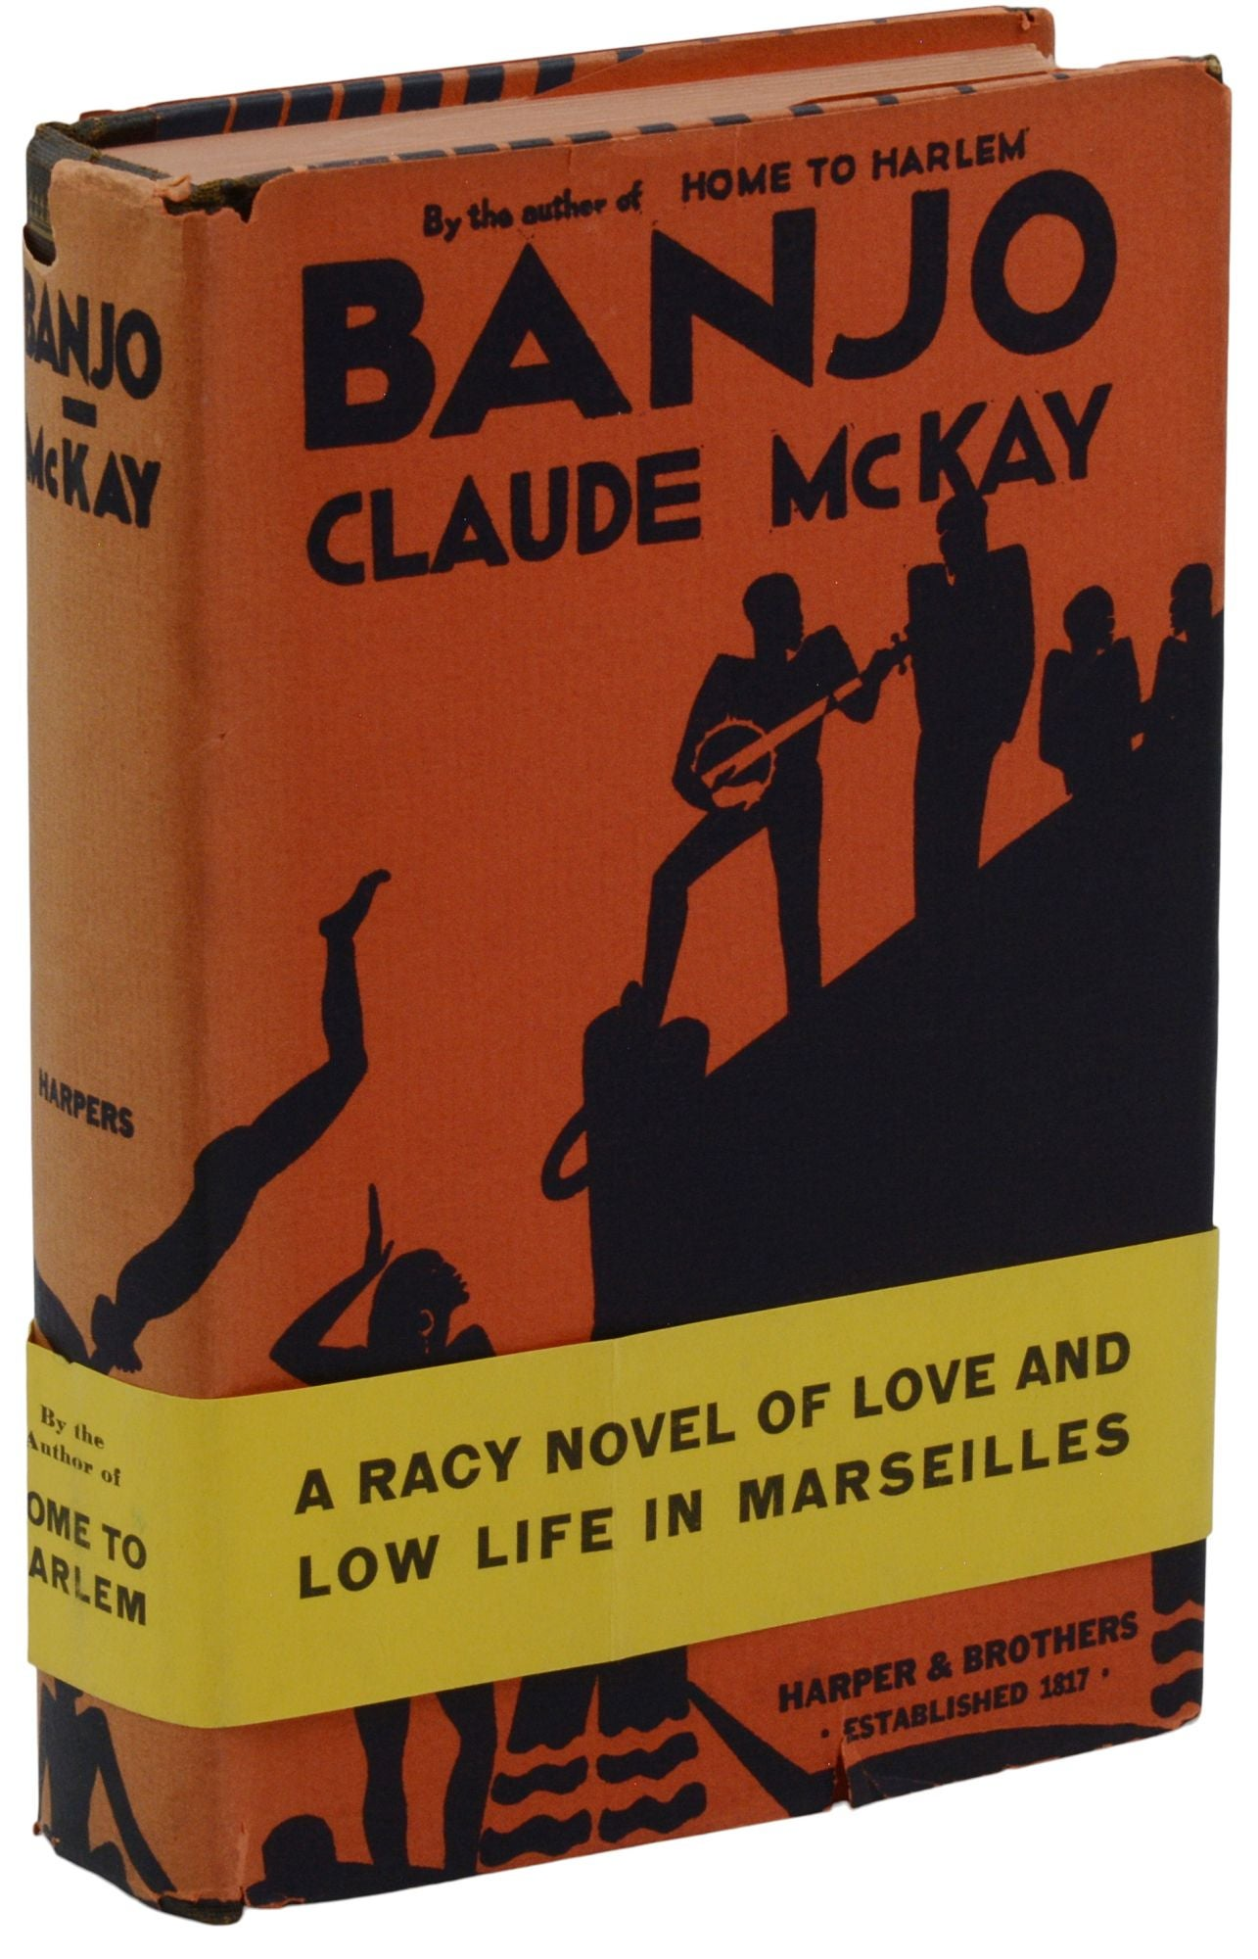
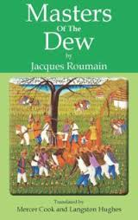

Slide 13
The Afro-Asian Writers Association
The AAWA “aimed to establish direct South-to-South literary relations that would bypass the (neo-)colonial metropoles of Paris, London, or New York. Many of the writers associated with it – Sembène Ousmane, Mulk Raj Anand, Faiz Ahmad Faiz, Mahmoud Darwish, Pramoedya Toer, Ngũgĩ wa Thiong’o, and Alex La Guma – are now seen as canonical postcolonial figures and their participation in such earlier, Soviet-aligned networks has been forgotten.”

Slide 15

1961-62, Sembène trained as a film-maker in Moscow at the Gor’kij Film Studio

Slide 16
Sembene: “In God’s Bits of Wood, I wanted to show that African unity cannot be envisioned outside of a Marxist purview.”

Slide 17
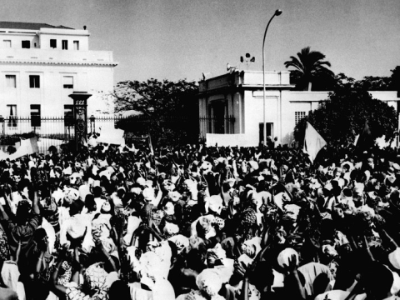
Denning: “The strike narrative becomes, not surprisingly, a core element in these works, representing the interruption in daily life—a festival of the oppressed—that creates a story.”

Slide 18
“If the truth be told, although Bakayoko, with his manner of disregarding destiny or bending it to his will, was the soul of the strike, it was Lahbib, the serious, thoughtful, calm, and modest Lahbib, who was its brain” (188).

Slide 19
“After the evening meal – on the days when there was a meal – the women would gather in a circle around the elders, and then their talk would go on far into the night. Sometimes an uneasy silence would fall, broken only by a mournful sighing, and then, in an effort to avoid the dark shadow of hunger and the dejection about the future which weighed on all of them when they were together, someone would begin to sing. First one woman would sing a verse or two, then another would take up the theme, and soon everyone was adding a stanza of her own thoughts and feelings, and the song echoed through the darkness. And it was always a song which was a kind of vow by the women to their men. (137-38)
“Ever since they left Thies, the women had not stopped singing. As soon as one group allowed the refrain to die, another picked it up, and new verses were born at the hazard of chance or inspiration, one word leading to another and each finding, in its turn, its rhythm and its place. No one was very sure any longer where the song began, or if it had an ending. It rolled out over its own length, like the movement of a serpent. It was as long as a life.” (192)

Slide 20
‘Let us look at it in another way. We are driving a train down the track, and ahead of us we think we see an obstacle which makes us afraid. Are we going to stop the train and say to the passengers, “I can’t go any farther; I think there is something up ahead that frightens me?” No – we are responsible for the train, and we must go forward and find out if the obstacle really exists. The gentleman beside me here is the obstacle which has made us afraid, but we cannot let ourselves be stopped by it.’ (177)

Slide 21
“The officer, sensing Ramatoulaye’s defiance, looking into the hatred that flamed in her eyes, began to grow angry himself. The women were on the verge of panic. They scarcely recognized the woman beside them as the Ramatoulaye they had always known, and they asked themselves where she had found this new strength. She had always been quiet and unassuming and gentle with the children; at the street fountain she never took part in the arguments, and she never spoke badly of her neighbors. Where, then, had this violence been born? What was the source of this energy so suddenly unleashed? It was not the war; Ramatoulaye was not a man and knew nothing of the rancors that well up in soldiers on the march. It was not the factory; she had never been subject to the inhuman dictatorship of machines. It was not even in the too frequent association of men; she had known only those of her own family. Where, then? The answer was as simple as the woman herself. It had been born beside a cold fireplace, in an empty kitchen.” (89)

