Slide 1
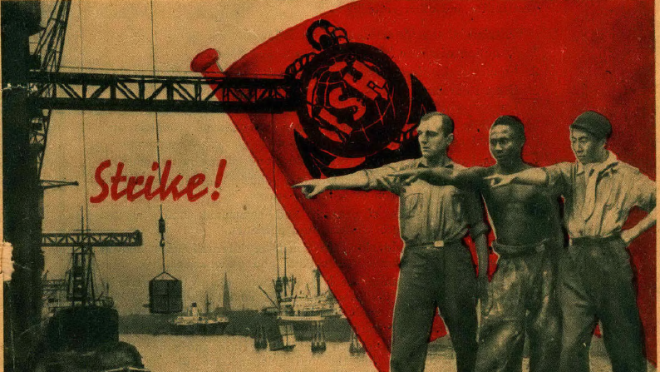
Week 5: Stories from the Sea

Slide 2
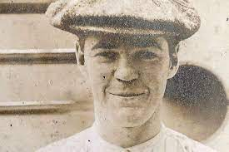
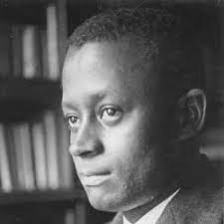

Eric Walrond, “The Wharf Rats” (1926)
James Hanley, “The Last Voyage” (1932)
George Garrett, “Fishmeal” (1936)

Slide 3
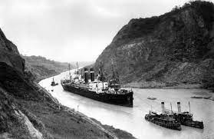
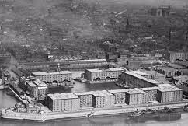

Slide 4
Ken Worpole, “Expressionism and Working-Class Fiction”
two traditions of proletarian literature
“the local,” comprising “writers who took as their political and aesthetic ambition the project of describing the life of the communities they lived in, usually employing a literary technique most easily summarized as ‘documentary realism’. [. . .] All of these books were essentially literary documents rooted in the continuity of class and place” (84)
These ‘local’ fictions have tended to be privileged in critical accounts of proletarian writing “at the expense of understanding attempts to create a different aesthetic of working-class experience based not on place and continuity but on dislocation and transience” (84)
“For as many people brought up in single industry communities, with strong local traditions, there were as many for whom class was experienced as the dislocation of the generations, the rootlessness of city life, a succession of casual jobs and the constant search for employment—often involving moving from town to town” (85).

Slide 5

Worpole: “Garrett, like Hanley, is concerned with extreme emotions of people trapped in extreme circumstances” (90)

Slide 6
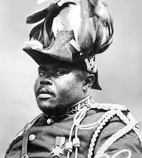
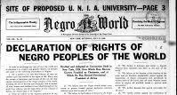
Eric Walrond (born in British Guiana in 1898)
Banjo: “Taloufa maintained that the Back-to-Africa propaganda had worked wonders among the African natives. He told Ray that all throughout West Africa the natives were meeting to discuss their future, and in the ports they were no longer docile, but restive, forming groups, and waiting for the Black Deliverer, so that, becoming aroused, the colonial governments had acted to keep out all propaganda, especially the Negro World, the chief organ of the Back-to-Africa movement” (102.)

Slide 7
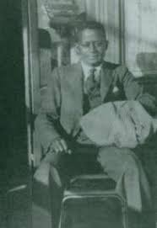
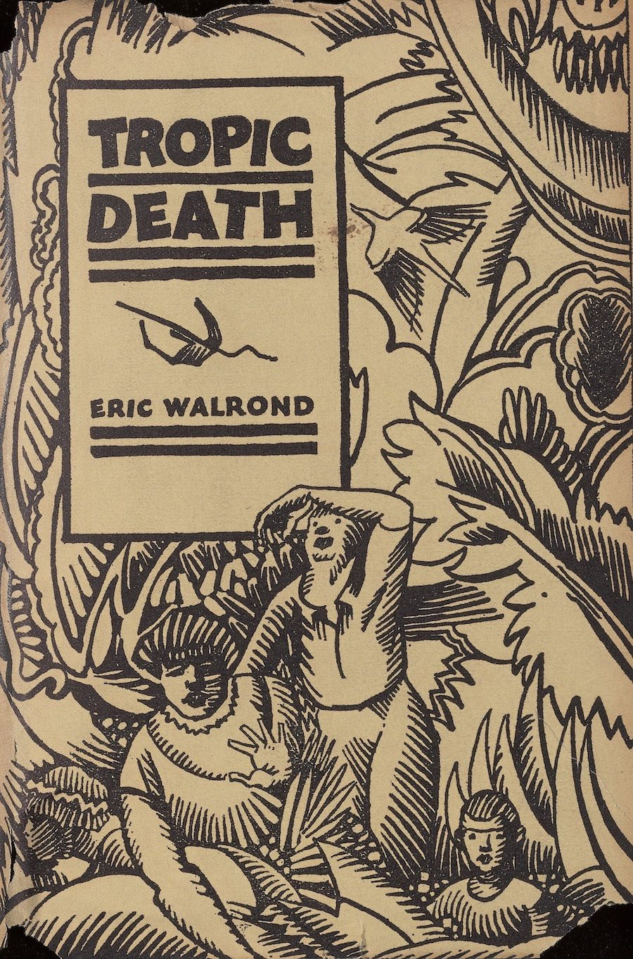
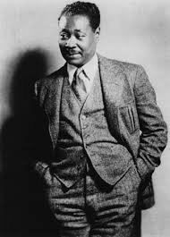

Slide 8
“‘Why don’t you write about the race men and women who are making good in Paris?’
‘I’m not a reporter for the Negro Press. Besides, I can’t afford to keep up with the Negroes of Paris. And as they are society folk, they might prefer to have a society writer do them.’
[. . .] ‘But since you’re a Negro, wouldn’t it be a good thing for the race if the best Negroes appreciate what you write?’
‘The best Negroes are not the society Negroes. I am not writing for them, nor the poke-chop-abstaining Negroes, nor the Puritan Friends of Color, nor the Negrophobes nor the Negrophiles. I am writing for people who can stand a real story no matter where it comes from’” (Banjo 115-7)
Walrond:
“Always conscious of the color problem, the Negro writer in the United States is vigilantly censorious of anything in his work or expression which may put the black race in a disparaging light. Thinking of the prejudiced white who’d take up his book and contemptuously review it, he writes with that preconceived bias in mind. And of course when he begins to write about his own people he lies miserably. He doesn’t paint pictures of people—of tantalizing black people—he knows. No. He dishes up yarns about aristocratic blacks who go to Harvard. He goes down to Wall Street and hires a skyscraper and puts a Negro bank president in it. [. . .] On occasion these Negro tales deal with what is known about town as “high society.” And by God if there is a society that is more stilted, more snobbish, that is harder to break into, than the Negro society these tales depict, then I’ve yet to hear about it. (“The Negro Literati” (1925), 32–33)

Slide 9

Kenneth Ramchand: Tropic Death is “one of the startling treasures in the lost literature of the West Indies”

Slide 10
Michael Murphy: “Though George Garrett’s work was discussed, praised and, most importantly of all, published by such influential figures as George Orwell, Sylvia Townsend Warner and John Lehmann, critics since the Second World War have done little more than acknowledge his presence amongst the many working-class writers active during the 1930s” (The Collected George Garrett, vii)
Garrett born 1896, Hanley in 1897, both in Liverpool.

Slide 11
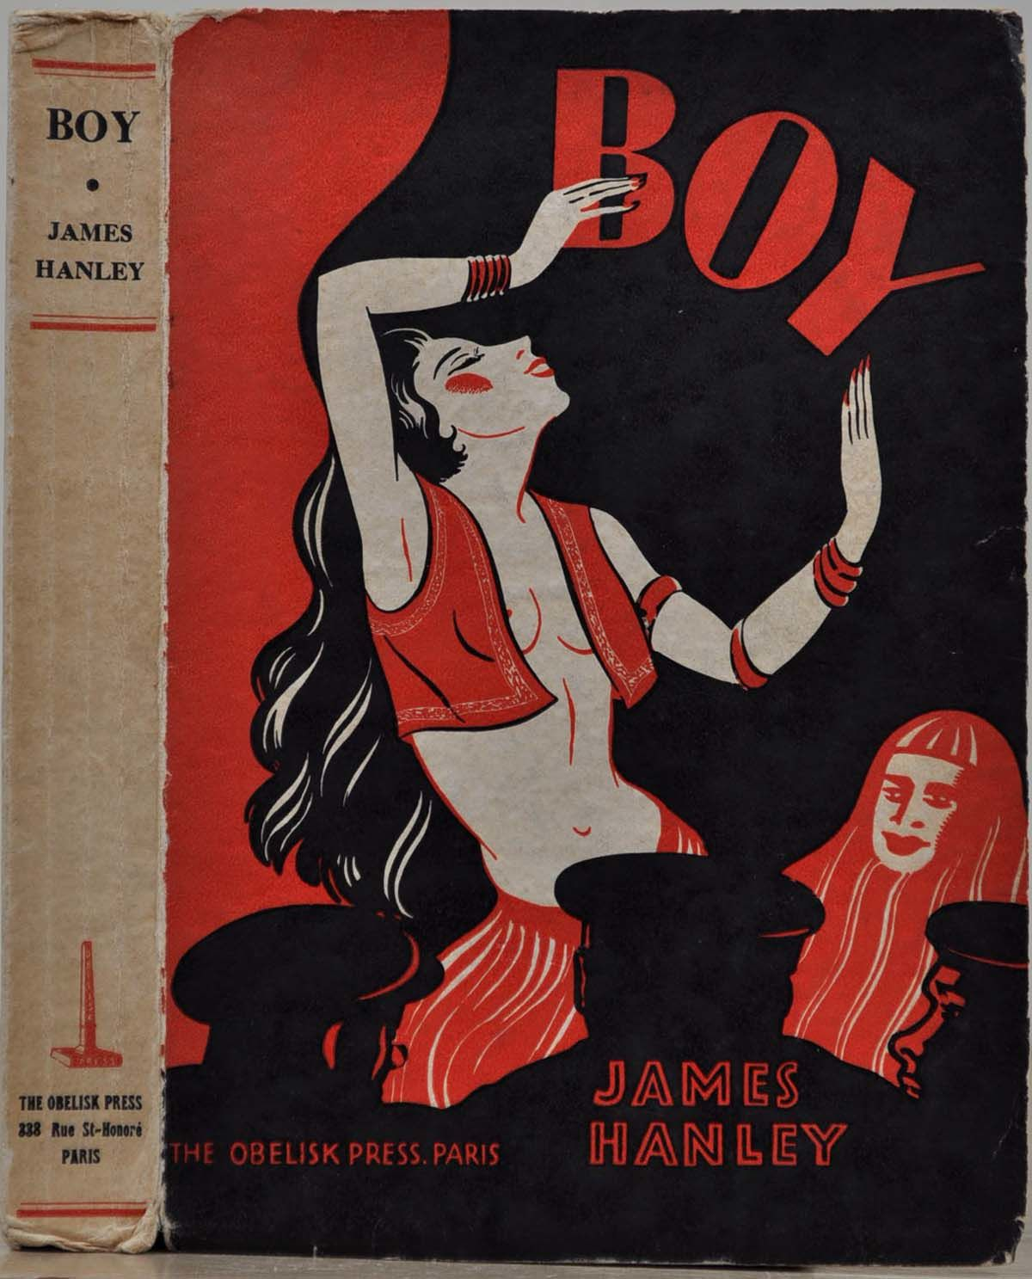

Slide 12
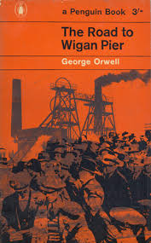
George Orwell:
“I was very greatly impressed by Garrett. Had I known before that it is he who writes under the pseudonym of Matt Low in the Adelphi and one or two other places, I would have taken steps to meet him earlier. He is a biggish hefty chap of about 36, Liverpool-Irish, brought up a Catholic but now a Communist. He says he has had about 9 months’ work in (I think) about the last 6 years. He went to sea as a lad and was at sea about 10 years, then worked as a docker. During the War he was torpedoed on a ship that sank in 7 minutes [. . .]. I urged him to write his autobiography, but as usual, living in about 2 rooms on the dole with a wife (who I gather objects to his writing) and a number of kids, he finds it impossible to settle to any long work and can only do short stories. Apart from the enormous unemployment in Liverpool it is almost impossible for him to get work because he is blacklisted everywhere as a Communist.” (“The Road to Wigan Pier Diary,” 27/2/36)

Slide 13
Garrett in 1921:
“Fellow workers, it is all very well criticising the alien as one of your speakers has been doing, and telling you that he is the cause of your unemployment. It is not so. The present rotten system is the cause. These speeches by my friend here are only storing up racial hatred . . . My friend’s speeches are also doing another thing. This Seaman’s Vigilance Committee, if it is to be any good, must show an unbroken front. As it is now we are broken into different lines of argument and this has been caused by my friend. We must stick together or we will not get anywhere. All workers are slaves to the capitalists no matter what their race, colour or creed is, and there is more slavery under British Imperialism and the Union Jack than under any other flag. You Britishers, you sometimes give me a pain. I don’t tell people I’m a Britisher. I had no choice in being where I was born. How many of you have the guts of the Indians who are following Gandhi in India today, or following Michael Collins in Ireland? There people are only trying what we should be doing, breaking the bonds of their serfdom. [. . .] [We] must fight on for the emancipation of all workers no matter what country, colour, or creed.”

Slide 14
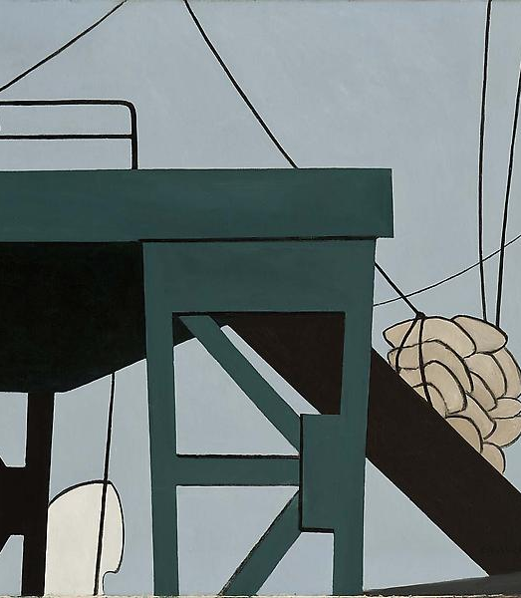
Holger Weiss:
“The employment of colonial maritime workers of different ethnic backgrounds on European and US vessels had gained momentum during the second half of the nineteenth century. Especially during the era of the steam ship, Asian, Arab, African and Caribbean seamen were hired for unskilled work on board. During the first decades of the twentieth century, their number counted already tens of thousands.”
Yet in this period “the official maritime trade unions in the United States, Britain and elsewhere were predominantly exclusionary and segregationist.”
"‘Unite in International Solidarity!’ The Call of the International of Seamen and Harbour Workers to ‘Colonial’ and ‘Negro’ Seamen in the Early 1930s“ in The Internationalisation of the Labour Question (2020): 145-162.

Slide 15
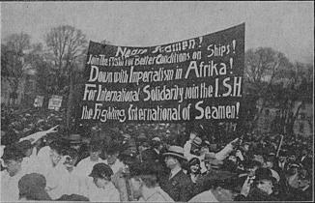
The International of Seamen and Harbour Workers
Patrick King: “Established in 1930 as part of the broader initiative to reach workers of colour in the industrial capitalist centers as well as the colonial or semi-colonial territories in both the Atlantic and Pacific, the ISH was constructed to be an umbrella body that would encompass and bring together radical unions and committees of maritime transport workers in which communist militants had a firm foothold. At one point, it boasted chapters in 22 countries and 19 colonies.” (https://viewpointmag.com/2018/02/01/appeal-negro-seamen-dockers-1932/)

Slide 18
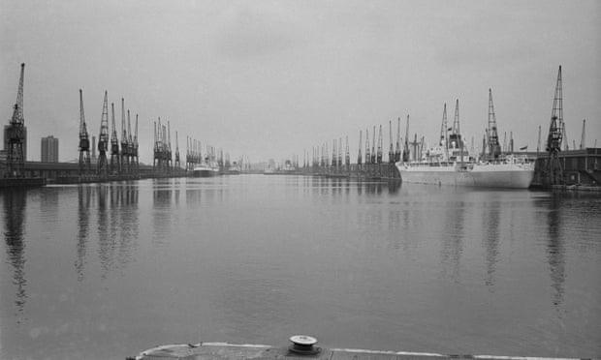
Patrick King: “The significance of longshoremen, harbour-workers, and maritime laborers, their capacity to scramble the nerve system of capital-in-motion [. . .]. These waterfront and ship-bound workers have often been decisive actors in the most bitter, extraordinary, and consequential episodes in the global class struggle.”

Slide 19
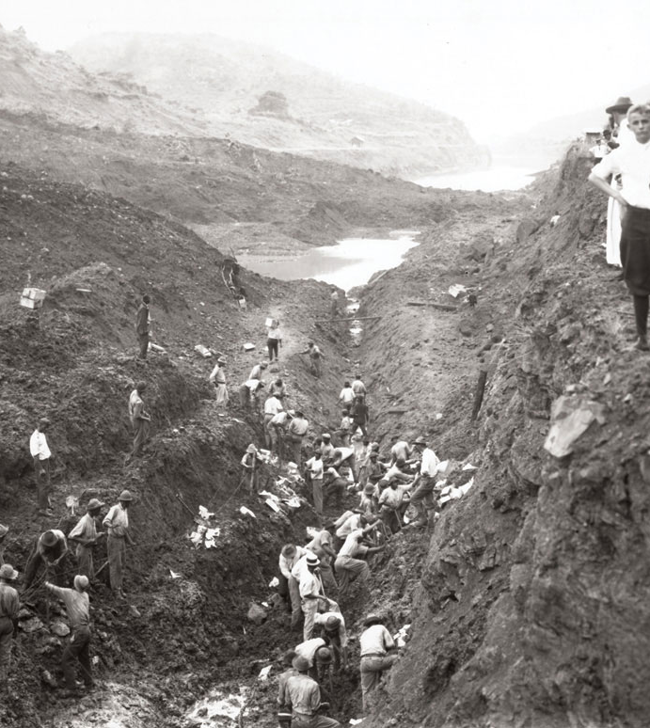
Walrond:
“Among the motley crew recruited to dig the Panama Canal were artisans from the four ends of the earth. Down in the Cut drifted hordes of Italians, Greeks, Chinese, Negroes—a hardy, sun-defying set of white, black and yellow men. But the bulk of the actual brawn for the work was supplied by the dusky peons of those coral isles in the Caribbean ruled by Britain, France and Holland.” (67)
“At the Atlantic end of the Canal the blacks were herded in boxcar huts buried in the jungles of ‘Silver City’; in the murky tenements perilously poised on the narrow banks of Faulke’s River; in the low, smelting cabins of Coco Té. The ‘Silver Quarters’ harboured the inky ones…” (67).

Slide 20

Walrond:
“Old brass staves—junk dumped there by the retiring French—thick, yawping mud, barrel hoops, tons of obsolete brass, a wealth of slimy steel faced him.” (82)
“Iron staves bruised his shins.” (82)
“Hewing a lane through the hostile sea Philip forgot the cunning of the doddering beast and swam noisier than he needed to. Faster grew his strokes. His line was a straight, dead one. Fancy strokes and dives––giraffe leaps … he summoned into play. He shot out recklessly. One time he suddenly paused––and floated for a stretch. Another time he swam on his back, gazing at the chalky sky. He dived for whole lengths.” (83)

Slide 21
Garrett:
“He looked back once more against the bulkhead, gazed downwards at his thin naked sweating body, and wearily rubbed the back of his arm along his forehead. The flesh felt as if it were taut. His skull was expanding, and to his disordered mind was almost big enough to burst. His face seemed to be bloated like a monster carnival mask. The terrible thought struck him that it might explode. Could such a thing happen, he wondered. There seemed to be a tremendous weight on his head also, some horrid unbearable load that was crushing down on him all the time, as if his skull had been trapped in the jaws of a monstrous vice; yes, a tightening vice that was squeezing his overstrained eyes from their sockets.” (123)

Slide 22
“No space is more haunted than the sphere of capitalist (factory) production, a veritable ‘House of Terror’ (Marx), and no poltergeist more effective than the workplace thumping that is often literalized with disfiguring industrial accidents.” Stephen Shapiro, “Transvaal, Transylvania: Dracula’s World-System and Gothic Periodicity.” Gothic Studies 10.1 (2008): 30

Slide 23


Slide 24
Hanley:
“Remembered fifteen years ago. Was young and strong and worked hard on Lucania when her engines broke down in the Western ocean. Heavy shafting to be lifted and he was strong. Was no thought for himself then, only for ship that had to be in New York by Wednesday, ten fifteen p.m. Company were anxious to get passengers for Advertisers’ Convention in England, before Red Star line got them. Remembered that. And Chief Engineer said to second: ‘Call the men for’ard, and tell the steward to give each man a tot of rum.’ Good job that.
Remembered that. Had the rum. Forgot all about strain on body. Six years later the rupture came. It was bad too.” (59)

