Slide 1
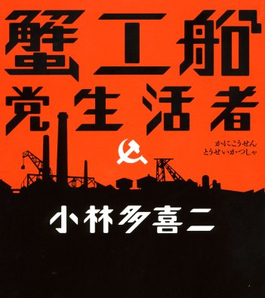
Week 7:
Kobayashi Takiji
The Crab Cannery Ship (1929)

Slide 2
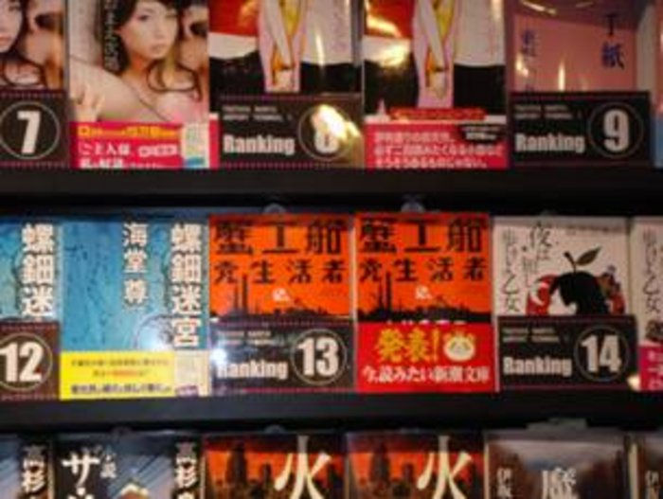
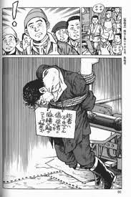


Slide 3
Zeljko Cipris:
“In 2008—the year Takiji’s novel skyrocketed to fame—over thirty thousand Japanese people killed themselves, tens of thousands were homeless, some three million were unemployed, twenty million were living in poverty, and more than a third of the active labor force comprised irregular workers who were poorly paid and could easily be fired. This does not explain why a fiercely anticapitalist novel burst into light at this particular moment, but it does provide a highly receptive background of frustration, outrage, and smoldering rebellion that warmly welcomed its fiery call for united, collective action.” (“Translator’s Introduction,” x)

Slide 4
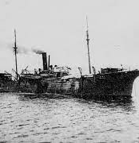
“Crab cannery ships were considered factories, not ships. Therefore maritime law did not apply to them. [. . .] The crab cannery ships were factories pure and simple. And yet factory laws did not apply to them either. Consequently, no other site offered such an accommodating setting for management’s freedom to act with total impunity.” (35)

Slide 5
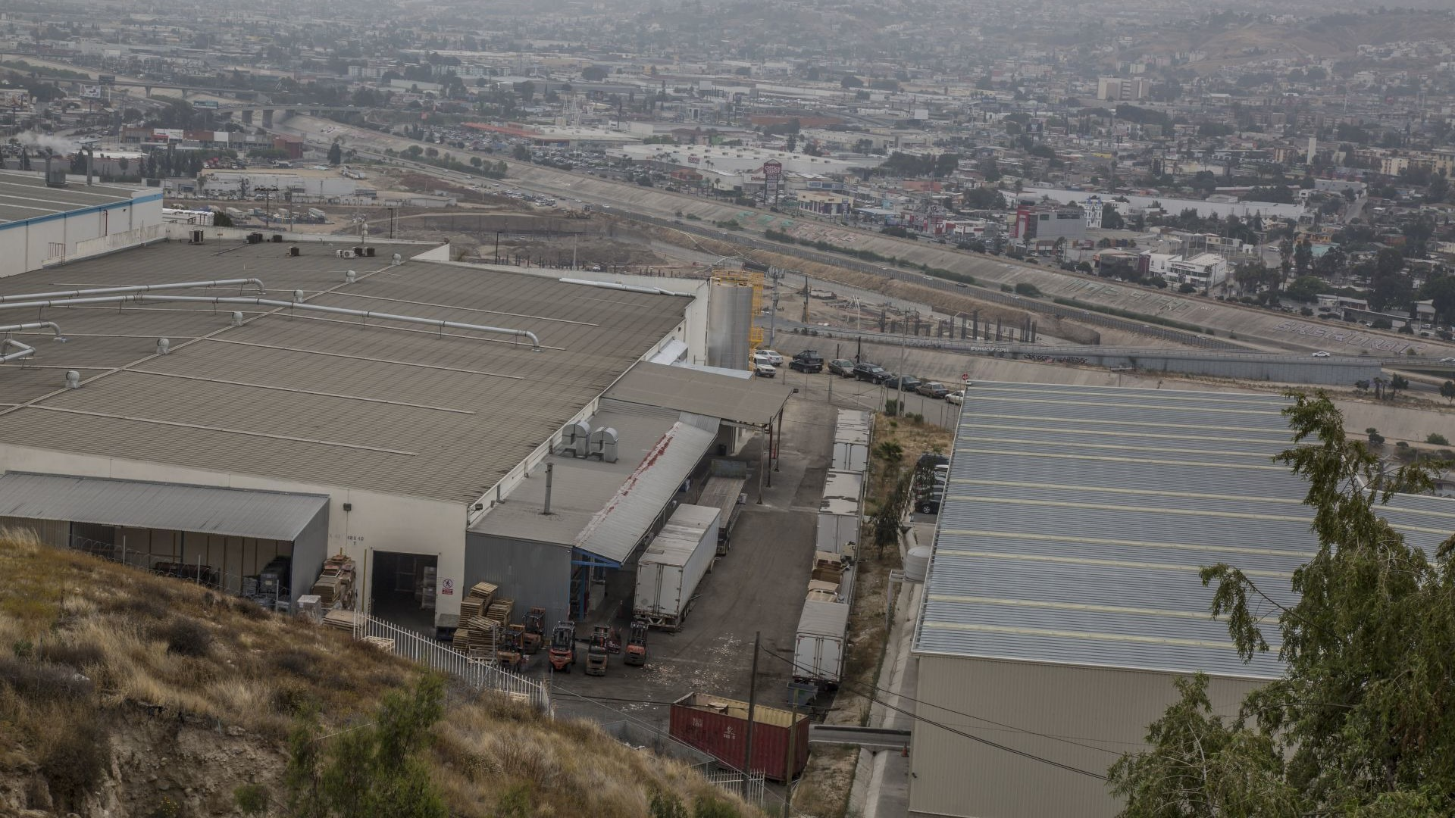
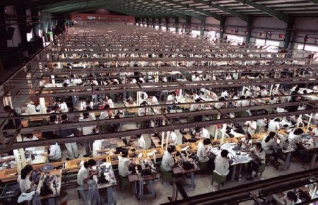

Slide 6
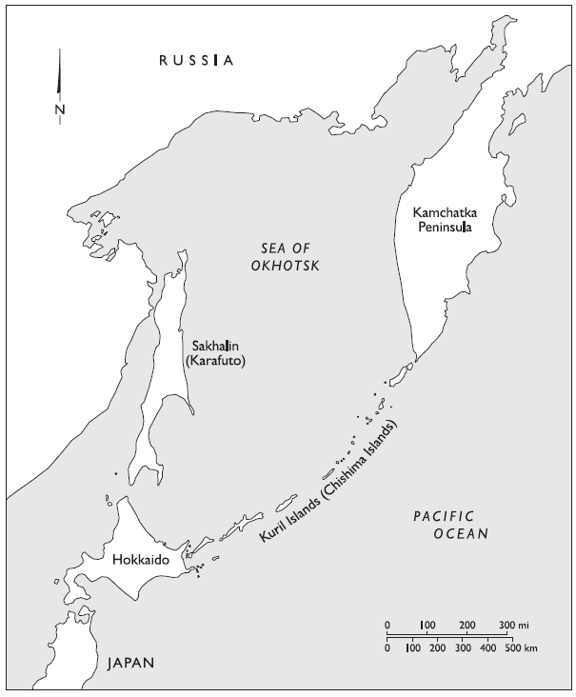

Slide 7
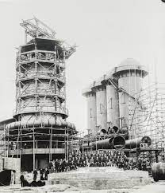
“The task of feeding their families, impossible despite working in the fields from before dawn, had forced them to come here. They had left the oldest sons behind, still short of food, and sent the daughters to secure new forms of wage-labour in order work in factories. Even the second and third sons had to go somewhere to work. Masses of such surplus people, like beans scooped up in a pan, were driven away from the countryside and flowed into the cities. All of them dreamed of saving up a bit of money and returning home. But once they began to work—in Hakodate, Otaru, and other cities—they struggled like fledglings trapped in sticky rice-cake until they were thrown out of work as stark naked as the day they were born.” (23-24)

Slide 8
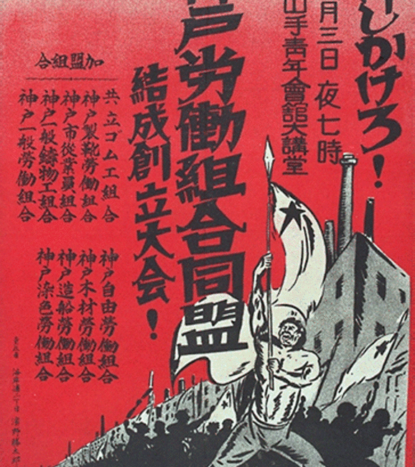
1920 – formation of the Japanese Socialist League party.
1921 – publication of The Sower, journal established by writers and critics including Komaki Omi, who in 1923, along with Sasaki Takamaru, published a Japanese translation of Clarté
1922 – founding of Japanese Communist Party
1925-35 – the ‘Red Decade’; boom in proletarian literature
1928 – founding of the proletarian arts organization NAPF (Nippona Artista Proleta Federacio)

Slide 9
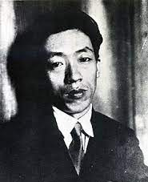
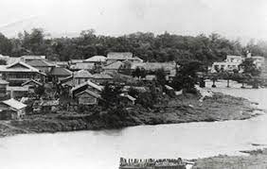
Heather Bowen-Struyk: “Takiji brought to the proletarian literature movement centered in Tokyo the important experience of growing up in Hokkaido, Japan’s northern frontier territory with a still palpable sense of colonization and an uneasy relation to ‘Japan.’” (“Rival Imagined Communities,” 380)

Slide 10
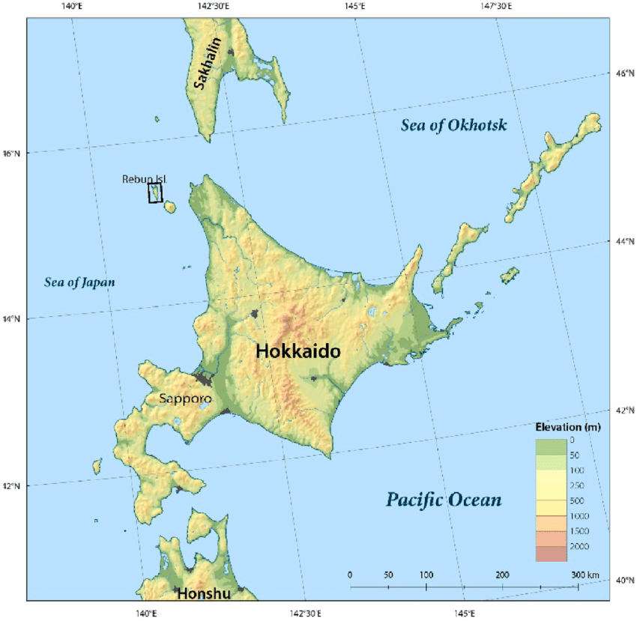
Takiji writing in a letter in 1921:
Crab Cannery Ship as dealing with “a unique form of labor”
“a type of exploitation typical of colonies and undeveloped areas”
it had “the advantage of making transparently clear” not only “the conditions of Japanese workers” but also the “international, military, and economic relations” constituting those conditions.

Slide 11
“When workers on the mainland grew “arrogant” and could no longer be forced to overwork, and when markets reached an impasse and refused to expand any further, then capitalists stretched out their claws, “To Hokkaido, to Karafuto!” There they could mistreat people to their hearts’ content, ride them as brutally as they did in their colonies of Korea and Taiwan. The capitalists understood quite clearly that there would be no one to complain. In workers’ quarters at highway and railway construction sites laborers were being beaten to death more easily than lice.” (53)

Slide 12
“They’re saying that Kamchatka and northern Karafuto are rolling with money to be made, and they’re making damned sure to add this whole area to Japan. They say this region is just as important to Japan as China and Manchuria. On top of that, it seems that this corporation’s gotten together with Mitsubishi to nudge the government along. If the company president gets into the Diet at the next election, they’ll really be stepping things up.” (72)

Slide 13
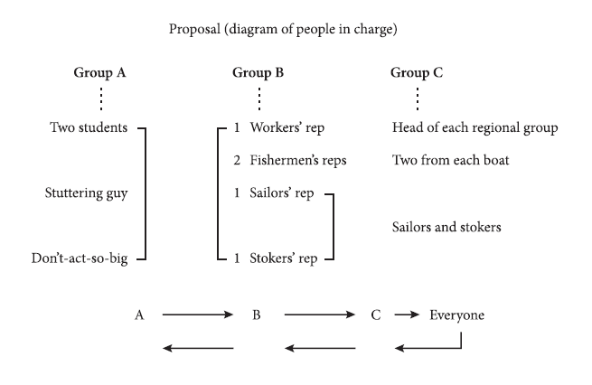

Slide 14
Two or three Russians began noisily to say something. The Chinese was listening. And then picking up the words one by one as if stammering, he translated for them. “Boss do nothing, get rich. Proletariat always this.” (He showed a person being choked.) “This, no good! Proletariat, all you, one, two, three . . . hundred, thousand, fifty thousand, hundred thousand, all, all, this.” (He imitated children joining hands.) “Get strong. All right!” (He slapped his arm.) “No lose, nobody. Understand?”
“Yes, yes!”
“Rich man boss, run.” (He made as if to flee at top speed.) “All right, sure. Working people, proletariat, is proud.” (He strode about in a dignified manner.) “Proletariat, number one great. . . . If no proletariat, all no have bread. All die. Understand?” (45-46)

Slide 15
“Asakawa doesn’t think of you fellows as human beings” (40)
Tajiki’s novel is one among a number of Japanese proletarian works that “manifest [. . .] a keen anxiety that capital is reducing everything and everyone to exchange value” (Bowen-Struyk, “Rival Imagined Communities”, 399)

Slide 16
“The fishermen’s shit-hole was lit by feeble electric lights. Its air was thick with tobacco smoke and the odor of crowded human bodies; the entire cabin stank like a toilet. People moving about in their bunks looked like squirming maggots.” (25-26)
“Once the work ended everyone crept back into their shit-hole. Hands and feet hung from bodies like radishes, frozen and devoid of sensation. The men all crawled into their bunks like silkworms, no one uttering a single word.” (30)
“Lice, fleas, and bedbugs kept on emerging from somewhere and attacking them throughout the night. It was impossible to eradicate them. As the men climbed into their damp and gloomy bunks, they instantly began to itch with dozens of fleas crawling up their shins. Finally they began to wonder whether their own flesh was starting to rot. A sinister notion assailed them that they might in fact be decomposing corpses swarming with maggots and flies.” (57)

Slide 17
“Outlined distinctly against the sea that shone silvery grey after a recent rainfall, the black shape of a tightly bound worker hung from the jutting arm of the winch. He had been hoisted skyward all the way to the top of the winch. There he hung like a rag for some twenty minutes. Then he was partly lowered, his body twisting and writhing, his legs struggling as though caught in a spider’s web.
Presently his body disappeared in the shadow of the saloon. Only the taut line of the wire occasionally moved like a swing. [. . .]
Alerted by a faint sound, the carpenter turned around. The wire was swaying as though shaken by someone below, and he heard dull, sinister thumps. The face of the worker who was hanging from the winch was deathly pale. Foam dribbled from lips that were shut as tightly as those of a corpse.” (59)

Slide 18

Hiroshi Aramata: “proletarian literature is a kind of horror literature” (Puroretaria bungaku wa mono sugoi! / Proletarian Literature Is Awesome!)

Slide 19
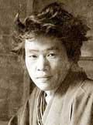
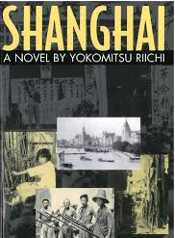
Shinkankakhua, or the New Sensationist movement in Japan

Slide 20
Brian Bergstrom: “Nakamoto was not alone in her attempts to combine the formal experimentation characteristic of modernisms like New Sensationism with the political activism of the proletarian movement; authors like Hayashi Fusao and Kataoka Teppei produced works that spanned the supposed gulf between the movements, using the striking imagery typical of New Sensationism to illustrate the Marxist theories the stories elucidated.” (“Revolutionary Flesh: Nakamoto Takako's Early Fiction and the Representation of the Body in Japanese Modernist and Proletarian Literature” positions 14.2 (2006,

Slide 21
“Fishermen who till now had known only servile submission, quite unexpectedly felt a tremendous force thrusting them forward. At first they were bewildered. Gradually they realized that their own power, whose presence they had not suspected, was manifesting itself.
“But are we capable of making use of that power?” they wondered. Of course they were.
Once they understood it, a wonderful spirit of rebellion filled their hearts. The very hardships of the agonizing work that had been wrung from them turned into a splendid foundation for their defiance. Now the manager and his ilk could go to hell! They were elated. This new feeling suddenly enabled them to see their wormlike lives vividly, as though illuminated by a flashlight’s beam.” (79)

