Slide 1

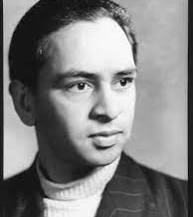
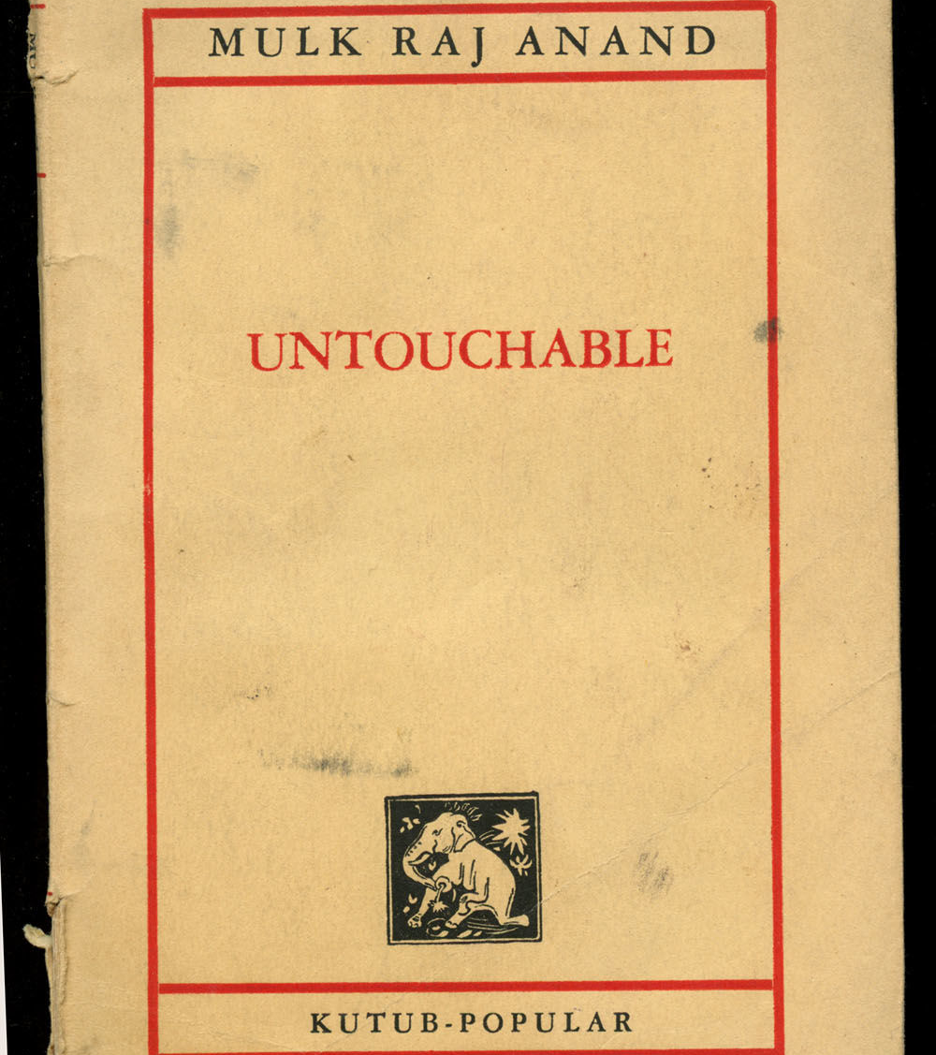

Slide 2
SIMLA – SS Viceroy of India – BLOOMSBURY.
September–October 1933.

Slide 3
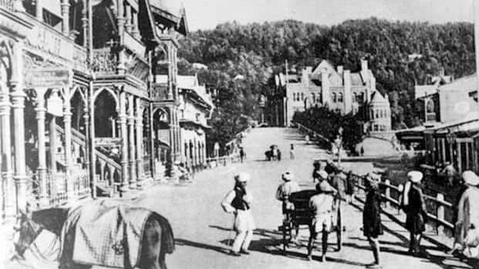
Simla (Shimla) under the Raj

Slide 4
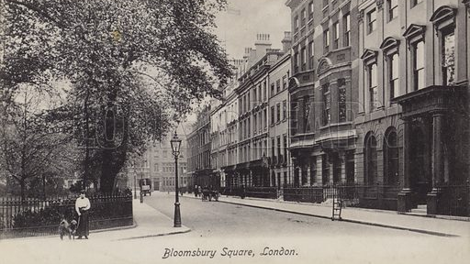
Bloomsbury, London

Slide 5
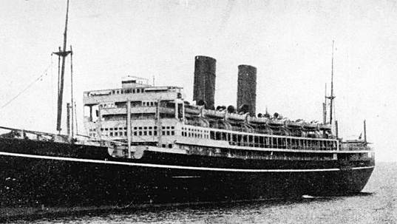
SS Viceroy of India

Slide 6
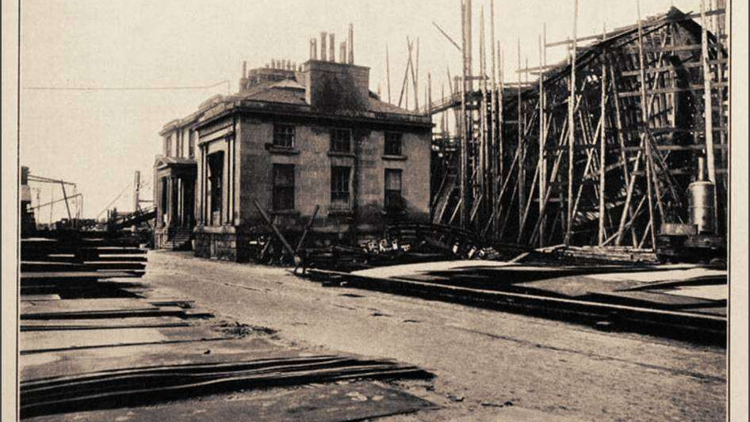
Alexander Stephens and Sons, Clydeside

Slide 7
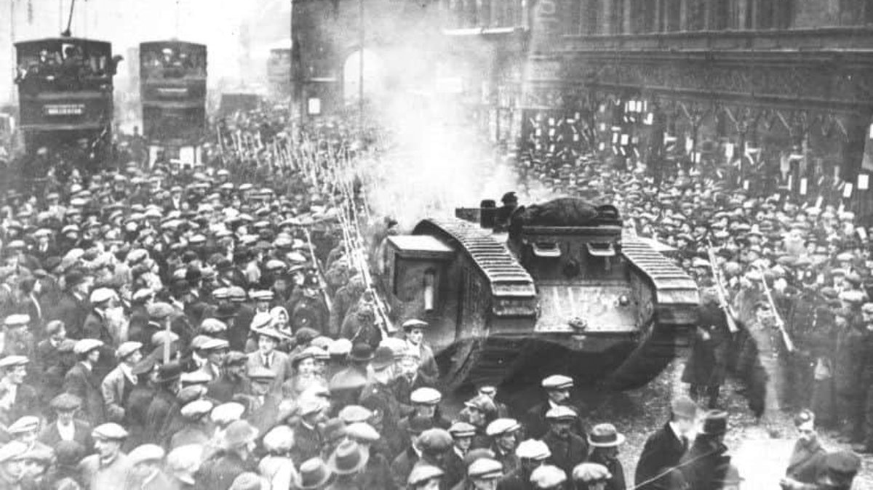

Slide 8
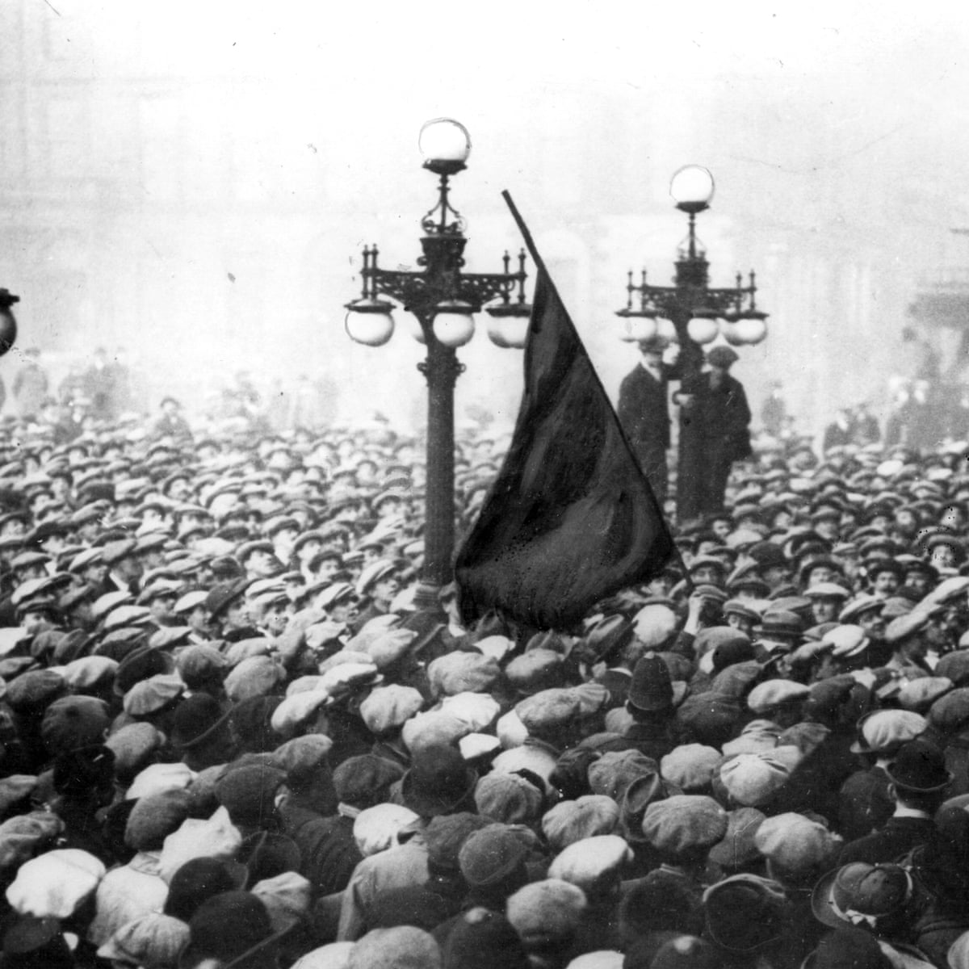
George Square, Glasgow, January 1919

Slide 9
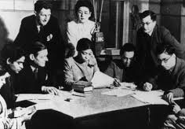
Katerina Clark: “In the London of the 1920s, he became something of a darling of the Bloomsbury set and other Modernists, including Virginia and Leonard Woolf, Lytton Strachey, T. S. Eliot, D. H. Lawrence, and E. M. Forster.” (“Indian Leftist Writers of the 1930s…”)

Slide 10
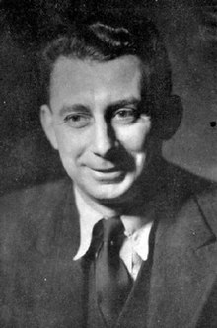


Slide 11
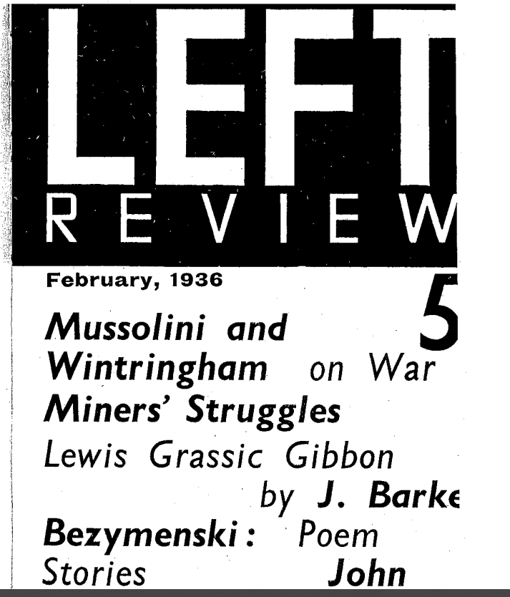
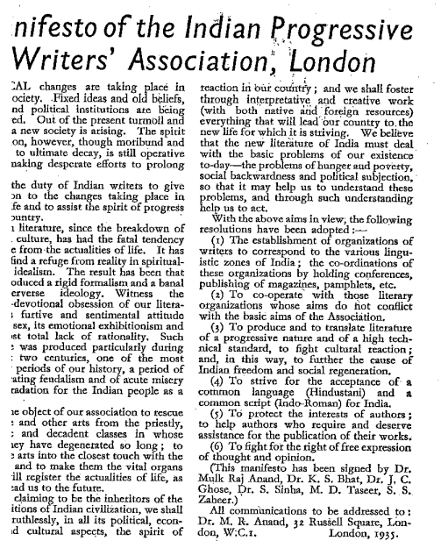


Slide 12
SIMLA – BLOOMSBURY – MOSCOW

Slide 13
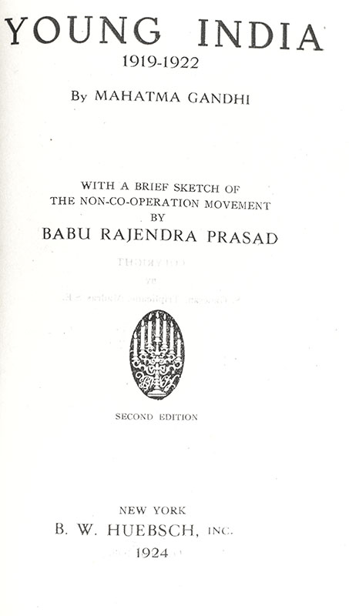
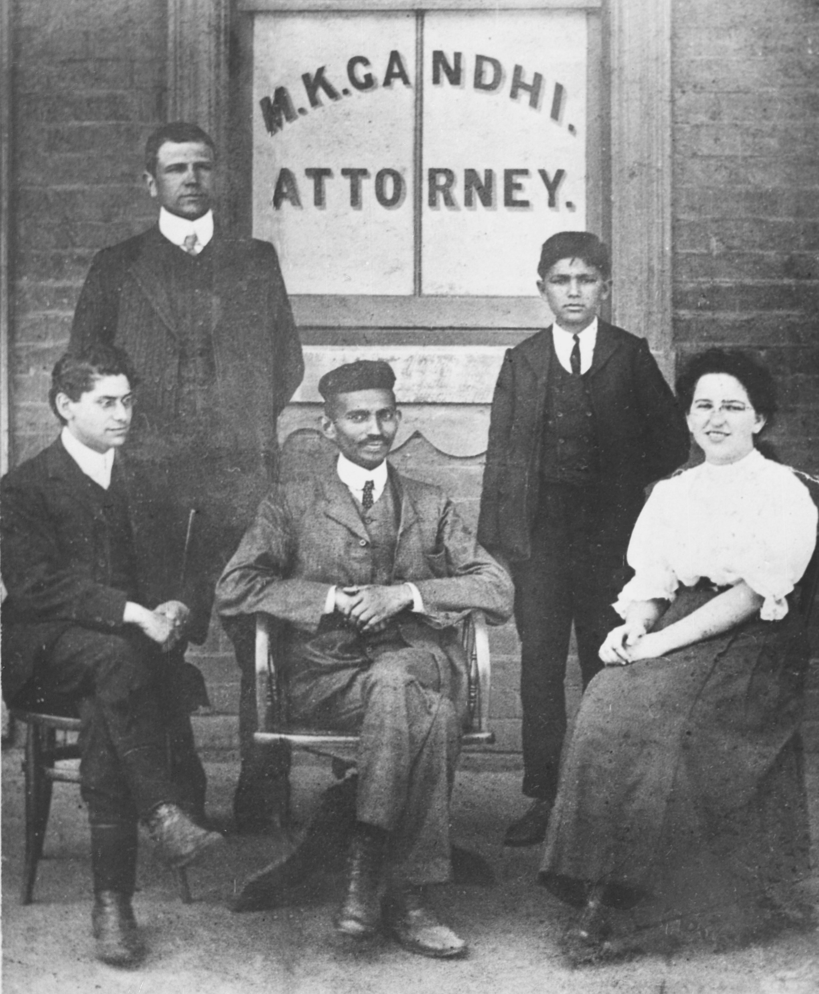

Slide 14
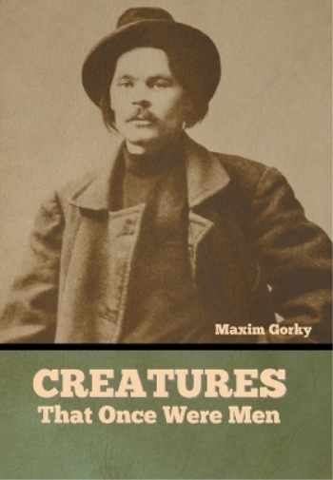

Slide 15
Anand in “On the Genesis of Untouchable”: “During a long weekend in the early Twenties in Dublin, in the novella, then called Bakha, I had before me the model of the novel form as it had grown in the hands of a modern writer, James Joyce, in his A Portrait of the Artist as a Young Man, especially as he revealed Stephen Daedalus and the other characters through their streams of consciousness, without resort to biographical commentary.”

Slide 16
“Passing through the huge brick-built gate of the town into the main street, he was engulfed in a sea of colour [. . .] and he couldn’t help being swept away by the sensations that crowded in on him from every side. He followed the curves of the winding, irregular streets lined on each side with shops, covered with canvas or jute awnings and topped by projecting domed balconies. He became deeply engrossed in the things that were displayed for sale, and in the various people who thronged around them. His first sensation of the bazaar was of its smell, a pleasant aroma oozing from so many unpleasant things, drains, grains, fresh and decaying vegetables, spices, men and women and asafœtida. Then it was the kaleidoscope of colours, the red, the orange, the purple of the fruit in the tiers of baskets which were arranged around the Peshawari fruit-seller, dressed in a blue silk turban, a scarlet velvet waistcoat, embroidered with gold, a long white tunic and trousers; the gory red of the mutton hanging beside the butcher who was himself busy mincing meat on a log of wood, while his assistants roasted it on skewers over a charcoal fire, or fried it in the black iron pan; [. . .]. [He] drifted in his unconscious happiness towards the cloth shop where a big-bellied lalla (Hindu gentleman), clad in an immaculately white loose muslin shirt, and loin-cloth was busy writing in curious hieroglyphics on a scroll book bound in ochre-coloured canvas, while his assistants unrolled bundles of Manchester cloth one after another, for inspection by an old couple from a village, talking incessantly the while of the ‘tintint ’ and ‘matchint,’ just to impress the rustics into buying.” (34-35)

Slide 17
“The vagaries of Bakha’s naïve tastes can be both explained and excused. He didn’t like his home, his street, his town, because he had been to work at the Tommies’ barracks, and obtained glimpses of another world, strange and beautiful; he had grown out of his native shoes into the ammunition boots that he had secured as a gift. And with this and other strange and exotic items of dress he had built up a new world, which was commendable, if for nothing else, because it represented a change from the old ossified order and the stagnating conventions of the life to which he was born.” (66)

Slide 18
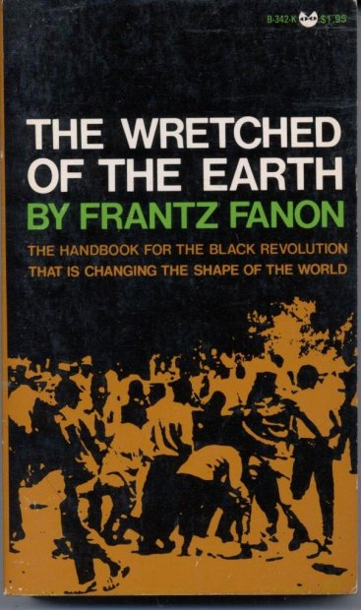
“The settler’s town is a strongly-built town, all made of stone and steel. It is a brightly-lit town; the streets are covered with asphalt, and the garbage-cans swallow all the leavings, unseen, unknown and hardly thought about. [. . .] The town belonging to the colonized people, [. . .] the Negro village, the medina, the reservation, is a place of ill fame, peopled by men of evil repute. [. . .] It is a world without spaciousness; men live there on top of each other, and their huts are built one on top of the other.” (Frantz Fanon, The Wretched of the Earth, 30)
“They think we are mere dirt because we clean their dirt” (67)

Slide 19


