Slide 1
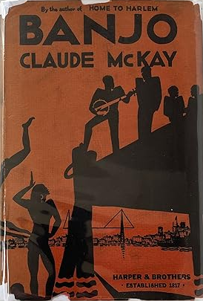
https://www.youtube.com/watch?v=YXr4ZpkhTgE
https://www.youtube.com/watch?v=dIwHWZQT16M

Slide 2
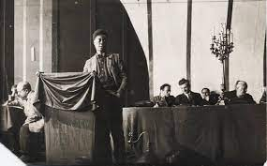
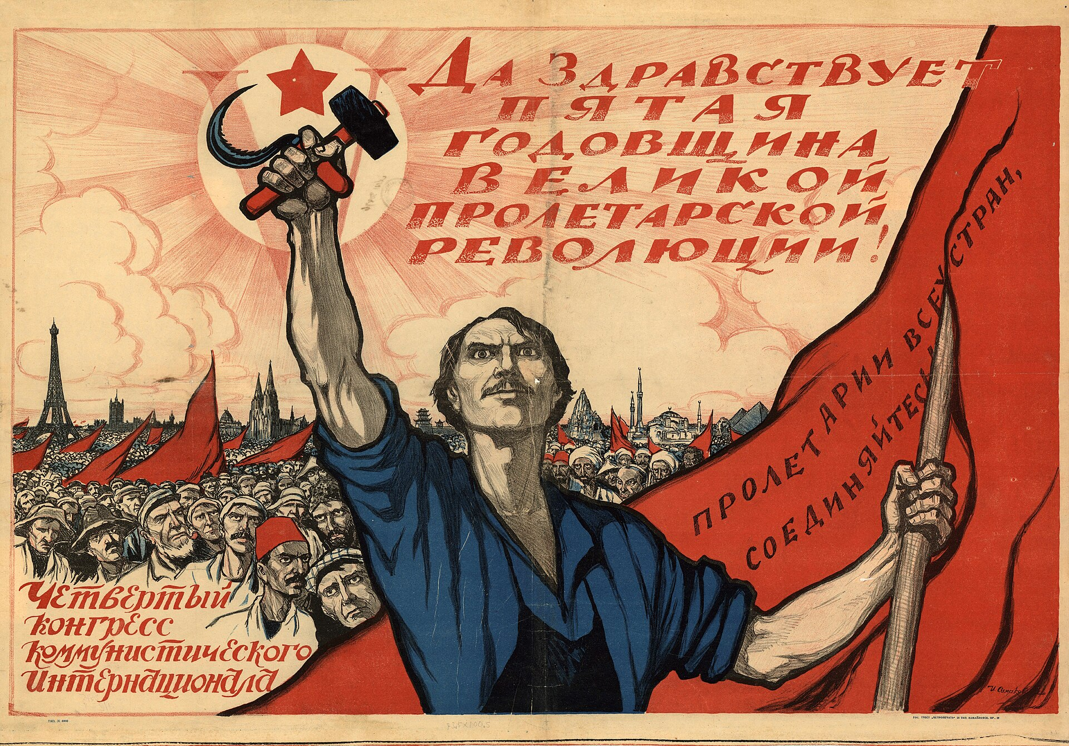
The resolution called for “the ‘Theses on the National and Colonial Question’ to be applied by its members to the situation of Black people; the support the any Black movement that ‘undermines or weakens capitalism or places barriers’ to its further expansion; the struggle for ‘equality of the white and black races, and for equal wages and equal political and social rights’; the use of its powers to ‘compel’ the trade unions to accept Black members and to organize Black workers in their own unions if necessary; and the Comintern to organize a congress of Black peoples in Moscow” (Winston James, “The the East Turn,” American Historical Review (September 2021), 1028).

Slide 3
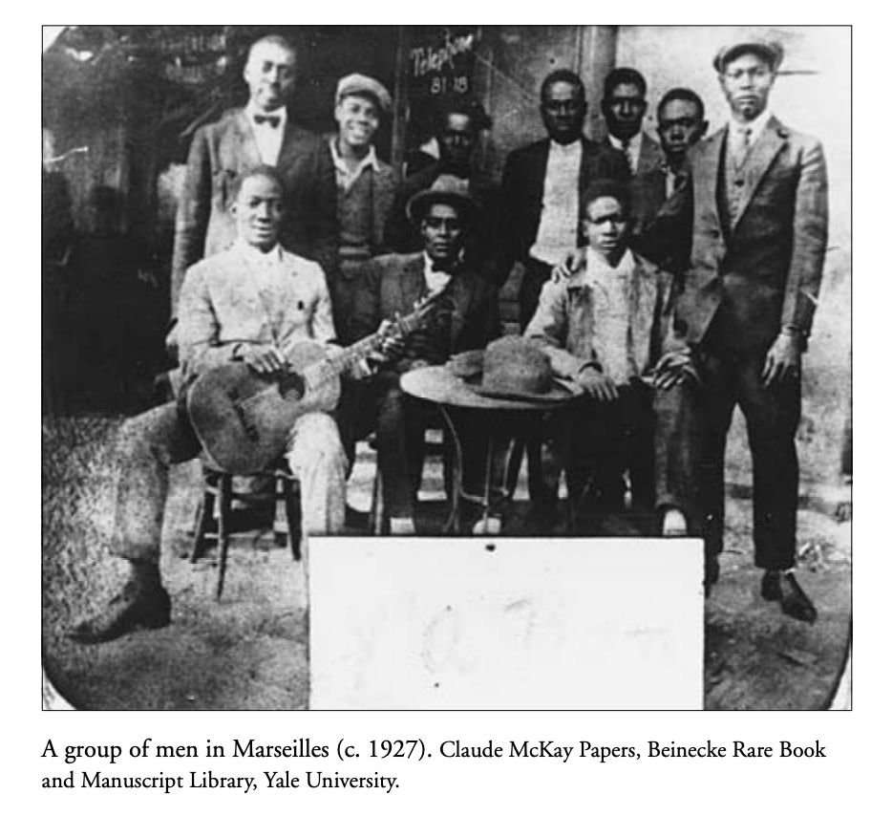
“Over two decades and in the midst of urban riots and upheavals, these port cities had attracted millions of migrants, some from rural hinterlands, others from across oceans, most bringing songs, instruments, rhythms, and dances to play in the city’s streets, taverns, and dance halls. […] this noise uprising was prophetic: it not only preceded but prepared the way for the decolonization of legistlatures and literatures ” Michael Denning, Noise Uprising, 6, 9.

Slide 4

“vagabonds, discharged soldiers, discharged criminals,escaped galley slaves, swindlers, confidence tricksters, lazzaroni, pick-pockets, slight-of-hand experts, gamblers, maquereaux, brothel-keepers, porters, pen-pushers, organ-grinders, rag-and-bone merchants,knife-grinders, tinkers, and beggars: in short, the whole indetermi-nate mass, tossed backwards and forwards, which the French call labohème”
Karl Marx, “The Eighteenth Brumaire of Louis Bonaparte” (1852)

Slide 5
“They were all on the beach, and there were many others besides them – white men, brown men, black men. Finns, Poles, Italians, Slavs, Maltese, Indians, Negroids, African Negroes, West Indian Negroes – deportees from American for violation of the United States immigration laws – afraid and ashamed to go back to their own lands, all dumped down in the great Provençal port, bumming a day’s work, a meal, a drink, existing from hand to mouth, anyhow any way, between box car, tramp ship, bistro, and bordel” (6)
“If the aspect of the town itself was harsh and forbidding, the docks were of inexhaustible interest. There any day [Ray] might meet with picturesque proletarians from far waters whose names were warm with romance: the Caribbean, the Gulf of Guinea, the Persian Gulf, the Bay of Bengal, the China Seas, the Indian Archipelago. And, oh the earthy mingled smells of the docks! Grain from Canada, riche from India, rubber from the Congo, tea from China, brown sugar from Cuba, bananas from Guinea, lumber from the Soudan, coffee from Brazil, skins from the Argentine, palm-oil from Nigeria, pimento from Jamaica, wool from Australia, oranges from Spain and oranges from Jerusalem. In piled-up boxes, bags, and barrels, some broken, dropping their stuff on the docks, reposing in the warm odor of their rich perfumes – the fine harvest of all the lands of the earth” (67)

Slide 6
Harlem Renaissance

Slide 7
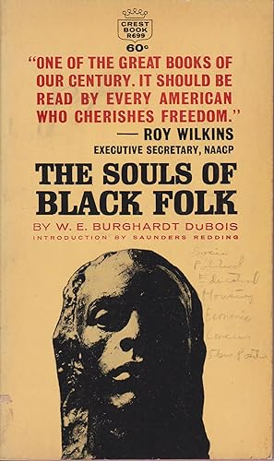
“Work, culture, liberty,–all these we need, not singly but together, not successively but together, each growing and aiding each, and all striving toward that vaster ideal that swims before the Negro people, the ideal of human brotherhood, gained through the unifying ideal of Race; the ideal of fostering and developing the traits and talents of the Negro, not in opposition to or contempt for other races, but rather in large conformity to the greater ideals of the American Republic, in order that some day on American soil two world-races may give each to each those characteristics both so sadly lack.”
-W.E.B DuBois “Of Our Spiritual Strivings,” The Souls of Black Folk, 1902.

Slide 8
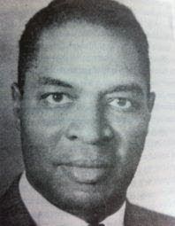
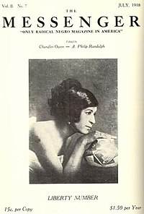
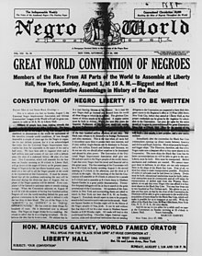
Claude McKay
WA Domingo
Marcus Garvey

Slide 9
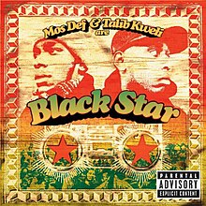
Taloufa’s “gone Back-to-Africa. He thinks colored people scattered all over the world should come together and go Back-to-Africa. He bought a hundred dollars of Black Star Line shares’
‘He did!’ exclaimed Banjo. ‘And what does he think now they got the fat block a that black swindler in the jail-house?’” (90)

Slide 10
Jacob Lawrence’s Great Migration Series (1941)

Slide 11
Zora Neale Hurston
Ralph Ellison
Richard Wright

Slide 12
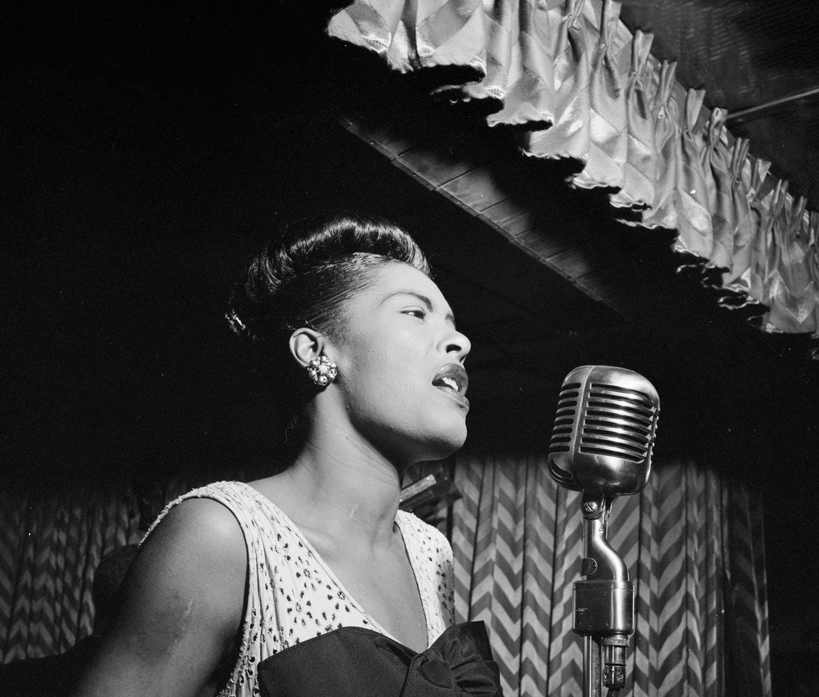
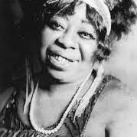
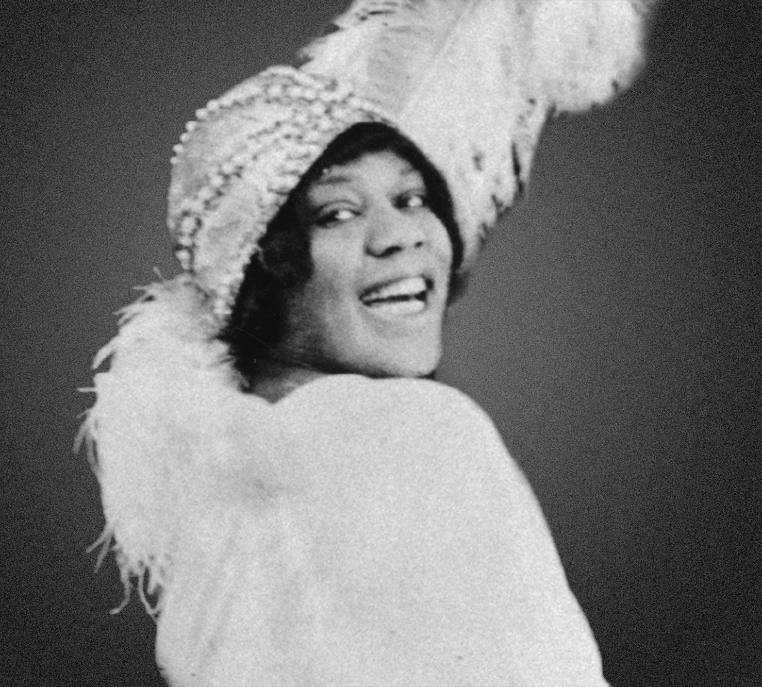
Billie Holiday
Ma Rainey
“Ma Rainey, Bessie Smith and Billie Holiday’s performances offered a “rich terrain for examining a historical feminist consciousness that reflected the lives of working-class black communities. That their aesthetic representations of the politics of gender and sexuality are informed by and interwove with their representations of race and class makes their work all the more provocative” (Angela Davis, Blues Legacies and Black Feminism, Knopf, 2011, pp. xv)
Bessie Smith

Slide 13
Preaching the Blues (Bessie Smith)
Down in Atlanta, GA, under the viaduct ev’ry
day,
drinking corn and Hollerin' hooray
Pianos playing till the break of day But as I turned my head, I loudly said, "Preach 'em blues, sing them blues"
They certainly sound good to me
I've been in love for the last six months and ain't done worrying yet
Moan them blues, holler them blues
Let me convert your soul
'Cause just a little spirit of the blues tonight
Let me tell you, girls, that your man ain't treating you right
Let me tell you I don't mean no wrong
I will learn you something if you listen to this song
I ain't here to try to save your soul, just want to teach you how to save Your good jelly roll
Going on down the line a little further now
There's many a poor woman down
Read on down to chapter nine,
Woman must learn how to take their time
Read on down to chapter ten,
Taking other women's men, you are doing a sin Sing'em, sing'em, sing them blues
Let me convert your soul
Now one sister by the name of Sister Green Jumped up and done a shimmy you ain't never seen Sing'em, sing'em, sing them blues
Let me convert your soul

Slide 14
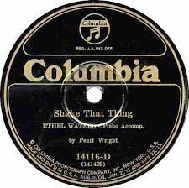
“Sing, Banjo! Play, Banjo! Here I is, Big Boss, keeping step, sure step, right long with you in some sort a ways. He-ho, Banjo! Play that thing! Shale that thing!
‘Old brother Mose is sick in bed.
Doctor says he is almost dead.
From shaking that thing, shaking that thing.
He was a jelloy-roll king. Oh shake that thing!’
[…]
[…] It roused an Arab-black girl from Algeria into a shaking-mad mood. And she jazzed right ot into the center of the floor and shook herself in a low-down African shimmying way
[…]
Handsome, happy brutes. The music is on again. The Senegalese boys crowd the floor, dancing with one another. They dance better male with male or individually, than with the girls, putting more power in their feet, dancing more wildly, more natively, more savagely. Senegalese in blue overalls, Madagascan soldiers in khaki, dancing together. A Martiniquan with his mulattress flashing her gold teeth. A Senegalese sergeant goes round with his fair blond. A Congo boxer struts it with his Marguerite” (“Jelly Roll”)

Slide 15
“‘Garvey was good for all Negroes,’ the barkeeper turned upon Banjo, ‘Negroes in America and in Europe and in Africa. You don’t know what you’re talking about. Why, the French and the British were keeping the Negro World, Garvey’s newspaper, out of Africa. It was because Garvey was getting to o big that they got him.’
‘There was nothing big left to him, if you ask me,’ said Banjo. ‘I guess he thought like you, that he was Moses or Napoleon or Frederick Douglass, but he was nothing but a fall, big-mouth nigger”’ (77)

Slide 16
Goosey: “ ‘No. Banjo is bondage. It’s the instrument of slavery. Banjo is Dixie. The Dixie of the land of cotton and massa and missus and black mammy. We colored folks have got to get away from all that in these enlightened progressive days. Let us play piano and violen, harp and flute. Let the white folks play the bajo if they want to keep on remembering all the Black Joes signing and the hell they made them live in.’
‘That ain’t got nothing to do with me, nigger,’ replied Banjo. ‘I play that theah instrument becaz I likes it. I don’t play no Black Joe hymns. I play lively tunes. All that you talking about slavery and bondage ain’t got nothing to do with our starting up a li’l orchestry’ […]
‘Hmm’ Goosey reflected a little. ‘I’m a race man’” (90)
*
Goosey: ‘But since you’re a Negro, wouldn’t it be a good thing for the race if the best Negroes appreciate what you write?’
Ray ‘The best Negroes are not the society Negroes. I am not writing for them, nor the poke-chop-abstaining Negroes, nor the Puritan Friends of Color, nor the Negrophobes nor the Negrophiles. I am writing for people who can stand a real story no matter where it comes from’” (117)

Slide 17
Ray and Banjo
“Banjo was a great vagabond of lowly life. He was a child of the Cotton Belt, but he had wandered all over America. His life was a dream of vagabondage that he was perpetually pursuing and realizing in odd ways, always incomplete but never unsatisfactory. He had worked at all the easily-picked-up jobs – longshoreman, porter, factory worker, farm hand, seaman […] Banjo’s tramp was a casual one. So much so that it was four months and nineteen days after sailing down through the Panama Canal to New Zealand and Australia, cruising cargo around the island continent and up along the coast of Africa, before his dirty overworked ‘broad’ reached the port of Marseilles ” (11)
“Ray laughed. Banjo’s rich Dixie accent went to his head like old wine and reminded him happily of Jake. He had seen Banjo before with Malty and company on the breakwater, but had not yet made contact with any of them. Since he had turned his back on Harlem he had done much voyaging sometimes making a prolonged stay in a port whose aspect had taken his imagination” (64)
“In America he had lived like a vagabond poet, erect in the racket and rush and terror of that stupendous young creation of cement and steel, determined, courageous and proud in his sweaty skin, quitting jobs when he wanted to go on a adream wish or a love drunk, without being beholden to anybody. […] More and more the urge to write was holding him with an enslaving grip and he was beginning to feel that any means of achieving self-expression was justifiable. Not without compunction”Tolstoy was his ideal of the artist as a man and remained for him the most wonderful example of one who balanced his creative work by a life lived out to its full illogical end” (65)

Slide 18
Internationalism and Solidarity
“All shades of Negroes came together there. Even the mulattoes took a step down from their perch to mix in. For, as in the British West Indies and South Africa, the mulattoes of the French colonies do not usually intermingle with the blacks. But the magic had brought them all together to shake that thing and drink red wine, white wine, sweet wine. All the British West African blacks, Portuguese blacks, American blacks, all who had drifted into this port that the world goes through” (46)
“They played the ‘beguin,’ which was just a Martinique variant of the ‘jelly-roll’ or the Jamaican ‘burru’ or the Senegalese ‘bombé.’” (105)
Banjo “gave the boys twenty-five francs apiece. Dividing up was a beach boys’ rite. It didn’t matter what share of the spoils the lucky beggar kept for himself, so long as he fortified the spirit of solidarity by sharing some of it with the gang” (158)
“The sentiment of patriotism was not one of Ray’s possessions, perhaps because he was a child of deracinated ancestry. To him it was a poisonous seed that had, of course, been planted in his child’s mind, but happily, not having any traditional soil to nourish it, had died out with other weeds of the curricula of education in the light of mature thought. It seemed a most unnatural thing to him for a man to love a nation – a swarming hive of human beings bartering, competing, exploiting, lying, cheating, battling, suppressing, and killing among themselves; possessing, too, the faculty to organize their villainous rivalries into a monstrous system for plundering weaker peoples” (137)
“It was no superior condescension, no feeling of race solidarity of Back-to-Africa demonstration – no patriotic effort whatsoever – that made Ray love the environment of the command black drifters. He loved it with the poetical enthusiasm of the vagabond black that he himself was. After all, he had himself lived the rough-and-tumble laboring life, and the most precious souvenirs of it were the joyful friendships that he had made among his pals. There was no intellectual friendship to be compared with them” (202)

Slide 19
Consciousness and Instinct
“It was easy enough for Banjo, who in all matters acted instinctively. But it was not easy for a Negro with an intellect standing watch over his native instincts to take his own way in this white man’s civilization. But of one thing he was resolved: civilization would not take the love of color, joy, beauty, vitality, and nobility out of his life and make him like one of the poor mass of its creatures. Before he was aware of what was the big drift of this Occidental life he had fought against it instinctively, and now that he had grown and broadened and knew it better, he could bring intellect to the aid of the protest. Could he not see what Anglo-Saxon standards were doing to some of the world’s most interesting peoples? Some Jews ashamed of being Jews […] Educated Negroes ashamed of their race’s intuitive love of color, wrapping themselves up in respectable gray, ashamed of Congo-sounding laughter, ashamed of their complexion (bleaching out), ashamed of their strong appetites. No being ashamed for Ray. Rather than lose his soul, let intellect go to hell and live instinct” (165)

