Slide 1
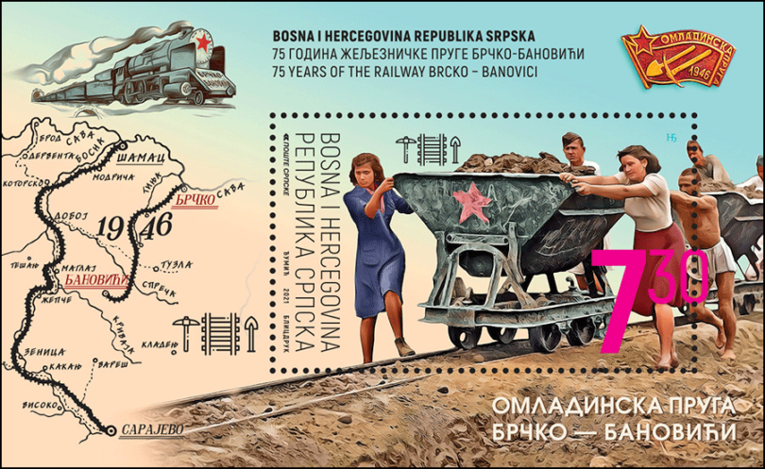
https://vimeo.com/810177597
Sunny Railways and The Railway:
An Adventure in Construction
Global Literary Radicalism

Slide 2
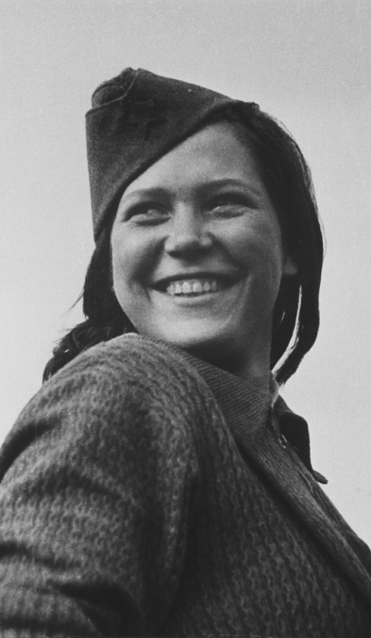
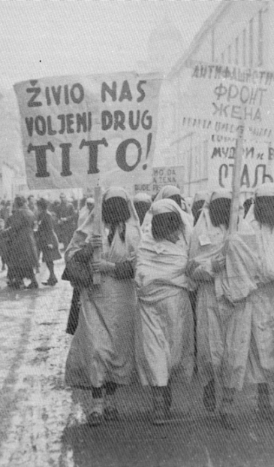
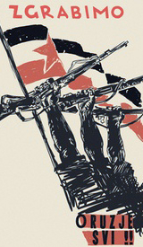

Slide 3
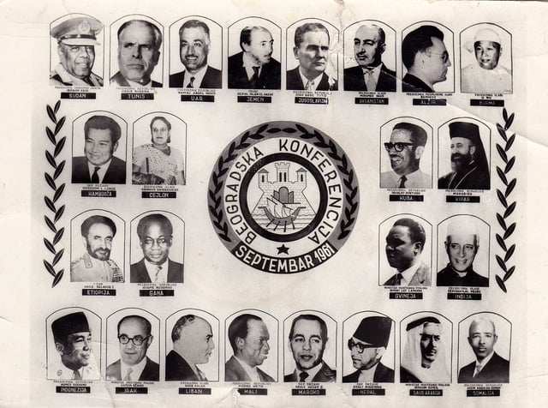

Slide 4
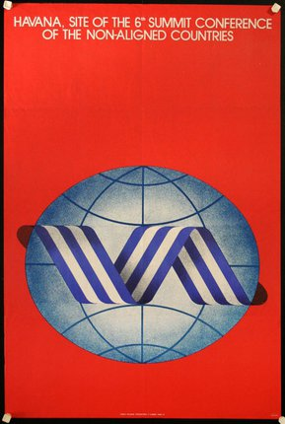

Slide 5
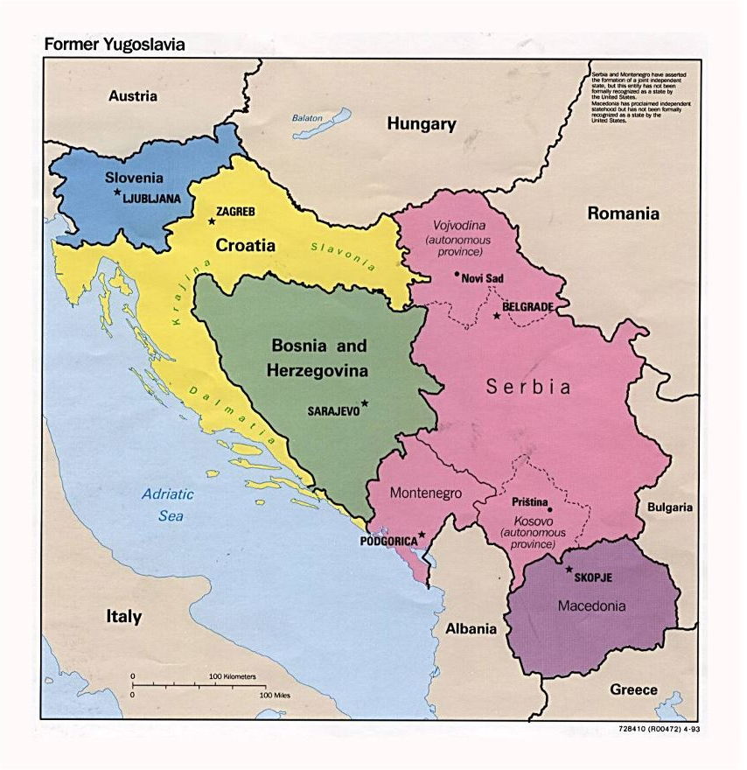
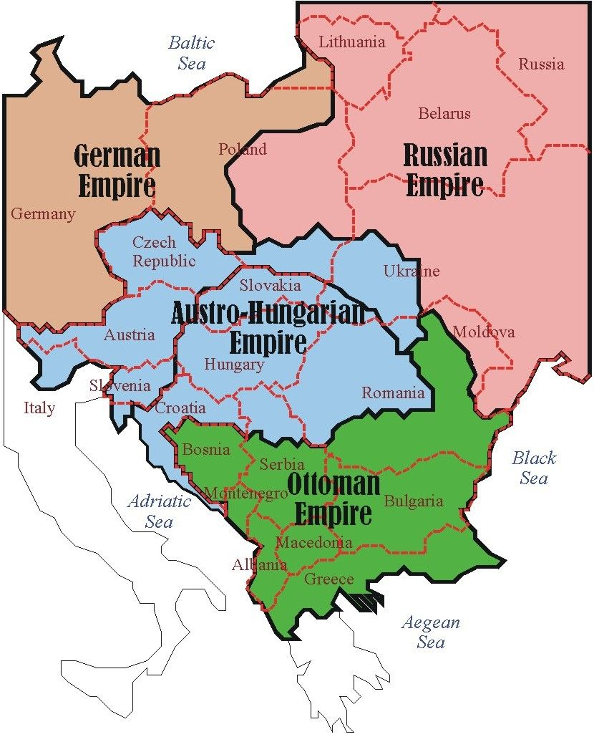

Slide 6
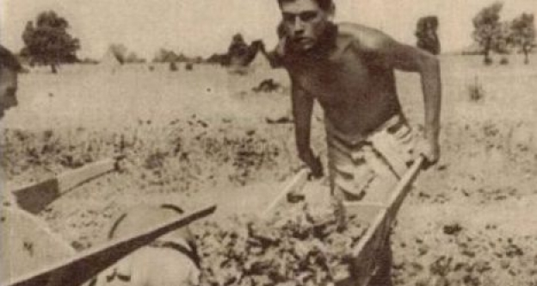
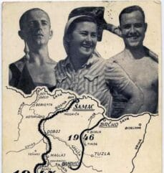
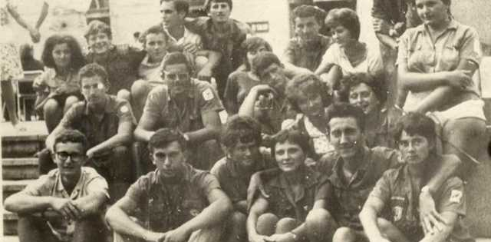

Slide 7
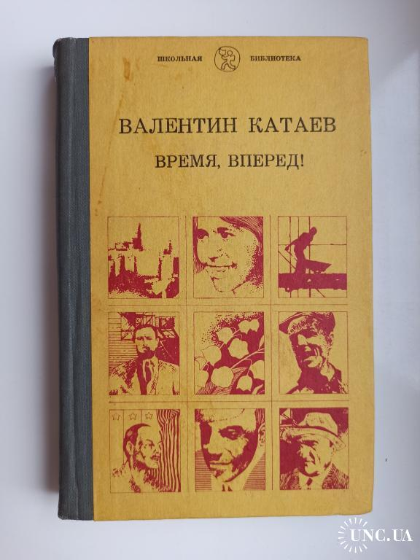
“Figures with barrows ran in all directions over the brightly illuminated planking. […] The rhythm was calculated with precision to one second, and the brigade worked like a clock.
A barrow of grave.
A barrow of cement.
A barrow of sand.
‘Scoop and water!’
One turn of the lever. Now the scoop and the water fell simultaneously with one motion of the arm” (289-29)

Slide 8
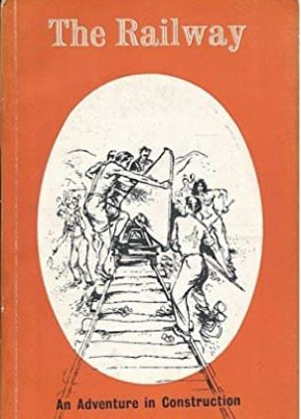
“The old Austrian-controlled companies which built much of Yugoslavia’s pre-war railway system might have completed this work in nine years. The Youth Railway was started on the 1st of May, 1947 and the first train ran from Samac to Sarajevo on the 15th of November. This work was carried through, night and day, by volunteers between the ages of 16 and 25 – young men and women from industry, university students, boys and girls from schools and peasant farms. The great bridge over the Saca at Samac was built, ahead of schedule, by engineering students and disabled ex-servicemen and ex-partisans. Many of these young men and women had lost one of their limbs in the war. Vranduk tunnel was built ahead of schedule. Among the workers who built it were young peasants, mining students from Belgrade, young refugees from the terror in Greece […] The workers had compressors and drills, dynamite, tip-wagons, mining equipment. But most of the work went on without supervision and with only the most primitive tools – care hands, picks, spades, heavy wheelbarrows. And the work was always finished ahead of schedule.
The work was driven forward, not by threats or by personal incentives, but by songs and an amazing spirit of co-operative will.” (viii-ix)

Slide 9
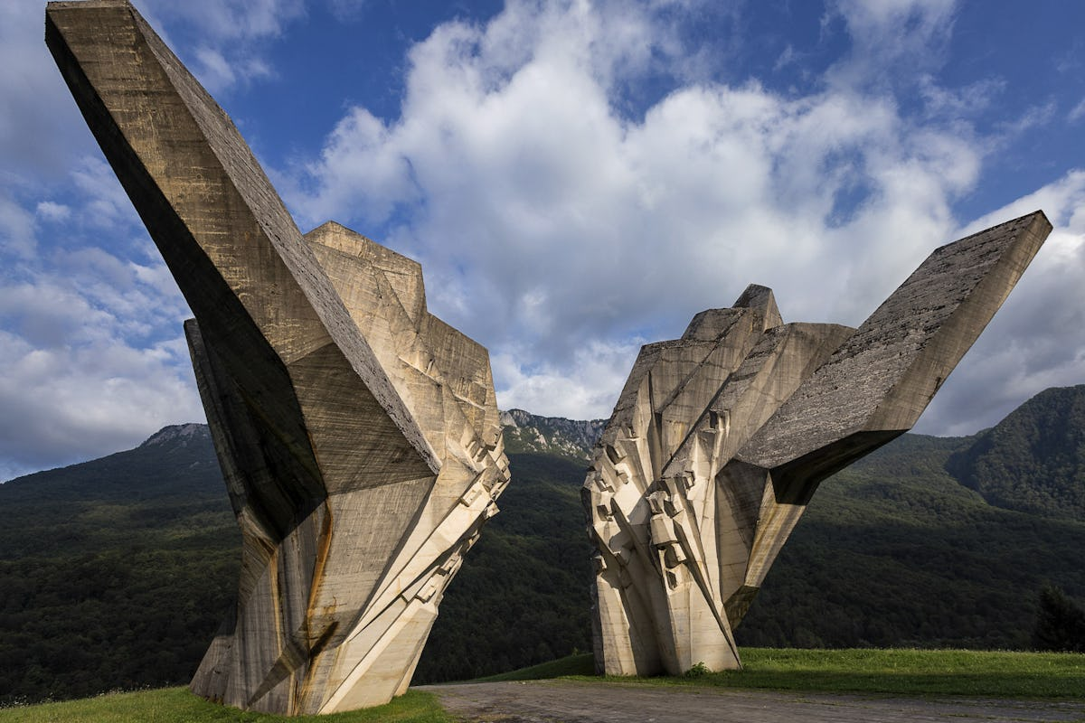
“With the collapse of multinational Yugoslavia, the process began of confiscating the Yugoslav collective memory and its replacement by the construct of national memory. The war simply speeded up the process and radicalized the measures. Today, it seems, the work has been success- fully completed: one memory has been erased in order to establish another”
(Dubravka Ugresic, "The confiscation of memory." New Left Review 218 (1996), 34)

