Slide 1
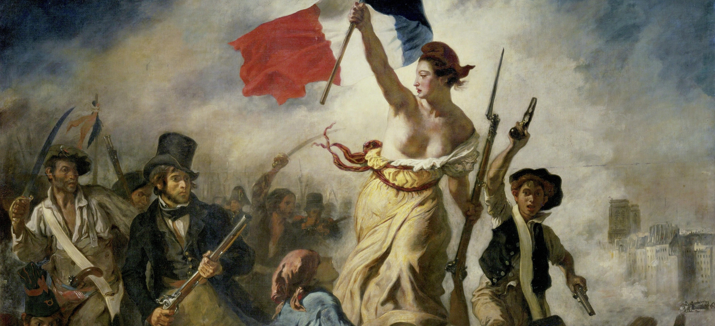
Summer Will Show
Global Literary Radicalisms

Slide 2
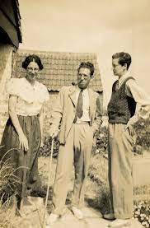

Slide 3
“She had arranged her mind before his coming, telling herself that black blood is stronger than that of the white races, that the boy would bear little or no resemblance to Julius, and might well be no more than a woolly negro. But the boy who stepped from the carriage and walked towards her up the sunlit steps might have come, not from any surmisable country, but from a star, and before his extreme beauty and grace she felt her mouth opening like that of any bumpkin” (34)

Slide 4
“ ‘Children do die hereabouts,’ he said. ‘There’s the smallpox, and the typhus, and the cholera […] Plenty of things for children to die of […] Plenty more children, they say, where the dead ones came from. If they die like cattle, the poor, they breed like cattle too” (81-2).
“Fate should not defeat her. She would have a child yet. And having already a husband it was certainly best and most convenient that the child should be his. So she would go to Paris, fetch Frederick back if needs be, beguile him, at the barerst, explain her purpose and strike a bargain. As other women could trudge of to the lime-kiln, Mrs. Willoughby might go to Paris […] As other people go to Paris to buy gloves, she was going to Paris to bargain for a. child” (84/90)

Slide 5
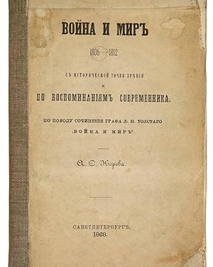
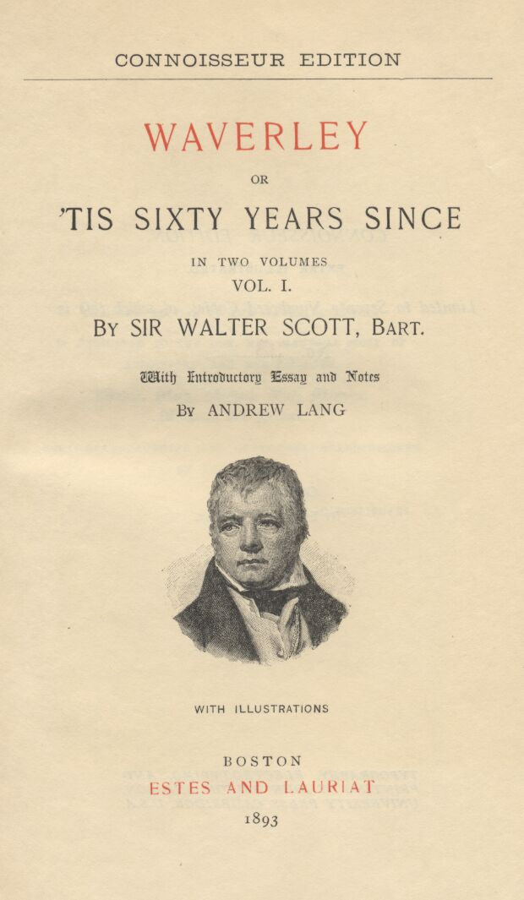
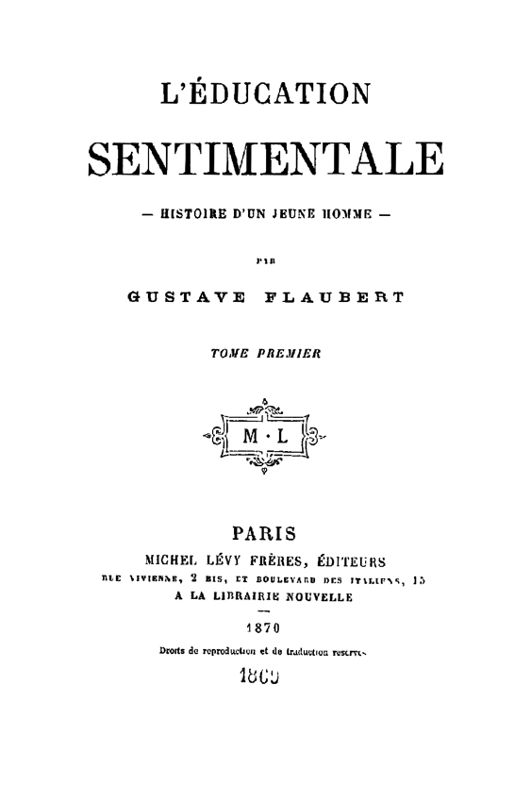
The historical novel emerges from the “French revolution, the revolutionary wars and the rise and fall of Napoleon, which for the first time made history a mass experience, and moreover on a European scale” (Georg Lukacs The Historical Novel, Beacon Press, 1962 [1937], 23)
The historical novel, Lukacs writes “portray[s] how historical necessity asserts itself […] through the passionate action of individuals, but often against their individual psychology, in showing how this necessity has its roots in the real social and economic basis of popular life.”
The heroes of these novels are not themselves the great men who appear to make history (e.g. Napoleon), but rather “a more or less mediocre, average [man…] who generally possesses a certain, though never outstanding, degree of practical intelligence, a certain moral fortitude and decency when even rises to a capacity for self-sacrifice, but which never grows into a seeping human passion, is never enraptured to a great cause” (Lukacs 33)

Slide 6
“It is in the nature of a bourgeois revolution that, if seriously carried through to its conclusion, the national idea becomes the property of the broadest masses. In France it was only as a result of the Revolution and Napoleonic rule that a feeling of nationhood became the experience and property of the peasantry, the lower strata of the petty bourgeoisie and so on. For the first time they experienced France as their own country, as their self-created motherland” (Lukacs 25)

Slide 7
“Entering, her embarrassment had been given a final wrench by the impression that all the women were in full evening-dress; but now, among these islands of glittering silk and lace she noticed other figures, some habited, as she said to herself, ‘like artists,’ others patently of the working class. Immediately in front of her stood a bald-headed old gentleman, wearing a plaid rug over his shoulders. To her left looked down upon the polished shoulders and swaying fan of a ballroom elegant. Beside her was a Jewish boy, a hump-back, with a face that hunger had sharpened into a painful beauty. He had moved aside to make way for her and, seeing her flowers, had smiled. Otherwise no one seemed inclined to take the least notice of her” (95)

Slide 8
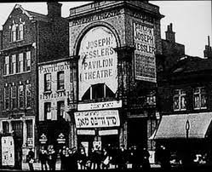
“Laura’s attraction to [London’s] East End, besides it being imbued with nonconformist, anti-establishment sensibilities within a working class milieu, it its Jewish identity and concomitant link with communism While the East End has long been associated with the proletariat, from dock to produce to sweatshop workers, Jews have also had a conspicuous presence in this section of the city, particularly with Russian Jews”
(June Dunn "Tracking Sylvia Townsend Warner's Red Footsteps in Lolly Willowes." The Journal of the Sylvia Townsend Warner Society 13.1 (2012).4)

Slide 9
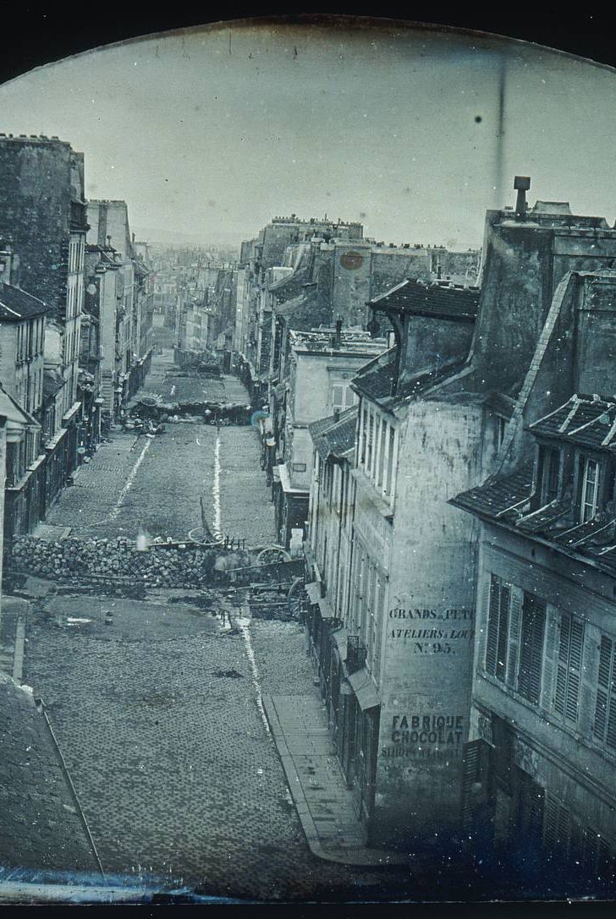
‘I shall not forget what I suffered in the priest’s house…’ But the stir at the back of the room, discretely swelling, had now arched itself into an enquiring silence. Into that silence broke a preliminary cough, and a dull snuffling voice said, ‘Excuse me, ladies and gentlemen. But the people in the street are demanding the carriages for their barricade,’ ‘What?’ Without animation the concierge repeated, ‘’The people in the street are demanding the carriages for their barricade.’ ‘Good God!’ exclaimed Frederick, speaking from the heart of England […] the lady with diamonds embraced Minna and cried out, ‘Ah, my dear! It has come at last, our revolution’” (112)
“With the cold air came the sound of voices, of picks striking upon stone. From the balcony they could look down upon the barricade a-building. Already it stretched almost across the street, a random barrier of sawn-off boughs bristling, tables and chairs piled together, a cab or two (Stanislas seemed to have preserved the carriage), a mangle and a bedstead. Round it was a group of men, some busy uprooting the paving-stones, others artistically rearranging the confusion of boughs and bedsteads, like demented furniture-removers. Except for these, the street was empty” (116)

Slide 10
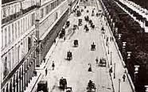
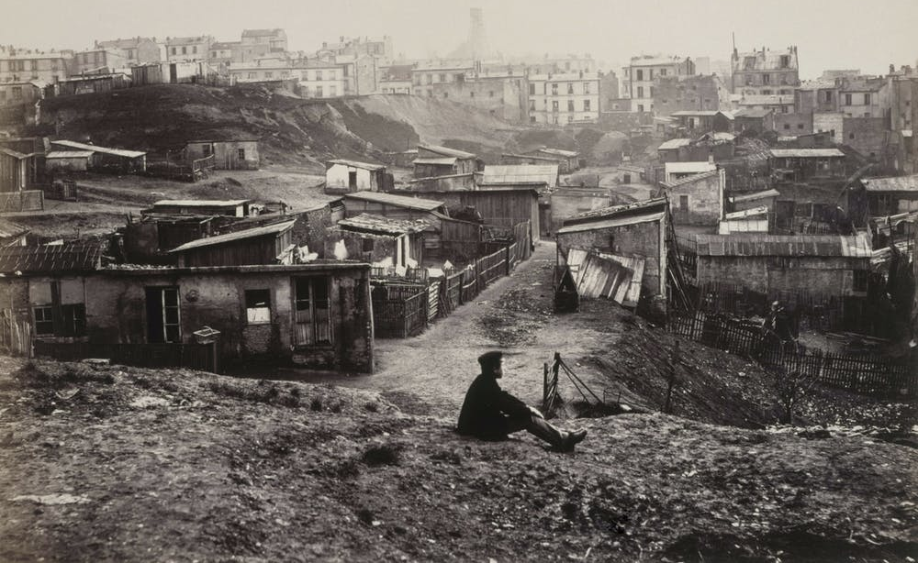
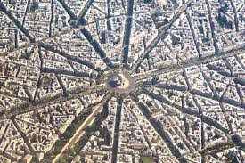

Slide 11
Timeline of 1848 Revolution
February 1848 Parisians overthrew King Louis Philippe during three days of street fighting
February 24 1848 Insurgents proclaimed the Second French Republic. Provisional Government establishes itself and passes decrees for: the elections for a Constituent Assembly; freedom of the press, assembly and association; the abolition of the death penalty for political crimes; and most importantly the right to work. Provisional Government set up a program of National Workshops and a special Commission of Labour, under the direction of the socialist Louis Blanc
February-April 1848 Explosions of radical newspapers and pamphlets, revolutionary clubs.
Easter Sunday, April 23 National elections are held. In the cities revolutionary candidates are elected, but in the provinces conservative candidates, traditional elites, and royalists win. Creates a conflict between Paris and the provinces and between the radical democrats and the conservative majority in the National Assembly.
June 1848 Conservative majority in the assembly decree the end of the National Workshops and place all members of the Workshops on call for army duty in the provinces in what is understood as a call to war.
June 22 barricades erected in the working-class quarters of Paris and four days of “the bloodiest street fighting that Paris had ever known” follows. 3000-4500 insurgents are killed.
June 24 Insurrection was put down. An estimated 1,500 insurgents were executed without trial
December 1848 Louis-Napoleon Bonaparte (nephew of Napoleon Bonaparte) wins the presidential election
December 2 1851 Louis Napoleon staged a carefully planned coup d’état, suspended the republican constitution, and assumed dictatorial powers. A year later, he had himself proclaimed Emperor and began a reign that would last until 1870 with the Paris Commune
All information taken from Beecher, Jonathan. Writers and Revolution: Intellectuals and the French Revolution of 1848. Cambridge University Press, 2021.

Slide 12
“ ‘Take the truth with it, then. It is not as you think, a you have every right to think. I am not trying to pay off Frederick’s arrears of honour. When I set out to find you, an hour ago, I thought I was. I was in a rage, I had one of my impulses, I set off at once with all I had. It ought to convince you,’ she said wryly, ‘that this is not a mediated insult, since I bring so little. But now it seems to me that if any one has treated you shabbily, it is I. So it is only fit that the amends should be shabby too.’
She had spoken, staring at the floor, at the hem of Minna’s dress. Now, seeing it stirred, she looked up to say farewell. With the carriage of some one moving proudly through a dance Minna walked towards a collecting box labelled For the Polish Patriots. When the last coin had fallen through the slit she turned on Sophia with a look of brilliant happiness.
‘It was all that you had,’ she said, her voice smoothly quivering like water under the sun, ‘and there it goes. Vive la liberté!’
‘Vive la liberte!’’ answered Sophia.
For she was released, God knows how, and could praise liberty with a free mind. Somehow by that action, so inexplicable, unreasonably, and showy, Minna had revealed a new world” (175)

Slide 13
“With a queer glance, now, she looked on people of her own class. Not many such came into their quarter; but on forays into ‘that other Paris,’ as she learned to think of it, she saw them, elegant and lifeless as she had been; and sometimes when she was singing in the streets, such a one would pause for a moment, a fish-like wavering, a stare with glassy eyes, a compassionate glove, maybe, advanced. And her body would tighten with malice […] The decorum of class had gone, the probity of class had gone too” (235)

Slide 14
“He had changed almost beyond recognition: to her conscience, accusingly changed. He was lanky and overgrown; his clothes would have been too small for him if they had not given at every seam. His hair had been vilely chopped, and had out grown the chopping in grotesque tufts and drakes-tails; his knuckles were discoloured, his nails were broken, one of his teeth had been knocked out, the dusky grape-like bloom which had sat o his skin had been rubbed off, leaving nothing but a sallow complexion with spots. Only his honeyed voice and his rolling eyes declared him to be the Caspar who had played so prettily with Damian and Augusta” (240)

Slide 15
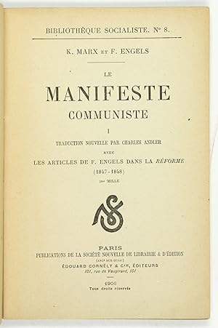
“A Spectre is haunting Europe – the spectre of Communism….”
She seated herself; and leaning her elbows on the table, and sinking her head in her hands, went on reading, obdurately attentive and by degrees absorbed” (329)

