Slide 1


Week 10: Sorry to Bother You

Slide 2

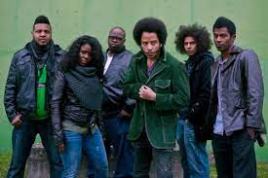
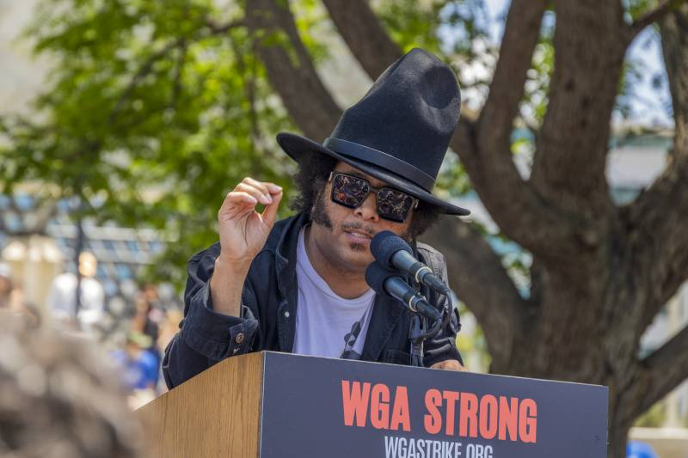

Slide 3
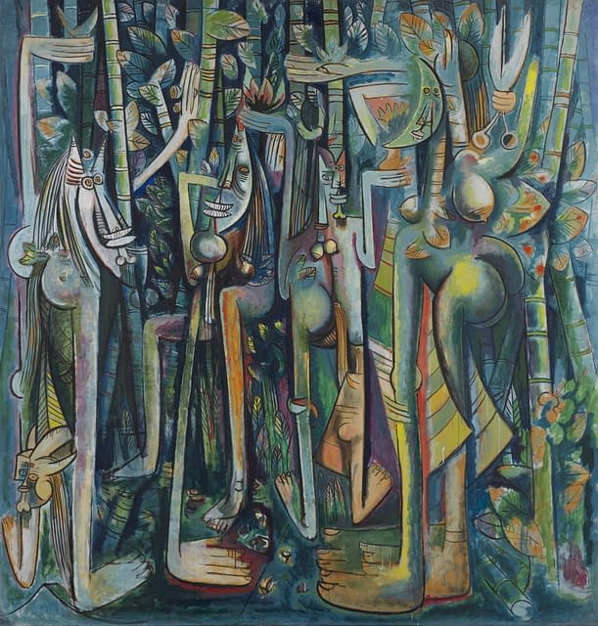
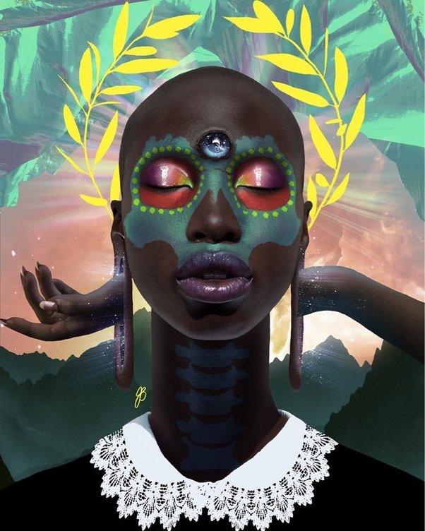

Slide 4
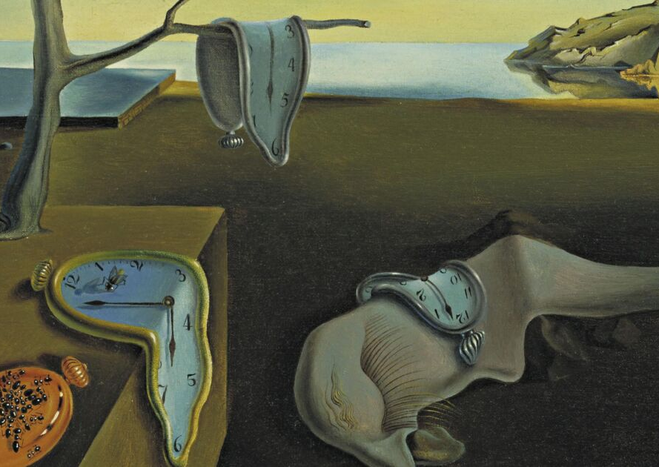
Britannica: “[Surrealism is a] movement in visual art and literature, flourishing in Europe between World Wars I and II. Surrealism grew principally out of the earlier Dada movement, which before World War I produced works of anti-art that deliberately defied reason; but Surrealism’s emphasis was not on negation but on positive expression. The movement represented a reaction against what its members saw as the destruction wrought by the “rationalism” that had guided European culture and politics in the past and that had culminated in the horrors of World War I. According to the major spokesman of the movement, the poet and critic André Breton, who published The Surrealist Manifesto in 1924, Surrealism was a means of reuniting conscious and unconscious realms of experience so completely that the world of dream and fantasy would be joined to the everyday rational world in “an absolute reality, a surreality.” Drawing heavily on theories adapted from Sigmund Freud, Breton saw the unconscious as the wellspring of the imagination. He defined genius in terms of accessibility to this normally untapped realm, which, he believed, could be attained by poets and painters alike.”

Slide 5
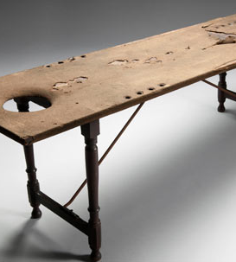


“The [surreal] image cannot be born from a comparison but from a juxtaposition of two more or less distant realities. The more the relationship between the two juxtaposed realities is distant and true, the stronger the image will be – the greater its emotional power and poetic reality.” (Pierre Reverdy, Nord-Sud, March 1918)
“… beautiful as the chance meeting on a dissecting table of a sewing machine and an umbrella” (Lautréamont)

Slide 6
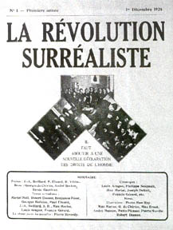
Robin Kelley, Freedom Dreams: “Surrealists frequently looked outside Europe for ideas and inspiration, turning most notably to the “primitives” under the heel of European colonialism. Indeed, what later became known as the Third World turned out to be the source of the surrealists’ politicization during the mid-1920s. The Paris Surrealist Group and the extreme Left of the French Communist Party were drawn together in 1925 by their support of Abd-el-Krim, leader of the Rif uprising against French colonialism in Morocco. In tracts like “Revolution Now and Forever!” the surrealists actively called for the overthrow of French colonial rule.” (159)

Slide 7
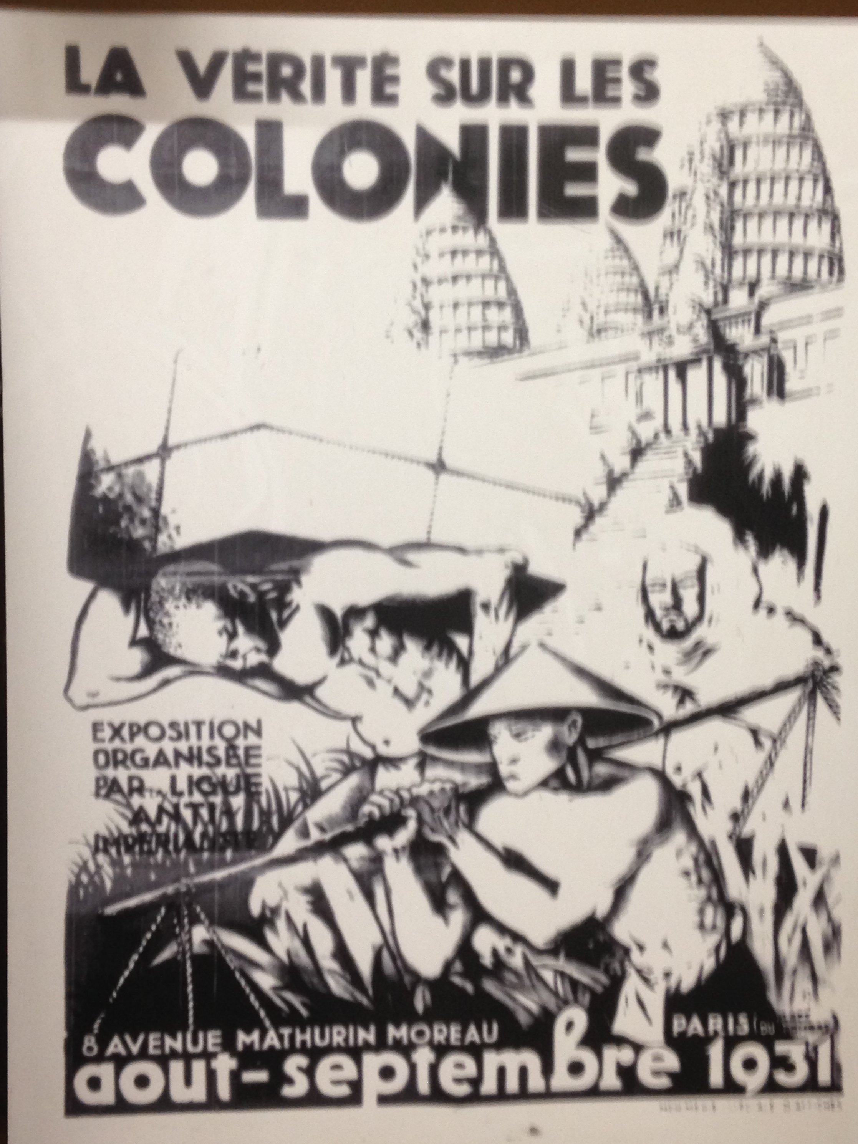
“We surrealists pronounced ourselves in favor of changing the imperialist war, in its chronic and colonial form, into a civil war. Thus we placed our energies at the disposal of the revolution, of the proletariat and its struggles, and defined our attitude towards the colonial problem, and hence towards the color question.”
“The white man preaches, doses, vaccinates, assassinates and (from himself) receives absolution. With his psalms, his speeches, his guarantees of liberty, equality and fraternity, he seeks to drown the noise of his machine guns. It is no good objecting that these periods of rapine are only a necessary phase and pave the way, in the words of the time-honored formula, ‘for an era of prosperity founded on a close and intelligent collaboration between the natives and the metropolis!’ It is no good trying to palliate collective outrage and butchery by jury in the new colonies by inviting us to consider the old, and the peace and prosperity they have so long enjoyed. “Murderous Humanitarianism,” Surrealist Group of France, 1932”

Slide 8
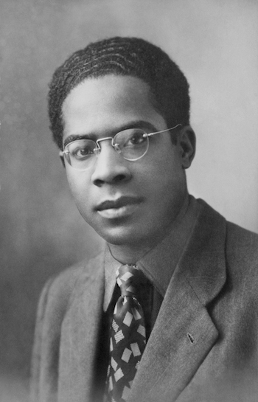
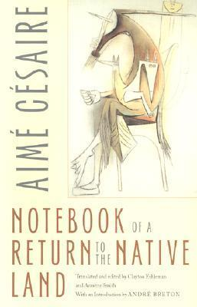

Slide 9
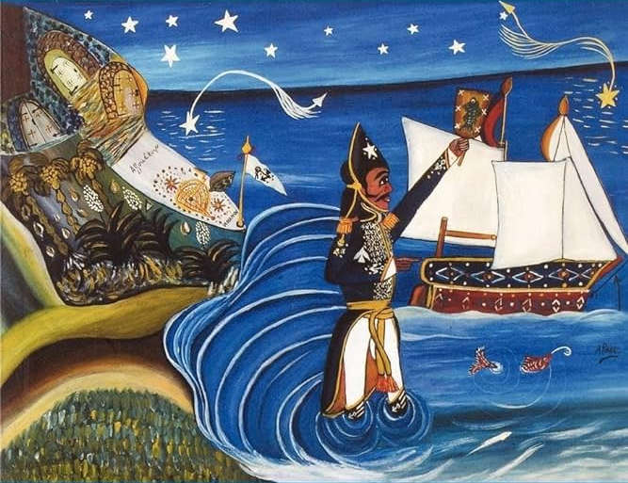
Neil Larsen: “…Surrealism's fundamental aesthetic principle, namely, montage. It's theory is simply formulated: merely by removing the objects of daily existence from their familiar context and then juxtaposing them again, only in the "wrong" sequence or constellation, an effect of estrangement or shock is produced. [. . .] But suppose the routinized object-world were structured in such a way that the shock effects of montage were themselves the spontaneous, even, in a sense, the routine experiences of everyday life and thus did not have to be consciously induced, but only pointed out or rendered self-aware. Suppose that, rather than taking the form of a self-encasing modernity that had rationalized daily existence down to its last detail and thus managed to protect itself on all sides from the "repressed" or negated forces continuously pushed beyond its margins, history itself were structured like a Surrealist montage?” (“Preselective Affinities: Surrealism and Marxism in Latin America” in Determinations, 129)

Slide 10
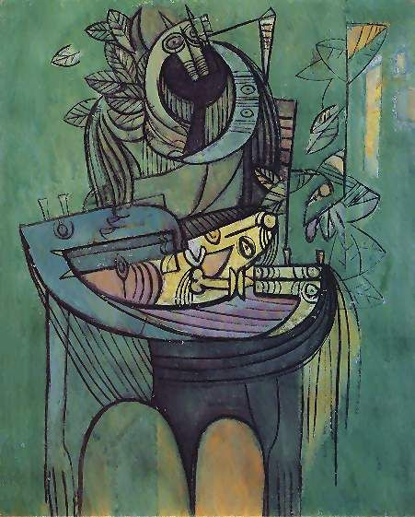
Robin Kelley: “The influence of surrealism on Aimé Césaire has been called into question many times, by critics as different as Jean-Paul Sartre (1948) and Jahnheinz Jahn (1958). The question of his surrealism, however, is generally posed only in terms of André Breton’s influence on Césaire. In this view, surrealism is treated as “European thought” and, like Marxism, is considered alien to non-European cultural traditions. But such a “diffusionist” interpretation seems too simplistic, too one-sided, overlooking the possibility that the Césaires (Aimé and Suzanne) were creative innovators of surrealism—that they actually introduced fresh surrealist ideas to Breton and his colleagues. I don’t think it is too much to argue that the Césaires not only embraced surrealism—independently of the Paris Group, I might add—but also expanded it, enlarged its perspectives, and contributed enormously to theorizing the ‘domain of the Marvelous.’” (Freedom Dreams, 169).

Slide 11

Suzanne Césaire, “Surrealism and Us: 1943”:
“Thus, far from contradicting, diluting, or diverting our revolutionary attitude toward life, surrealism strengthens it. It nourishes an impatient strength within us, endlessly reinforcing the massive army of refusals. And I am also thinking of tomorrow. Millions of black hands will hoist their terror across the furious skies of world war. Freed from a long benumbing slumber, the most disinherited of all peoples will rise up from plains of ashes. Our surrealism will supply this rising people with a punch from its very depths. Our surrealism will enable us to finally transcend the sordid antinomies of the present: whites/Blacks, Europeans/Africans, civilized/savages—at last rediscovering the magic power of the mahoulis, drawn directly from living sources. Colonial idiocy will be purified in the welder’s blue flame. We shall recover our value as metal, our cutting edge of steel, our unprecedented communions.”

Slide 12
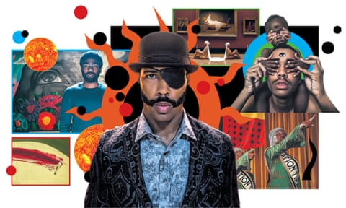
The Guardian, “From Beyoncé to Sorry to Bother You: the new age of Afro-surrealism”
“So why is the Afro-surrealist revival happening now? And is escaping into the strange and fantastical simply a natural response to living in a world bound by structural racism? According to Terri Francis, director of the Black Film Center/Archive at the University of Indiana, it’s no wonder our pop cultural landscape is turning Afro-surreal at a time when society is wrestling with racial violence, bias and inequality. “I think their work is very realistic in representing the absurdity of black life,” says Francis. “[In America] the ideals are there and you’re aware of what should be going on … but that’s not the reality.”
https://www.theguardian.com/tv-and-radio/2018/dec/06/afro-surrealism-black-artists-racist-society

Slide 13
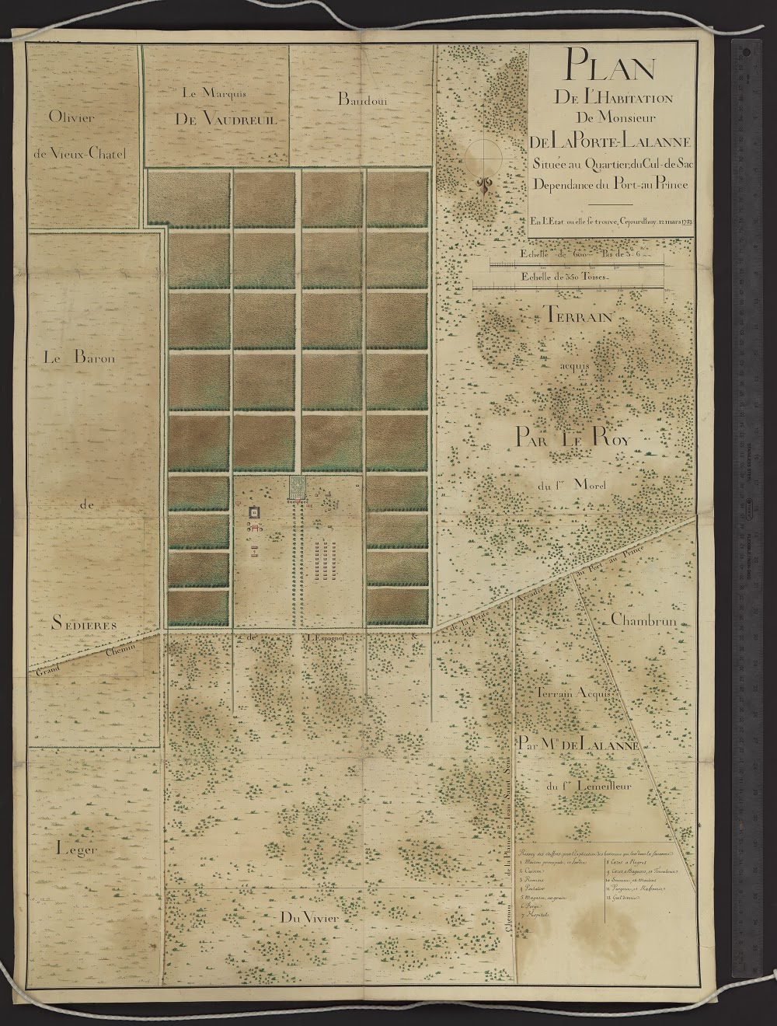
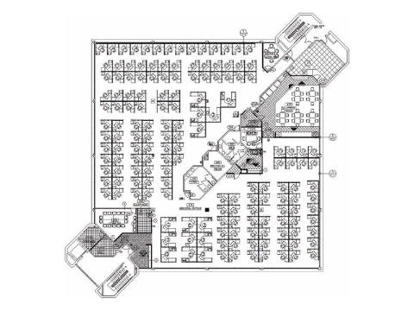
Clyde Woods, "Sittin’on top of the world: The challenges of blues and hip-hop geography." Black Geographies and the Politics of Place (2007)
“The historical plantation has been described as both a military form of agriculture and a capitalist institution having extensive land requirements, intensive capital and labour requirements, and internal forms of governance. However, the plantation and state models have numerous permutations that extend beyond agriculture: slavery and sharecropping; enclosures and reserves; industrial estates and mill villages; free-trade and export zones; enterprise and empowerment zones; ghettos and gated communities; suburbanization and gentrification; game preserves and tourist resorts; pine plantations and mines; and migratory and prison labour.” (56)
“All of these economic forms are designed to reproduce the basic features of plantation capitalism: resource monopoly; extreme ethnic, class, racial, and gender polarization; an export orientation; and the intense regulation of work, family, speech, and thought. [. . .] A final set of features that have survived the centuries are manifest in the militarized diminution of human rights, labour rights, and democratic forms of governance. The present period is defined by the ever-increasing monopolization and mining of an ever-decreasing supply of viable air, sea, land, subterranean, and communal resources.” (56)

