Slide 1
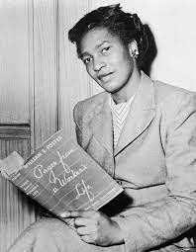
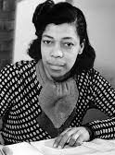
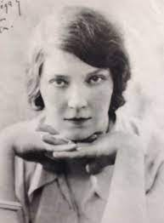
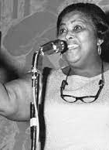

Claudia Jones (1915-64); Una Marson (1905-65); Jean Rhys (1890-79); Louise Bennett (1919-06)

Slide 2
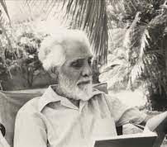
Trinidadian writer Alfred Mendes reflecting on the two major factors that had prompted an explosion of literary activity in the Caribbean in the 1930s and 1940s: “The first was, of course, the First World War where a large number of us had been abroad [. . .], and the second event was the Russian Revolution. Those, I think, were the two events in our lives at that time which drove us into writing about our islands”

Slide 3
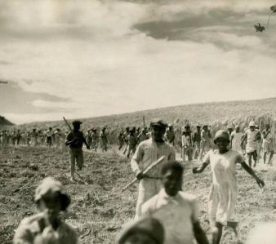
Selwyn Cudjoe: “In 1935 there were sugar strikes in St. Kitts and Guyana, a coal strike in St. Lucia, and a strike protesting customs duties in St. Vincent; in 1936 there was a general strike of waterfront workers in Guyana; in 1937 a general strike tied up the entire island of Trinidad, with Barbados workers striking in sympathy, and there were sugar strikes again in Guyana and St. Lucia, spreading this time to Jamaica; in 1938 there was further unrest in Jamaica and Guyana.” (Resistance and Caribbean Literature, 45)

Slide 4
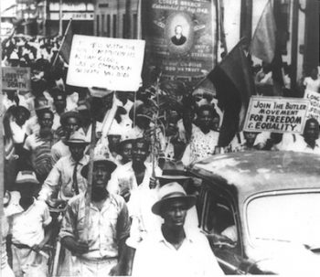
Hunger Marches in Jamaica and Trinidad and Tobago in the 1930s

Slide 5
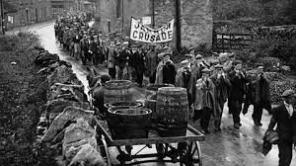
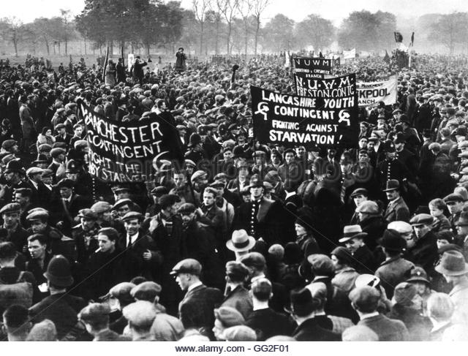
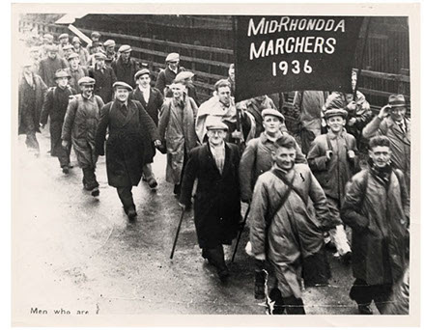

Slide 6
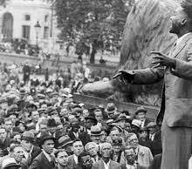
C. L. R. James, commenting on the situation in Trinidad during the general strike of 1937: “trade unions are being formed all over the island, and the advanced workers are clamouring for revolutionary literature of all sorts, by Marx and Engels and other writers on Communism”

Slide 7
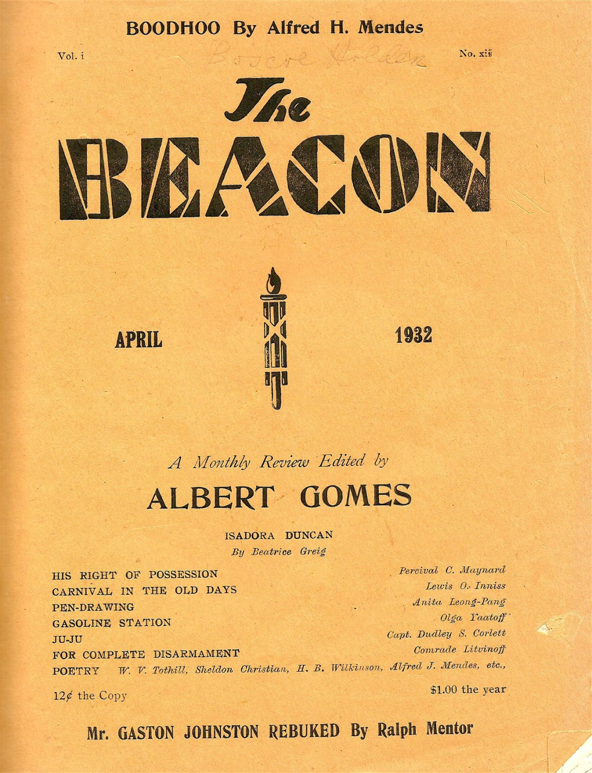

Slide 8
Stephen Cobham, Rupert Gray: A Tale in Black and White (1907):
“The Port-of-Spain Railway Station was the scene of hurrying and hustling. Cabs kept arriving in an endless procession. [. . .] Men with umbrellas and hand-bags crossing from the restaurant opposite hastily consulted their watches. The gong clanged everlastingly of each tram car as it circled past. [. . .] There out in the distance on the southernmost confines of the shipping, a great ocean liner rode at anchor. [. . .] Already industrious Indian matrons – red-spittled Madrassees – armed with buckets, were boarding the united chariots ere their wheels grew cold. A watering cart followed in the wake of a heavy stone-crusher along the convex street, improving on the recipe Sir John McAdam gave to the world. [. . .] Off yonder a stupendous crane wheels lazily for ever, its half-greased mechanism creaking and groaning. [. . .] Smart-looking youngsters busy themselves between Customs, or bank and counting house, with red-marked paper bags of money.” (7, 18)

Slide 9
Kathleen Archibald, “Clipped Wings” (1937):
“They rise and go towards the fish market to see the seines being dried near there. They rotate from there back to the wharf. They look at lumber being landed, also bricks and lump-coal. Men sit there with tally-books. At the end of St. Vincent Street is a crane at work on the jetty and alongside is drawn up a small steamer which they know goes to Tobago. That they know and all about the lighters being loaded along the quay. But there are other things which they would like to know and they can only ask the questions among themselves. How are the bricks which the men are pelting ashore made so hard, and the lump coal too? How is the lumber made so smooth and from where does it come? The erection for the wireless puzzles them. They argue among themselves and are satisfied with their conclusions.” (81)

Slide 10
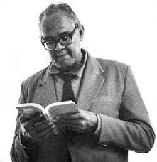
Martin Carter, “Death of a Slave” (1952):
cane field is green dark green
green with life of its own
heart of slave is red deep red
red with life of its own.
day passes like long whip
over the back of slave
day is burning whip
biting the neck of slave. (53)

Slide 11
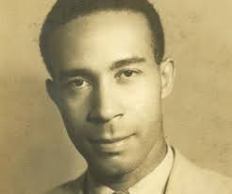
George Campbell, “History Makers” (1945):
Women stone breakers
Hammers and rocks
Tired child makers
Haphazard frocks.
Strong thigh
Rigid head
Bent nigh
Hard white piles
Of stone
Under the hot sky
In the gully bed.

