Slide 1

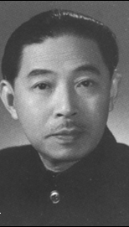
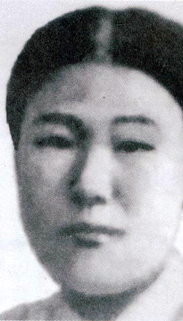
Mao Dun, Village Trilogy (1932-33)
Kang Kyeong-ae, “Salt” (1934)

Slide 2
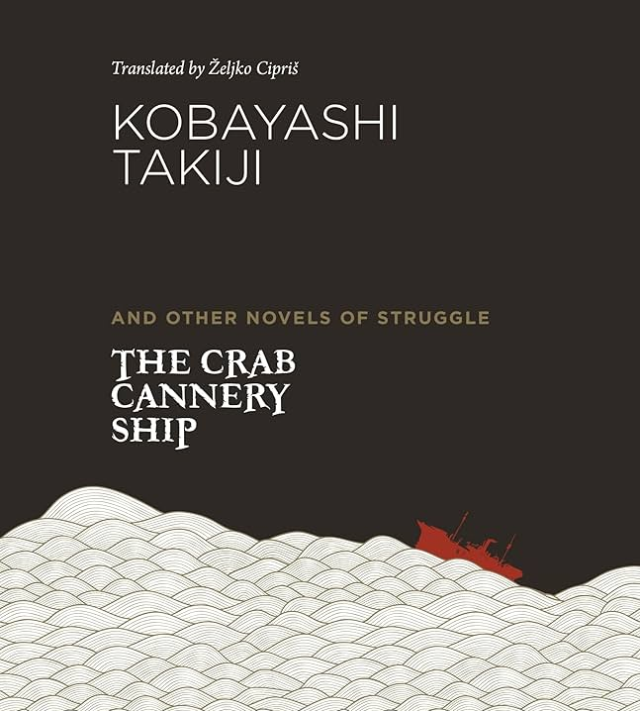
“Once the work ended everyone crept back into their shit-hole. Hands and feet hung from bodies like radishes, frozen and devoid of sensation. The men all crawled into their bunks like silkworms, no one uttering a single word. Throwing themselves down, they grabbed hold of the iron rails. The ship bucked and shook desperately, like a horse struggling to drive a biting horsefly off its back. The fishermen cast hopeless glances at the ceiling whose white paint had turned yellow with soot, and at the bluish-black portholes that were almost sunk underwater. Some gazed blankly into space, their mouths half open as though they had lost their minds. No one was thinking of anything. A dazed, anxious awareness made everyone sullenly silent.” (30)

Slide 3
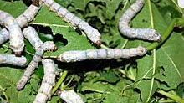

Bombyx mori
“By the time the old man ordered another thirty loads, and the first ten were delivered, the sturdy “little darlings” had gone hungry for half an hour. Putting forth their pointed little mouths, they swayed from side to side, searching for food. Daughter-in-law’s heart had ached to see them. When the leaves were finally spread in the trays, the silkworm shed at once resounded with a sibilant crunching, so noisy it drowned out conversation.” (29)

Slide 4
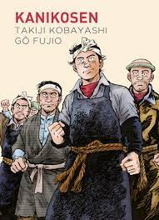
“Fishermen who till now had known only servile submission, quite unexpectedly felt a tremendous force thrusting them forward. At first they were bewildered. Gradually they realized that their own power, whose presence they had not suspected, was manifesting itself.
“But are we capable of making use of that power?” they wondered. Of course they were.
Once they understood it, a wonderful spirit of rebellion filled their hearts. The very hardships of the agonizing work that had been wrung from them turned into a splendid foundation for their defiance. Now the manager and his ilk could go to hell! They were elated. This new feeling suddenly enabled them to see their wormlike lives vividly, as though illuminated by a flashlight’s beam.” (79)

Slide 5
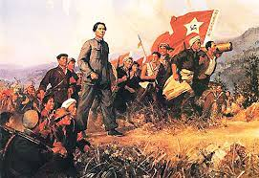
Chinese Revolution, 1949

Slide 6
1911: National Democratic revolution in which the Qing dynasty overthrown
1919: May Fourth Movement (anti-imperialist and cultural movement)
Chen Duxiu on the May 4th Movement: the basic task is to “import the foundation of Western society – that is, the new belief in equality and human rights. We must be thoroughly aware of the incompatibility between Confucianism and the new belief, the new society, and the new state.”
1921: Founding of the Chinese Communist Party
CCP under Mao Zedong vs. the Nationalist Party (the Kuomintang) under Chiang Kai-shek). Massacre of the Communists in Shanghai, 1927
1934: the ‘long march’ of the Red Army; in 1935, they reach Northwestern China and establish bases in the poverty-stricken Yan’an area

Slide 7
1931: Japanese invasion of Manchuria; establishes the puppet state of Manchukuo
1937: full-scale Japanese invasion of China, with Japan capturing Beijing and Shanghai
Communists and Nationalists come together again in the ‘Second United Front’
Following the end of WWII, the Civil War resumes, with the Communists winning out in 1949

Slide 8
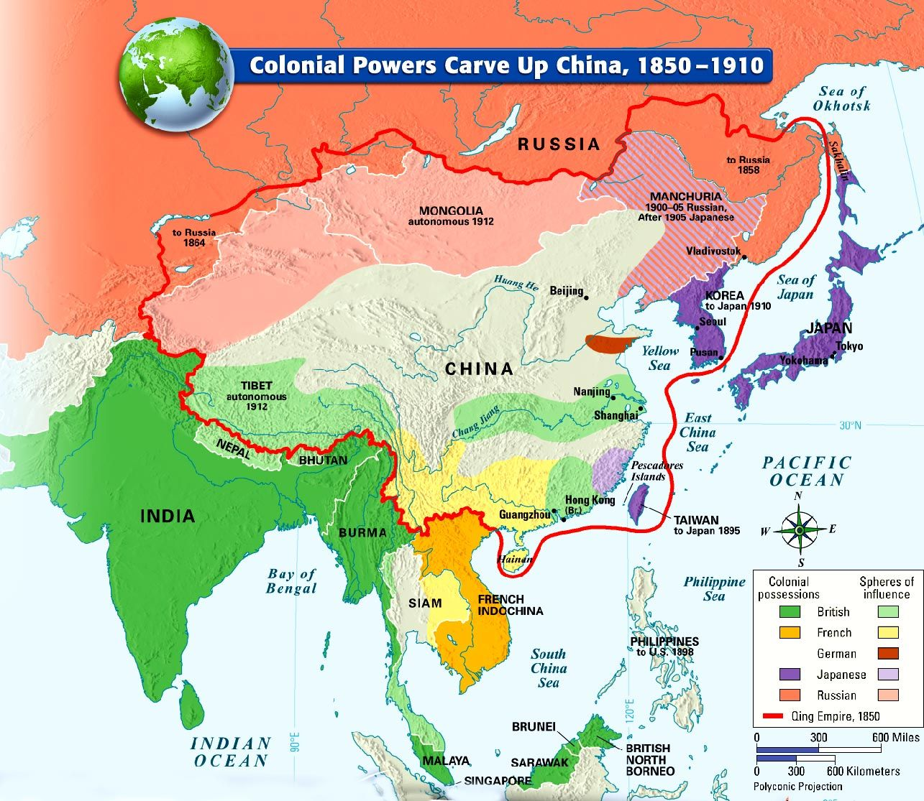

Slide 9
Harold Isaacs, The Tragedy of the Chinese Revolution
“The very coming of foreign imperialism, the end of Chinese isolation, and the appearance of the machine-made commodity on the Chinese market inexorably decreed the revolutionary transformation of Chinese society. Once entrenched, imperialism threw its weight into the balance for the perpetuation of all that was archaic and retrograde in that society. Revolutionary change for China now required the destruction of the old system of land-holding and the release of pressure on the land. Imperialism joined in propping up the sway of the landlords, merchants, and officials who kept the mass of peasants in bondage and who provided the channels for the flow of foreign commercial capital into the remotest hinterland.” (10-11)

Slide 10
‘semi-colonialism’,
originated in the work of Lenin; described situations in which states were penetrated by imperial capital, trade, and political influence, but retained their juridical independence
Jürgen Osterhammel: the idea of semi-colonialism was developed by Chinese Marxists as integral to a “comprehensive theory of China’s semi-feudal semicolonial society”
“The theory tried to make sense of a historical process in which ‘feudalism’ obviously disintegrated, but no significant transition to capitalism took place. A feudal system was penetrated, but not superseded, by colonialism, thus giving rise to a hybrid social formation that had not been anticipated by classical historical materialism.” ("Semi-colonialism and informal empire in twentieth-century China: Towards a framework of analysis.“)

Slide 11
“Chinese society remained feudal for 3,000 years. But is it still completely feudal today? No, China has changed. After the Opium War of 1840 China gradually changed into a semi-colonial and semi-feudal society. Since the Incident of September 18 1931, when the Japanese imperialists started their armed aggression, China has changed further into a colonial, semi-colonial and semi-feudal society. [. . .] About forty years ago, at the turn of the century, China's national capitalism took its first steps forward. Then about twenty years ago, during the first imperialist world war, China's national industry expanded, chiefly in textiles and flour milling, because the imperialist countries in Europe and America were preoccupied with the war and temporarily relaxed their oppression of China. [. . .] However, the emergence and development of capitalism is only one aspect of the change that has taken place since the imperialist penetration of China. There is another concomitant and obstructive aspect, namely, the collusion of imperialism with the Chinese feudal forces to arrest the development of Chinese capitalism. It is certainly not the purpose of the imperialist powers invading China to transform feudal China into capitalist China. On the contrary, their purpose is to transform China into their own semi-colony or colony. To this end the imperialist powers have used and continue to use military, political, economic and cultural means of oppression, so that China has gradually become a semi-colony and colony.” (“The Chinese Revolution and the Chinese Communist Party”, 1939)

Slide 12
“Not far from where Old Tung Pao was sitting, a grey two-storey building crouched beside the road. That was the silk filature, where the delicate fibres were removed from the cocoons. Two weeks ago it was occupied by troops; a few short trenches still scarred the fields around it. Everyone had said that the Japanense soldiers were attacking in this direction. The rich people in the market town had all run away. Now the troops were gone and the silk filature stood empty and looked as before. There would be no noise and excitement in it until cocoon selling time.
Old Tung Pao had heard Young Master Chen – son of the Master Chen who lived in town – say that Shanghai was seething with unrest, that all the silk weaving factories had closed their doors, that the silk filatures here probably wouldn’t open either. But he couldn’t believe it.” (10)

Slide 13
“Old Master Chen was still alive then. His son, the present Master Chen, hadn’t begun smoking opium yet, and the ‘House of Chen’ hadn’t become the bad lot it was today. Moreover, even though the House of Chen was of the rich gentry and his own family only ordinary tillers of the land, Old Tung Pao had felt that the destinies of the two families were linked together” (11)

Slide 14
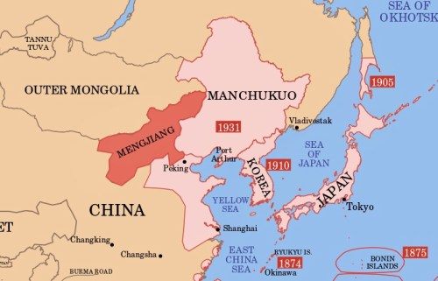
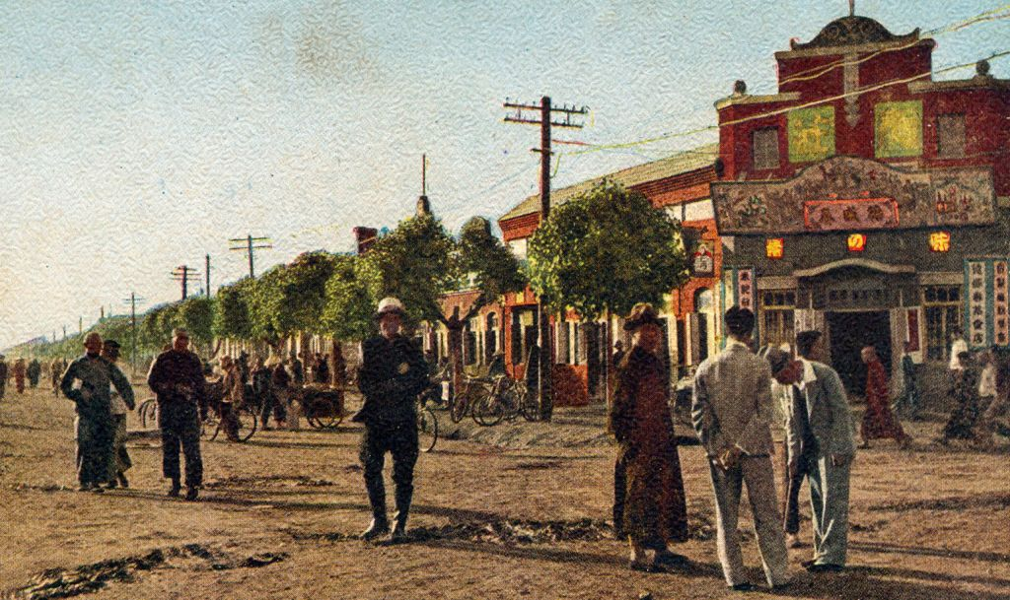

Slide 15
Jeehyun Choi: “It seems that Kang, to her surprise, found the local inhabitants of Manchukuo to be no less perceptive than she in detecting the illogic of their shared world. In a vignette [. . .] she recalls a lumberjack who deceived her into buying a stack of poor-quality firewood. When Kang confronts him, the man does not apologize for his misdeed but instead retorts, “When all things [deceive], why should a tree not do the same?” Kang writes that the matter-of-fact quality of the response astonished her into paying full price for the wood, and she expresses curiosity and admiration for Kando’s peasants. What captures her admiration is the capacity of the peculiar remark to tersely but incisively distil a profound outlook acquired from the lived experience. This image of the peasant, lucidly understanding the absurd, inhumane material conditions in which they must operate, appears in many of Kang’s stories set in Kando.” (“Writing Manchukuo: Peripheral Realism and Awareness in Kang Kyŏngae's Salt.” Cross-Currents: East Asian History and Culture Review 7.2 (2018): 449-473.

Slide 16
“Then Bongyeom remembered something that her teacher had talked to her about, and she realized it was not her mother who was at fault for their poverty. But she could not help resenting her mother whose first instinct was always to castigate her daughter.
‘How do I know why we don’t have money! Why were you born to beggars instead of rich parents! You useless child, I’d be better off without you.’
Bongyeom stared at her mother. She was reminded of what happened at last autumn’s threshing, how her mother and father’s harvest of rice was all taken away by Fang Tong. Her mother’s face then was the same as it was now. Mother and Father, who knew nothing of resisting, nothing of fighting back! Her mother, who was so wretched it was almost pathetic! ‘Mother, you have to know why we don’t have any money. Why can’t we afford exercise shoes? Why can’t we afford Big Brother’s education? You must see the reason why!’
She realized as she was shouting this that there was nothing wrong with her desire for exercise shoes. She began to recall a thing or two that her teacher had said to her …
‘You stupid girl, why else would we be poor? We have no land. If only we had some land …’ The woman’s heart was so full of sorrow that she closed her mouth.” (19-20)

Slide 17
“She felt a jolt of electricity run through her as she remembered the words spoken by the voice on the hill, the voice she had listened to with contempt.
‘You are our comrades! Only when we work as one can we fight against the rich bastards who are our real enemies!’
Those words thrown at her from the dark! Her heart was fit to burst. [. . .] The real enemies were the rich bastards who were stealing her salt! She was shouting this aloud before she even realized.” (55)

Slide 18
Ever since that night, Fang Tong’s attitude, no matter how she considered it, had gone cold. At first, she thought it was because he was a stately older man and his finicky wife was by his side, but as the days passed, jealousy began to rear its ugly head. On the other hand, she felt an affection towards him that was careening down a path into the unknown. She sighed and wiped the sweat from her forehead. When would she be able to talk to Fang Tong comfortably and receive his love? The more she thought about him, the worse she found herself wanting him. The thought brought tears to her eyes. She envied his wife no end.
Her thoughts then fell to the fact she was with child. Her head dropped in silent despair. That night seemed to conjure itself up from the point of her needle. Did not Fang Tong jump on her like an angry tiger? And was she not so afraid that she had accidentally ripped the tarp over the windows of that dark room, and was that not why she was with child now? She had committed no sin. But why was it so difficult to talk to him? She could not even ask for the noodles in icy broth that she so wanted. Everything felt like it was her fault. Why could she not talk to him, why was she hesitating? She would talk to him this time for sure. She would! She was going to ask for a bowl of noodles, too. Her mouth watered at the thought. This was all just a fantasy, she thought as she gave out an empty laugh. It was almost funny that despite the mountains of difficulties that lay ahead, all she could think of were cold noodles. But she wanted them badly. Her throat itched at the thought of them, and she could barely sit still. (27-28)

