Slide 1
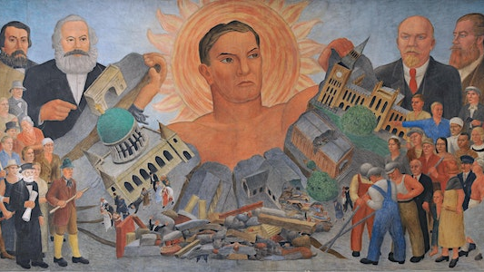
Lewis Jones Cwmardy (1937)

Slide 2

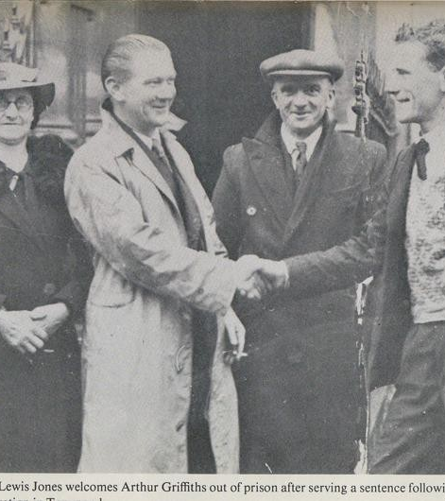
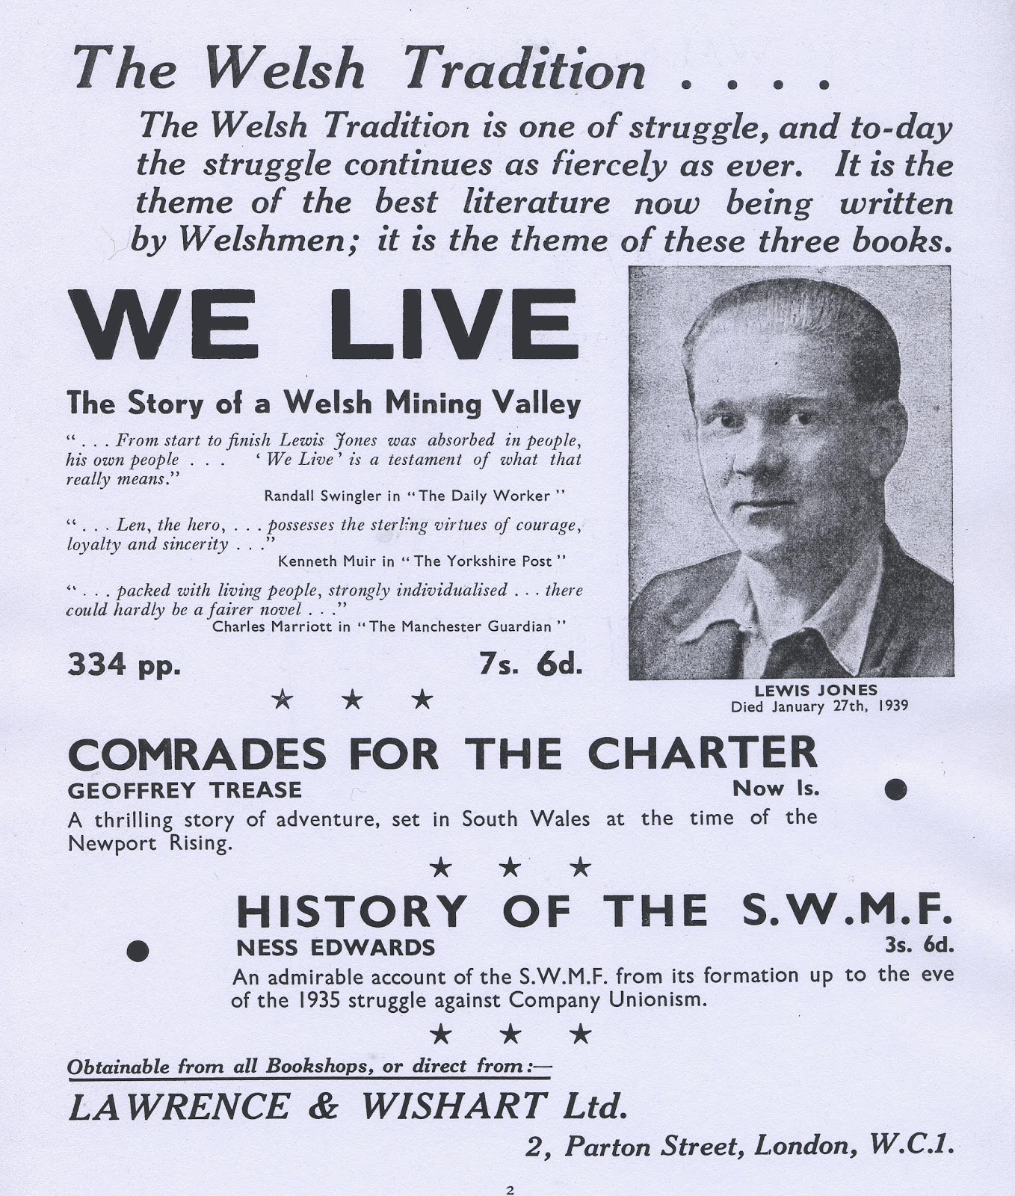

Slide 3
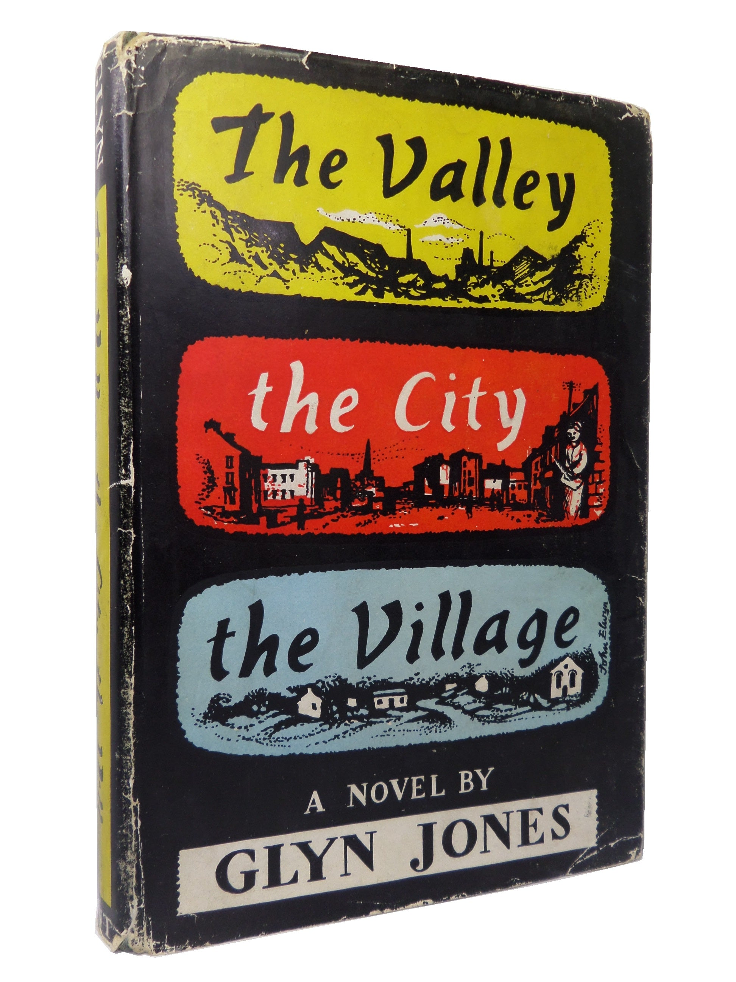
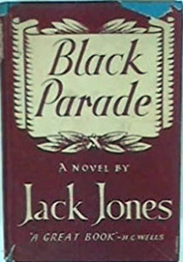
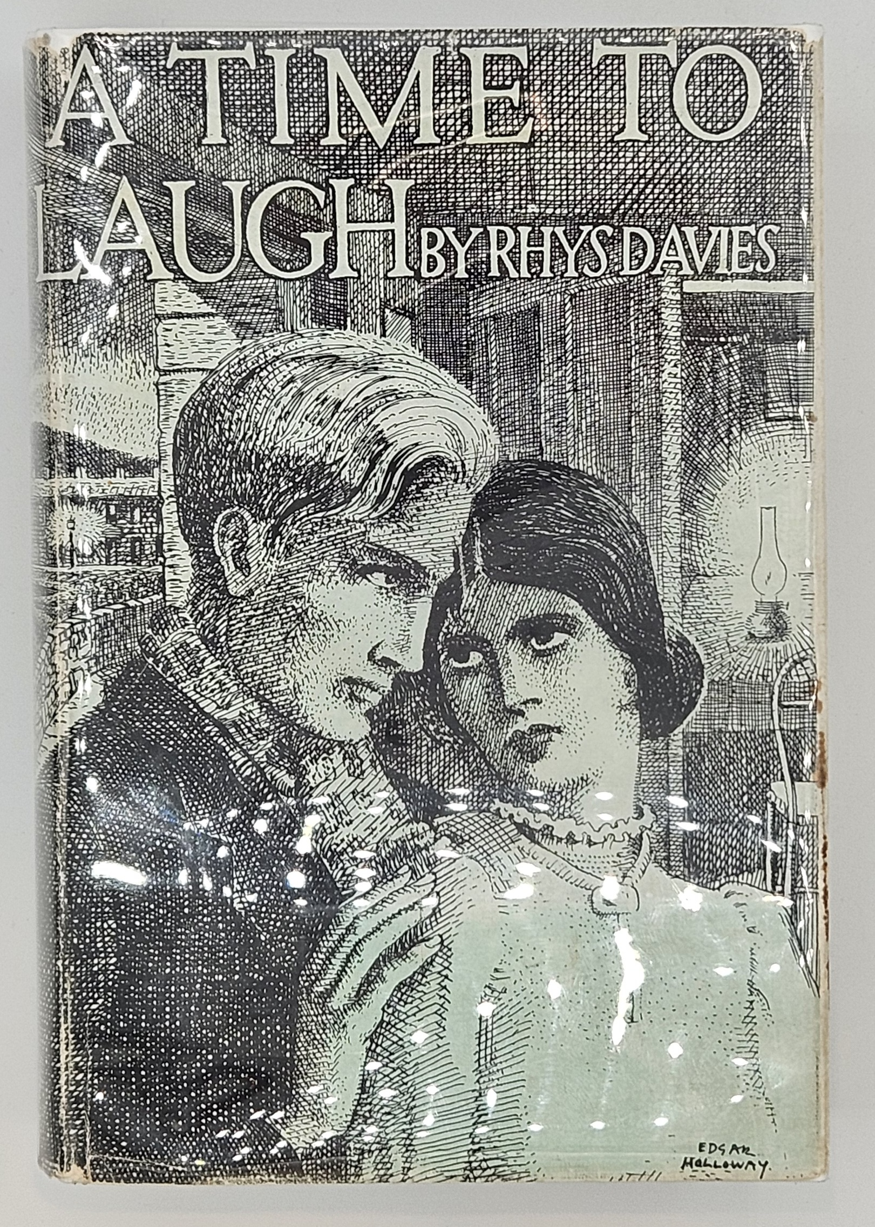
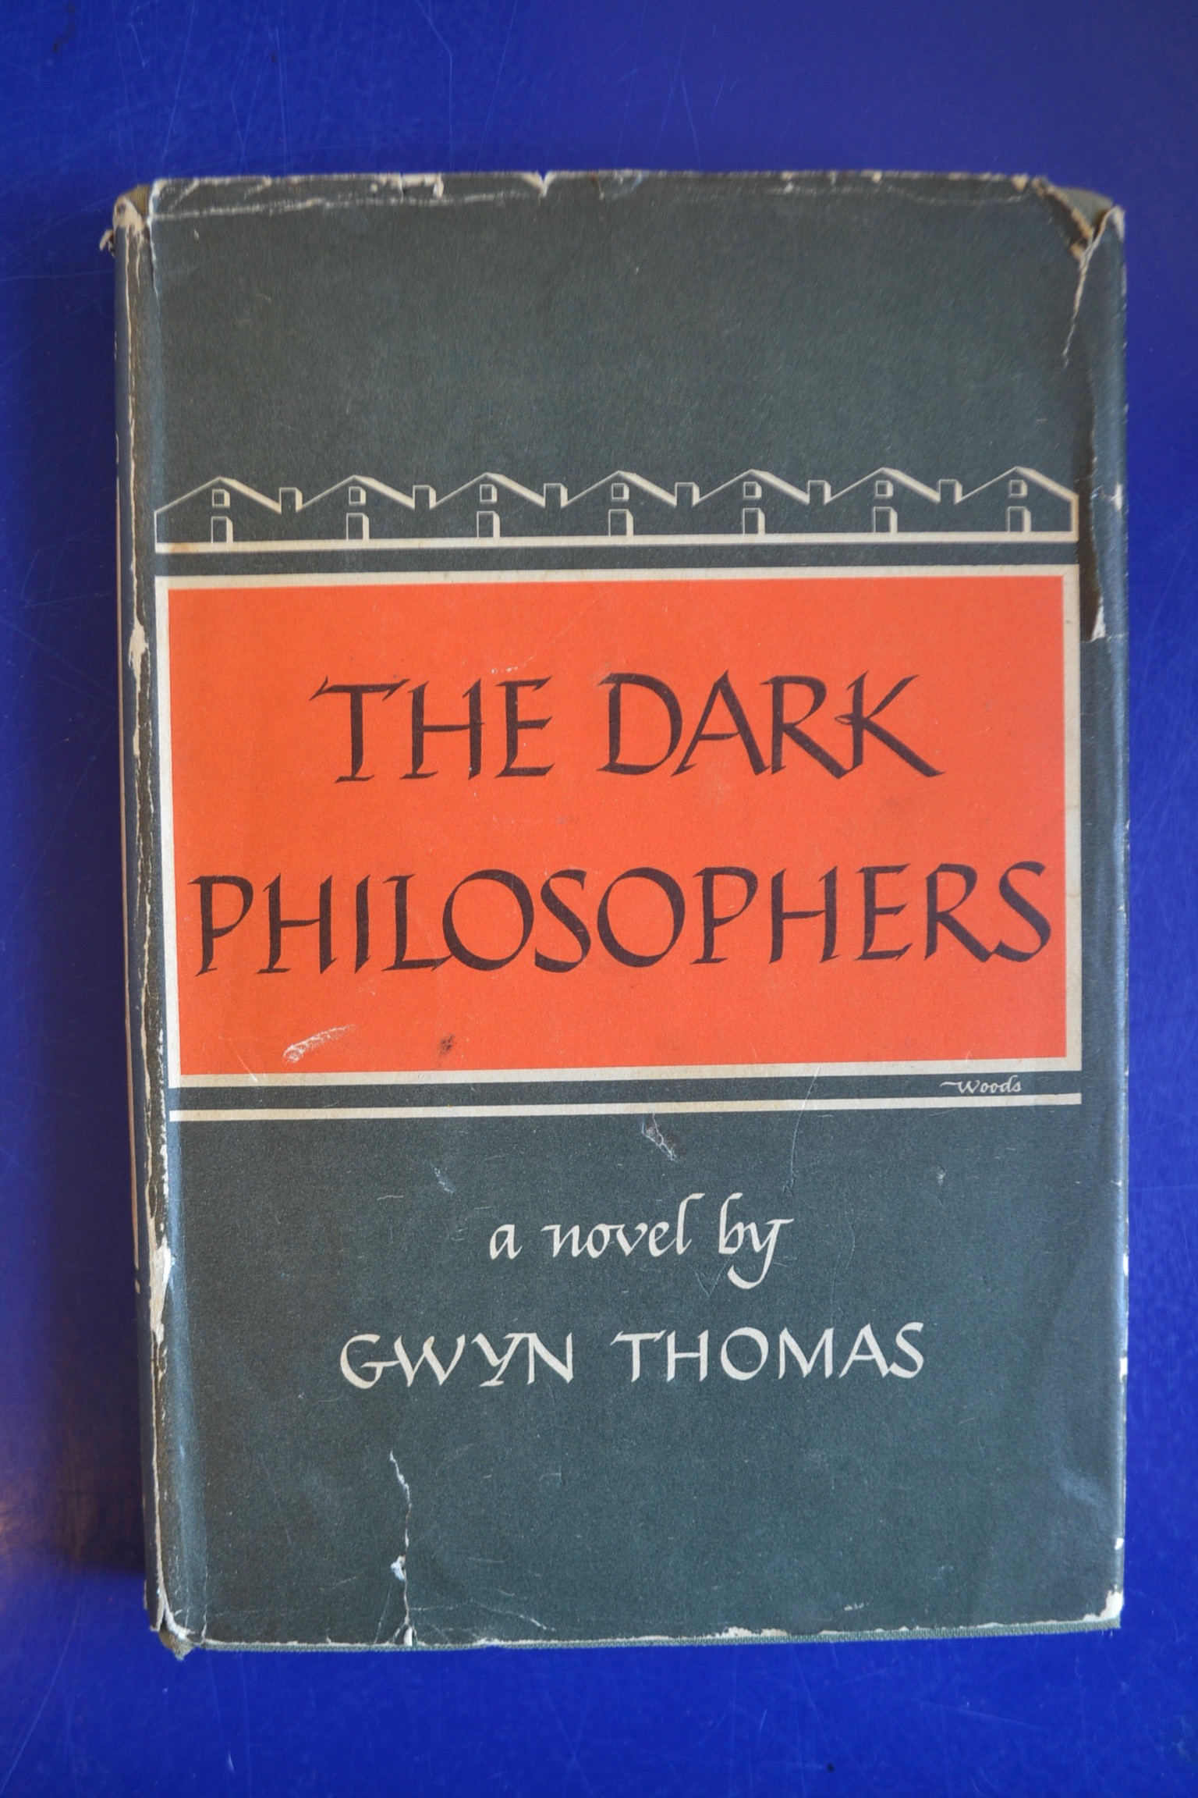


Slide 4
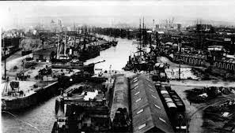
At its height in the 1880-1890s, Cardiff, in terms of tonnage exported, was “the largest port in the world and the centre of a commercial empire which stretched to the farthest reaches of the globe” (John Davies, A History of Wales, 2007: 456).

Slide 5
“Between 1861 and 1911, as a result of the explosive growth of the coal industry, the population of the county of Glamorgan grew by 253 per cent, and, in the decade preceding the First World War, Wales was ranked second to the United States as a centre for immigration. In 1850, 20 percent of the Welsh population lived in towns. That percentage increased to a little under 50 in 1861, and 60 by 1911. Wales, an agricultural land of about 500,000 people in 1800, was transformed into an urban nation of 2,500,000, with the majority packed into the coalfields of the south by 1911. [. . .] The Welsh, along with English, Irish, Italians and Jews, were moving into the industrial valleys of south Wales” (Daniel Williams, Black Skin, Blue Books, pp. 192-93)

Slide 6
B. L. Coombes, These Poor Hands (1939): “What a mixture of languages and dialects were there sometimes. Yorkshire and Durham men, Londoners, men from the Forest of Dean, North Welshmen – whose language is much deeper and more pure than the others from South Wales – two Australians, four Frenchmen, and several coloured gentlemen” (59).

Slide 7
“Thus language was perceived quite differently: it was no longer, in the old sense, customary and naturalized, but in many ways arbitrary and conventional. To the immigrants especially, with their new second common language, language was more evident as a medium – a medium that could be shaped and reshaped – than as a social customs. Even within a native language, the new relationships [. . .] forced certain productive kinds of strangeness and distance: a new consciousness of conventions and thus of changeable, because now open, conventions.” (Raymond Williams, Politics of Modernism, pp. 45-46)

Slide 8
a metropolitan modernism that developed out of the experience of imperial capitals, where “there was at once a complexity and a sophistication of social relations [. . .] that contrasted very sharply with the persistence of traditional social, cultural and intellectual forms in the provinces and in the less developed countries” (44-45)
the complexity and “miscellaneity of the metropolis – which in the course of capitalist and imperialist development had characteristically attracted a very mixed population, from a variety of social and cultural origins” – was the “key cultural factor of the modernist shift” (45)
the “most important general element of the innovations in [literary] form is the fact of immigration to the metropolis” and the impact this had on perceptions of language (45).

Slide 9
Cwmardy: “The pits never ceased their throbbing night or day. The ‘foreigners’ had intermarried with the natives, their children, now young adults, creating a new cosmopolitan population in the valley” (310).

Slide 10
The Cambrian Combine Strike and the Tonypandy Riots of 1910-11
“Amongst the many incidents that shaped his political outlook a few stand out, such as the 1910/11 strike, which ended in a humiliating defeat for the miners, and the Tonypandy riots sparked off by the strike. (Alyce von Rothkirch, “Liberty and the Party Line: ‘novelising’ working-class history”)
“Much of Jones’s text dramatises a struggle that is pivotal in Welsh industrial history, the story of Tonypandy in 1910-1911” (Melanie L. Williams, "Coercion and the labour contract: revisiting Glasbrook Brothers and the political fiction of Lewis Jones." International Journal of Law in Context 8.01 (2012): 1-25).

Slide 11
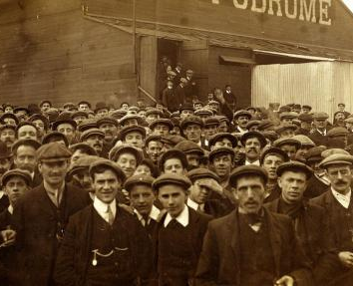
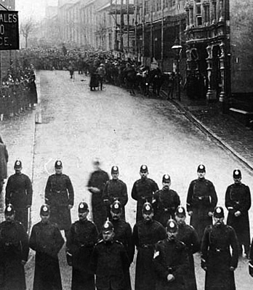

Slide 12
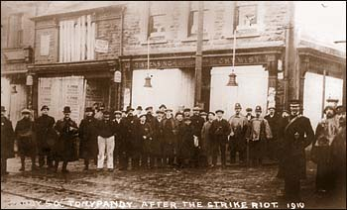

Slide 13
The Tonypandy Riots
Dai Smith: since most of the miners had only been paid off that week, they had “money in their pockets, though none, of course, to spend on inessentials. They were already deprived – not yet, absolutely, of the wherewithal to live, but rather, relatively, of the ability to enjoy consumption of those conspicuous goods that were the hallmark and sole justification of this high-wage society, from Saturday-night shaves and barbered hair to women’s hats and the white muffler scarves that no collier dandy could be without. The shops in Tonypandy were not looted for food. They were wrecked by men and women who knew closely the intricate and inseparable local factors that made up the skein of socio-economic connections which enwrapped their community. They knew, further, who aspired to control everything through this basic lever.” (Wales: A Question for History, 1999: 129)

Slide 14
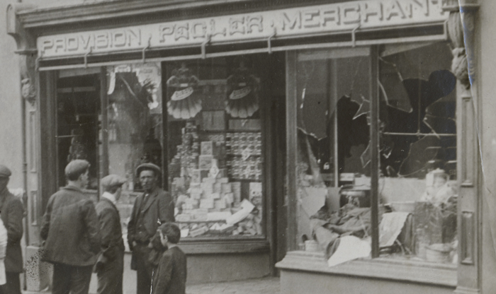
there was an element of performance to the riots
they were characterized by an “art of gesture” encapsulated in the “contemptuous spillage of foodstuffs and apparel on the roads in place of theft” (Smith, Wales: A Question for History, 118).

Slide 15
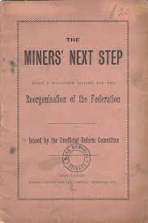
Paul Foot: “one of the landmarks in our trade union literature”: “It exposed the treacherous role which the union leaders had played in the struggle with the coal owners. Its answer was…to bring the power of officials much more firmly to heel, and to place the union and the people who ran it under the control of the rank and file” (An Agitator of the Worst Kind: A Portrait Of Miners’ Leader A J Cook).

Slide 16
proposals for the reorganization of the South Wales Miners’ Federation were circulated to the mining districts, where groups were “asked to sit, deliberate, and suggest improvements; hold a series of joint meetings; and eventually to meet in conference at Cardiff.”
“No name appears on the pamphlet as it is not the work of any one man, but if it is criticised as it ought to be, and no doubt will be, there will be no lack of men to take up its defence. We venture to think this is a record for a democratic work of an entirely voluntary character” (Miners’ Next Step, 1912: n.p.).

Slide 17
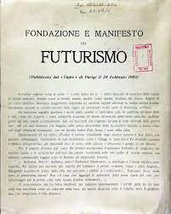
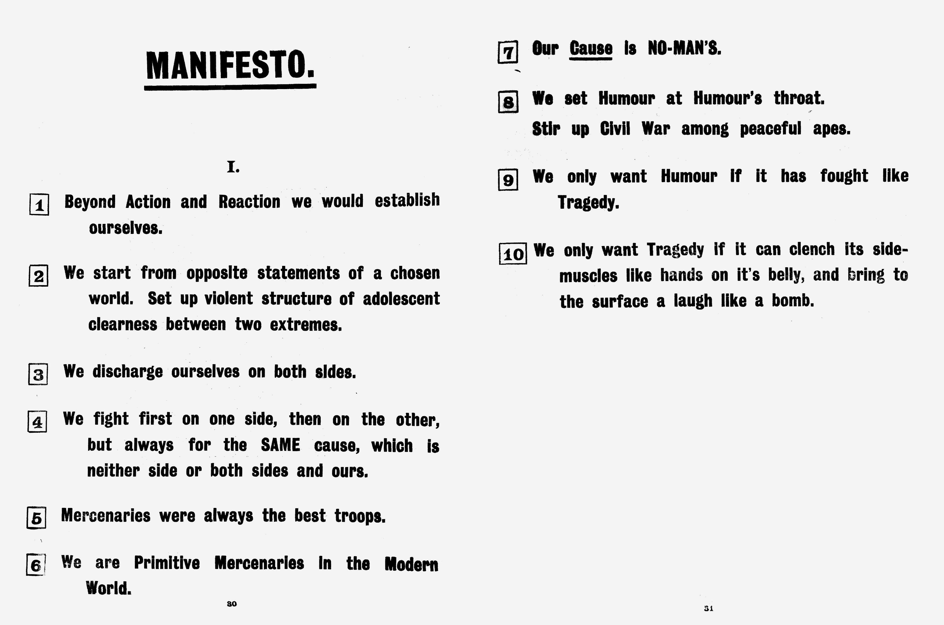

Slide 18
Dai Smith: the “kinetic aestheticism” and “cubist” geometry of valleys’ life
Idris Davies, “Dai to Dali”:
Come down and see our crooked valleys,
Our black tips sulking by the poisoned streams,
And, Dali bach, you’ll find wheels whanging to the heavens
And dragons making rings around your dreams;
For truth is stranger than any surrealistic art
Where the slag-heap holds a mirror to the heart.

Slide 19
Jones in his foreword to Cwmardy: a “collective work in the sense that my fellow workers had to fight the battles I tried to picture, and also in the sense that I have shamefully exploited many comrades for incidents, anecdotes, typing, correcting and multifarious details connected with writing” (1978: n.p.).
Carole Snee: this collectivist impulse remains in tension with the received generic forms Jones mobilizes (“Working-Class Literature or Proletarian Writing?” in Culture and Crisis in Britain in the 30s, p. 185).

Slide 20
Graham Holderness: to read Jones’ works “solely as accurate imaginative accounts of real events is to privilege their naturalistic elements over their more experimental fictional interventions” (“Miners and the Novel” in The British Working-Class Novel in the Twentieth Century, ed. Jeremy Hawthorn, p. 28)
Melanie L. Williams: Jones draws upon “certain elements of modernist writing to empower the message of revolutionary politics, most notably in the realism with which he represents the brutal physical manifestations of prevailing cultural and political cruelties”.
Jon Gower: Cwmardy as “sensational realism” … its “action-packed” and “emotionally-soaked” narrative (“Gwn Revisited,” Wales Arts Review (2017).

Slide 21
“The hill became a symbol to him. He saw it as a belt taking live men up to the pit, then bringing them down dead to the cemetery. The pit became an ogre to him. He likened it to some inhuman monster that fed on men and spewed up mangled bodies to be buried in the graveyard. He conjured the hill and the pit as common enemies of the people, working in connivance to destroy them.” (136)

Slide 22
Falling on his knees he began to feverishly turn over the black blotches that lay in queer heaps upon the ground. [. . .] They had found the first victims of the explosion. (108)
His fertile mind, egged on by the storm and the horrible loneliness, [. . .] conjure[d] up pictures of burned and mangled bodies. (114)
He put his arms gently beneath the poor mangled body and lifted it carefully away from the fallen roof. (179)
All who fell or were struck down were trampled upon in the mad fury of the battle, until the roadway was covered with still and squirming bodies. (275)
Big Jim sprang forward to see what was the matter, and in a few moments they had uncovered a naked arm that had been ripped out of its shoulder socket. [. . .] Alongside the still conveyor they saw the silent form of a young lad who had only recently started work. His body twisted and squirmed as if with convulsions [. . .]. His lips kept moaning: ‘Bring my arm back, bring my arm back.’ (397)

Slide 23
“Five days after Jane had died Len was again taken in to see her. This was to be the last occasion before they screwed the coffin down ready for the funeral next day. As before, Big Jim lifted his son above the edge. Len looked down and a look of horror filled his eyes. Jane’s beautiful face was gone. In its place was a dirty yellow mask with snarling lips that curled back from shiny white teeth. A blackened penny grinned at him mockingly for each of her eyes. [. . .] Dark blobs filled the places where her cheeks had been.” (81)

Slide 24
Dot Jones: in the Rhondda coalfield in the period 1881-1911, “the mortality rates of women who worked in the home were higher than those of their menfolk who worked in the pit, in direct contrast to national mortality trends” (“Counting the Cost of Coal: Women’s Lives in the Rhondda, 1881-1911” in Our Mother’s Land, ed. Angela John, p. 110).
Alexandra Jones: tasks such as “cleaning coal-embedded clothing [and] drawing hot baths were made exceptionally onerous by homes that lacked sanitation such as running water, and the exceptionally dirty nature of the coal industry, in which washing after each shift was essential. Men in the household might also be working different shifts, which meant that baths were needed at different times of day. Women would therefore spend a considerable portion of their day carrying heavy buckets of water from communal taps to the home.” (“‘Her body [was] like a hard-worked machine’: Women’s Work and Disability in Coalfields Literature, 1880-1950,” Disability Studies Quarterly 37.4 (2018): 2)

