Slide 1


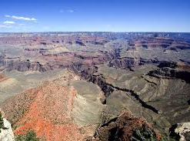
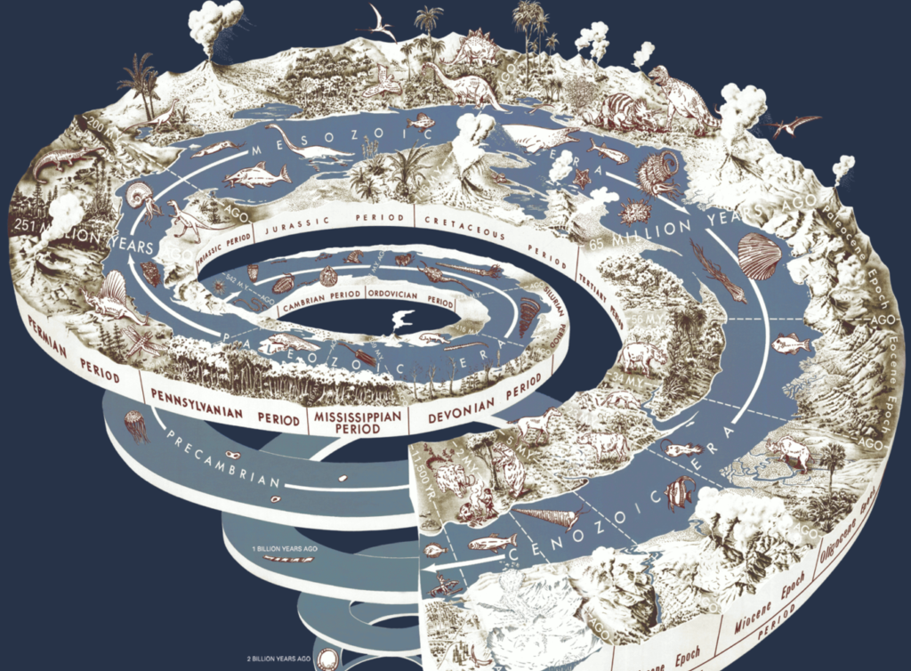

Deep Time
Liz Barry: EN377 Literature, Theory and Time (Term 2, Week 9)

Slide 2
Stef Craps and Rick Crownshaw, ‘Introduction: The Rising Tide of Climate Change Fiction’, 2
The International Commission on Stratigraphy’s Working Group on the Anthropocene voted in 2016 to identify the mid-twentieth century—the beginning of the nuclear age and the Great Acceleration in greenhouse gas emissions—as the official start of the Anthropocene, [although some (e.g. Crutzen), see it start in the C18, with the beginnings of industrial capitalism, the intensification of resource extraction, large-scale burning of fossil fuels and consequent atmospheric emissions, polar ice melt, etc.]
As a social and cultural formation, the novel has always been enabled by economic and industrial systems of modernity and their resources, from its origins to the present day (LeMenager, Living Oil […]). The product of energy regimes as much as intellectual labor, the novel is the materialization of the very environmental histories it represents (at least in climate change fiction).
The novel bodies forth […] entangled human and nonhuman dramas of people and things, and their agencies in shaping the planet […]

Slide 3
Dipesh Chakrabarty, ‘The Climate of History: Four Theses’ (2009)
Weisman’s The World Without Us: [an experiment that demonstrates that] the current crisis can precipitate a sense of the present that disconnects the future from the past by putting such a future beyond the grasp of historical sensibility (197)
a tipping point at which this slow and apparently timeless backdrop for human actions transforms itself with a speed that can only spell disaster for human beings. (205)
Globalization means “we as human beings collectively constitute ourselves and, hence, are responsible for ourselves” (Geyer and Bright, “WH,” 1059) OR [qua Anthropocene] in the process of dominating other species, [we have acquired] the status of a geologic force… a natural condition. (214)

Slide 4
Scale Effects (Timothy Clark)
You are lost in a small town, late for a vital appointment somewhere in its streets. You stop a friendly-looking stranger and ask the way. Generously, he offers to give you a small map which he happens to have in his briefcase. The whole town is there, he says. You thank him and walk on, opening the map to pinpoint a route. It turns out to be a map of the whole earth.
The wrong scale.
A scale (from the Latin scala for ladder, step or stairs) usually enables a calibrated and useful extrapolation between dimensions of space or time.
With climate change, however, we have a map, its scale includes the whole earth but when it comes to relating the threat to daily questions of politics, ethics or specific interpretations of history, culture, literature, etc., the map is often almost mockingly useless.
Timothy Clark - Derangements of Scale - YouTube

Slide 5
Environmental, economic, technological and health factors are global, but our governance systems are still based on the nation state, while our economic system (‘free market’ capitalism) and many national political systems (interest group ‘democracy’) remain profoundly individualistic in input, albeit tragically collective in output (Jim Dator, 215–6).
As a result of scale effects what is self-evident or rational at one scale may well be destructive or unjust at another. Hence, progressive social and economic policies designed to disseminate Western levels of prosperity may even resemble, on another scale, an insane plan to destroy the biosphere (Timothy Clark, ‘Introduction: Scale Effects’, n. p.)

Slide 6
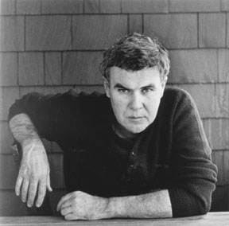
Timothy Clark, Reading of Raymond Carver’s ‘Elephant’
A comic monologue in which a modestly paid narrator complaining about the way his relatives all over the country depend on him for money, his recently unemployed brother to pay his mortgage, his daughter to support her husband who can’t hold down a job, his son who has alimony payments to make after his divorce, his spendthrift mother… Walking to work, a co-worker gives him a lift:
“Go,” I said. “What are you waiting for, George.” And that’s when we really flew. Wind howled outside the windows. He had it floored, and we were going flat out. We streaked down that road in his big unpaid-for car. (Carver, 90)
“Capitalism must be regarded as an economy of unpaid costs,” (K. William Kapp, qtd. in Foster 37)

Slide 7
Struggling with his resentment as he writes all the cheques, the narrator [of ‘Elephant’] reaches a turning point with two dreams, one of them being about how his father used to carry him on his shoulder when he was a child, and he would feel safe, stretch out his arms and fantasize that he was riding an elephant. (Clark)
Personal scale contained within sphere of narrator’s family over time scale of a few years: love and forgiveness win out over misfortune
Scale of national culture, over a few decades [scale of most literary criticism]: issues of unemployment, consumer culture, materialism, domesticity, masculinity [or alternatively post-war genre]
Hypothetical scale: whole earth, 600 year time scale: population and consumption expanding at an unsustainable rate (so very temporarily).
→ different view on all the (unnecessary number of) houses and cars owned by individuals/ very small family units. They are only under ‘threat’ relative to norms of consumption, reproduction, travel, home and car ownership that are themselves part of the “bizarre, destructive and temporary energy” (Clark) for consumption and (over)population that imperil the planet.

Slide 8
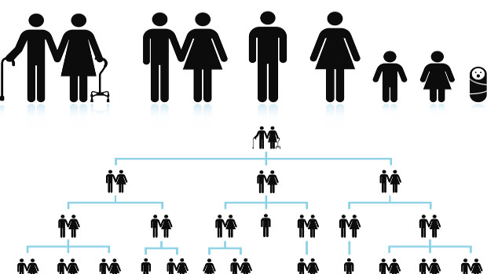
Temporal parochialism
Samuel Scheffler on “temporal parochialism.”
We have become more cosmopolitan geographically, but (arguably) more parochial in relation to past and future generations.
Scheffler: “our sense of the connections among different human generations has become increasingly impoverished, as compared, say, with more traditional societies, which often had rich and vivid conceptions of the importance of ancestors and descendants and of the continuity of the generations” (3)

Slide 9
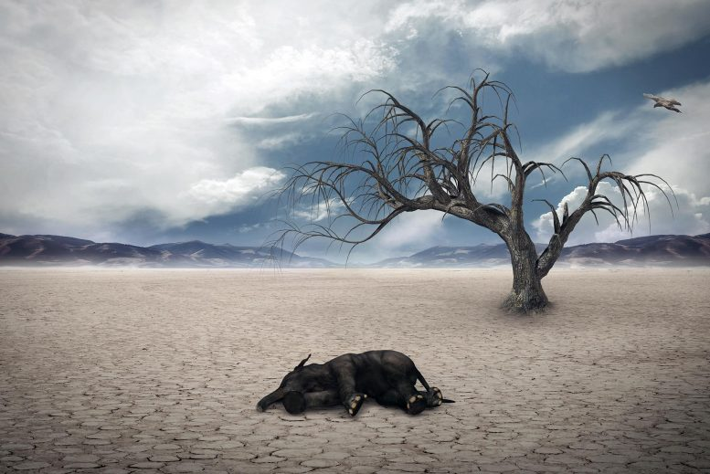
Time and the Anthropocene
Ursula Heise in Imagining Extinction: The Cultural Meanings of Endangered Species: the very power of the concept of the word Anthropocene “resides not in its scientific definition of a geological epoch, but in its capacity to cast the present as a future that has already arrived” (67).
Roy Scranton in Learning to Die in the Anthropocene, by which he means learning to accept that civilization as we know it will necessarily change: “Everybody already knows” (68).

Slide 10
Deep Time/ Climate change writing
Richard Wilbur, ‘Advice to a Prophet’ (1961)
Alice Oswald, ‘Vertigo’ 'Our melting, shifting, liquid world': celebrities read poems on climate change | Environment | The Guardian
Patrick White, ‘Five-Twenty’ (1974)
Jackie Kay, ‘Extinction’ (2015)

Slide 11
Works Cited
Clark, Timothy. “Derangements of Scale.” Telemorphosis: Theory in the Era of Climate Change, Vol. 1. Ed. Tom Cohen. Ann Arbor, University of Michigan Library: Open Humanities Press, 2012. 147-62.
Heise, Ursula. Imagining Extinction: The Cultural Meaning of Endangered Species. University of Chicago Press, 2016.
Ghosh, Amitav. The Great Derangement: Climate Change and the Unthinkable. Chicago: U of Chicago P, 2016.
Scheffler, Samuel. Why Worry about Future Generations? Oxford UP, 2018.
Scranton, Roy. Learning to Die in the Anthropocene: Reflections on the End of a Civilization. City Lights, 2015.

