Slide 1
Grief Time
Week 3

Slide 2
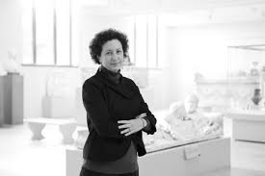
Andrea Bayer, curator of European paintings at the Metropolitan Museum of Art in New York: Connections/Grief
Grief | Connections | The Metropolitan Museum of Art (metmuseum.org)

Slide 3
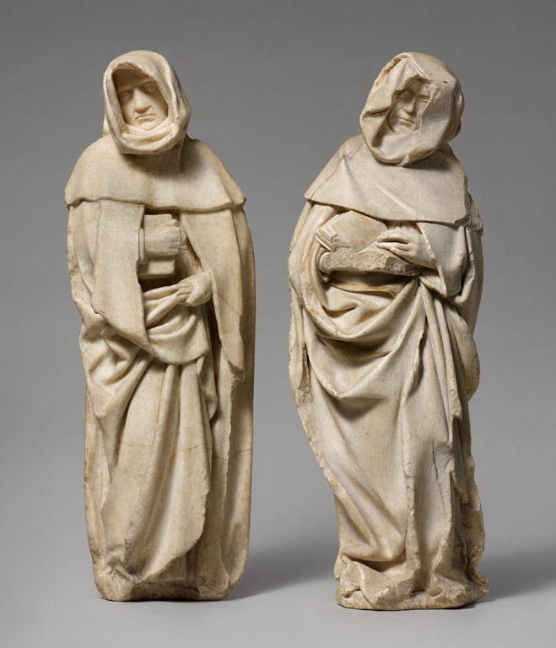
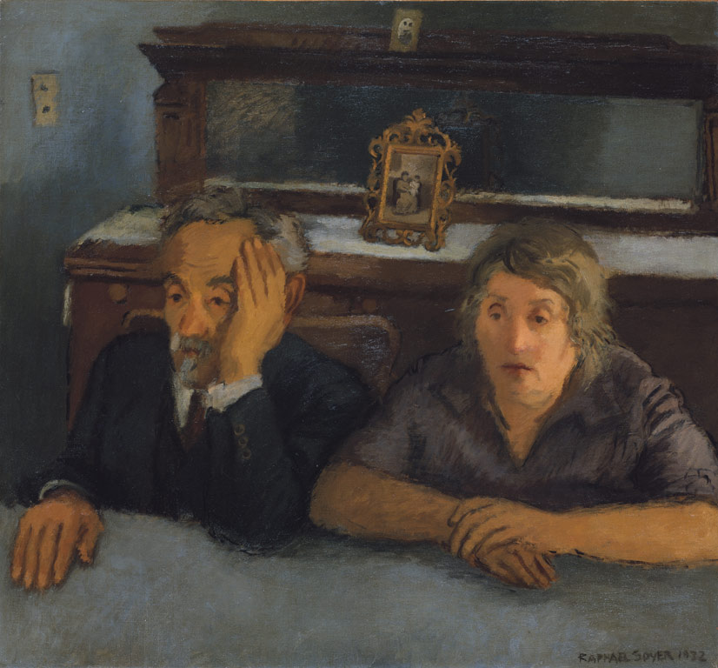
Mourning figures
The Artist's Parents | 1932 | Raphael Soyer (American, born Russia) | Oil on canvas |

Slide 4
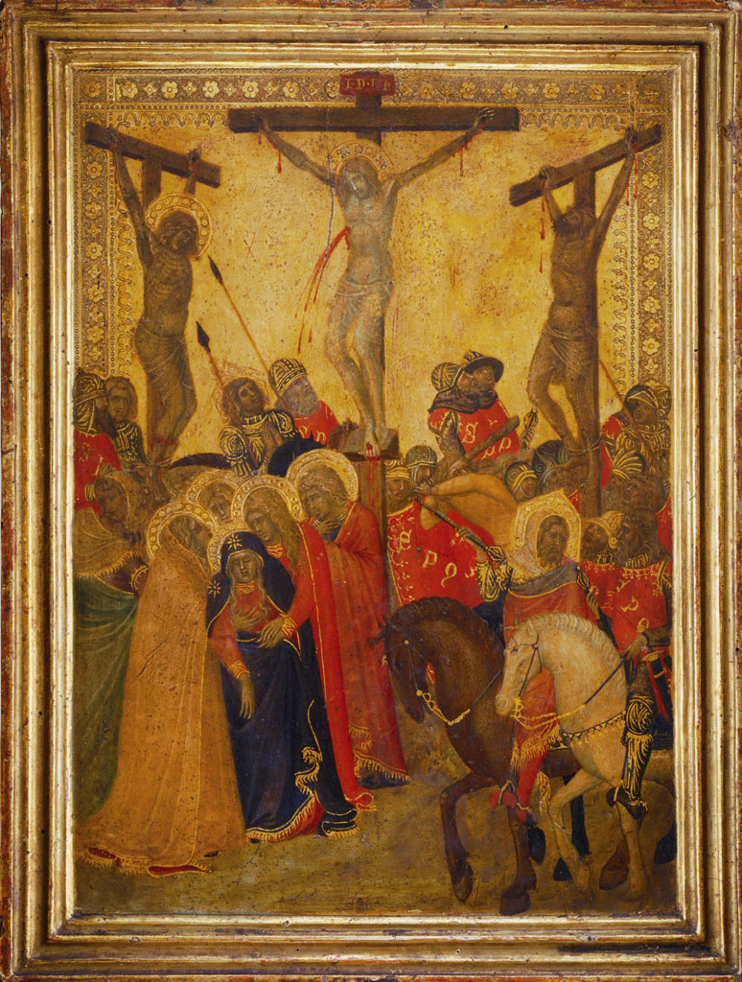
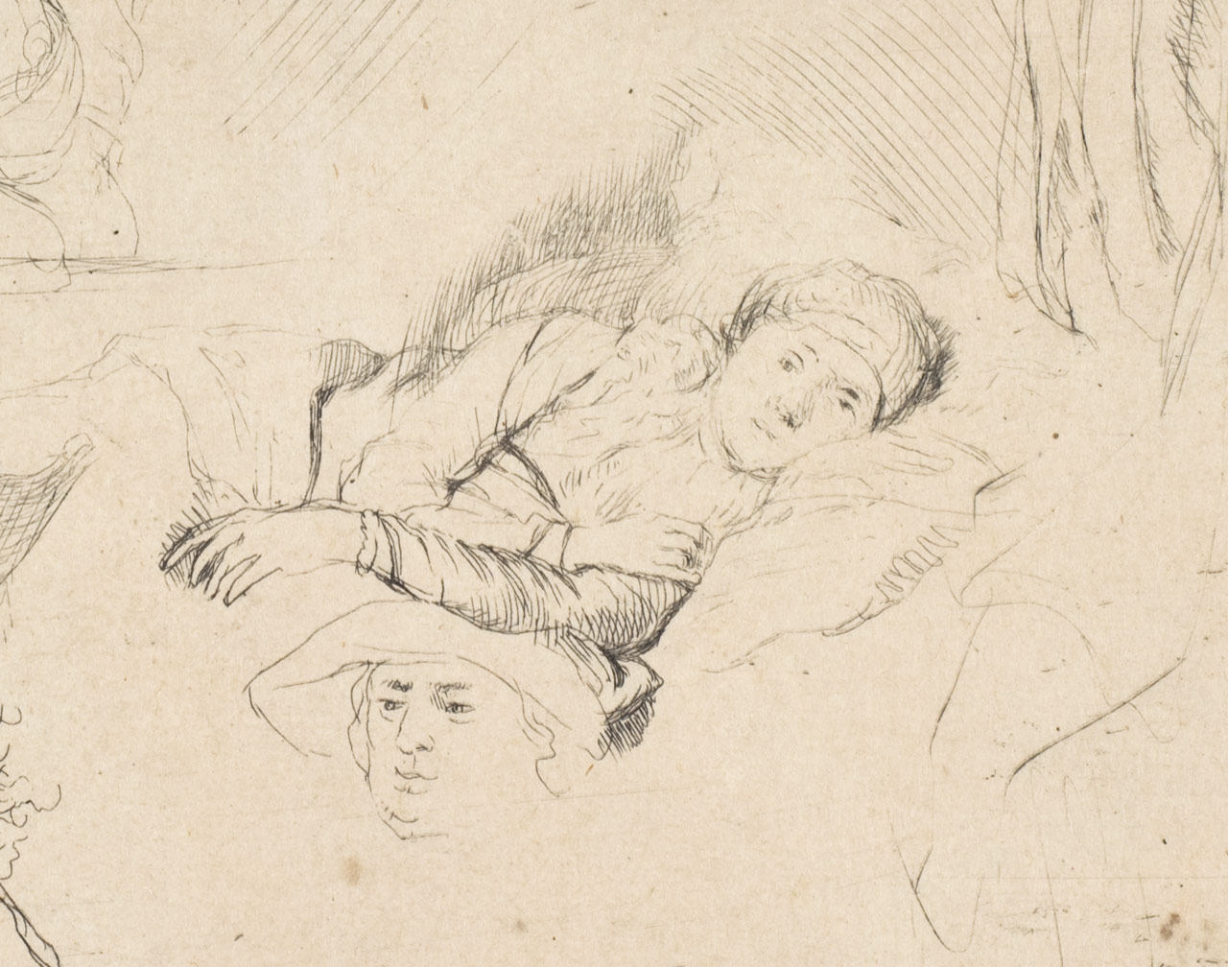
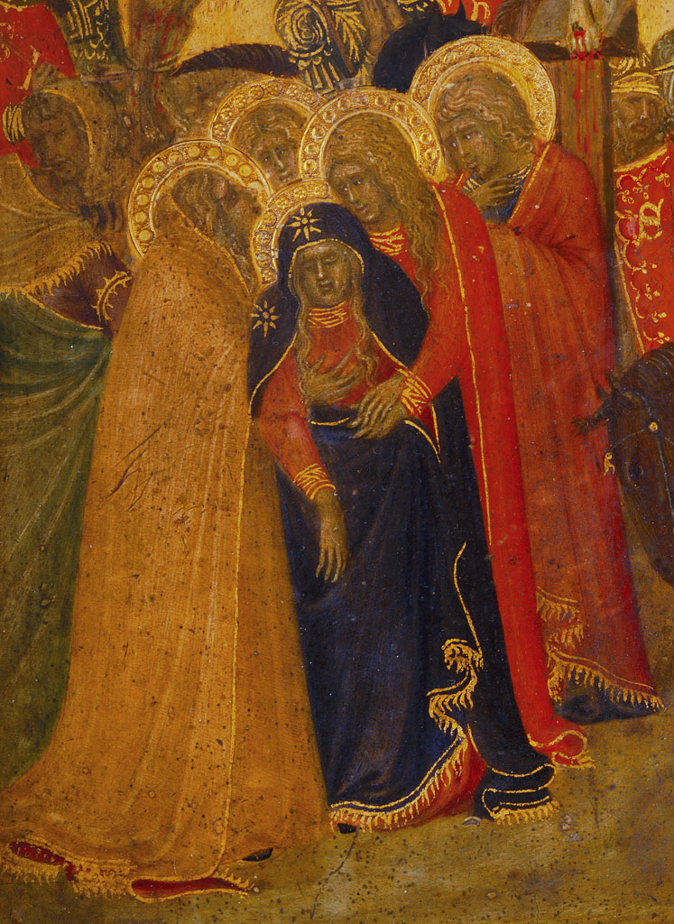
Sheet of Studies with a Woman Lying Ill in Bed, etc. | ca. 1641/42 | Rembrandt (Rembrandt van Rijn) (Dutch) | Etching |
The Crucifixion | 1340s | Pietro Lorenzetti (Italian, Sienese) | Tempera on wood, gold ground

Slide 5
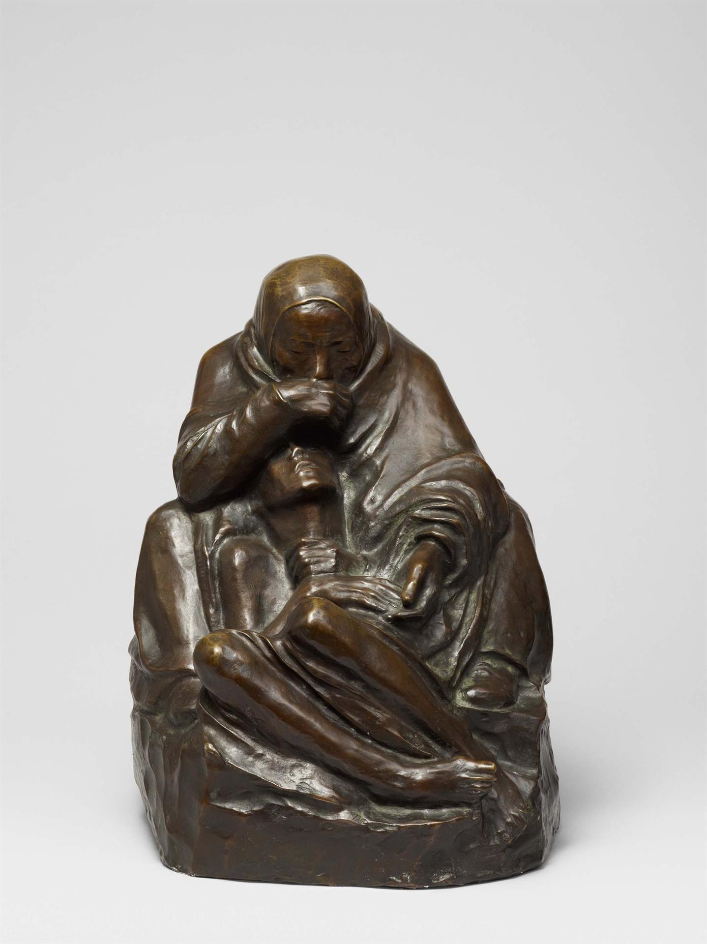
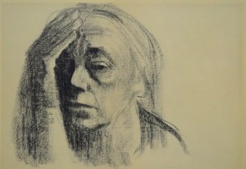
Artist Käthe Kollowitz, who lost her son Peter in WW1
Self-portrait (1947)
Mother with Dead Son (1938)

Slide 6
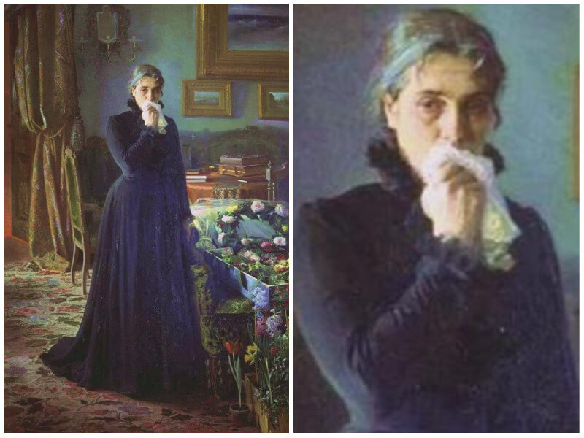
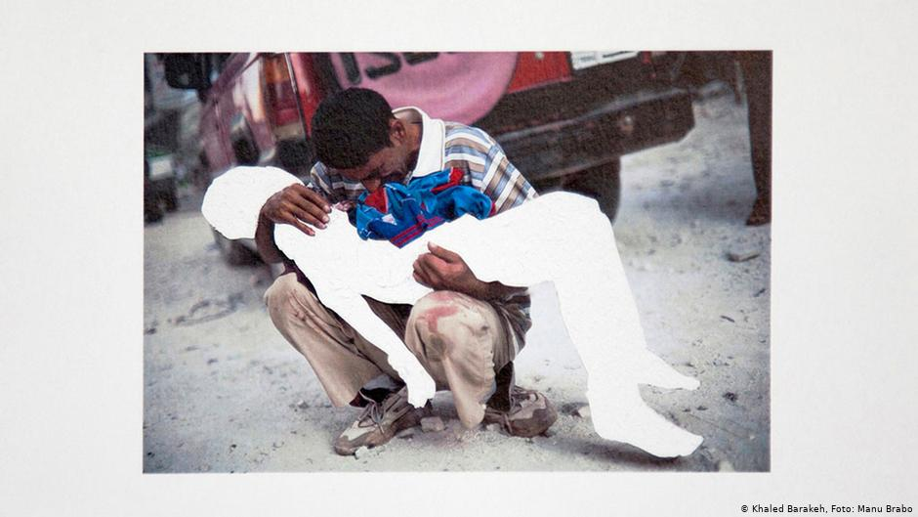
‘Inconsolable Grief’ by Ivan Kramskoi, 1884
Khaled Barakeh, from Untitled Images (2014)

Slide 7
Riley (Week 3): I will put you into 4 (? depending on numbers) breakout rooms.
Find the slide below corresponding to your room (also on the Word handout in the ‘Term 2 Week 3’ folder under our general Team (Literature, Time and Theory 1/2/3)
Think about what Riley says about time in relation to the critical reading (not just this week’s or last – you might reach back to e.g. Bergson or Ricoeur or Bakhtin or…).
Do any comparisons with The Iceberg suggest themselves?
How does her imagery strike you?
Think about the use, invocation, presentation of any of the following:
- space / place - classical or archetypal images (of time or generally)
- body - past/present/future
- light/ dark - writing/ language
What else is noteworthy?
If you finish discussing this material, have a look at the ‘Everyone’ slide (Slide 12) below and talk about those quotations from later in the memoir.

Slide 8
Denise Riley, Time Lived Without Its Flow
[Room 1]
….living in suddenly arrested time: that acute sensation of being cut off from any temporal flow that can grip you after the sudden death of your child. (9)
This ‘arrested time’ is also a question about what is describable; about the linguistic limits of what can be conveyed. I’m not keen on conceding to any such limits. Yet it seems that the possibilities for describing, and the kinds of temporality that you inhabit, may be intimately allied. For there do turn out to be ‘kinds’ in the plural. (9)
The prospect of recounting it in a written form stayed, for me, both repugnant and implausible for well over two and a half years after the death. You can’t, it seems, take ths slightest interest in the activity of writing unless you possess some feeling of futurity. […] Narrating would imply at least a hint of ‘and then’, and ‘after that’. (10)
A few of my notes are reproduced below, though they can walk around only the rim of this experience. At times they loop back on themselves, for one effect of living inside such a temporal suspension is that your reflections will crop up all over again but as if, on each occasion, they’re newly thought.
What follows is what I set down at the time at infrequent intervals, in the order that I lived it. (13)

Slide 9
[Room 2]
Riley, Time Lived (cont.)
One month after the death:
This so-called ‘work of grief’ is turning out to be a shatteringly exhausting apprehension of the needed work of living. It demands to be fully lived, while the labour of living it is physically exhausting – like virulent jetlag, but surging up in waves.
So intricate and singular a thing can’t just vanish from the surface of life: that would run counter to all your accumulated experience. […] wiping away […] tiniest bits of his hair […] This solid persistence of things.
[…] this quiet feeling of living, only just, on this near side of a cut between the living and the dead.
[…] the edge of the living world gives onto burning whiteness. This edge is as clean as a strip of guillotined celluloid film. / […] This candid whiteness, where a life stopped. Nothing ‘poetic’, not the white radiance of eternity – but sheer non-being, which is brilliantly plain. (14-15)

Slide 10
[Room 3]
Six months after:
A summer has gone, a cold autumn is setting in, but I’ve no sense of my time as having any duration, or any future. Time now is a plateau. I only know whether an event came before or after the date of the death. […] What a lumpish little word: ‘dead’. And ‘died’ seems an increasingly silly verb. ‘Dead’, used of the lively J, strikes me as not only unlikely, but mistaken. A prematurely coarse verdict. (16)
Nine months after:
Now it’s thirty-nine weeks, the duration of a pregnancy, since he vanished. As if a pregnancy had by now been wound backwards past the point of conception and away into its pre-existence.
What do the dead give us? A grip on the present instant in which we’re now relentlessly inserted. Not in a contemplative sense, but vigorously. A carnal sensation. If to be dead is to / exist outside earthly time, then this tough-minded energetic ‘living in the present’ is also the life of the dead. My new ability to live in the present joins in that timelessness of being dead. Or the nearest I can get to it. (16-17)
Ten months after:
No tenses any more. Among the recent labels for temporality is ‘time dilation’, referring to our perception’s elasticity, its capacity to be baggy. But are there any neurological accounts of this feeling of completely arrested time. […]
I’ll try again: a sudden death, for the one left behind, does such violence to the experienced ‘flow’ of time that it stops, and then slowly wells up into a large pool. […] You live inside a great circle with no rim […] lodged in the present, wandering over some vast saucer-like incline of land […] (17)

Slide 11
[Room 4]
Ten months after:
His sudden death has dropped like a guillotine blade to slice through my old expectation that my days would stream onwards into my coming life. Instead I continue to sense daily life as paper-thin. As it is. But this cut through any usual / feeling of chronology leaves a great blankness ahead. (17-18)
‘Only in the present moment is our happiness’: the stoics’ pronouncement. The irony is that now you’ve succeeded brilliantly in living exclusively in the present, but only as a result of that death. To endure, yes, but when the usual passage of time is in shards? What does your old philosophy of endurance mean, when there’s no longer any temporality in which to wait it out?
Unanticipated death does such violence to your ordinary suppositions, as if the whole inductive faculty by which you’d previously lived has faltered. Its textbook illustration was always ‘Will the sun rise tomorrow?’ But now that induction itself is no more, the sun can’t any longer be relied on to rise. And my son does not rise. This silly pun alone can reliably work its mechanical work.
…the drift of time is a mutable perception; one which can stop, leaving you breathing but stranded, stock still. […] the perception of a ‘flowing’ time must have been secreted by the mind like a silkworm spinning out its silken thread from its jaws (18)

Slide 12
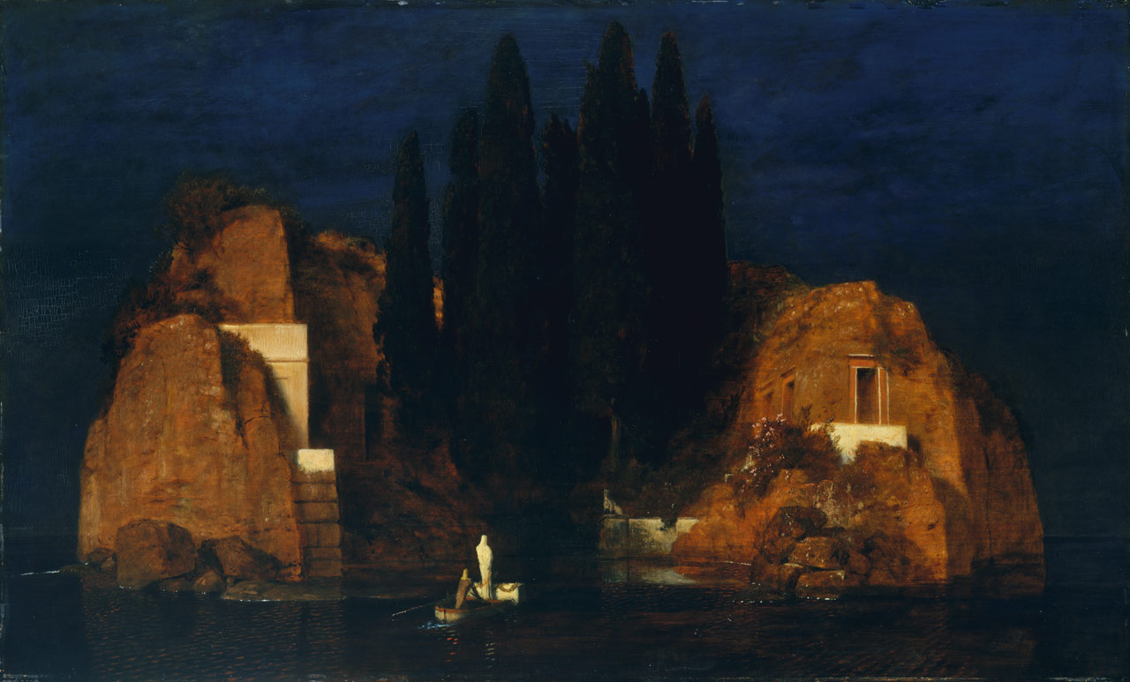
[Everyone]
No subject can easily be conceived as extinguished. Language doesn’t want to allow that thought; its trajectory is always to lean forward into life, to push it along, to propel the dead onward among the living (56)
the continuing possibilities for discussing the no longer existing person induce a curious linguistic quasi-resurrection. Perhaps language, at least, possesses a belief in the spirit (55).
an elaborate, dynamic, silent, temporal abundance, even as this is also an abundance of loss (74)
See David James, Discrepant Solace: Contemporary
Literature and the Work of Consolation (221-2)
Arnold Bocklin, Isle of the Dead c. 1880]

Slide 13
‘A Part Song’
i
You principle of song, what are you for now Perking up under any spasmodic light To trot out your shadowed warblings?
Mince, slight pillar. And sleek down Your furriness. Slim as a whippy wire Shall be your hope, and ultraflexible.
Flap thinly, sheet of beaten tin That won’t affectionately plump up More cushioned and receptive lays.
But little song, don’t so instruct yourself For none are hanging around to hear you. They have gone bustling or stumbling well away.
[…]
iv
Each child gets cannibalised by its years. It was a man who died, and in him died The large-eyed boy, then the teen peacock In the unremarked placid self-devouring That makes up being alive. But all at once Those natural overlaps got cut, then shuffled Tight in a block, their layers patted square.
vii Oh my dead son you daft bugger This is one glum mum. Come home I tell you And end this tasteless melodrama – quit Playing dead at all, by now it’s well beyond A joke, but your humour never got cruel Like this. Give over, you indifferent lad, Take pity on your two bruised sisters. For Didn’t we love you. As we do. But by now We’re bored with our unproductive love, And infinitely more bored by your staying dead Which can hardly interest you much, either.
[Forward Prize for best single poem, 2012]

Slide 14
Caroline Pearce
Pathologies of grief (diagnosis of ‘complicated’ or ‘prolonged’ grief beyond 6 or 12 months – time is the predominant factor in justifying diagnoses and distinguishing between them)
Culture of trauma (Shepard (2002) – reconfiguration of clinical and academic understandings of mental distress; emphasis on talking therapies (recovery also recovery of time, memory, selfhood?); ‘recovery industrial complex’ (Glyde 2014); media/ culture preoccupation with trauma)
→ Grief memoir/ writing (genre – blurring of boundaries between fiction and non-fiction; status of ‘truth claims’; complication of boundary between ‘public’ and ‘private’ expression of grief)
Meaning of grief (connection between ‘recovery’ and sense of meaning of grief; rational ‘explanations’, symbolic (and creative?) processing; narrative understanding; failure to make sense of grief – complicated, prolonged grief)
Narrative self (disruption of selfhood; distortion of experience of time – and so consistent sense of self over time, narrative organization of memory etc.)

Slide 15
Narrative
Grief is widely believed to be an event that disrupts an individual’s ‘self-narrative’ (Neimeyer 2005). Tis is a belief that rests on a further assumption: that each individual possesses his or her own ‘narrative-identity.’ Creating a story about illness or grief, remedies the disruption of personal self-identity caused by traumatic experiences. 80 C. Pearce Coutts described the process of producing The Iceberg as one of ‘writing against annihilation’ (Law 2014).
What has been described as a ‘narrative turn’ in the social sciences sought to acknowledge how telling stories is ‘universal’ and that human beings understand and make sense of their lives in narrative (Bury 2001; Clandinin and Connelly 2000; Frank 2010; Squire 2005).
The healing properties of narrative have been especially highlighted in studies of illness, and increasingly in grief and bereavement, where constructing a narrative is believed to repair disrupted identities and enable people to reconstruct their biographies (Bury 2001; Frank 2006)

