Slide 1
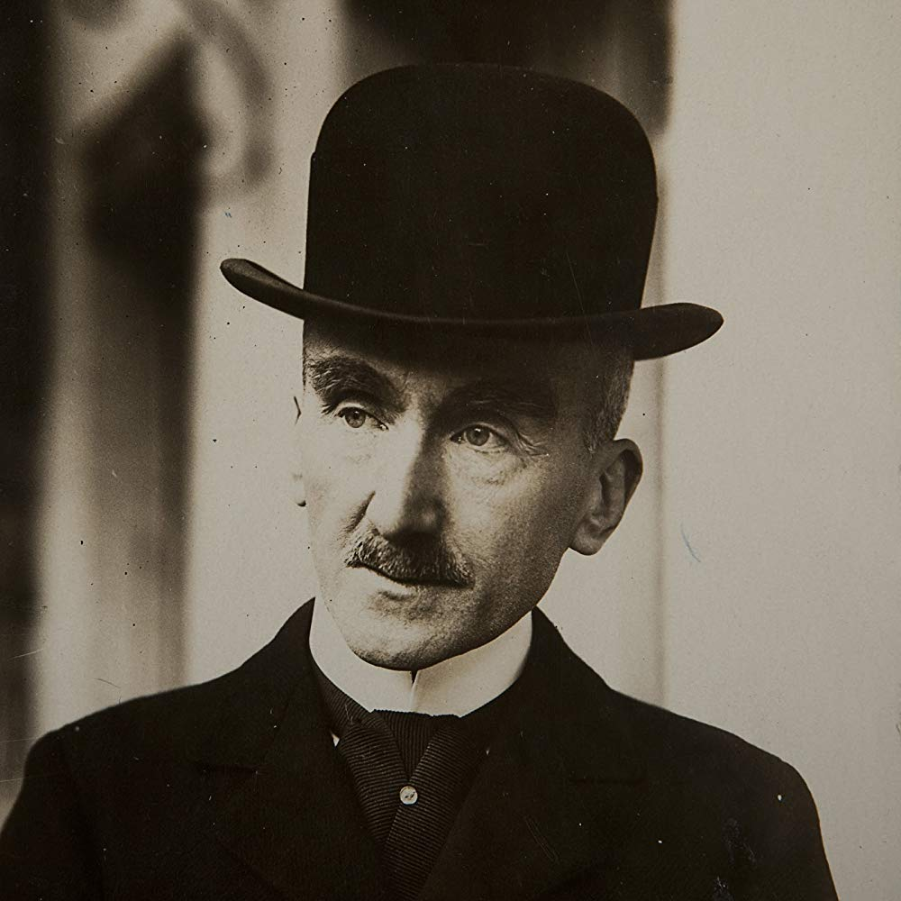

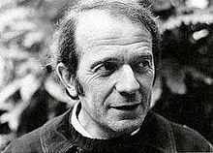
Phenomenological Time: Bergson and Deleuze
https://www.youtube.com/watch?v=2RomMlPHGqU

Slide 2
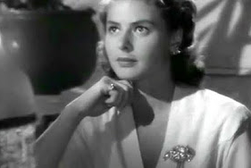
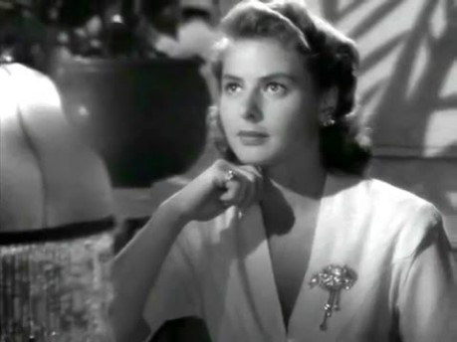
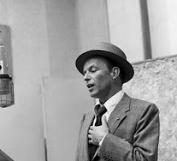
The essence of time is that it goes by. (Bergson, 1991, 137)
Change: “time is the dimension of change, a fact which distinguishes it from the three dimensions of space” (Ted Honderich)
https://www.youtube.com/watch?v=2RomMlPHGqU

Slide 3
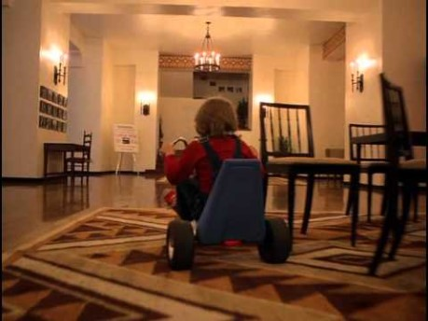
Diegetic sound in The Shining

Slide 4
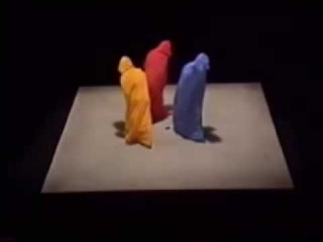
Spatial analogies
Ways of thinking about the physical external world – mechanism, logic, quantity – are imported into the way we think about mental life. But spatial conceptualization is reversible (an equation can go forwards or backwards). Not true for time. So spatial analogies for time are problematic.

Slide 5
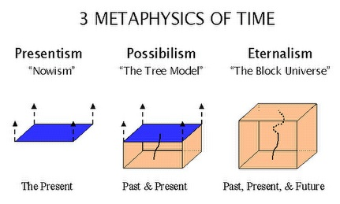

Slide 6

Henri Bergson, Time and Free Will
Duration: “the form which the succession of our conscious states assumes when our ego lets itself live, when it refrains from separating its present state from its former state” (100).
“…as happens when we recall the notes of a tune, melting, so to speak, into one another” (100).
Feelings are not distinct or discrete; ‘real’ time (duration) is only encountered via intuition. Every moment of duration overlaps with every other.
Influences philosophers like Max Scheler, psychiatrists like Eugene Minkowski and psychoanalysts like (Woolf’s sister in law) Karin Stephen.

Slide 7
Bergson’s time as psychological
Duration: the varying speed at which the mind apprehends the length of experiences according to their different intensities, contents and meaning for each individual. [So radically HETEROGENEOUS.]
“Bergson’s view of time removes the external standard and replaces it with what the internal sense of time reveals—that real time is that in which people live and it is qualitative, not quantitative in nature” (Mary Ann Gillies, ‘Bergsonism: ‘Time out of Mind’’, A Concise Companion to Modernism, 102).

Slide 8
“In the Bergsonian construction of reality, though real living goes on in the indivisible realm of durée (duration), this world is broken into segments in order to explain, analyze, and even understand the nature of experience. The conscious reconstruction of our experiences [e.g. via images] distorts them, but this distortion is inevitable because of the impossibility of ever halting the flow of durée and because of the equally inevitable human need to violate this flow in order to assert our will over the natural environment” (Mary Ann Gillies, ibid.)
Images can only reveal duration indirectly; it is only apprehended through intuition and imagination.
Does reality have an intrinsic structure or is it “an incessant shower of innumerable atoms” (Woolf, ‘Modern Fiction’)?

Slide 9
Bergson and Woolf
Critics vary on whether they think Bergson a direct influence on Woolf or not – there is no very concrete evidence that she read him. (Leonard Woolf said ‘no’, but it seems unlike;y that she didn’t as much as glance aat her sister-inlaw, Karin Stephen’s book on him.) But she spent time with lots of philosophers and read them and others, and Bergson was a huge presence in early C20 thought.
They share a central concern with three things:
  Time
  Intuition
  Memory
Woolf seems to treat these in a way very consistent with Bergson’s thought (Mary Ann Gillies, Henri Bergson and British Modernism, 108)

Slide 10
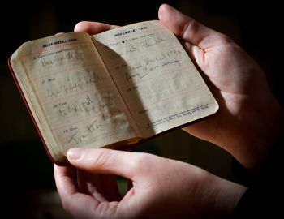
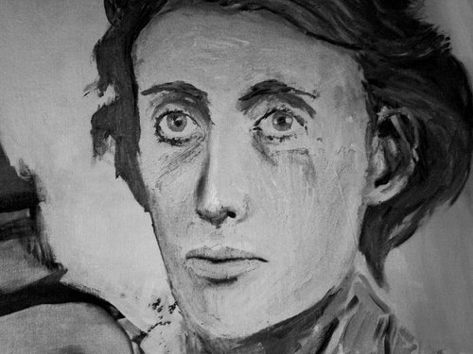
Gillies in HB and British Modernism quotes Shiv Kumar on Woolf: “Of all the stream-of-consciousness novelists, Virginia Woolf alone seems to have presented a consistent and comprehensive treatment of time. Time with her is almost a mode of perception, a filter which distils all phenomena before they are apprehended in their true significance and relationship” (Kumar, 64).
Woolf contrasts ‘moments of non-being’ and ‘moments of being’ – we live most of our day(s) through the former, not attending to the phenomenon of time itself or ourselves relative to it: in “cotton wool”, as Woolf puts it (‘A Sketch of the Past’, 84). But occasionally we become ‘alive’ for a moment – intensely aware of our immediate surroundings and our place in history.
Woolf’s diary, 4th January 1929: “this moment I stand on… transitory, flying, diaphanous” (1981: 138)
Such moments seem to arrest the flow of time – they are in Bergson’s terms, pure duration, when past and present co-exist and are known to us. She puts such moments together into a sustained moment of being – such that a day can encompass a lifetime.

Slide 11
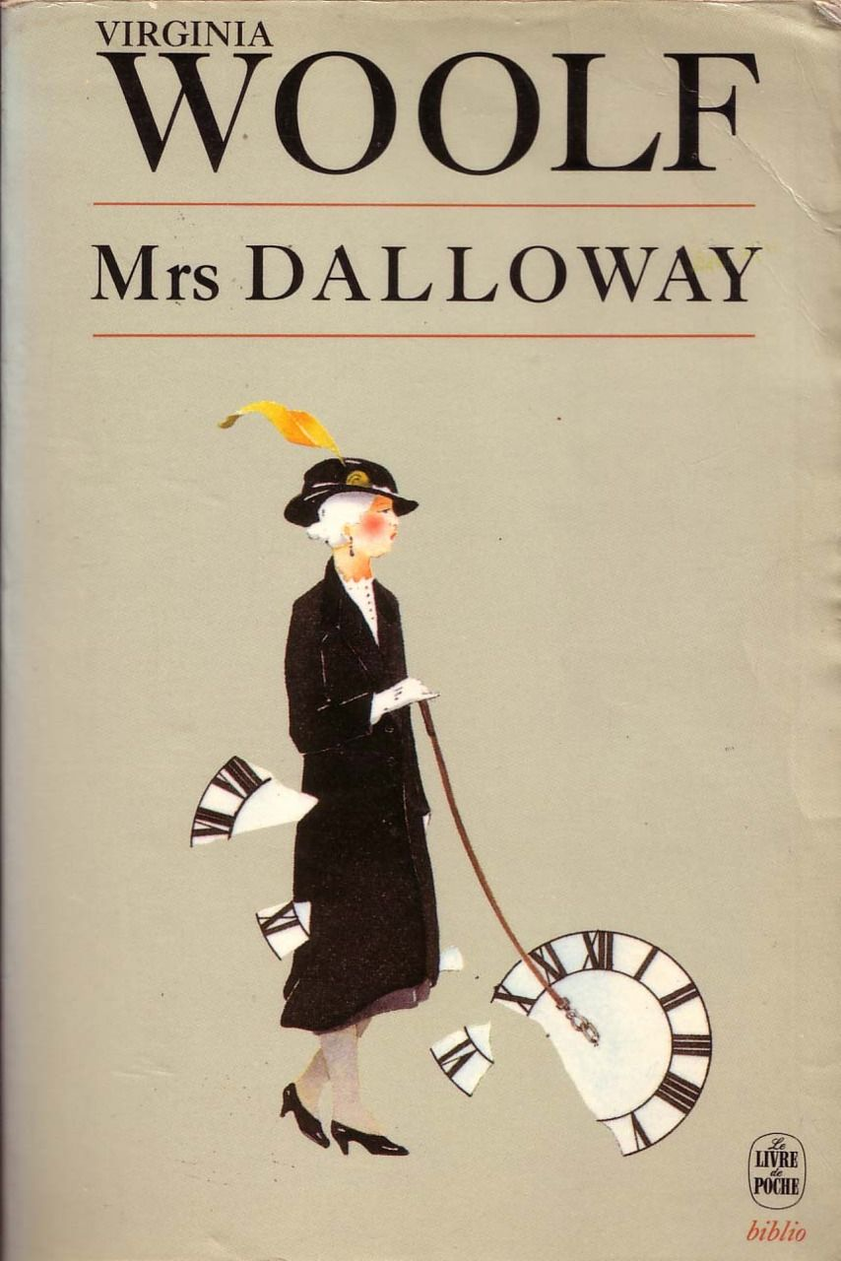
Bergson and Mrs Dalloway
‘A’ Groups: Look at the passage of Bergson from ‘Whilst I am writing these lines’ to ‘symbolical representation derived from extensity’ in relation to the paragraph in Mrs Dalloway that begins ‘For having lived in Westminster’ (and ends ‘Life, London, this moment of June’. How does each characterize the experience of listening to their respective clock towers chime?
‘B’ Groups: Look at the passage of Bergson from ‘By separating these moments from each other’ [this feeling being ‘a violent love or a deep melancholy’] to ‘He has brought us back into our own presence’ in relation to the paragraph in Mrs Dalloway starting ‘Looking back over that long friendship’ [as Peter Walsh is doing] and ending ‘One scene after another at Bourton…’. How far is she such a ‘bold novelist’?

Slide 12
Bergson, Matter and Memory (1988, 150)
If […] what you are considering is the concrete present such as it is actually lived by consciousness, we may say that this present consists, in large measure, in the immediate past. …in truth, every perception is already memory. Practically, we perceive only the past, the pure present being the invisible process of the past gnawing into the future.

Slide 13
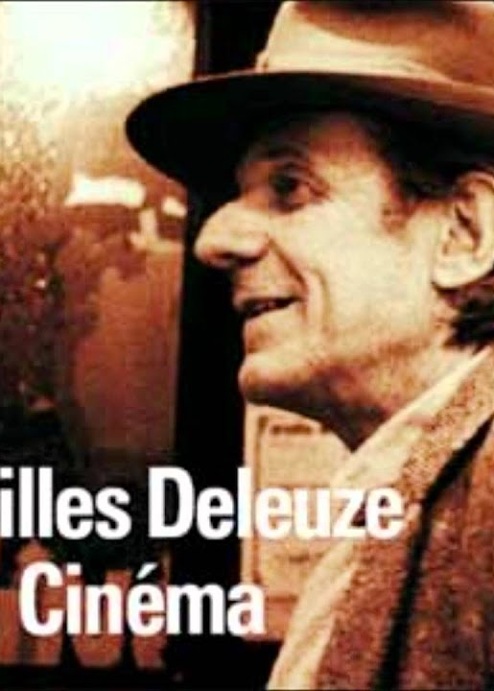
Deleuze, ‘Preface’, Cinema 2: movement-image gives way to time-image
Over several centuries, from the Greeks to Kant, a revolution took place in philosophy: the subordination of time to movement was reversed, time ceases to be the measurement of normal movement [but] appears for itself and creates paradoxical movements. Time is out of joint: Hamlet's words signify that time is no longer subordinated to movement, but rather movement to time. It could be said that, in its own sphere, cinema has repeated the same experience, the same reversal, in more fast-moving circumstances. The movement-image of the so-called classical cinema gave way, in the postwar period, to a direct time-image. (Preface, xvi)

Slide 14
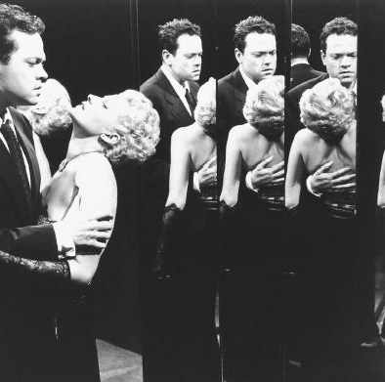
…time, 'a little time in the pure state‘ […] rises up to the surface of the screen. Time ceases to be derived from the movement, it appears in itself and itself gives rise to false movements. Hence the importance of false continuity in modern cinema: the images are no longer linked by rational cuts and continuity, but are relinked by means of false continuity and irrational cuts. Even the body is no longer exactly what moves; […] it becomes rather the developer [revelateur] of time, it shows time through its tirednesses and waitings (Antonioni). (Deleuze, Cinema 2, xi)
Orson Welles, The Lady from Shanghai (1947)

Slide 15
This is to say that the time-image has nothing to do with a flashback, or even with a recollection. Recollection is only a former present, whilst the characters who have lost their memories in modern cinema literally sink back into the past, or emerge from it, to make visible what is concealed even from recollection.
[…] Flashback [gives way to] much more complex temporal movements. (Cinema 2, xii)

Slide 16
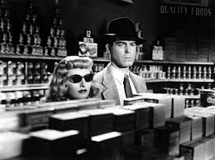
Time and post-war cinema (Deleuze, Cinema 2)
False continuity
False movements
The ‘time-image’
  Time that appears for itself
  Time ‘developed’ or revealed
  Image that reveals relationships of time
Characters that have lost their memories
Complex temporal movements
An oppressive, useless and unsummonable time – analogous to post-war cinema’s non-spaces, “spaces reduced to their own descriptions (city-deserts or places which are constantly being destroyed)”. Or see Vivian Sobchack on ‘lounge time’ and ‘no-places’ (‘Lounge Time’, 1998).

Slide 17
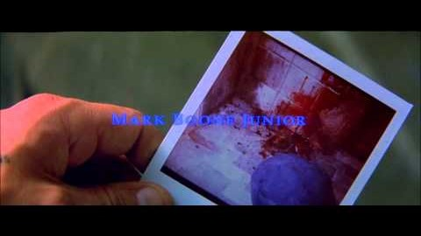
Memento (2000), dir. Christopher Nolan
Leonard, left amnesiac after a violent attack in which his wife was killed, is trying to identify her killer and take revenge. He cannot establish new memories, however, so can never be sure about the new information he receives, about others’ deeds and identities, and his own. He has written and tattooed information related to the crime on his own body.
Watch the opening titles and first few minutes of Memento. Where might Deleuze’s time-image be manifest? How might we read this film in relation to the ideas about time explored so far?

Slide 18
Melissa Clarke, ‘Space-Time Image: The Case of Bergson, Deleuze and Memento’
Leonard meets a series of people, and we are given a plausible explanation of how he knows them. Later in the film, however, doubt is cast on these explanations.
“The irresolvability of truth in the [different] presents shows each is contingent on its connection with one among several alternative, coexisting pasts.” (Clarke, 176)
Those gaps in Leonard’s memory still exist as parts of the ‘social past’, however, as pasts to his present, whether or not he can remember them. Duration persists even in the face of the failure of individual memory.

