Slide 1
Race and Time
Week 5

Slide 2
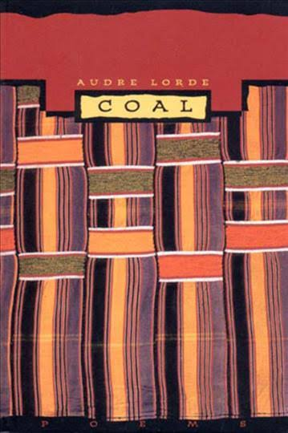
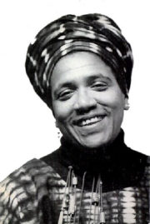
‘Coal’ by Audre Lorde
I
Is the total black, being spoken
From the earth's inside.
There are many kinds of open.
How a diamond comes into a knot of flame
How a sound comes into a word, coloured
By who pays what for speaking.
Some words are open
Like a diamond on glass windows
Singing out within the crash of passing sun
Then there are words like stapled wagers
In a perforated book—buy and sign and tear apart—
And come whatever wills all chances
The stub remains
An ill-pulled tooth with a ragged edge.
Some words live in my throat
Breeding like adders. Others know sun
Seeking like gypsies over my tongue
To explode through my lips
Like young sparrows bursting from shell.
Some words
Bedevil me.
Love is a word another kind of open—
As a diamond comes into a knot of flame
I am black because I come from the earth's inside
Take my word for jewel in your open light.

Slide 3
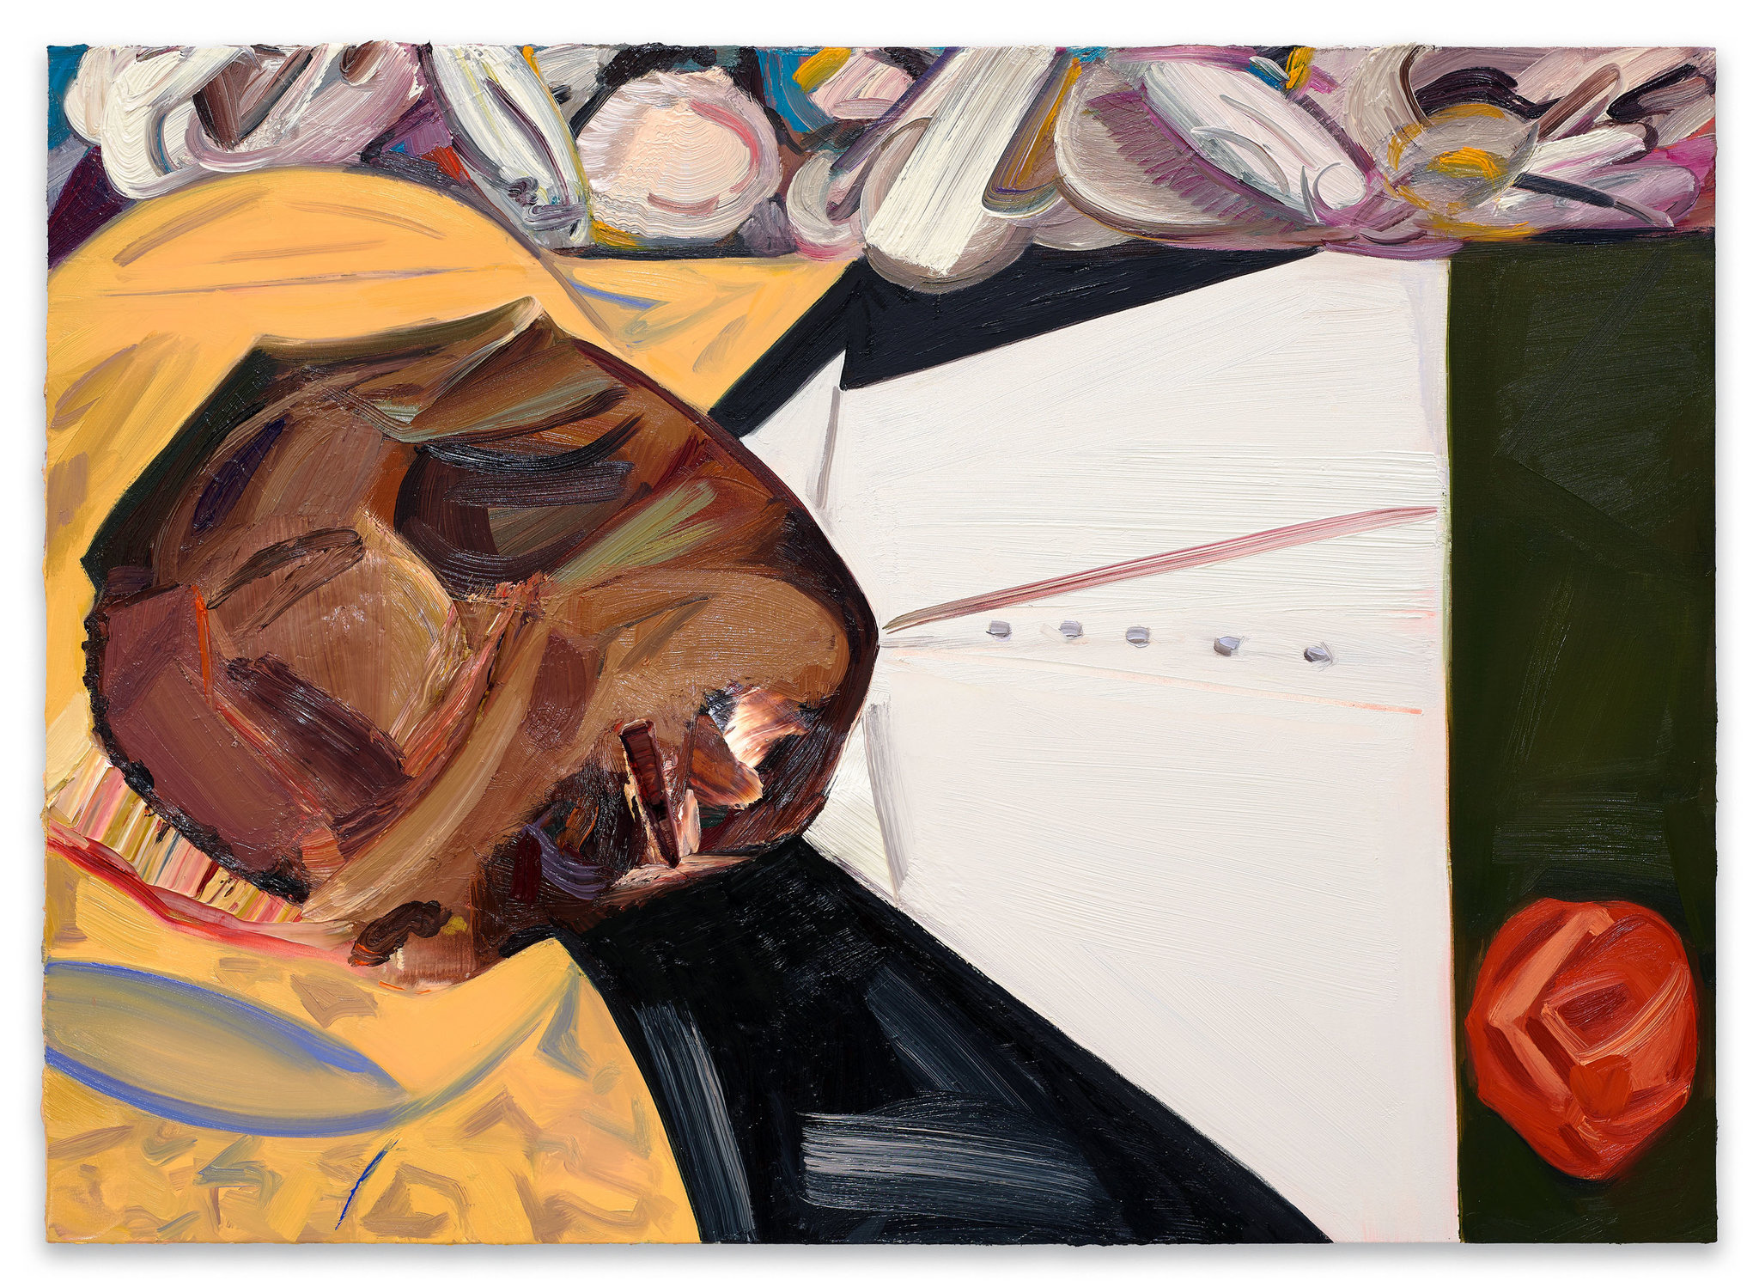
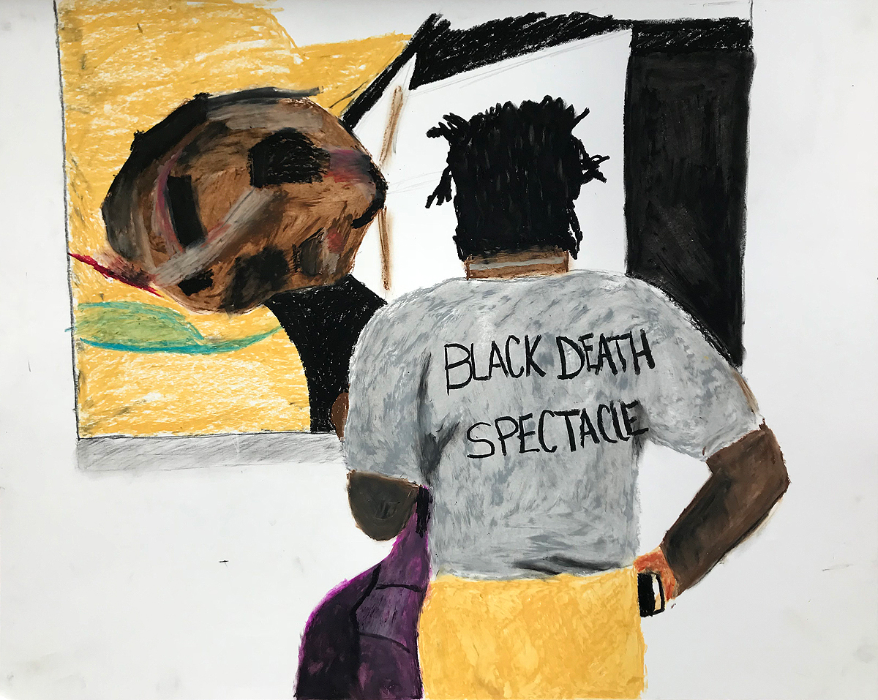
Emmet Till and Art at the Witney Biennial, New York, 2017
Dana Schutz, ‘Open Casket’ (2016)
Parker Bright, ‘Confronting My Own Possible Death’ (2018)

Slide 4
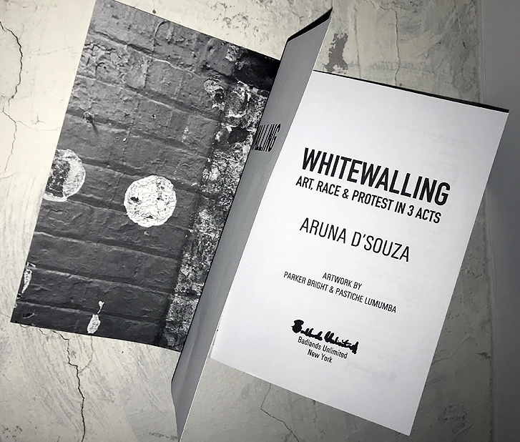
‘Whitewalling’
Aruna D’Souza, Whitewalling: Art, Race and Protest in 3 Acts
“whitewalling,” which D’Souza defines in her introduction as “a neologism that expands in many directions: the literal site of contention, i.e., the white walls of the gallery; the idea of ‘blackballing’ or excluding someone; the notion of ‘whitewashing,’ or covering over that which we prefer to ignore or suppress; the idea of putting a wall around whiteness, of fencing it off, of defending it against incursion.”

Slide 5


Slide 6

Tarell Alvin McCraney, In Moonlight, Black Boys Look Blue (unpublished) becomes Moonlight (2016), dir. Barry Jenkins
Original play: “the circular structure of the play, with the three different versions of the character playing out their lives at the same time.”
Film makes this circular structure linear, but film progresses by a series of disconnected ‘moments’. Features Chiron, the central character, at 11, 16 and 25.
The film doesn’t proceed according to the “normal” rules of narrative development: cause–effect logic, clear linear development, steady pacing.

Slide 7
Pamela Demory on ‘queer time’ in Moonlight (2016)
Judith Halberstam writes in In a Queer Time and Place that the threat of having “no future” produced an “urgency of being [that] also expands the potential of the moment and … squeezes new possibilities out of the time at hand” (2). Halberstam argues that this queer temporality—the intense focus on “the now”—applies also to “women, transgenders, and queers,” particularly “queer people of color” (3). It would also apply to the characters in Moonlight, who are living under a similar threat of “no future”—in this case due to pervasive poverty, violence, and drugs.
Tarell Alvin McCraney (who wrote the original play the film is based on] says he often tells people his plays take place in “the distant present,” a phrasing that suggests a time that is “just out of reach, yet not quite fully in the time of the now. But it is close enough to register as familiar” (Roman 188). The concept is similar to what Valerie Rohy calls an “expanded present tense” (253) or what Carolyn Dinshaw calls “the multitemporality of the now” (qtd. in Rohy 253)

Slide 8
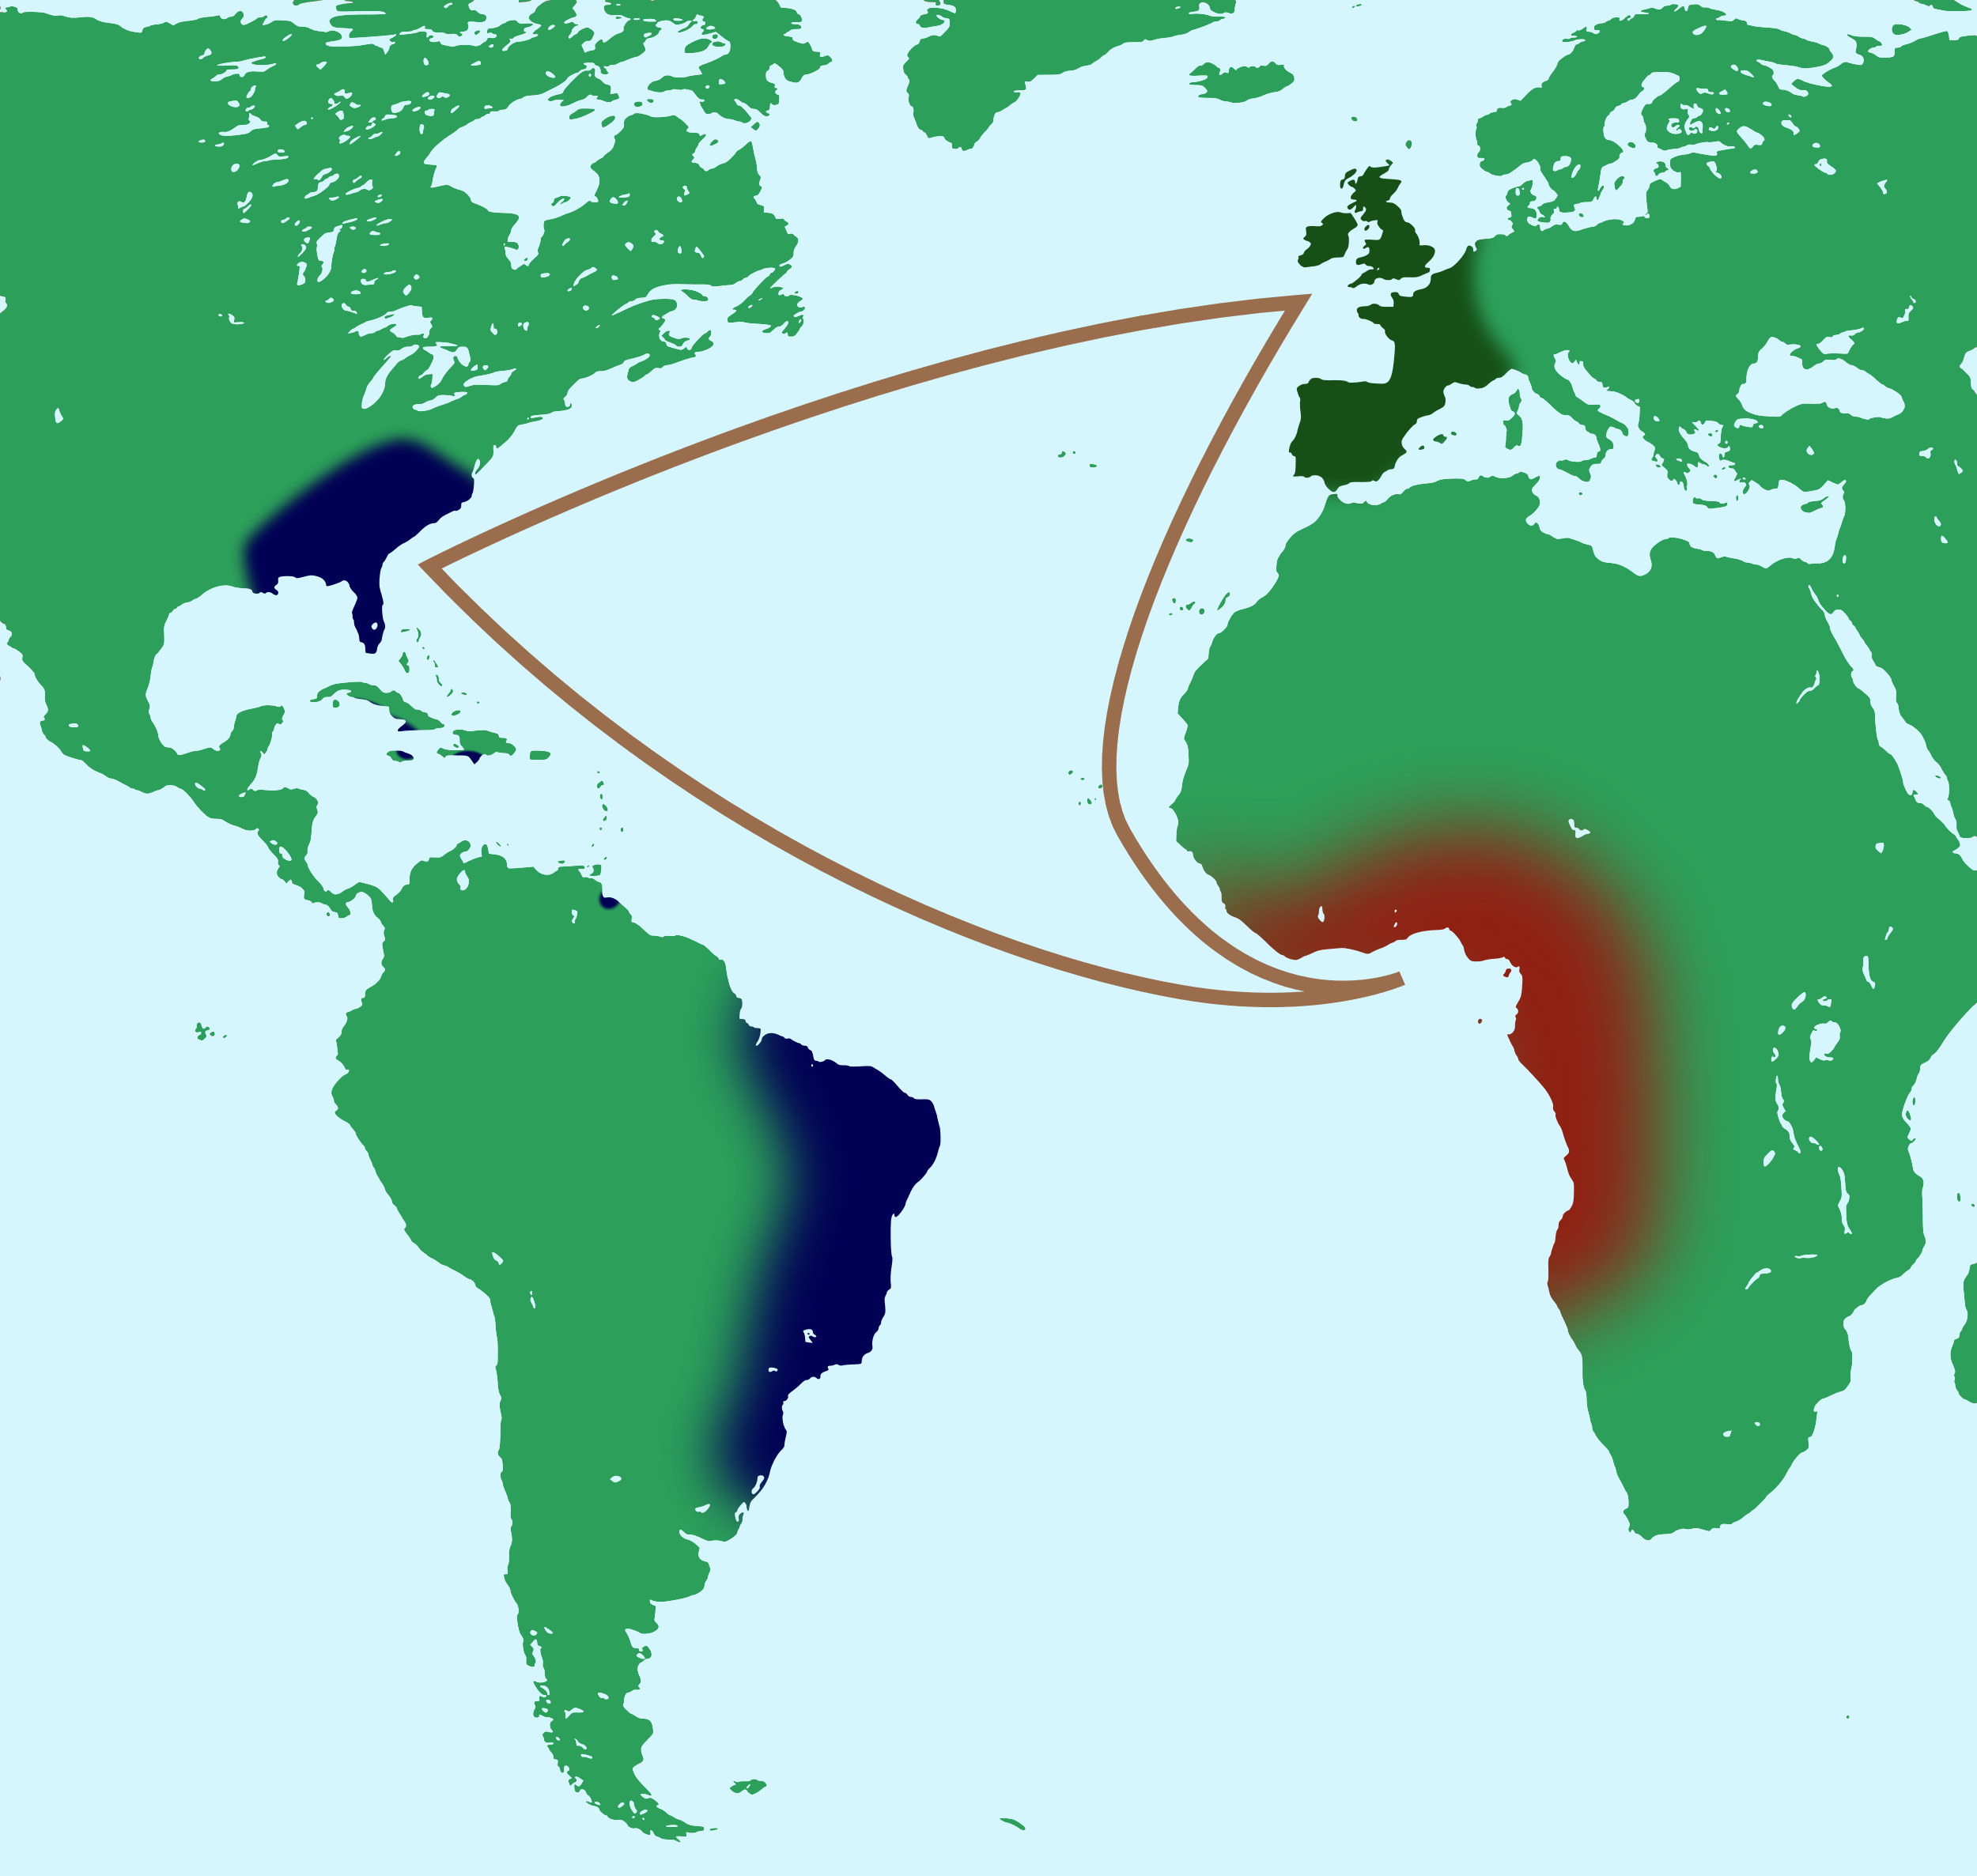
Michael Hanchard, ‘Afro-Modernity
Transnational black movements of C19 and C20 used ideas of their time (of modernity): nation state, universal human rights, racial selfhood and collective identity, democracy, international socialism, etc.
Industrial and nationalist revolutions offered conditions and discourse for critique of subordinated position of black people
Diaspora: the displacement of African people across the globe, often forcibly and violently through slavery.
Middle Passage: ‘triangular trade’ in people between Africa, North America and Europe

Slide 9
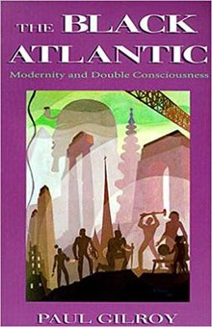
Black Atlantic
Black Atlantic arts movement: term used by Paul Gilroy in his book of 1993, who argued that the Atlantic world and its culture had been deeply influenced by slavery and the slave trade.
Between 1492 and 1820 about two-thirds of the people who crossed the Atlantic to the Americas were African, and this violently brutal migration played a key role in the development of a black consciousness in the Americas and Europe.
“a [black Atlantic] culture that is not specifically African, American, Caribbean, or British, but all of these at once” (Gilroy)
Black consciousness has engaged with white culture and played a key part in the development of modernism
The Black Atlantic has constituted a black nationalism without a nation

Slide 10
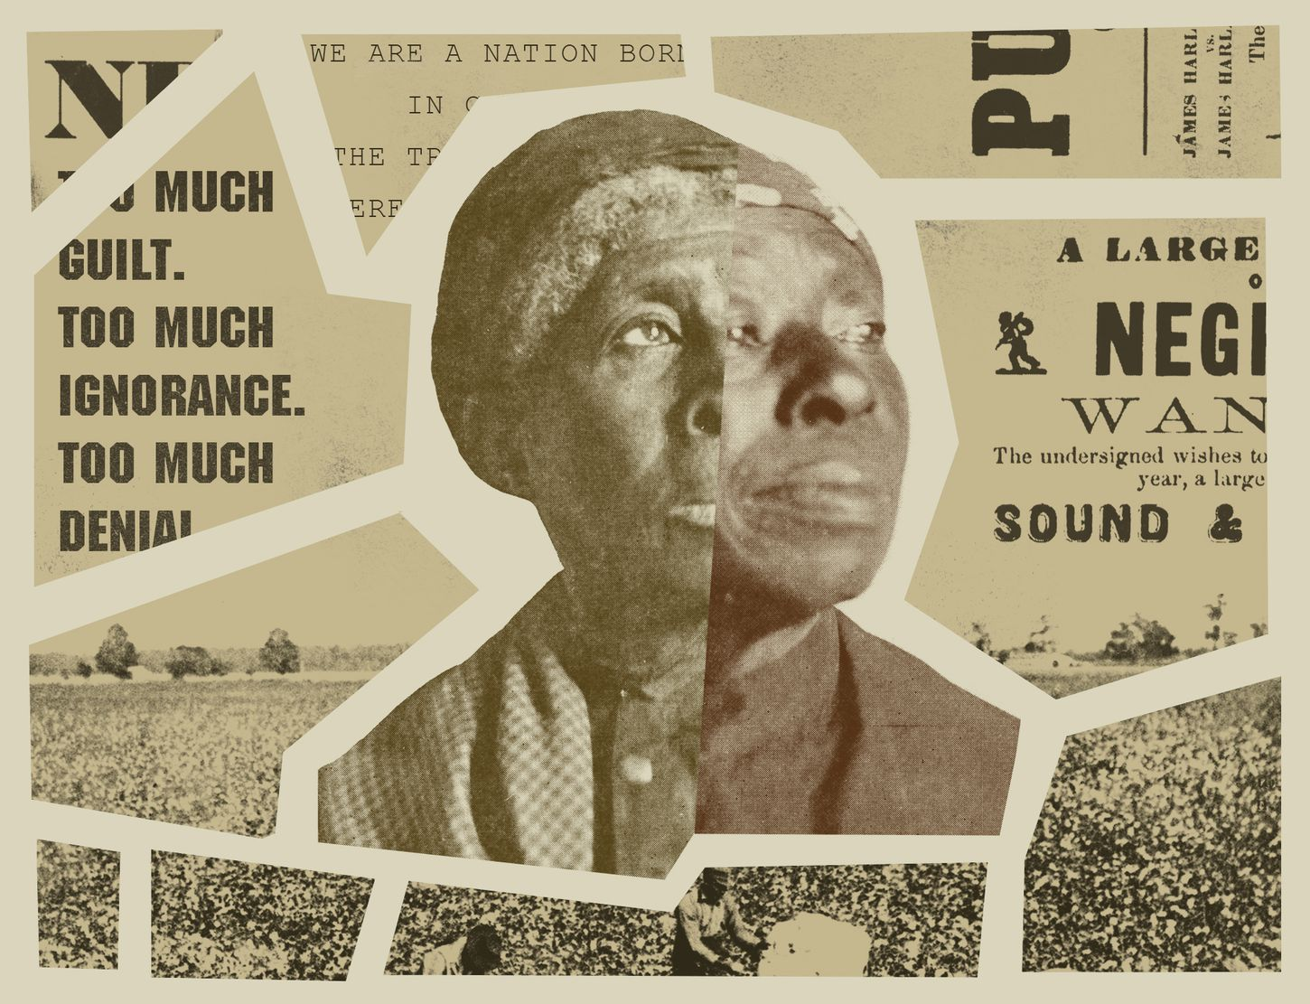
Hanchard cont.
African history forgotten, obscured and erased via a kind of tabula rasa
Post- World War II, a reconstruction of the past – one of the first pedagogical projects of Afro-Modern activists (Hanchard, 251)
Not just give continuity with African past of diaspora peoples, but give some coherence to their present, continuous lives – the idea of a “future past” (Kirkland) made in the ongoing black consciousness

Slide 11
Time inequality
An understanding of the past acknowledging the temporal disjuncture imposed on African-descended people (displacement and deferral that slavery and imperialism imposed)
Idea that African-derived people had to ‘sophisticate themselves’ through their relation to Western ideals in order to have a relationship with the modern West – either ‘catching up’ or finding themselves looking across a chasm (Hanchard, 252)
Temporal inequality. “Waiting” as a “time structure that is imposed upon us” (Schutz and Luckman) – belated access to instutitions, goods, services, resources, power and knowledge. (252)

Slide 12
Slaves and ‘time management’
Imposition of slave owner’s construction of temporality on the slaves
Work occupied almost all of the time.
“From the calories they expended to the music they played, no aspect of their lives was untouched by their work regimen—its physical and psychological demands, its organization, its seasonal rhythms, and its numerous divisions by skill, age and sex.” (Hanchard 254)
No ‘contract’ such as between even labourer and employer (cf. Marx in Weeks) – total labour. No time belonged solely to the slave.
Idea of ‘seasoning’ – slaveowners’ term for the acculturation of slaves to the linguistic, social and labouring practices of the New World

Slide 13
Racial Time
1) Waiting – wait for goods and services delivered first to the dominant group. (Waiting for seats on the bus in the ‘black’ section. Using out of date textbooks after white students had finished with them. Hanchard 263-4)
2) Time appropriation – collective action to ‘seize’ time, e.g. strikes, ‘go-slow’ working, bus boycotts to protest transport apartheid
3) ideas of human progress – eschatological images of racial time – a sometimes vengeful God punishing sinful whites, a time to come in which prejudice will be obliterated. Religion providing language and concept for an impending confrontation (theological time frame but taking place in the current sites of prejudice: plantation, tenement, city, farm). (Hanchard, 257)

Slide 14
Hanchard, 265:
Paul Virilio on the synthesis of speed and politics: the struggle for black rights as a movement to reduce waiting, to explore the differentials of human time.
Incrementalism (‘bit by bit’ progress) is slow, and therefore conservative.
Acceleration of racial equality was temporally and politically emancipating and thereby good for the “race” .
Waiting “denotes taking one’s cues from somewhere or someone other than oneself”; the end of waiting means the beginning of autonomy.

Slide 15
Martin Luther King, Why We Can’t Wait
“It is important to understand, first of all, that the Revolution is not indicative of a sudden loss of patience within the Negro. The Negro had never really been patient in the pure sense of the word. The posture of silent waiting was forced upon him psychologically because he was shackled physically.”
“We can, of course, try to temporize, negotiate small, inadequate changes and prolong the timetable of freedom in the hope that the narcotics of delay will dull the pain of progress. We can try, but we shall certainly fail. The shape of the world will not permit the luxury of gradualism and procrastination. Not only is it immoral. It will not work.”

Slide 16
Christina Sharpe, In the Wake: On Blackness and Being
Wake: the track left on the water’s surface by a ship; the disturbance caused by a body swimming or moved, in water; it is the air currents behind a body in flight; a region of disturbed flow. (3)
Wakel in the line of recoil of (a gun). (8)
Blanchot: ‘The disaster ruins everything, all the while leaving everything intact. …When the disaster comes upon us, it does nont come. The disaster is its imminence, but since the future, as we conceive of it in the order of lived time, belongs to the disaster, the disaster has always already withdrawn or dissuaded it; there is no future for the disaster, just as there is no time or space for its accomplishment.’ Transatlantic slavery was and is the disaster. The disaster of Black subjection was and is planned; … “terror has a history” (Youngquist 2011, 7). (5)

Slide 17
Much Black history is, Sharpe suggests, not recorded, or erased, or suppressed. And so both the material and the methods of academic scholarship are not fit for purpose in investigating this history and its influence on the present.
“myriad silences and ruptures in time, space, history, ethics, research, and method as we do our work.”
How can scholarship accommodate the everyday knowledge that comes from “sitting in the room with history” (Diionne Brand)? To disregard such knowledge is to do ‘epistemic violence’ on ourselves and others. To be “drafted into the service of a larger destructive force” (Saunders 2008, 67)
How do recover ourselves from a “narratively condemned status” (Sylvia Wynter, 1994, 70) (Sharpe 12-13)

Slide 18
Dionne Brand, A Map to the Door of No Return memoir (2001)
The door: “that place where our ancestors departed one world for another; the Old World for the New. The place where all names were forgotten and all beginnings recast” (Brand, p.5).
Learning that neither her father nor her grandfather know which African nation they are descended from: “A small space opened in me. I carried this space with me . . . the rupture this exchange with my grandfather revealed was greater than the need for familial bonds. It was a rupture in history, a rupture in the quality of being” (4–5).
Her identity “a place emptied of beginnings” (6)
“this door exists as through a prism, distorted and shimmering . . . An absent presence” (11)
Yet: “every gesture our bodies make somehow gestures to this door” (25), “my body feels always in the middle of a journey” (87|)

