Slide 2
“My first impression of Dean was of a young Gene Autry – trim, thin-hipped, blue-eyed, with a real Oklahoma accent – a sideburned hero of the snowy West. In fact he’d just been working on a ranch, Ed Wall’s in Colorado, before marrying Marylou and coming East. Marylou was a pretty blond with immense ringlets of hair like a sea of golden tresses; she sat there on the edge of the couch with her hands hanging in her lap and her smoky blue country eyes fixed in a wife stare because she was in an evil grey New York pad that she’d heard about back West, and waiting like a long bodied emaciated Modigliani surrealist woman in a serious room” (2)
“I first met Dean not long after my wife and I split up. I had just gotten over a serious illness that I won’t bother to talk about, except that it had something to do with the miserably weary split-up and my feeling that everything was dead. With the coming of Dean Moriarty began the part of my life you could call my life on the road” (3)

Slide 3
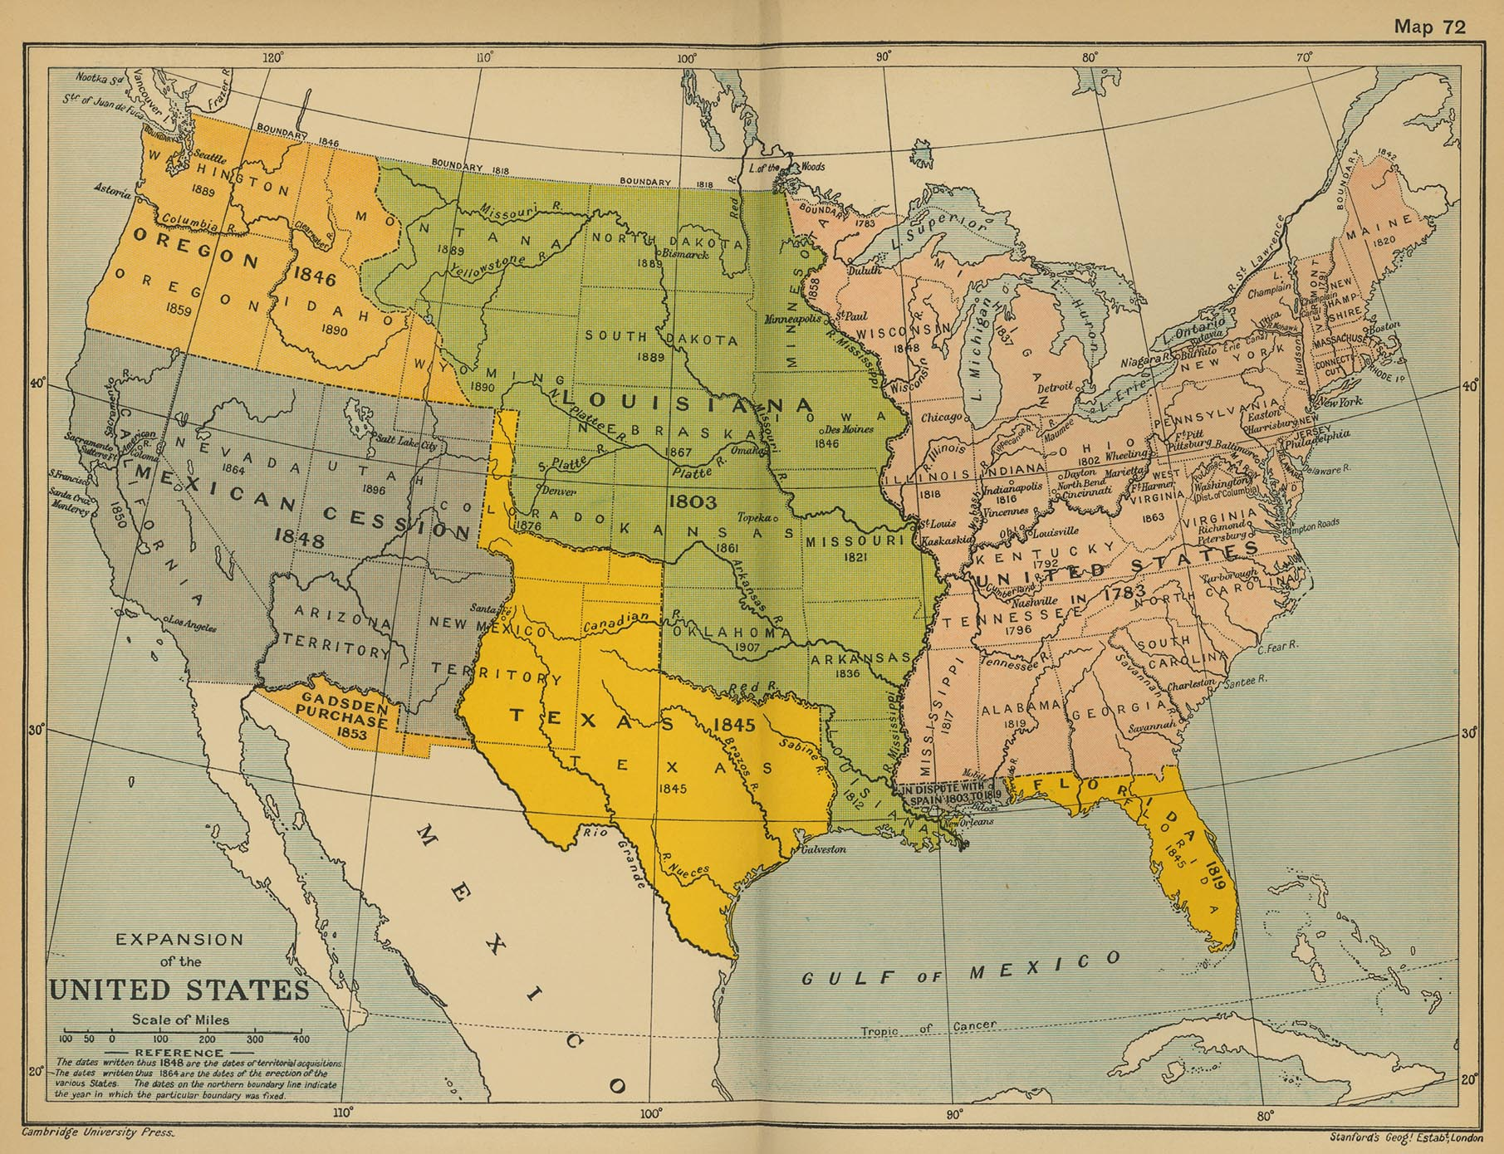
Louisiana Purchase (1803)
Indian Removal Act 1830
Anenxation of Texas 1845
Mexican-US War 1848

Slide 4
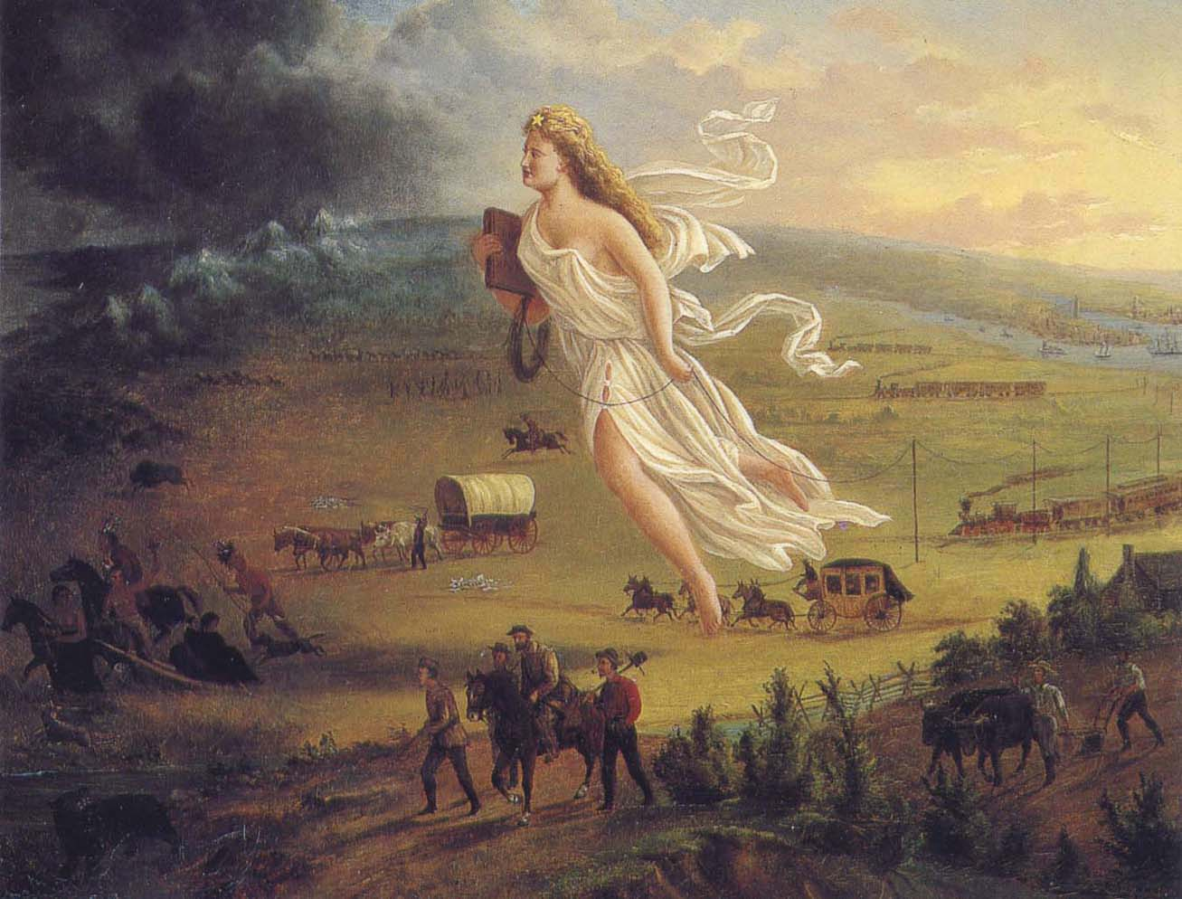
John Gast Spirit of the Frontier (1872)
[Manifest Destiny]

Slide 5
“The frontier is the line of most rapid and effective Americanization. The wilderness masters the colonist. It finds him a European in dress, industries, tools, modes of travel, and thought. It takes him from the railroad car and puts him in the birch canoe. It strips off the garments of civilization and arrays him in the hunting shirt and the moccasin. It puts him in the log cabin of the Cherokee and Iroquois and runs an Indian palisade around him. […] Little by little he transforms the wilderness; but the outcome is not the old Europe, not simply the development of Germanic germs, any more than the first phenomenon was a case of reversion to the Germanic mark. The fact is, that here is a new product that is American”
-Frederick Jackson Turner

Slide 6
“the Western hero […] strives to "master" his Western environment, to overturn the balanced code of frontier talk and action in order to ride forth as "an important man, with a strong grip on many various enterprises. " In these efforts to "master" the West, efforts which underwrite not only the ethos of American national expansion but the originary fantasy of the American pioneer, the upwardly mobile cowboy comes to seem very much like the Eastern tenderfoot urbanite who has dominated the arenas of commerce and industry but at the cost of neurasthenic strain. […] In this mythical space in which conquest and expansive effort take place without the fear of nervous "breakdown," [Western authors] imagined an improbable yet potent new national hero” (Barbara Will The Nervous Origins of the Western)

Slide 11
“I first met Dean not long after my wife and I split up. I had just gotten over a serious illness that I won’t bother to talk about, except that it had something to do with the miserably weary split-up and my feeling that everything was dead. With the coming of Dean Moriarty began the part of my life you could call my life on the road” (3)
“Critics and historians of the fifties have exposed a contrasting underside of postwar American culture consisting of fears and anxiety that mocked the barbecue and hoola hoops. Instead of one familiar and reassuring representation of the fifties, there are two interdependent and symbiotic. The first […] is of a white, affluent, suburbanized society compensating for the deprivations and disruptions of the Depression and World War II.
The alter image is of a people alienated, disoriented, and discontent: ‘Ours is a time of uneasiness and indifference … Instead of troubles – defined in terms of values and threats – there is often the misery of vague uneasiness; instead of explicit issues there is often merely the beat feeling that all is somehow not right.’”
(Wini Breines. Young, White, and Miserable: Growing up Female in the Fifties)

Slide 12
https://www.youtube.com/watch?v=sClZqfnWqmc
“When the first white settlers moved in to open up the Middle West, they did not have to build for themselves the roads which carried them out there. They used routes already there: Indian paths and buffalo trails. The American bison, heavy yet fleet of foot, tough and hard-traveling, had torn wide paths east and west, north and south, along the high ground linking the best grazing ranges and water holes. […] All over the world, in fact, man has taken over the routes of animals […] All primitive races travel close to the ridges, relying on the safety of the higher ground. This custom, in fact, is the origin of the term highway.” (Bel Geddes Magic Motorways 19)

Slide 13
“We bent down and began picking cotton. It was beautiful. Across the field were the tents, and beyond them the sere brown cottonfields that stretched out of sight to the brown arroyo foothills and then the snow-capped Sierras in the blue morning air. This was so much better than washing dishes on South Main Street. But I knew nothing about picking cotton. I spent too much time disengaging the white ball from its crackly bed; the others did it in one flick. Moreover, my fingertips began to bleed; I needed gloves, or more experience. There was an old Negro couple of the field with us. They picked cotton with the same God-blessed patience their grandfathers had practiced in ante-bellum Alabama; they moved right along their rows, bent and blue, and their bag increased” (96)

Slide 14
I wished “I were a negro, feeling that the best the white world had offered was not enough ecstasy for me, not enough life, joy, kicks, darkness, music, not enough night. I stopped at a little shack where a man sold hot red chili in paper containers; I bought some and ate it, strolling in the dark mysterious streets. I wish I were a Denver Mexican, or even a poor overworked Jap, anything but what I was so drearily, a ‘white man’ disillusioned. All my life I’d had white ambitions; that was why I’d abandoned a good woman like Terry in the Son Joaquin valley. I passed the dark porches of Mexican ans Negro homes; soft voices were there, occasionally the dusky knee of some mysterious sensual gal; and dark faces of the men behind the rose arbors. Little children sat like sages in ancient rocking chairs. A gang of colored women came by, and one of the young ones detached herself from motherlike elders and came to me fast – ‘Hello Joe!’ – and suddenly saw it wasn’t Joe, and ran back blushing. I wished I were Joe. I was only myself, Sal Paradise, sad, strolling in this violet dark, this unbearably sweet night, wishing I could exchange worlds with the happy, true-hearted, ecstatic Negroes of America” (180)

Slide 15
“The last time I saw him it was under sad circumstances. Remi Boncoeur had arrived in New York after having gona around the world several times in ships. I wanted him to meet and know Dean. They did meet, but Dean couldn’t talk anymore and said nothing, and Remi turned away. Remi had gotten tickets for the Duke Ellington concert at the Metropolitan opera and insisted Laura and I come with him and his girl. Remi was fat and sad now but still the eager and formal gentleman, and he wanted to do things the right way, as he emphasized. So he got his bookie to drive us to the concert in a Cadillac. It was a cold winter night. The Cadillac was parked and ready to go. Dean stood outside the window with his bad, ready to go to Penn Station and on across the land.
‘Good-by, Dean,’ I said. ‘I sure wish I didn’t have to go to the concert.’
‘D’you think I can ride to Fortieth Street with out?’ he whispered. ‘Want to be with you as much as possible, m’boy, and besides it’s so durned cold in the his here New Yawk…’ I whispered to Remi. No, he wouldn’t have it […]
So Dean couldn’t ride uptown with us and the only thing I could do was sit back in the wheel and wave at him” (307)

