Slide 1
Jorge Amado, The Violent Land (1943)

Slide 2
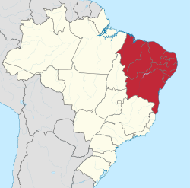
Maranhão
Piauí
Ceará
Rio Grande do Norte
Paraíba
Pernambuco
Alagoas
Sergipe
Bahia

Slide 3
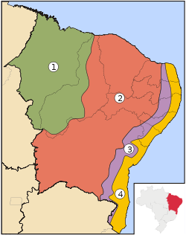
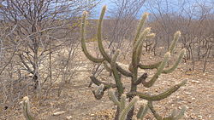
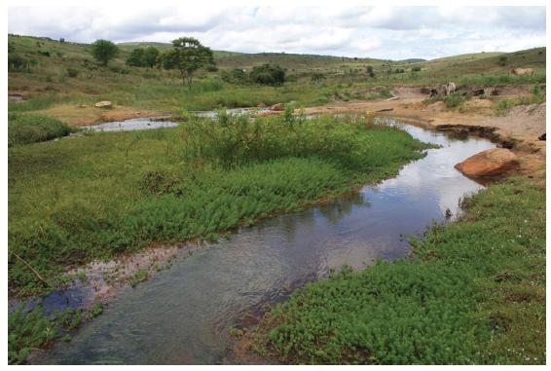
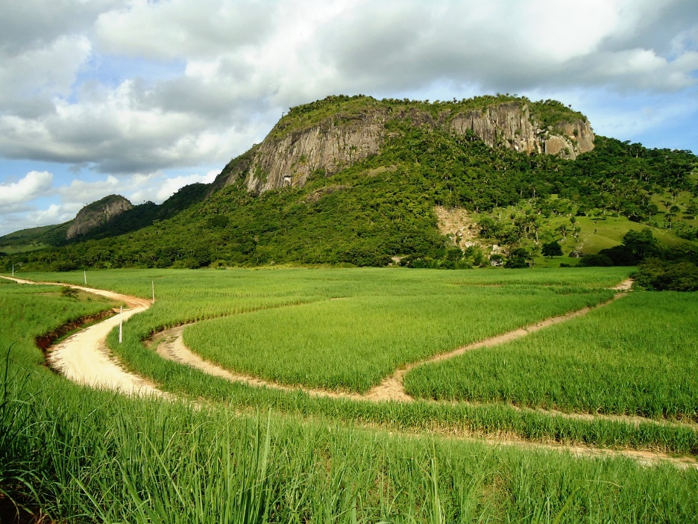
1 Meio-Norte
2 Sertão
3 Agreste
4 Zona da Mata

Slide 4
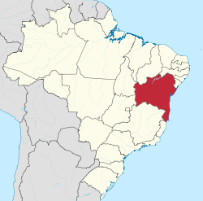
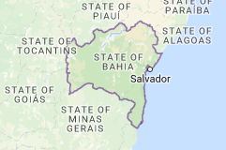

Slide 5
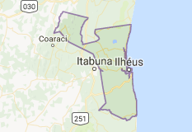

Slide 6
“The Portuguese first imported Africans as slaves to Salvador da Bahia from Guinea in 1538. Legal slavery lasted three and a half centuries. Brazil absorbed approximately forty percent of the entire volume of the trans-Atlantic slave trade (the region that would become the United States, by contrast, absorbed less than five percent).”
“Salvador da Bahia developed into one of the top slave-receiving ports of all time. Between 3.5 and five million African slaves entered Brazil between 1538 and 1850, when imports were banned by international treaty. Approximately 1.2 million enslaved Africans passed through the Bay of All Saints—that is, between a quarter and one third of Brazil’s total intake of foreign slaves, and nearly ten percent of the volume of the whole trans-Atlantic slave trade. No other single port in history has absorbed and processed so many enslaved human beings.”
Walker, 'Slave Labor and Chocolate in Brazil: The Culture of Cacao Plantations in Amazonia and Bahia (17th-19th Centuries)', Food and Foodways 15:1 (2007): 75-106

Slide 7
The late 19th century in Latin America – the global context:
Great Depression of 1873-1896
response of core capitalist powers = mix of productivity and plunder
‘second industrial revolution’ of late 19th century
ratcheting up of colonial domination / imperialist incursions as core capitalist powers sought out cheap raw materials, labour, and new markets;
increasingly rapid industrialization “generated an accelerated demand for agricultural commodities of all kinds, with a particular burst of expansion from the 1870s onwards [. . .] As well as a new scale of international demand for grains, sugar, tea, coffee, tobacco and bananas, there was an even greater expansion of demand for crops associated with industrial processing and manufacturing, such as vegetable oils, cotton, sisal, jute and rubber” (Brass and Bernstein, “Introduction: Proletarianisation and deproletarianisation on the colonial plantation”, Journal of Peasant Studies, 19:3-4 (1992): 4)

Slide 8
Demand for raw materials prompts an export boom in Latin America
1870 – 1930 – the ‘export age’
Ericka Beckman: “During the last quarter of the nineteenth century, the consolidation of liberal regimes in Latin America resulted in the creation of export driven economies, organized around the production of a handful of commodities for the global market” (Capital Fictions, p. 9)
“[the] world was turned upside down during the export boom, as everything became open to question and subject to power. Even such apparently immutable verities as time and geography were contorted and realigned. The strict discipline and linearity of the clock challenged the more forgiving and circular flow of the natural seasons; the iron rail and the telegraph brought far-flung elites into closer contact with one another than they were with much more physically proximate – but culturally distant – peoples.” (Topik and Wells, The Second Conquest of Latin America, p. 2

Slide 9
“Cocoa production did not accelerate toward a truly large scale until the 1890s. Expansion in Brazil responded to the shift in demand in the new century toward the ordinary grades of cocoa that Brazil along with West Africa produced for milk chocolate (Wickizer, 1951), which was only invented in 1879 by Nestle among others. [. . .] In 1937, Brazil’s total cocoa production reached a peak of 138,000 tons and then declined until the mid-1940s”
“The best cocoa land in Bahia was often cleared by squatters who were then dispossessed of the land by large landowners, often through violence, swindles, and manipulation of the law. Some large landowners of the boom period had begun as small holders, but others traced family roots to slave-owning estate owners long before the cacao boom, going back even to owners of large sugar mills. By the 1910s, fewer than 20 families probably dominated cacao production in Ilheus, the most important municipality for cacao growing in Bahia.”
Leiter and Harding, “Trinidad, Brazil, and Ghana: three melting moments in the history of cocoa”, Journal of Rural Studies, 20 (2004): 113-130

Slide 10
Literary Form and the Frontier:
realism “requires a conviction as to the massive weight and persistence of the present as such, and an aesthetic need to avoid recognition of deep structural social change as such”
“To acknowledge the imminence of some thoroughgoing revolution in the social order itself, is at once to disqualify those materials of the present which are the building blocks of narrative realism, for from the revolutionary perspective they become mere appearances or epiphenomena, transitory moments of history” (Fredric Jameson, “A Note on Literary Realism in Conclusion” in Adventures in Realism. Ed. Matthew Beaumont (2007), p. 263).

Slide 11
Michael Löwy’s concept of “critical irrealism”
for Löwy, irrealism designates not the opposite of realism, but rather “the absence of realism”. An irrealist literary work might include elements of fantasy, the oneiric, and the surreal; it may well be founded on “a logic of the imagination, of the marvellous, of the mystery or the dream” (Michael Löwy, “The Current of Critical Irrealism” in Adventures in Realism (2007), pp. 194-95).

Slide 12
Werner Sombart: “If he is a specially able type of speculating undertaker, he may possibly possess the poet’s gift of calling up to the minds of his audience ravishing pictures of realms of gold, in order to show the marvels he is capable of producing” (The Quintessence of Capitalism, p. 92)
“…a poetics of capital in Latin America, one I call ‘export reverie’. This mode emerges as the waking dream of nineteenth-century liberal visionaries, providing beautiful visions of national and regional wealth before it had actually materialized. Characterized by optimism, ebullience, and effervescence, this discourse flourished especially at the dawn of the Export Age in the 1870s and 1880s, when it seemed as though the realization of America’s vast stores of natural wealth was not only possible but imminent, awaiting only the touch of human labour for its realization.” (Beckman, Capital Fictions, pp. 4-5).

Slide 13
The radical simplification of nature:
In the interests of securing greater and more efficient control over human and extrahuman natures, capitalism seeks to reduce all kinds of ecological specificities to interchangeable parts
e.g., landscapes are simplified, rationalized to allow greater control of labour, increase efficiency
Such material transformations are usually accompanied by symbolic revolutions – in taxonomy or cartography, for example – that allow for the remapping of reality in ways conducive to capital

Slide 14
Radical simplification of nature: in addition to material transformations of landscapes, work regimes etc, “its historical expressions are found in the family of processes through which capitalists and state-machineries map, identify, quantify, measure, and code human and extra-human natures in service to capital accumulation.” (Moore, “The Capitalocene, Part II”), p. 3.

Slide 15
Walter Johnson, River of Dark Dreams
“The work of the Land Office was to make the concrete landscape abstract: to turn this salt lick into a salt lick; to turn a trail blazed through the woods into field notes in a field book; to turn the surveyors’ recorded experience into maps to be sent to Washington [. . .]. The business of the land office was to translate the practical knowledge of the surveyor into the abstract knowledge of the investor, to refashion the particularity of the landscape into terms susceptible of generalization and comparison, to make the land legible – and salable – at a distance.” (2013: 36)

Slide 16
“various modes of irrealism emerge when forms of conventional narrative realism are untenable for peoples within nations where the State bureaucratic apparatus of reporting is weak, untrustworthy, or deeply contaminated by the convergence of pre-existing graft and corruption amplified by the new dictates of foreign capital. Realism is the narrative and visual mechanism that becomes available only after a strong, centralizing State can reliably garner tax revenue through the establishment of roving agents, who can ensure the control and reliability of reporting from outlying lands to sedentary bureaus in the urban or court administrative center. [. . .] Realism emerges when the State has gained a firm hold on its legitimate monopoly on violence, which it can make invisible and sanitized through the flow of “empirical” reportage. Irrealism, on the other hand, appears in weak or peripheral states that have been shunted into structured underdevelopment in the world-system.”
  Stephen Shapiro, “The Weird’s World-System”, Paradoxa 28.

Slide 17
The romance form: typically associated with frontier expansion; tales of adventure in strange lands where ‘civilized world’ meets ‘wilderness’
e.g., late 19th century imperial romances (Rider Haggard, Kipling etc), part of ‘romance revival of 1880s-1920s
Heroic individuals venturing into ‘pre-modern’ settings, securing resources (gold, treasure etc)
Romance as form corresponding to moments of plunder / primitive accumulation – expansion of frontiers into new areas

