Slide 1
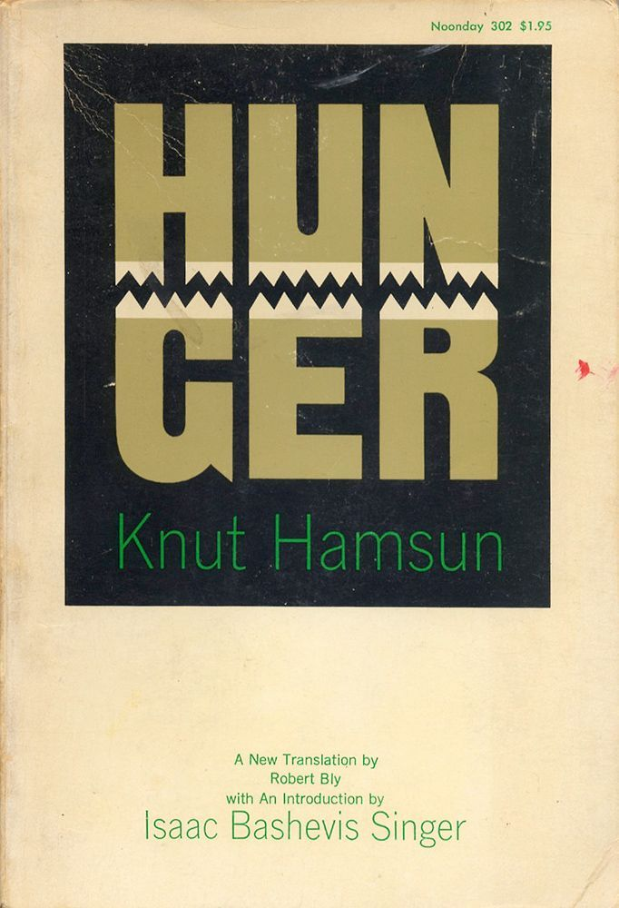
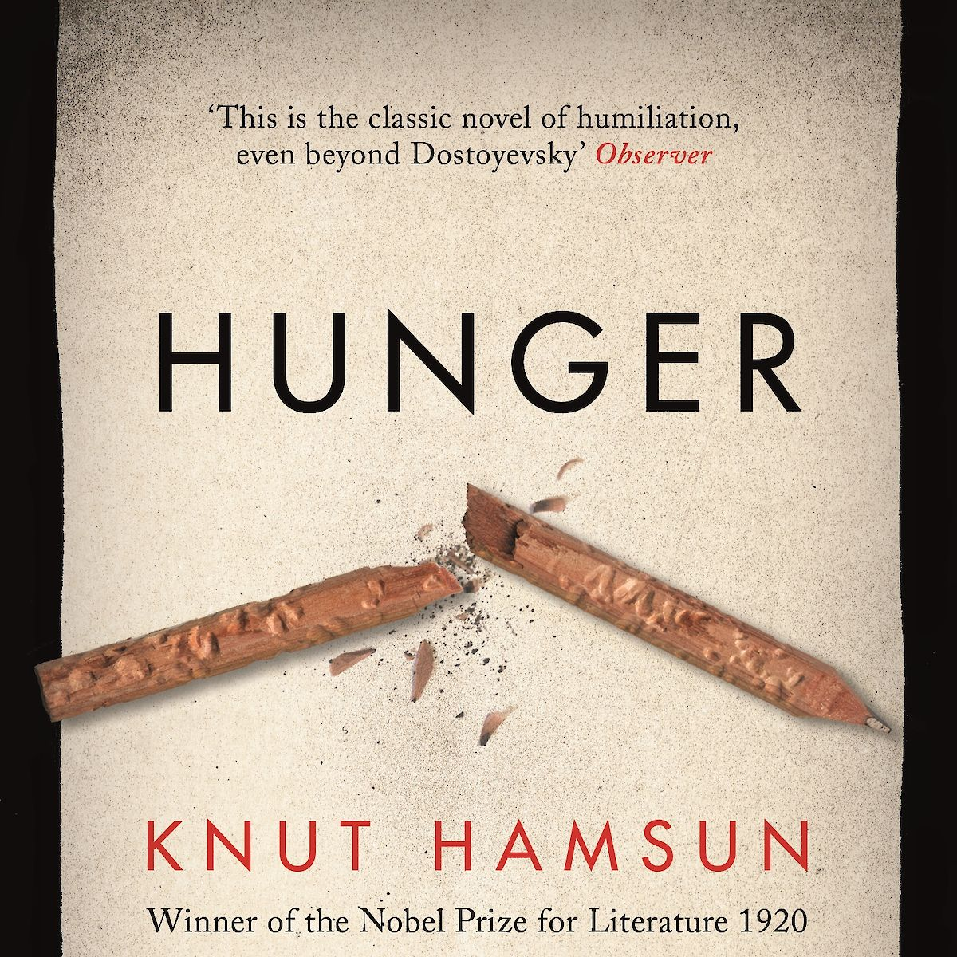
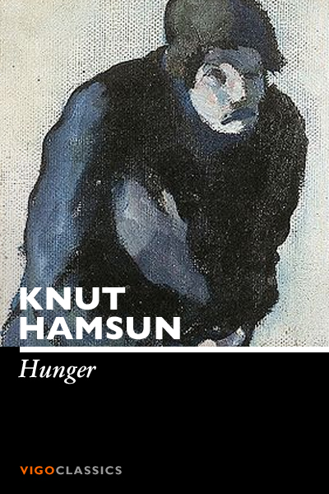
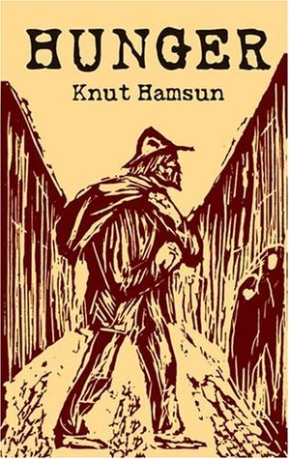
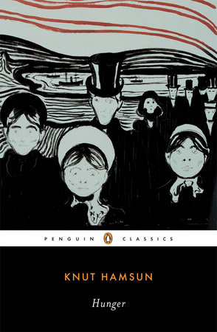
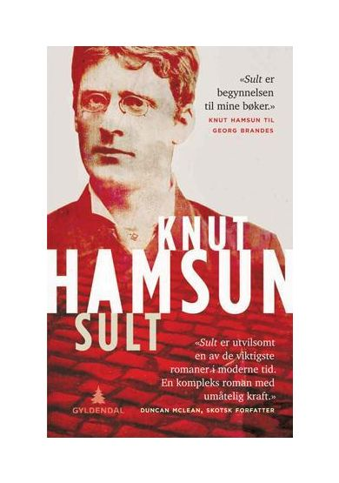

Slide 2
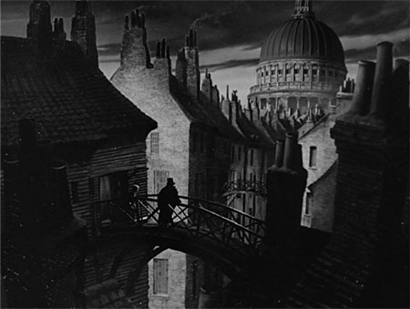
https://gloria.tv/video/RbTPXJ2vUd6W3BawWq4PtHjGh
….the dingiest collection of shabby buildings ever squeezed
together in a rank corner as a club for Tom-cats. …..a
melancholy little square that looked to me like a flat
burying-ground. I thought it had the most dismal trees
in it, and the most dismal sparrows, and the most dismal
cats, and the most dismal houses (in number half a dozen
or so), that I had ever seen. I thought the windows of the
sets of chambers into which those houses were divided,
were in every stage of dilapidated blind and curtain,
crippled flower-pot, cracked glass, dusty decay, and
miserable makeshift; while To Let To Let To Let, glared
at me from empty rooms, as if no new wretches ever
came there, and the vengeance of the soul of Barnard
were being slowly appeased by the gradual suicide of
the present occupants and their unholy interment under
the gravel. A frouzy mourning of soot and smoke attired
this forlorn creation of Barnard, and it had strewn
ashes on its head, and was undergoing penance
and humiliation as a mere dust-hole.
GREAT EXPECTATIONS

Slide 3

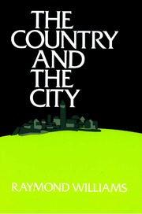
All novels are in some sense knowable communities. It is part of a traditional method – an underlying stance and approach – that the novelist offers to show people and their relationships in essentially knowable and communicable ways. The full extent of Dickens’s genius can then only be realised when we see that for him, in the experience of the city, so much that was important, and even decisive, could not simply be known, or simply communicated, but had, as I have said, to be revealed, to be forced into consciousness. And it would then be possible to set up a contrast between the fiction of the city and the fiction of the country. In the city kind, experience and community would be essentially opaque, in the country kind, essentially transparent. As a first way of thinking, there is some use in this contrast. There can be no doubt, for example, that identity and community become more problematic, as a matter of perception and as a matter of valuation, as the scale and complexity of the characteristic social organisation increased. Up to that point, the transition from city to country – from a predominantly rural to a predominantly urban society – is transforming and significant. The growth of towns and especially of cities and a metropolis; the increasing division and complexity of labour; the altered and critical relations between and within social classes: in changes like these any assumption of a knowable community – a whole community, wholly knowable – became harder and harder to sustain. But this is not the whole story, and once again in realising the new fact of the city, we must be careful not to idealise the old and new facts of the country. For what is knowable is not only a function of objects – of what is there to be known. It is also a function of subjects, of observers – of what is desired and what needs to be known. And what we have then to see, as throughout, in the country writing, is not only the reality of the rural community; it is the observer’s position in and towards it; a position which is part of the community being known.’
Raymond Williams, The Country and the City (London: The Hogarth Press, 1973)

Slide 4
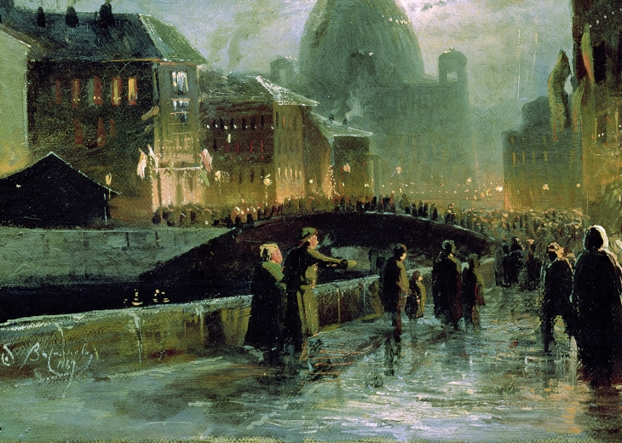
Raskolnikov went straight to Voznessensky Bridge, stopped in the middle of it, put his elbows on the railing, and gazed into the distance. After parting with Razumikhin, he felt so dreadfully weak that he just managed to get to this place. He wished he could sit or lie down somewhere in the street. Bending over the water of the canal, he watched mechanically the last pink reflection of the sunset, the row of houses, getting darker and darker in the gathering dusk, an attic window on the left bank blazing, as though on fire, in the last rays of the sun, which lit up for an instant, and the darkening water of the canal, on which his whole attention seemed to be more and more concentrated. At length red circles began whirling before his eyes, the houses seemed to move, the passers-by, the quays, the carriages – everything began to dance and rotate before his eyes. Suddenly he gave a start, and was perhaps saved from fainting again by a strange and horrible sight. He became aware that someone was standing close beside him, on his right. He looked up, and saw a tall woman with a shawl on her head and a long, yellow, haggard face and red hollow eyes. She looked straight at him, but she quite obviously saw nothing, nor did she seem to be aware of the presence of anyone. Suddenly she put her right hand on the parapet, lifted first her right, then her left leg over the railing and threw herself into the canal. The dirty water parted, swallowed up its victim for a moment, but in another instant the drowning woman came up again and floated gently down with the current, face downwards, her head and legs in the water, and her skirt gathered up and puffed out like a pillow.
‘A woman’s drowned herself! A woman’s drowned herself!’ dozens of voices shouted.
People came running from all over the place; both sides of the canal were thronged with onlookers; a whole crowd of people gathered round Raskolnikov, pressing him against the railing. (Part 2, Ch6)
Fyodor Dostoevsky, Crime and Punishment

Slide 5
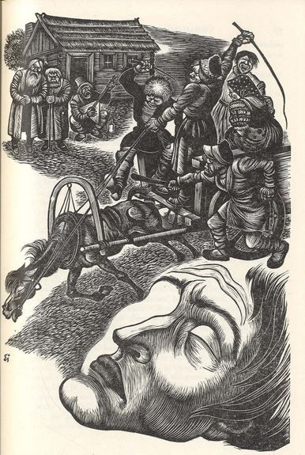
Dostoevsky considered himself a ‘fantastic realist,’ one who dealt with the crucial moments of human experience and strange personalities, who, he contended, were none the less genuine for being unusual: did not journalism offer us reports of that which was extraordinary but still real?
Richard Freeborn, ‘The Nineteenth Century: The Age of Realism, 1855-80,’ in Charles A. Moser ed., The Cambridge History of Russian Literature (Cambridge: CUP, 1989; 248-49)
Sometimes the essence of the real is to be found in the fantastic and the exceptional (in the sense of abnormal). In Russia, as a matter of fact, the fantastic is sometimes not exceptional at all (in the sense of rare) but an everyday occurrence. As people become divorced from their native traditions (the soil) they become more fantastic and the depths of the human soul are more easily discerned in them (as, one might say, the psychopathology of everyday life is more easily discerned in the abnormal patient). Indeed in Russia the truth almost always seems to assume a fantastic character.
(Malcolm Jones, Dostoevsky after Bakhtin: Readings in Dostoevsky’s Romantic Realism (Cambridge: CUP, 1990; 3)

Slide 6
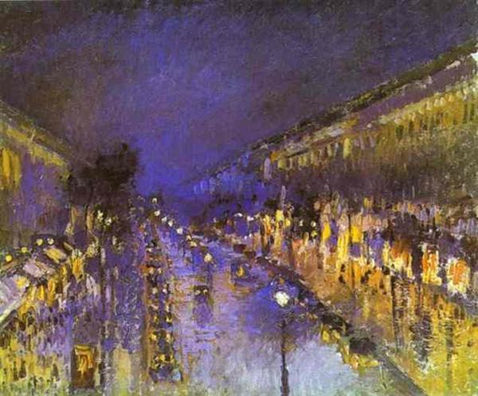
Pissarro ‘Montmartre la Nuit’

Slide 7
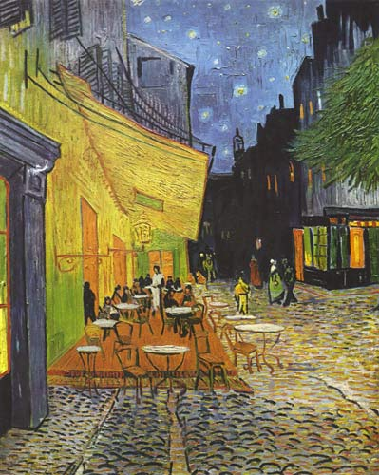
Van Gogh, ‘Café Terrace at Night’

Slide 8
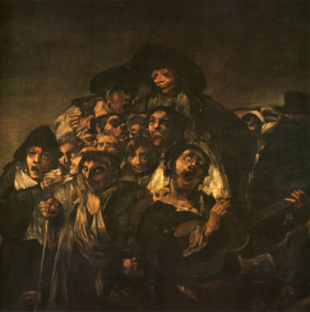
Francisco de Goya, Detail from ‘La romería de San Isidro’, Black Painting

Slide 9
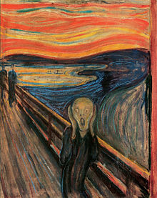
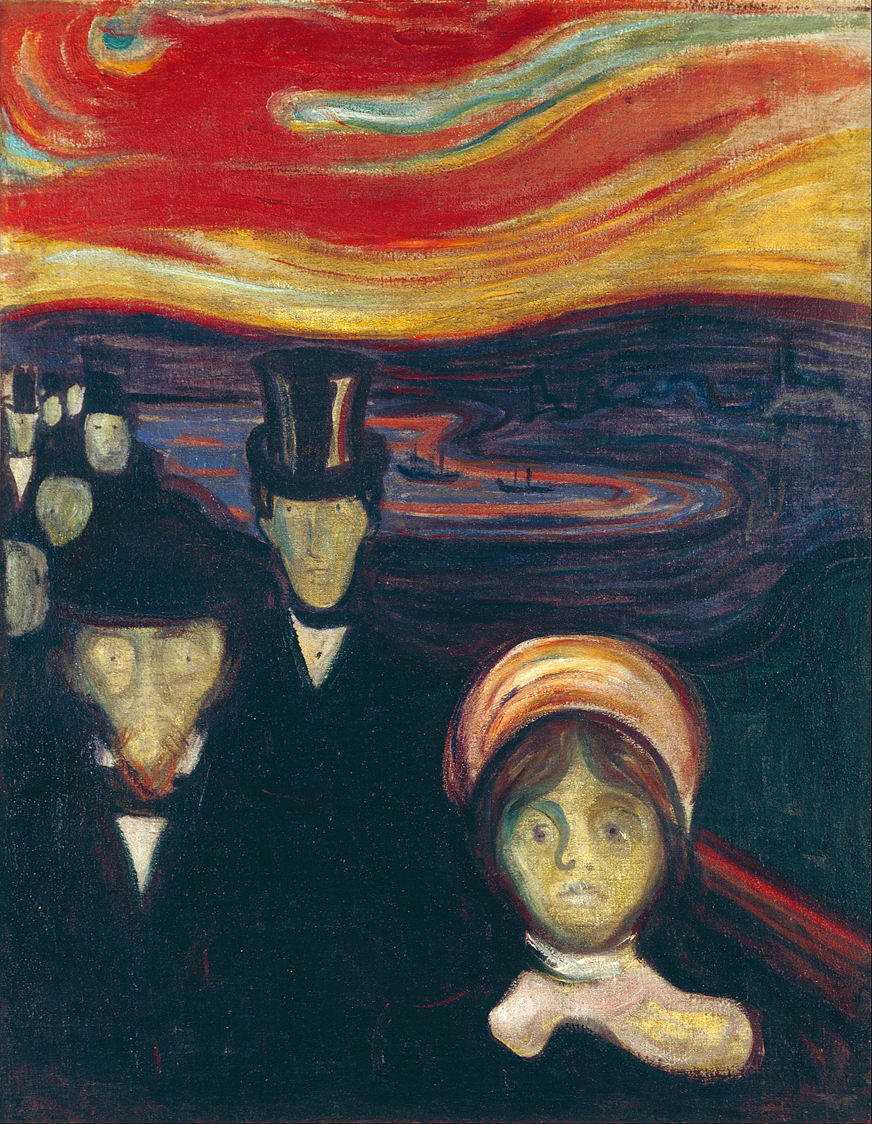
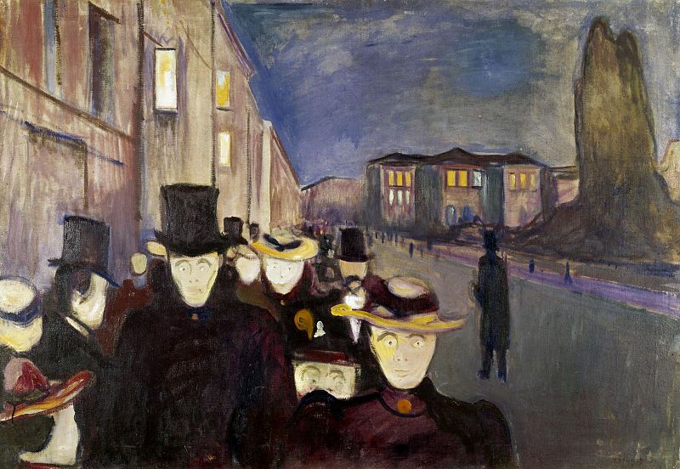
Edvard Munch (1863-1944)
Anxiety (1894)
Evening on Karl Johan St (1894)
The Scream (1893)

Slide 10
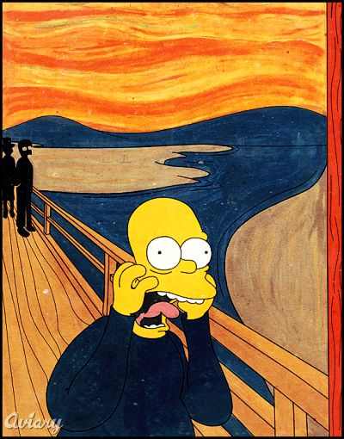

Slide 11
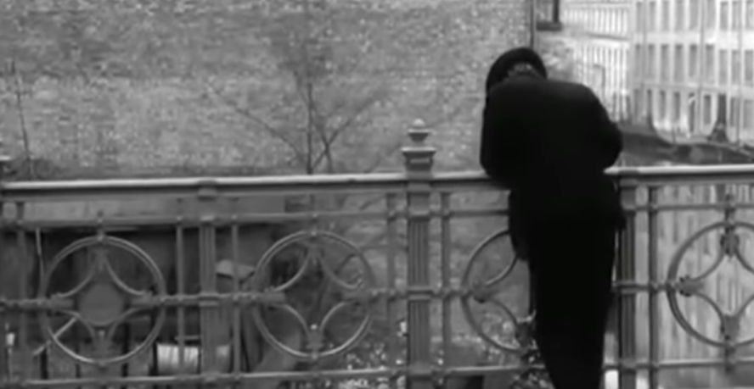
Sult, film, opening scene by Henning Carlsen (1966)

Slide 12
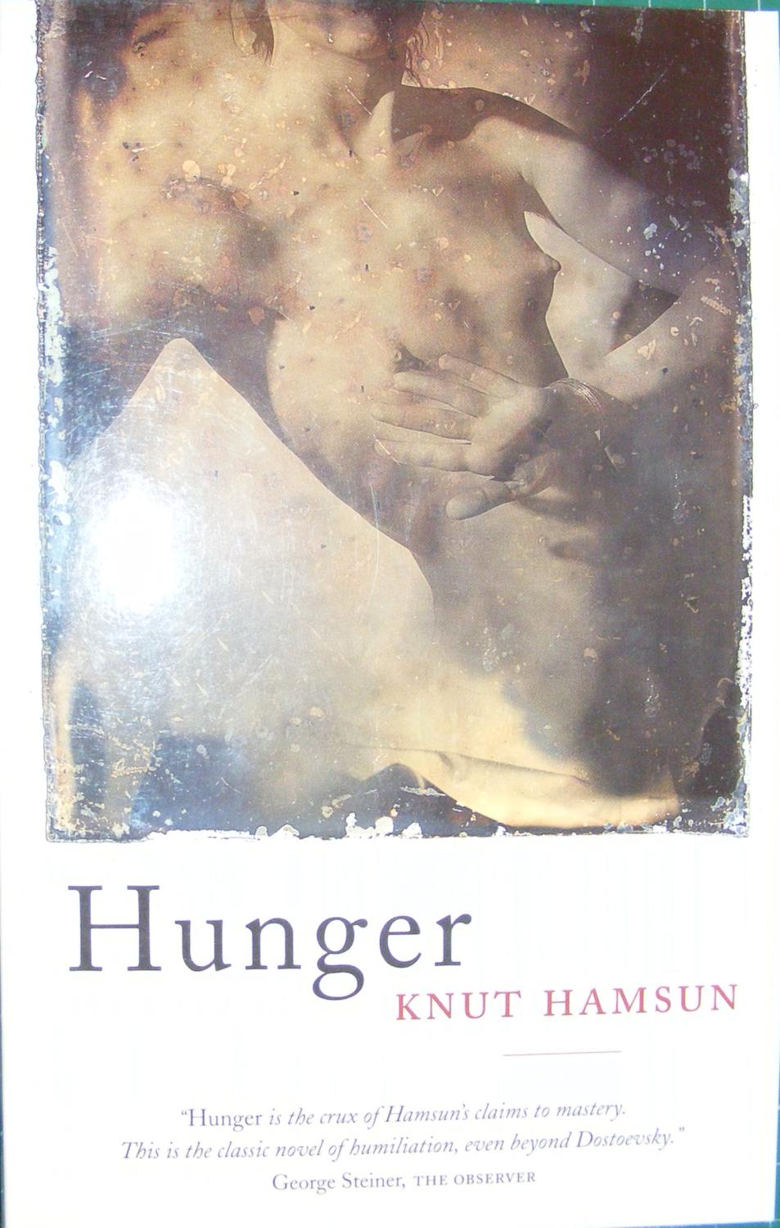
It was in those days when I wandered about hungry in Kristiania, that strange city which no one leaves before it has set its mark upon him. . . .
Lying awake in my attic room, I hear a clock strike six downstairs. It was fairly light already and people were beginning to walk up and down the stairs. Over by the door, where my room was papered with old issues of Morgenbladet, I could see, very clearly, a notice from the Director of Lighthouses, and just left of it a fat, swelling ad for freshly baked bread by Fabian Olsen, Baker.
As soon as I opened my eyes I started wondering, by force of habit, whether I had anything to look forward to today. I had been somewhat hard up lately; my belongings had been taken to ‘Uncle’ one after the other, I had grown nervous and irritable, and a couple of times I had even stayed in bed for a day or so because of dizziness. Every now and then, when I was lucky, I managed to get five kroner for an article from some newspaper or other.
As it grew lighter and lighter, I started reading the ads over by the door; I could even make out the thin, grinning letters concerning ‘Shrouds at Madam Andersen’s, main entrance to the right’. This occupied me for quite a while – I heard the clock strike eight downstairs before I rose and got dressed.
I opened the window and looked out. From where I stood I had a view of a clothesline and an open field; in the distance was a forge, left over from a burned down blacksmith’s shop where some workers were busy cleaning up. I leaned forward with my elbows on the windowsill and gazed at the sky, It promised to be a clear day. Autumn had arrived, that lovely, cool time of year when everything turns colour and dies.
Hunger, opening paragraphs.

Slide 13
It was nine o’clock. The air was filled with voices and the rumble of carriages, an immense morning chorus that mingled with the footsteps of the pedestrians and the cracks of the coachmen’s whips. This noisy traffic everywhere put me in a brighter mood immediately and I started feeling more and more contented. A strange, delicate mood, a feeling of cheerful nonchalance, had taken possession of me. I began to observe the people I met or passed, read the posters on the walls, caught a glance cast my way from a passing street car, and laid myself open to every trifle – all the little fortuitous things that crossed my path and disappeared.
If only one had a bite to eat on such a clear day! Overwhelmed by the impression of the happy morning, I experienced an irrepressible sense of well-being and started humming for joy for no particular reason. A woman with a basket on her arm stood outside a butcher shop pondering sausages for dinner; she glanced at me as I walked past. She had only a single tooth in the front of her mouth. Nervous and susceptible as I had become during the last few days, the woman’s face made a repellent impression on me right off; that long yellow tooth looked like a little finger sticking up from her jaw, and her eyes were still full of sausage as she turned toward me. I lost my appetite instantly and felt nauseated. […] Continuing through the streets, I roamed about without a care in the world, stopped at a corner without having to, turned and went down a side street without an errand there, I went with the flow, borne from place to place this happy morning, rocking serenely to and from among other happy people. The sky was clear and bright and my mind was without a shadow.
For ten minutes now I had constantly had a limping old man ahead of me….I was getting increasingly irritated by having this decrepit creature in front of me all the time. His journey would never end, it seemed; maybe he was going to the exact same place as I, and I would have him before my eyes all the way.
(Part One)
Knut Hamsun, Hunger

Slide 14
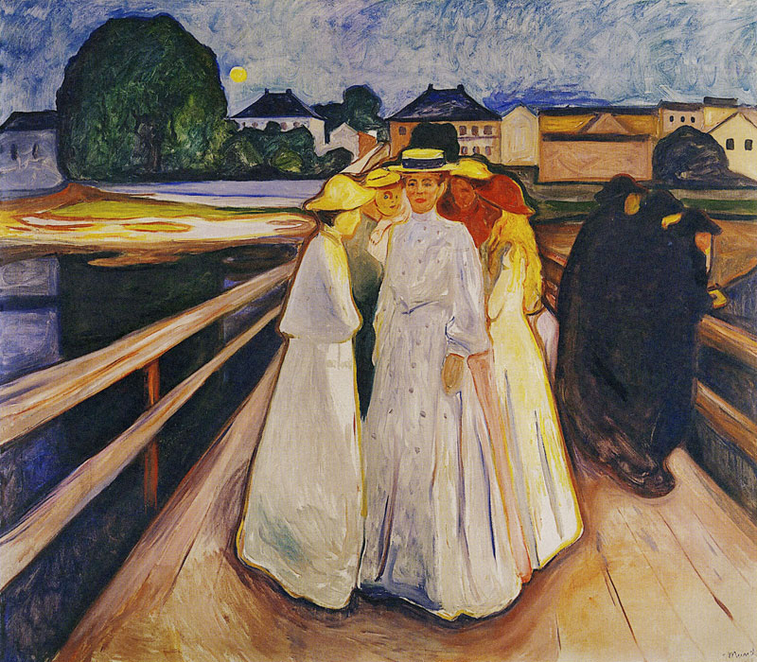
However estranged from myself I was at this moment, so completely at the mercy of invisible influences, nothing that was taking place around me escaped my perception. A big brown dog ran across the street, towards the Students’ Promenade and down to the amusement park; it had a narrow collar of German silver. Farther up the street a window was opened on the second floor and a maid with her sleeves turned up leaned out and began to clean the panes on the outside. Nothing escaped my attention, I was lucid and self-possessed, and everything rushed in upon me with a brilliant distinctness, as if an intense light had suddenly sprung up around me. The ladies before me had each a blue-bird’s wing in their hats and a plaid silk band around their necks. It occurred to me that they were sisters. (Part I)
Munch, The Women on the Bridge

Slide 15
I stagger away from the gate, drag myself along the walls of the buildings and come out onto the bright streets again. As I shuffle down Youngsbakken Lane, my brain suddenly begins to act in a strange manner. It occurs to me that those wretched hovels at the edge of the marketplace, the storage shacks and the old stalls with second hand clothing, were a real disgrace to the place. They spoiled the entire appearance of the marketplace and were a blot on the city – ugh, away with the junk!
Hunger, Pt III
My brain was bankrupt! Had I turned into an utter idiot…? But then, could I have lost my wits as long as I was asking myself questions like that? On top of it all, hadn’t I made the crystal-clear observation in the midst of my efforts with the bill that my landlady was pregnant? I had no basis for knowing that, nobody had told me anything about it, nor did it occur to me haphazardly – I saw it with my own eyes and I understood it immediately, in a moment of desperation at that….How was I to explain this?
I walked to the window and looked out; my window faced Vognmand street. Some children were playing on the pavement below, poorly dressed children in the middle of a poverty-stricken street. They were tossing an empty bottle back and forth amid loud yells. A moving van rolled slowly by; it must have been an evicted family, since they were moving at this unusual time of year. This though came to me immediately….
…I was watching this and hadn’t the least difficulty understanding what was going on…..In all that I observed in this way, there was nothing, not even a tiny incidental circumstance, that escaped me. My attention was most alert, every little thing was sensitively picked up, and I had my own ideas about these matters as they occurred. So there couldn’t possibly be anything wrong with my sanity. As things were, how could there possibly be anything the matter with it?”
Hunger Pt IV

Slide 16

Trams passed one another, ingoing, outgoing, clanging. Useless words. Things go on same ; day after day : squads of police marching out, back : trams in, out. Those two loonies mooching about. Dignam carted off. Mina Purefoy swollen belly on a bed groaning to have a child tugged out of her. One born every second somewhere. Other dying every second. Since I fed the birds five minutes. Three hundred kicked the bucket. Other three hundred born, washing the blood off, all are washed in the blood of the lamb, bawling maaaaaa.
Cityful passing away, other cityful coming, passing away too : other cityful coming on, passing on. Houses, lines of houses, streets, miles of pavements, piledup bricks, stones. Changing hands. This owner, that. Landlord never dies they say. Other steps into his shoes when he gets his notice to quit. They buy the place up with gold and still they have all the gold. Swindle in it somewhere. Piled up in cities, worn away age after age. Pyramids in sand. Built on bread and onions. Slaves Chinese wall. Babylon. Big stones left. Round towers. Rest rubble, sprawling suburbs, jerrybuilt. Kerwans mushroom houses, built of breeze. Shelter for the night.
No one is anything.
This is the very worst hour of the day. Vitality. Dull, gloomy : hate this hour. Feel as if I had been eaten and spewed.
James Joyce, “Lestrygonians”, Ulysses, (1922 text)

Slide 17
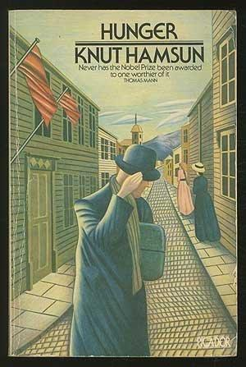
What sense could there possibly be to having absolutely all one’s most sincere and diligent endeavours come to nothing? Why had I written 1848 anyway? What was that damned year to me? Here I was walking around so hungry that my intestines were squirming inside me like snakes, and I had no guarantee there would be something in the way of food later in the day either […] I quickened my walk […] I didn’t stop, not even for a second, but the entire curious décor of the entrance immediately penetrated my consciousness. As I ran up the stairs, the most trifling details of the doors, the ornaments, and the paving stone stood out clearly in my mind’s eye. I furiously rang a bell on the second floor. Why did I stop exactly on the second floor? And why grab exactly this bell rope, which was the farthest from the stairway?
Knut Hamsun Hunger, Pt I
“You have invented a word….Kuboaa…of great grammatical importance.”
Then there is the clittterclatter on the cobblestones, and the officer takes a turn along the pier. I sat there with tears in my eyes, gasping for breath, quite beside myself with feverish merriment. I began to talk aloud, told myself the story of the cornet, aped the policeman’s movements, peeped into the hollow of my hand and repeated over and over to myself: He coughed when he threw it away! He coughed when he threw it away! I added new words, with titillating supplements, changed the whole sentence and made it more pointed: He coughed once – huh-huh!
I spent myself on variations of these words, and it got to be late evening before my merriment ceased. Hunger, Part III

Slide 18
The present increased awareness of ‘meta’ levels of discourses and experience is partly a consequence of an increased social and cultural self-consciousness. Beyond this however, it also reflects a greater awareness within contemporary culture of the function of language in constructing and maintaining our sense of everyday ‘reality’ […] Metafiction explicitly lays bare the conventions of realism; it does not ignore or abandon them. Very often realistic conventions supply the ‘control’ in metafictional texts, the norm of background against which the experimental strategies can foreground themselves […] What metafiction does is re-examine the conventions of realism in order to discover – through its own self-reflection – a fictional form that is culturally relevant and comprehensible to contemporary readers. In showing us how literary fiction creates its imaginary worlds, metafiction helps us to understand how the reality we live day by day is similarly constructed, similarly written.
Metafiction is a term given to fictional writing which self-consciously and systematically draws attention to its status as an artefact in order to pose questions about the relationship between fiction and reality.
Patricia Waugh, ‘What is Metafiction and Why are They Saying Such Awful Things About it?’ in Metafiction , Mark Currie (ed) (London: Longman, 1995)

Slide 19
Hey, you lot. Come on! What is the point of this lecture? Is it worth the money? The time?

Slide 20
STOP: LOOKING AT INSTAGRAM TEXTING THINKING OF YOU AND Insert name here IN Insert PLACE here

Slide 21
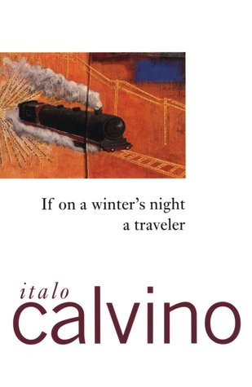
Chapter One
You are about to begin reading Italo Calvino’s new novel, If on a winter’s night a traveller. Relax. Concentrate. Dispel every other thought. Let the world around you fade. Best to close the door; the TV is always on in the next room. Tell the others right away, “No I don’t want to watch TV!” Raise your voice – they won’t hear you otherwise – “I’m reading! I don’t want to be disturbed!” Maybe they haven’t heard you, with all that racket; speak louder, yell: “I’m beginning to read Italo Calvino’s new novel!” Or, if you prefer, don’t say anything; just hope they’ll leave you alone.
Find the most comfortable position: seated stretched out, curled up, or lying flat. Flat on your back, on your side, on your stomach. In an easy chair, on the sofa, in the rocker, the deck chair, on the hassock. In the hammock, if you have a hammock. On top of your bed, of course, or in the bed. You can even stand on your hands, head down, in the yoga position. With the book upside down, naturally.
Of course, the ideal position for reading is something you can never find. In the old days they used to read standing up, at a lectern. People were accustomed to standing on their feet, without moving […] It’s not that you expect anything in particular from this particular book. You’re the sort of person who, on principle, no longer expects anything of anything.
[…] So then, you noticed in a newspaper that If on a winter’s night a traveller had appeared, the new book by Italo Calvino, who hadn’t published for several years. You went to the bookshop and bought the volume. Good for you.
In the shop window you have promptly identified the cover with the title you were looking for. Following this visual trail, you have forced your way through the shop past the thick barricades of Book You Haven’t Read, which were frowning at you from the tables and shelves, trying to cow you. But you know you must never allow yourself to be awed, that among them, extend for acres and acres the Books You Needn’t Read, the Book Made For Purposes Other Than Reading, Books Read Even Before You Open Them Since They Belong To The Category Of Books Read Before Being Written. And thus you pass the outer girdle of ramparts, but then you are attacked by the infantry of the Books That If You Had More Than One Life You Would Certainly Also Read But Unfortunately Your Days Are Numbered.
Italo Calvino, If on a winter’s night a traveller (1979)

Slide 22
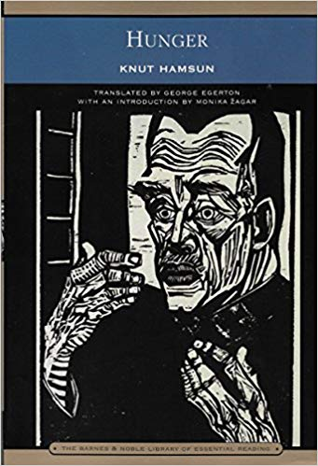
The fact of the matter was that my poverty had sharpened certain aptitudes in me to such a degree that it got me into outright trouble….But it also had its advantages, it helped me in certain situations. The intelligent poor individual was a much finer observer than the intelligent rich one. The poor individual looks around him at every step, listens suspiciously to every word he hears from the people he meets; thus, every step he takes presents a problem, a task, for his thoughts and feelings. He is alert and sensitive, he is experienced, his soul has been burned.
Pt. III

Slide 23
Hamsun, although he is virtually the inventor of a certain kind of modern fictionality, is also the great refiner of the stream of consciousness, that mode of writing that in some ways the culmination of novelistic realism, of the novel’s traditional devotion to human beings, that represents the soul’s stutter. His heroes are souls, not fictive fragments.
Hunger was Hamsun’s first strike against the novelistic representation of coherence. For Hamsun, such coherence was factitious. He wrote articles and lectures against Ibsen in 1890 and 1891, attacking him as a writer who created only ‘types’, characters with a single pressing element. Compared to Hamsun, Ibsen was always tying the moral bootlaces of his subjects, correcting them and dressing them in the public themes of the moment…. ‘I dream of a literature with characters in which their very lack of consistency is their basic characteristic,’ Hamsun wrote. The heroes of Hunger, Mysteries (1892) and Pan (1894) are all self-unravellers…. ‘Hunger is not a novel about marriages and country picnics and dances up at the big house’, Hamsun wrote in 1890. ‘I cannot go along with that kind of thing. What interests me is the infinite susceptibility of my soul, what little I have of it, the strange and peculiar life of the mind, the mysteries of the nerves in a starving body.’
Hamsun’s novels of this period, and in particular Hunger, are deliberate perversions of the Christian system of reward and punishment, confession and absolution, pride and humility. It is common to see Tangen as a precursor of Kafka’s ‘hunger-artist’, consuming himself with his art. But it would be more accurate to see his behaviour as a grotesque parody of the traditional Christian posture of martyrdom, of fasting and solitude.
James Wood, ‘Addicted to Unpredictability: Knut Hamsun’, London Review of Books, 26 November 1998

Slide 24
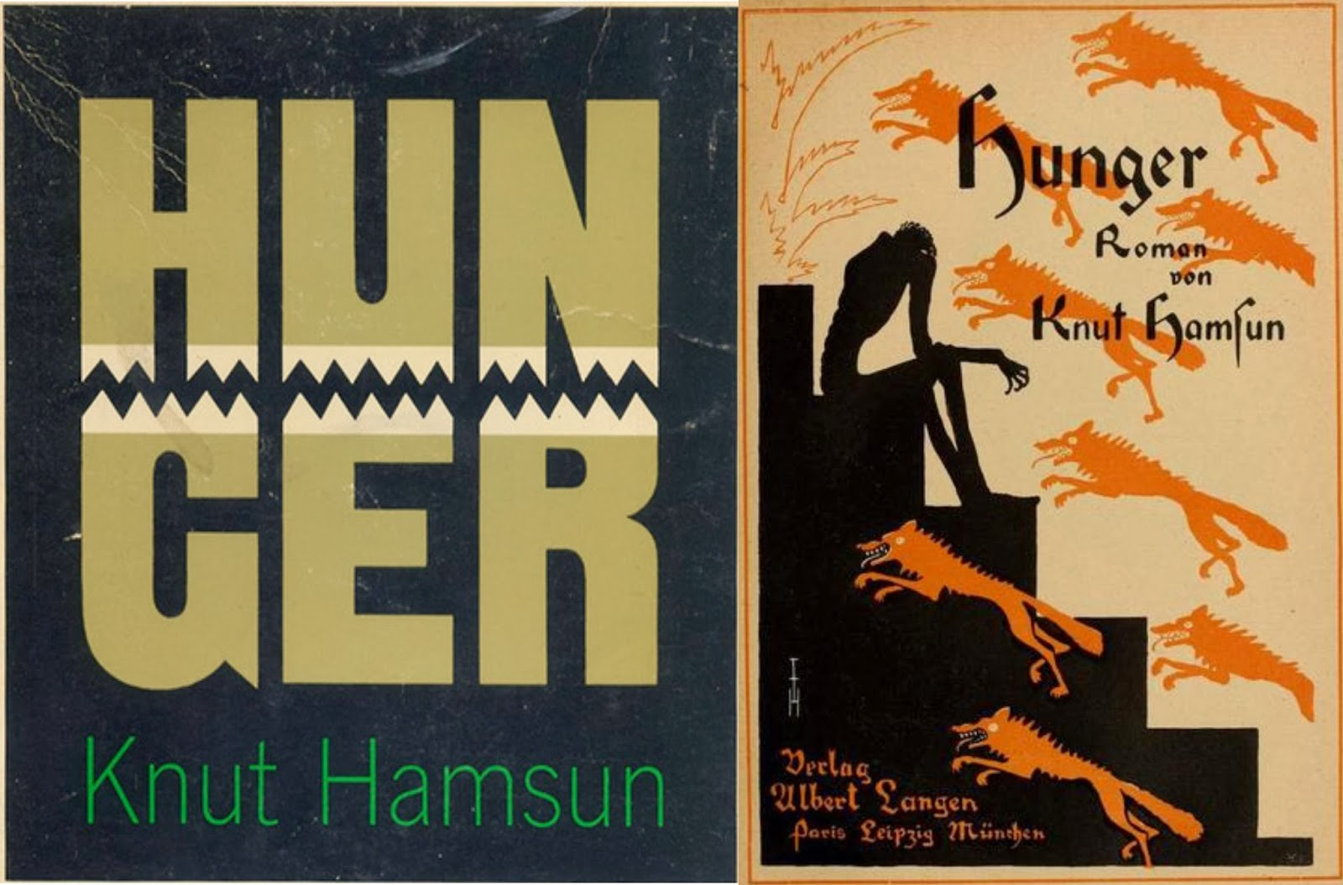
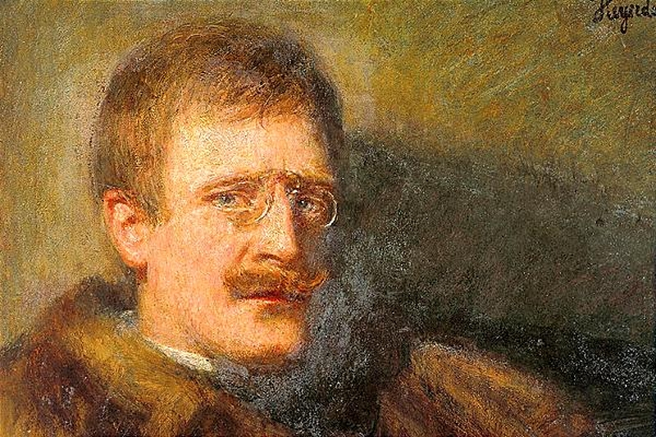
The fate of my story filled me with dark forebodings; the more I thought about it, the more absurd it seemed that I could have written something usable so suddenly, half asleep at that, my brain full of fever and dreams. I had deceived myself of course. Hunger, Pt I
Madness rages through my brain and I let it rage, fully aware of being subject to influences I cannot control. I began to laugh, noiselessly and passionately, without a trace of reason, still jolly and drunk from the couple of glasses of beer I had had….Kierulf, this trader in wool who had been haunting my brain for so long, this person who I had thought existed and whom I perforce had to see, had vanished from my thoughts, erased together with other mad inventions that came and went by turns. Pt III

Slide 25
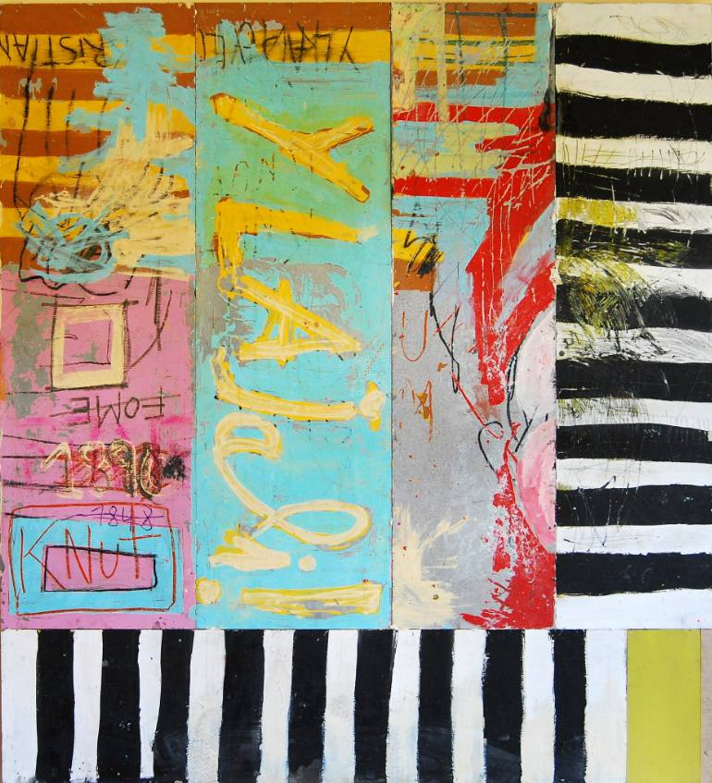
Goodbye!

