Slide 1
Modernism and Starvation
Hunger (1890)

Slide 2
The whole modern school of fiction in the twentieth century stems from Hamsun. (Isaac B. Singer)
When you read a canonical work for a first time you encounter a stranger, an uncanny startlement rather than a fulfillment of expectations. (Harold Bloom)
In 1883 Georg Brandes coined the term “the modern breakthrough” to convey the profound vistas and initiatives that we associate today with the names Ibsen, Strindberg, Jacobsen and Bjornsen. (Arnold Weinstein)

Slide 3
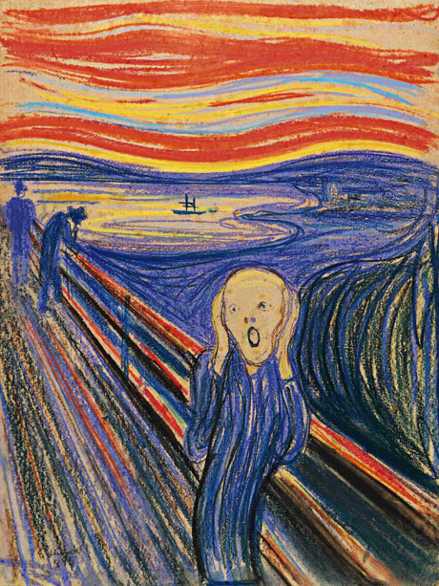
Breakthrough

Slide 4

Anxiety

Slide 5
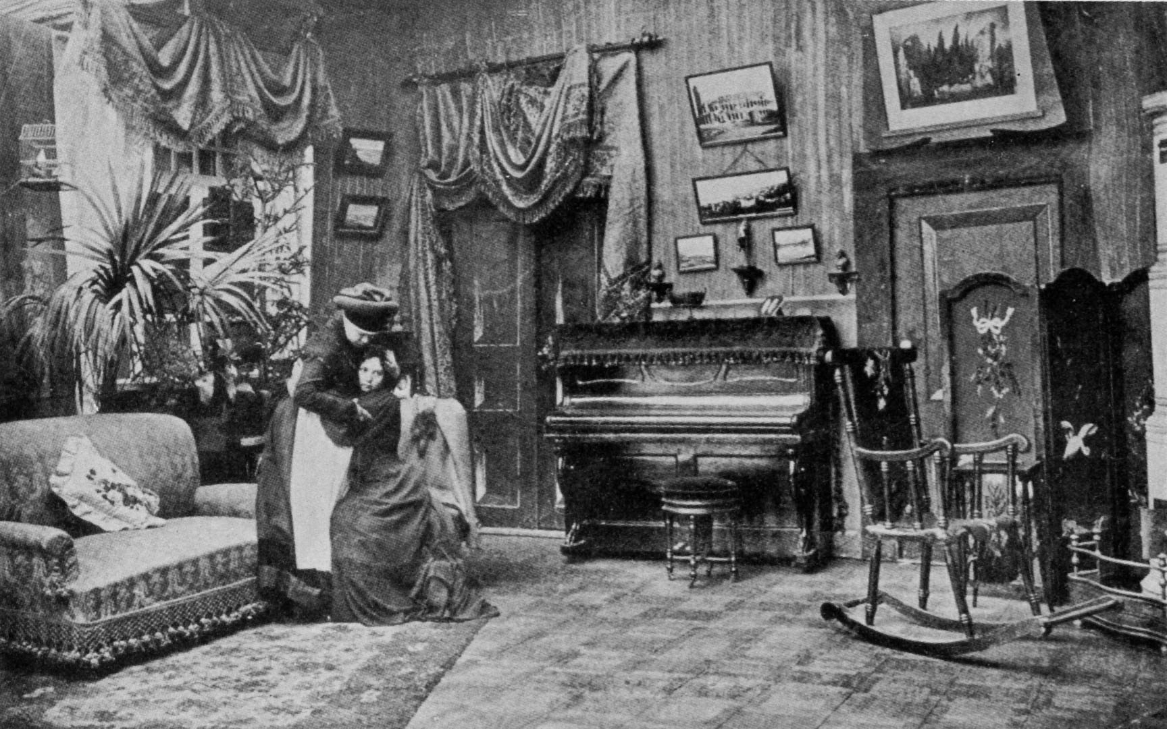
Shattering Boundaries

Slide 6

Or Simply, Shattered

Slide 7

The Meanings of Hunger

Slide 8
Self-starvation is above all a performance. Like Hamlet’s mouse-trap, it is staged to trick the conscience of its viewers, forcing them to recognize that they are implicated in the spectacle that they behold. (Maud Ellmann)
There is no such thing, Voloshinov suggests, as the real existence of hunger as category; rather, there are only particular hungers — their particularity to a large extent a consequence of the particular historical moment. (Dana B. Polan)

Slide 9
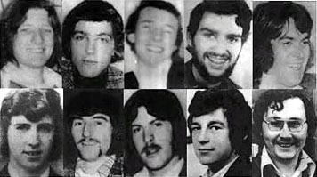
The Speech of Hunger

Slide 10


Slide 11
For writing voids the mind of words just as starving voids the body of its flesh, and both expresses the yearning for an unimaginable destitution. We do not starve to write but write to starve: and we starve in order to affirm the supremacy of lack, and to extend the ravenous dominion of the night.(Maud Ellmann)
Knowing all these things, Hamsun wages his counteroffensive: he will say NO to food and money and bounded identity and rational behavior; he will even say No to the dictionary. (Arnold Weinstein)

