Slide 1
The European Novel
The Novel and Class

Slide 2
Novel as vehicle for class representation and class interests
Narrative and class-consciousness – politics of narrative
Definitions of class – culture, occupation, relationship to mode of production (Marx); status, consumer (Weber)
Naturalism-Modernism and class (Zola, Baroja)

Slide 3
The conversation turned to the new trend in art, to the new bible illustrations by a French artist. Vorkuev accused the artist of realism pushed to the point of coarseness. Levin said that the French employed conventions in art as no one else did, and therefore they saw particular merit in the return to realism. They saw poetry in the fact that they were no longer lying. (Anna Karenina 7, X, trans. Pevear & Volokhonsky)
It was all drowned in the sea of cheerful common labour […] And whom was this labour for? What would its fruits be? These considerations were irrelevant and insignificant. (AK, 3, XII)

Slide 4
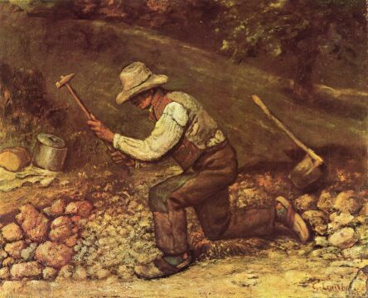
Gustave Courbet, ‘Quarryman’, 1850

Slide 5
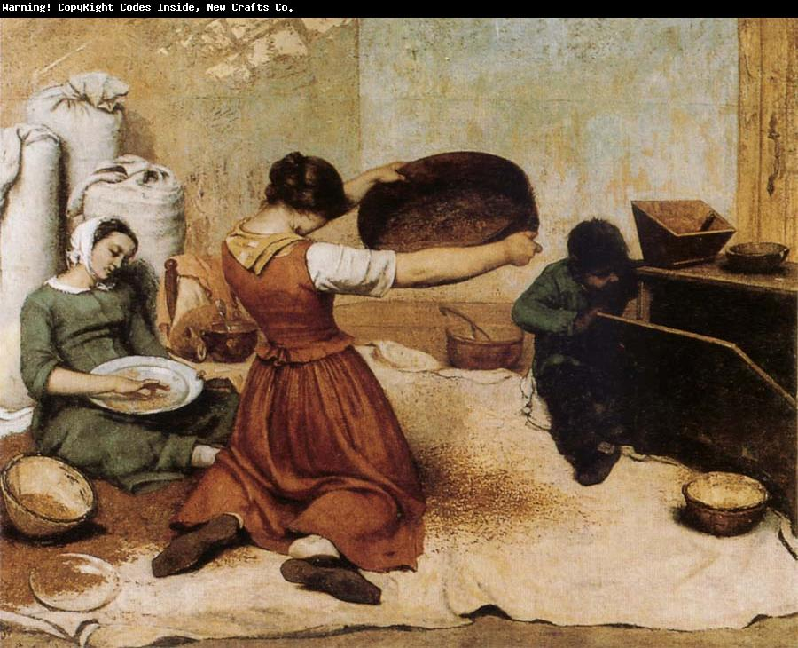
Gustave Courbet, The Winnowers’, 1855

Slide 6
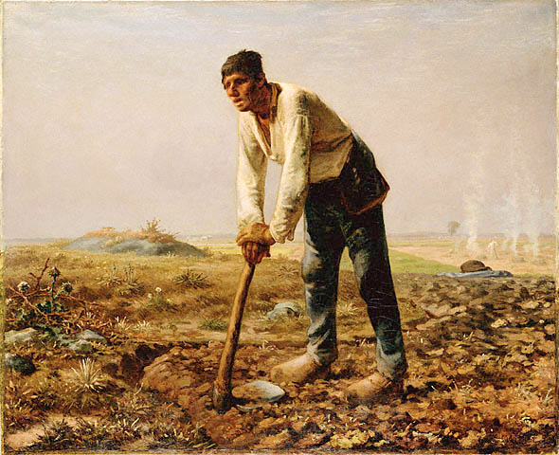
Jean-Francois Millet, ‘Man with a Hoe’ (1860)

Slide 7
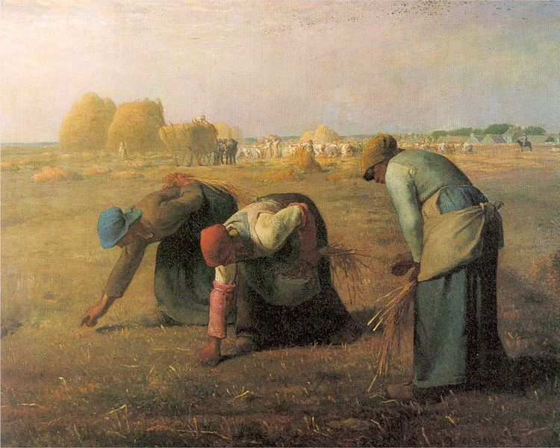
Jean-Francois Millet, ‘The Gleaners’ (1857)

Slide 8
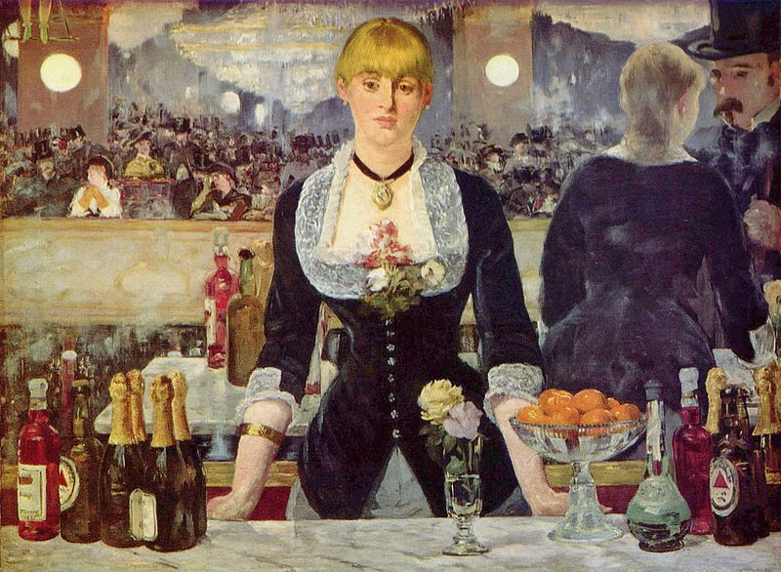
Édouard Manet, Le Bar des Folies-Bergère (1881)

Slide 9
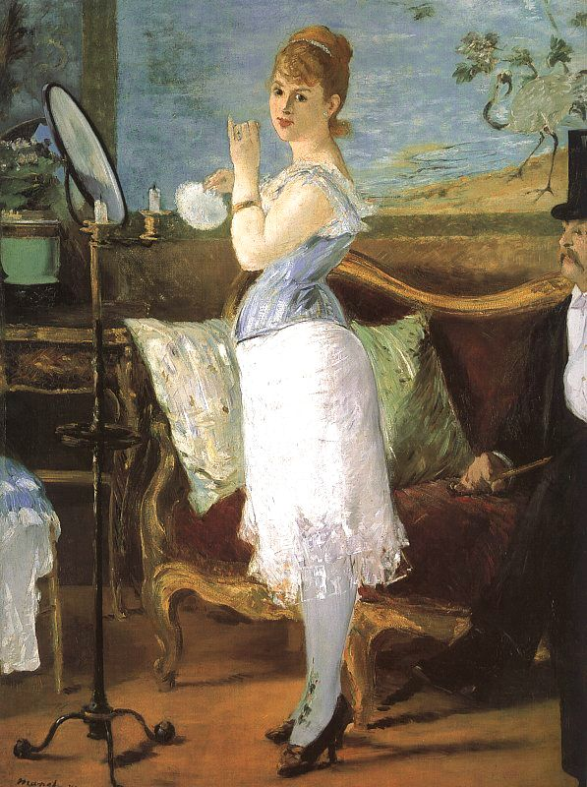

Slide 10
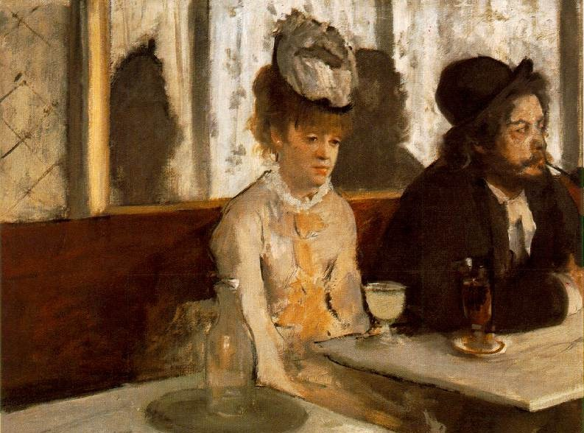
Degas, ‘L’Absinthe’ (1876)

Slide 11
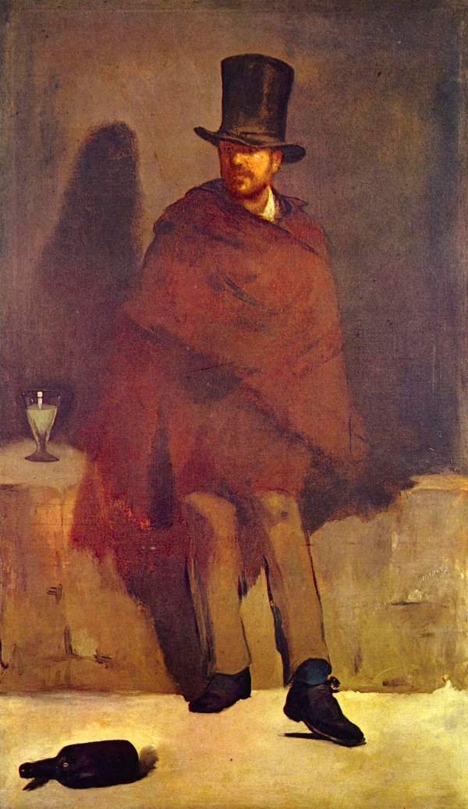
Édouard Manet, Absinthe Drinker
Notes:
Manet, The Absinthe Drinker

Slide 12
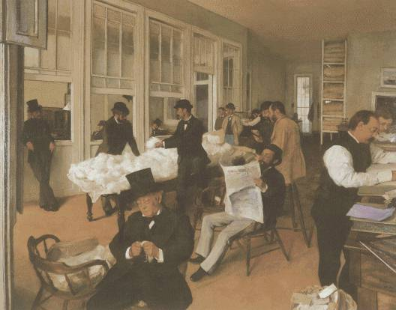
Edgar Degas, ‘Portraits in an Office’ (1873)

Slide 13
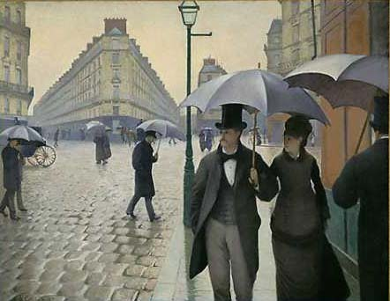
Gustave Caillebotte, ‘Paris Street, Rainy Day’ (1877)

Slide 14
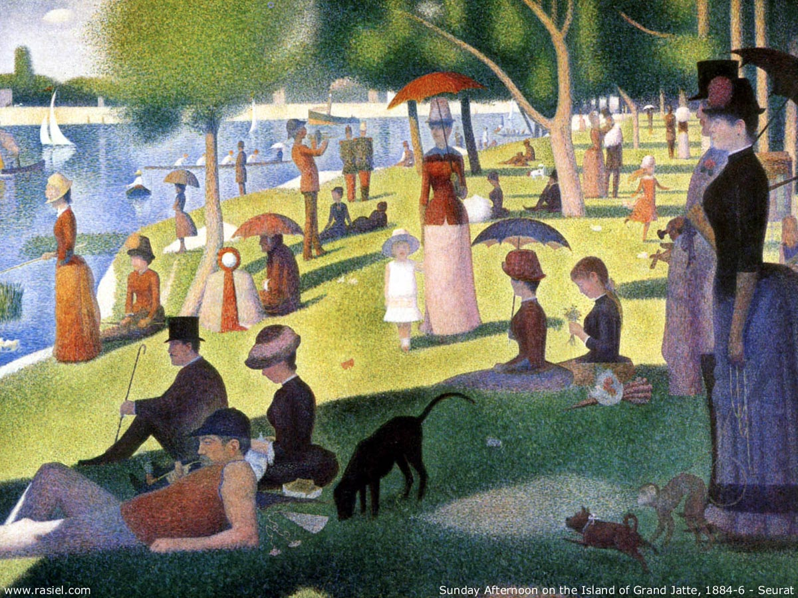
Georges Seurat, Sunday Afternoon on Grand Jatte (1884-6)

Slide 15
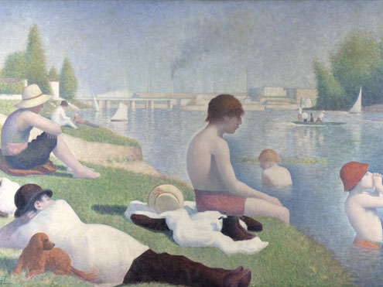
Georges Seurat, Bathers at Asnières

Slide 16
At first the foreman told them to wait, and shut the door on them. Then he came back and led them into the drawing room, pulling back the curtains. A soft light filtered through the lace. Left alone, the miners were afraid to sit down, but stood about awkwardly, all in their Sunday best and carefully shaved, with fair hair and moustaches, twisting their caps in their hands and throwing sidelong glances at the furniture, which was in that jumble of all the styles made fashionable by the craze for the antique: Henri II armchairs, Louis VX occasional chairs, a seventeenth-century Italian cabinet, a fifteenth century Spanish contador, an altar front draping the mantelshelf, and old chasuble embroideries cut out and sewn on to the portieres. The display of old gold, the tawny hues of old silks, and all this ecclesiastical splendour filled them with respectful awe. The deep pile of the oriental carpets seemed to cling to their feet. But the heat, above all, overwhelmed them: they could not understand this uniform heat given by the stoves, especially as their cheeks were stinging from the icy wind outside. Five minutes went by, and this discomfort increased in this sumptuous room so snugly closed to the outer world.
Monsieur Hennebeau came in at last, with his frock coat buttoned up in military fashion, and wearing on his lapel the little rosette of his decoration. He was the first to speak.
‘Ah! – here you are! This is a revolt, it seems.’
He broke off to add with stiff politeness:
‘Sit down. I am only too delighted to have a chat.’
The miners turned round looking for seats. A few ventured to sit on chairs, but most of them took fright at the look of the silken embroideries, and preferred to stand.
Germinal Pt 4, Ch2.

Slide 17
Oppositions in Germinal
Bourgeois (owner) Government Wealth Greed Conservatism Commitment
--------------------------------------------------------------------------------------------------------------------
Worker (producer) Citizen Poverty Need Progressivism Apathy
Collectivism Light Leisure Surface Rationalism
-------------------------------------------------------------------------------------------------------------------
Individualism Dark Labour Pit Instinct

Slide 18
Economic conditions had first transformed the mass of the people of the country into workers. The domination of capital has created for this mass a common situation, common interests. The mass is thus already a class against capital, but not yet for itself. In the struggle … this mass becomes united, and constitutes itself as a class for itself. The interests it defends become class interests.
Karl Marx, The Poverty of Philosophy, 1847

Slide 19
Not a word was exchanged. They were all hacking away, their irregular blows setting up a dull, distant-sounding, but pervasive barrage of noise. The sound had a harsh timbre in the thick air, which stifled any echo at birth. And the darkness seemed to be coloured an unnatural black, with swirling waves of coal-dust, and vapours which hung heavy on the eyelids. The wicks of the lamps, beneath their gauze chimneys, failed to penetrate the gloom with their small red glow. Hardly anything could be seen at the coalface, whose wide mouth led diagonally upwards like a wide but shallow chimney, where the soot had been gathering for a decade of winters to form an impenetrable blackness. Ghostly figures could be seen gesticulating, as a stray gleam revealed at random an arched hip, a muscular arm, or a grim face, camouflaged as if for some crime…nothing was audible but chesty breathing, and tired or painful grunts and groans, muffled by the heavy air and the sound of running water. (Germinal, PtI, CH4)

Slide 20
La Corrala was a microcosm; it was said that if all the denizens were placed in line they would reach from Embajadores lane to the Plaza del Progreso; it harboured men who were everything and yet nothing: half scholars, half smiths, half carpenters, half masons, half business men, half thieves.
In general, everybody who lived here was disoriented, dwelling in that unending abjection produced by everlasting, irremediable poverty; many sloughed their occupations as a reptile its skin; others had none; some carpenters’ or masons’ helpers, because of their lack of initiative, understanding and skill, could never graduate from their apprenticeship. There were also gypsies, mule and dog clippers, nor was their a death of porters, itinerant barbers and mountebanks. Almost all of them, if opportunity offered, stole what they could; they all presented the same pauperized, emaciated look. And all harboured a constant rage that vented itself in furious imprecations and blasphemies.
They lived as if sunk in the shades of a deep slumber, unable to form any clear notion of their lives, without aspirations, aims, projects or anything.
Pío Baroja, The Quest, Pt II, Ch2

Slide 21
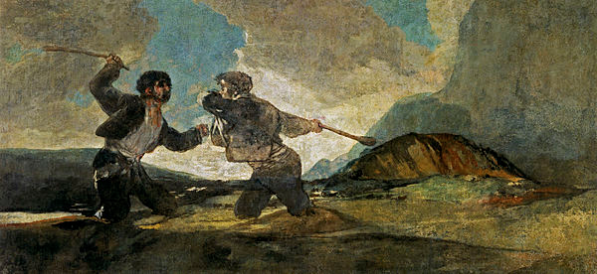
Francisco Goya, Pinturas negras (Black Paintings, 1819-23)

Slide 22
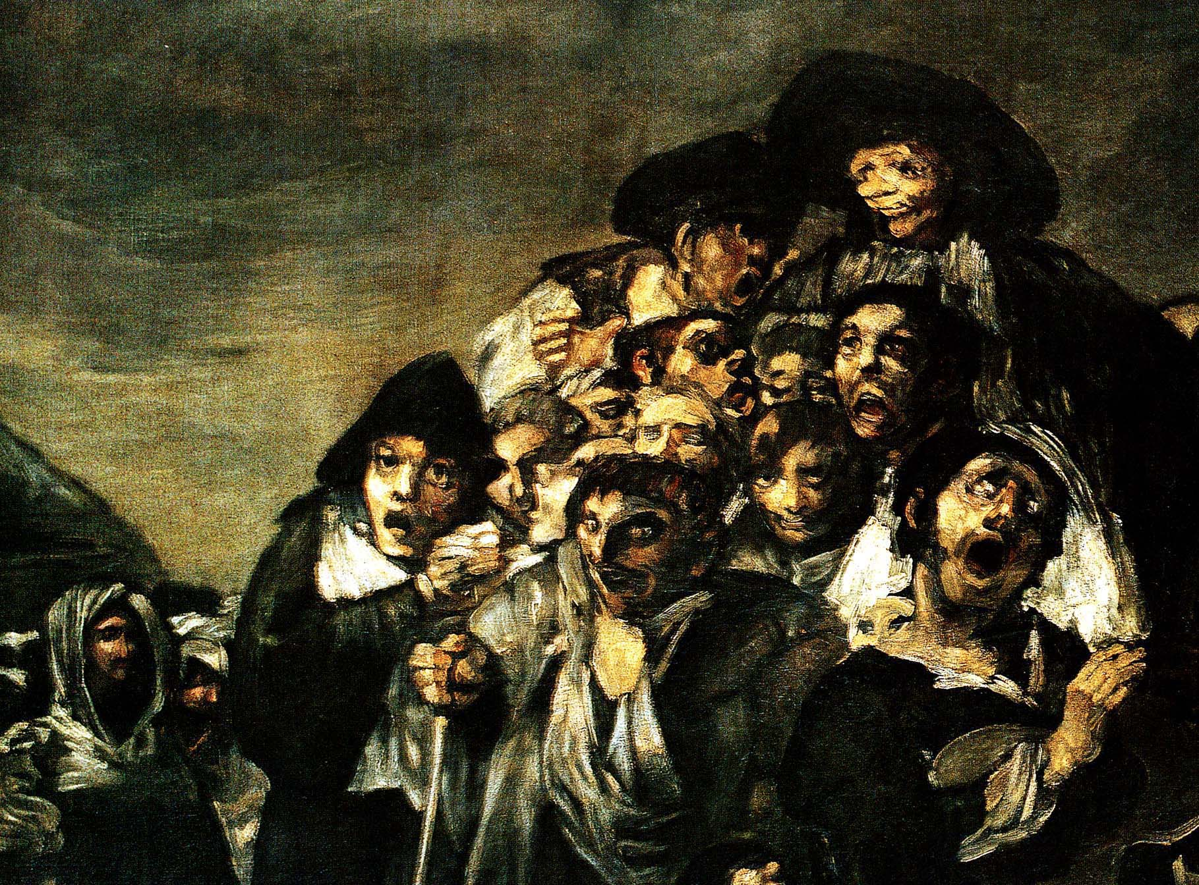

Slide 23
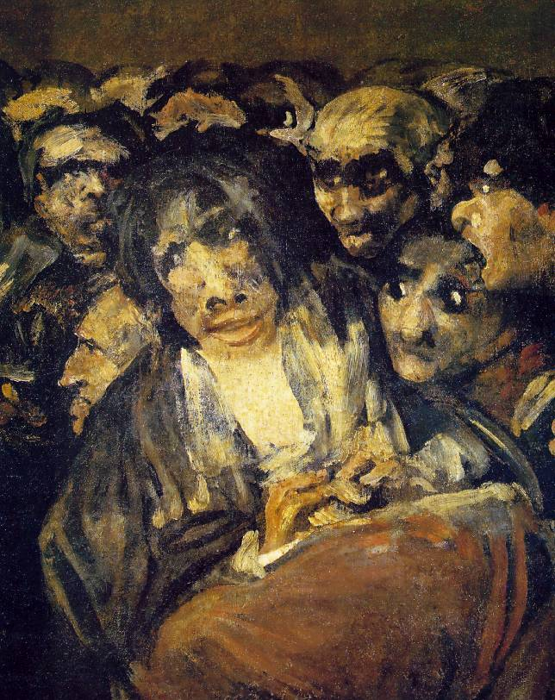

Slide 24
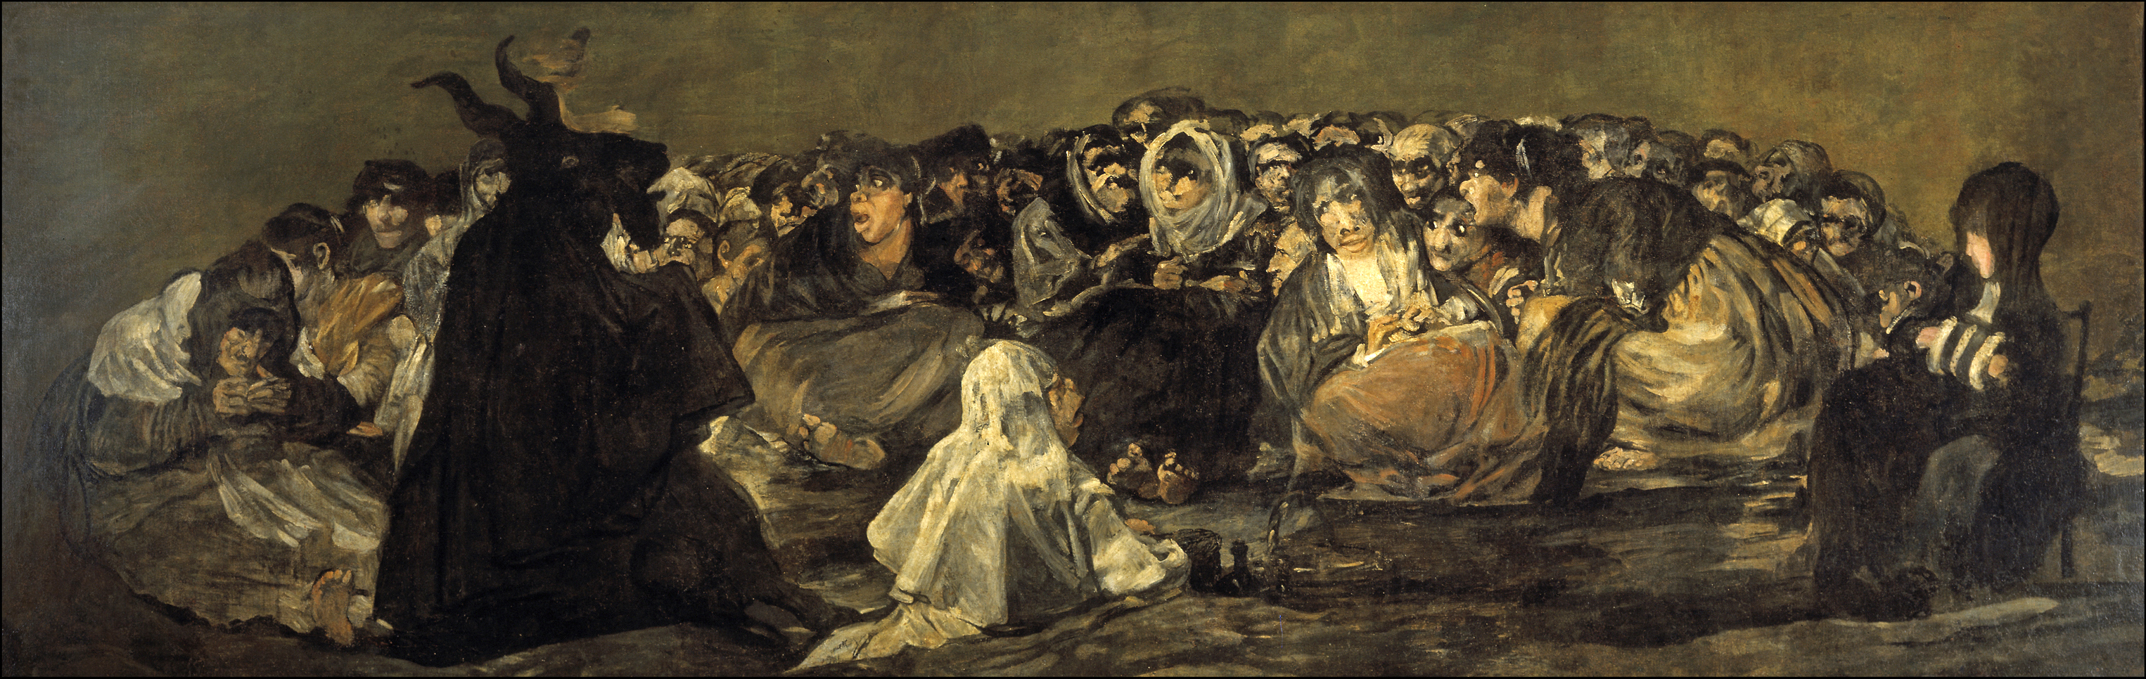

Slide 25
Gradually, his vanity at being their leader and the constant necessity of doing their thinking for them was setting him apart and creating within him the soul of one of the bourgeois he hated so much [...] he felt that sensation of repugnance and embarrassment that assails the workman who has risen above his class, been refined by study and begun to harbour ambitions (Germinal, Pt VI, Ch 3).

Slide 26
Étienne was leaving the road to Vandame and came on to the main paved highway. To the right he made out Montsou sloping away into the distance. Opposite him were the ruins of Le Voreux, the cursed abyss that three pumps worked tirelessly to empty. Then over on the horizon there were other pits, La Victoire, Saint-Thomas, Feutry-Cantel; while towards the north, smoke from the high chimneys of the blast furnaces and the batteries of coke ovens curled up through the clear morning air. If he wanted to catch the eight o’clock train he’d have to hurry up, for there were still six kilometres to go.
And far below, beneath his feet, the stubborn tapping of the picks continued. His comrades were all down there, and he could hear them following his every step. Wasn’t that La Maheude under the beetfield, her back broken, and her raucous breathing rising up to the accompanying rumble of the ventilator? Further away, to the left and to the right, he thought he could recognise others, beneath the wheat, the green hedges, and the young saplings. High in the sky the April sun now shone down in its full glory, warming the bountiful earth and breathing life into her fertile bosom, as the buds burst into verdant leaf, and the fields quivered under the pressure of the rising grass. All around him seeds were swelling and shoots were growing, cracking the surface of the plain, driven upwards by their need for warmth and light. The sap flowed upwards and spilled over into soft whispers; the sound of germinating seeds rose and swelled to form a kiss. Again and again, and even more clearly, as if they too were rising towards the sunlight, his comrades kept tapping away. Beneath the blazing rays of the sun, in that morning of new growth, the countryside rang with song, as its belly swelled with a black and avenging army of men, germinating slowly in its furrows, growing upwards in readiness for harvests to come, until one day soon their ripening would burst open the earth itself.
Zola, Germinal, final paragraphs.

Slide 27
And work? Nothing?” Asked Manuel.
“Work! … Let the cat work,” scoffed Vidal.
They didn’t work, stuttered Bizco; who was going to get fresh with him while he had his trusty steel in his hand?
Into the brain of this wild beast there had not penetrated, even vaguely, any idea of rights or duties. No duties, no rights or anything at all. To him, might was right; the world was a hunting wood. Only humble wretches could obey the law of labour. That’s what he said: Let fools work, if they hadn’t the nerve to live like men.
As the three thus conversed a man and woman with a child in her arms passed by. They looked dejected, like famished, persecuted folk, their glance timid and awed.
“There’s the workers for you,” exclaimed Vidal. That’s how they are.”
“The devil take them,” muttered Bizco.
“Where are they bound for?” asked Manuel, eyeing them sympathetically.
Pío Baroja, The Quest, Pt III, Ch1

Slide 28
We individuals of today are enamoured of the passing, fleeting and transitory moment, and the durability or lack of durability of our work concerns us little, so little, that it hardly concerns us at all.
Baroja, ‘Preface’, La dama errante (1908)

