Slide 1
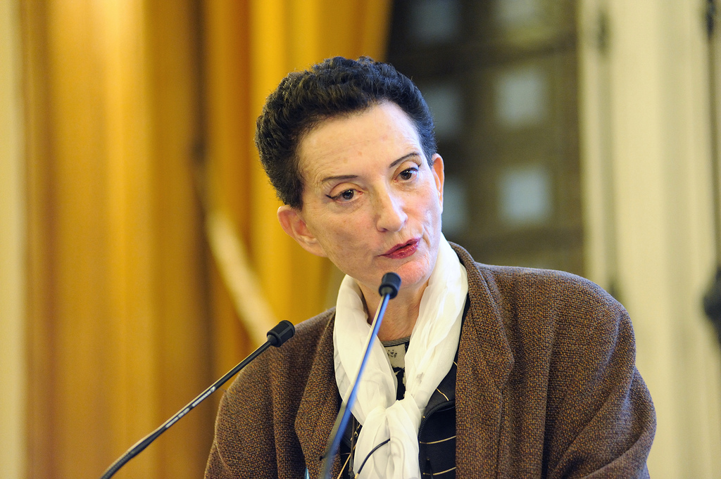
Hélène Cixous

Slide 2
The 7 Demands of the UK Women’s Liberation Movement
International Women’s Day 1971:
1. Equal pay now
2. Equal education and job opportunities
3. Free contraception and abortion on demand
4. Free 24-hour nurseries
National Women’s Liberation Conference, 1975:
5. Financial and legal independence
6. An end to all discrimination against lesbians and a woman’s
right to define her own sexuality
National Women’s Liberation Conference, 1978:
7. Freedom from intimidation by threat or use of violence or
sexual coercion, regardless of marital status and an end to all laws, assumptions and institution which perpetuate male dominance and men’s aggression towards women

Slide 3
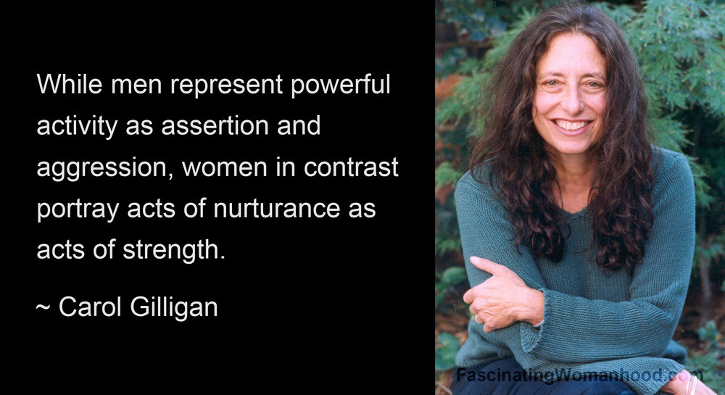

Slide 4
double demand, for equality and difference
[W]omen are obviously not to be expected to renounce equality in the sphere of civil rights. How can the double demand – for both equality and difference – be articulated? Certainly not by acceptance of a choice between ‘class struggle’ and ‘sexual warfare,’ an alternative that aims once again to minimize the question of the exploitation of women through a definition of power of the masculine type. More precisely, it implies putting off to an indefinite later date a women’s ‘politics,’ a politics that would be modeled rather too simplistically on men’s struggles (Luce Irigaray)

Slide 5
changing the structure of politics or changing the distribution of power?
when women’s movements challenge the forms and nature of political life, the contemporary play of powers and power relations, they are in fact working toward a modification of women’s status. On the other hand, when these same movements aim simply for a change in the distribution of power, leaving intact the power structure itself, then they are resubjecting themselves, deliberately or not, to a phallocratic order. This latter gesture must of course be denounced, and with determination, since it may constitute a more subtly concealed exploitation of women. Indeed, that gesture plays on a certain naiveté that suggests one need only be a woman in order to remain outside phallic power (Luce Irigaray).

Slide 6
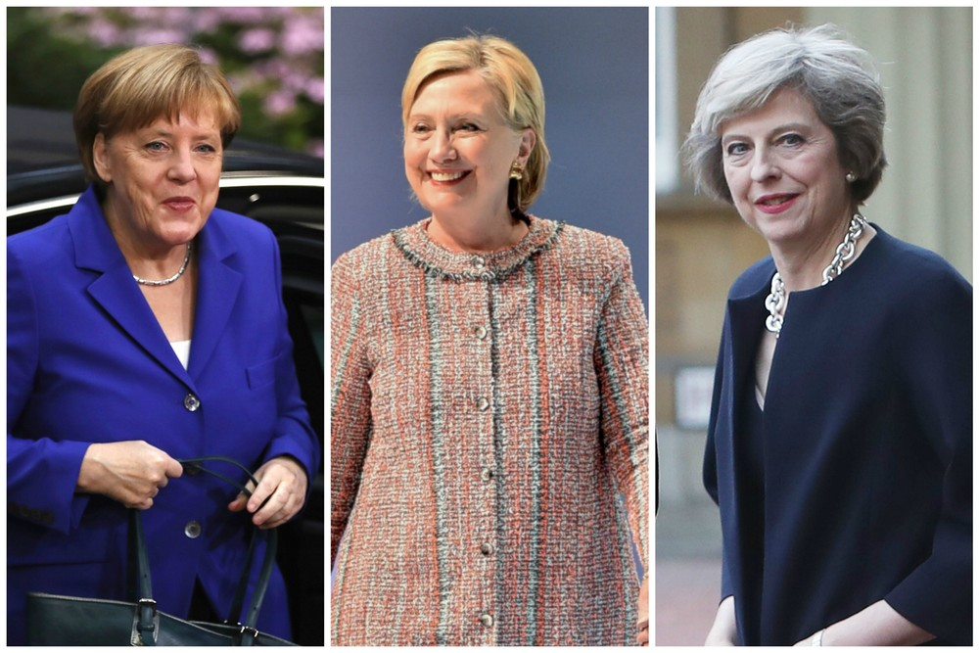

Slide 7

When you meet a human being, the first distinction you make is ‘male or female’? And you are accustomed to make the distinction with unhesitating certainty (Sigmund Freud).

Slide 8


Slide 9
Council of Europe
Gender Equality Strategy
Gender stereotypes are generalised views or preconceived ideas, according to which individuals are categorised into particular gen- der groups, typically de ned as “women” and “men”, and are arbitrarily assigned characteristics and roles determined and limited by their sex. Stereotypes are both descriptive, in that members of a certain group are perceived to have the same attributes regardless of individual differences, and prescriptive as they set the parameters for what societies deem to be acceptable behaviour. Stereotyping becomes problematic when it is used as a vehicle to degrade and discriminate women. Abolishing negative gender stereotypes is essential to achieving gender equality, and the media are central to prompting this change.

Slide 10
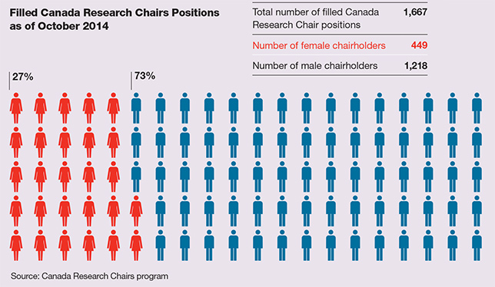

Slide 11
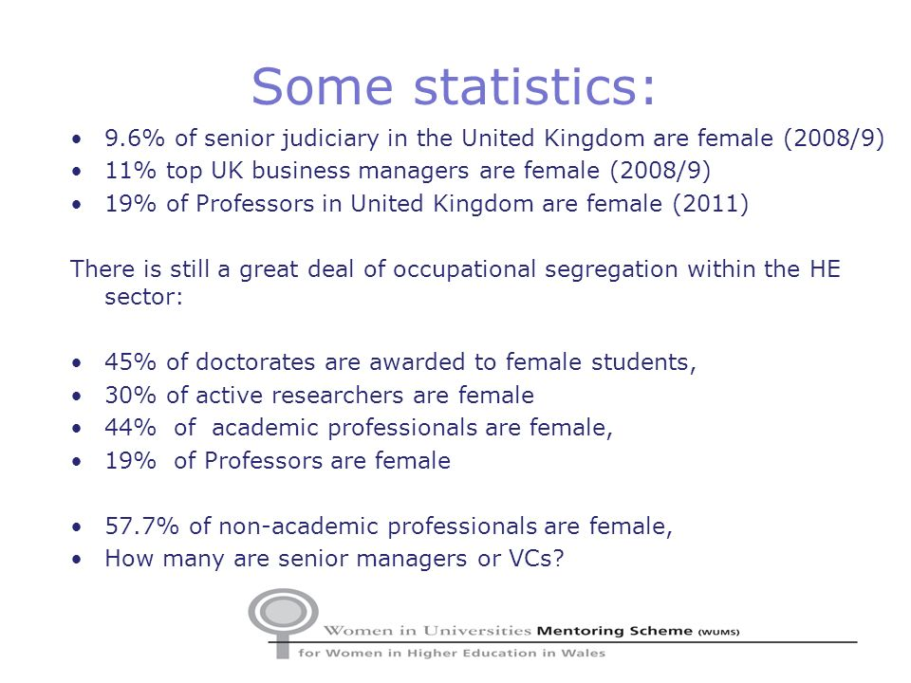

Slide 12
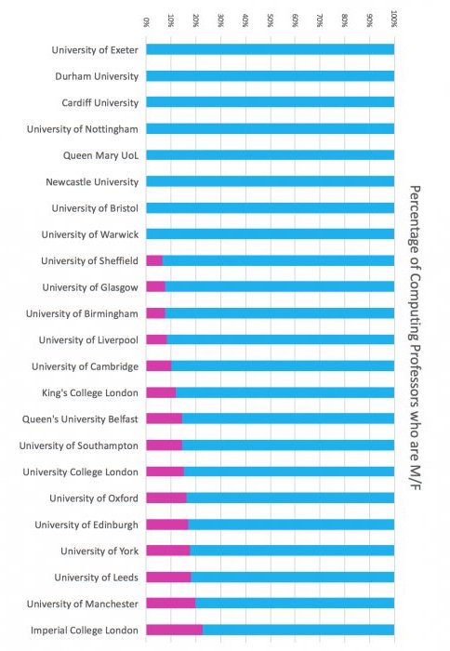

Slide 13


Slide 14
social/cultural production of women
Psychoanalysis should ‘not try to describe what a woman is’ but try to tell us ‘how she comes into being, how a woman develops out of a child with a bisexual disposition’
(Freud, ‘Femininity’)

Slide 15

‘men are people and women are people with waists’

Slide 16
the sexual indifference of psychoanalysis
In the process of elaborating a theory of sexuality, Freud brought to light something that had been operative all along though it remained implicit, hidden, unknown: the sexual indifference that underlies the truth of any science, the logic of every discourse… Freud does not see two sexes whose differences are articulated in the act of intercourse, and, more generally speaking, in the imaginary and symbolic processes that regulate the workings of a society and a culture. The ‘feminine’ is always descried in terms of deficiency or atrophy, as the other side of the sex that alone holds a monopoly on value: the male sex… Hence the all too well-known ‘penis envy’. How can we accept the idea that woman’s entire sexual development is governed by her lack of, and thus by her longing for, jealousy of, and demand for, the male organ? Does this mean that woman’s sexual evolution can never be characterised with reference to the female sex itself? All Freud’s statements describing feminine sexuality overlook the fact that the female sex might possibly have its own ‘specificity’ (Luce Irigaray)

Slide 17
Hom(m)osexuality
French ‘homme’ (‘man’, in the sense of ‘adult male’ and also ‘human species’)

Slide 18
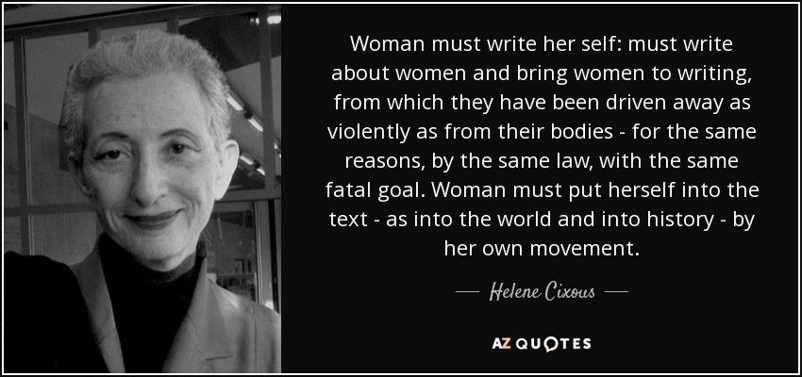

Slide 19
http://www.theguardian.com/commentisfree/video/2010/nov/05/helene-cixous-france

Slide 20
Terror: the impossibility of living
Terror: life arrest, death sentence: every child’s Terror. Perhaps being adult means no longer asking yourself where you come from, where you’re going, who to be. Discarding the past, warding off the future? Putting history in place of yourself? Perhaps. But who is the woman spared by questioning? Don’t you, you too, ask yourself: who am I, who will I have been, why-me, why-not-me? Don’t you tremble with uncertainty? Aren’t you, like me, constantly struggling not to fall into the trap? Which means you’re in the trap already, because the fear of doubting is already the doubt that you fear. And why can’t the question of why-am-I just leave me in peace? Why does it throw me off balance? What does it have to do with my woman-being? It’s the social scene, I think, that constrains you to it; history that condemns you to it. If you want to grow, progress, stretch your soul, take infinite pleasure in your bodies, your goods, how will you position yourself to do so? You are, you too, a Jewoman, trifling, diminutive, mouse among the mouse people, assigned to the fear of the big bad cat. To the diaspora of your desires; to the intimate deserts. And if you grow, your desert likewise grows. If you come out of the hole, the world lets you know that there is no place for your kind in its nations

Slide 21



Slide 22
‘The Jews are undoubtedly a race, but they are not human’
(Adolf Hitler)

Slide 23
I Say ‘Allemagne’
https://www.youtube.com/watch?v=pOwjIwIpRvw

Slide 24
For a man who no longer has a homeland, writing becomes a place to live (Adorno, Minima Moralia)
One summer I get thrown out of the cathedral of Cologne. It’s true that I had bare arms; or was it a bare head? A priest kicks me out. Naked. I felt naked for being Jewish, Jewish for being naked, naked for being a woman, Jewish for being flesh and joyful! – So I’ll take all your books. But the cathedrals I’ll leave behind. Their stone is sad and male.
The texts I ate, sucked, suckled, kissed. I am the innumerable child of their masses.
But write? With what right? After all, I read them without any right, without permission, without their knowledge.
The way I might have prayed in a cathedral, sending their God an imposter-message
Cixous, ‘Coming to Writing’

Slide 25
What’s the point of sexcusing oneself?
Gentlemen-gentlemen, Ladies-gentlemen,
All the while I am preparing to worry you, I am ceaselessly struggling with your internal difficulties, and I feel in advance that I am in the wrong rightly, so to speak.
My writings really have no raison d’être. Folly, madness! I fact, I know nothing: I have nothing to write except what I don’t know. I am writing to you with my eyes closed. But I know how to read with my eyes closed. To you, who have eyes with which not to read, I have nothing to reveal. Woman is one of the things that you are in no position to understand.
I’ve done everything possible to stifle it. What I’m saying is more than true. What’s the point of sexcusing oneself? You can’t just get rid of femininity. Femininity is inevitable. I ask you to take back your part of it. Take your shameful parts in hand. May Her proud parts come back to her.

Slide 26
Worldwide my unconscious, worldwide my body
At night I gather up my body, I step behind the wheel, I slip between my curtains, I circulate between two bloodstreams, according to what day of night it is I soar up, I descend, cities emerge from me, I travel through them, I leave them behind, all my outings on high. Am I dreaming? No. These are my lives that come to me, all the ones that lead me everywhere, into the regions, lands, countrysides, cities, cultures, nations, where my being has been touched, a single time suffices, to the quick, struck for life – to all the places from which a love letter or poison-pen letter has been mailed and then received so powerfully by my body that it could not respond. They have led me into almost all the single countries, the compound countries, the decomposed or reconstituted countries – to all the sites where History has fertilized my geography. I travel: where people suffer, where they fight, where they escape, where they enjoy, my body is suddenly there.
Worldwide my unconscious, worldwide my body. What happens outside happens inside. I myself am the earth, everything that happens, the lives that live me in my different forms, the voyage, the voyager, the body of travel and the spirit of travel, and all of this with such suppleness that I go in and out, in and out, I am in my body and my body is in me, I envelop myself and contain myself, we might be afraid of getting lost but it never happens, one of my lives always brings me back to solid body.

Slide 27
mimesis
In Plato, there are two mimeses. To simplify, there is mimesis as production, which would lie more in the realm of music, and there is the mimesis that would be already caught up in a process of imitation, specularization, adequation, and reproduction. It is the second form that is privileged throughout the history of philosophy… Yet it is doubtless in the direction of, and on the basis of, that first mimesis that the possibility of a woman’s writing may come about (Luce Irigaray).

Slide 28
Essentialism? The milky taste of ink
I give birth. I enjoy giving births. I enjoyed birthings – my mother is a midwife – I’ve always taken pleasure in watching a woman give birth. Giving birth “well.” Leading her act, her passion, letting herself be led by it, pushing as one thinks, half carried away, half commanding the contraction, she merges herself with the uncontrollable, which she makes her own. Then, her glorious strength! Giving birth as one swims, exploiting the resistance of the flesh, of the sea, the work of the breath in which the notion of “mastery” is annulled, body after her own body, the woman follows herself, meets herself, marries herself. She is there. Entirely. Mobilized, and this is a matter of her own body, the flesh of her flesh. At last! This time, of all times, she is hers, and if she wishes, she is not absent, she is not fleeing, she can take and give of herself to herself. It was in watching them giving birth (to themselves) that I learned to love women, to sense and desire the power and the resources of femininity; to feel astonishment that such immensity can be reabsorbed, covered up, in the ordinary. It wasn’t the “mother” that I saw. The child is her affair. Not mine. It was the woman at the peak of her flesh, her pleasure, her force at last delivered, manifest. Her secret. And if you could see yourself, how could you help loving yourself? She gives birth. With the force of a lioness. Of a plant. Of a cosmogony. Of a woman. She has her source. She draws deeply. She releases. Laughing. And in the wake of the child, a squall of Breath! A longing for text! Confusion! What’s come over her? A child! Paper! Intoxications! I’m brimming over! My breasts are overflowing! Milk. Ink. Nursing time. And me? I’m hungry, too. The milky taste of ink!

Slide 29
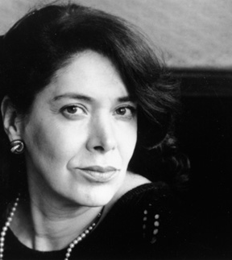

Slide 30
‘So it was for me with the French language. Ever since I was a child the foreign language was a casement opening on the spectacle of the world and all its riches. In certain circumstances it became a dagger threatening me. Should a man venture to describe my eyes, my laughter or my hands, should I hear him speak of me in this way, I risked losing my composure; then I immediately felt I had to shut him out. Make him feel by the way I started, suddenly bracing myself, shutting off my gaze, that he had made a fals move, worse, he was intruding. The game of banal, flirtatious compliments couldn’t take place, because it takes two to play.
Afterwards, I suffered from the misunderstanding: when I protected myself from flattery or made it clear that it was ineffectual, this was not because of either virtue or prudish reserve. I discovered that I too was veiled, not so much disguised as anonymous. Although I had a body just like that of a Western girl, I had thought it to be invisible, in spite of evidence to the contrary; I suffered because this illusion did not turn out to be shared.
The compliments – harmless or respectful – expressed in the foreign language, traversed a no-man’s-land of silence…’.
Assia Djebar, Fantasia: An Algerian Cavalcade

Slide 31
‘With friend or lover from my own birthplace, emerging from an identical childhood, swaddled in the same indigenous sounds, anointed with the same ancestral warmth, grazed by the same sharp ridges of frustration as my cousins, neighbours, intimate enemies, still steeped in the same garden of taboos, in the same thickets of lethargy, yes, with my brothers or my lover-friends, I finally recover my power of speech, use the same understatements, interlace the allusiveness of tone and accent, letting inflexions, whispers, sounds and pronounciation be a promise of embraces… At last, voice answers to voice and body can approach body’.
Assia Djebar, Fantasia

Slide 32
‘How could a woman speak aloud, even in Arabic, unless on the threshold of extreme age? How could she say ‘I’, since that would be to scorn the blanket-formulae which ensure that each individual journeys through life in a collective resignation?... How can she undertake to analyse her childhood, even if it turns out different? The difference, if not spoken of, disappears. Only speak of what conforms, my grandmother would reprove me: to deviate is dangerous, inviting disaster in its multiple disguises. Only speak of everyday mishaps, out of prudence rather than prudery, and so stave off misfortune… As for happiness, always too short-lived, but compact, succulent, close your eyes and concentrate all your strength on enjoying it but do not speak of it aloud…
My oral tradition has gradually been overlaid and is in danger of vanishing: at the age of eleven or twelve I was abruptly ejected from this theatre of feminine confidences – was I thereby spared from having to silence my humbled pride? In writing of my childhood memories I am taken back to those bodies bereft of voices. To attempt an autobiography using French words alone is to lend oneself to the vivisector’s scalpel, revealing what lies beneath the skin. The flesh flakes off and with it, seemingly, the last shreds of the unwritten language of my childhood. Wounds are reopened, veins weep, one’s own blood flows and that of others, which has never dried’.
Assia Djebar, Fantasia

Slide 33
masquerade
Psychoanalysts say that masquerading corresponds to woman’s desire. That seems wrong to me. I think the masquerade has to be understood as what women do in order to recuperate some element of desire, to participate in man’s desire, but at the price of renouncing their own. In the masquerade, they submit to the dominant economy of desire in an attempt to remain ‘on the market’ in spite of everything. But they are there as objects for sexual enjoyment, not as those who enjoy.
What do I mean by masquerade? In particular, what Freud calls ‘femininity’. The belief, for example, that is it necessary to become a woman, a ‘normal’ one at that, whereas a man is a man from the outset. He has only to effect his being-a-man, whereas a woman has to become a normal woman, that is, has to enter into the masquerade of femininity.

Slide 34
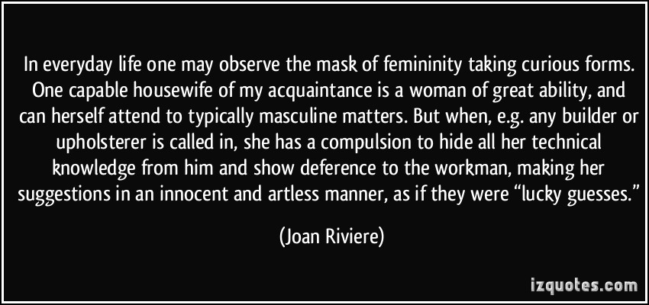

Slide 35
Adorno on femininity
The feminine character, and the ideal of femininity on which it is modelled, are products of masculine society… Glorification of the feminine character implies the humiliation of all who bear it (Minima Moralia)

Slide 36
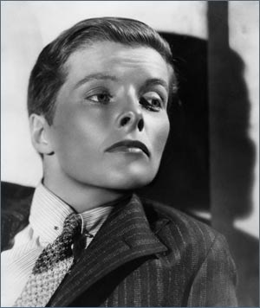
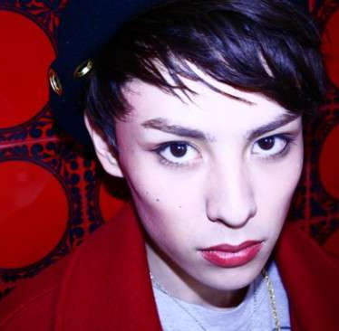

Slide 37
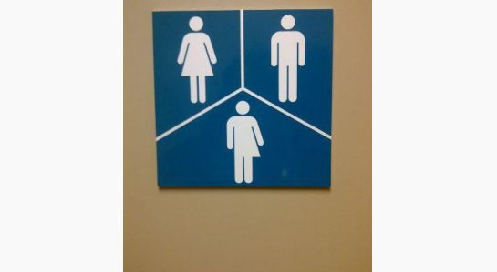
‘gender-neutral bathroom signs’, Canada

Slide 38
