Slide 1
Havelok the Dane
The ‘Matter of England’

Slide 2
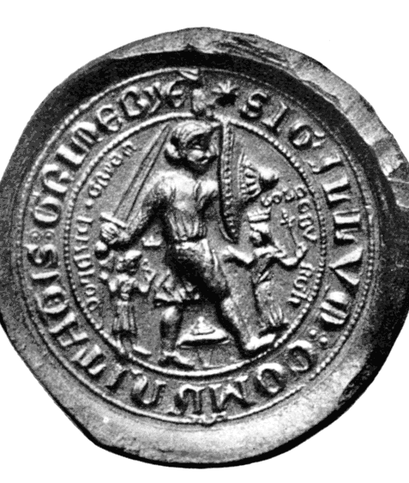
Manuscript and sources
Dated c. 1280-1290.
Earliest versions of the story in Geoffrei Gaimar’s L’Estoire des Engleis c. 1140 and Lai d’Haveloc.
The poem appears in Bodleian MS Laud Misc 108, dated c. 1300-25; also contains King Horn and saints’ lives. A note in the manuscript describes the poem as a ‘vita’.
http://medievalromance.bodleian.ox.ac.uk/The_earliest_surviving_English_romances

Slide 3
How does the poet structure the story?
What are the stages of Havelok’s development to maturity and the restoration of his kingly identity?

Slide 4
Halverson describes the poem as ‘a peasant fantasy of class ambition and resentment’?
How is social class treated in the poem?

Slide 5
How does the poem construct and represent England?

Slide 6
The poem describes itself as a ‘gest’ (l. 2984)
‘A poem or song about heroic deeds, a chivalric romance; (b) a poem or song of any kind; (c) a prose chronicle or history, a prose romance or tale; English geste(s, gestes of Engelond, history of England; gestes of the apostles, the Acts of the Apostles; (d) anything spoken or written, a saying, a writing; (e)?an inscription, ?a picture.’ (Middle English Dictionary)
How helpfully is the classification ‘romance’ applied to this poem?

