Slide 1
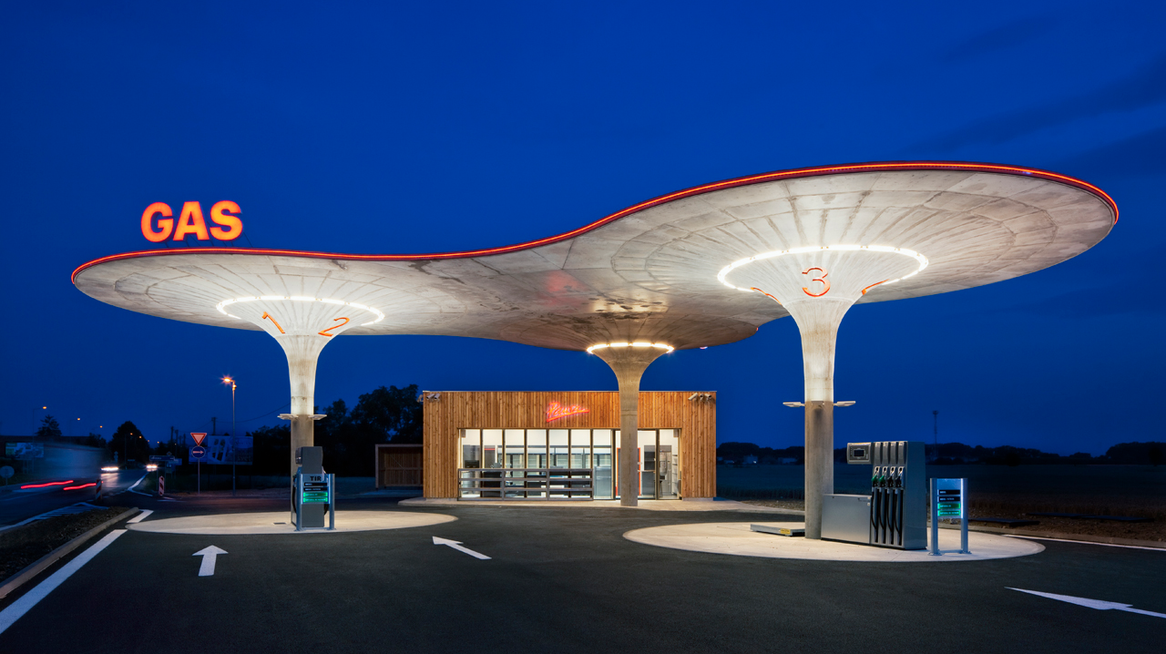
Petrocultures
Climate Imaginaries

Slide 2
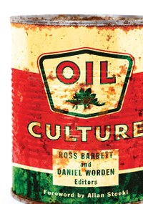
What is oil culture? (And are there cultures, more than one?) Along with that, and perhaps conditioning it: How are oil and culture conjoined? What is it for oil to be cultural? And culture to be oily? Why is oil culture and its fragmentation in cultures so fundamentally important?
Allan Stoekl, “Foreword” to Oil Culture, eds. Ross Barrett and Daniel Worden (Minneapolis: University of Minnesota Press, 2014), p. xi.

Slide 3


Slide 4


Slide 5
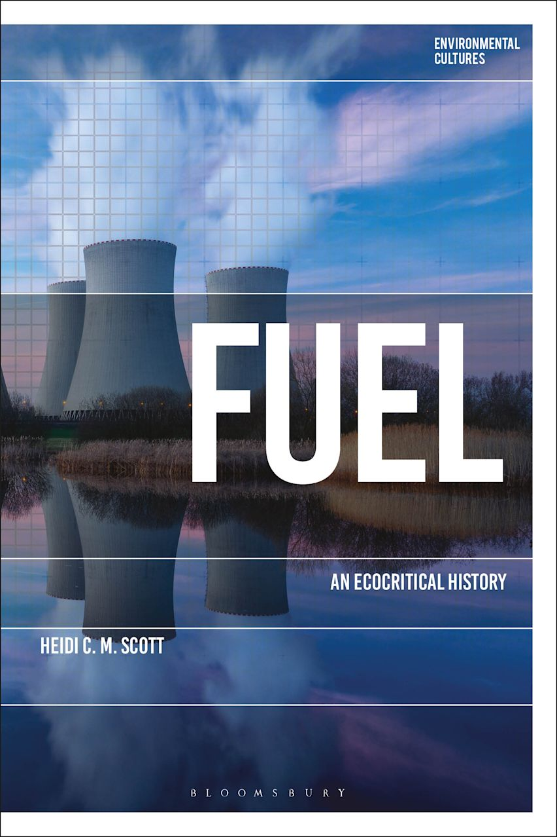
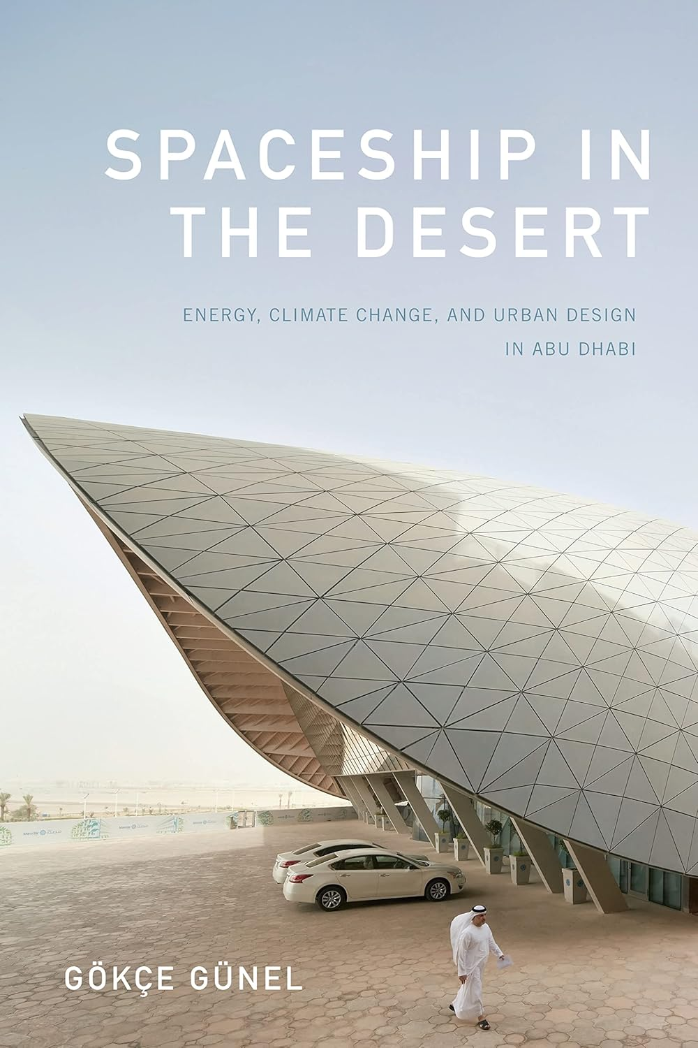
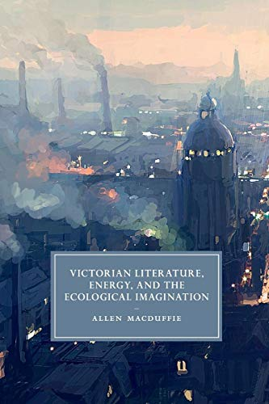
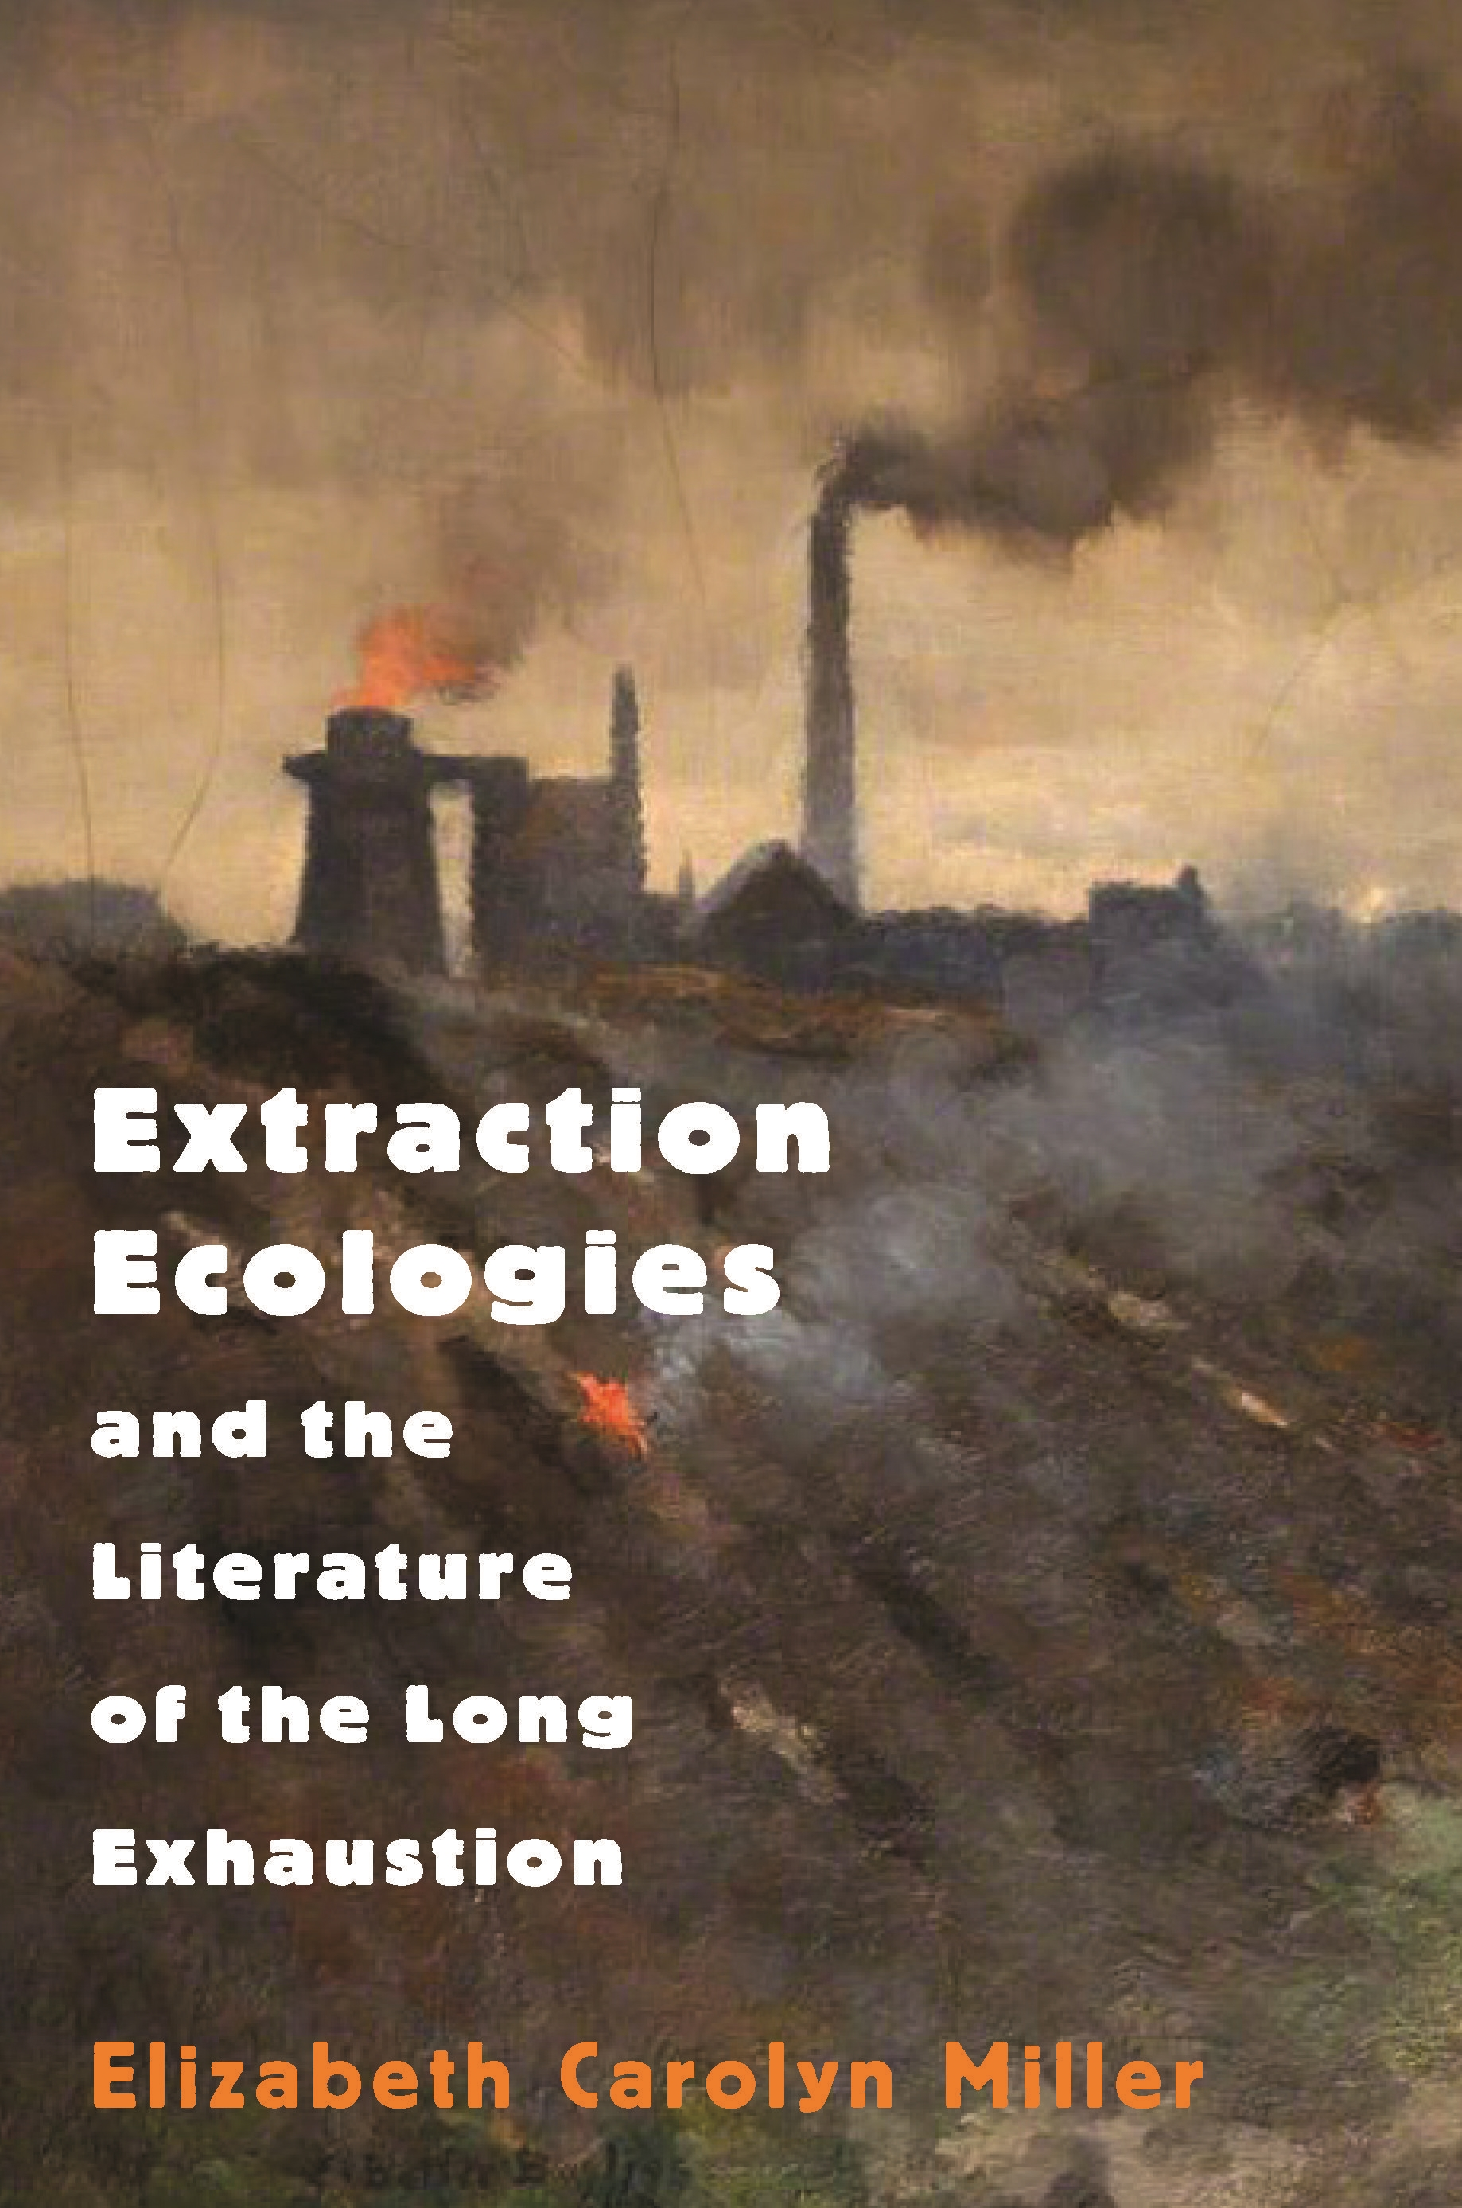
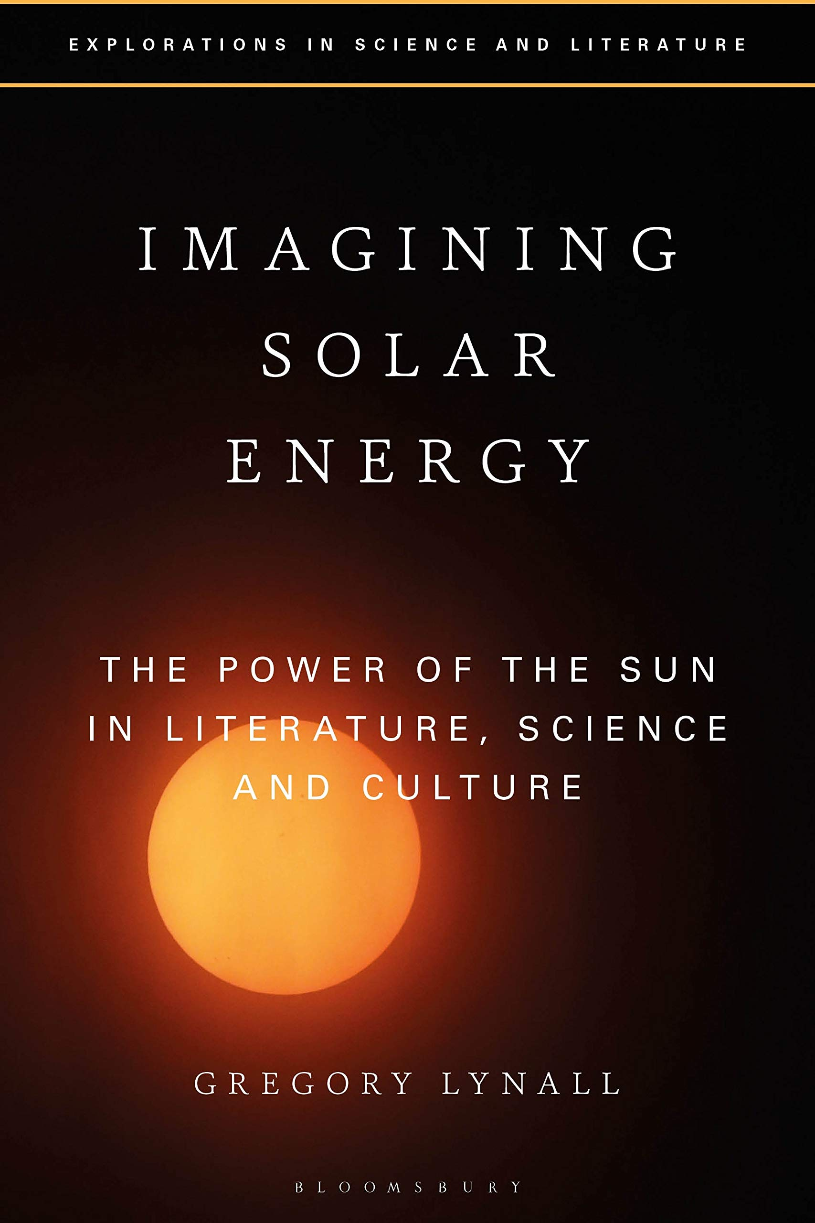
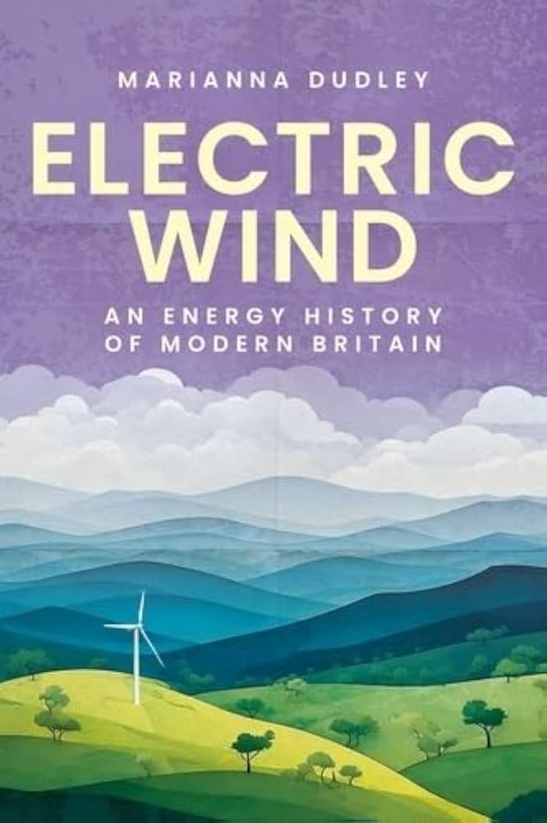
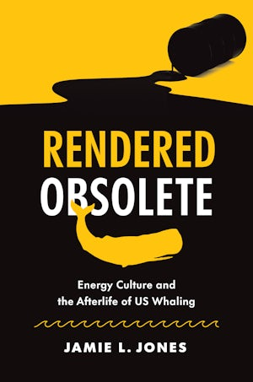

Slide 6
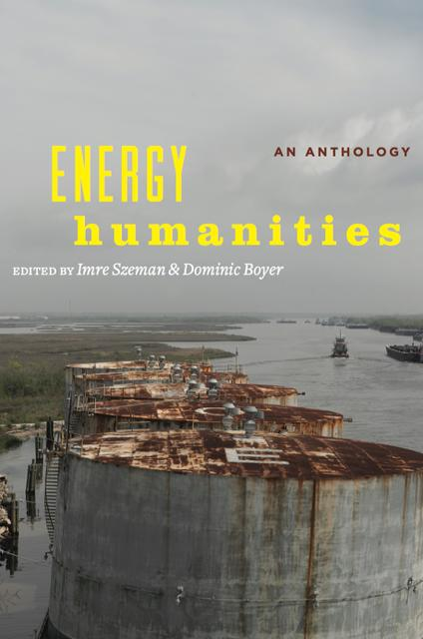
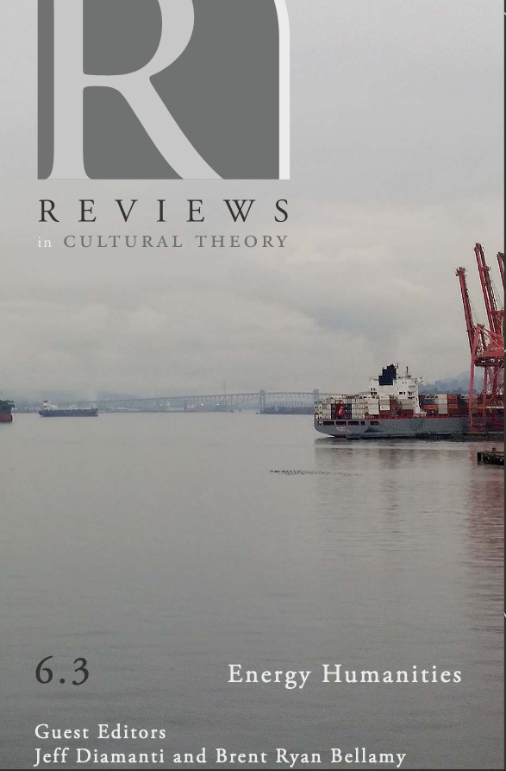
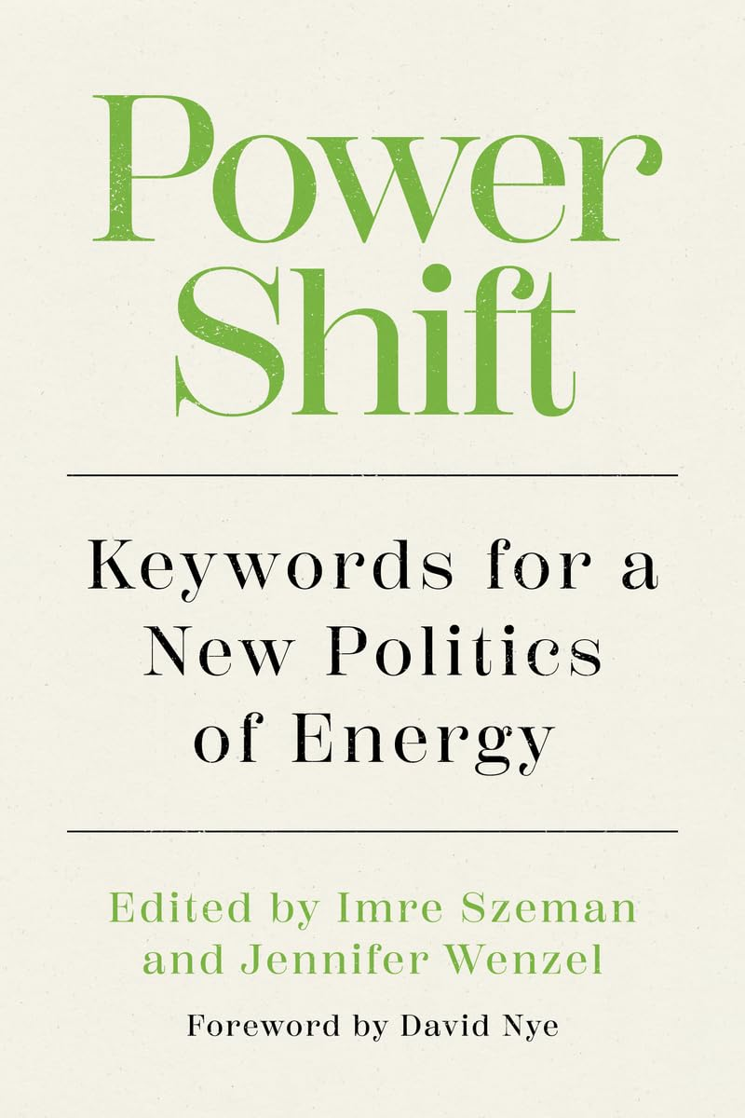

Slide 7



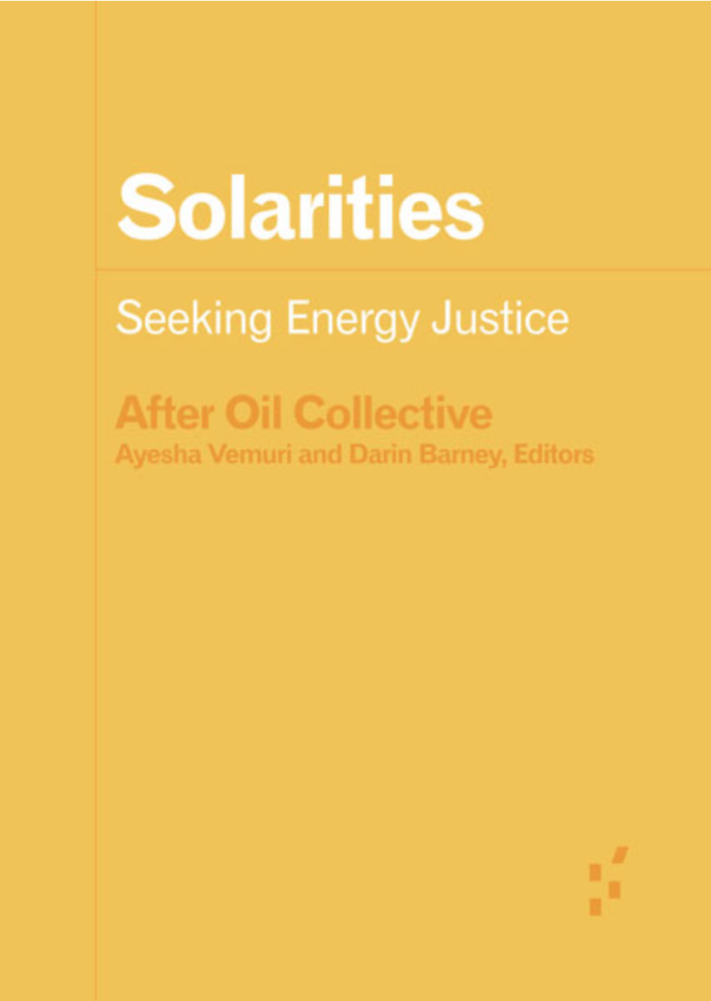
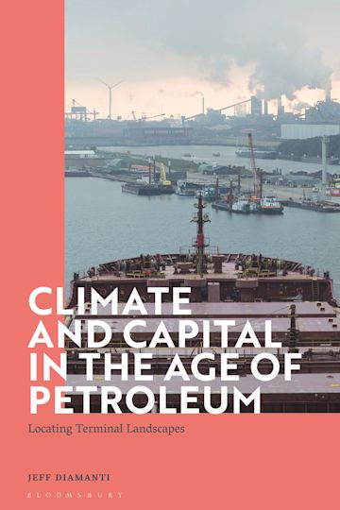

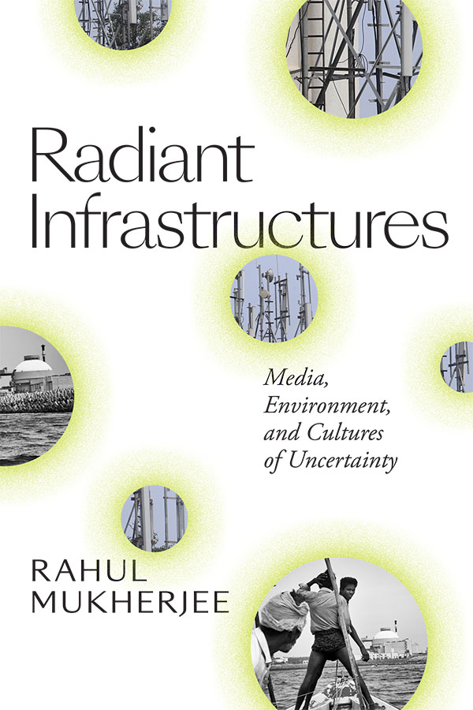
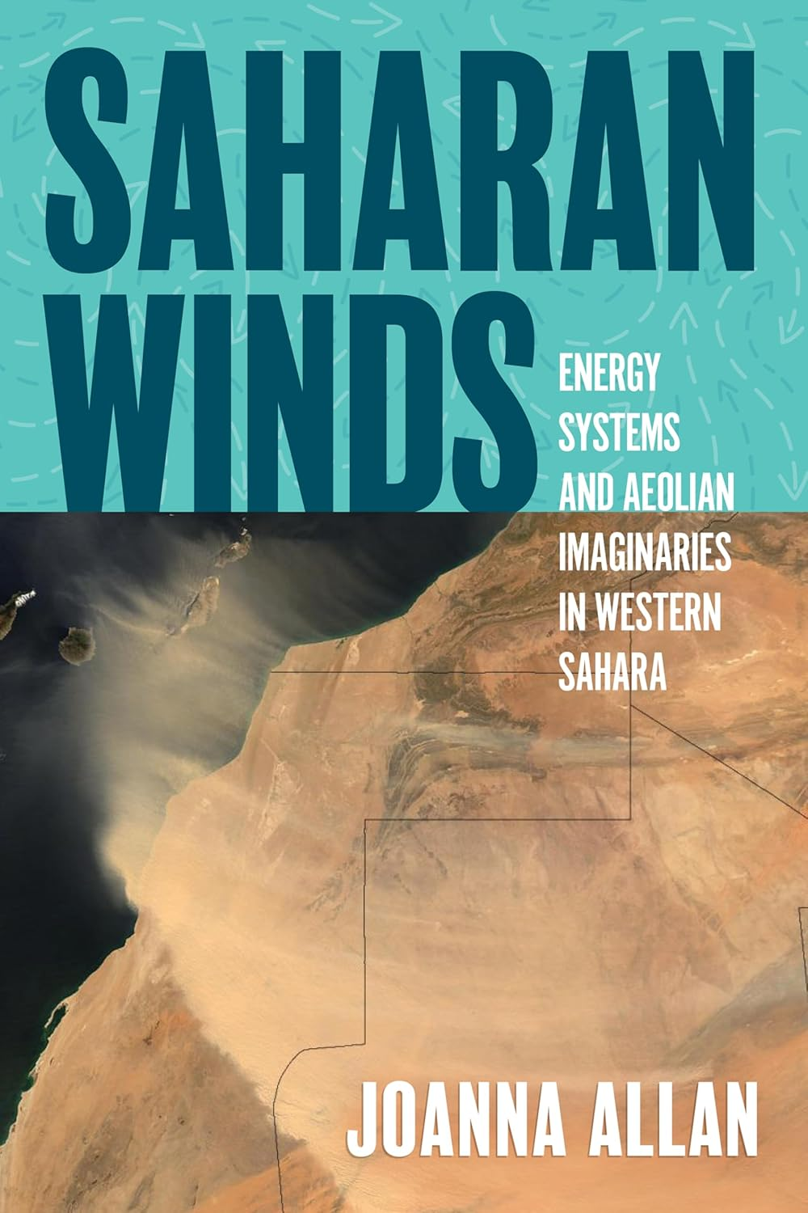
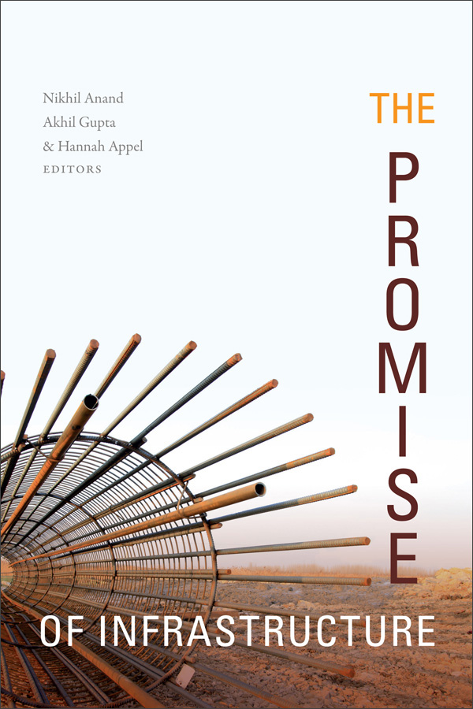

Slide 8
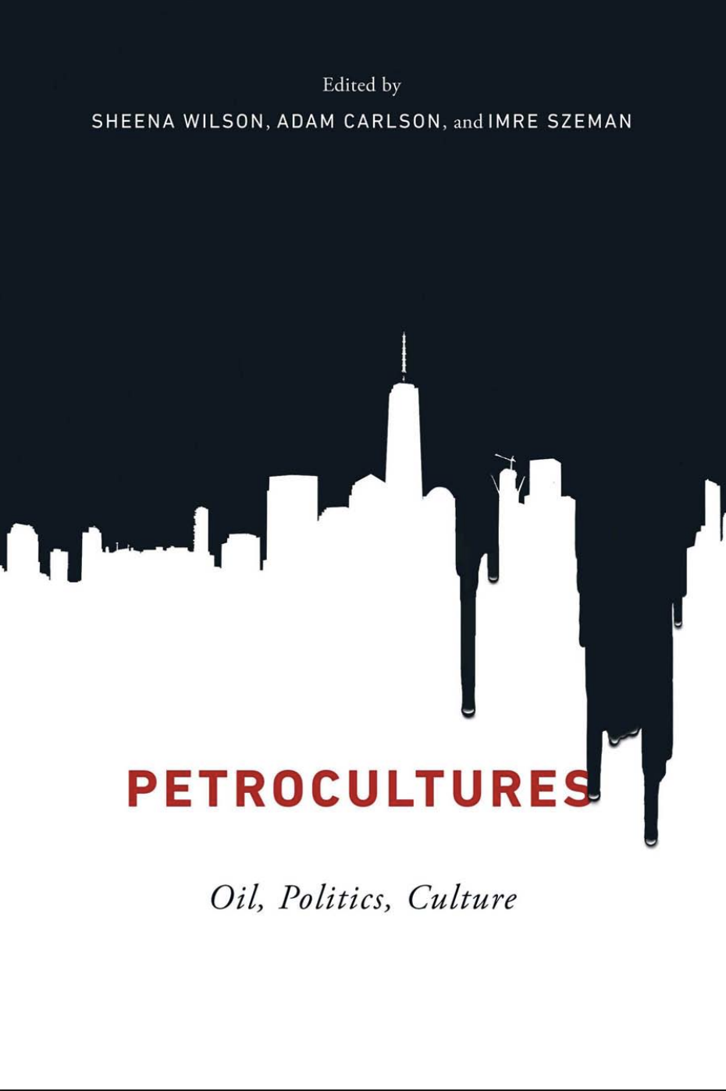
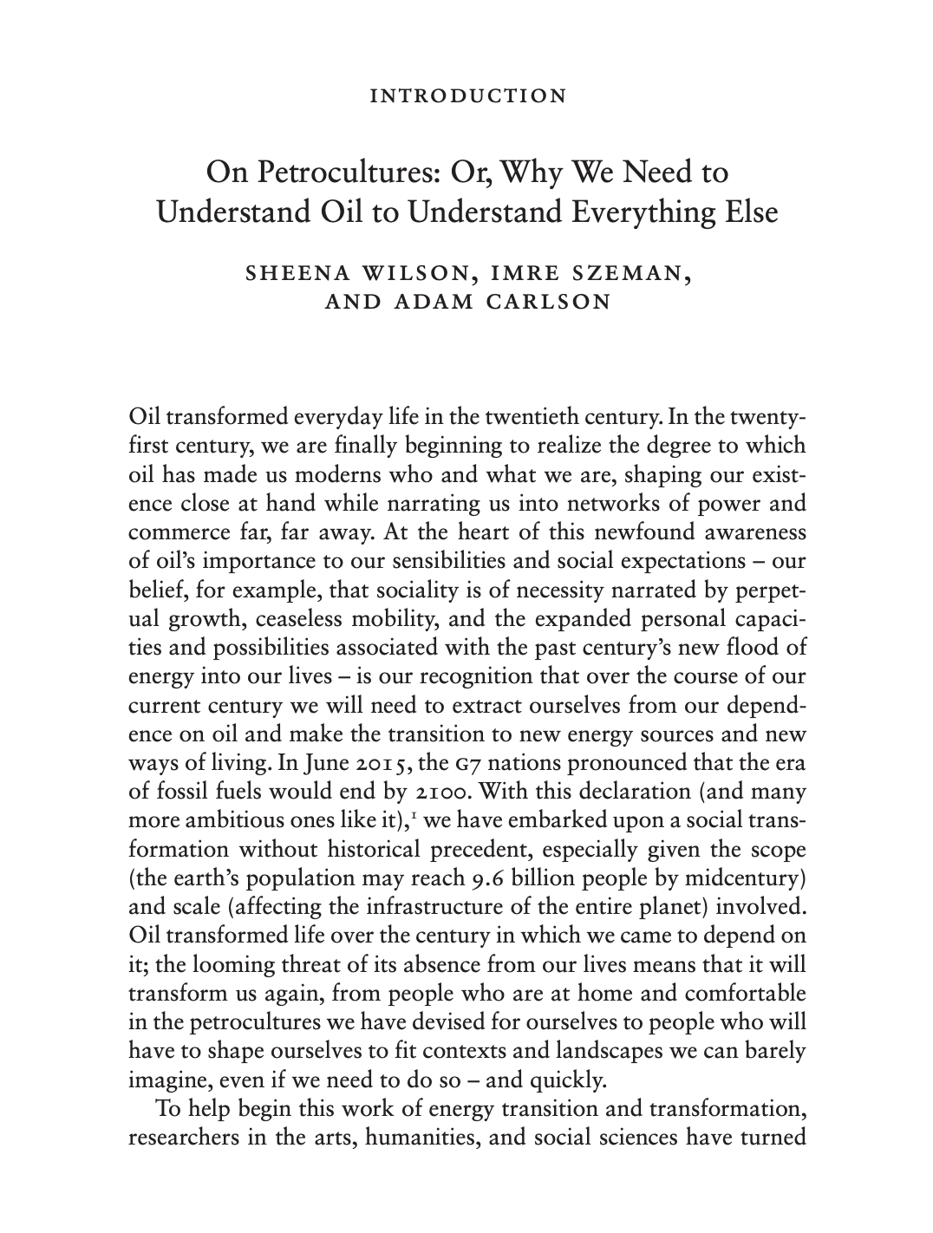

Slide 9
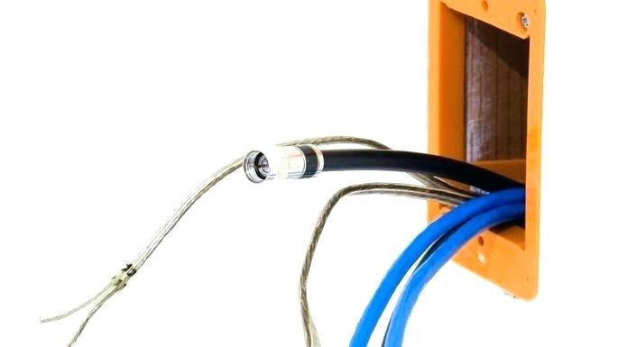
“The Energy Unconscious…..”
This Editor’s Column peruses the relation between energy resources and literature. Instead of divvying up literary works into hundred-year intervals (or elastic variants like the long eighteenth or twentieth century) or categories harnessing the history of ideas (Romanticism, Enlightenment), what happens if we sort texts according to the energy sources that made them possible?
What happens if we rechart literary periods and make energy sources a matter of urgency to literary criticism? What happens if we think systematically about how… texts relate to energy sources across time and space?
Patricia Yaeger, “Editor’s Column: Literature in the Ages of Wood, Tallow, Coal, Whale-Oil, Gasoline, Atomic Power and Other Energy Sources.” PMLA 126.2 (2011): 305–10.

Slide 10
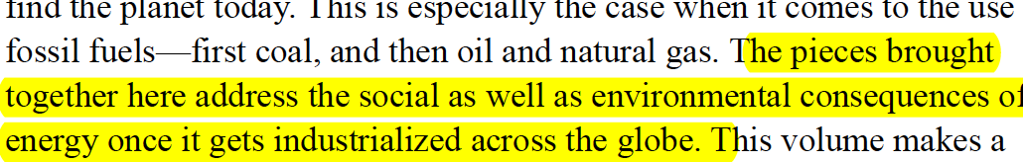
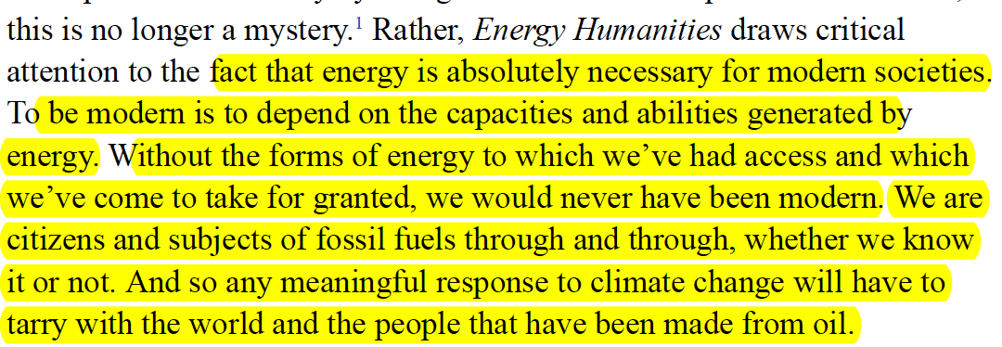
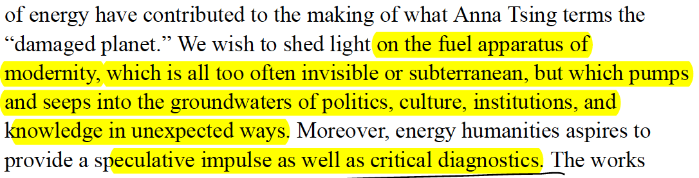

Slide 11
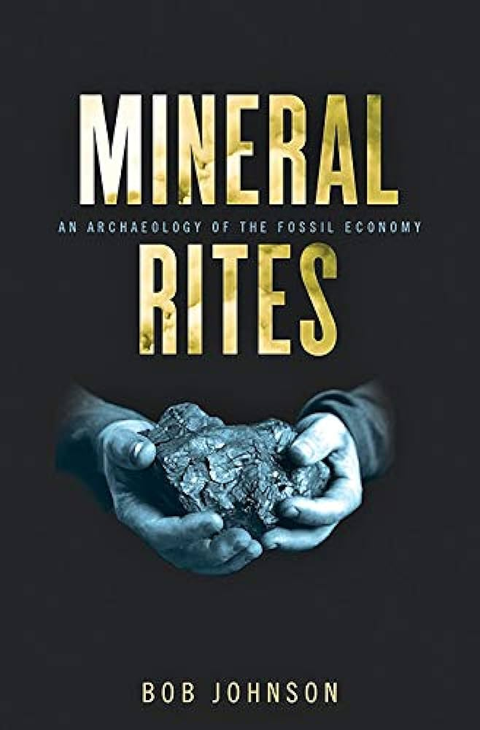
This book is an archaeology of the present. It unearths a buried set of
stories about the origins of modern life that center on the pivotal, if sublimated,
role that fossil fuels have played in the growth of capitalism and in
fueling our affective attachments to modernity. It recovers, in this respect,
a genealogy of the modern self, one oriented to a postcarbon future, by
demonstrating how our bodies, minds, identity, nature, reason, and faith are
energized by, given life by, an infrastructure of carbon flows where we are
fleshed out in everyday mineral rites, fossilized rituals, that imbue our sinews
with muscle memory, provide material for our imagination and senses,
and shape our expectations about being fully human in the twenty-first century.
In short, this book proposes an alternative history of modernity that
returns our attention to the dialectic of materiality and consciousness, body
and affect, that has taken shape under the terms of fossil combustion during
the past two hundred years—or, to push the matter further, under the terms
of “fossil capitalism” during that time. (1)

Slide 12


Slide 13
Notes:
Here – four flows are all in short supply – oil//milk/water, leading to a large flow of blood – a world of scarcity and neo-primitivism, violence and ritualized gatherings around gangsterish cults, driven by brutal climates and agricualtraul collapse – but eco-apocalyptic registers are complemented by others, such as techno-utopian genres – such as….next slide

Slide 14
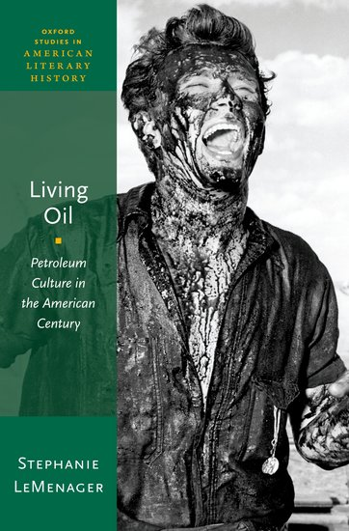
the petroleum infrastructure has become embodied memory and habitus for modern humans, insofar as everyday events such as driving or feeling the summer heat or asphalt on the soles of one’s feet are incorporating practices…de-coupling human corporeal memory from the infrastructures that have sustained it may be the primary challenge for ecological narrative in the service of human species survival beyond the twenty-ﬁrst century. (26)

Slide 15

We wish to lure imaginative designers to our workbench. In this spirit, I would describe energopower as an alternative genealogy of modern power, as an analytic method that looks in the walls to find the wiring and ducts and insulation, that listens to the streets to hear the murmur of pipes and sewage, that regards discourse on energy security today as not simply about the management of population (e.g., “biosecurity”) but also about the concern that our precious and invisible conduits of fuel and force stay brimming and humming. Above all, energopower is a genealogy of modern power that rethinks political power through the twin analytics of electricity and fuel.
Dominic Boyer, ‘Energopower’ (2014)

Slide 16
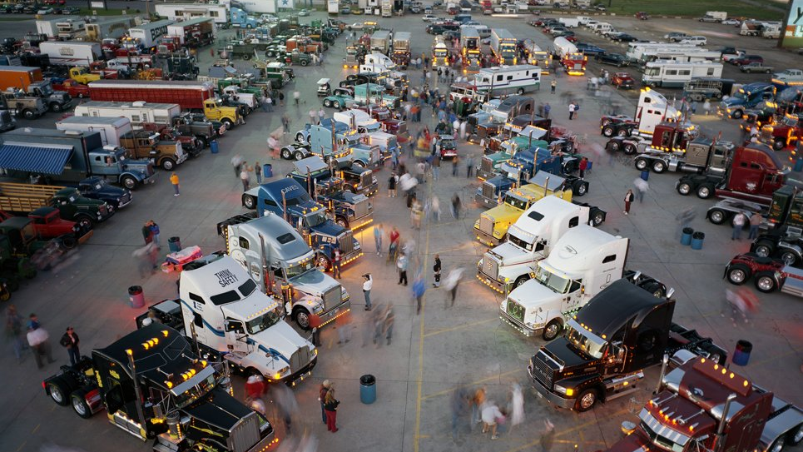

Slide 17
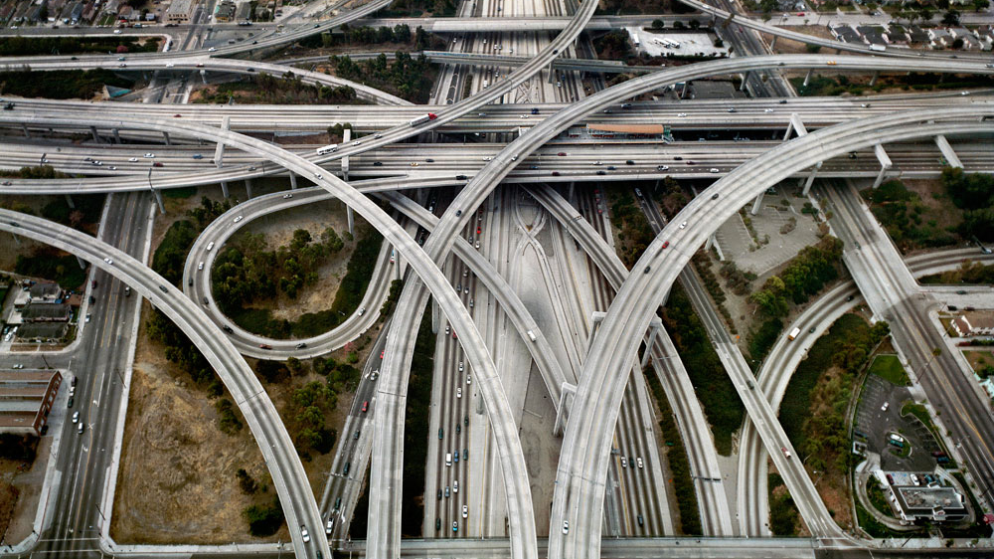

Slide 18
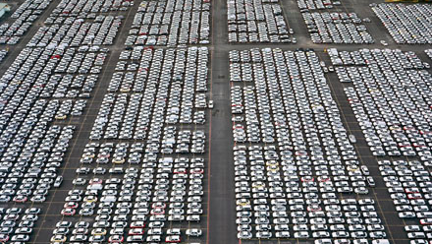

Slide 19
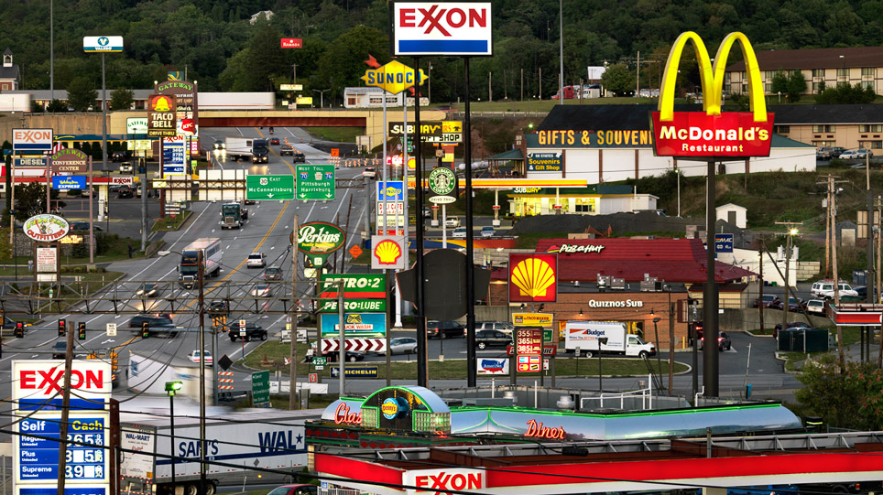

Slide 20
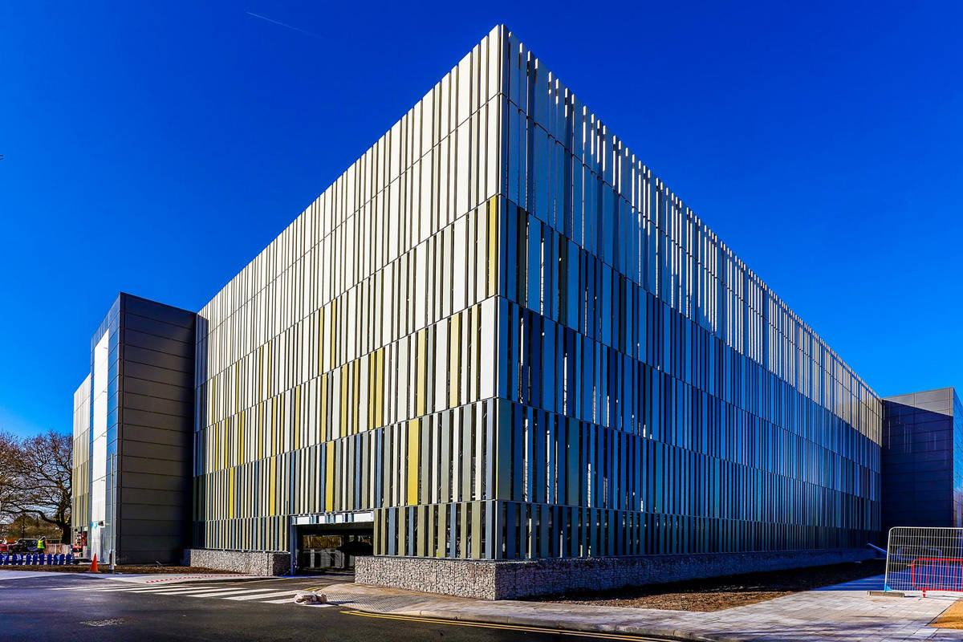

Slide 21


Slide 22
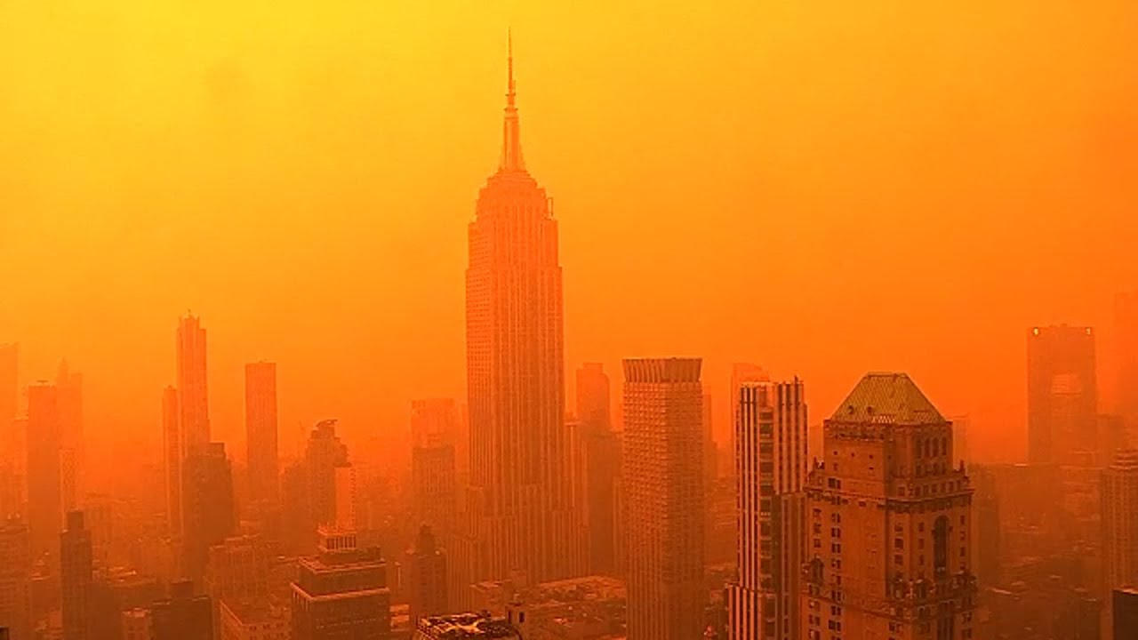

Slide 23



Slide 24
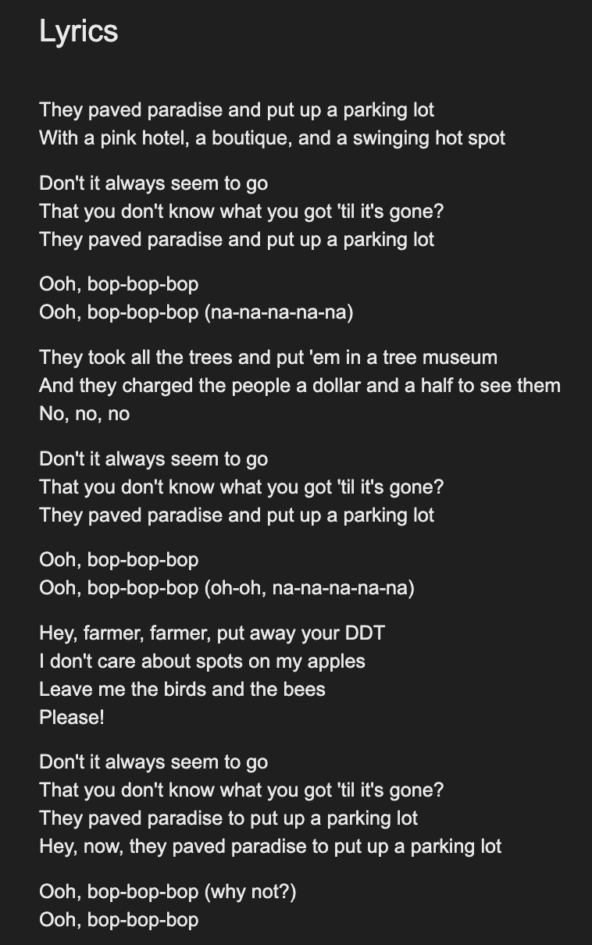
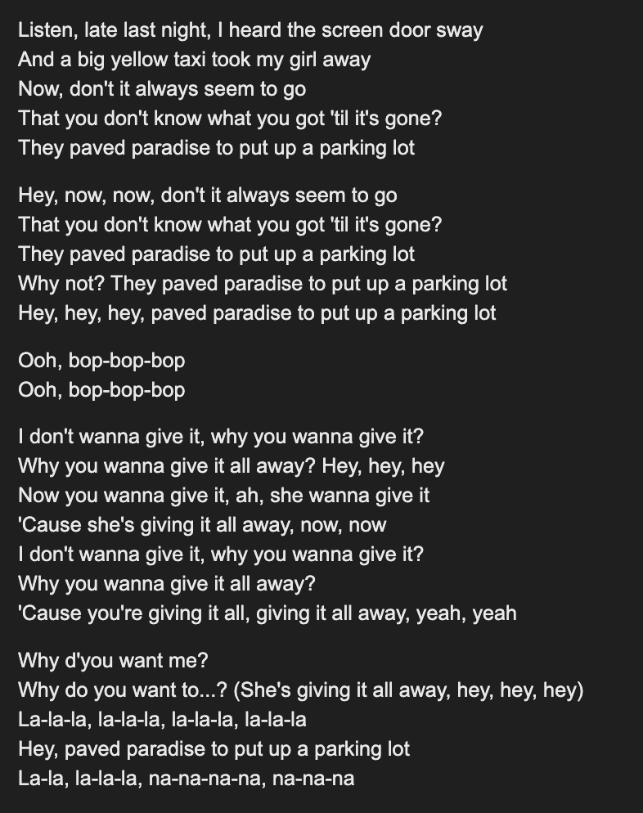
(1970

Slide 25
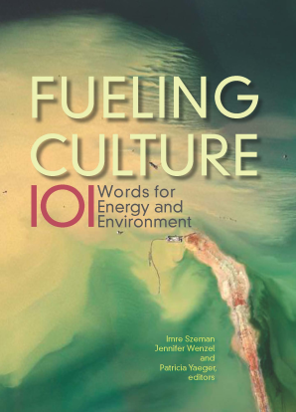
…to gain critical purchase not only on the pressure that energy exerts on culture but also the pressure that culture exerts on energy regimes. Jennifer Wenzel,
‘Introduction’
Fueling Culture, 2017.

Slide 26
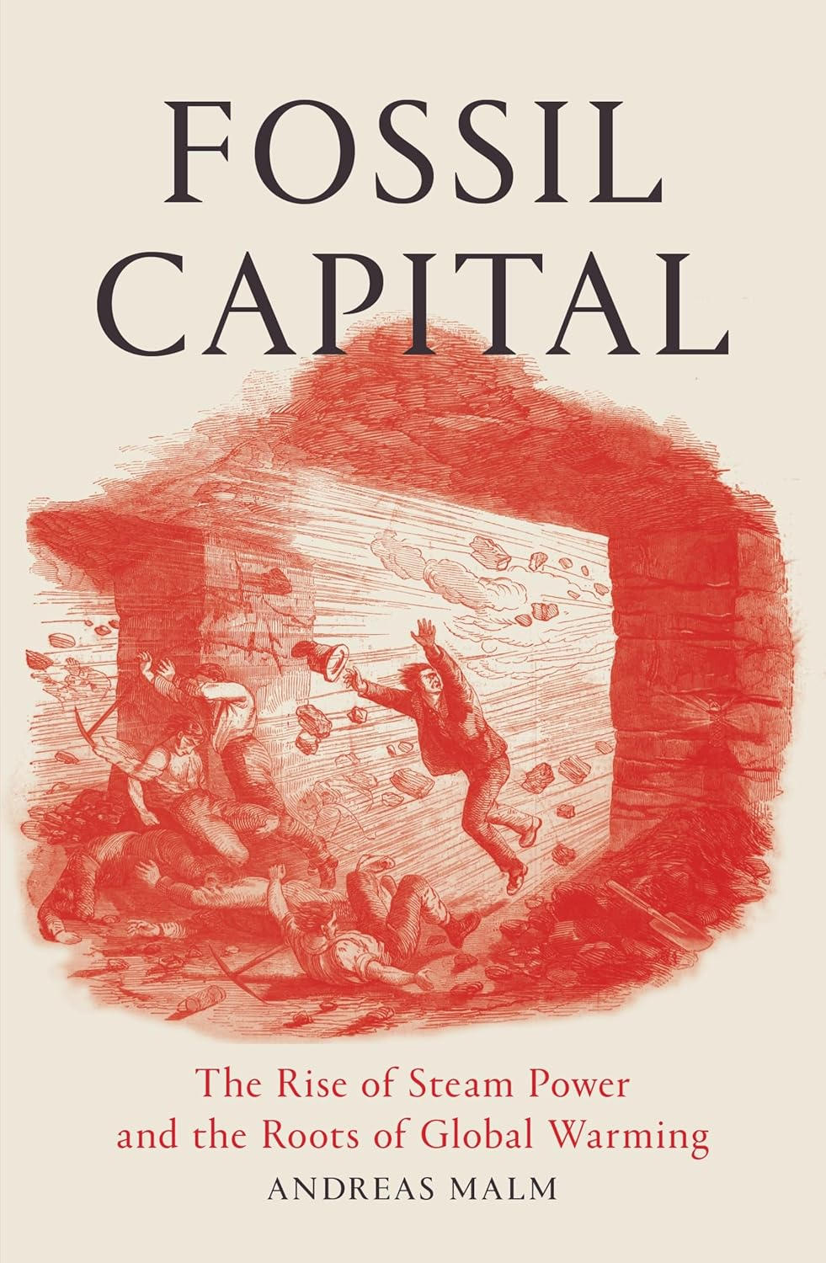

2016

Slide 27
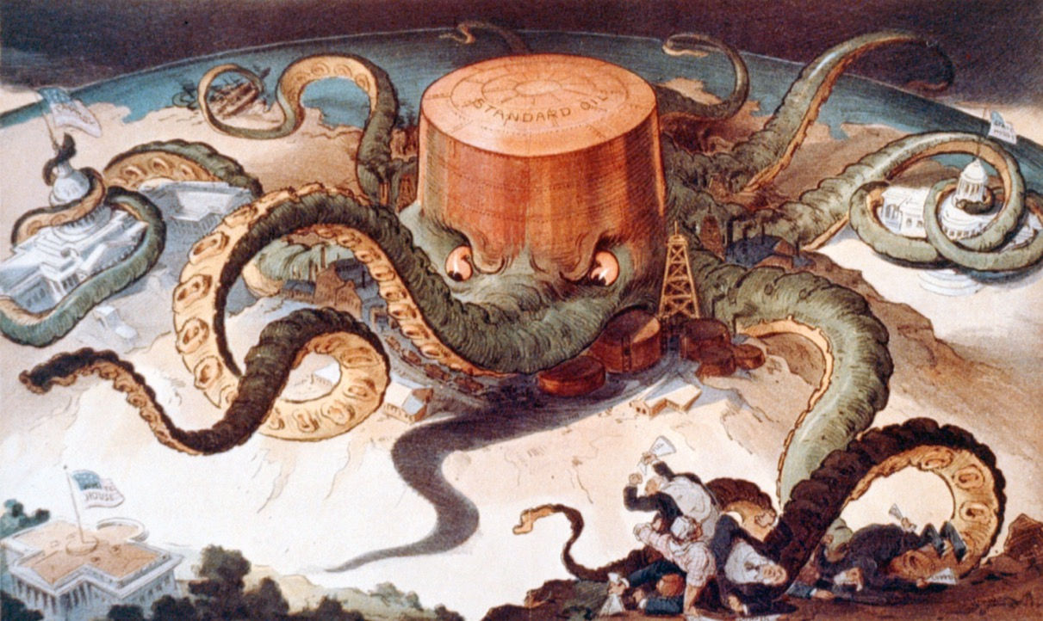

Slide 28
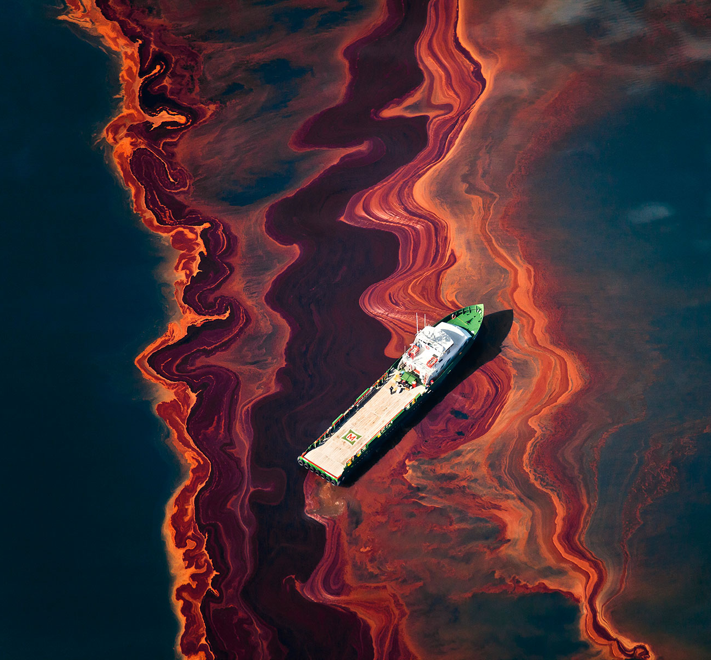

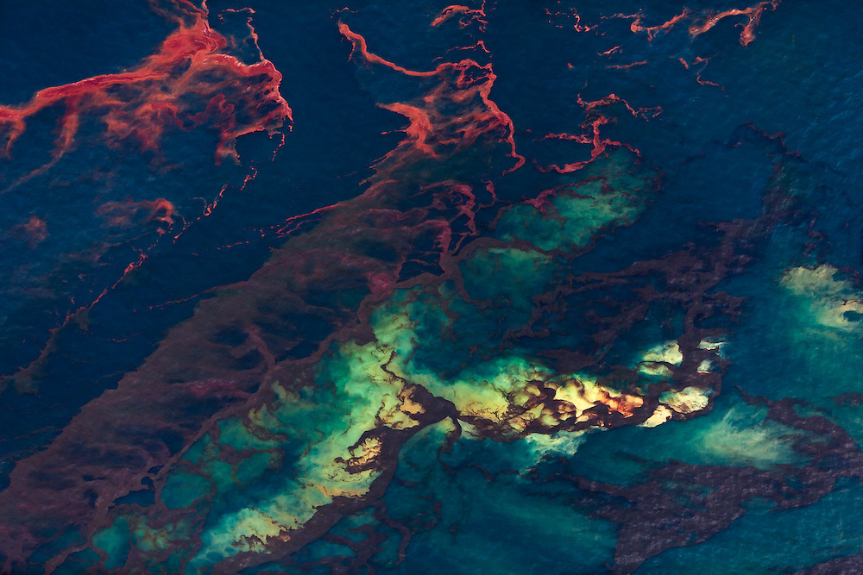

Slide 29
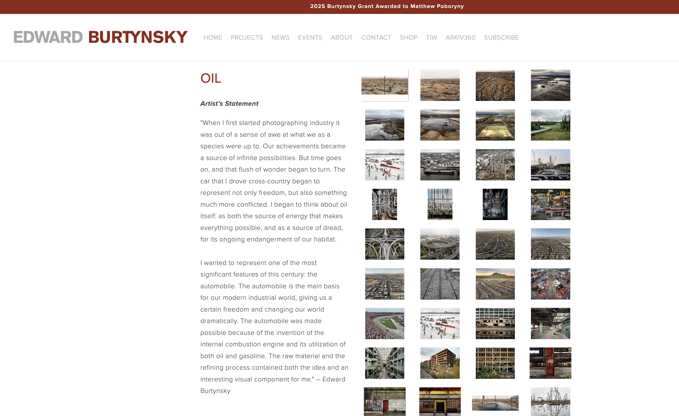

Slide 30
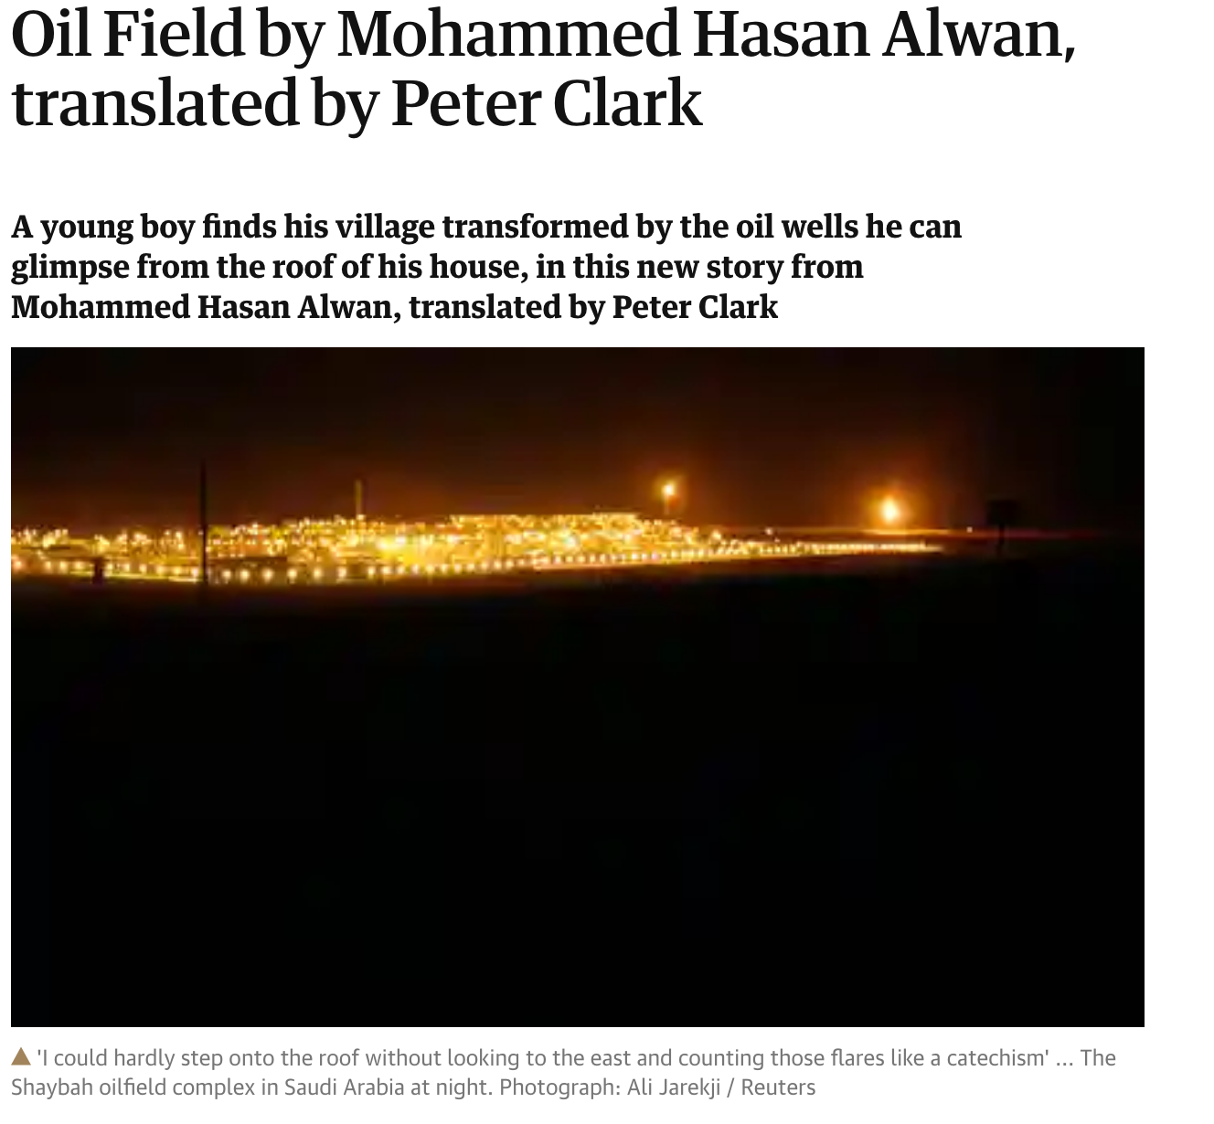
That night I dreamed about oil wells. I was up on the roof of our house
Singing the praises of the flares to a group of people down below but
I didn’t recognize them. The flares came closer and closer and I carried
on praising them … They flickered even brighter and came right up to me
in a circular wave of stars and fire…I dreamed of oil wells many times after
that night, and it seemed as if my dreams were coming true…the wells
sprung up nearer and nearer to my village.

Slide 31
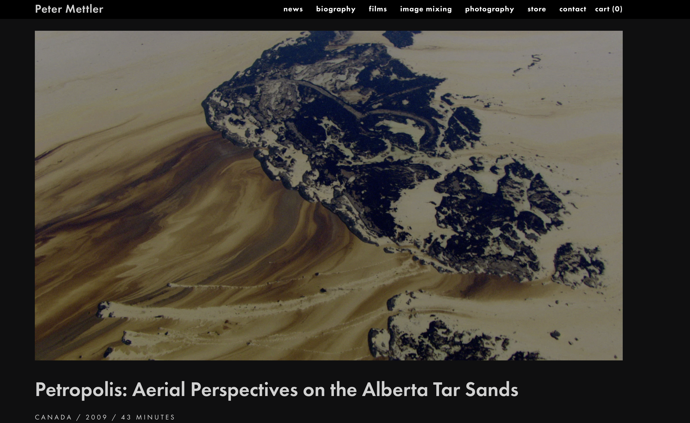

Slide 32
Petrofiction

Slide 33
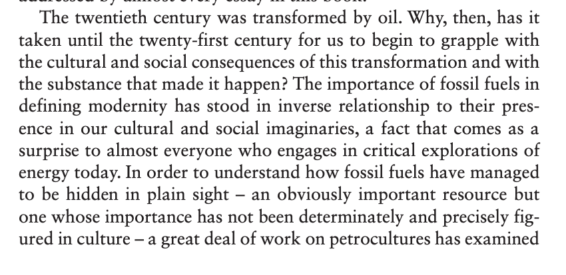
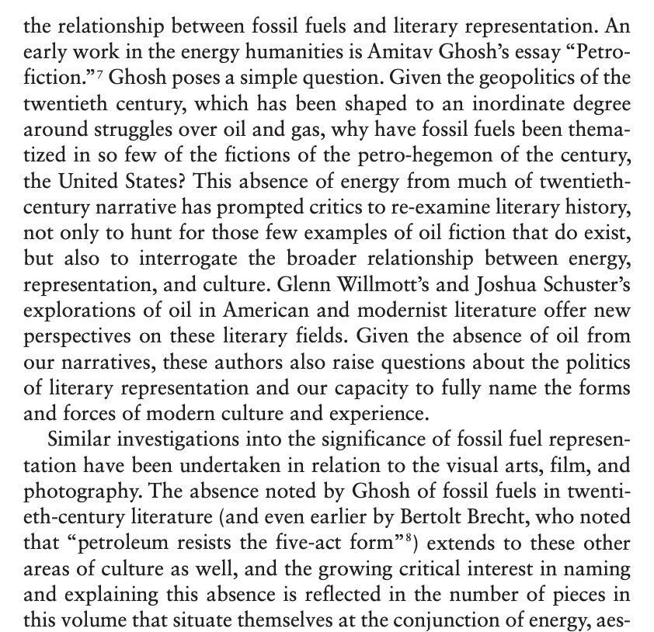

Slide 34
The question of how to write about the oil encounter has plagued novelists and critics, particularly those frustrated by what Szeman describes as the Left’s failure to generate alternatives to oil capital at a moment when the dwindling of conventional oil reserves might tip us toward Tough Oil or toward a more sustainable future… I’m not seeking a literary ace in the hole or novel that writes oil as it is, “intrinsically displaced, heterogeneous, and international.” Szeman and a dynamic group of self-named “petrocritics” have begun to archive potential candidates for this best, most representationally astute oil novel. But compelling oil media are everywhere. Films, books, cars, foods, museums, even towns are oil media. The world itself writes oil, you and I write it. Petrofiction provides one route to understanding our entanglement. So does everything else. As a critical essayist, my challenge has been to find a point of view from which to frame the everything of oil.
The regional frame assists, too, in the pursuit of the psychologically ultradeep, the affects and emotions lodged in gasoline fuel, cars, and in the thousands of everyday items made from petroleum feedstock, from lip balms to tampon applicators, dental polymers, and aspirin tablets… we must hold ourselves accountable to a materiality that is never merely an external, blank, or inert space but an active, emergent substance of ourselves and others.” What [Stacey] Alaimo calls “an ethics of mattering” becomes particularly complex, sticky, when it comes to petroleum. We wear and eat it. Our bodies write it.

Slide 35
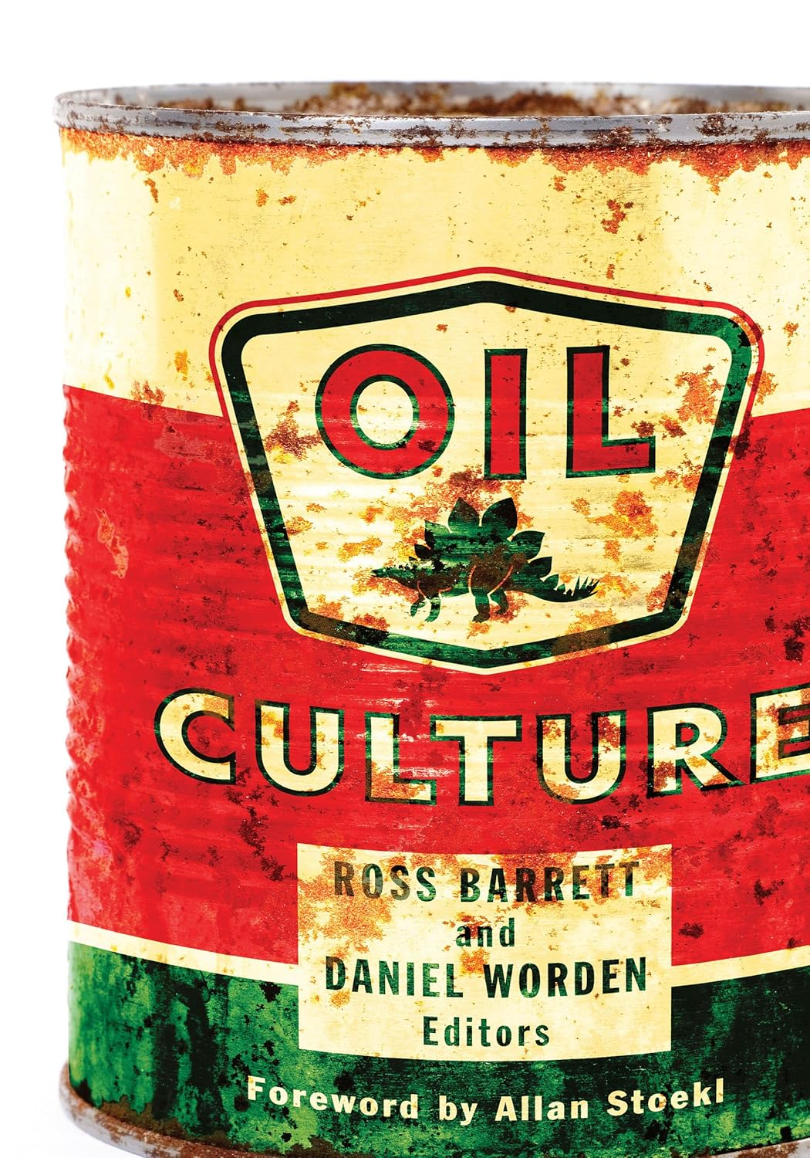
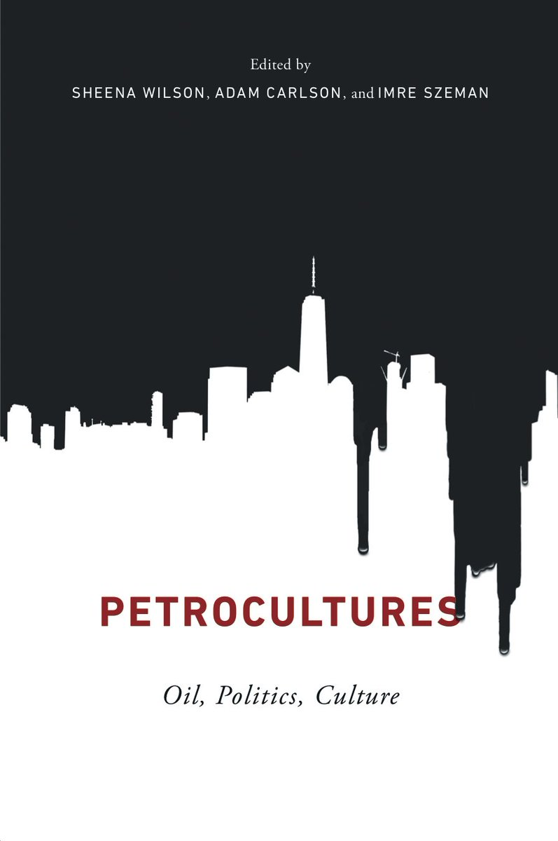

Slide 36
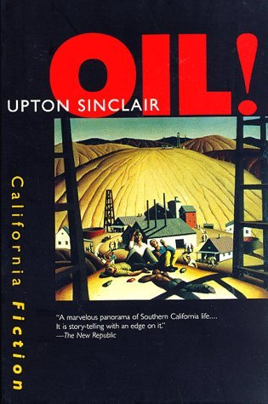

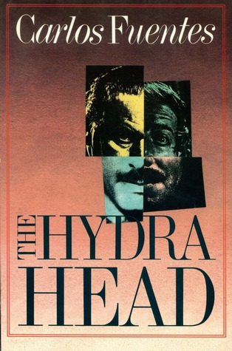


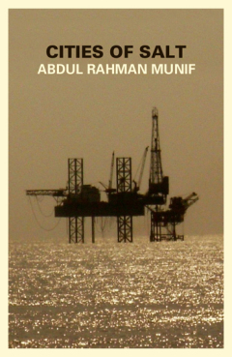



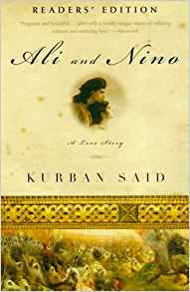


Slide 37
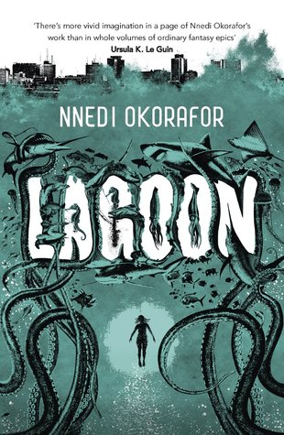










Slide 38





Slide 39



Slide 40










Slide 41







313 × 475

Slide 42









Slide 43

It was she who pointed, who first saw something in the sea […] A tower. A steeple of girders. Streaming and rising.
The girl stood. The metal was twisted. Off-true and angular like a skew-whiff crane, resisting collapse. It did not come steadily but lurched, hauling up and landward in huge jerks. After each swaying hesitation; then another move higher and closer.
The lights on the beach went out. Flame ignited at the tower’s tip. Sooty sepia guttering lifted the shaft. The sea at its base spread flat and fell away from suddenly rising intricate blackness, black angled and extrusioned. As if a quarried wedge of the seabed itself had come up to look.
The towerwork was on a platform. In the glow of the thing’s own flame they saw edificial flanks, the concrete and rust of them, the iron of the pylon barnacled, shaggy with benthic growth now lank gelatinous bunting.
It was coming at the Covehithe cliff. Under its strains and excrescences were more regular markings, stencilled warnings. Paint remnants: an encircled H.
China Miéville, “Covehithe” (2011)

Slide 44


Slide 45


Slide 46

Hayao Miyazaki
Howl’s Moving Castle
(2003)

Slide 47


Slide 48


Slide 49






Slide 50



“Once in a while, a building of modern construction, properly painted and maintained, would peep out of the bush, a reminder of other possibilities. Now and again we would drive past a gas flare reminding us that this was oil-bearing country….”
Ken Saro-Wiwa, ‘Progres’, from Forest of Flowers

Slide 51





From ‘Rigland’

Slide 52

Ade Adesina,
“Hope” (Linocut)

Slide 53


