Slide 1
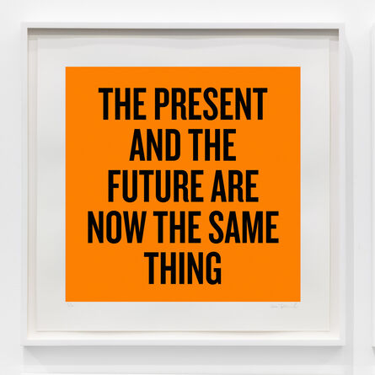
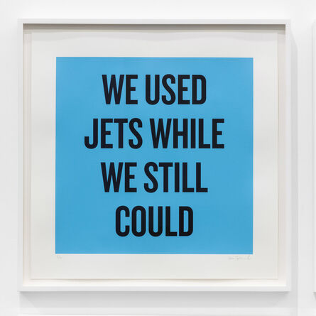

Climate Imaginaries Week Seven: Futuring (I) : The Museum of Carbon Ruins
Douglas Coupland

Slide 2
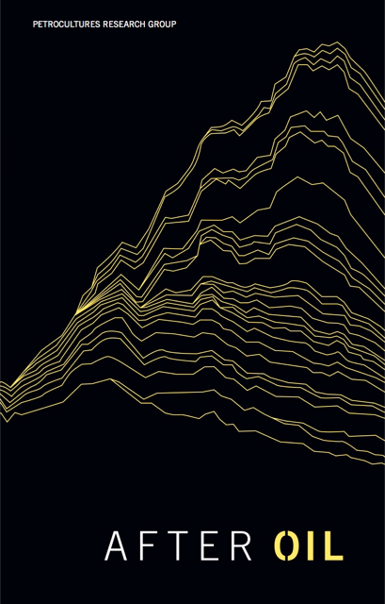
“We will not make an adequate or democratic transition to a world after oil without first changing how we think, imagine, see, and hear [transition] is an “imaginative” exercise, with distinct roles played by words, images, and performances.”
Petrocultures Research Group: After Oil (2016)

Slide 3
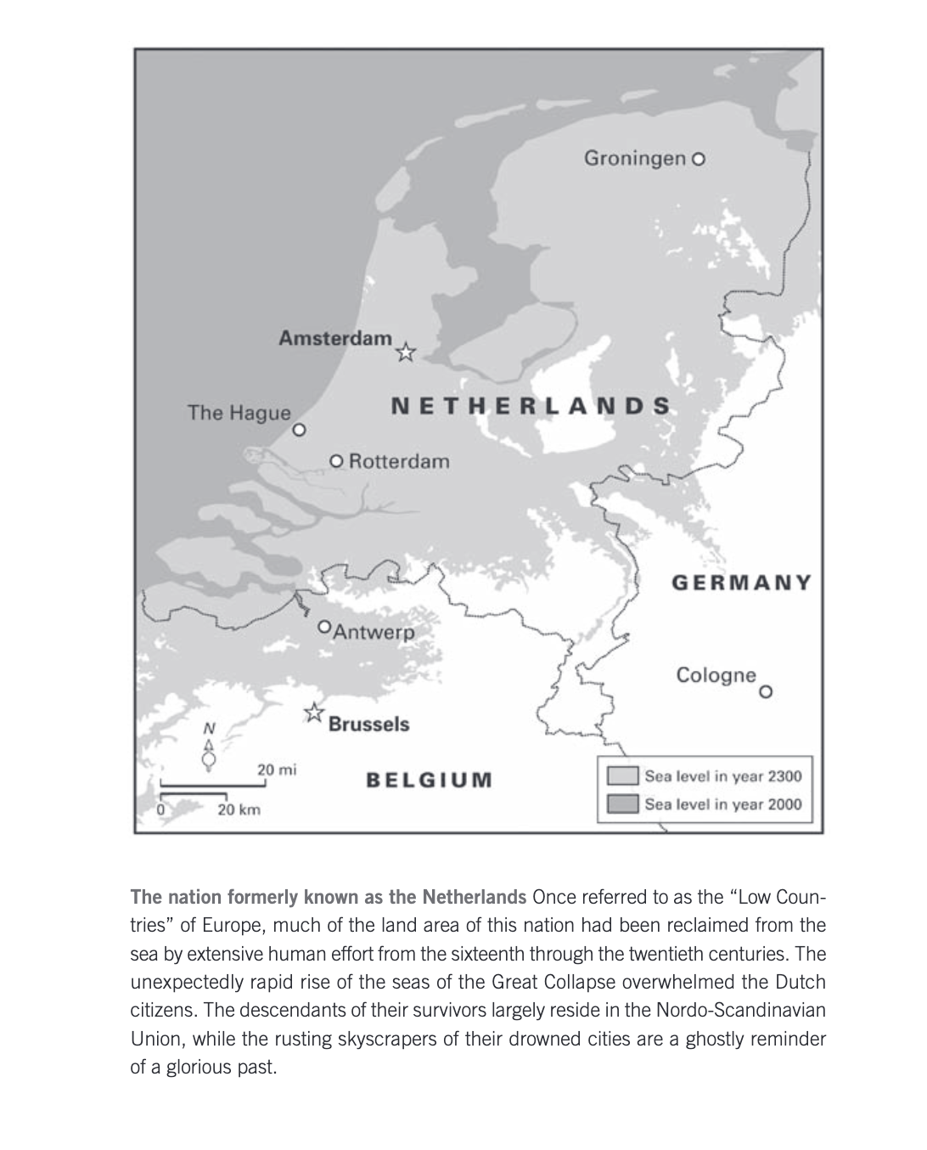

Slide 4
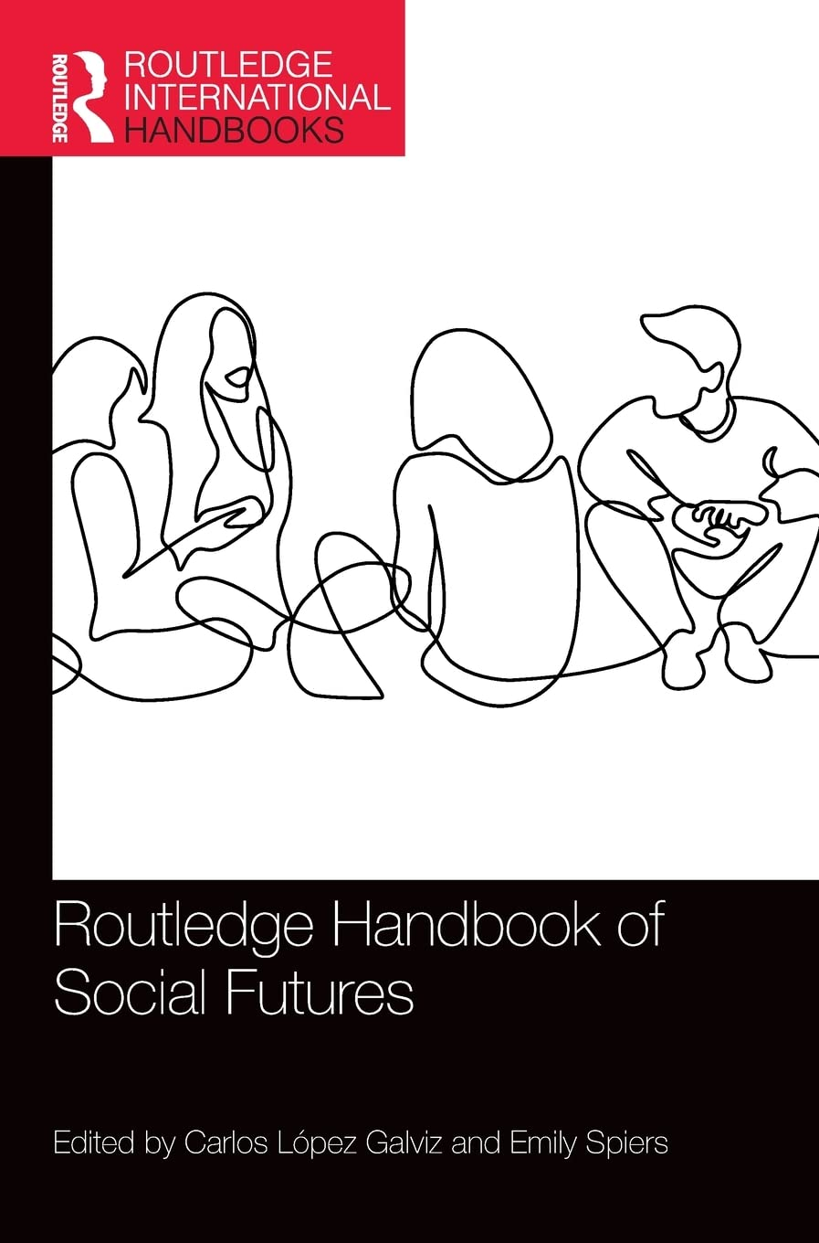
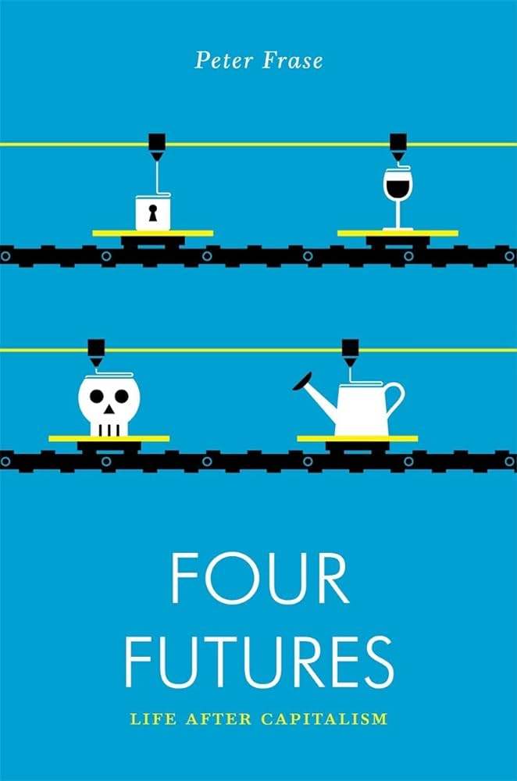
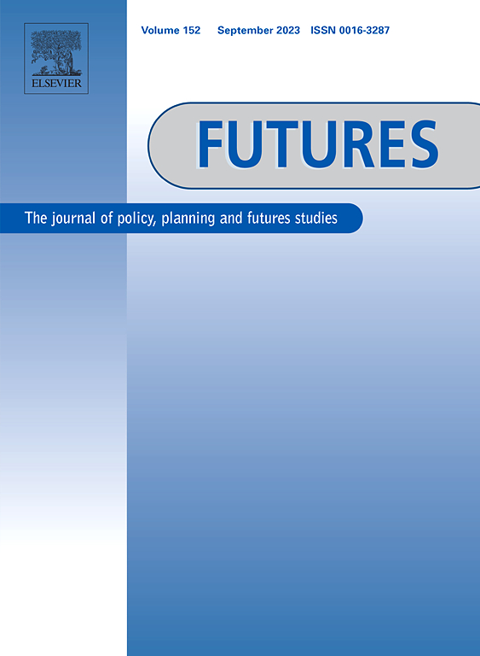
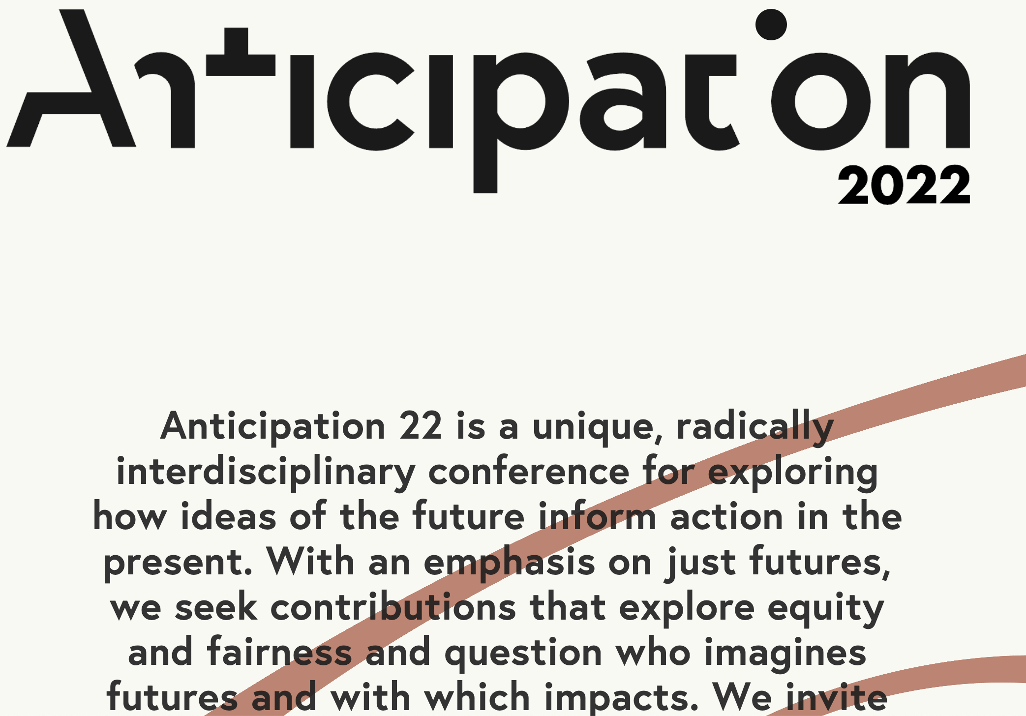

Slide 5
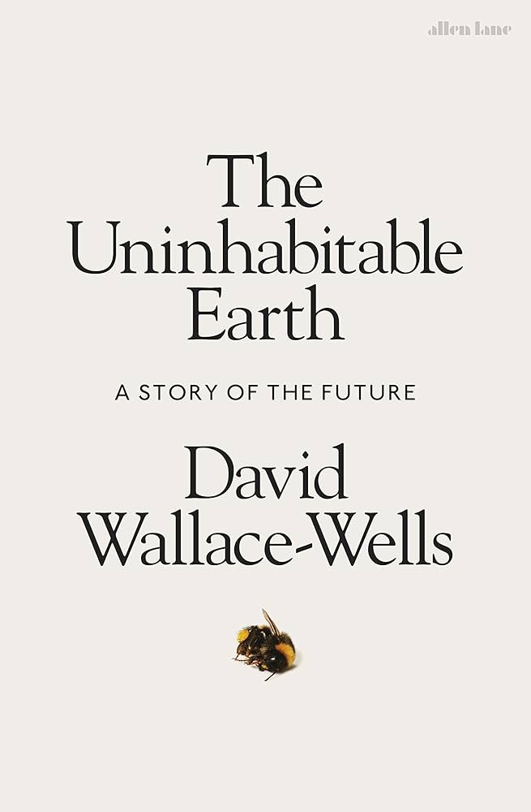
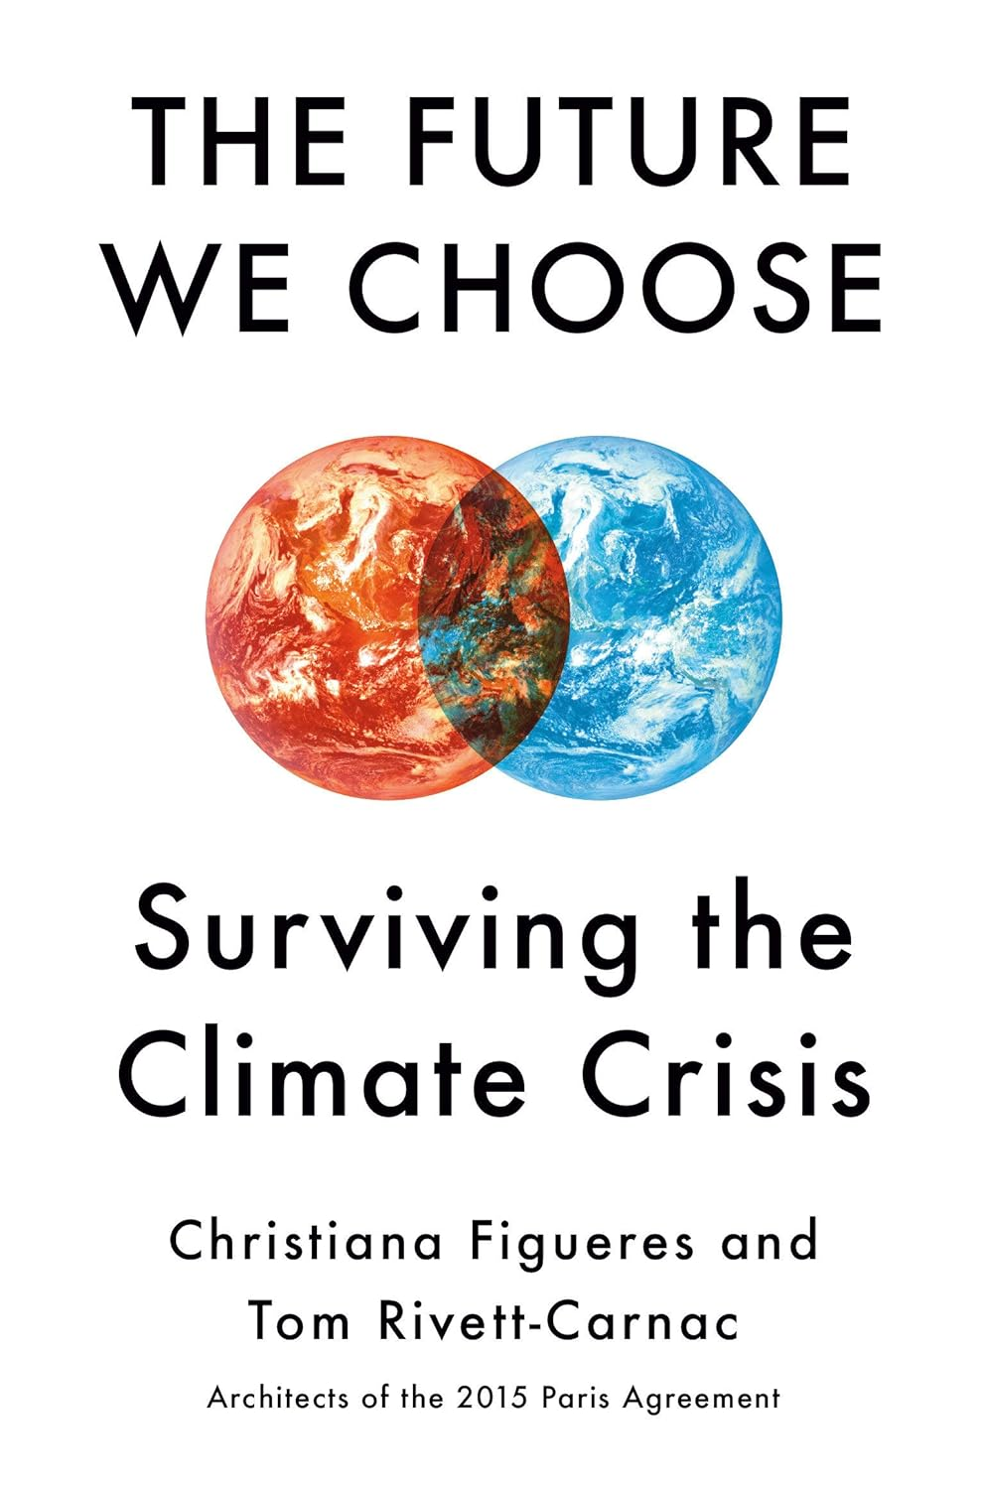
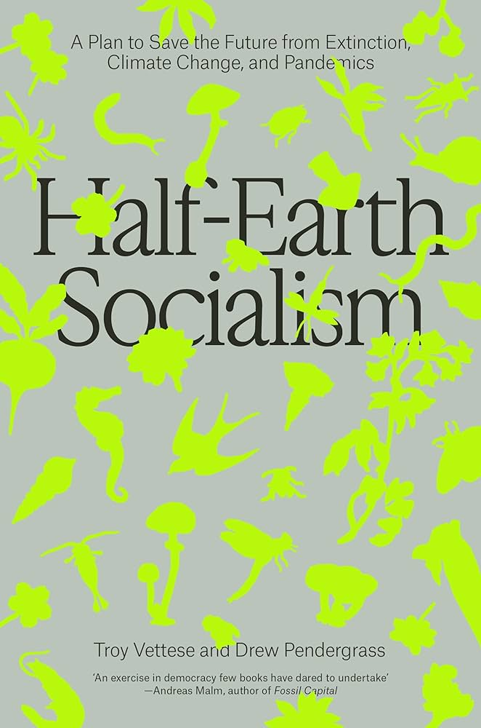
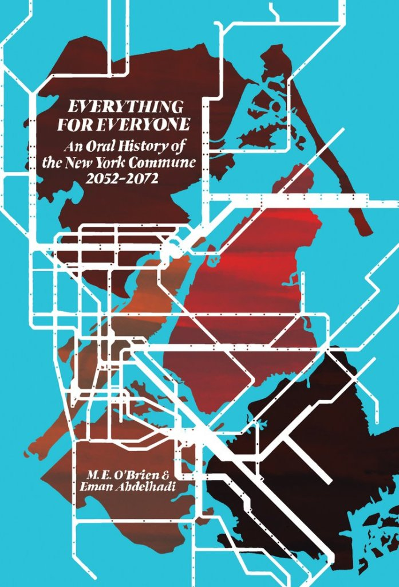
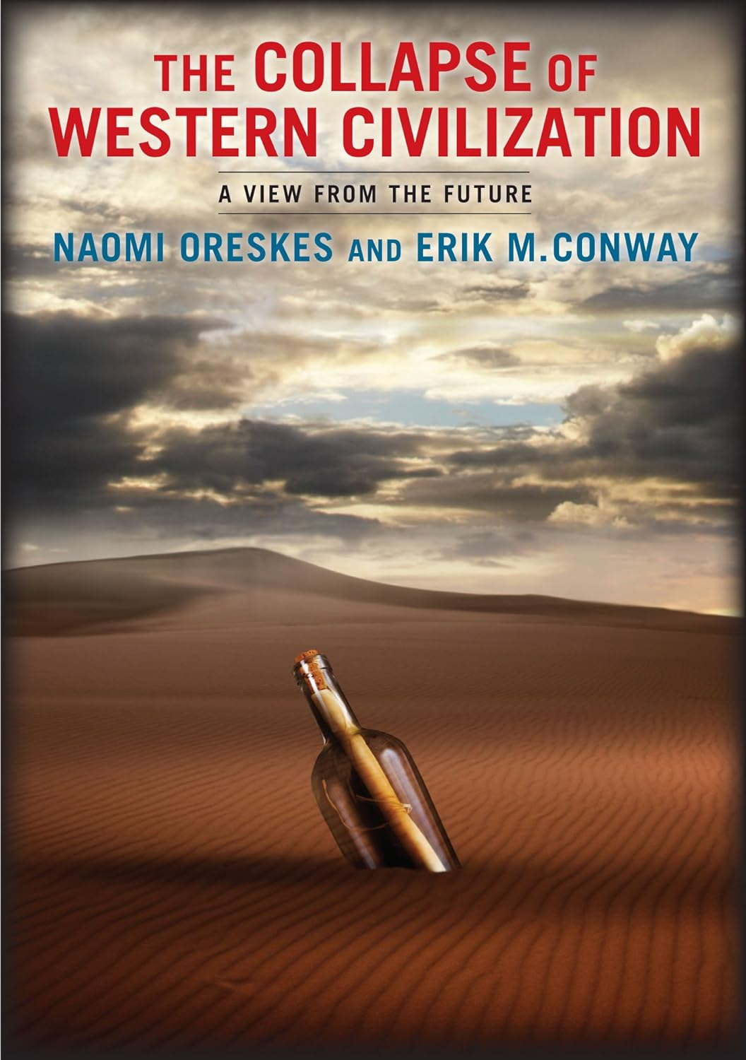
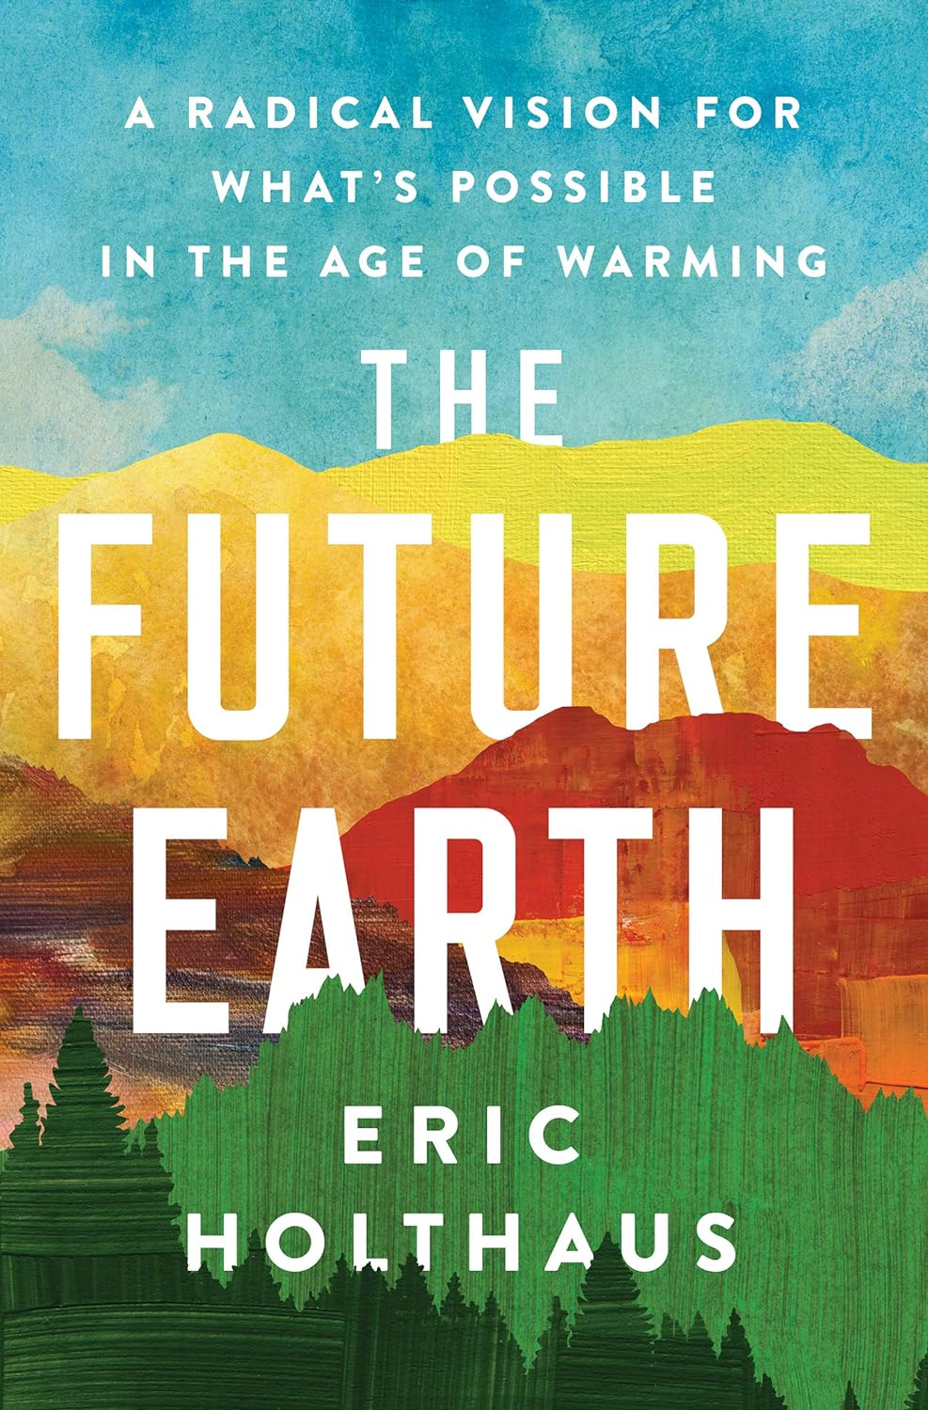

Slide 6
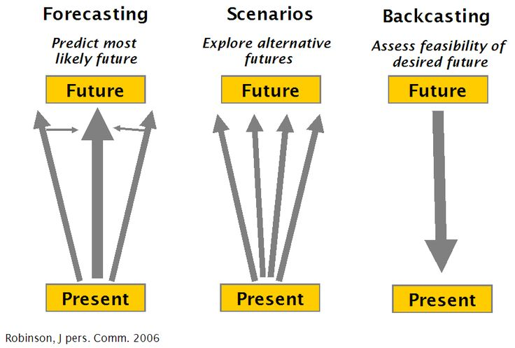

Slide 7
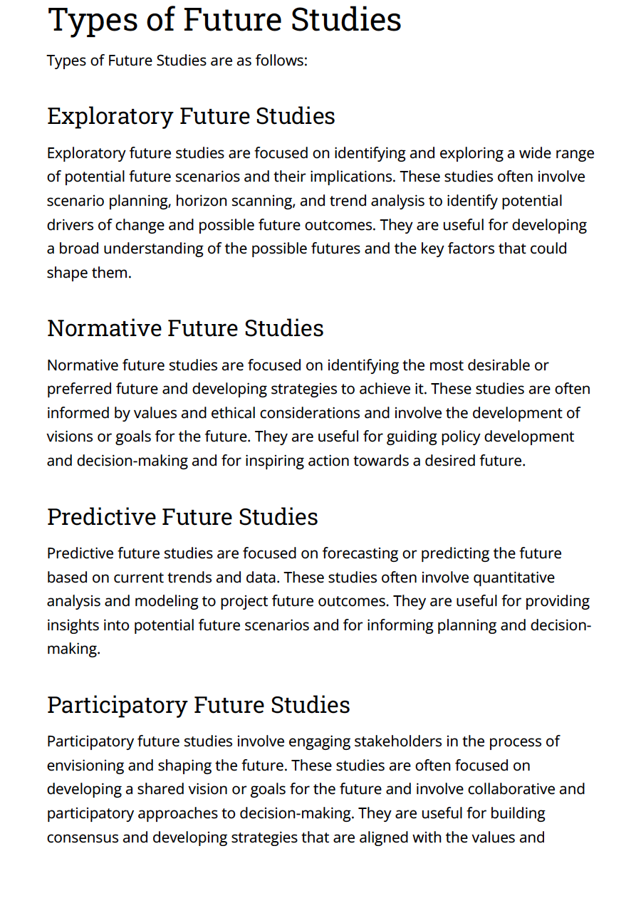
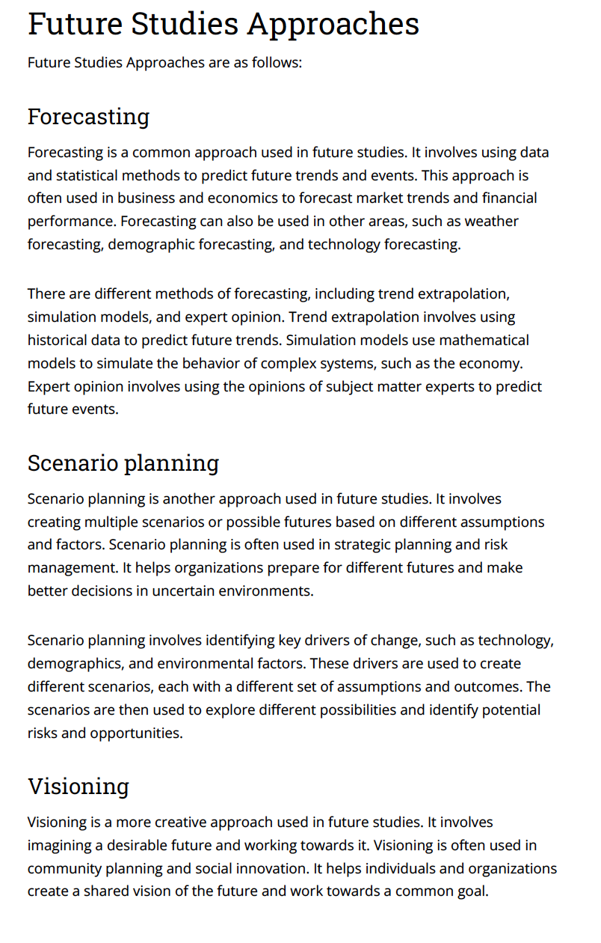
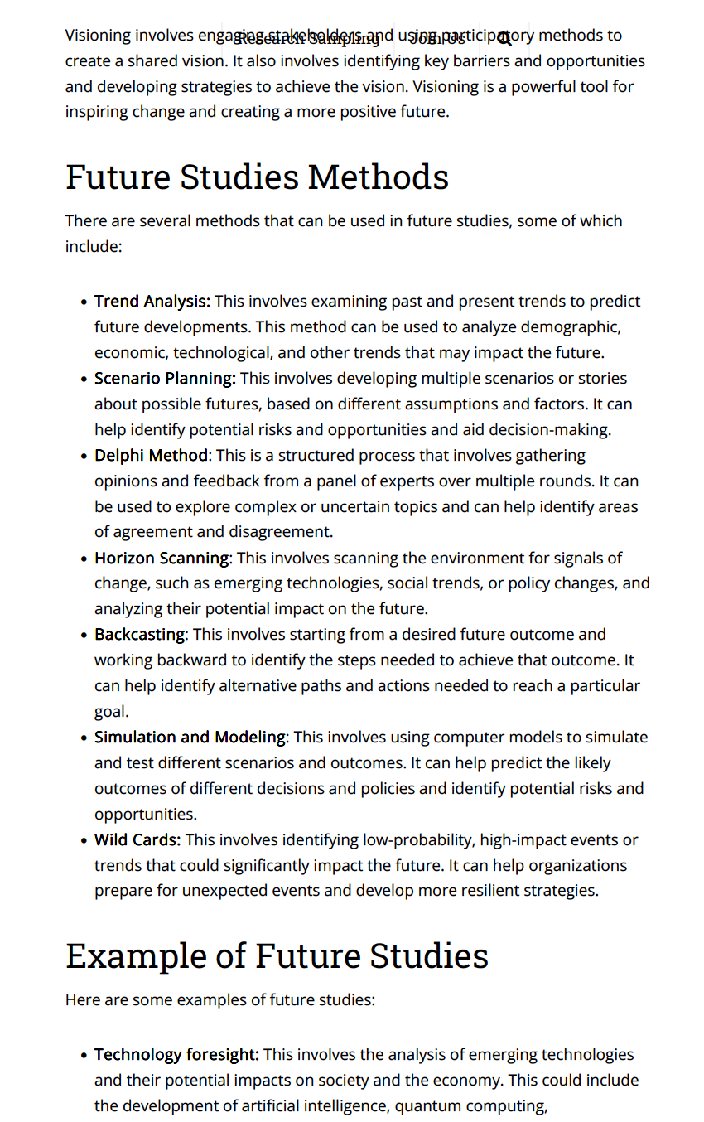

Slide 8
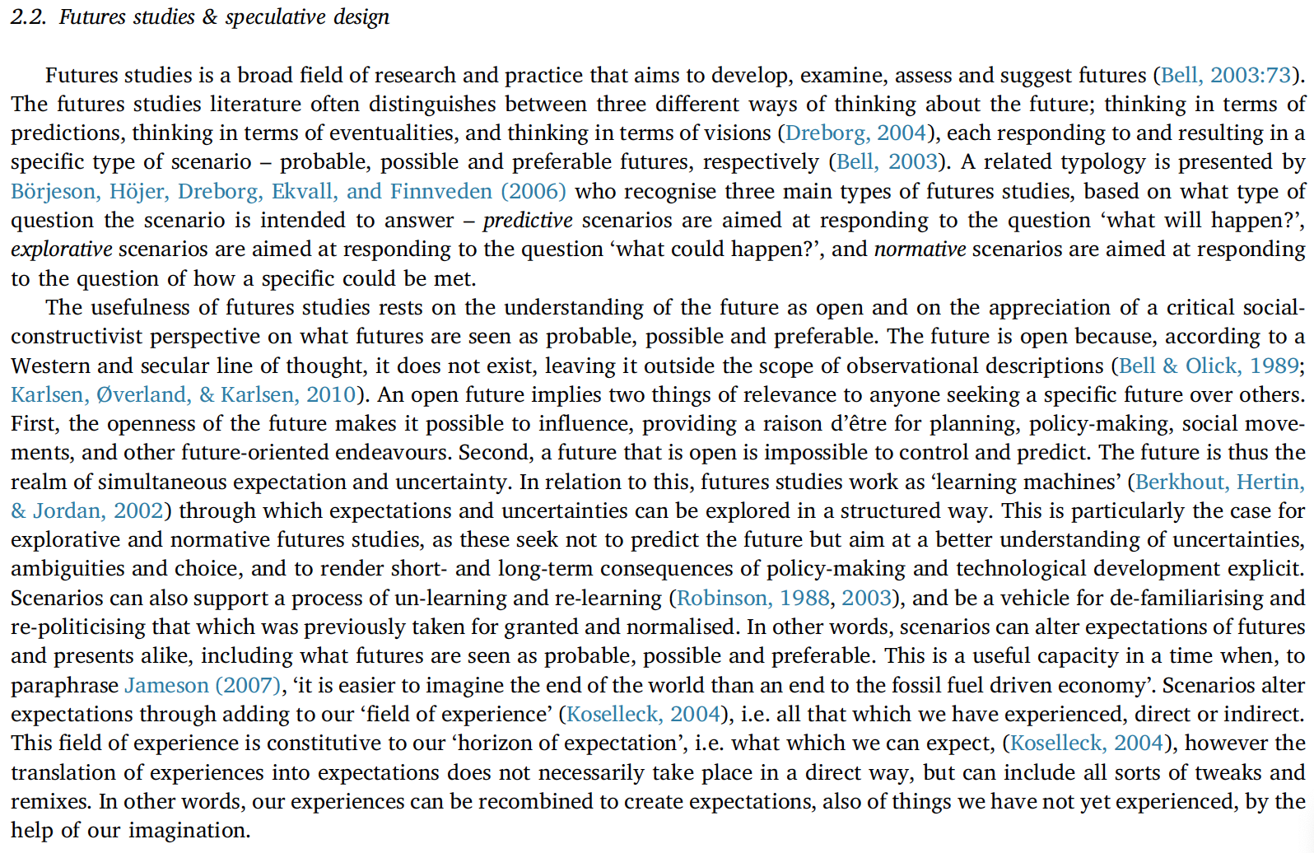
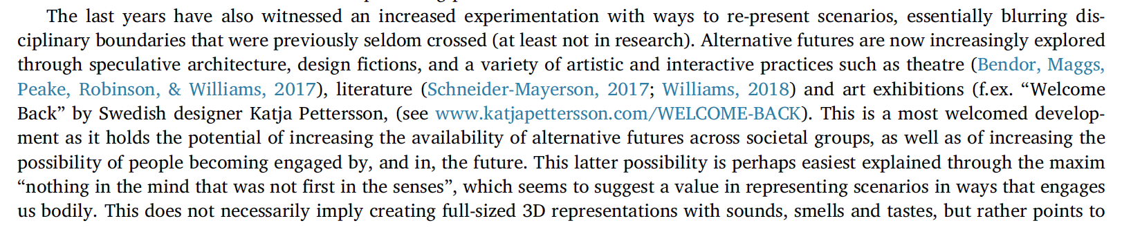
“Vitiden: Transforming a policy-orienting scenario to a practiceoriented
energy fiction”
Josefin Wangel, Mia Hesselgrend, Elina Erikssone, Loove Bromsb,c, Gabriel Kanulff,
Andrejs Ljunggreng
Futures (2019)

Slide 9
More than ever, we are determined to play our part in ensuring our future is one that we deliberately choose, rather than one we stumble into blindly.
Do we watch the world burn or do we choose to do what is necessary to achieve a different future?
We are choosing between two utterly contrasting futures, one to be feared and the other to be proud of….We can do this.
This book is an invitation for you to take part in creating the future of humanity. We invite you to be stubbornly optimistic.
The effects of climate change do not proceed along a straight line.
Some believe we are hardwired to react to threats only if they are immediate.
Devastation is admittedly a growing possibility but not yet our inevitable fat…we have to write a story of regeneration of both nature and the human spirit. But we have to choose….We present two scenarios. One or the other will become our reality
We are aware that making predictions about the world in thirty year’s time is to some degree an imaginative enterprise….read each scenario not as a prediction of the future but as a warning of what may come and what we still have a chance to change.

Slide 10
Our book belongs to the utopian tradition.
This philosophical shorthand allows neoliberals to diagnose
the ills of the world and to propose a slate of prescriptions. It
allows them to act. We believe that environmentalists and socialists
need a similar shorthand to regain political momentum.
As we sketch what Half-Earth socialism might look like, we strive to carefully account for what is necessary and feasible, even if such things are hardly politically expedient now….our utopian imagination is constrained by quite conservative parameters derived from the scientific literature on energy production, land use, planning, and ‘planetary boundaries’. Much of the book is dedicated to debunking panaceas beloved across much of the political spectrum, such as nuclear power, geoengineering, ‘green growth’, and carbon capture and storage.

Slide 11
The World We Are Creating
It is 2050. Beyond the emissions reductions registered in 2015, no further efforts were made to control emissions. We are heading for a world that will be more than 3 degrees warmer by 2100.
—
The first thing that hits you is the air.
In many places around the world, the air is hot, heavy, and depending on the day, clogged with particulate pollution. Your eyes often water. Your cough never seems to disappear. You think about some countries in Asia, where out of consideration sick people used to wear white masks to protect others from airborne infection. Now you often wear a mask to protect yourself from air pollution. You can no longer simply walk out your front door and breathe fresh air: there might not be any. Instead, before opening doors or windows in the morning, you check your phone to see what the air quality will be. Everything might look fine—sunny and clear—but you know better. When storms and heat waves overlap and cluster, the air pollution and intensified surface ozone levels can make it dangerous to go outside without a specially designed face mask (which only some can afford).

Slide 12
The World We Must Create
It is 2050. We have been successful at halving emissions every decade since 2020. We are heading for a world that will be no more than 1.5 degrees Celsius warmer by 2100.
—
In most places in the world, the air is moist and fresh, even in cities. It feels a lot like walking through a forest, and very likely this is exactly what you are doing. The air is cleaner than it has been since before the Industrial Revolution.
We have trees to thank for that. They are everywhere.1
It wasn’t the single solution we required, but the proliferation of trees bought us the time we needed to vanquish carbon emissions. Corporate donations and public money funded the biggest tree-planting campaign in history. When we started, it was purely practical, a tactic to combat climate change by relocating the carbon: the trees took carbon dioxide out of the air, released oxygen, and put the carbon back where it belongs, in the soil. This of course helped to diminish climate change, but the benefits were even greater. On every sensory level, the ambient feeling of living on what has again become a green planet has been transformative, especially in cities. Cities have never been better places to live. With many more trees and far fewer cars, it has been possible to reclaim whole streets for urban agriculture and for children’s play. Every vacant lot, every grimy unused alley, has been repurposed and turned into a shady grove. Every rooftop has been converted to either a vegetable or a floral garden. Windowless buildings that were once scrawled with graffiti are instead carpeted with verdant vines.

Slide 13
This book’s purpose, however, is not primarily to criticize the present
but to posit a countervailing positive vision for the future. We survey the
present crisis and detail how an eco-socialist alternative might work in
practice. This is not to say that we have drafted the only
possible solution for everything that ails the world today; this is merely a
start, a provocation, for a broader but more serious discussion about life
after capitalism. We want to ask the hard questions about politics in an age
of ecological collapse: What is socialism? How does socialist democracy
work? What does a truly environmentally stable society look like? How
could an eco-socialist coalition take power? How would local, national, and
global levels of government interact? Half-Earth socialism’s tension
between utopianism and practicality allows us to create a framework
commensurate with the scale of the task at hand but is simultaneously
realistic enough to provide the basis for socialism in our lifetime.
For us, agreeing on the details of what that utopia might look
like matters less than agreeing that speculation is a vital political act. This means reviving the utopian socialist tradition that has for far too long been marginalized by the ‘scientific socialism’ of Marxism. What was a nuanced critique of utopian socialism in Marx’s hands became a bludgeon wielded by his epigones who scorned post-revolutionary proposals as frivolous ‘recipes for the cookshops of the future’. Condescension towards utopianism is not only poetically impoverished but also a tactical mistake, because it limits the Left’s ability to implement a socialist programme upon
taking power. There is in fact a literal need to write recipes for society after
the revolution, because the environmental crisis makes clear that those
cook-shops must be vegan.”

Slide 14
“Stubborn Optimism”
People, ultimately, are still in control. Our choices determine
whether or not these conflicts will happen.
2040–2042: SHAPING THE FUTURE
By the 2040s, we achieved a carbon-free society in the United States,
Europe, and many other places throughout the world. We began to draw carbon back out of the atmosphere in huge quantities in the oceans, soils, grasslands, and forests. We turned the corner toward an ecological society, because we prioritized justice and the inherent dignity of every living being on the planet. A revolution in our mindset and our relationship with the Earth allowed us to recognize that we all have value—that everyone and every species deserves the right to exist.

Slide 15
We understood that capitalist consumerism propped up the oil-rich
economies, and once they went away, the rest of the world agreed to
support the former oil states in their transition to a circular economy.
but during an emergency global summit in Dubai, world leaders
agreed on a plan to enhance cooperation on an aggressive carbon drawdown and began discussions to geoengineer the climate, a temporary endeavor that would be phased out gradually as carbon dioxide levels were drawn back below 350 parts per million. This approach proved consistent with a long-term stabilization of climate at levels that would no longer risk a largescale breakdown in society. This global effort for disaster preparedness and prevention extended the
gains of a newly resilient circular economy in Europe and North America to the entire world.
Despite these challenges, the 2040s was a decade of regrowth—not of
the extractive fossil fuel economy, of course, but of the plants, animals,
ecosystems, and communities of people that have been stunted for so long by the status quo.

Slide 16
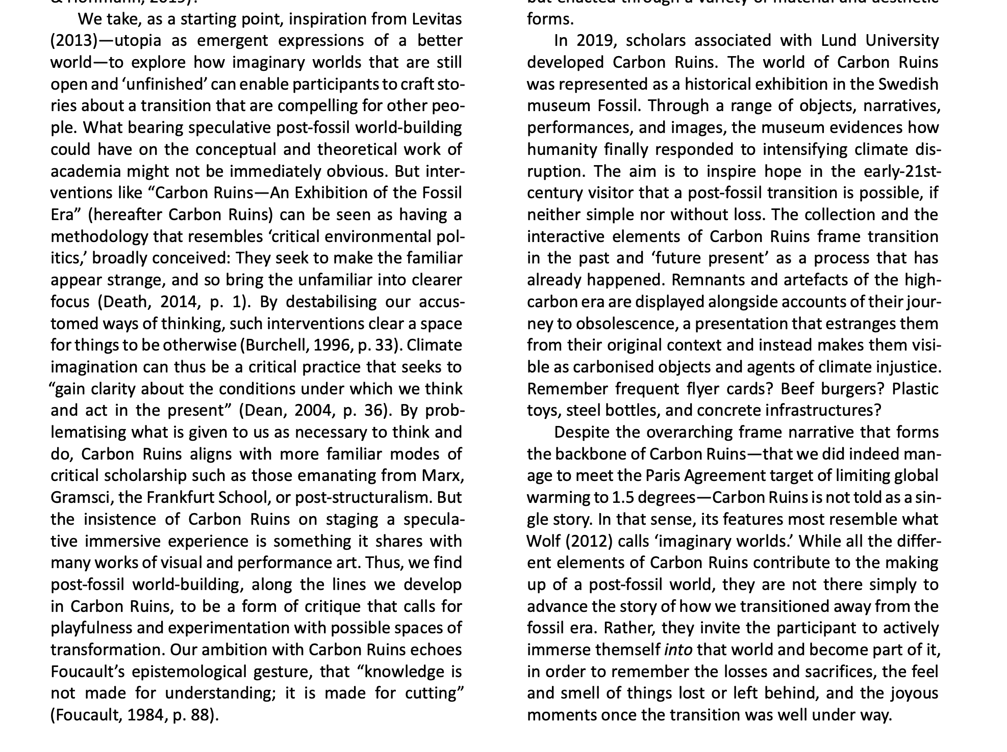
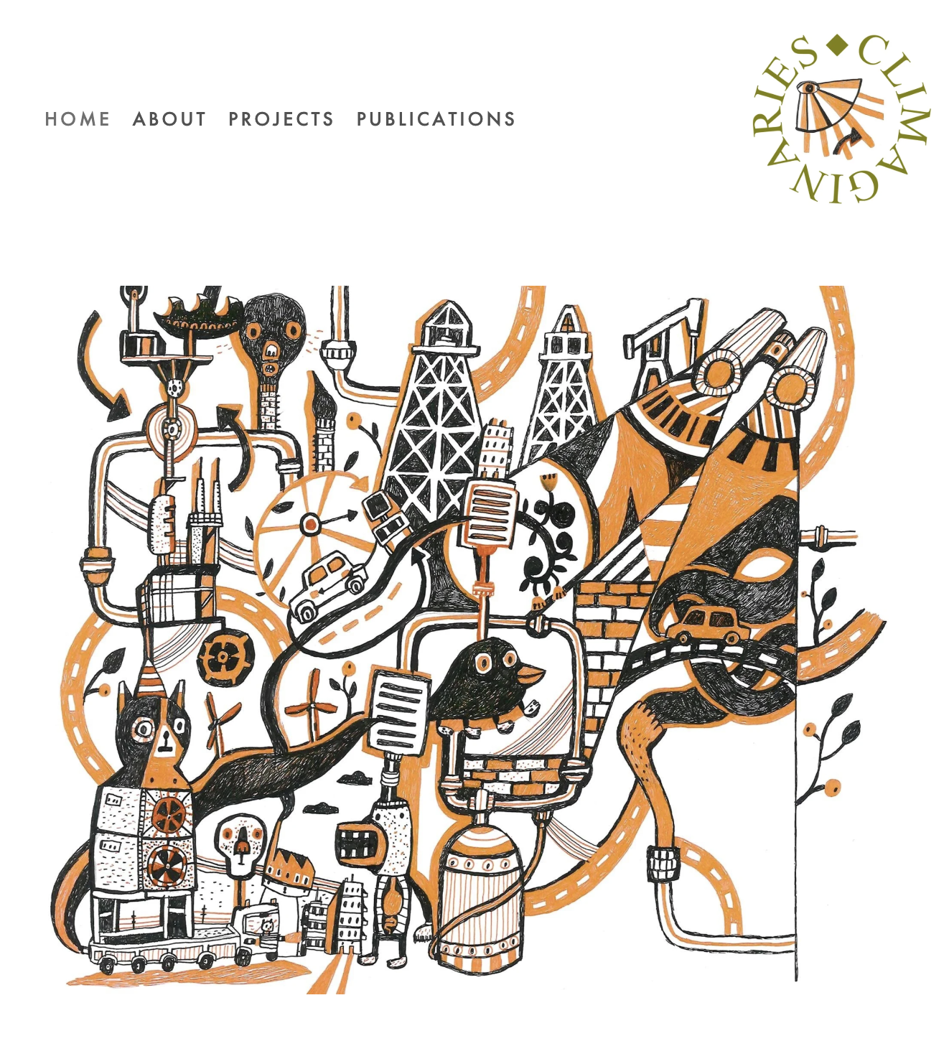
Stripple, J.; Nikoleris, A.; Hildingsson. R. (2021). “Carbon Ruins: Engaging with Post‑Fossil Transitions through Participatory World-Building”. Politics and Governance, 9(2), 87‑99.

Slide 17
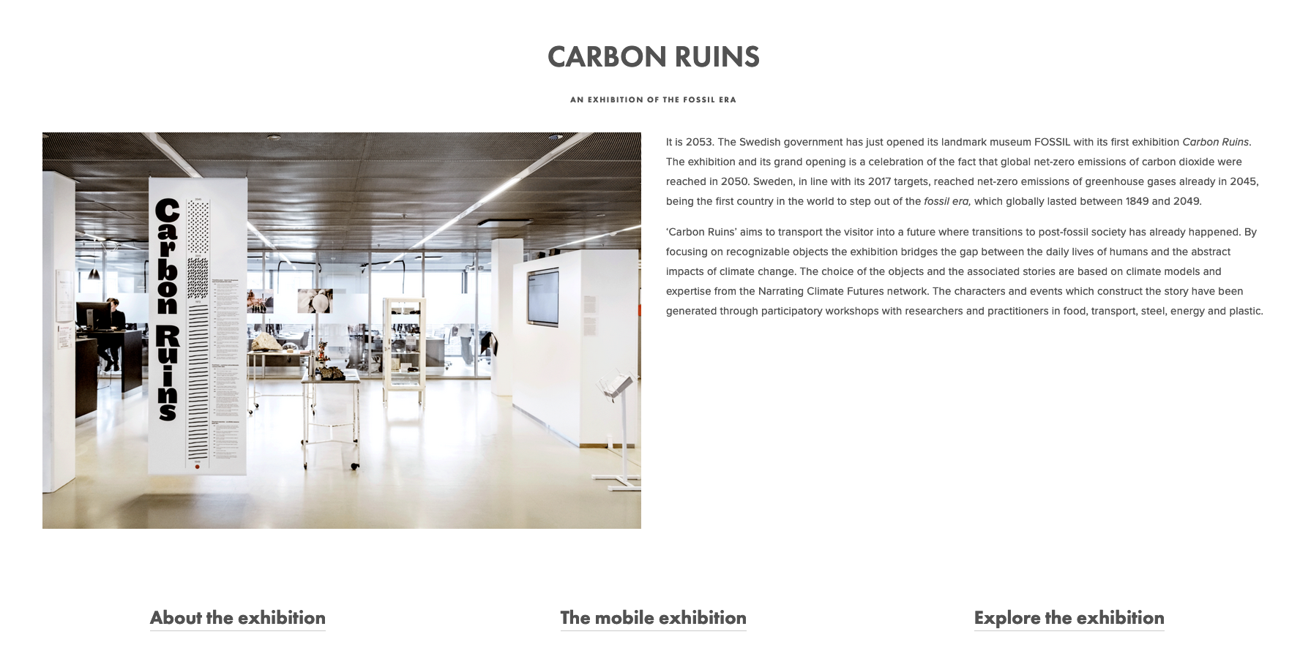
https://www.climaginaries.org/carbon-ruins

Slide 18
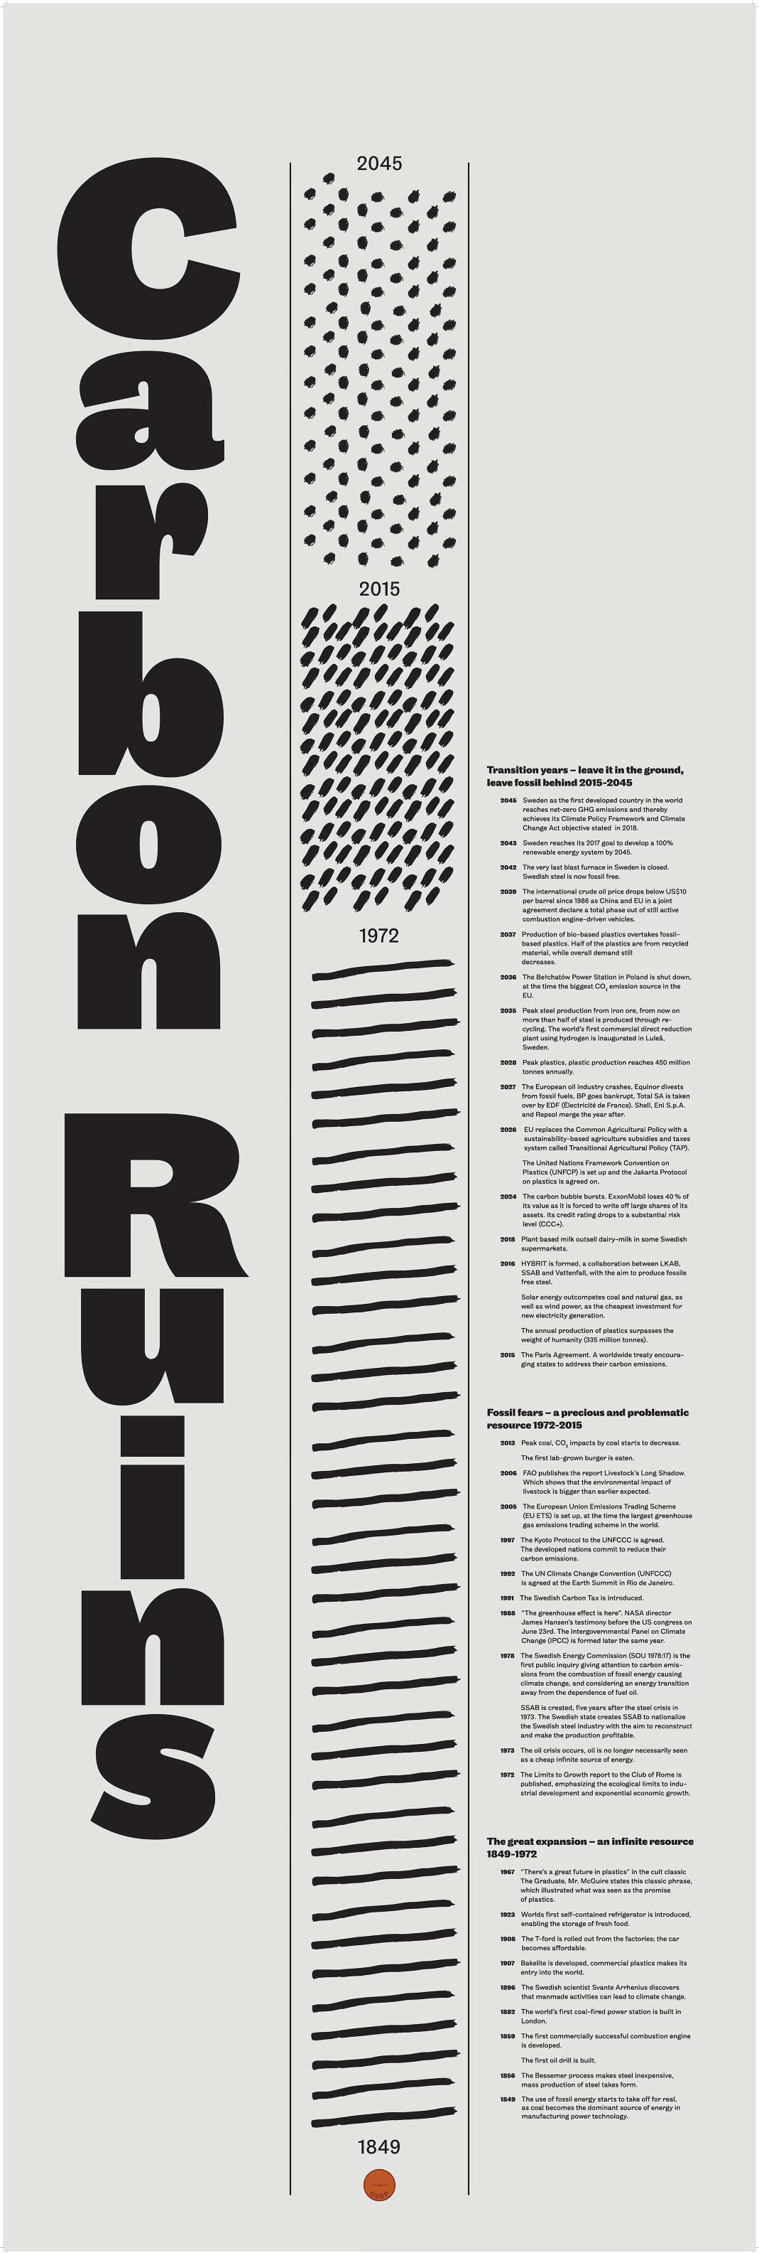
Notes:
THE TIMELINE – made one passed around here – NEXT SLIDE

Slide 19
Why a museum from the future?
Making the familiar unfamiliar.
Neither dystopia nor utopia – critical utopia
Stories anchored in everyday objects and materials
A science communication tool.
A site for deliberation, discussion, provocation and imagining
”The sites where a carbon-constrained world is represented and acted upon are nowadays everywhere…and yet long-term decarbonised futures are seldom situated and made palpable. Carbon Ruins proposes a methodology for crafting a space where imaginative, as well as tangible, engagement with a post-fossil world can emerge. It does so by problematising contemporary social practices by defamiliarising them, provoking imagination and critical self-reflection through the sharing of stories and memories around particular artefacts. CR is a kind of experiental future, a process of co-creating a post-fossils world, which invites participants to experience fragments of a future, to alter them, expand on them, perhaps reject them and create new fragments.”
Carbon Ruins: Engaging with Post-Fossil Transitions through Participatory World-Building.” (Stripple et al, Politics and Governance 9: 2 2021)
Notes:
So why did we do this?
A core idea of this project is that carbon is deeply embedded in our lives. Looking back at the fossil age allows us to make that which today is familiar, unfamiliar.
The dominating climate imaginaries are either dystopic catastrophe porn or utopic techno-fix scenarios. The museum is hopeful in that we reach our climate targets – but we highlight the pain and suffering that might be associated with such a transtion. Minerals are extracted from sensitive biotopes and people are displaced, insects go extinct due to an increasingly intensive forestry sector and violence ensues as the benefactors of the fossil society react to their new position in society.
Climate communication have long had a problem of perceived distance: we are far away from the impacts and the causes of climate change. By using places, characters and objects that are distinctly Swedish climate science is embodied with a new meaning.
The museum deliberately does not tackle every issue, and the visitors are invited to suggest objects and topics for us to cover. By transporting them in space and time, we allow discussions to escape the trenches of 2019 climate politics and instead focus on the type of society we want to build.

Slide 20
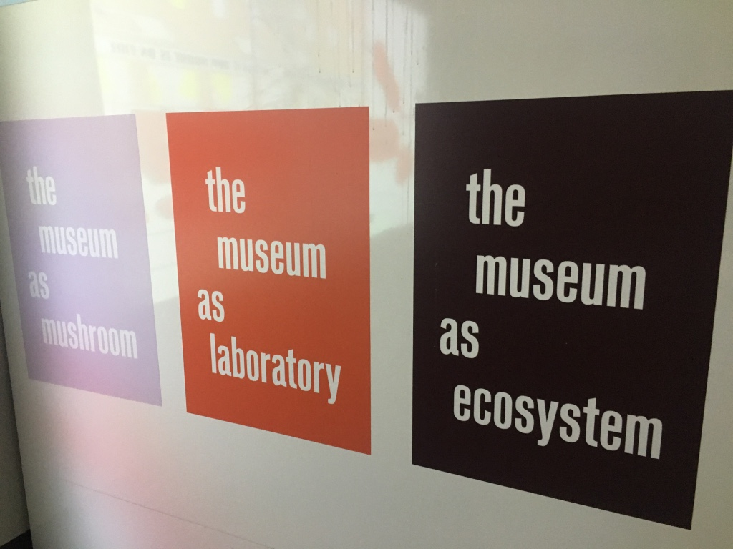

Slide 21
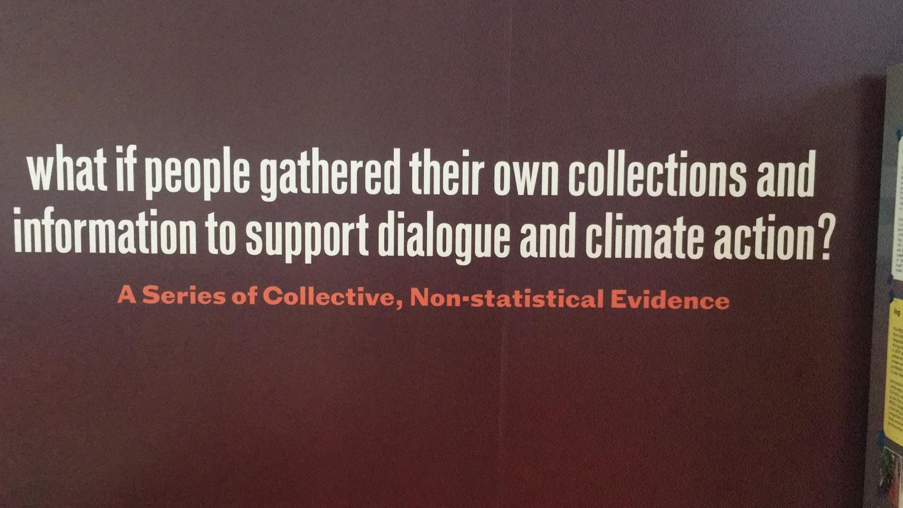
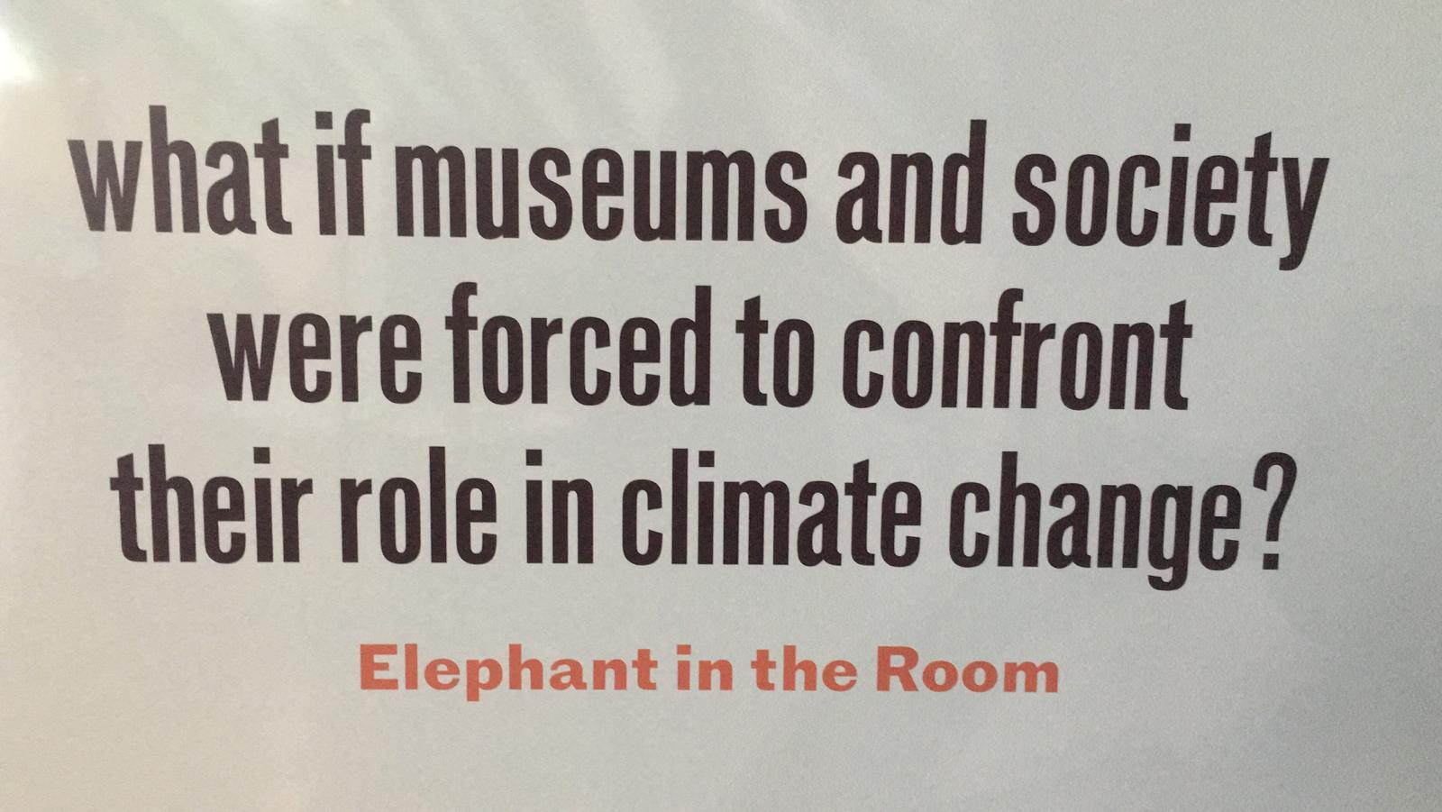

Slide 22
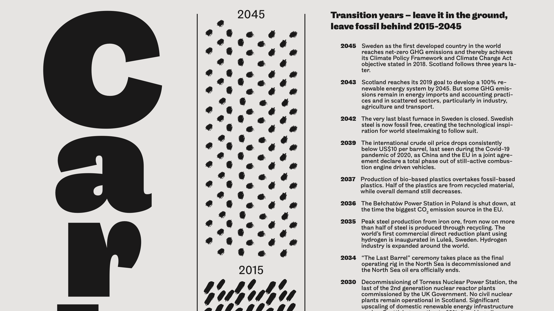

Slide 23
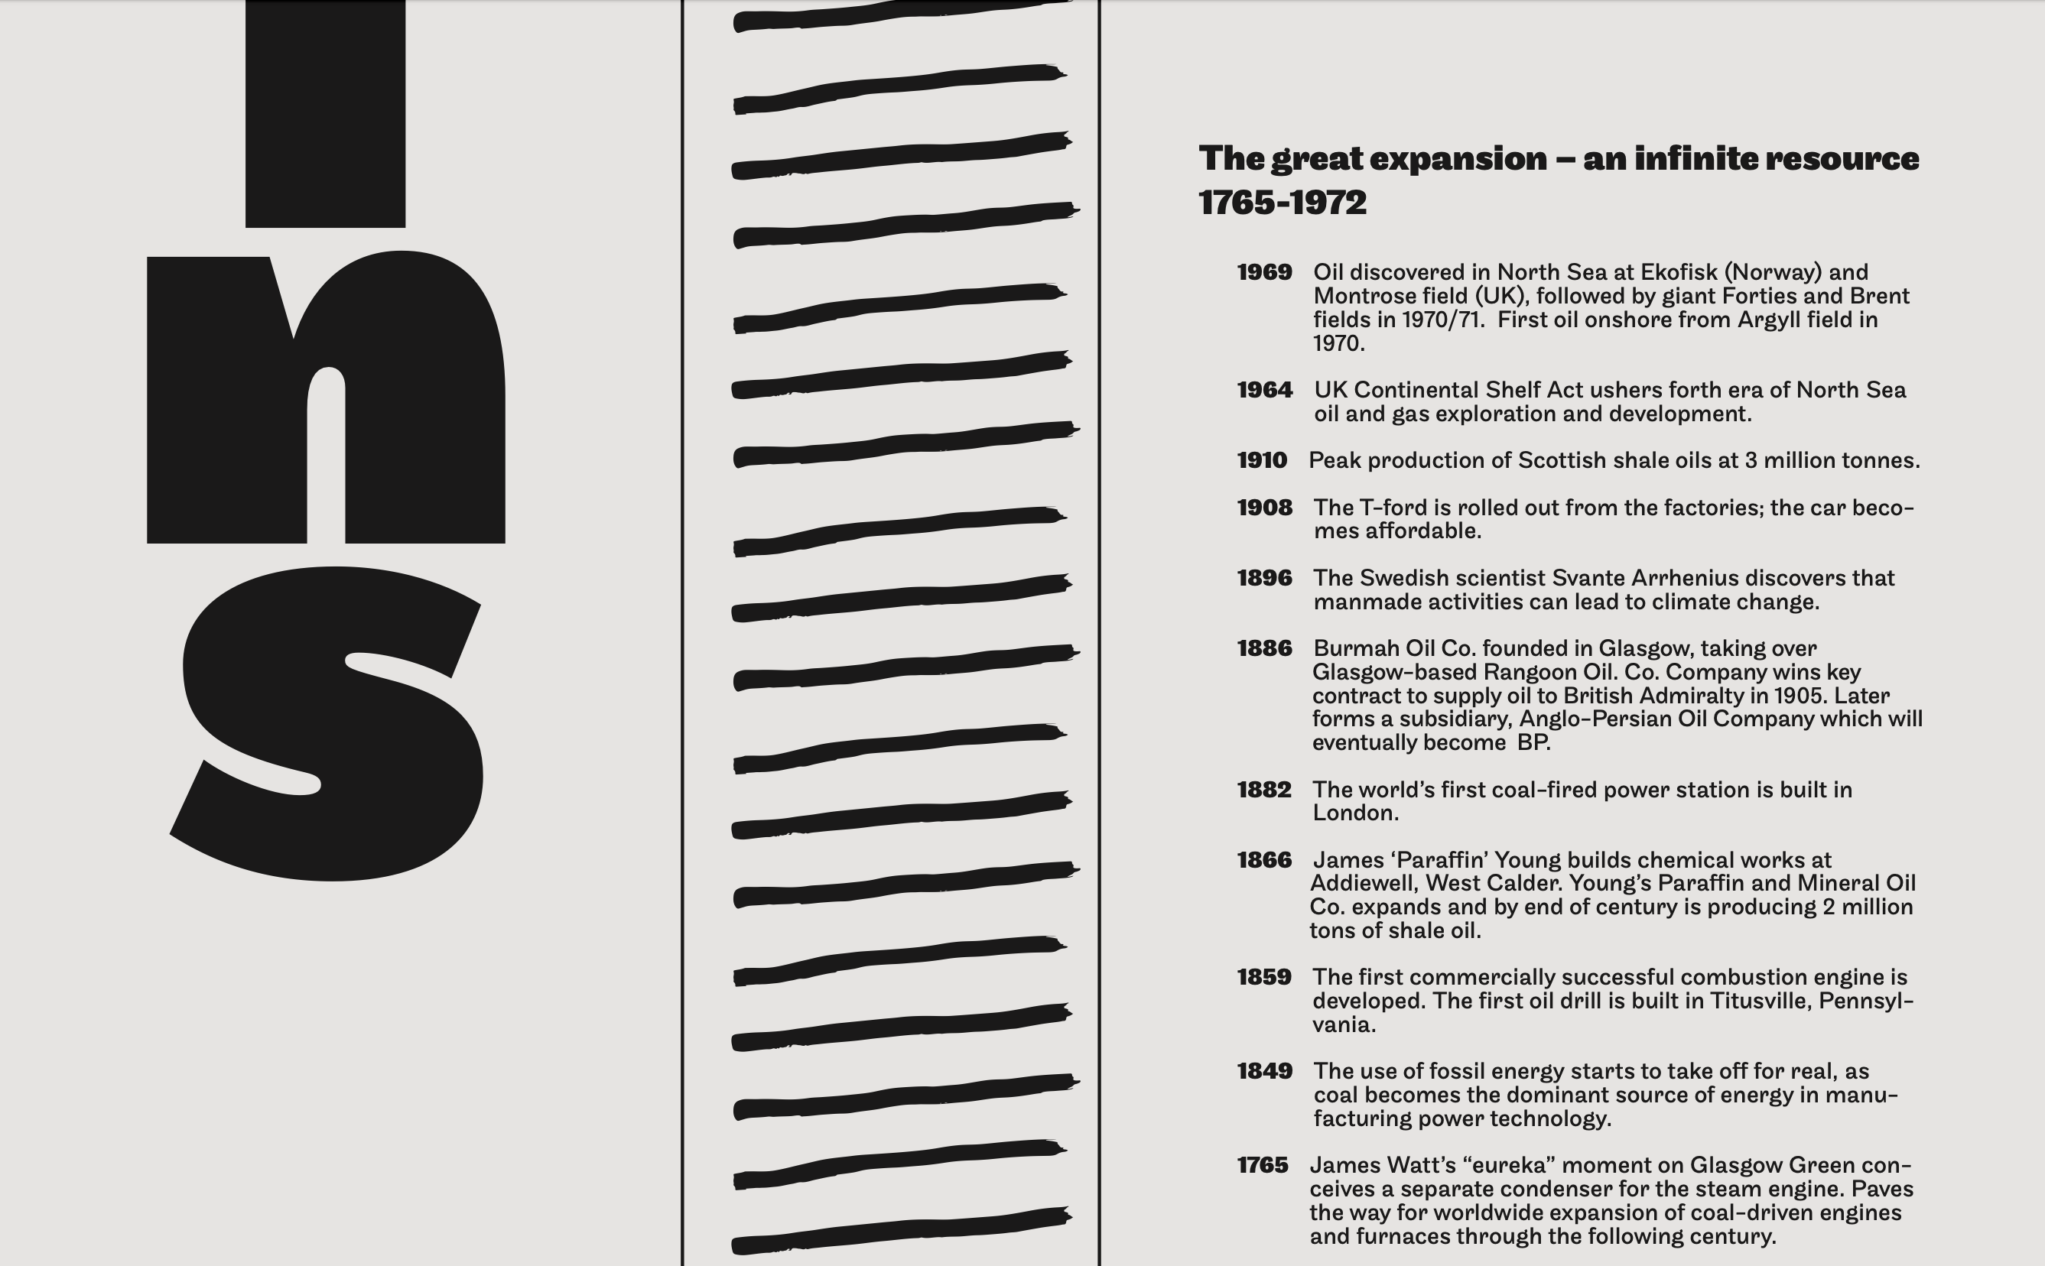

Slide 25
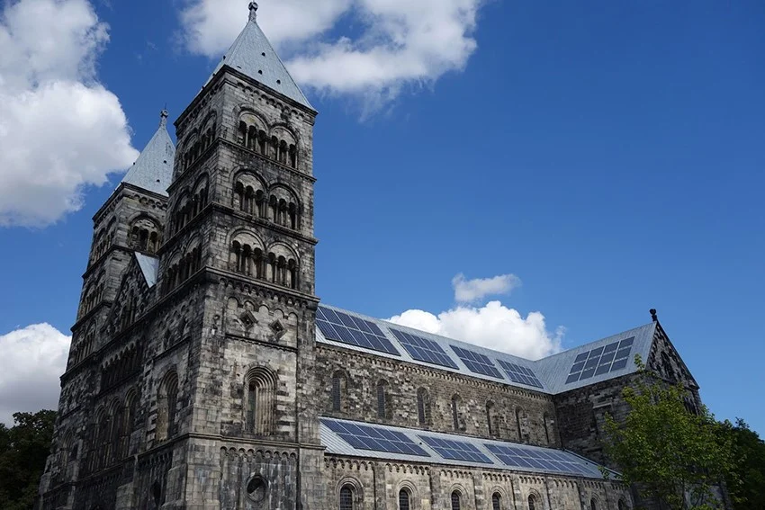
Notes:
So why did we do this?
A core idea of this project is that carbon is deeply embedded in our lives. Looking back at the fossil age allows us to make that which today is familiar, unfamiliar.
The dominating climate imaginaries are either dystopic catastrophe porn or utopic techno-fix scenarios. The museum is hopeful in that we reach our climate targets – but we highlight the pain and suffering that might be associated with such a transtion. Minerals are extracted from sensitive biotopes and people are displaced, insects go extinct due to an increasingly intensive forestry sector and violence ensues as the benefactors of the fossil society react to their new position in society.
Climate communication have long had a problem of perceived distance: we are far away from the impacts and the causes of climate change. By using places, characters and objects that are distinctly Swedish climate science is embodied with a new meaning.
The museum deliberately does not tackle every issue, and the visitors are invited to suggest objects and topics for us to cover. By transporting them in space and time, we allow discussions to escape the trenches of 2019 climate politics and instead focus on the type of society we want to build.

Slide 26
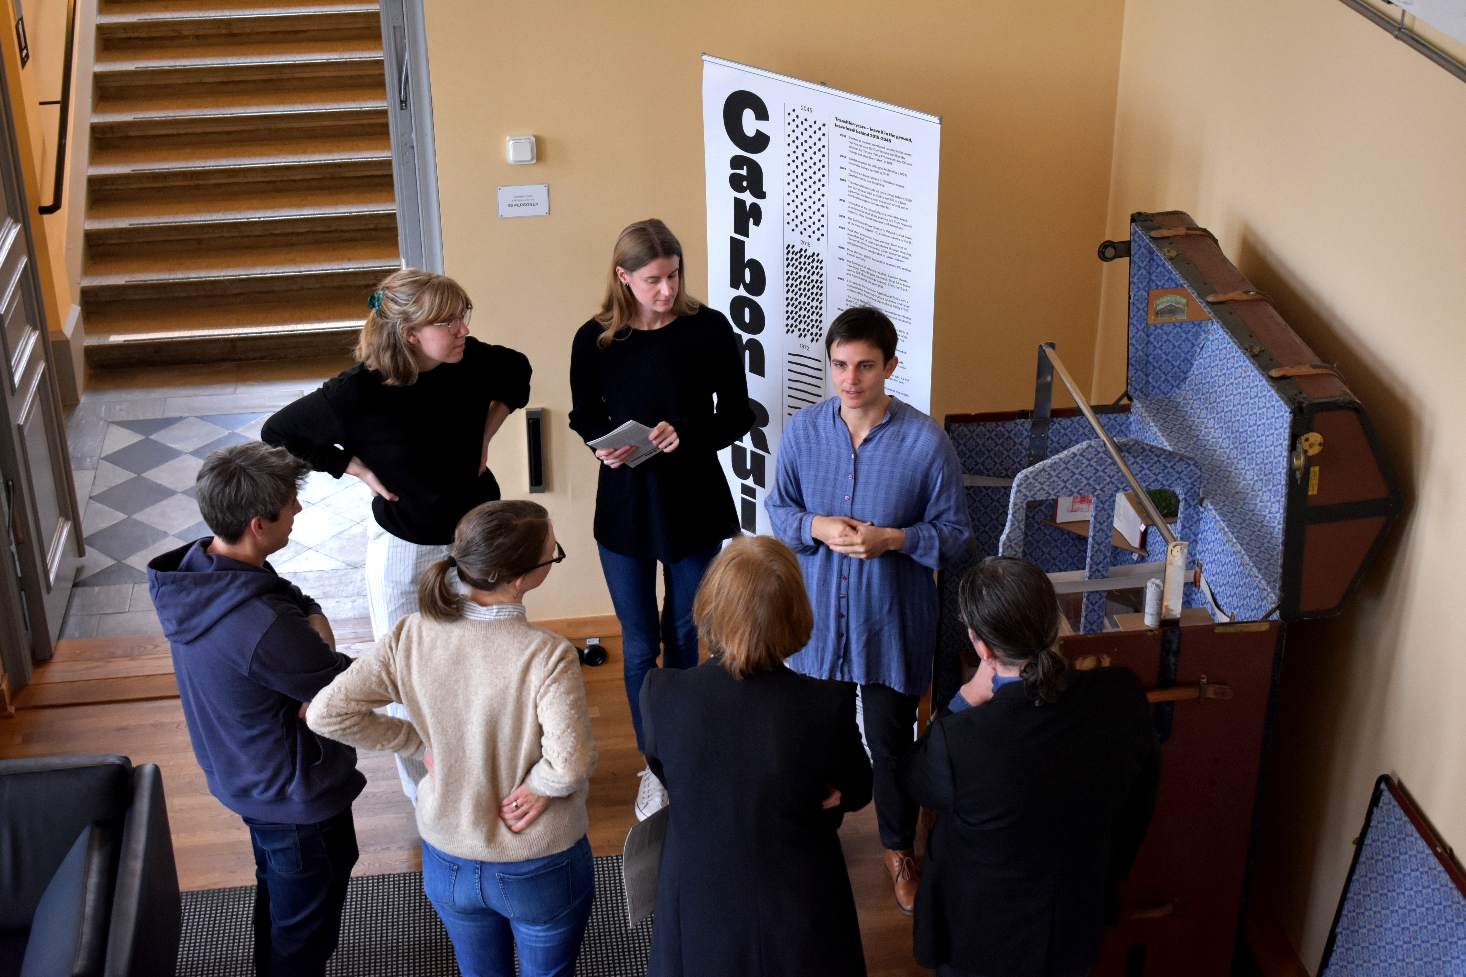
Notes:
A guided tour of Carbon Ruins would normally look more like this.
It has been a joint effort between four researchers at Lund University, an artist and an art historian within the Climaginaries research project and the Narrating Climate Futures network.
The boundary conditions were set early on: we suceed in our ambitions to limit warming to 1.5C, we reach net-zero emissions in Sweden by 2045 and globally by 2050. We knew the physical limitations of that goal, 500 gigatons of CO2 between 2018 and 2050, but how we got there was an excersise in imagination.
We then held workshops with experts in agriculture, energy, transport, materials and with the think-tank LU Futura to decide on the objects, the stories and the characters that would be shown in the museum.
After an intense three months, the inagurual version of the museum was opened to the public in April this year.

Slide 27
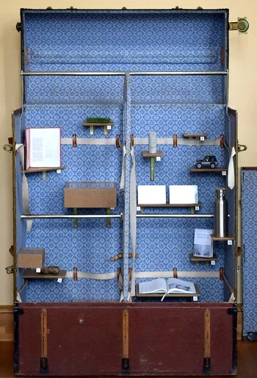
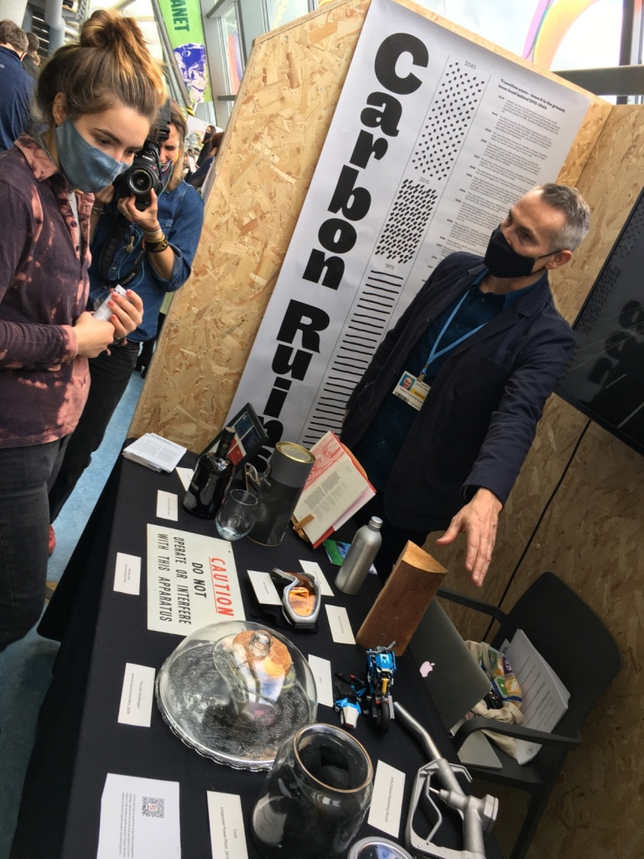

Slide 28
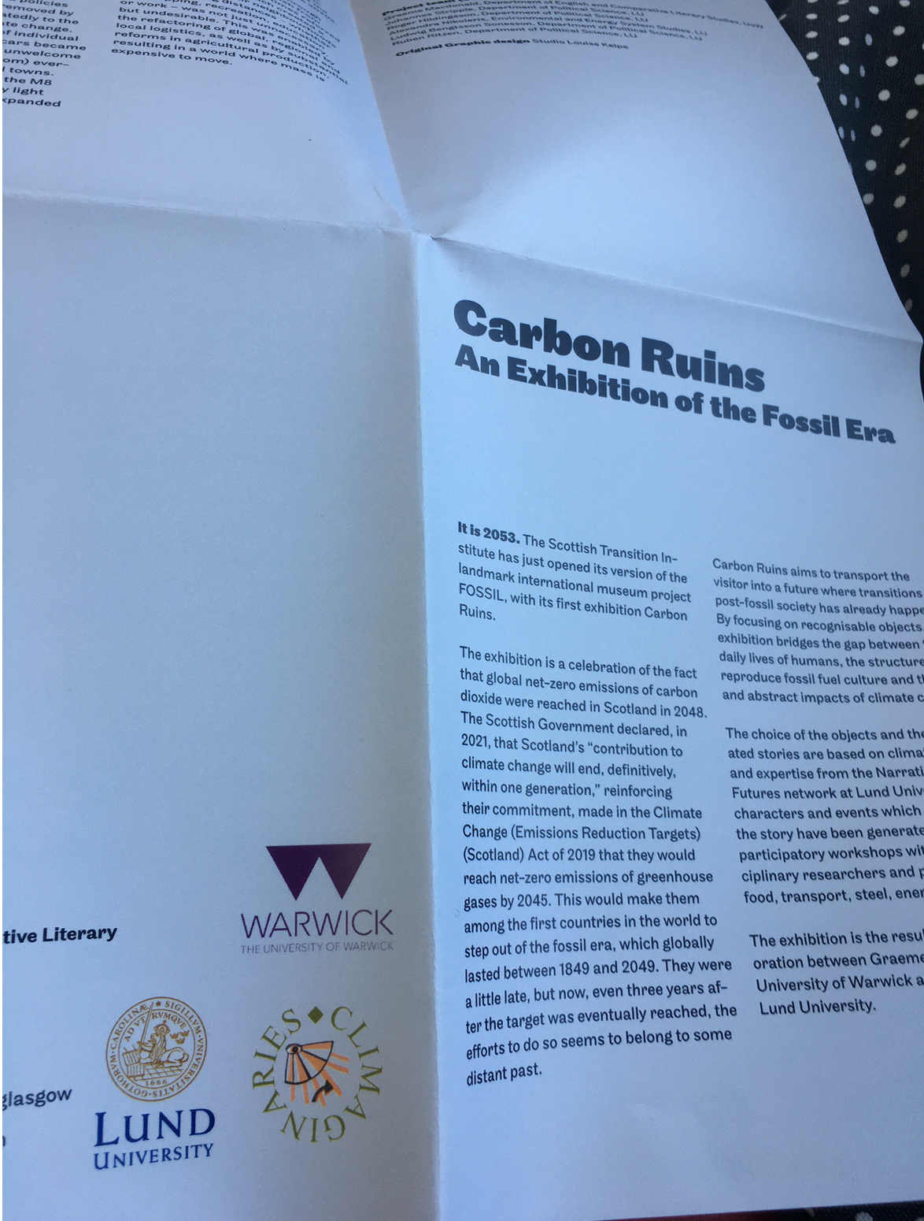
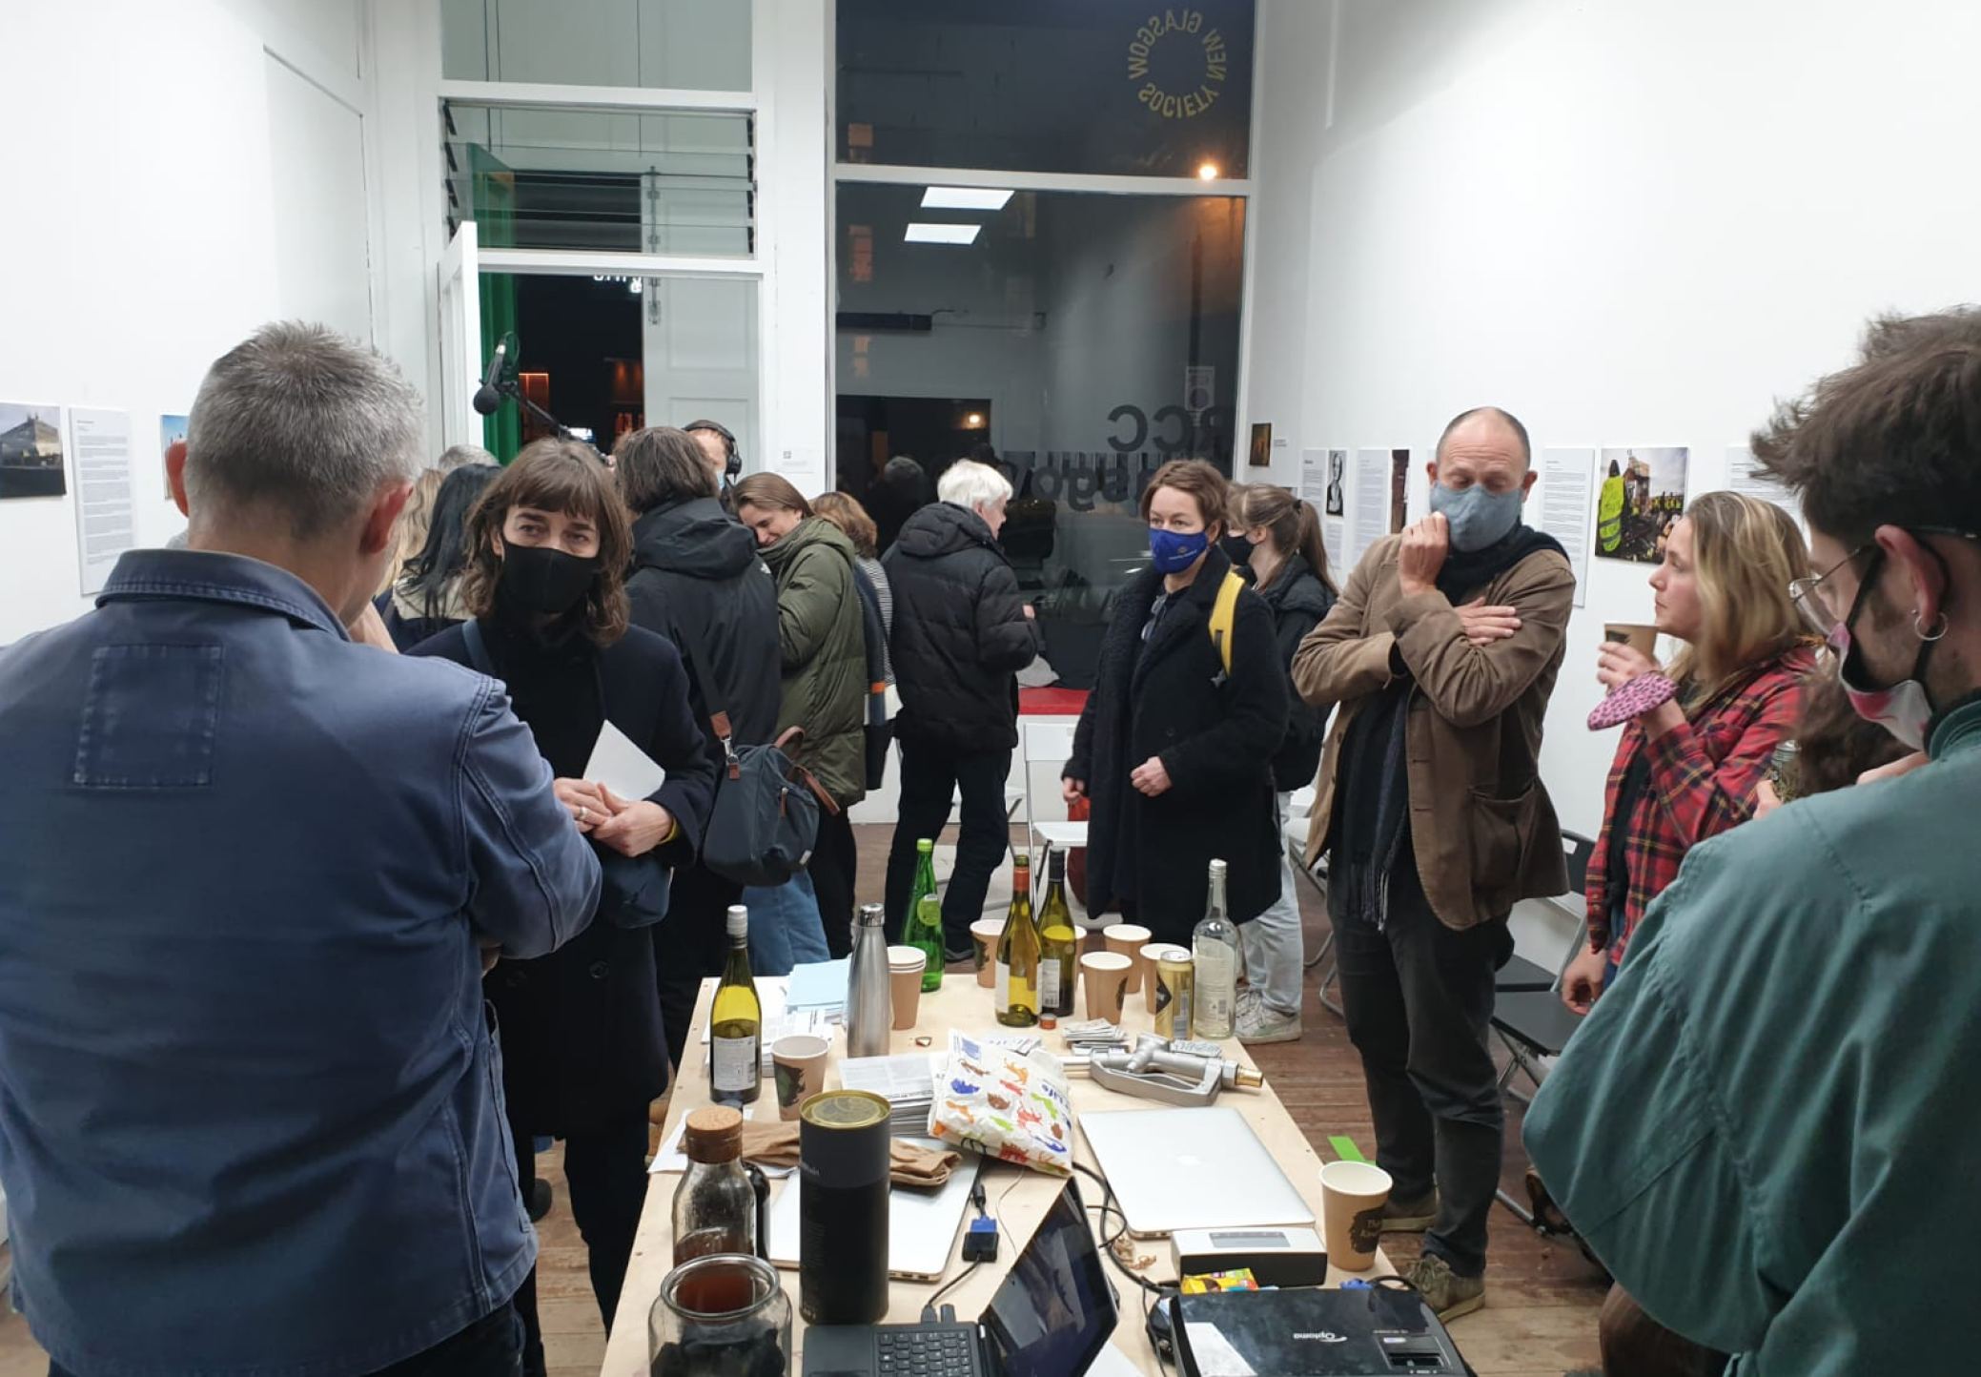
Notes:
Was also a PERFORMANCE WHERE I WAS THE FUTURE CURATOR – we could do a bit of that if you like…..

Slide 29
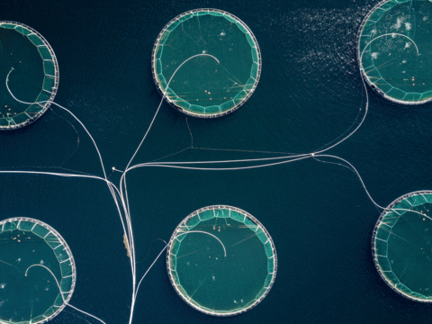
Notes:
What you are about to experience is an exhibition from the future. The Museum of Carbon Ruins opened in Lund, Sweden in 2053, in part to celebrate the successful transition, made across the world, away from the fossil-fuel era. The critical challenges set down in the Paris Agreement of 2015, to reach a world of net-zero emissions of carbon-dioxide – were met. Emergencies were declared. Arguments were had. But calls were answered. Actions were taken. We held 1.5 degrees. Concerted efforts by a variety of stakeholders across the world made the high-carbon lifeworld, born in the mid-19th century, intensified and accelerated in the 20th ­– an obsolescence. This was not effortless or without struggle, some of it violent. It was not without some mourning. Remember, those of you alive then, back in 2019: the range of the structures, products and practices of that world were formidable – and often invisible. They went deep. They saturated our social and cultural domains. They built our economies and our banking practices. They materialized and made functional all manner of incredible infrastructures – transport, energy, health, agriculture, digital. We were citizens of carbon. It percolated into our affective lives. It fired our emotions, generated a great many of our bodily and intellectual pleasures. Our sense of freedom and the good life, were at root, carbon refinements, oily mediations, fossily pleasures. But these practices we knew and eventually almost universally acknowledged, were destructive – on multiple levels. So. We made the necessary shifts. Some countries led the way, Sweden among them. The objects gathered in the Museum of Carbon Ruins are testament to that.

Slide 30
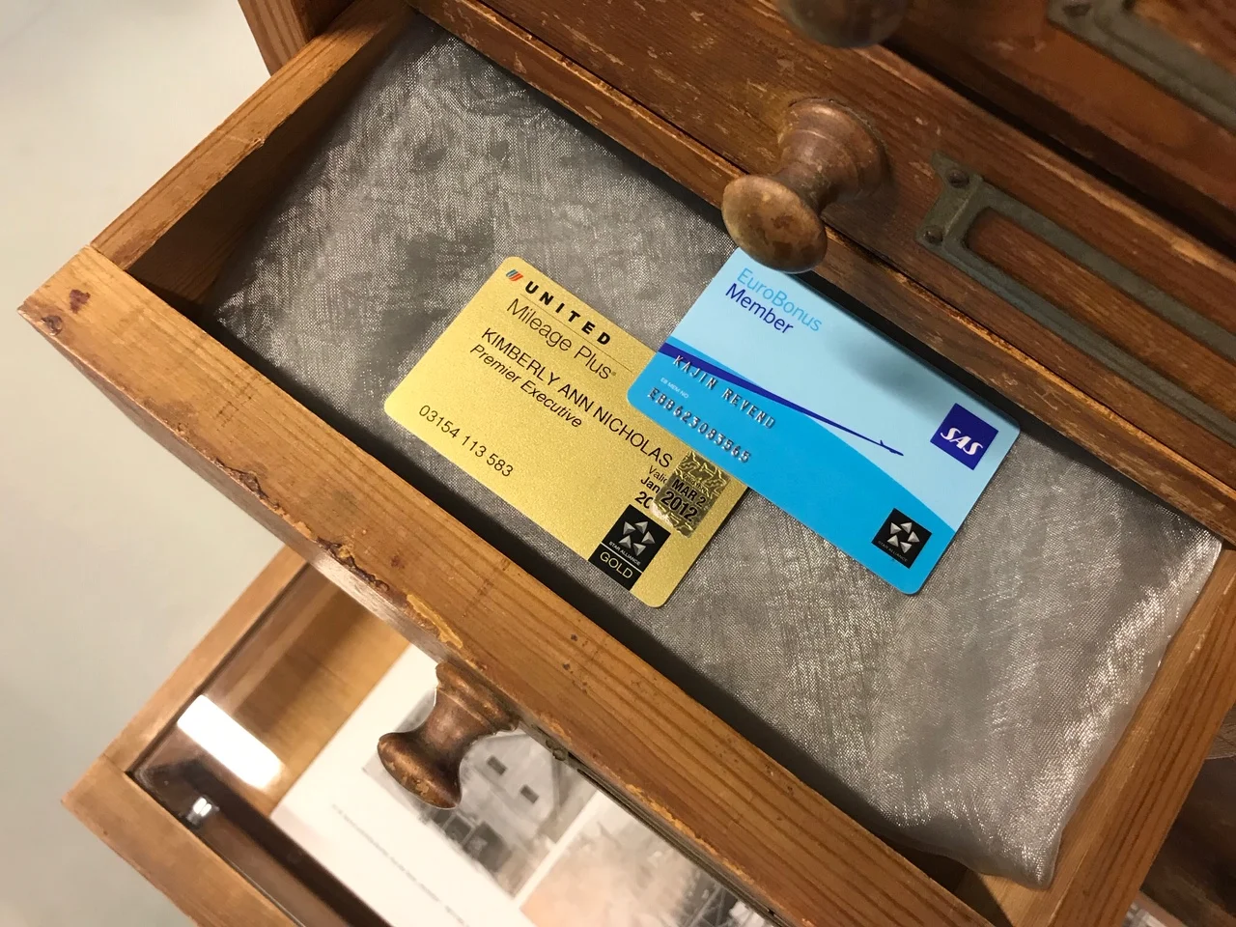
Notes:
Here we see an oil-platform built from vintage, oil-based LEGO-bricks, we've borrowed it from one of the toy-libraries in Lund. In a sense, oil-drilling was seen as a great job prospect for young people – especially in countries such as Norway and Nigeria with vast oil reserves. And the fossil fuel industry wanted to keep it that way – which is why they often partnered with LEGO to produce models of oil wells, gas stations, SUVs. ‘get them while they’re young as you say’.
I repeat: this plastic was made from oil, not the bio-based stuff you find in stores today. As parents of school-striking kids looked around their living rooms, LEGO came to represent the refiniries, the pipelines, the fossil structures that were endangering the childrens’ futures. Protests where held outside Billund where LEGO's headquarters were located. Children were dressed up in white gowns and had black liquid pouring down their hands. When these images hit the front-page of Jyllandsposten, LEGO’s stock plummeted but were eventually bailed out by the Danish state on the condition that they wholly transition into bio-plastic.

Slide 31
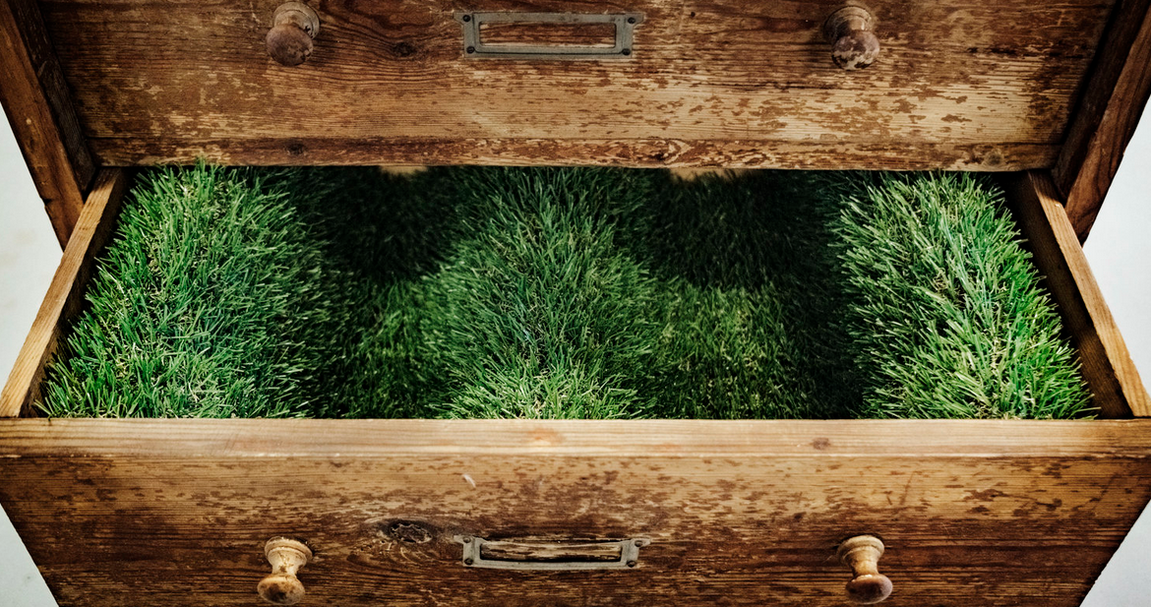

Slide 32
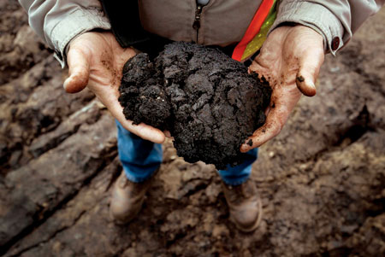
450 × 301

Slide 33
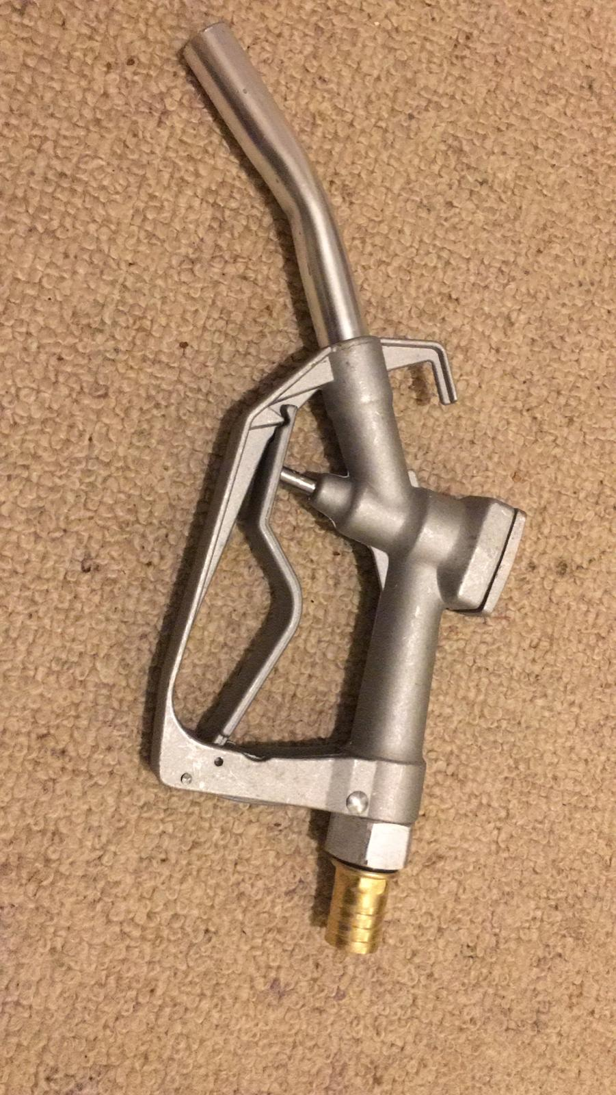
Notes:
This thing they called “PETROCULTURE”

Slide 34
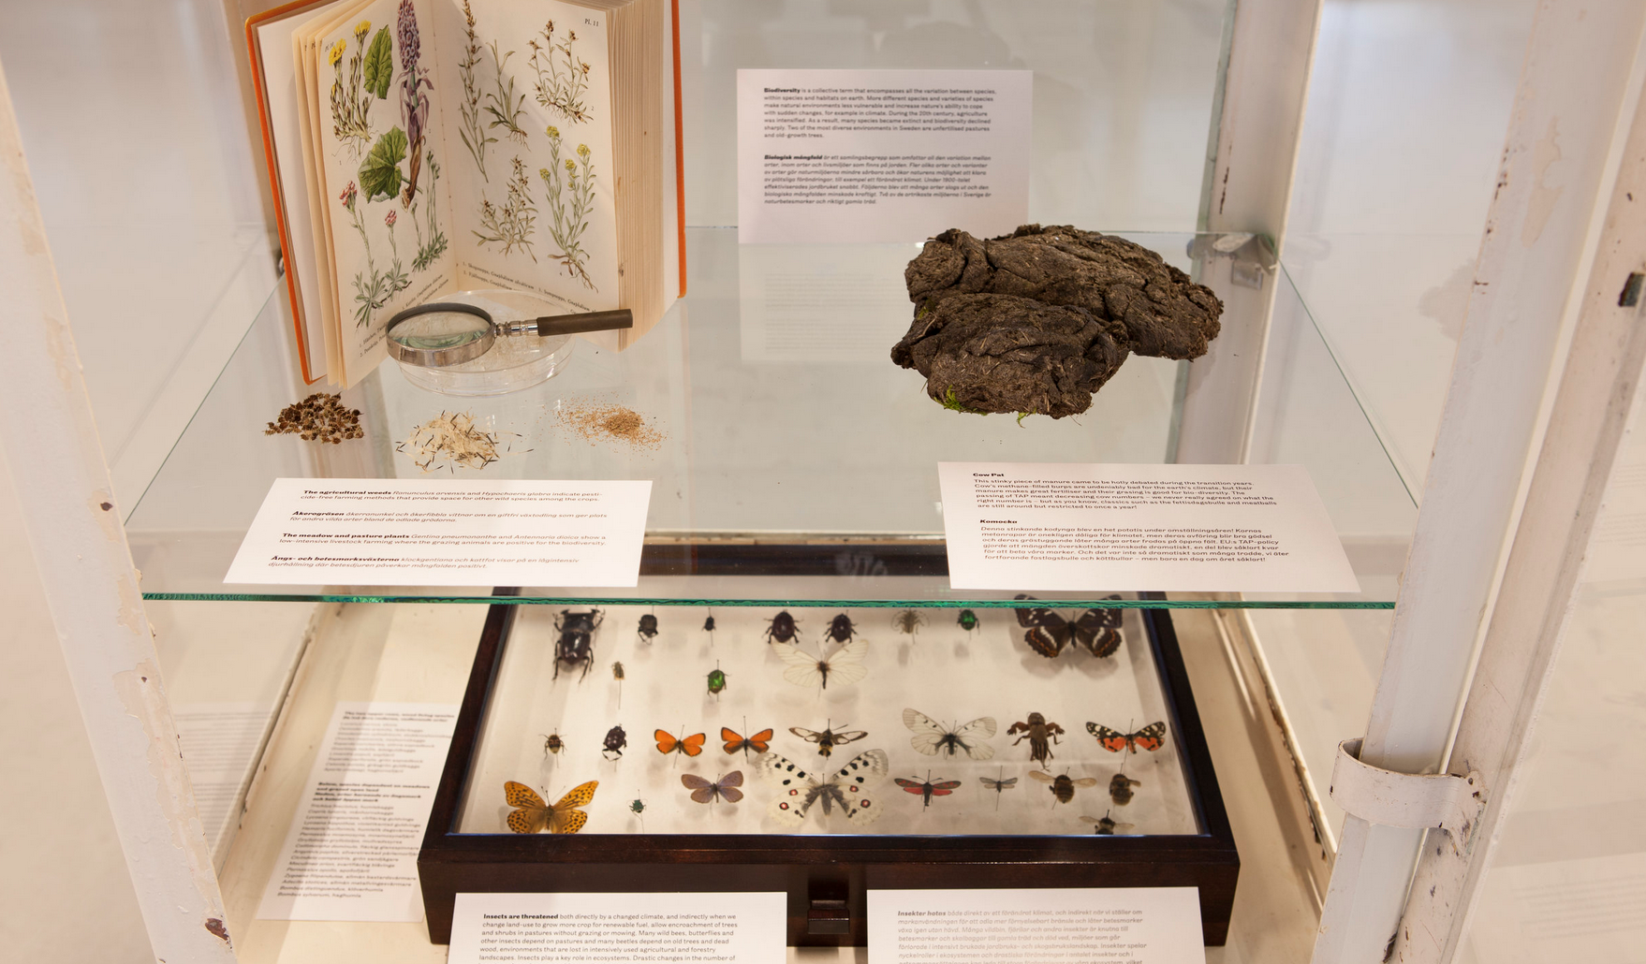

Slide 35
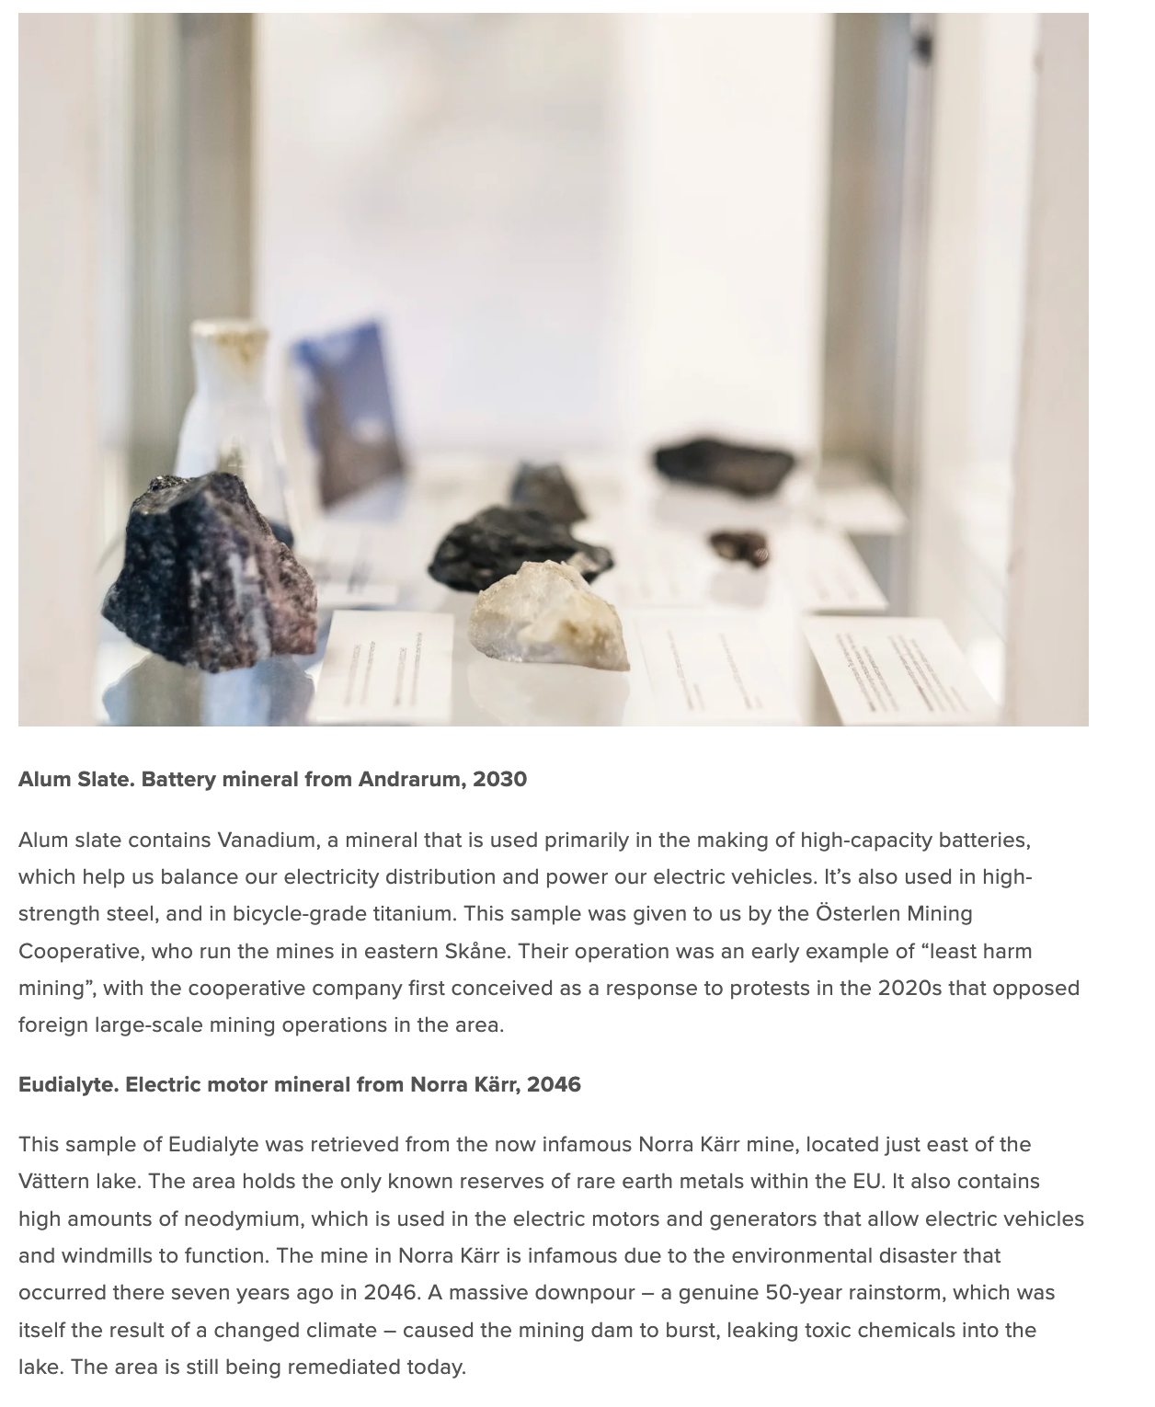
Notes:
So why did we do this?
A core idea of this project is that carbon is deeply embedded in our lives. Looking back at the fossil age allows us to make that which today is familiar, unfamiliar.
The dominating climate imaginaries are either dystopic catastrophe porn or utopic techno-fix scenarios. The museum is hopeful in that we reach our climate targets – but we highlight the pain and suffering that might be associated with such a transtion. Minerals are extracted from sensitive biotopes and people are displaced, insects go extinct due to an increasingly intensive forestry sector and violence ensues as the benefactors of the fossil society react to their new position in society.
Climate communication have long had a problem of perceived distance: we are far away from the impacts and the causes of climate change. By using places, characters and objects that are distinctly Swedish climate science is embodied with a new meaning.
The museum deliberately does not tackle every issue, and the visitors are invited to suggest objects and topics for us to cover. By transporting them in space and time, we allow discussions to escape the trenches of 2019 climate politics and instead focus on the type of society we want to build.

Slide 36
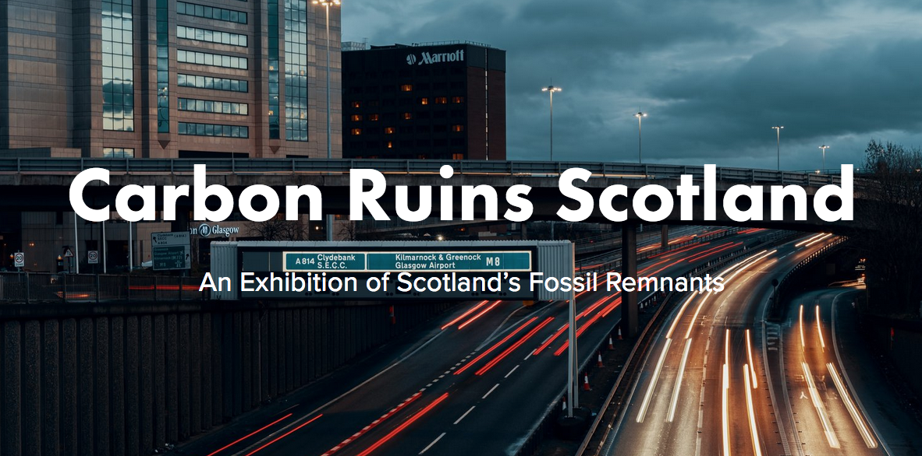

Slide 37
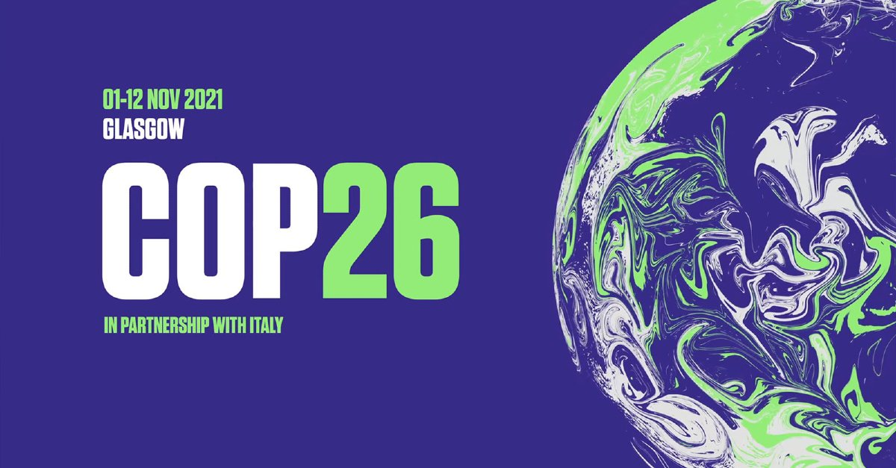

Slide 38
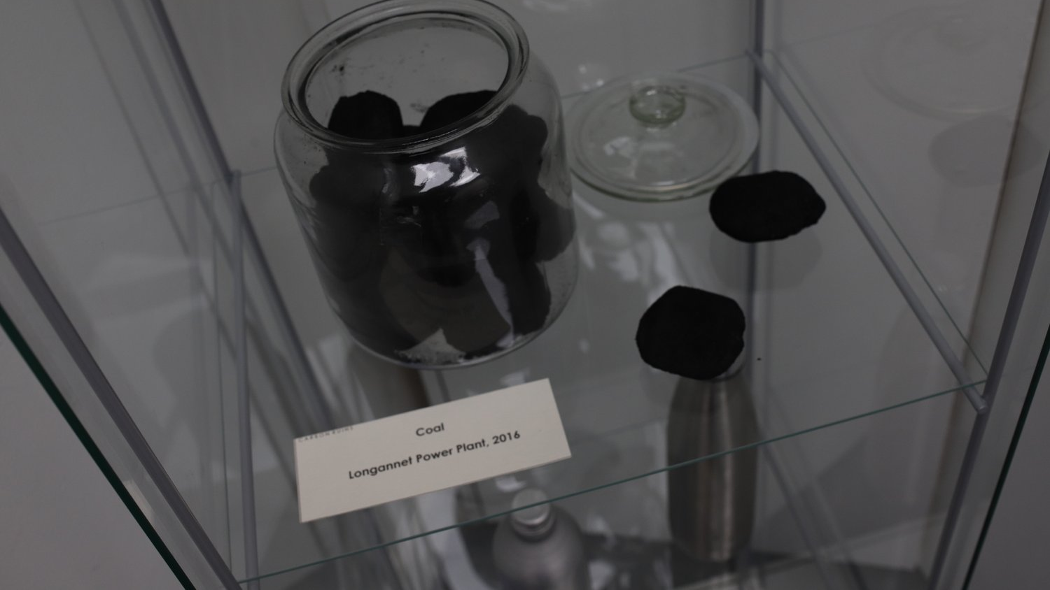

Slide 39
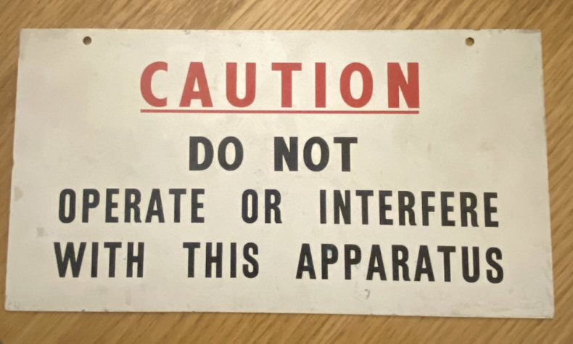
CONTROL ROOM SIGN, HUNTERSTON B NUCLEAR PLANT (DECOMMISSIONING)
Notes:
SMRS IN 2025 !!
A core idea of this project is that carbon is deeply embedded in our lives. Looking back at the fossil age allows us to make that which today is familiar, unfamiliar.
The dominating climate imaginaries are either dystopic catastrophe porn or utopic techno-fix scenarios. The museum is hopeful in that we reach our climate targets – but we highlight the pain and suffering that might be associated with such a transtion. Minerals are extracted from sensitive biotopes and people are displaced, insects go extinct due to an increasingly intensive forestry sector and violence ensues as the benefactors of the fossil society react to their new position in society.
Climate communication have long had a problem of perceived distance: we are far away from the impacts and the causes of climate change. By using places, characters and objects that are distinctly Swedish climate science is embodied with a new meaning.
The museum deliberately does not tackle every issue, and the visitors are invited to suggest objects and topics for us to cover. By transporting them in space and time, we allow discussions to escape the trenches of 2019 climate politics and instead focus on the type of society we want to build.

Slide 40
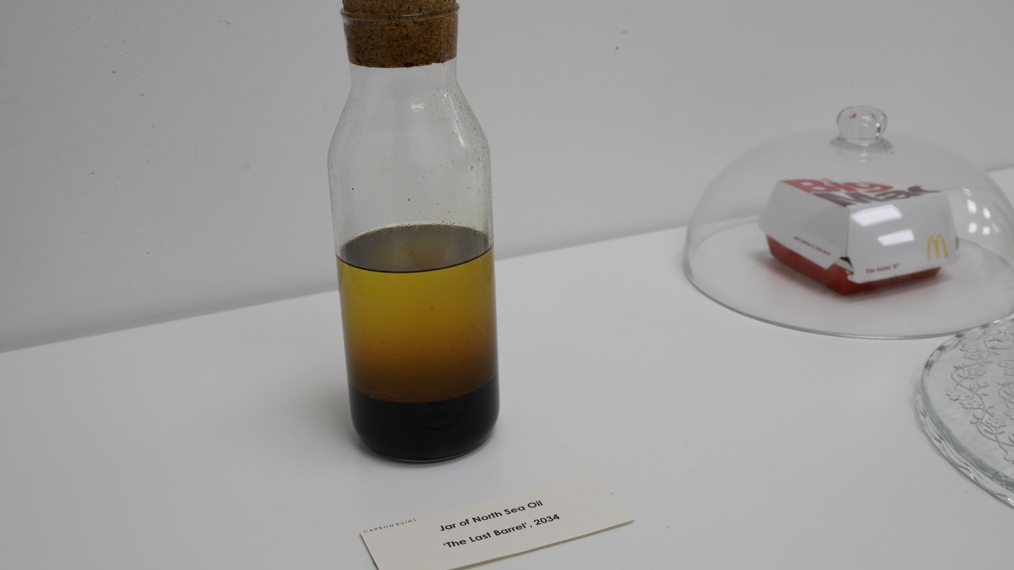

Slide 41
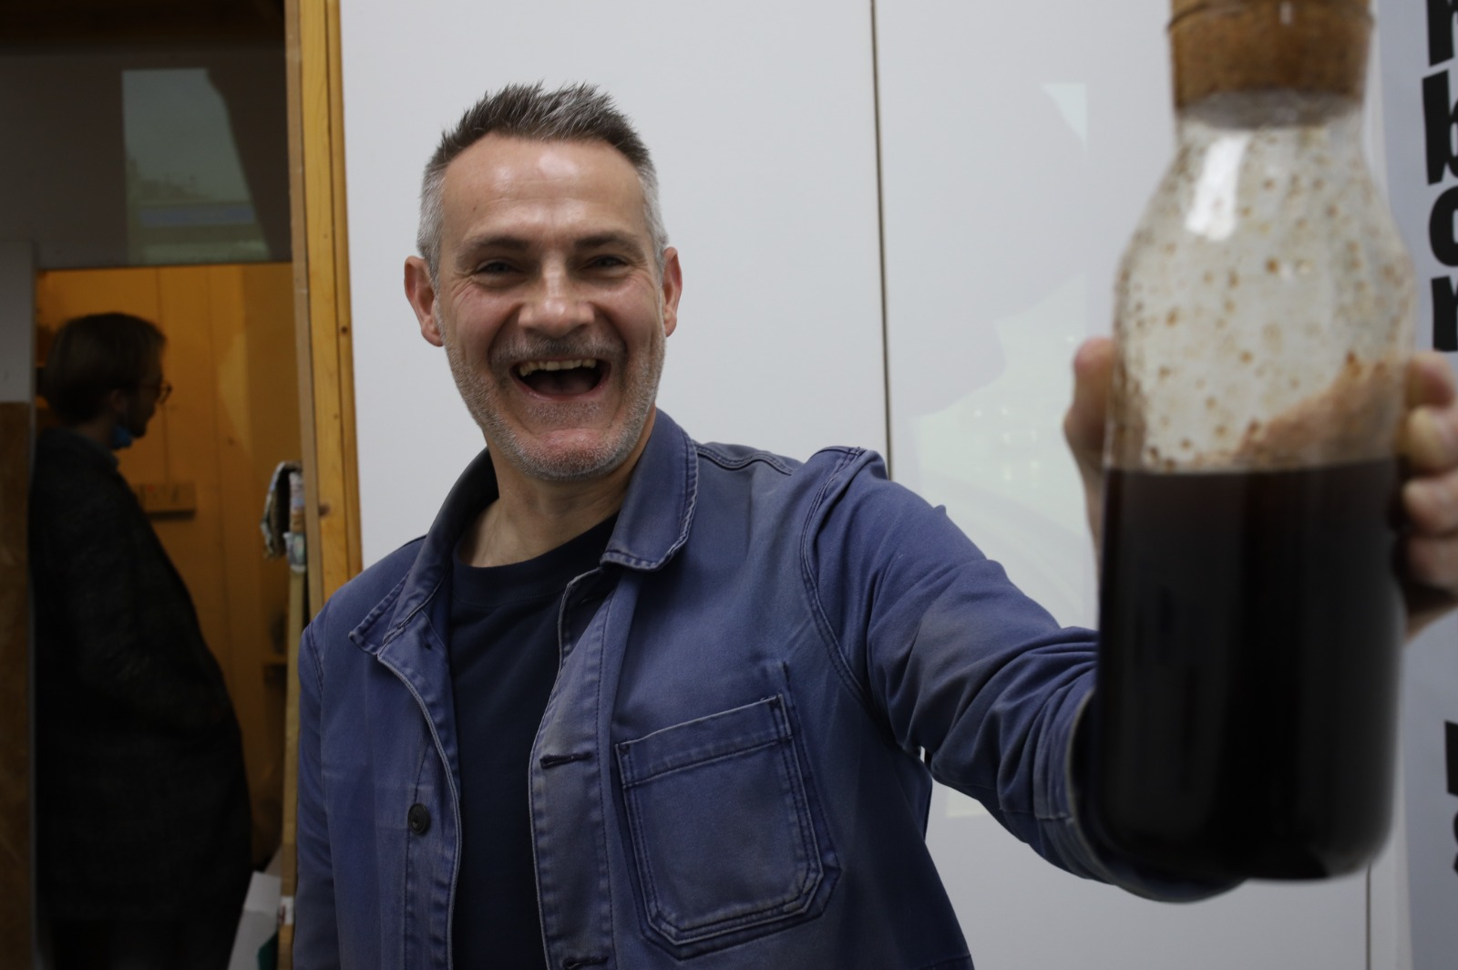
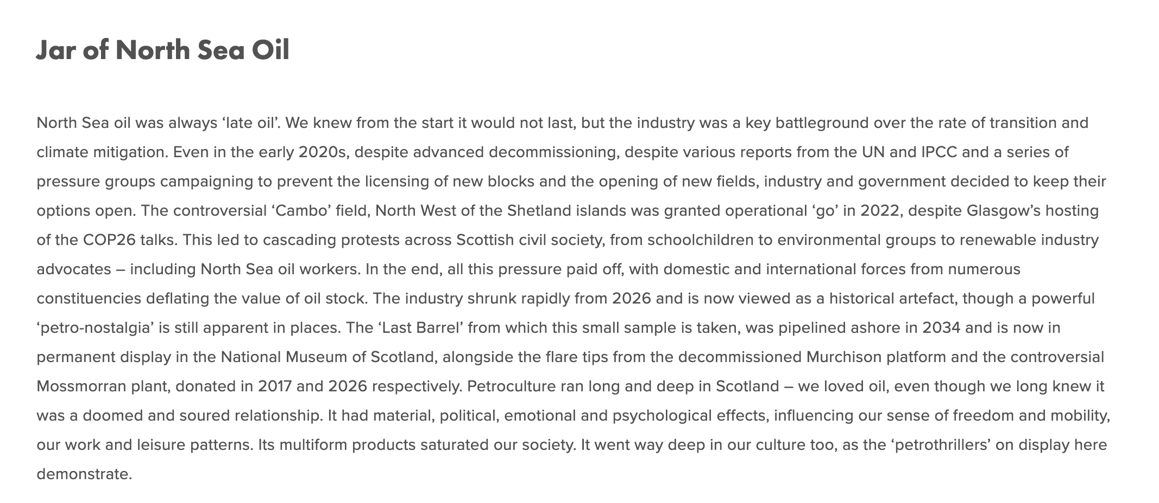

Slide 42
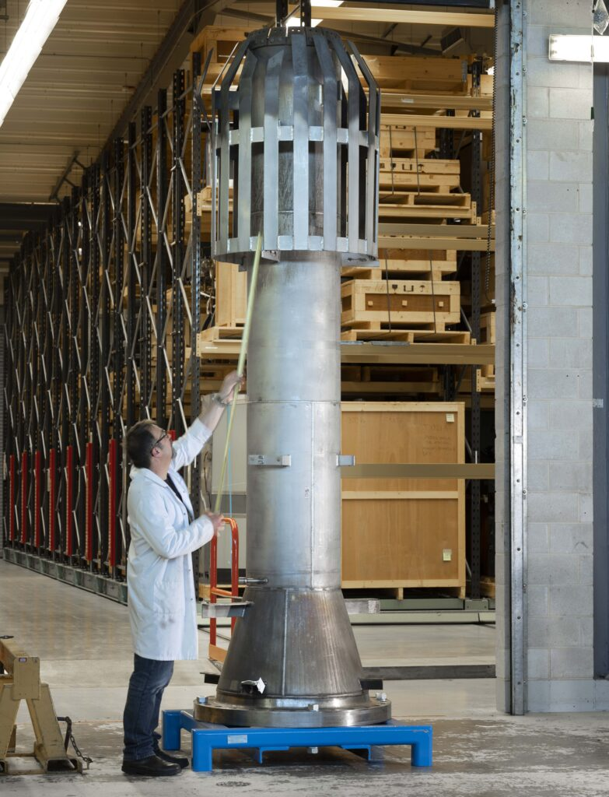

Slide 43


Slide 44



Slide 45


Slide 46


Slide 47


Notes:
So why did we do this?
A core idea of this project is that carbon is deeply embedded in our lives. Looking back at the fossil age allows us to make that which today is familiar, unfamiliar.
The dominating climate imaginaries are either dystopic catastrophe porn or utopic techno-fix scenarios. The museum is hopeful in that we reach our climate targets – but we highlight the pain and suffering that might be associated with such a transtion. Minerals are extracted from sensitive biotopes and people are displaced, insects go extinct due to an increasingly intensive forestry sector and violence ensues as the benefactors of the fossil society react to their new position in society.
Climate communication have long had a problem of perceived distance: we are far away from the impacts and the causes of climate change. By using places, characters and objects that are distinctly Swedish climate science is embodied with a new meaning.
The museum deliberately does not tackle every issue, and the visitors are invited to suggest objects and topics for us to cover. By transporting them in space and time, we allow discussions to escape the trenches of 2019 climate politics and instead focus on the type of society we want to build.

Slide 48


Slide 49


Slide 50


Slide 51


Slide 52


Slide 53


Slide 54


Slide 55


Slide 56


Slide 58
Macdonald, Graeme, and Jonathan Skinner. ‘Sounding Carbon Ruins: Speculative Design for Climate Futures’. Lagoonscapes, no. 2, Dec. 2025. https://doi.org/10.30687/lgsp/2785-2709/2025/02/007
Stripple, J.; Nikoleris, A.; Hildingsson. R. (2021). “Carbon Ruins: Engaging with Post‑Fossil Transitions through Participatory World-Building”. Politics and Governance, 9(2), 87‑99.
Raven, P.G. (2021). “Concretise, Situate, Democratise: The Museum of Carbon Ruins”. Transforming Society, 16 February. https://www.transformingsociety.co.uk/2021/02/16/concretise-situate-democratise-themuseum-of-carbon-ruins/
Raven, P.G. (2023). “Rough Guides and Carbon Ruins: The Role of Sf (Studies) in the (Re)Construction of Decarbonized Futures”. Extrapolation, 64(1), 11‑31.
Raven, P.G.; Stripple, J. (2021). “Touring the Carbon Ruins: Towards an Ethics of Speculative Decarbonisation”. Global Discourse, 11(1‑2), 221‑40.

