Slide 1
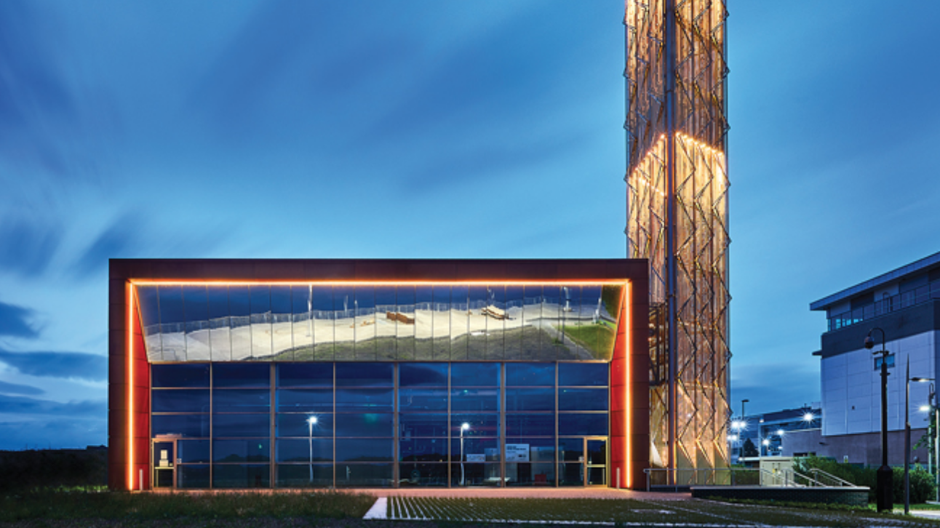
Climate Imaginaries Week 10
Futuring (2) Where Now? Renewability/Solarfutures/Geoengineering?
Notes:
Thanks to Jessica and Jamie for the invitation to come to this excellent gathering + Oksana - exemplary.
detail some recent work in practice-based climate futuring.
reflect on my experience on 3 intersecting projects focussed on the cities of Glasgow and Coventry, where I live and work
LOT OF SLIDES – HAPPY FOR YOU TO HAVE THEM – JUST BECAUSE I AM DEMONSTRATING OBJECTS AND EVENTS, SO DON’T GET FREAKED OUT IF I WHIZZ BY SOME….
used speculative methods from theories and techniques of futuring to worldbuild distinct climate imaginaries of the climate-changed city: a museum of the future 2050s called ‘Carbon Ruins’; a digital app, called VIDI, of alternative climate-transformed scenarios in iconic city landscapes, and a co-created visual artwork, an abstract painting called ‘Memories of a Future City’, which visualises and narrates Coventry’s radical transformations from the mid 19th Century to 2123.
All the projects were developed and presented to a variety of publics and stakeholders, including COP delegates and museum audiences, academics, schoolchildren, churchgoers, politicians and the general public.
manifest in digital and physical forms: art and museum exhibitions, i-pad apps, school curriculums, live performances, academic and open lectures, media items and other forms.
I'll use the time here to introduce the work but also to reflect on the viability of specific futuring methods, their adaptability and feasibility for different spaces and places and their limits, challenges and possible alternatives - possibly a topic for discussion period.
next slide

Slide 2
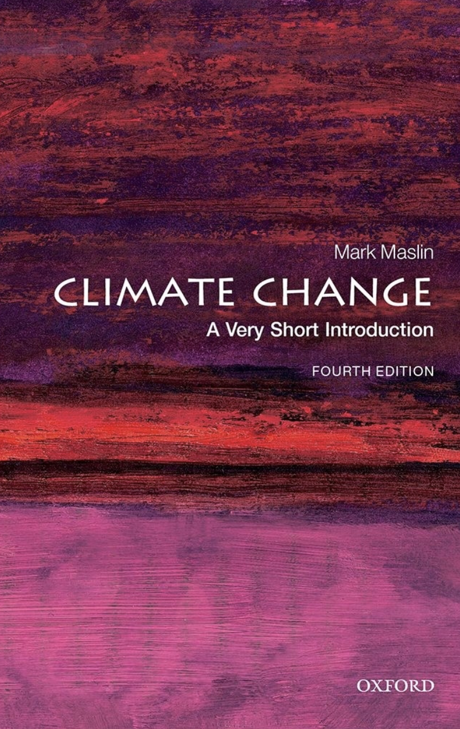
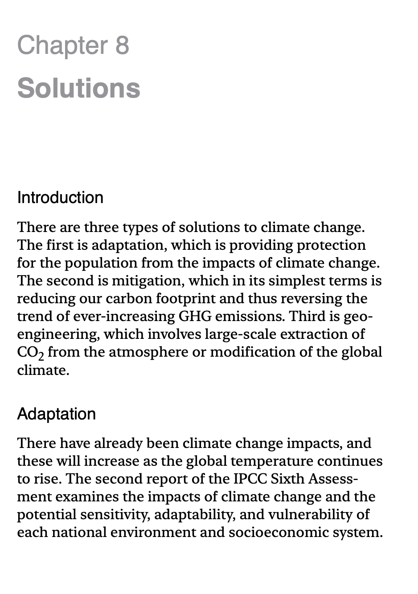

Slide 3
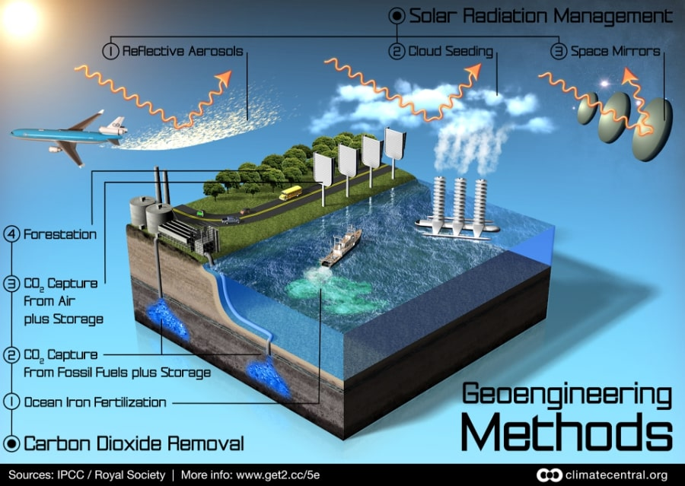

Slide 4
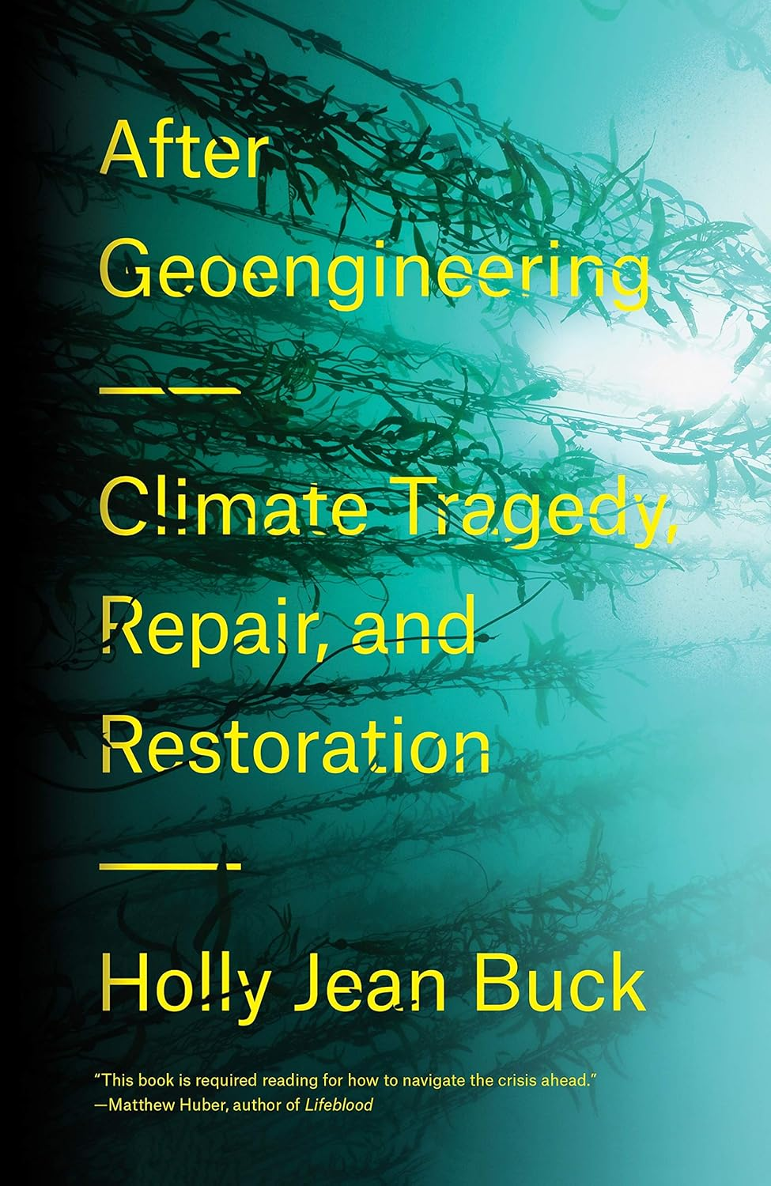
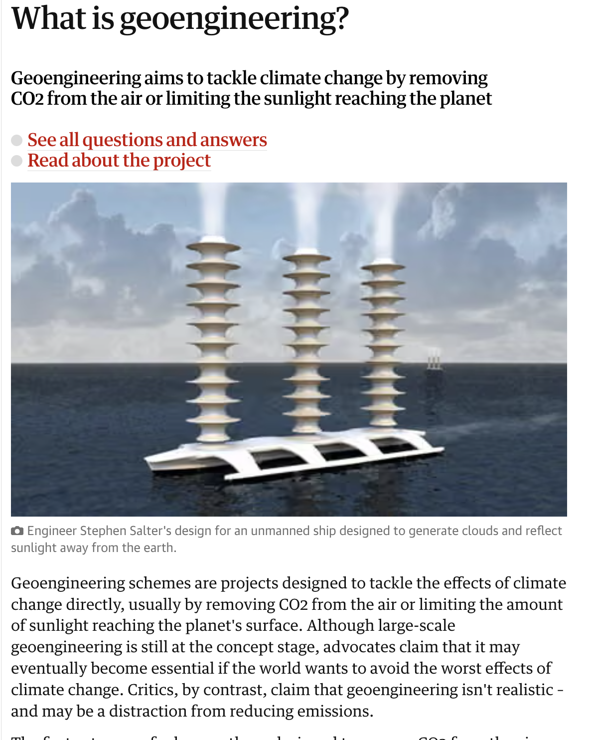

Slide 5
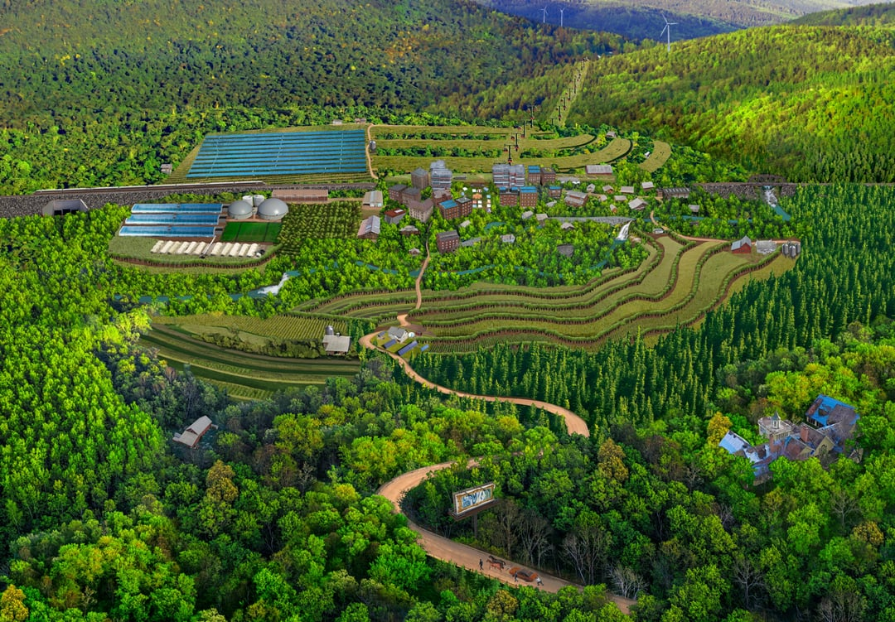

Slide 6
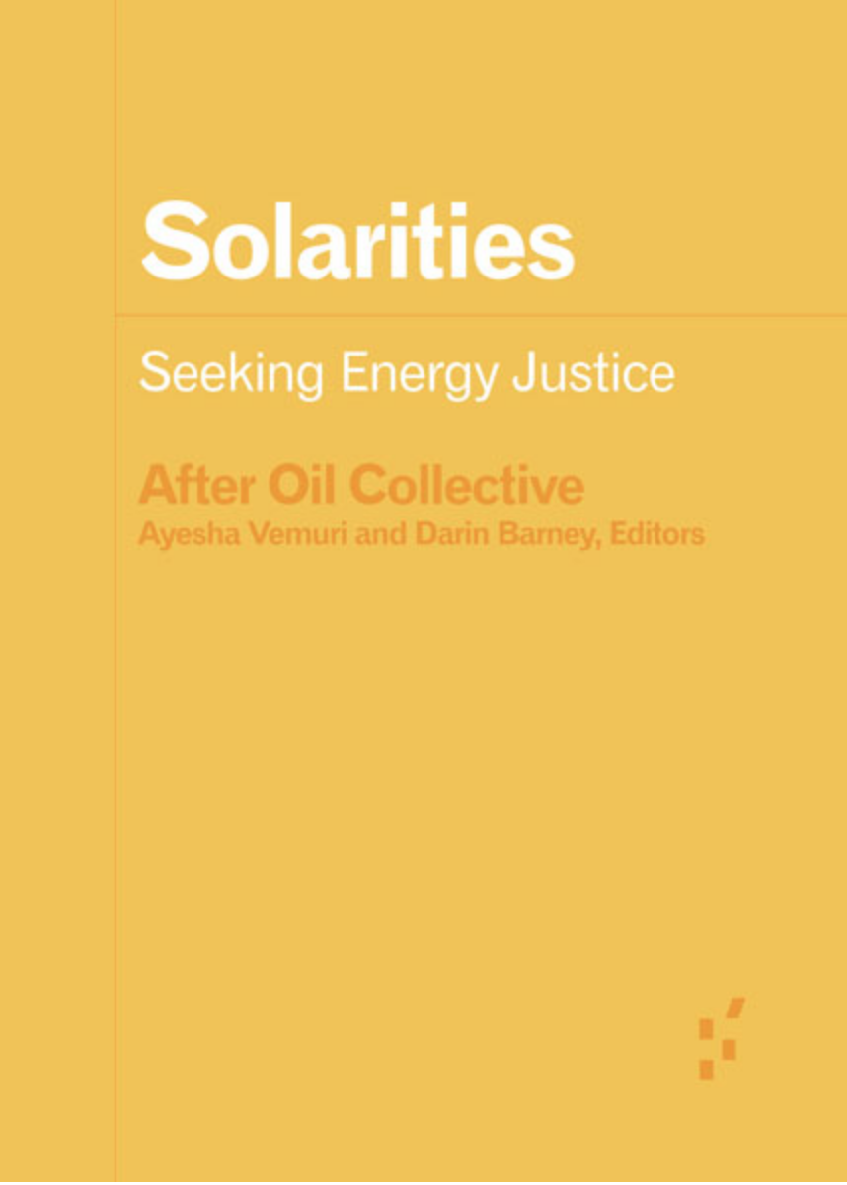
Solarities are orientations to the energy of the sun.
These orientations also imply terrestrial relationships,
including relationships to lands, minerals, waters,
animals and people, relationships that are mediated by
and materialized in infrastructure. What will the
infrastructures of solarity be? What will they be made of,
and what will they make of us? One of the imaginaries
attached to solar energy is that, in its universal
availability and infinite supply, it does not require
the sorts of mediation necessary for energy to become
fuel. This is precisely what makes it “imaginary.”
An orientation that approaches the sun as a source
of unlimited energy, capable of saving the planet by
replacing fossil-fuels, necessarily implies
infrastructural mediation with specific material
implications.
University of Minnesota Press, Forerunners Series, 2022
(Open Access)

Slide 7
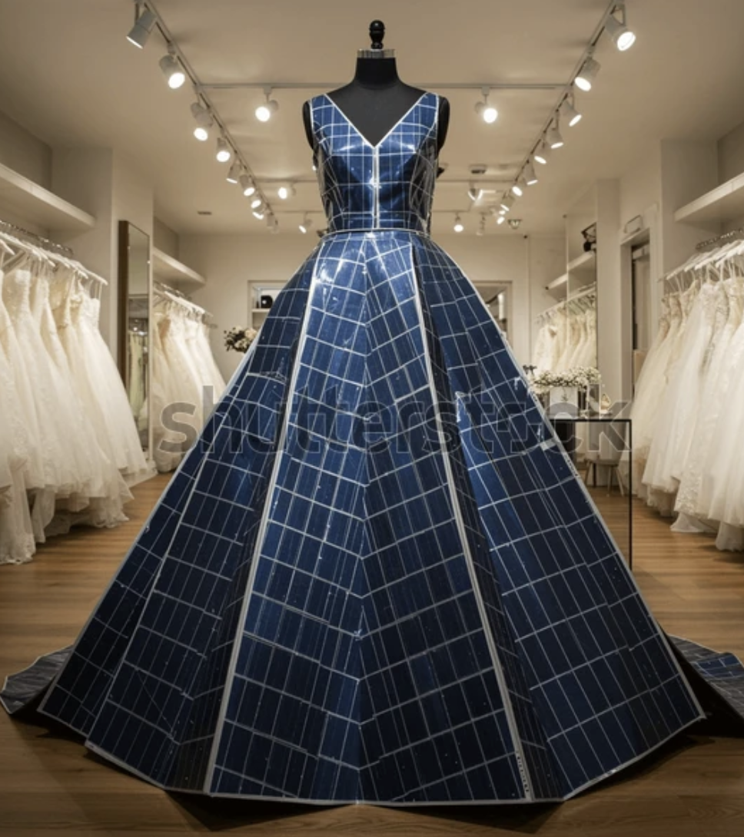

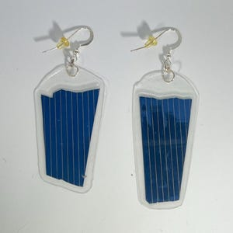

Slide 8
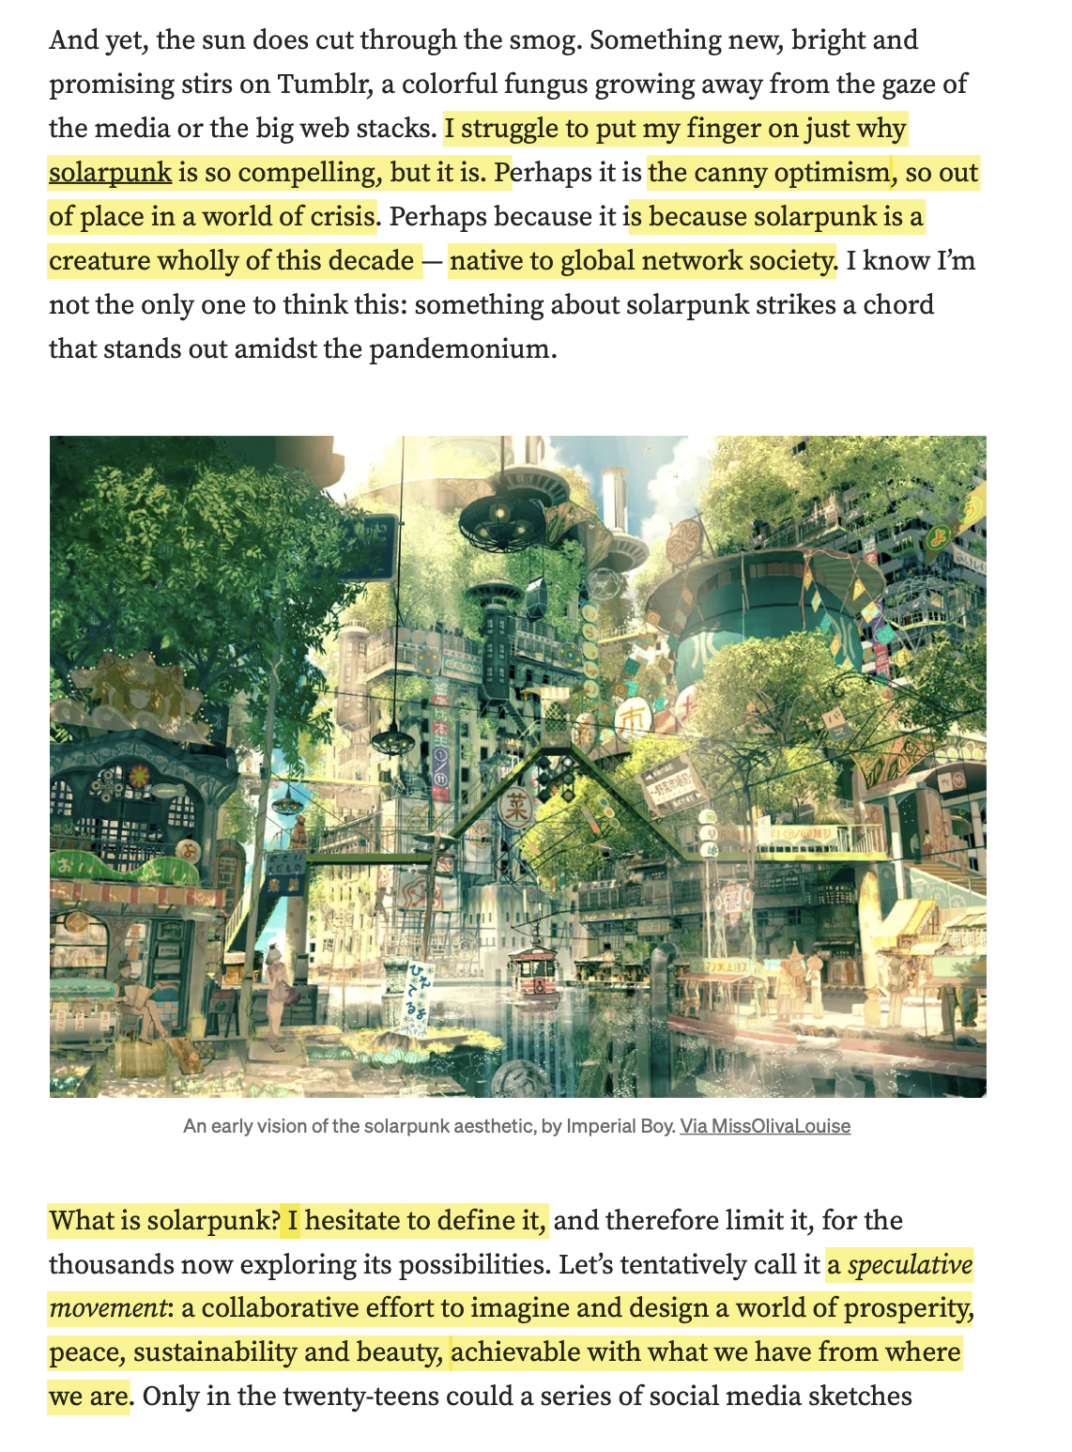
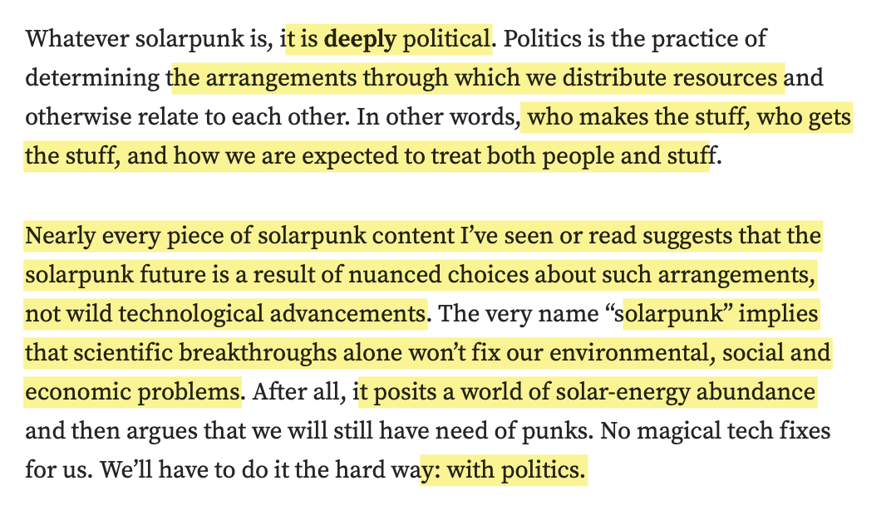
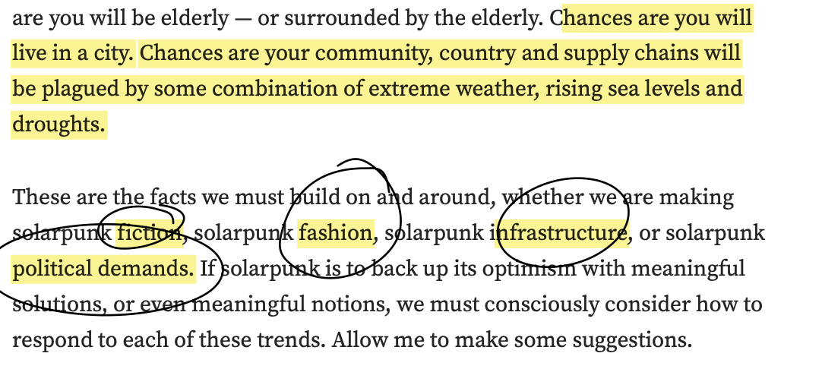
Andrew Dana Hudson

Slide 9
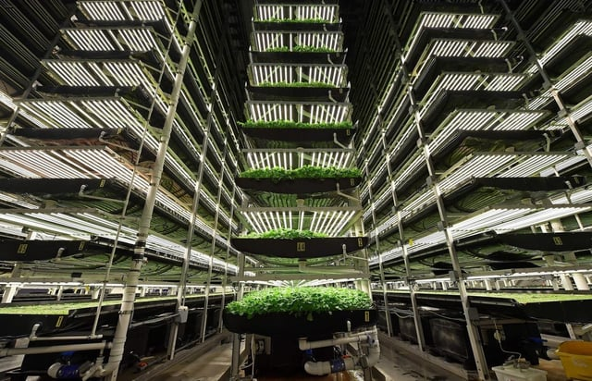
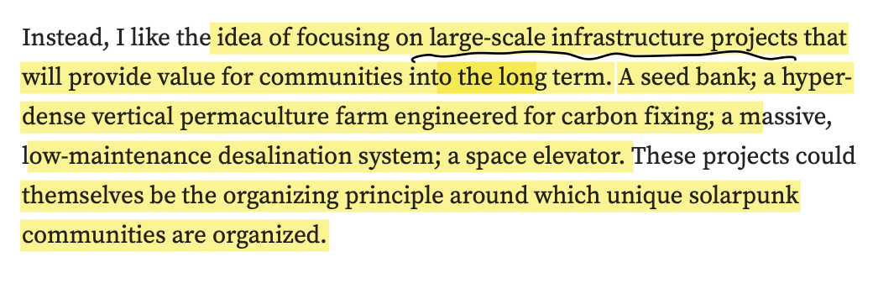
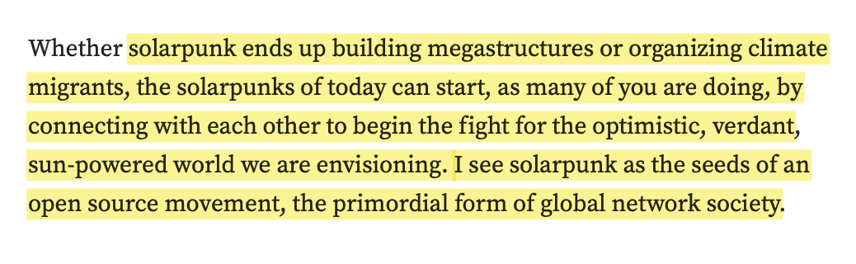
Andrew Dana Hudson

Slide 10
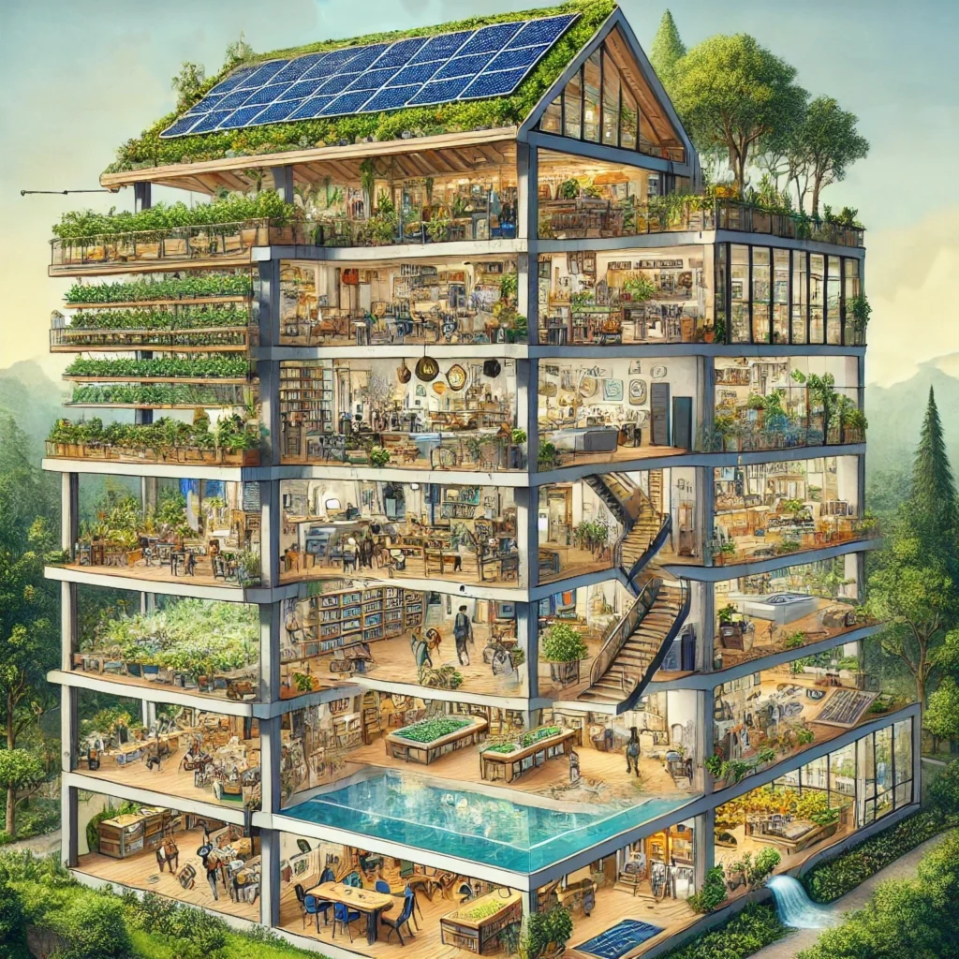

Slide 11
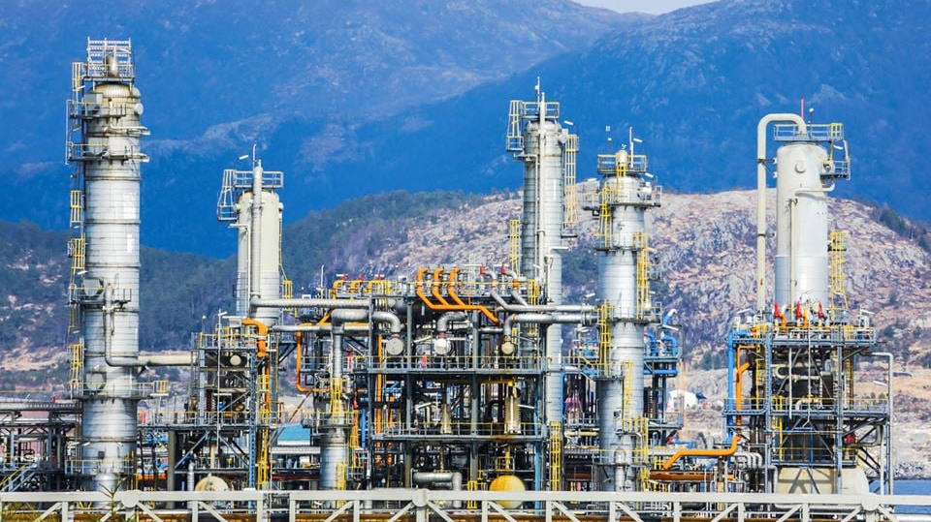
CCS Plant, Norway

Slide 12
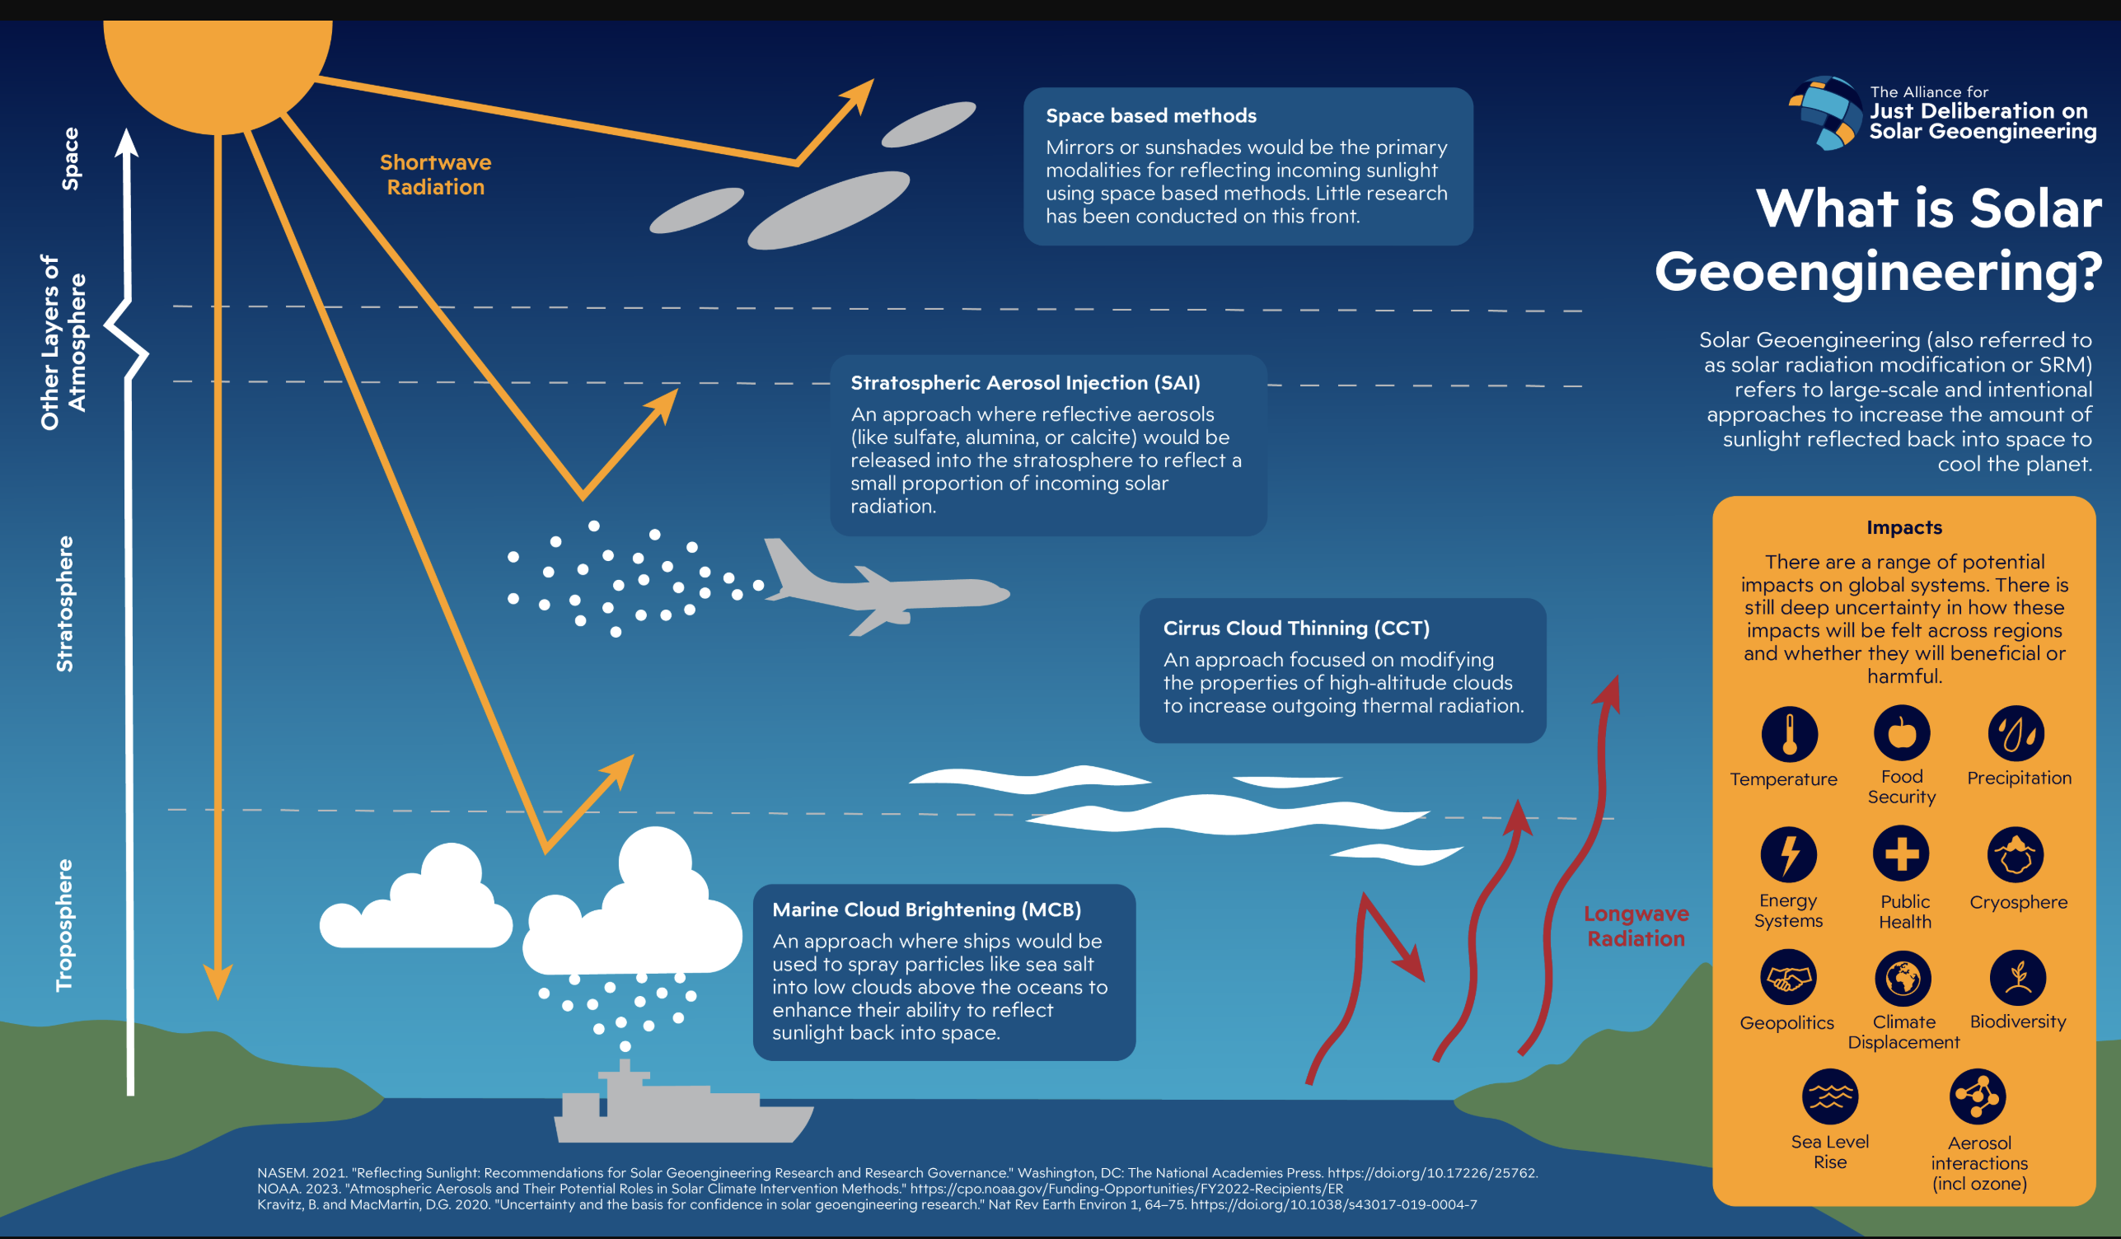

Slide 13
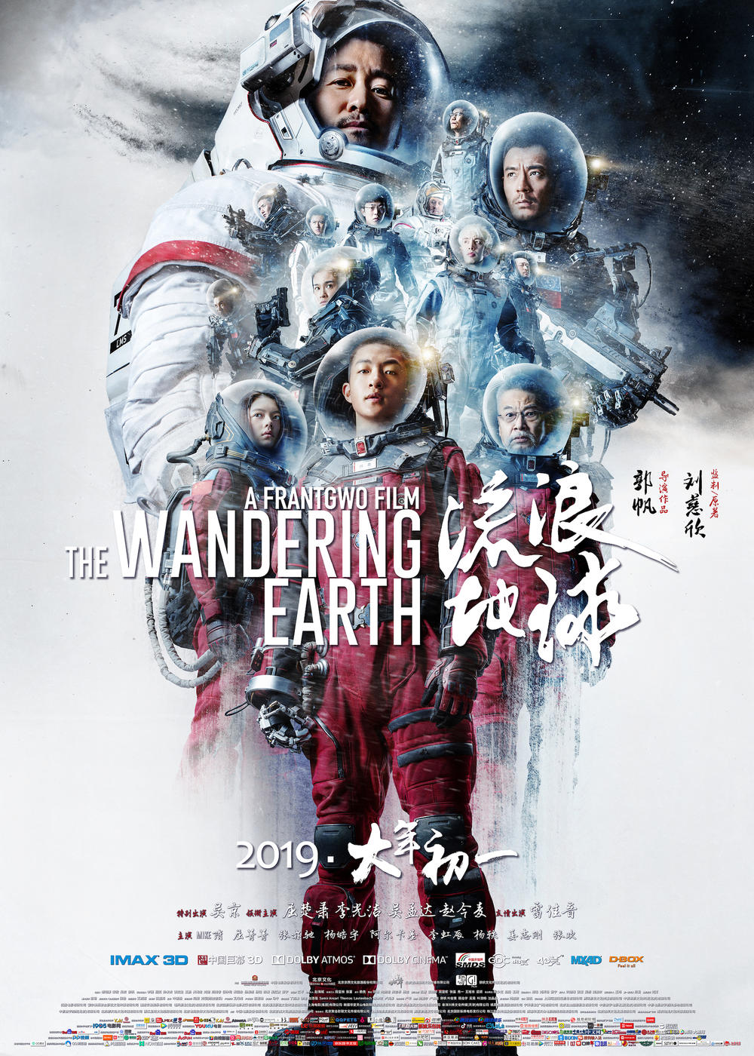
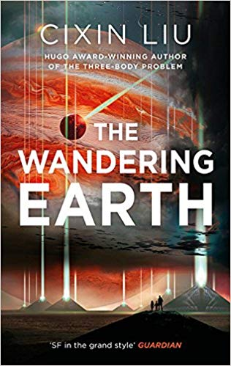
Notes:
FRANT GWO (2019 – AND CIXIN LIU (2000) – expanding sun – technoutopianism – underground life is only ever temporary because of rhe volatile earth – in the end overcomes STRATEGIC REALISM of government’s responses to climate change because the various nations of the world have to overcome their differences and interests to accommodate a CO-ORDINATED RESPONSE– (although china wins in the end) and this bad faith of techno-utopianism and cautionary tale is also seen in various Hollywood fantasies, such as SLIDE

Slide 14
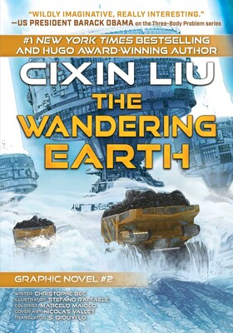
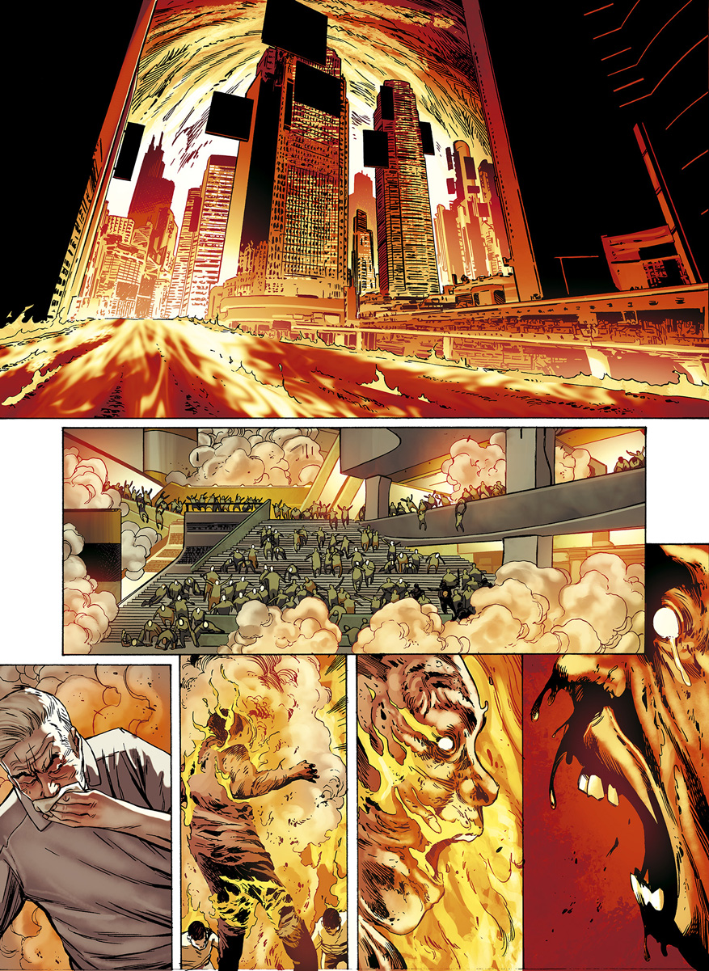
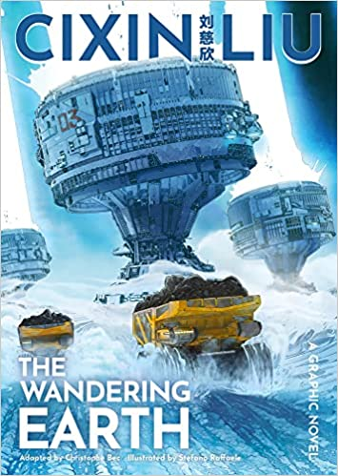

Slide 15
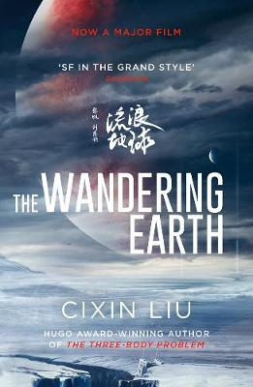
After we left Jupiter behind, Asia’s ten thousand Earth Engines roared to life again. They would operate at full capacity for the next five hundred years, constantly accelerating the planet. During those five hundred years, the engines would consume half of the mountains of the Asian continent as fuel.
Freed at last from the fear of death after four centuries, humanity breathed a collective sigh of relief. But the expected revelry never took place, and what happened next was beyond anyone’s imagining.
After our subterranean city’s celebratory rally concluded, I donned my thermal suit and ascended to the surface alone. The familiar mountains of my childhood had already been leveled by mega-excavators, leaving only bare rock and hard frozen soil. The bleak emptiness was broken by patches of stark white covering the land as far as the eye could see: the salt marshes left behind by the great ocean tide. Before me, the city in which my father and grandfather had lived out their days – a city once home to ten million – lay in ruins. In the blue light of the earth Engine’s plasma beams, the exposed steel skeletons of skyscrapers dragged long shadows behind them, like the fossilized remains of prehistoric beasts. The chronic floods and meteor strikes had destroyed virtually everything on the surface. All that humankind and nature had wrought over millenia lay in ruins; our planet had been rendered as barren and desolate as Mars.
Cixin Liu, The Wandering Earth (2000)

Slide 16
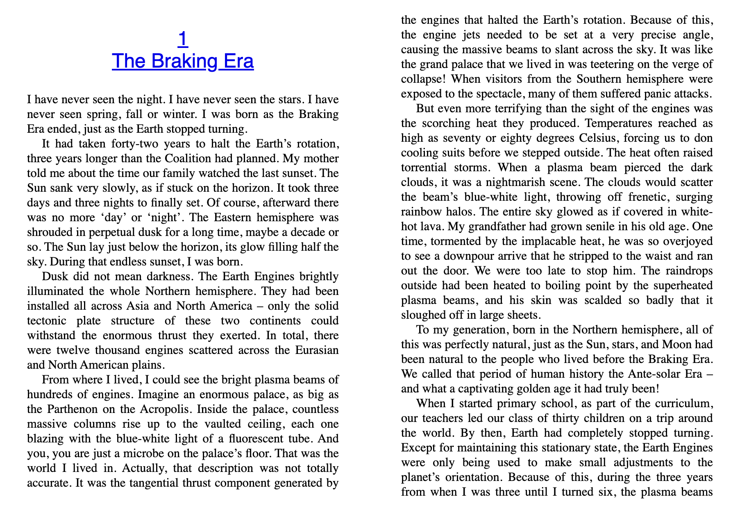

Slide 17
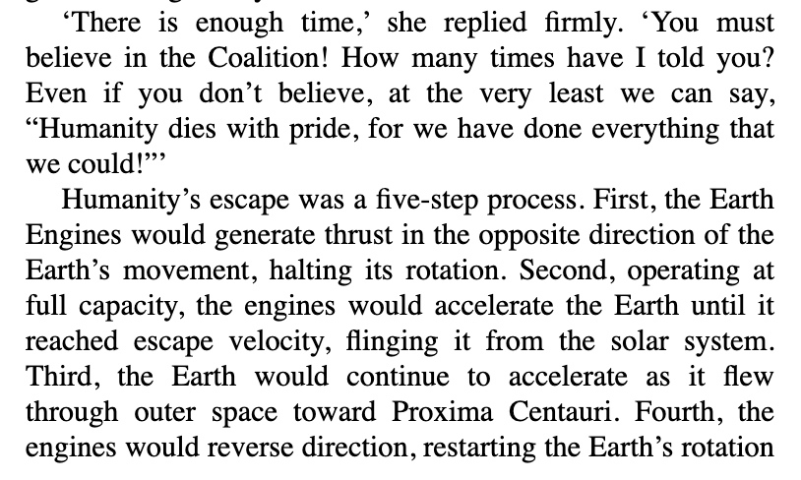
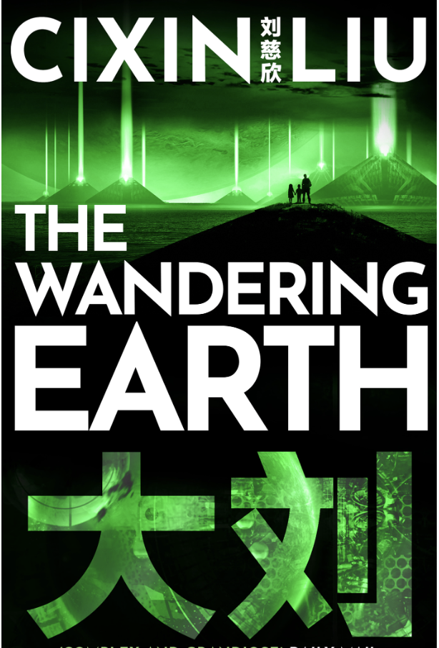
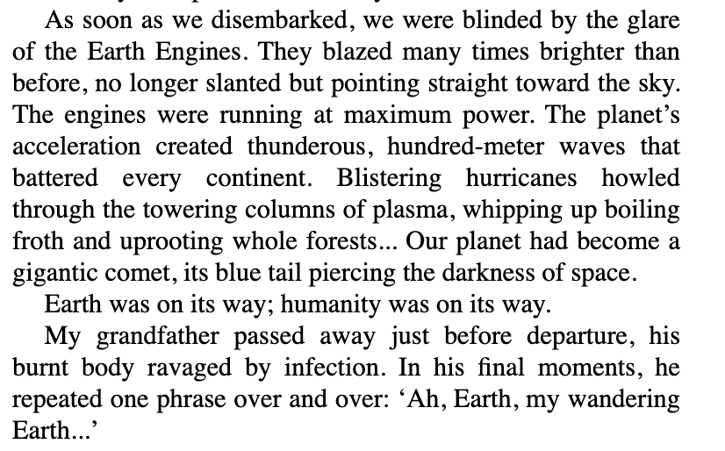

Slide 18
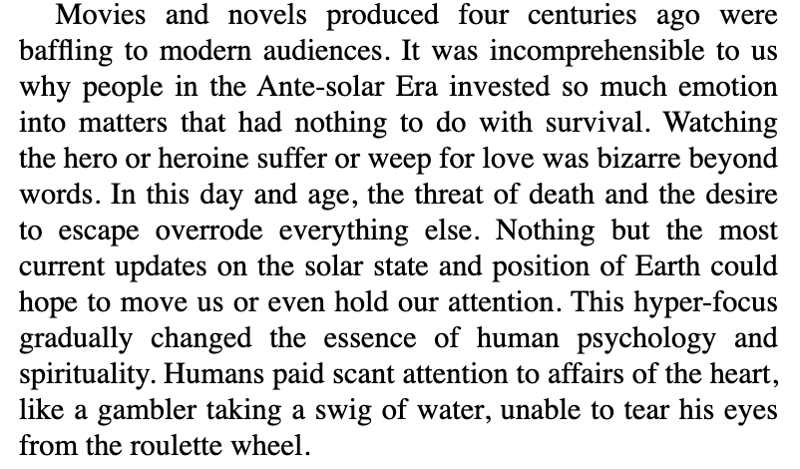
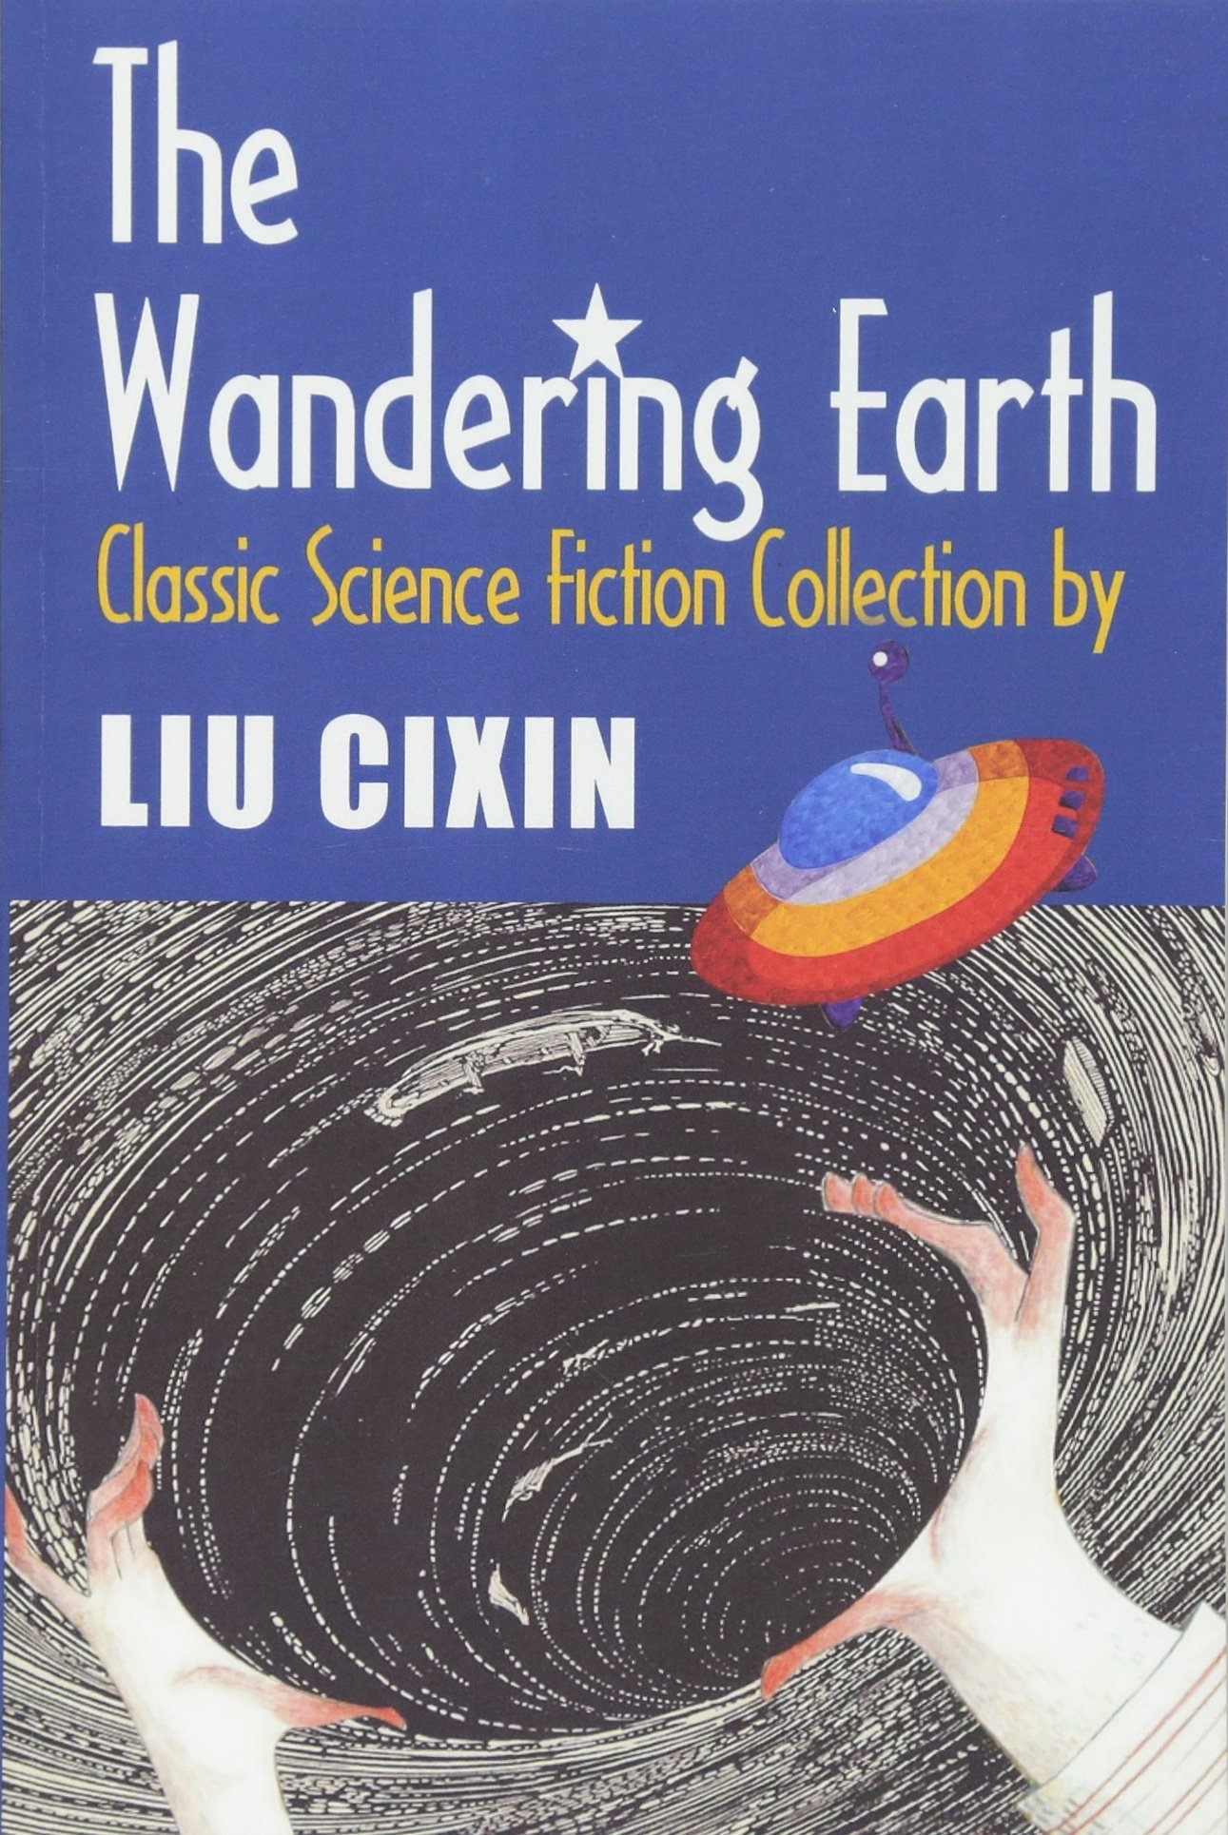
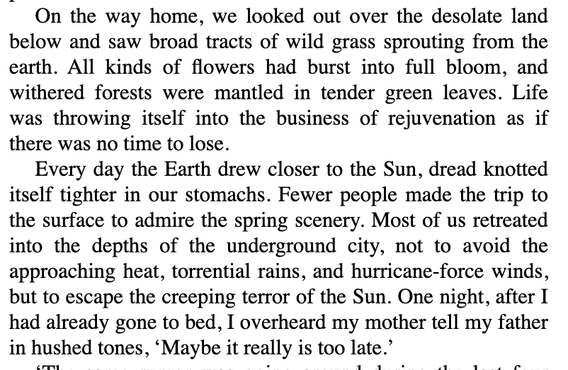
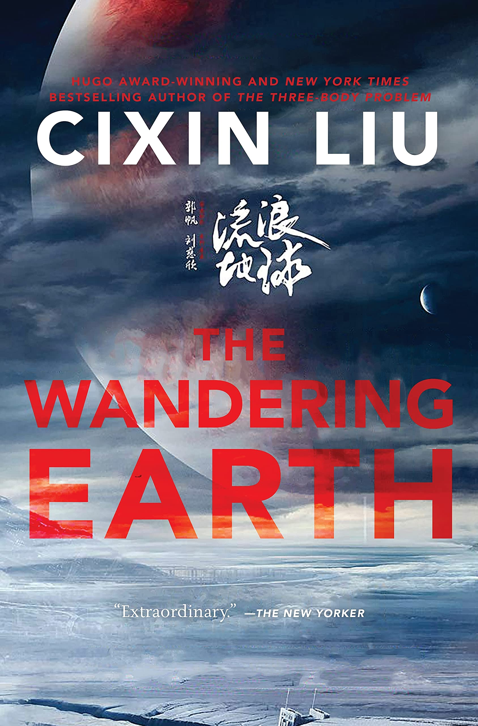

Slide 19
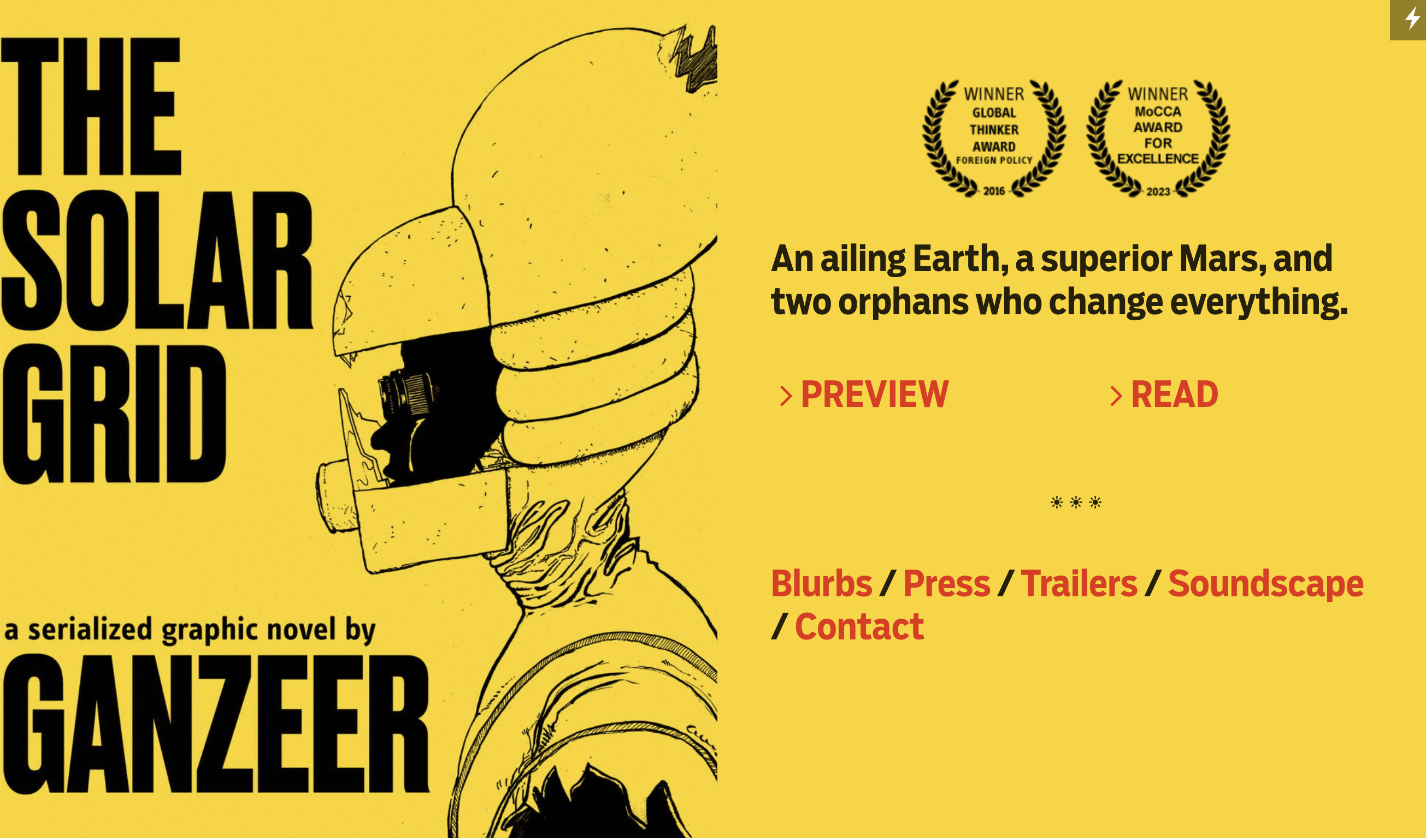

Slide 20
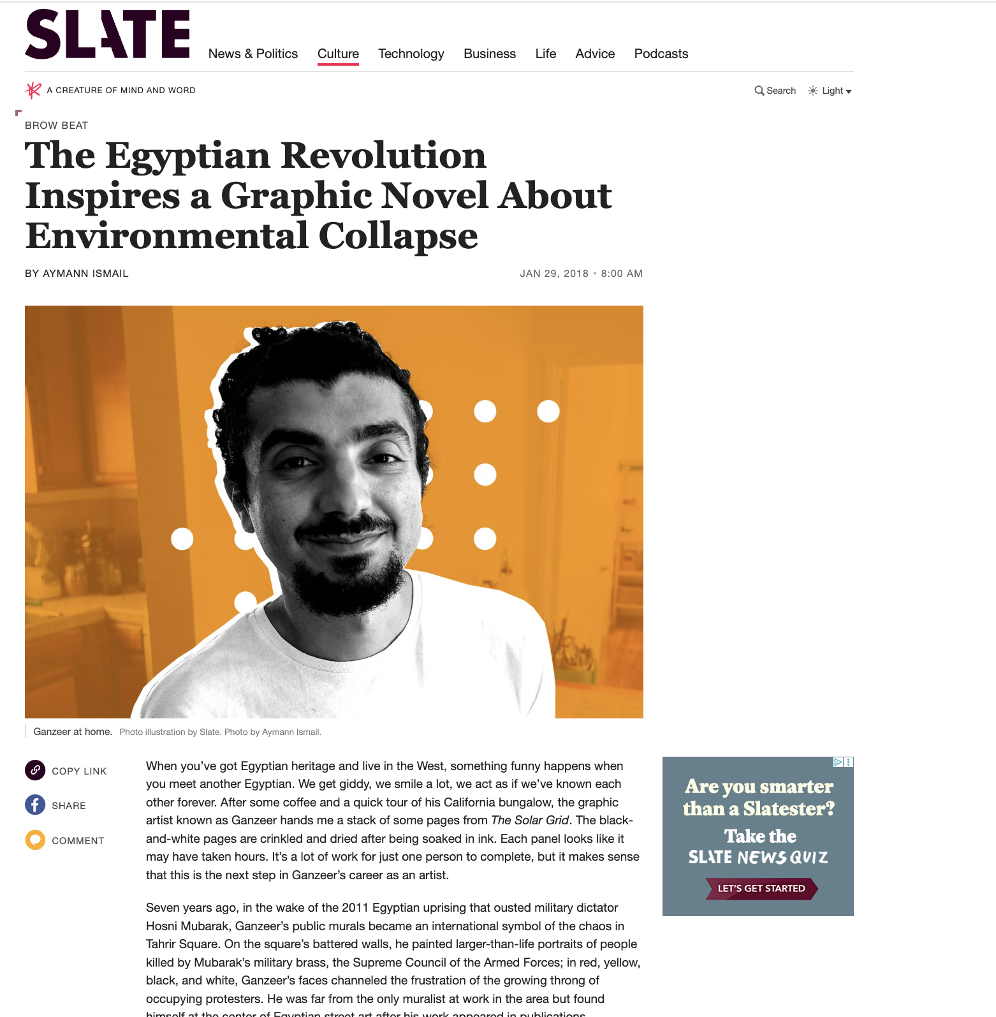
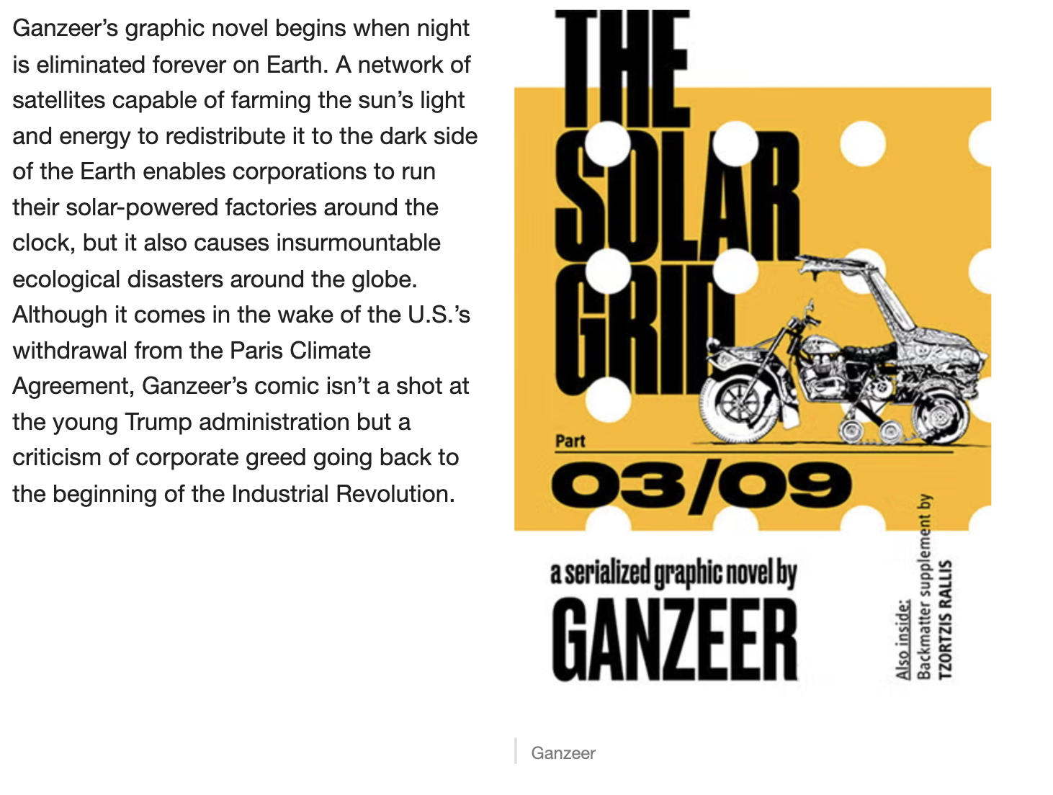

Slide 21
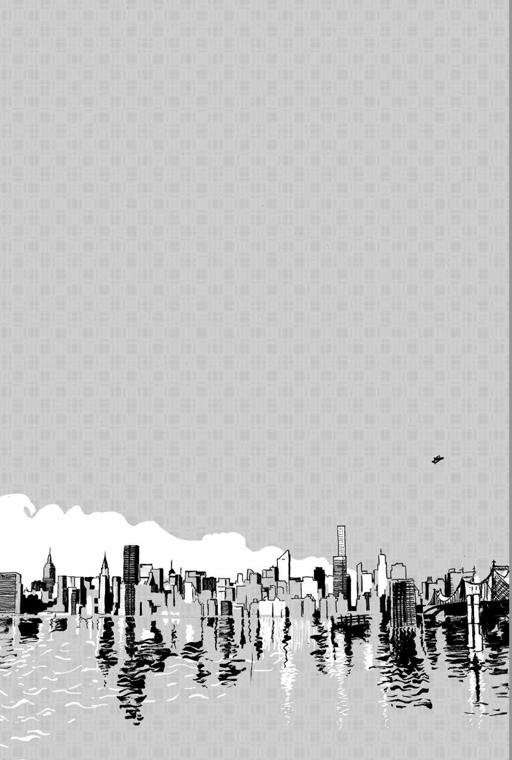
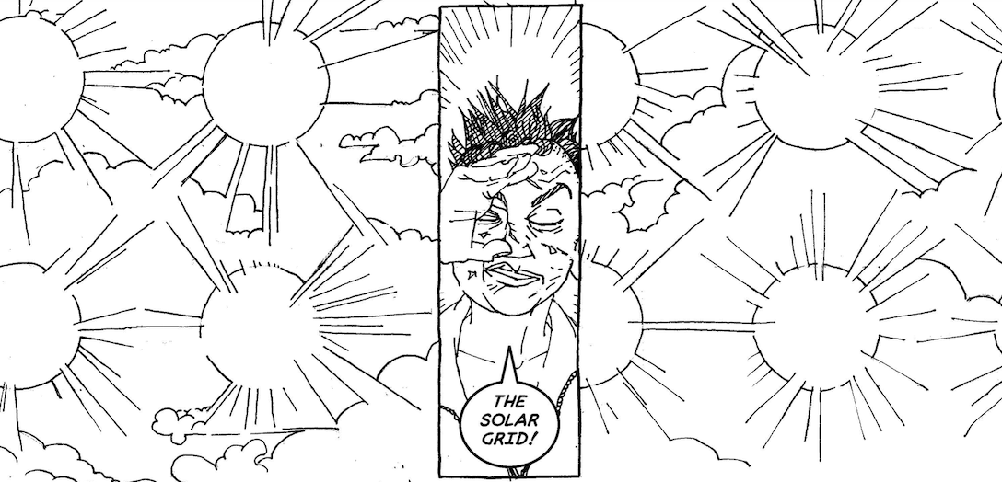

Slide 22
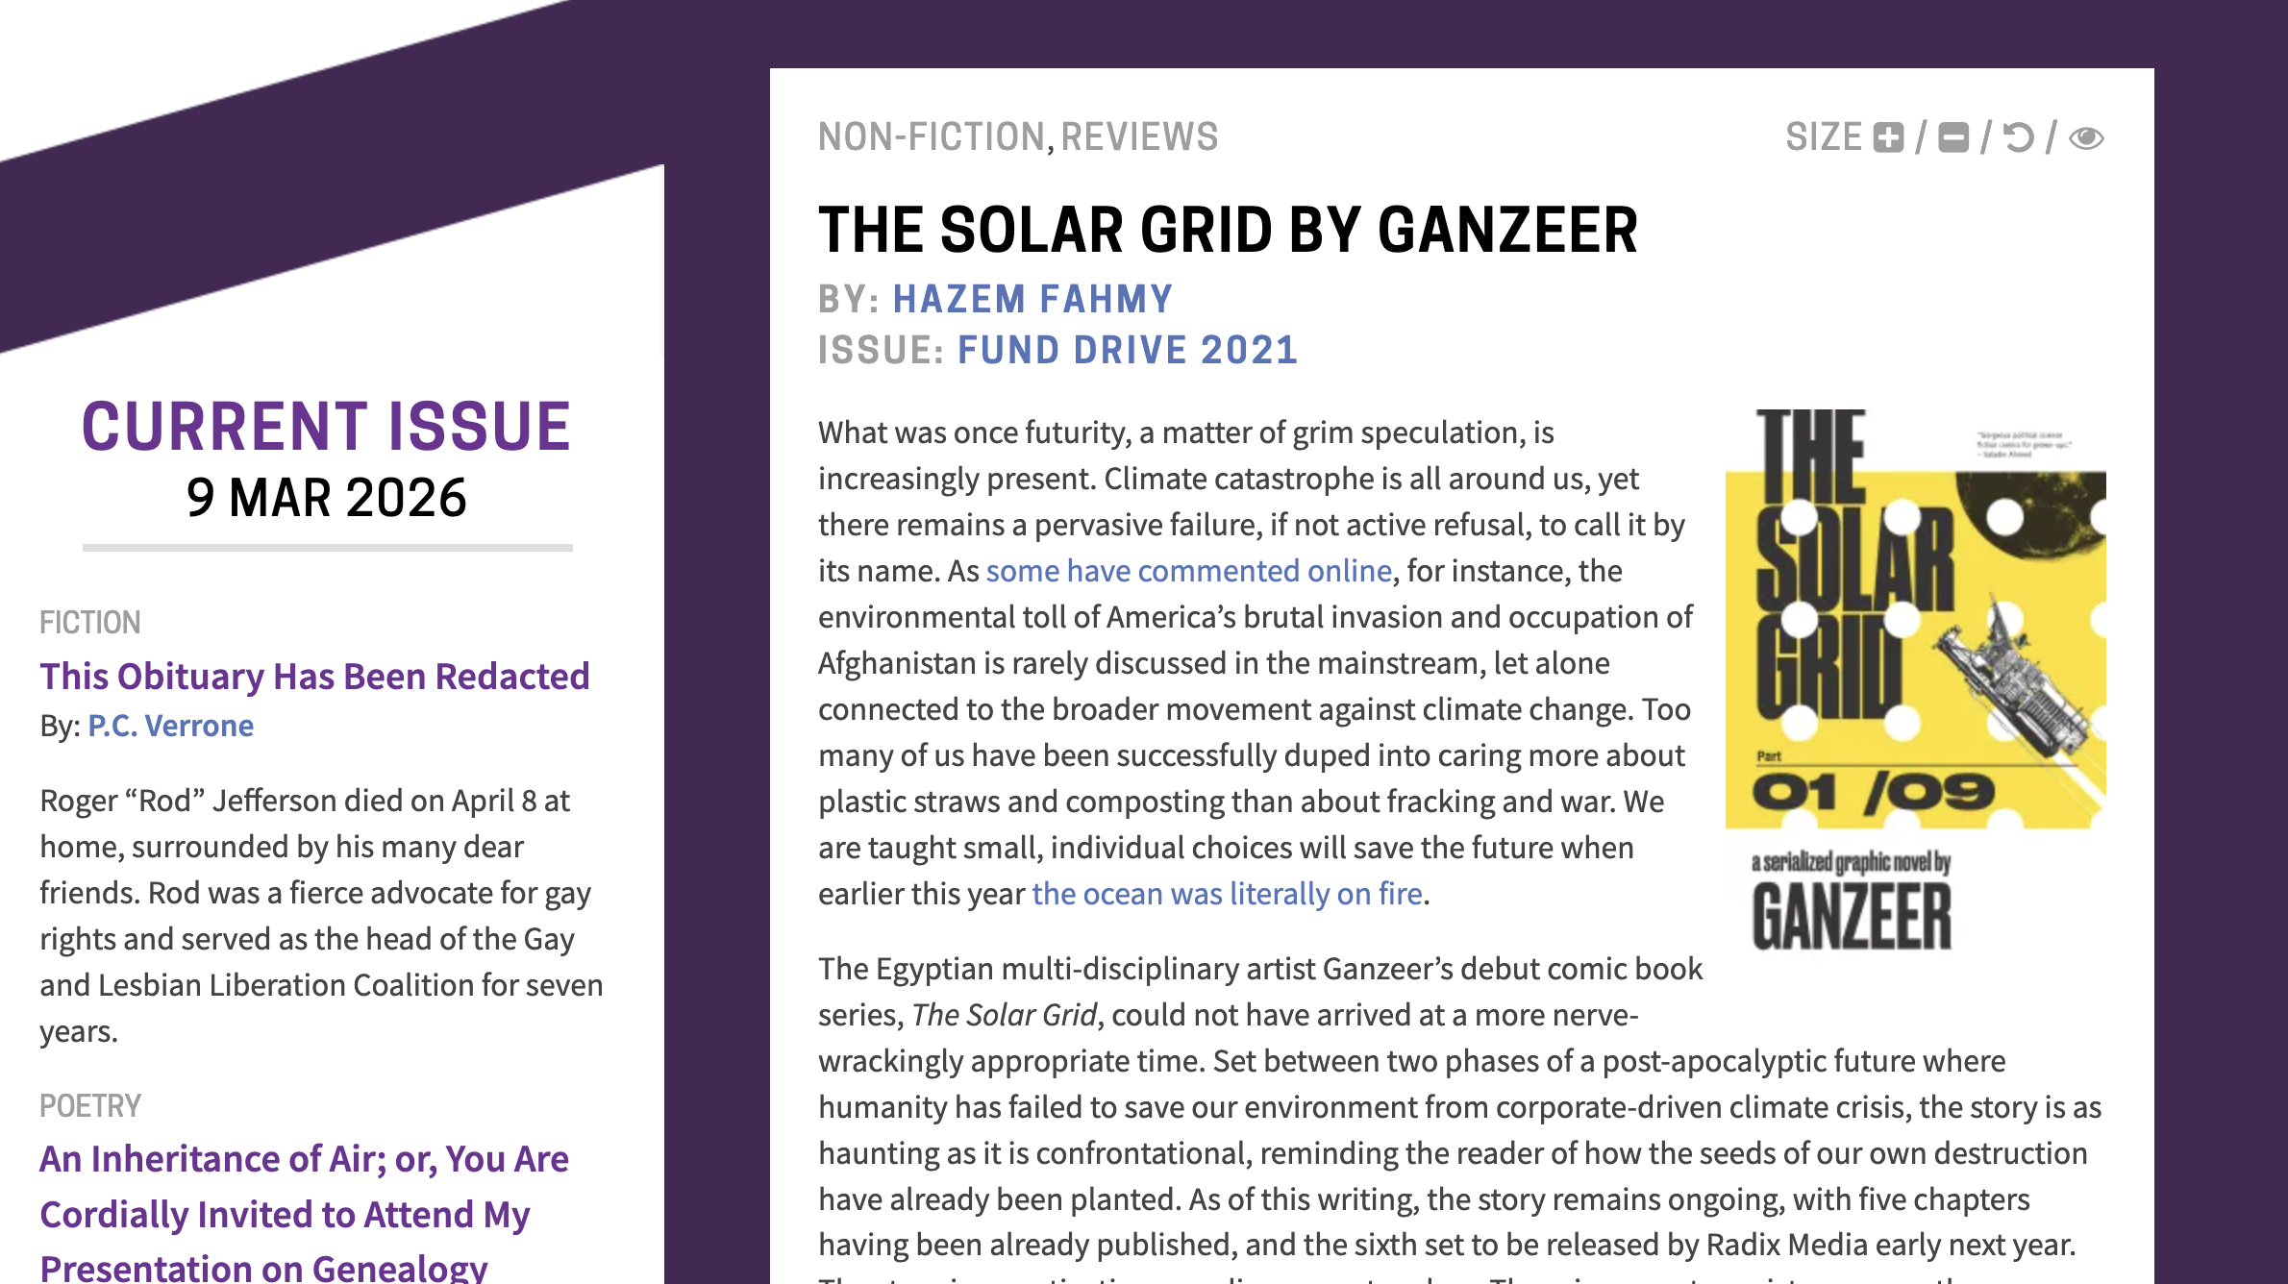

Slide 23

Wanuri Kahui
Kenya (2010)

Slide 24
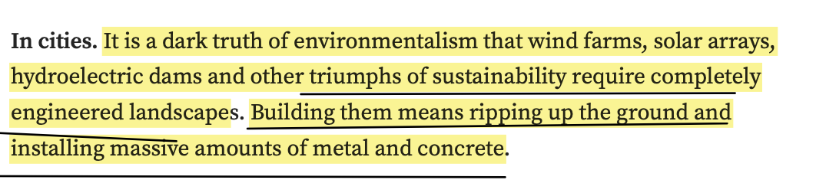
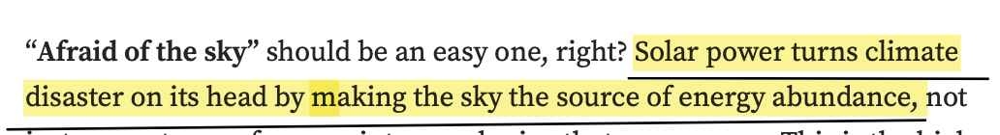
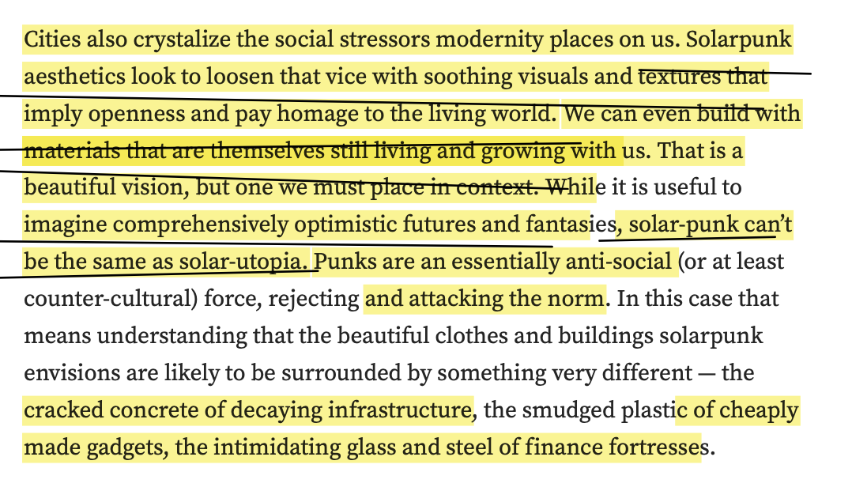
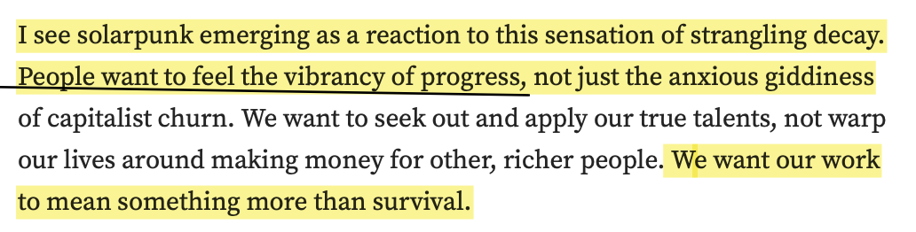
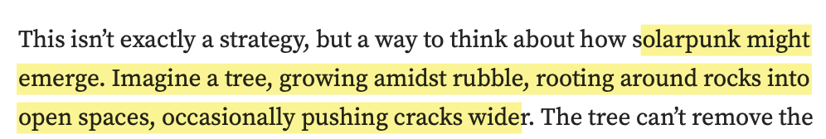

Slide 25
Solarity, then, requires a reckoning with our material and affective attachments to the present. For those of us in the overdeveloped world living lives of hyperconsumption, shame, guilt, and anger are often our first emotional responses to the climate crisis. Solarity asks for much more: it demands a radical hope as well as a radical reassessment of what, of the present, we might wish to retain as we attempt to rescue our future.
The promise of solarity’s redistribution must contend not only
with the temporal and spatial logics of the sun’s radiation but also
with the forms of technological and infrastructural mediation required
to convert solar energy into electrical energy. It also requires
us to overcome decades of negative campaigning by the many-tentacled
arms of the fossil fuel complex, from media to politics, that have not
only consistently emphasized—falsely and heinously—its material limits
but also preposterously claimed it as destructive to industry, environment,
and even health.

Slide 26
But today, this desire cannot be disentangled from an impetus to
overturn the prevailing energy order and its coextensive injustices.
Petroculture is premediating the way solarity unfolds. The utopian
aspirations of solarity will be informed by global oil’s history
of social and environmental exploitation. In other words, while
solarity might supplant the petrocultural regime, it is also at risk
of succumbing to its slow violence and necropolitics. What seems
certain is that the transition to solarity will be messy, incomplete,
and unevenly distributed.
What will solarity mean if a primary use of the sun as fuel is to power
air conditioners that make it possible (for some) to withstand the sun’s
relentless heat? The desire for infinite and limitless energy seems,
in many ways, too deeply intertwined with capitalist obsessions
with limitless growth that have ignored the needs of the many in
favor of serving the greed of the few. Can the desire for infinite energy
be disentangled from these extractive and oppressive histories of
unfettered growth?
An abundant energy transition would untether our visions of the
good life from narratives of growth and private accumulation and
mobilize behind equitable sharing of energy as a collective good.

Slide 27
We can detect this bright depiction of “solar power” in the
popular image bank of solarity. A quick internet search for “solar
power,” for example, presents standard images of large-scale
Farms and arrays tending toward an aesthetics of gleaming futurity and
industrial-scale possibility. The future is bright and upscaled in such
visions. [Jamie] Cross’s warning, however, of the reality of “green dystopias”
has powerful representative examples in some solar imaginaries.

Slide 28
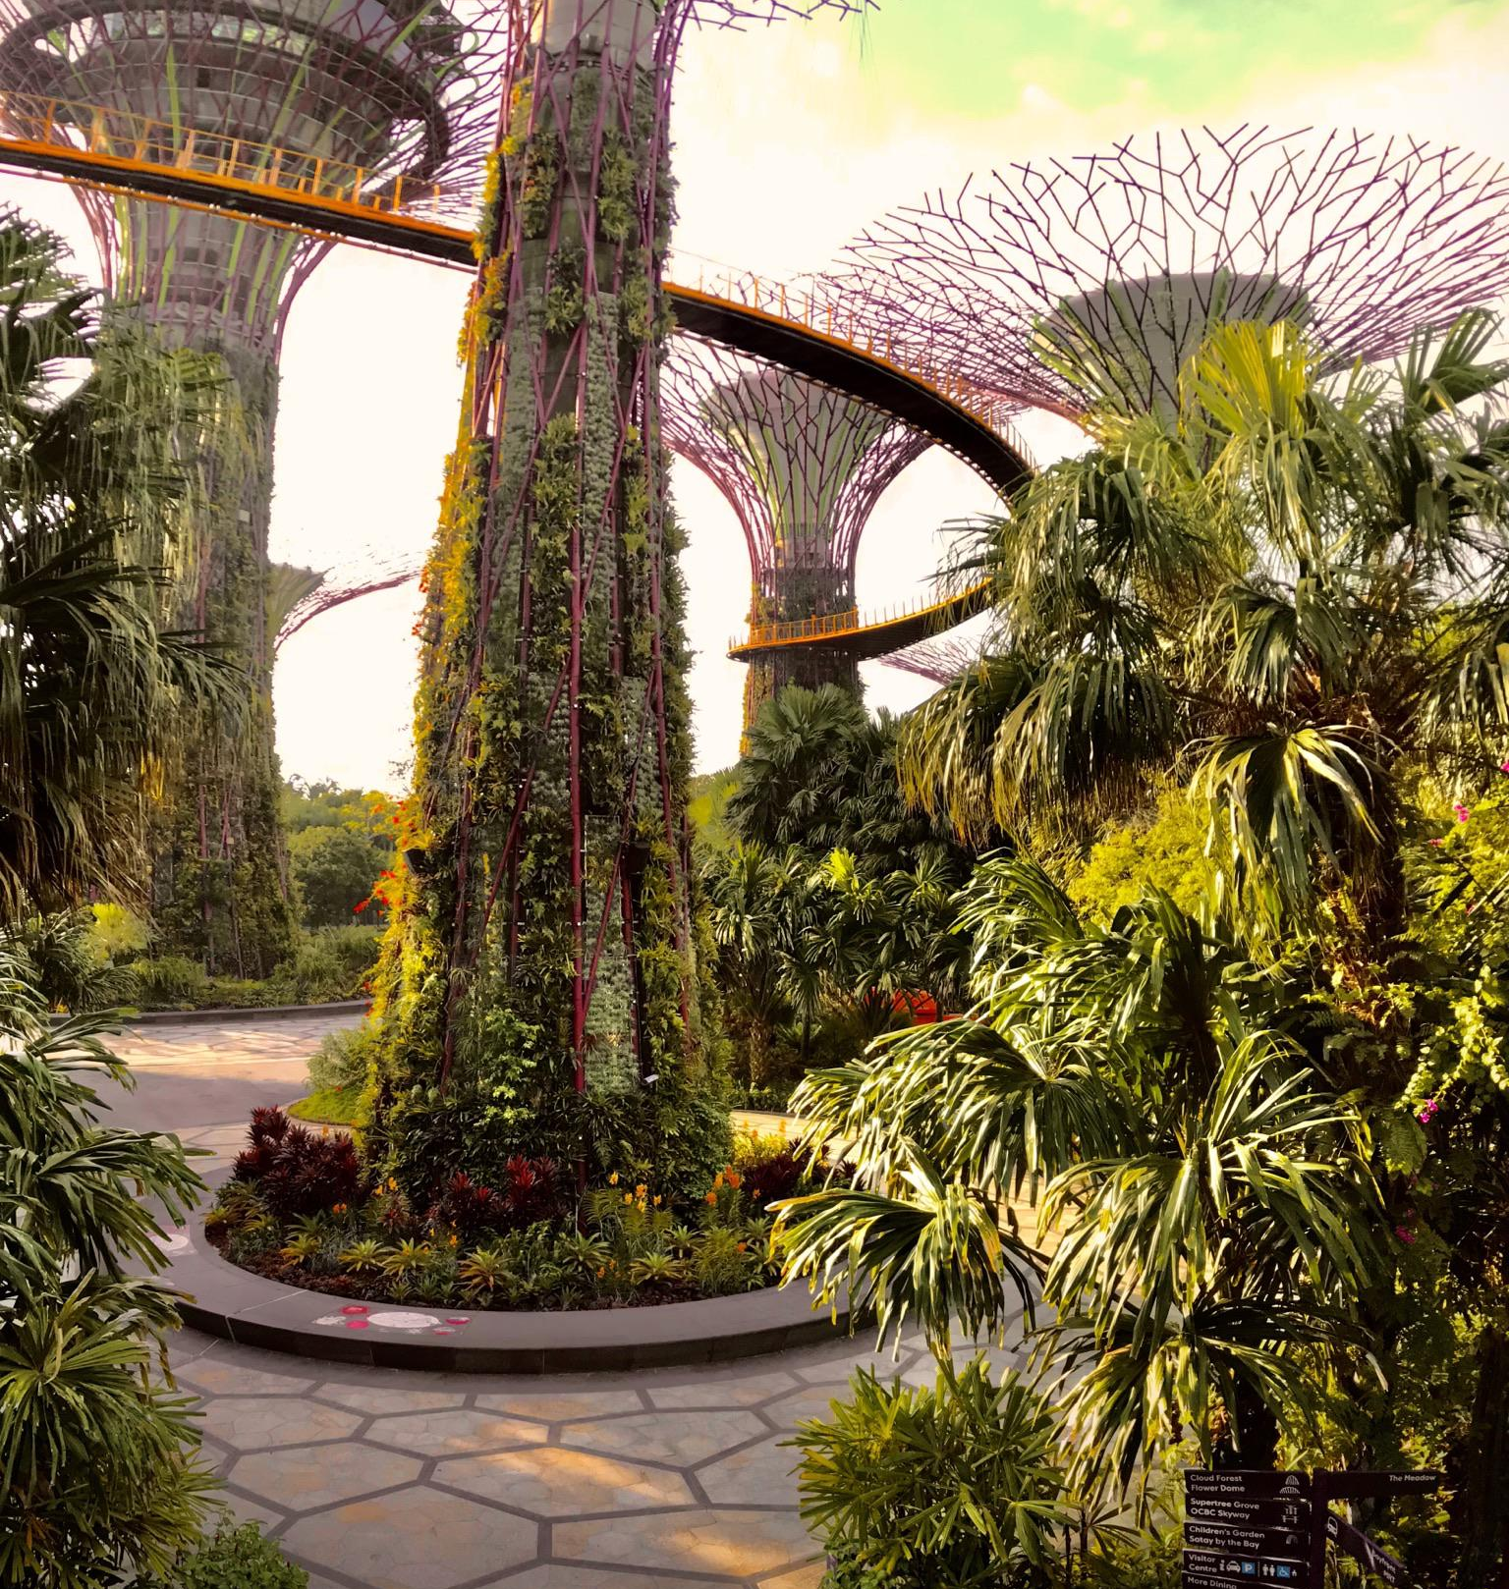
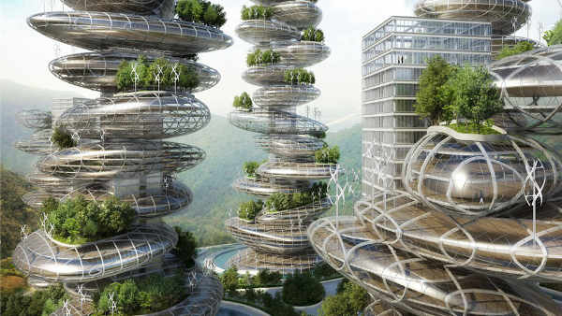
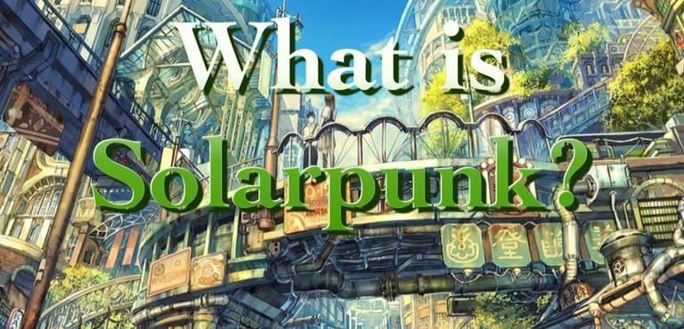
Notes:
or one of the most resonant and historically iconic examples of future city imaginaries - Gerard O'Neill's High Frontier
NEXT SLIDE

Slide 29
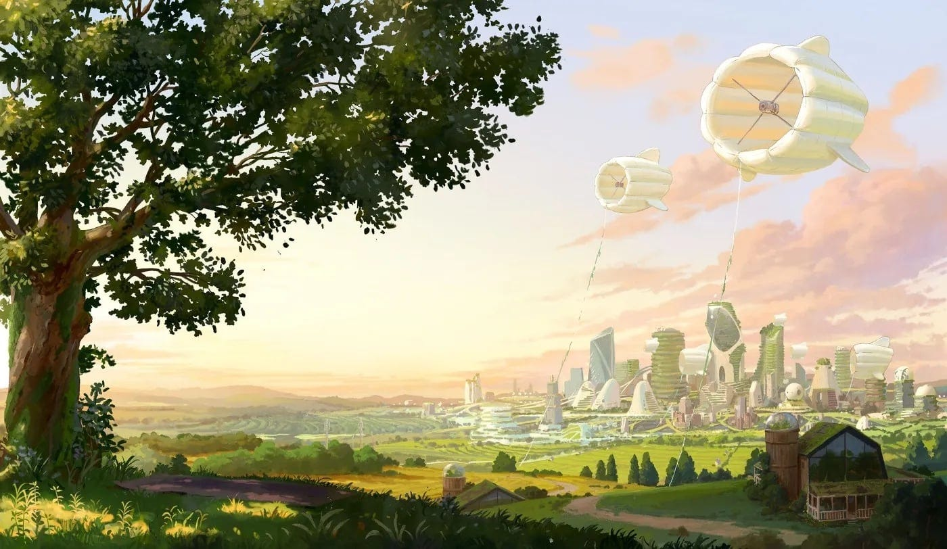

Slide 30


Slide 31
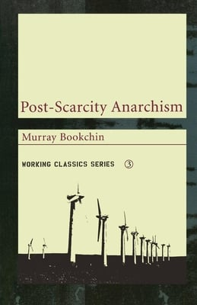
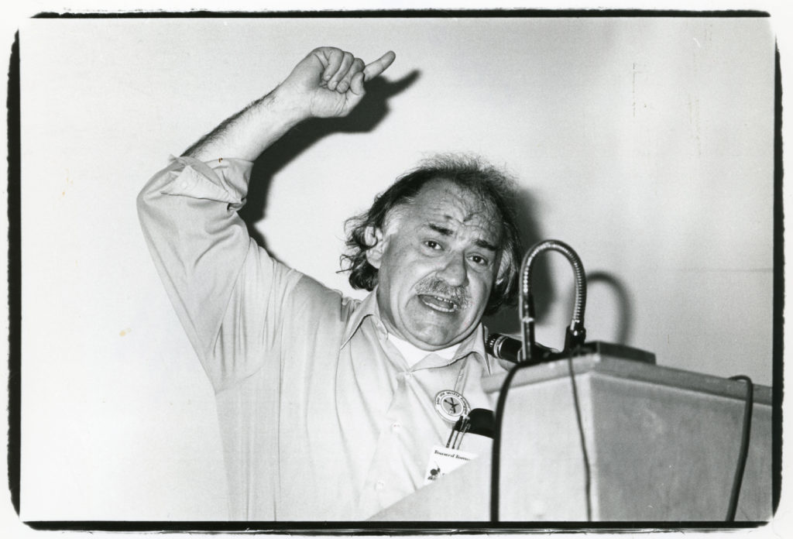


(1971)

Slide 32
One of the imaginaries attached to solar energy is that,
in its universal availability and infinite supply, it does not require
the sorts of mediation necessary for energy to become
fuel. This is precisely what makes it “imaginary.”
An orientation that approaches the sun as a source
of unlimited energy, capable of saving the planet by
replacing fossil-fuels, necessarily implies
infrastructural mediation with specific material
implications.
University of Minnesota Press, Forerunners Series, 2022
(Open Access)

Slide 33

“There seemed always to be breakages and
malfunctions in the small machines that
moved our little riverside world—storms
came through and wrecked the solar panels;
the heat warped the circuitry of our lawn
mowers and generators.” (2017)

Slide 34

Horizon Zero Dawn, Guerilla Games 2017

Slide 35



Slide 36


Slide 37

Andrew Dana-Hudson

Slide 38

“The Wandering Earth”

Slide 39

Bladerunner 2049

Slide 40




Slide 41



Slide 42



Slide 43


Slide 44



Slide 45


Slide 46

Williams, R., (2019) “‘This Shining Confluence of Magic and Technology’: Solarpunk, Energy Imaginaries, and the Infrastructures of Solarity”, Open Library of Humanities 5(1), 60. doi: https://doi.org/10.16995/olh.329

Slide 47

“They're all over the place. That gorgeous, beautiful Pennsylvania countryside they got these big ugly suckers hanging down.”
“They're rusting and rotting, half of them weren’t spinning and the ones that were, were going so slow… it’s not too windy but you know they're going like slow the other ones were just dead.”
“The wind, the wind it sounds so wonderful. The wind is bullshit.”
Donald Trump, Campaign Speech, Pennsylvania, October 2024
The Wandering Earth

Slide 48


Slide 49

Whitelee Wind Farm, South Glasgow

Slide 50


Slide 51



Slide 52

Instead of thinking abstractly about epistemology or on a global scale in
terms of climate models, we focus our perspective on a neighbourhood
and try to imagine quotidian life under Half-Earth socialism. What would
it be like to work without the threat of unemployment? How would
economic coordination function without money or a market? What
might it be like to live in a world where nature can recover because
half the planet has been rewilded? What does it mean to live in a society
where the economy is consciously and democratically controlled?
The first is as a prospectus outlining what would be necessary to
transcend the environmental crisis. Some and therefore we
invite them to use the book a second way, as a guide to utopian thought
experiments.
For too long the Left has been better at critique than creating its own
positive proposals.

Slide 53


Slide 54


Slide 55

Terraforming is the process—at this point, entirely hypothetical and theoretical—by which a planet or a moon could be altered so as to make it able to support life, possibly human life. Sometimes termed "planetary ecosynthesis" by environmental scientists and interplanetary astronomers, terraforming would involve using extreme modification technologies, most of which do not even exist yet save in theory, to change the atmosphere, the temperature, even the surface configurations of a planet or moon in order to convert it into an environment that would support the particular biological needs of human beings. Although the concept of terraforming originated in science fiction, it is now the subject of serious scientific speculation. Concerns over the growing and unchecked damage to the Earth’s ecosystem, seen by many scientists as irreversible, have led scientists to consider how terraforming might actually work, as humanity is seen more and more as needing to find a backup planet when, not if, Earth is no longer habitable.
Joseph Dewey, “Terraforming”, Salem Press Encyclopedia of Science, 2020

Slide 56


Slide 57


Slide 58


Slide 59







Slide 60


Slide 61


Slide 62


Slide 63




Slide 64

Week Ten
Futures

Slide 65

Notes:
What do you want? This? Or……FINAL SLIDE MAD MAX (AND GO BACK AND FORTH)

Slide 66


Slide 67

Wall E, Pixar, 2008

Slide 68

There is no need to rehearse the details of the human
tragedy that occurred; every schoolchild knows of the terrible
suffering. Suffice it to say that total losses—social, cultural, economic, and demographic—were greater than
any in recorded human history. Survivors’ accounts make
clear that many thought the end of the human race was
near.
BUT JAPANESE LICHEN SAVES US…..
However, around 2090 (the date cannot be determined
from extant records), something occurred whose exact
character remains in dispute. Japanese genetic engineer
Akari Ishikawa developed a form of lichenized fungus in
which the photosynthetic partner consumed atmospheric
CO2 much more efficiently than existing forms, and was
able to grow in a wide diversity of environmental conditions.
This pitch-black lichen, dubbed Pannaria ishikawa,
was deliberately released from Ishikawa’s laboratory,
spreading rapidly throughout Japan and then across most
of the globe. Within two decades, it had visibly altered
the visual landscape and measurably altered atmospheric
CO2, starting the globe on the road to atmospheric recovery
and the world on the road to social, political, and economic
recovery.

Slide 69



Slide 70


Slide 71
[The] Unified Nations Convention on Climate Engineering and
Protection (UNCCEP)…began preparing blueprints
for the International Climate Cooling Engineering Project
(ICCEP).
As a first step, ICCEP launched the International
Aerosol Injection Climate Engineering Project (IAICEP,
pronounced ay-yi-yi-sep) in 2052.25 Sometimes called the
Crutzen Project after the scientist who first suggested the
idea in 2006, projects like this engendered heated public
opposition when first proposed in the early twenty-first
century but had widespread support by mid-century—
from wealthy nations anxious to preserve some semblance
of order, from poor nations desperate to see the world do
something to address their plight, and from frantic lowlying
Pacific Island nations at risk of being submerged by
rising sea levels.
IAICEP began to inject submicrometer-size sulfate
particles into the stratosphere at a rate of approximately
2.0 teragrams per year, expecting to reduce mean global
temperature by 0.1 degrees Celsius annually from 2059 to
2079. (In the meantime, a substantial infrastructural conversion
to renewable energy could have been achieved.)

Slide 72


Slide 73
Notes:
What do you want? This? Or……FINAL SLIDE MAD MAX (AND GO BACK AND FORTH)

Slide 75

“Mars was empty before we came”
Red Mars

Slide 76


Slide 77
We don’t know yet how to live in solarity; we are not, and don’t
know how to be, solar subjects. The world that would produce such
a subject has not (yet) come into being. That leaves us in a position of
radical insecurity, where our knowledges, embedded in practice and
habit and tradition, concretized in our infrastructures, articulated
in our politics, are insufficient, improper, polluted, and polluting.
Solarity confronts us with the challenge of learning to live and do and
think and love again, to hold ourselves askance to the world
we knew, to estrange ourselves from both the world we know and
ourselves, to begin to be differently and to build differently.
A key difficulty here is the willed relinquishing of expertise. We
have learned how to successfully be in the world.

Slide 78


Slide 79

Robert Montgomery

