Slide 1
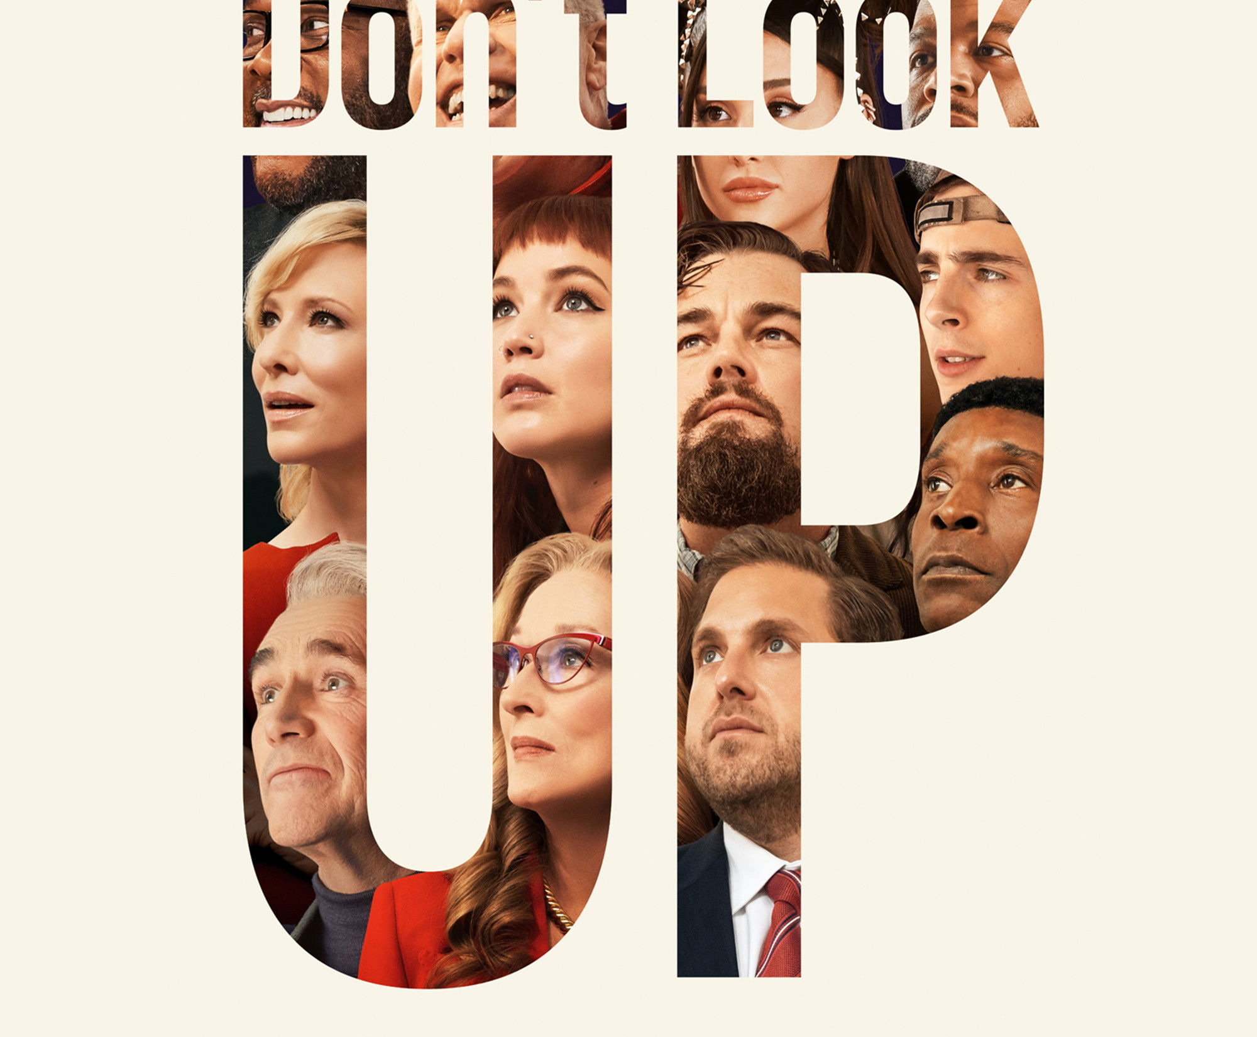

Climate Imaginaries
Week Five : Denial
Don’t Look Up
(Dir. Adam McKay, 2021)

Slide 2
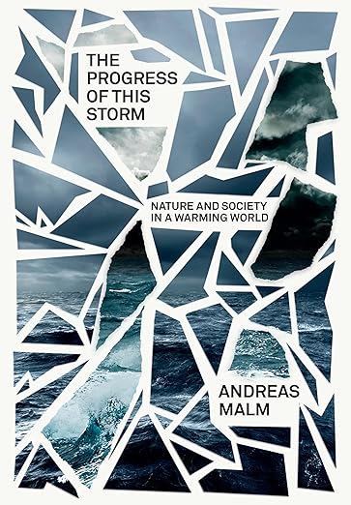
The warming condition is still, however, far from constituting a total ‘cultural logic’ in Jameson’s “sense. Indeed, climate fiction (or cli-fi) in film and literature notwithstanding, one might argue that most culture still ignores the facts of global warming and that denial is the real hallmark of the present.
Moreover, denial, particularly in its suppressive and obsessive forms, is a negative confirmation. It suggests that the thing is there, everywhere, only just below the surface, a distressing presence in the collective subconscious – perhaps global warming is, to use another term of Jameson’s, a political unconscious that already pervades culture.

Slide 3
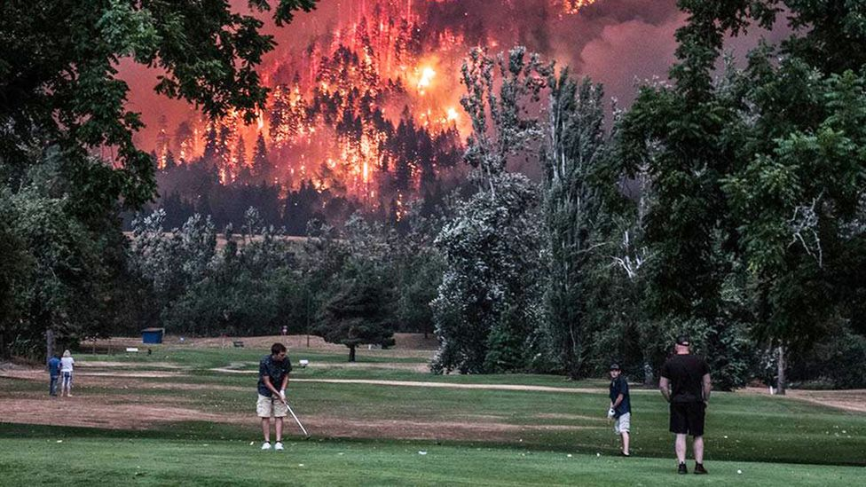
Kristi McCluer/Reuters, Eagle Creek Fire, Oregon, 2017

Slide 4
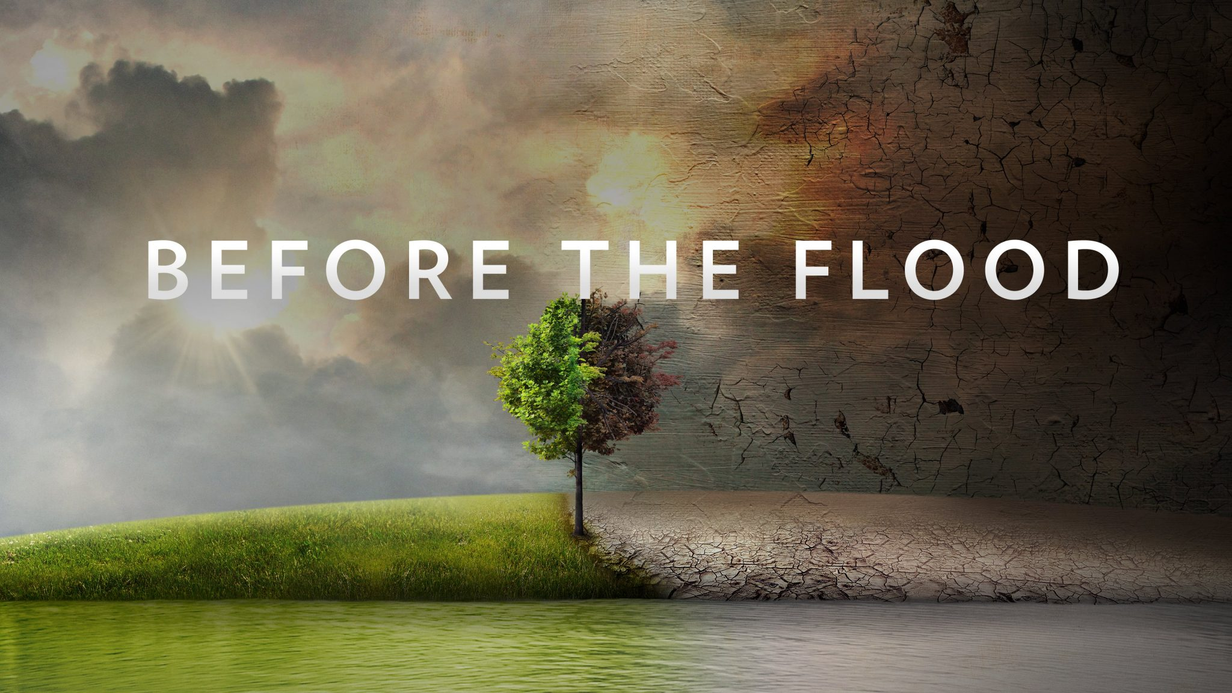
2016

Slide 5
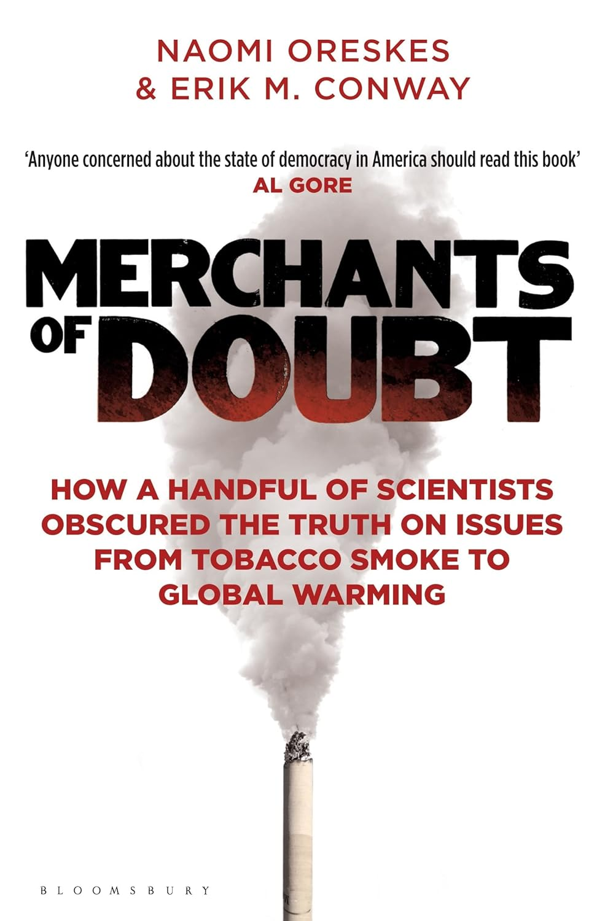
(2012)

Slide 6
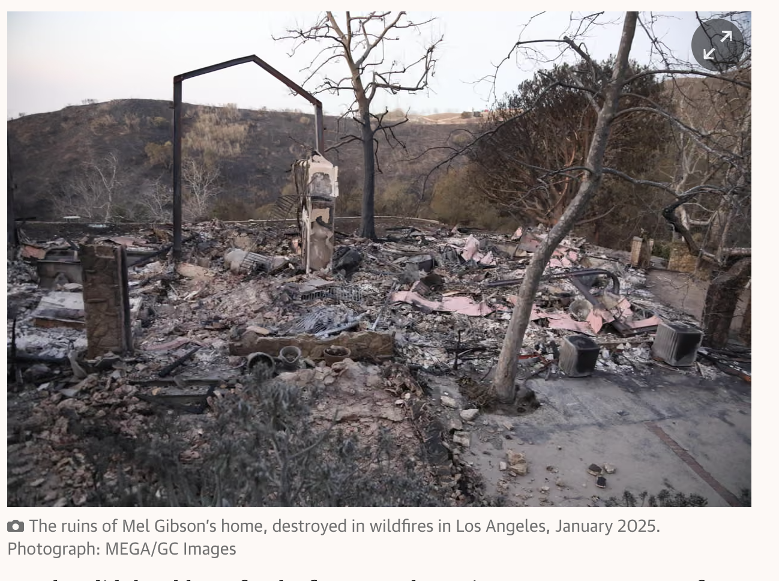
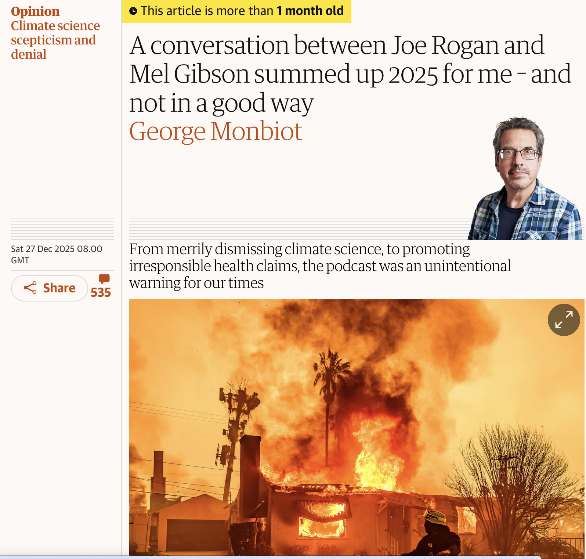
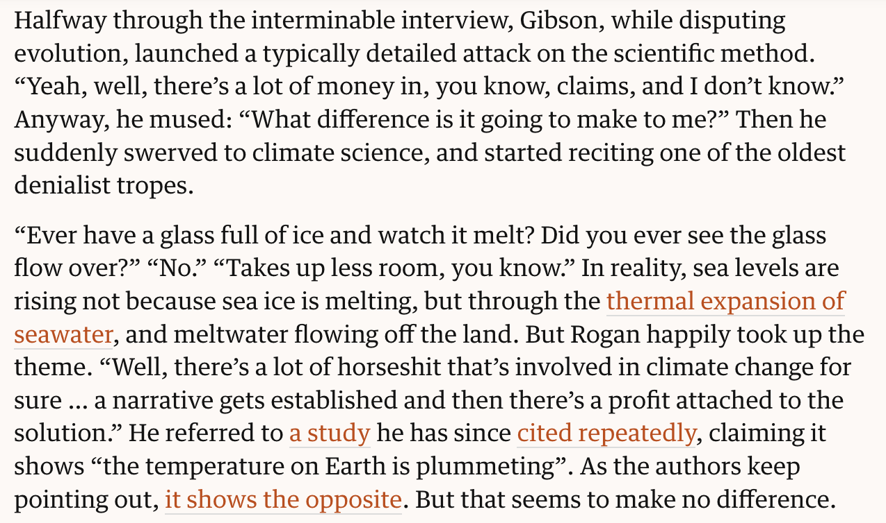

Slide 7
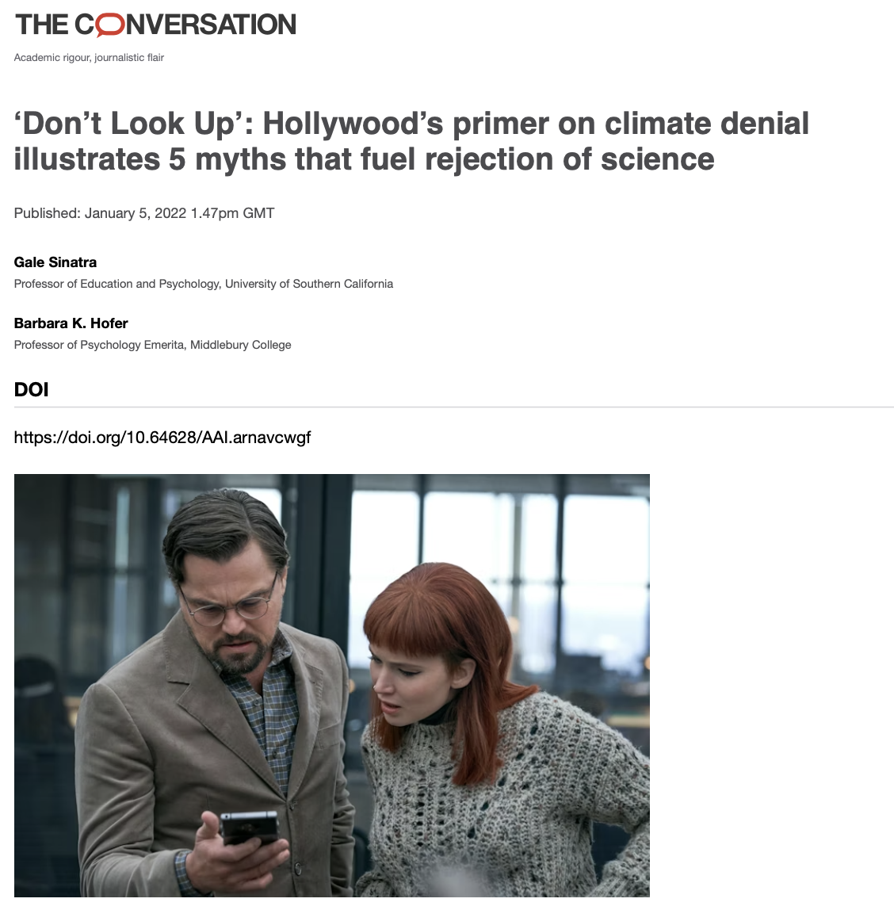
Myth #1: We can’t act unless the science is 100% certain
Myth #2: Disturbing realities as described by scientists are too difficult for the public to accept
Myth #3: Technology will save us, so we don’t have to act
Myth #4: The economy is more important than anything, including impending crises predicted by science
Myth #5: Our actions should always align with our social identity group

Slide 8
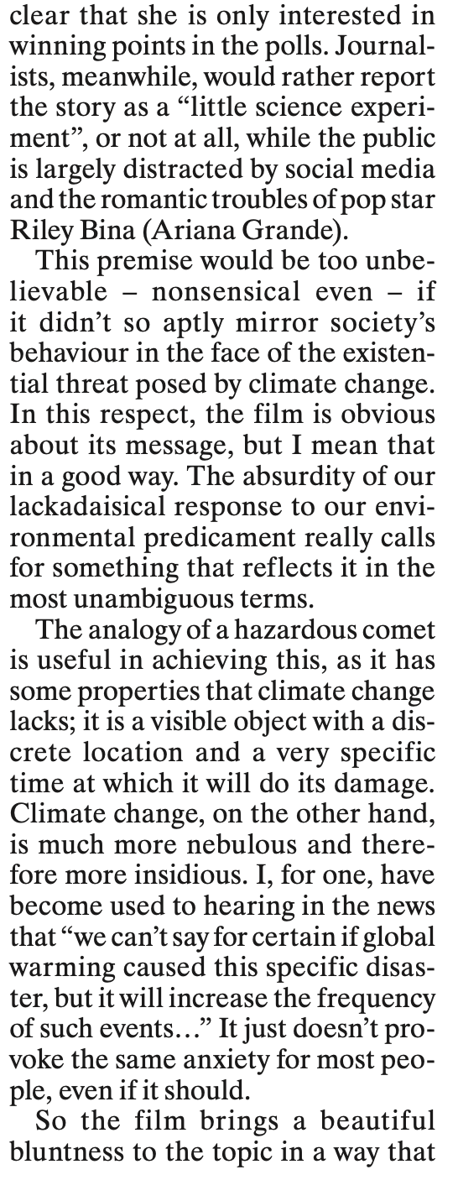
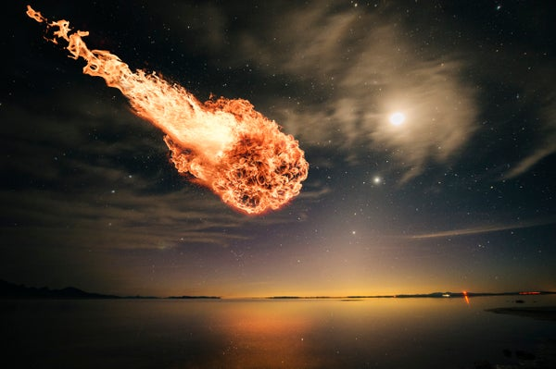
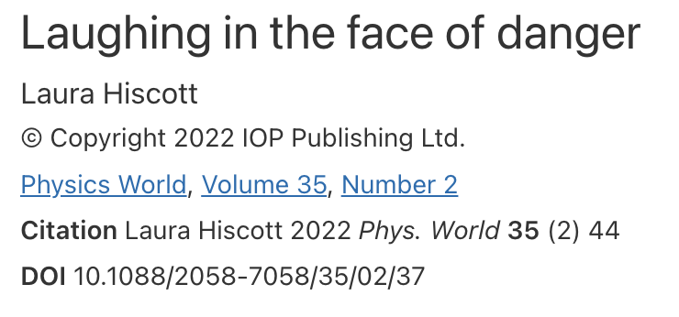

Slide 9
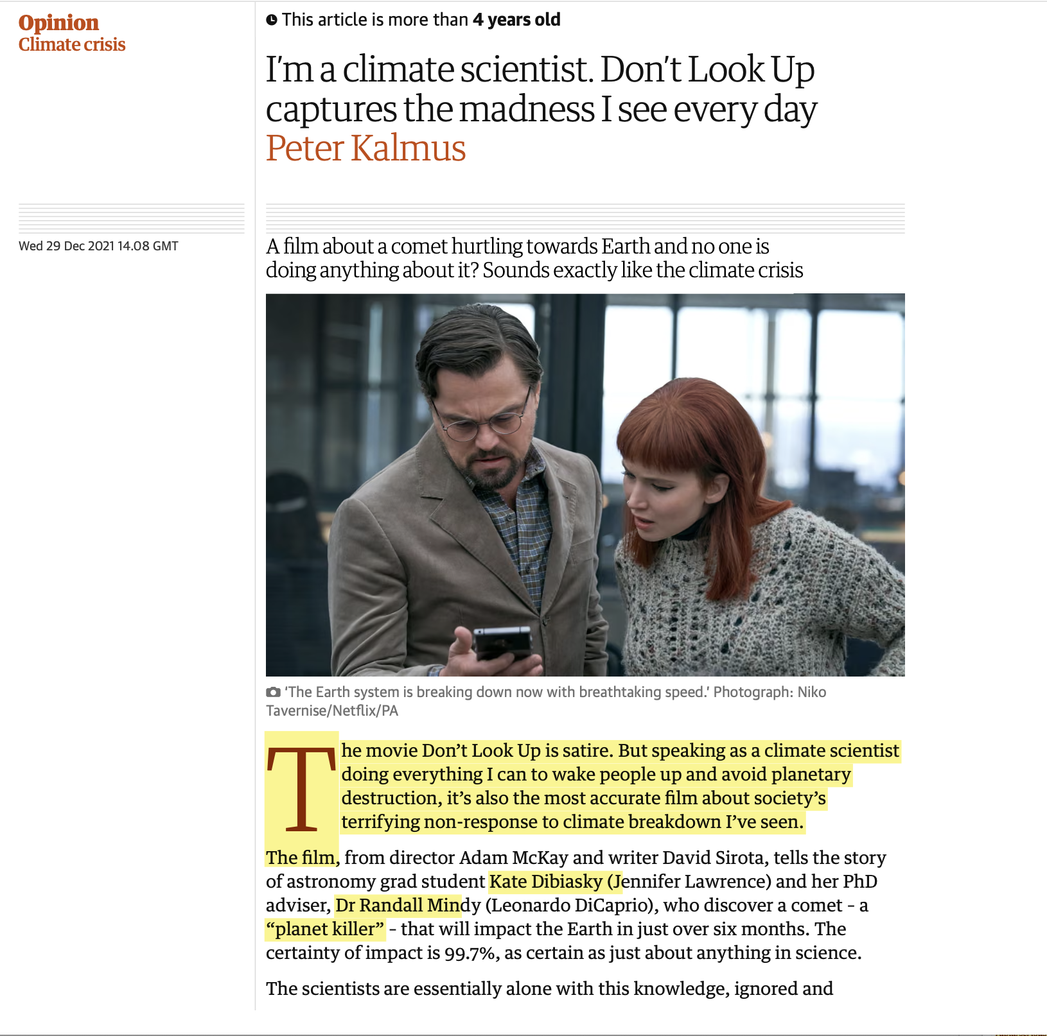
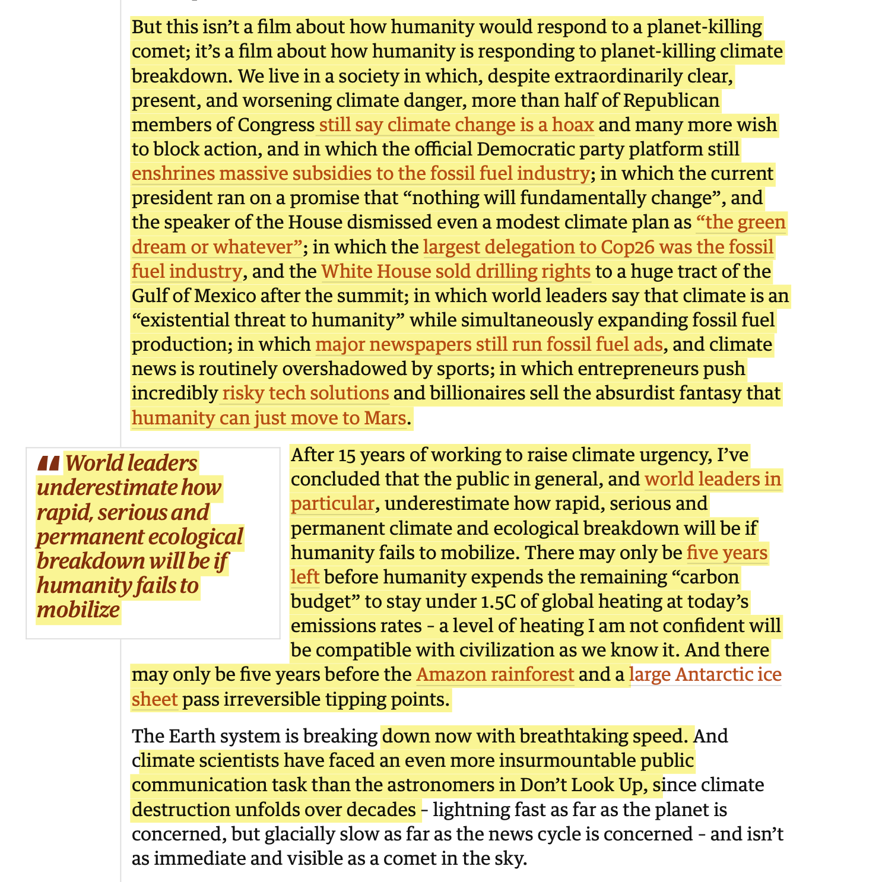

Slide 10
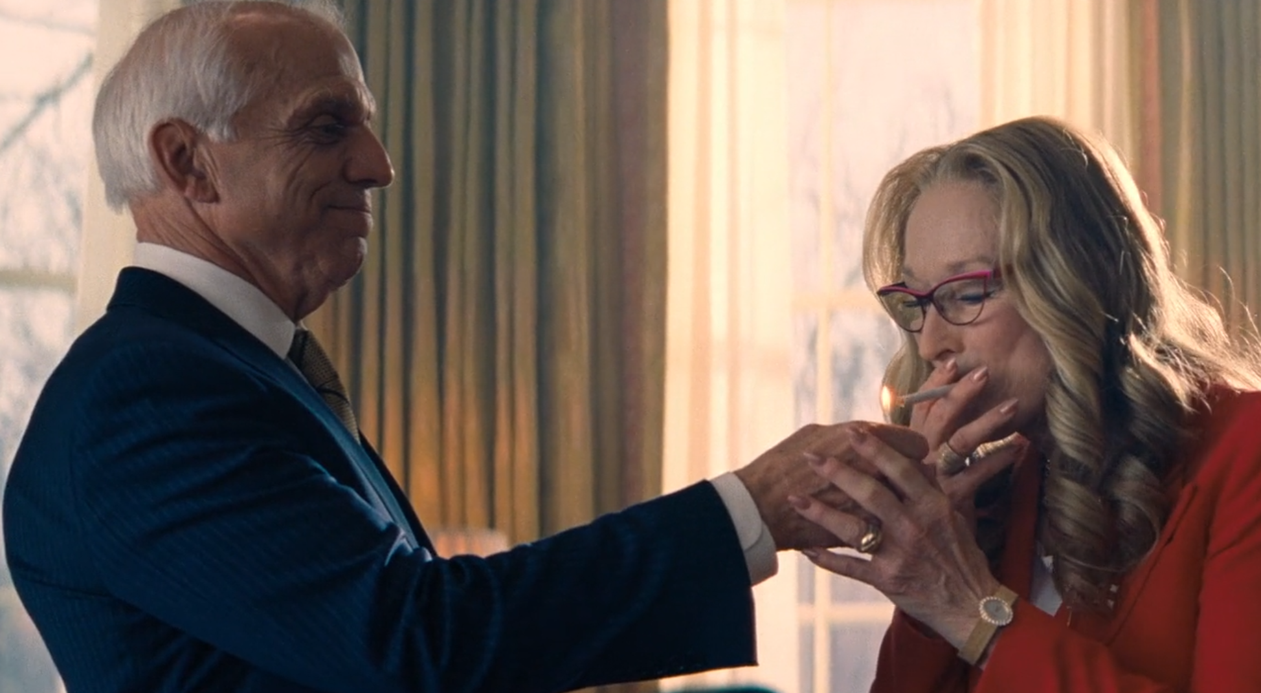
Politics…….

Slide 11
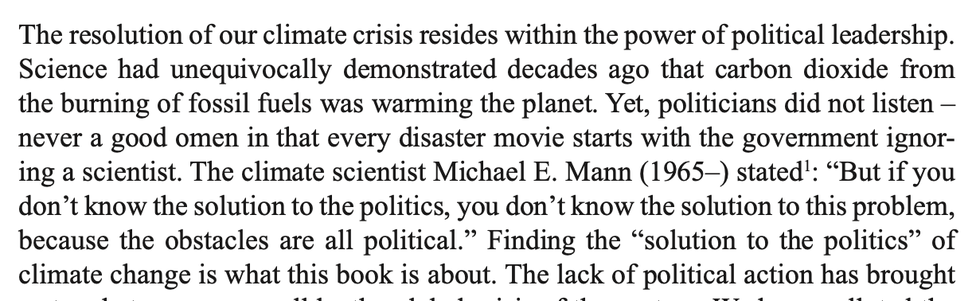

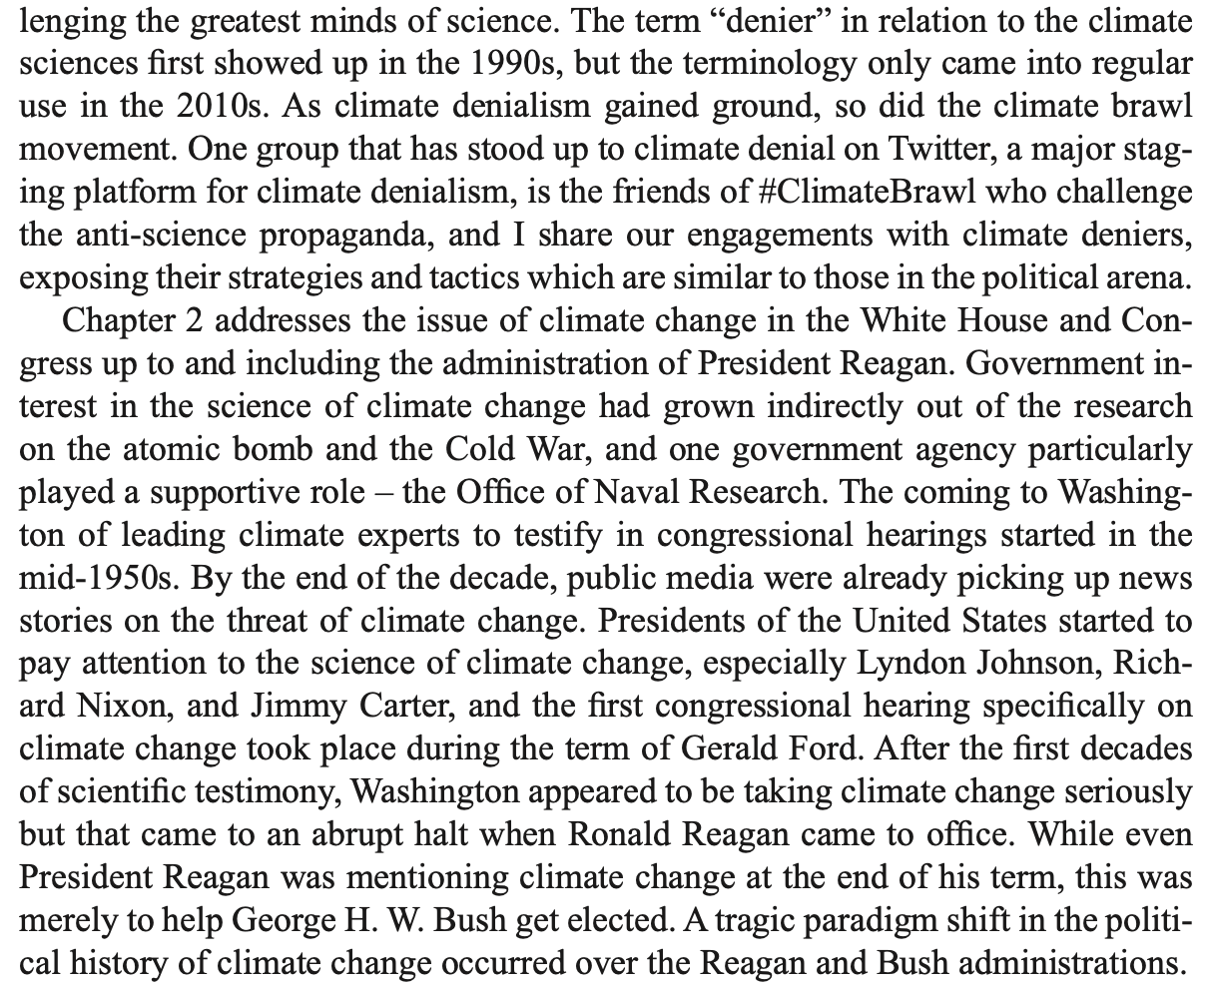
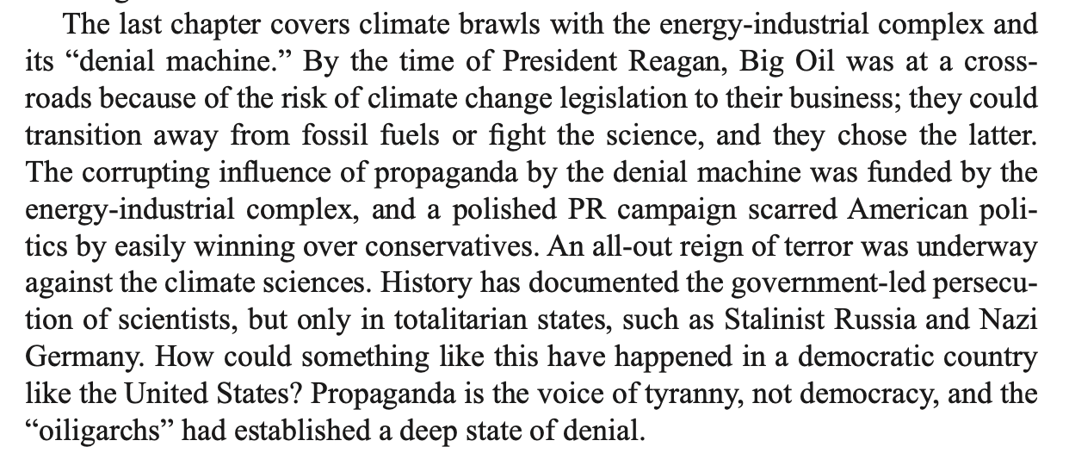

Slide 12

Media….

Slide 13
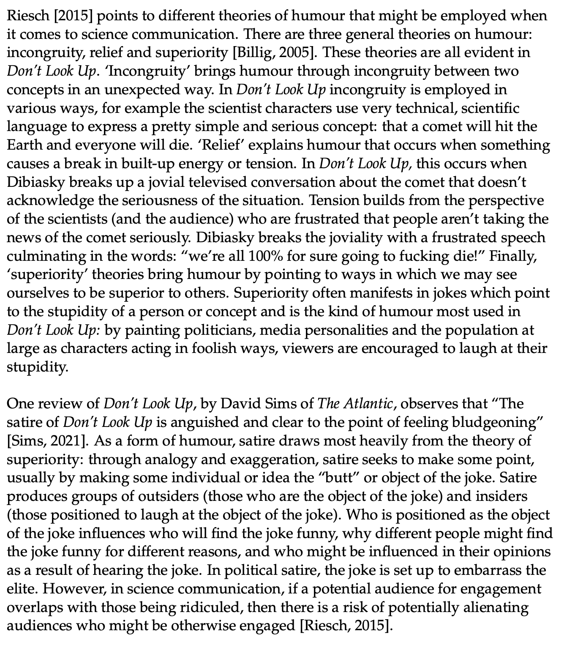
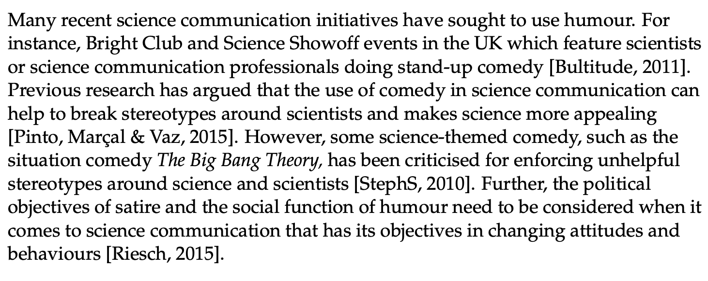
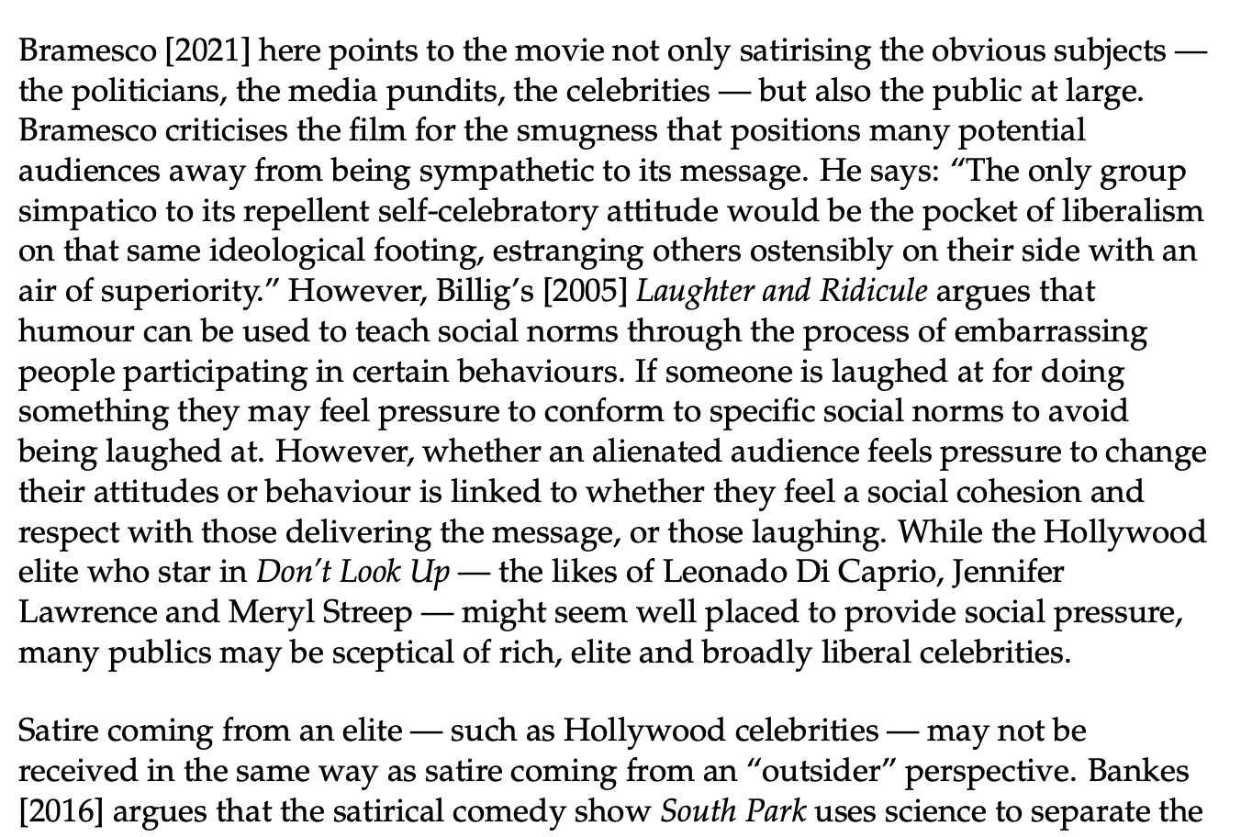

Slide 14
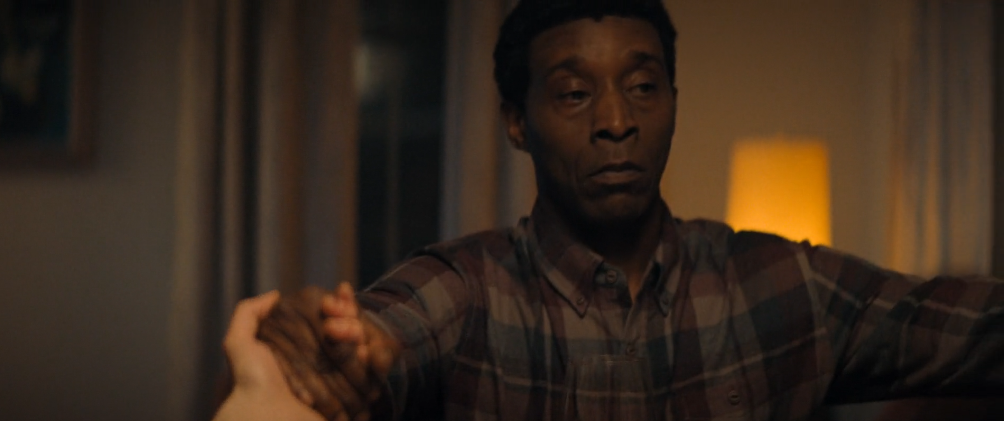
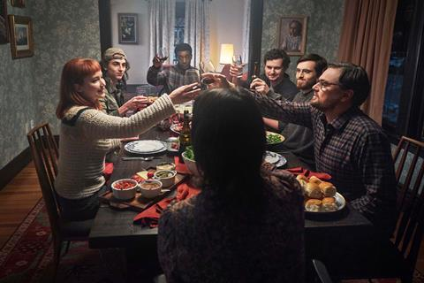
Community and Coalition…

Slide 15
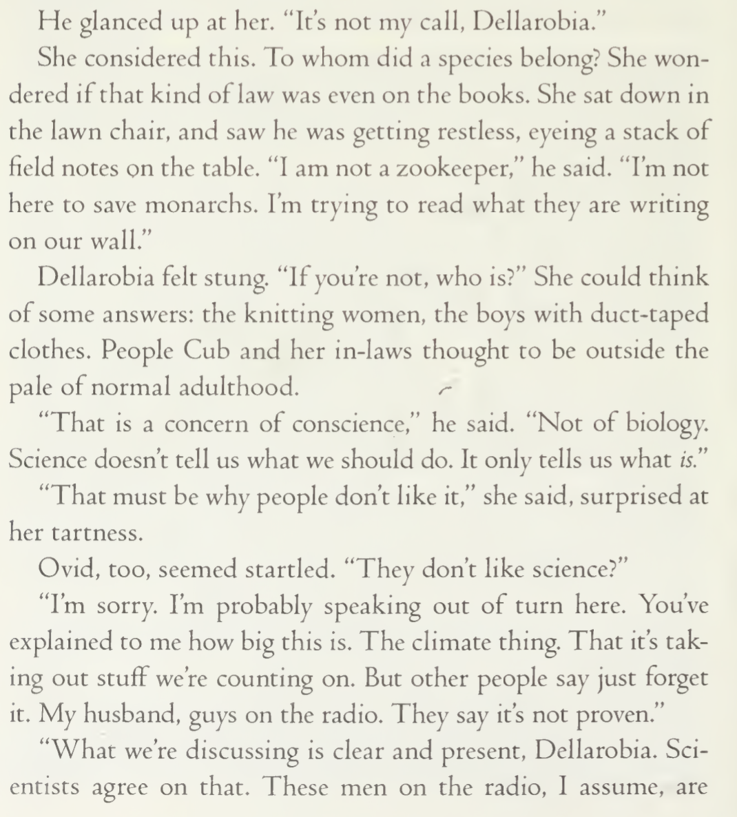
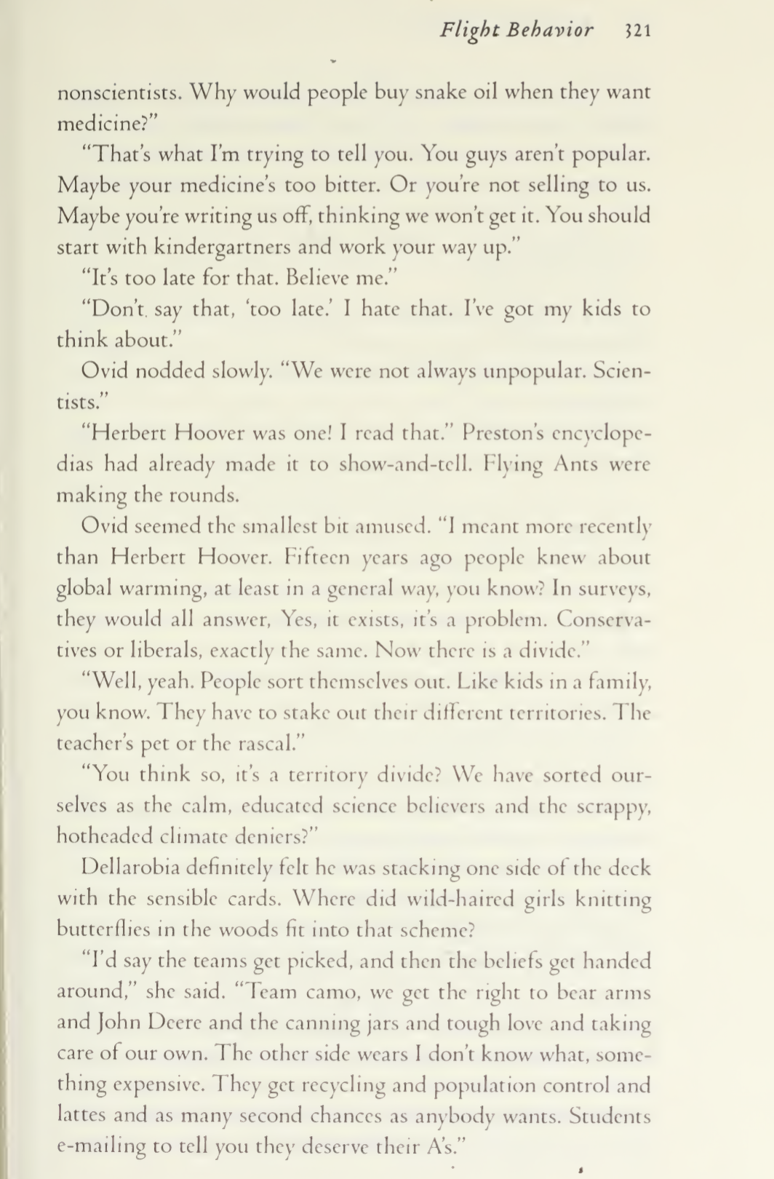


Slide 16
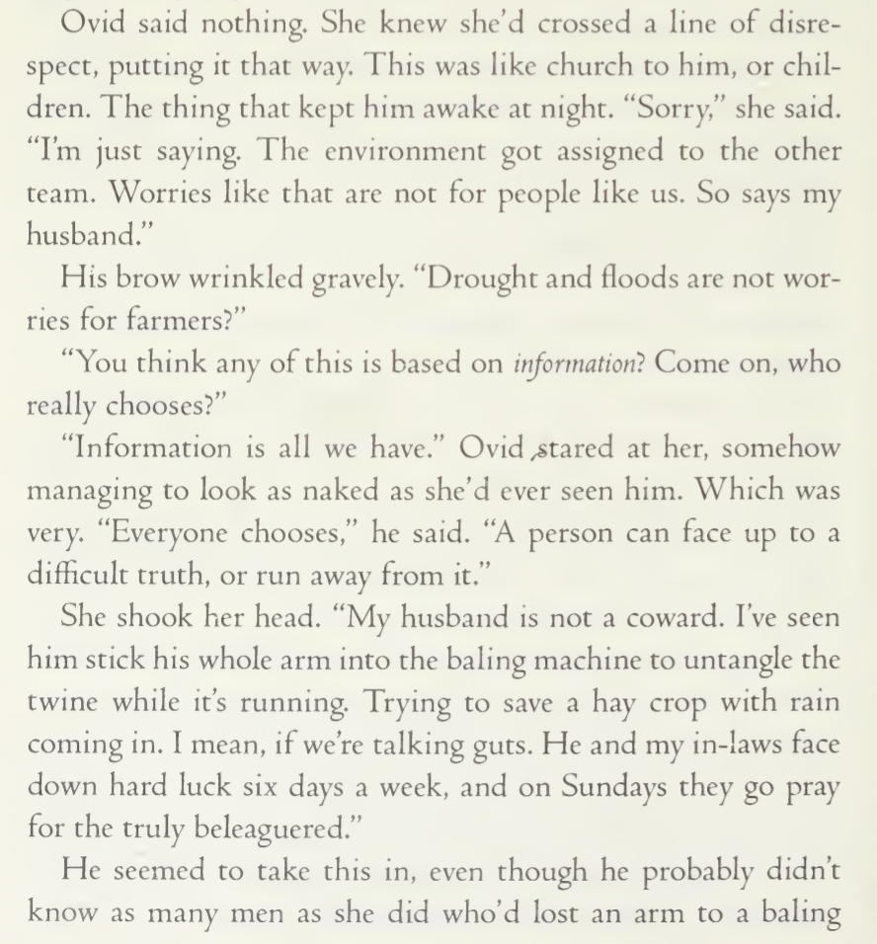
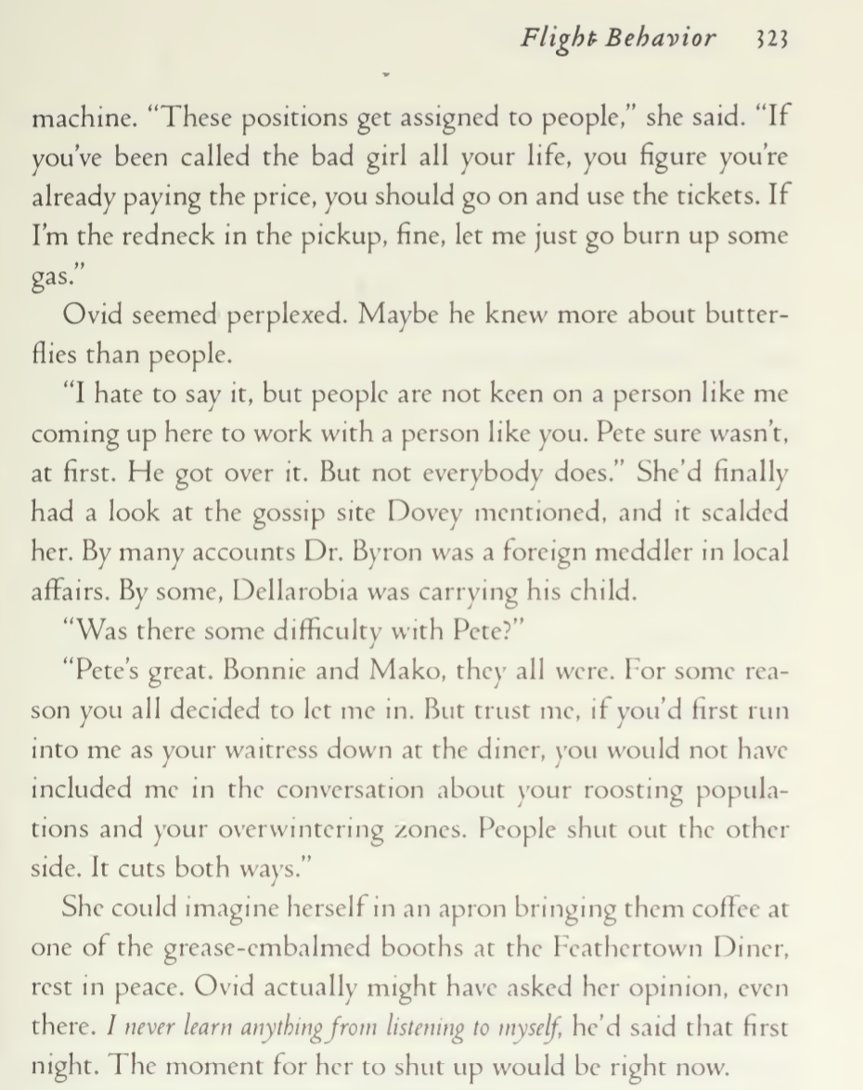

Slide 17
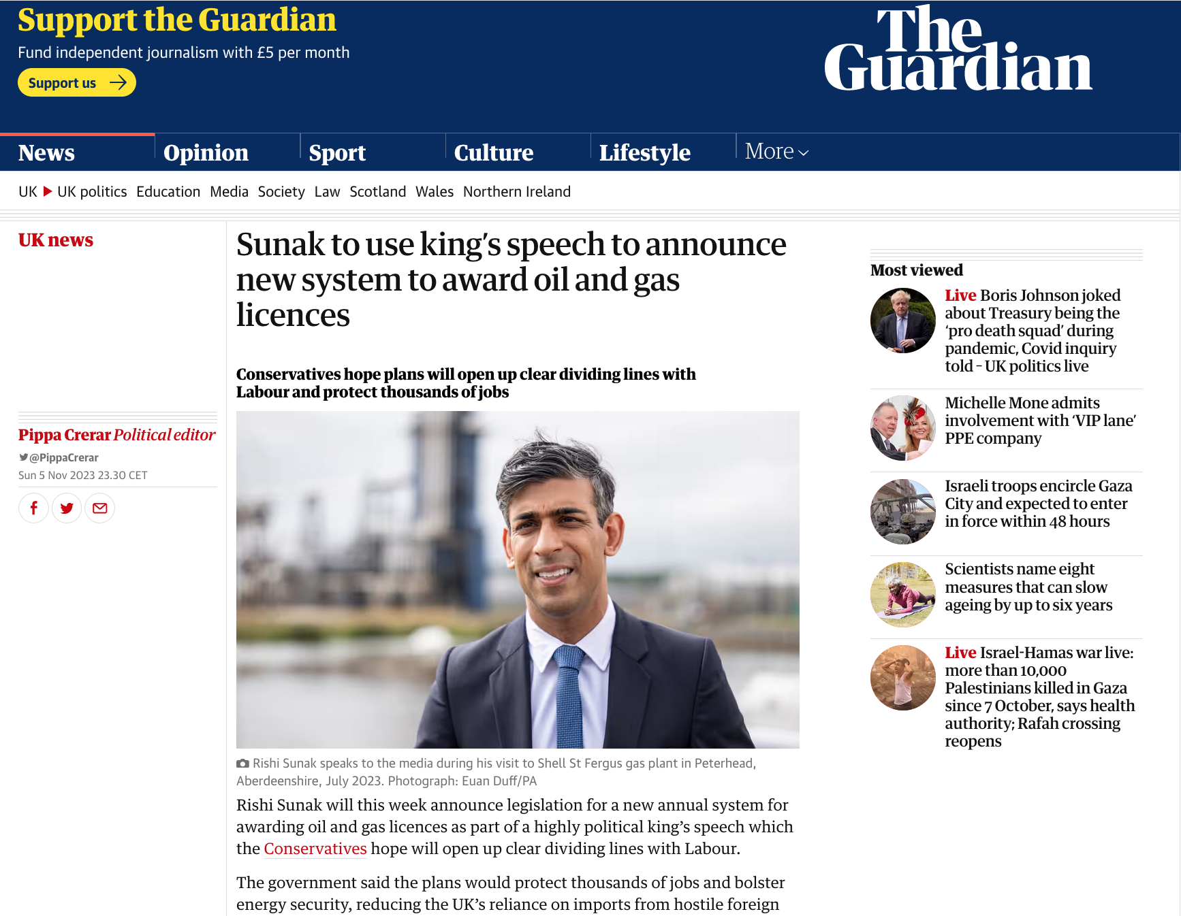
“We should conclude, first of all,
that building a new coal-fired power plant,
or continuing to operate an old one, or
drilling for oil, or expanding an airport,
or planning for a highway is now irrational
violence.” Malm, The Progress of This Storm

Slide 18
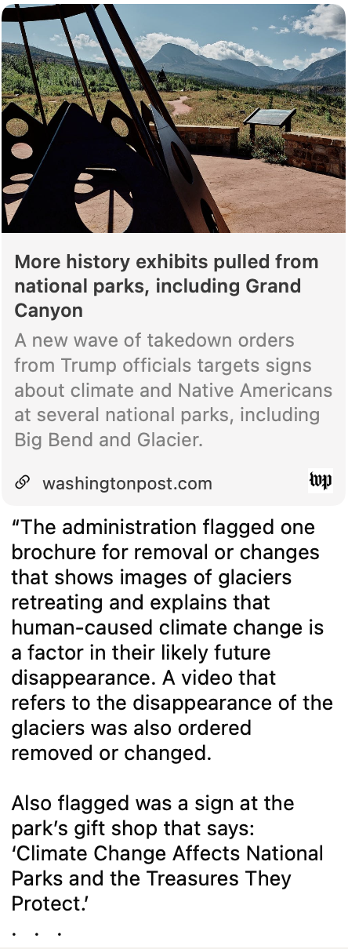
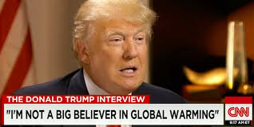
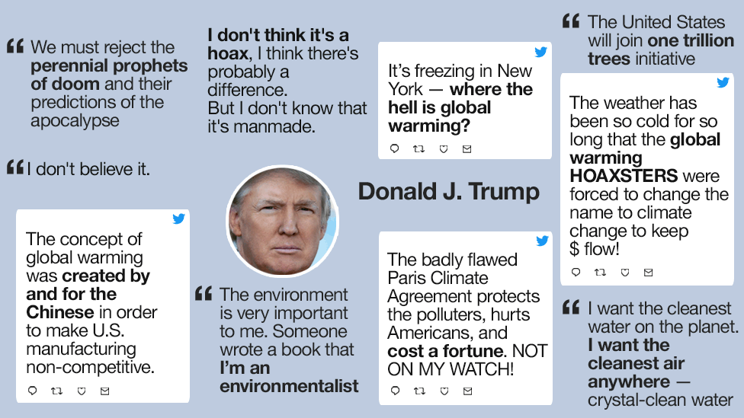

Slide 19

Greenhouse Agency

