Slide 1
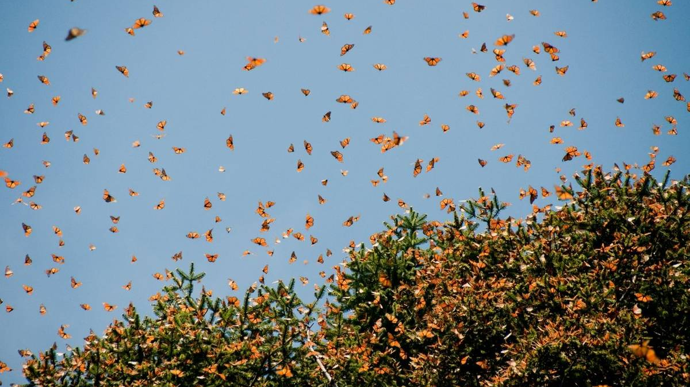
CLIMATE IMAGINARIES WEEK 2
FLIGHT BEHAVIOUR

Slide 2
The Stakes, The Context…….

Slide 3
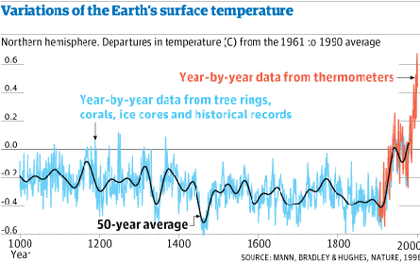

Slide 4
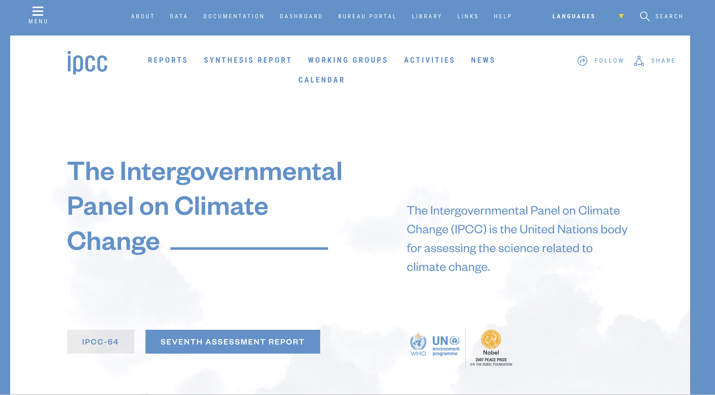

Slide 5
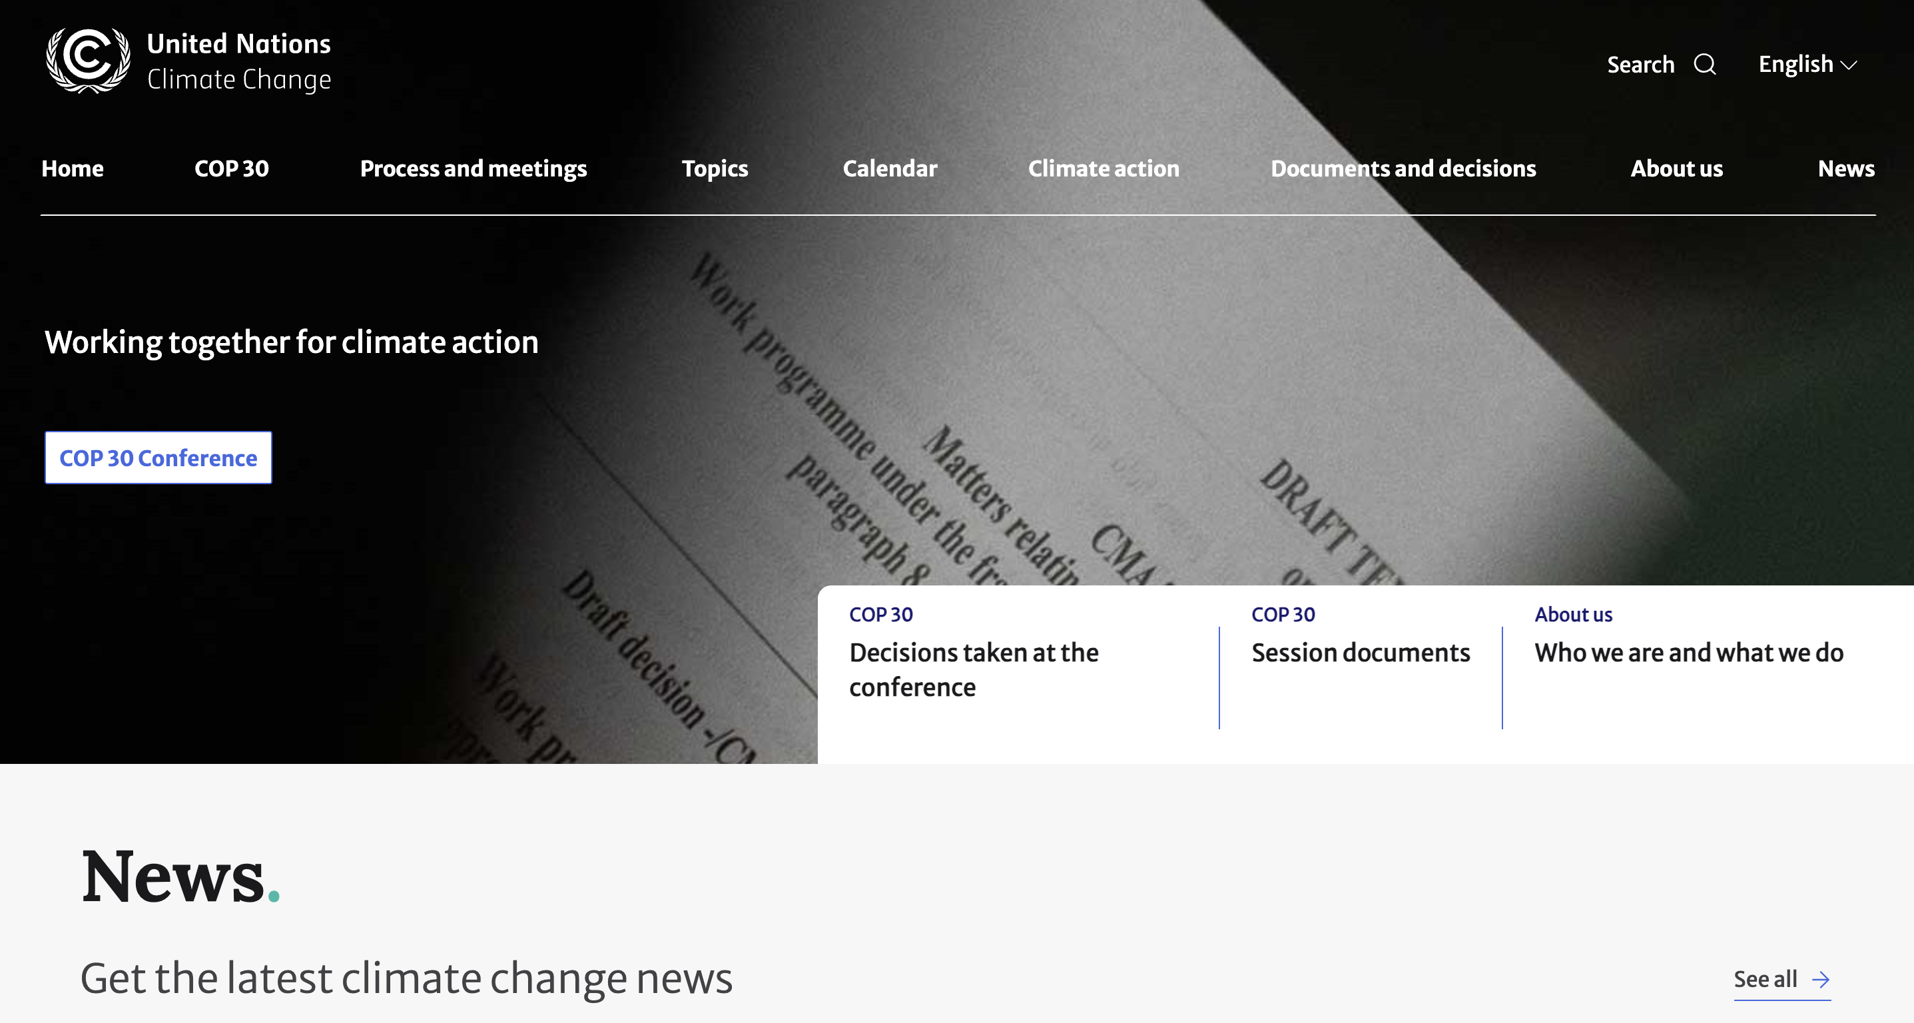

Slide 6
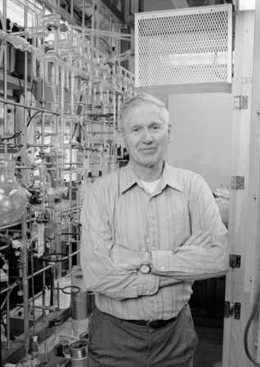
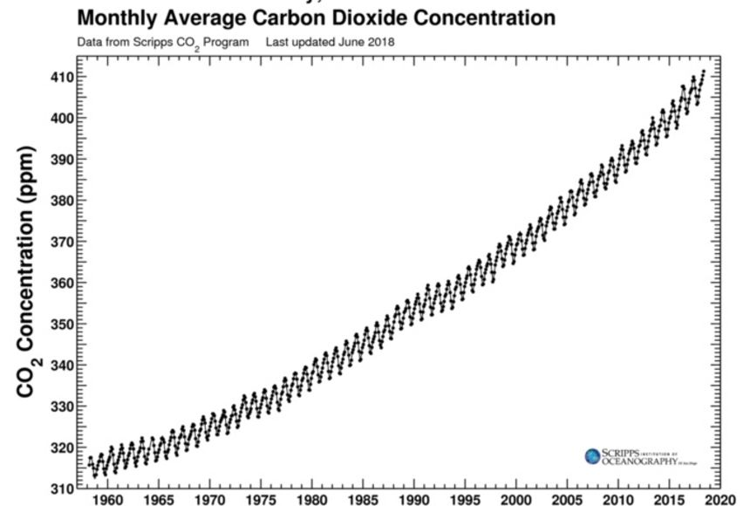
Charles Keeling, of the ‘Keeling Curve’, (1958-)
National Oceanic and Atmospheric Administration (NOOA)

Slide 7
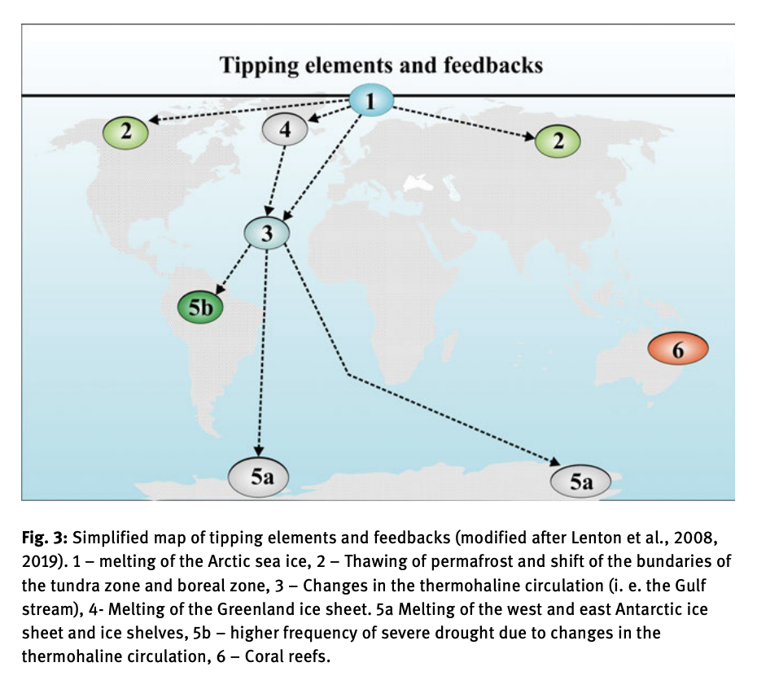

Slide 8
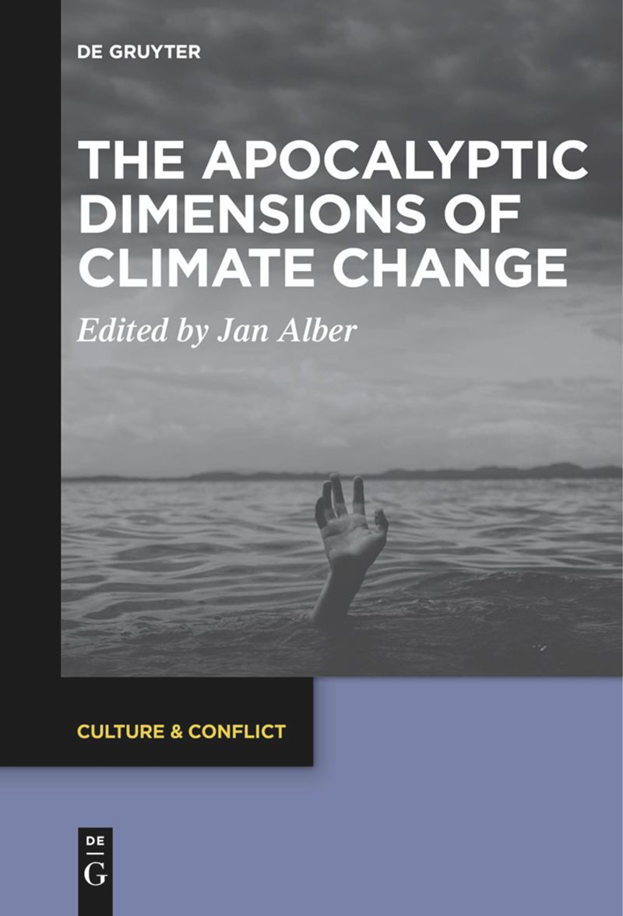
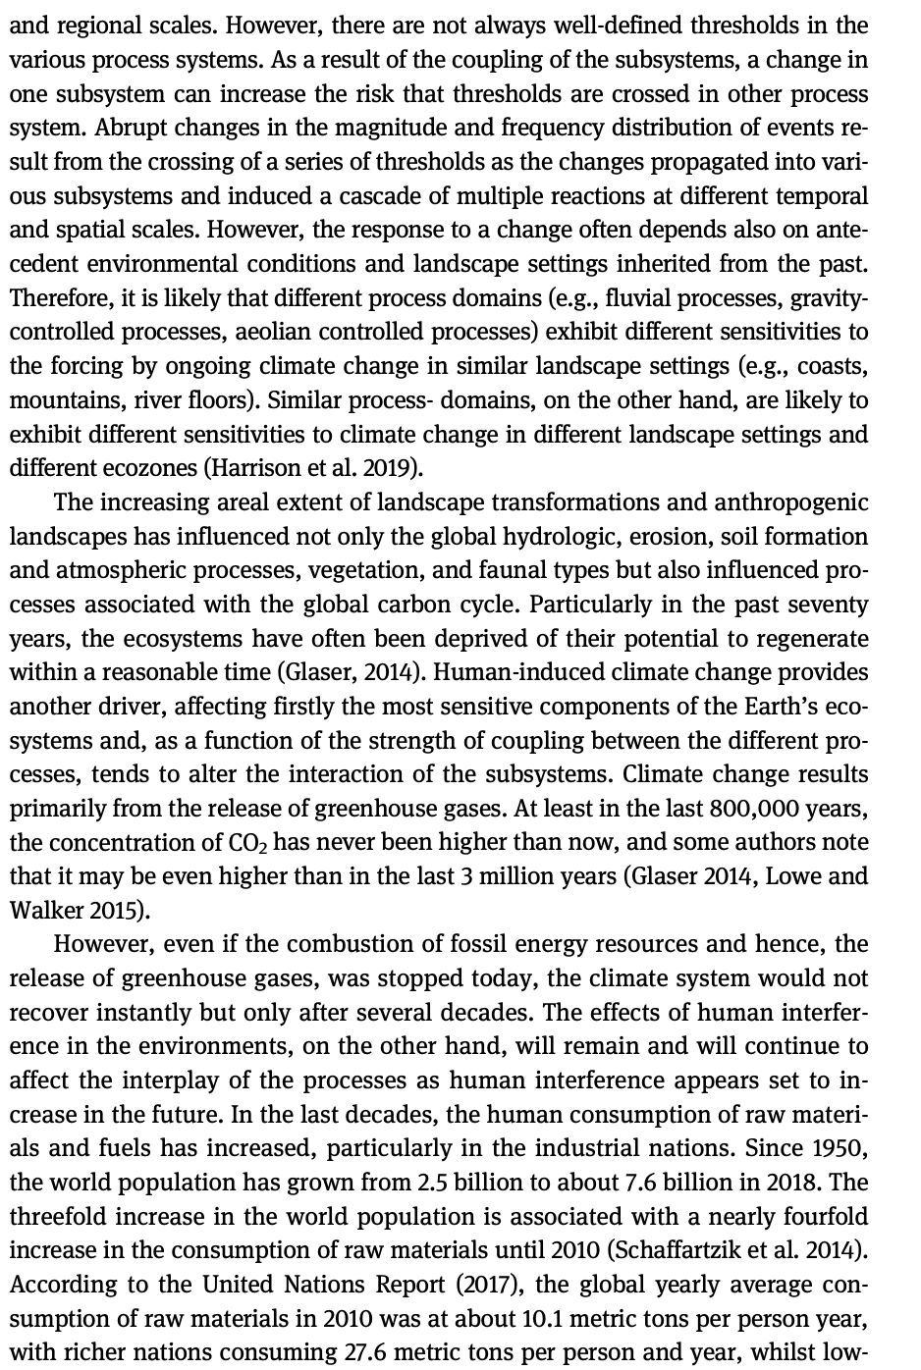
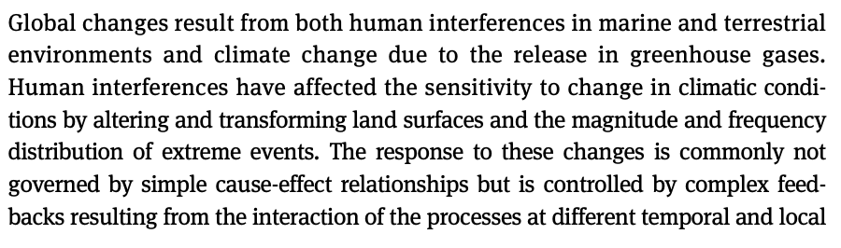
Wolfgang Römer, “Scenarios of Human-Induced Climate and Environmental Changes at Different Spatial and Temporal Scales”(2021)

Slide 9
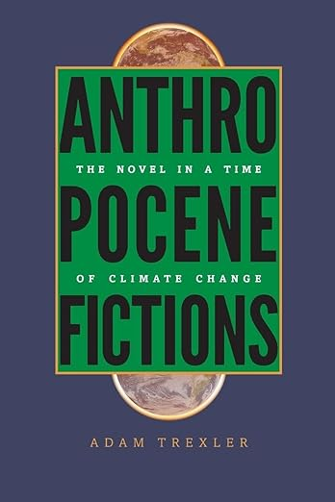
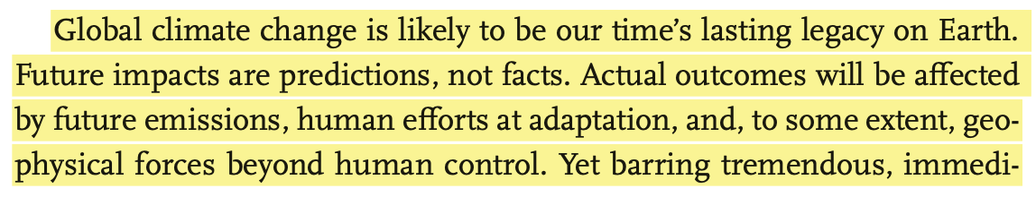
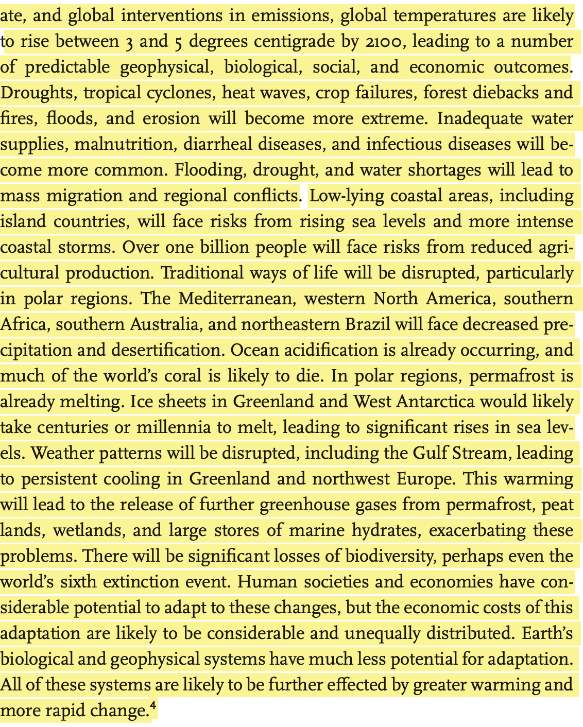
Introduction: Contextualising the
Climate Change Novel (2015)

Slide 10
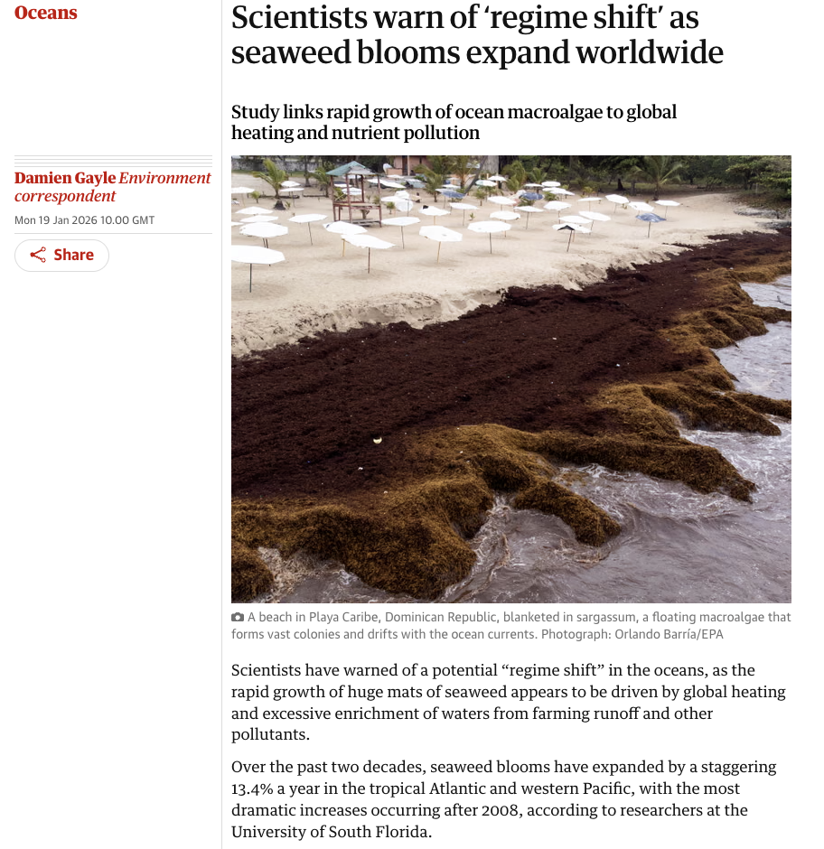
The Guardian, Today….

Slide 11
Ovid Byron: “This has not happened before. There is not an evacuation plan.”
Flight Behaviour, pps 384-87.

Slide 12
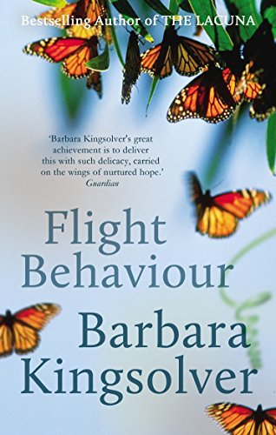



2012

Slide 13
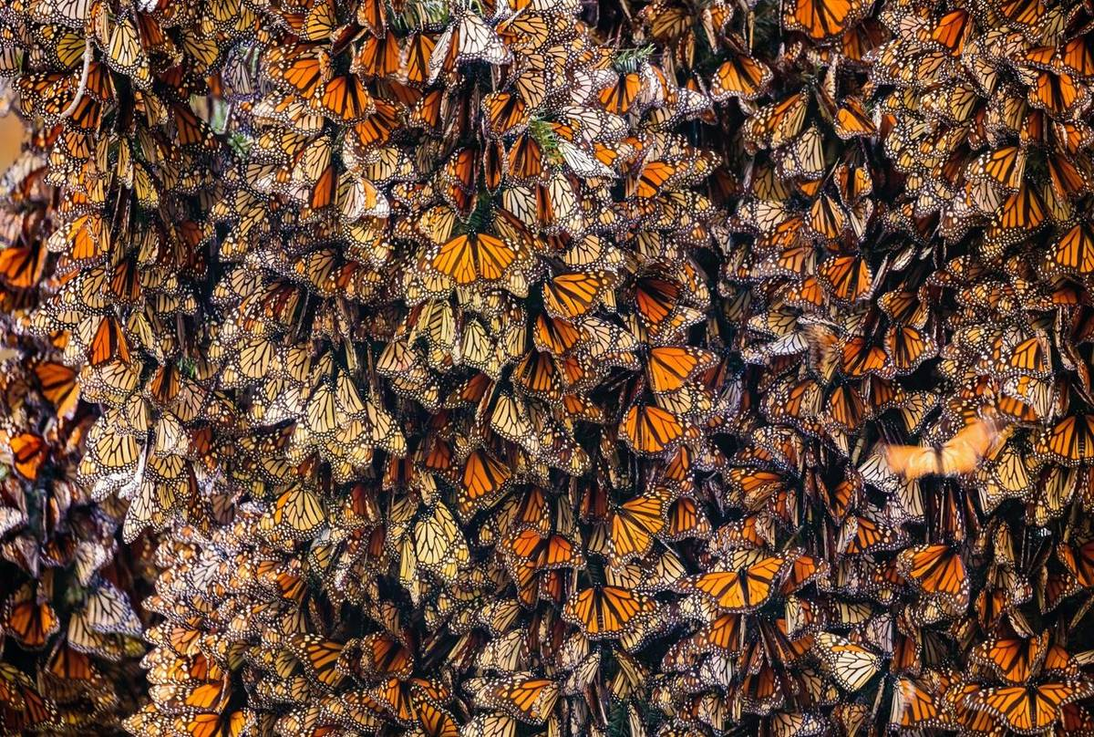

Slide 14
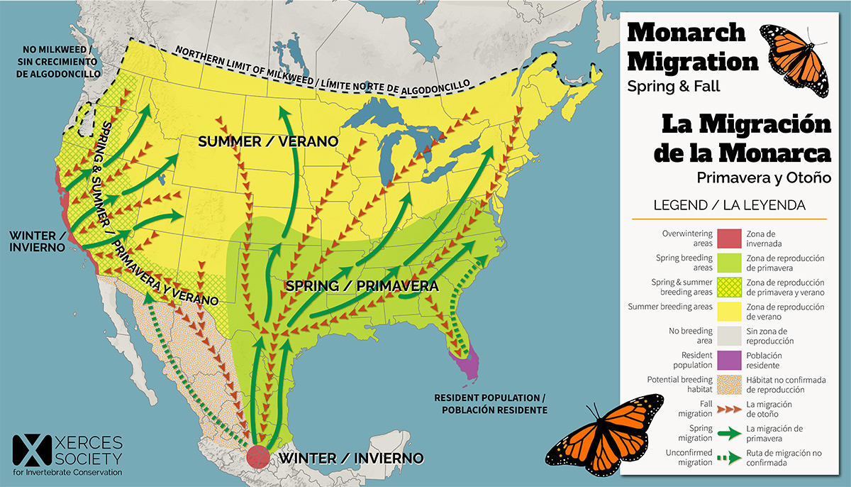

Slide 15
It’s only 4 degrees…..

Slide 16
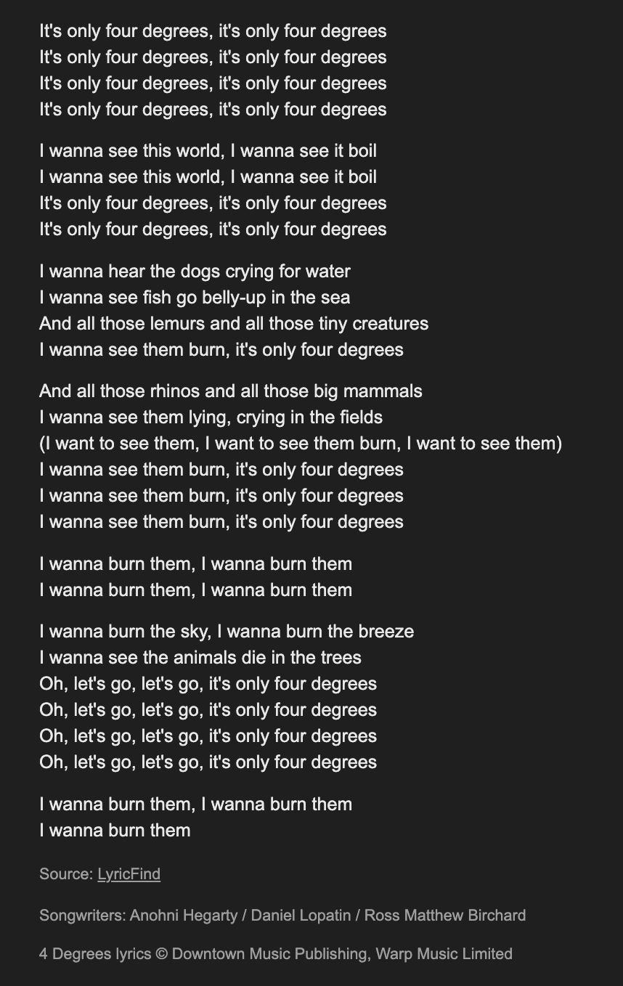


Slide 17
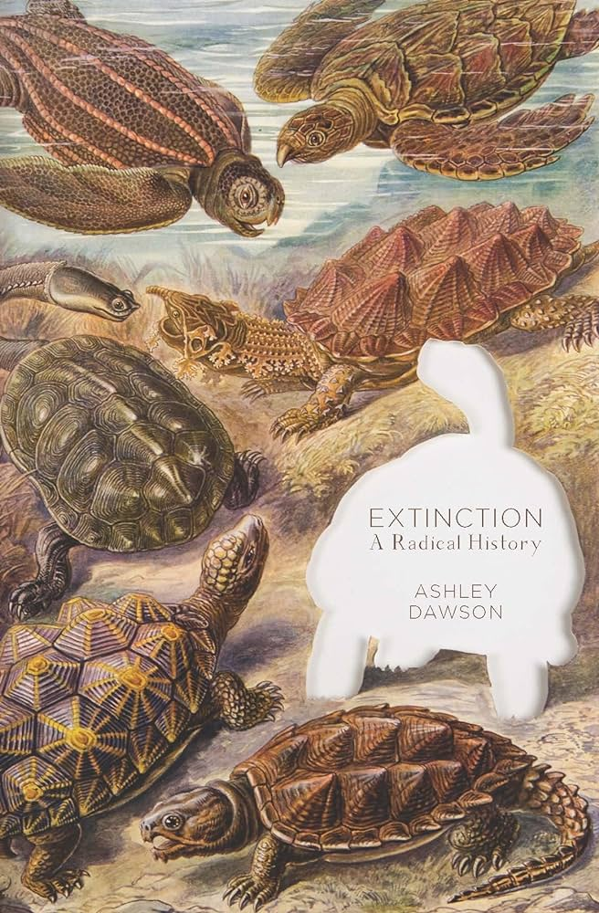
What would a radical anti-capitalist conservation movement
look like? It would begin from the understanding that the extinction
crisis is at once an environmental issue and a social justice issue,
one that is linked to long histories of capitalist domination over
specific people, animals, and plants. The extinction crisis needs to
be seen as a key element in contemporary struggles against accumulation
by dispossession. This crisis, in other words, ought to be a key
issue in the fight for climate justice. If techno-fixes such as deextinction
facilitate new rounds of biocapitalist accumulation, an anti-capitalist
movement against extinction must be framed in terms of a refusal
to turn land, people, flora, and fauna into commodities….. Most of all,
an anti-capitalist conservation movement must challenge the privatization of
the genome as a form of intellectual property, to be turned
into an organic factory for the benefit of global elites. 86

Slide 18
IMAGINATION
The wave of extinction that is decimating plants
and animals around the planet strikes at the most intimate
and potent of human faculties: our ability to imagine. The
power of human dreams has historically been closely tied
to the generative multiformity of the plant and animal
life that surrounds us. 141
Even in the “advanced” capitalist
cultures, we encourage our children to learn basic forms
of empathy and imagination by giving them toy animals
and reading them stories like The Tale of Peter Rabbit. We
have always used animals and plants to symbolize our most
intimate fears, our hopes, and even our greatest loves. As
capitalism tears increasingly gaping holes in the beautiful
web of life of which we are a part, our capacity to dream,
to imagine different, more manifold worlds is radically
impoverished. Dawson, 102-03

Slide 19
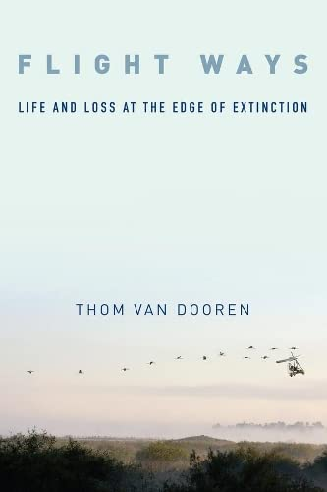
In an important sense Flight Ways: Life and Loss at the Edge of Extinction is
a continuation of the now well-established tradition of telling “extinction
stories” that implicate people. But it is also an effort to tell these all-too familiar stories in a new way. Specifcally, the approach to thinking through
extinction taken up in this book centers on “avian entanglements.” Which
is to say that this is a book about birds and their relationships, about the
webs of interaction in which living beings emerge, are held in the world,
and eventually die. Life and death do not take place in isolation from others;
they are thoroughly relational affairs for fleshy, mortal creatures. And
so it is, in the worlds of birds-woven into relationships with a diverse
array of other species, including humans. These are relationships of coevolution and ecological dependency. But they are also about more than
“biology” in any narrow sense. It is inside these multispecies entanglements
that learning and development take place, that social practices and
cultures are formed. In short, these relationships produce the possibility
of both life and any given way of life. And so these relationships matter.
This is true at the best of times, but in times like these when so many
species are slipping out of the world, these entanglements take on a new
significance. 4

Slide 20
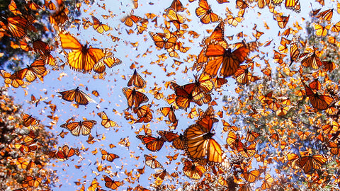
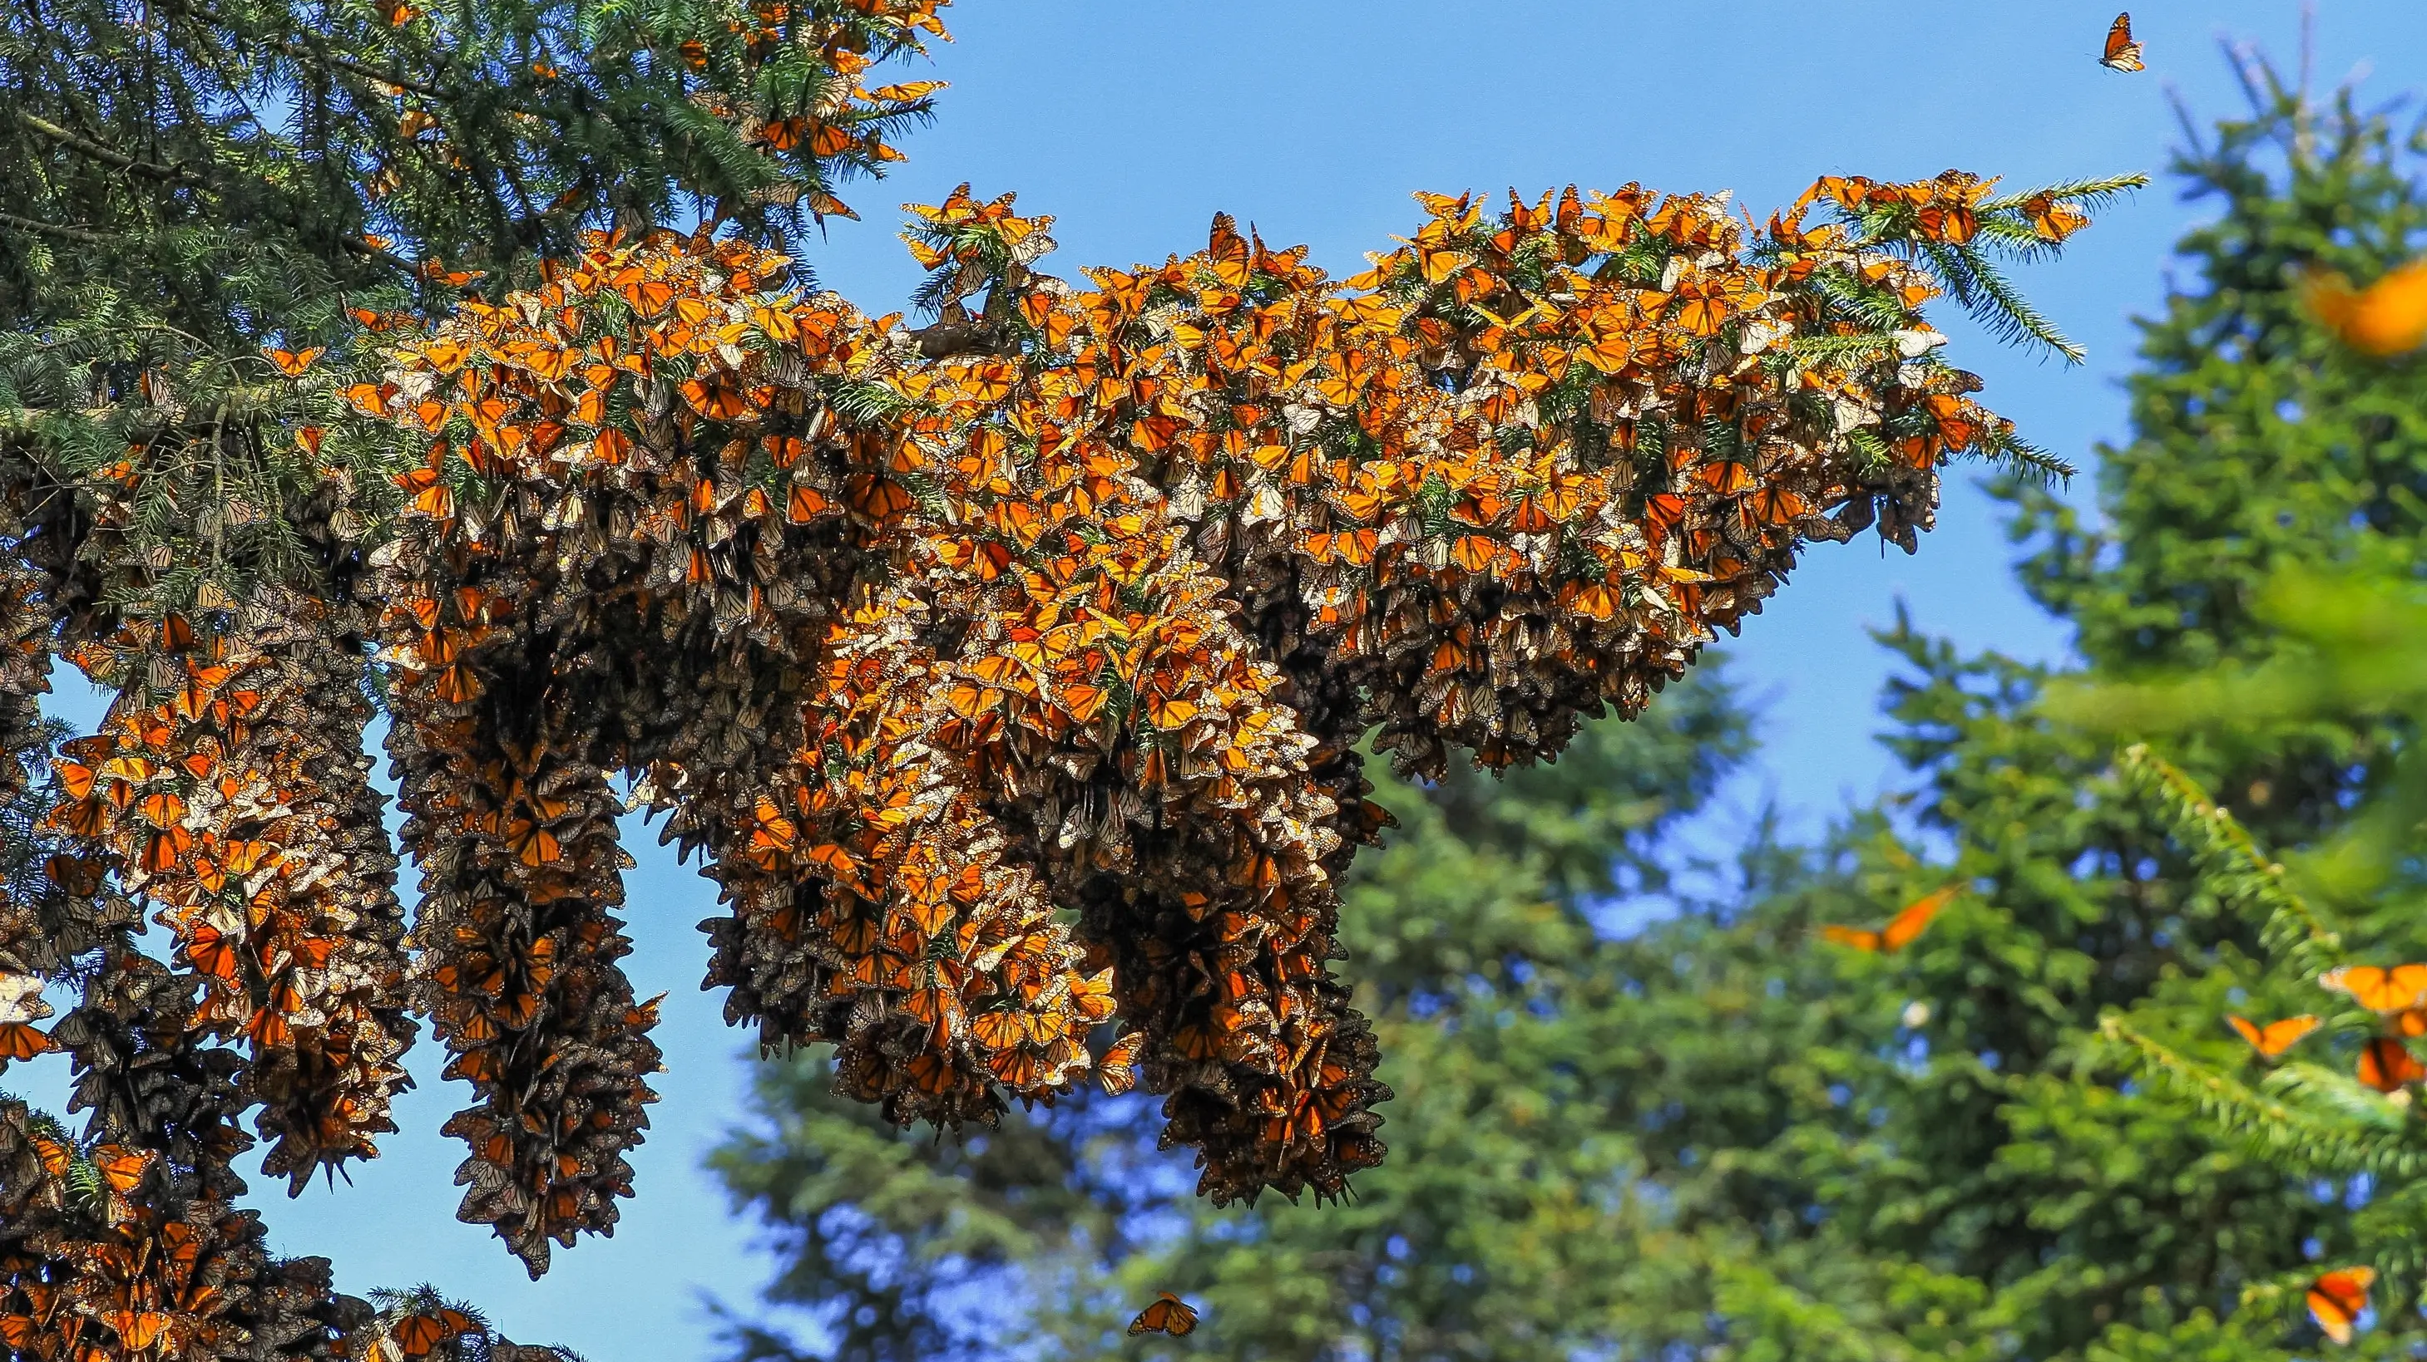
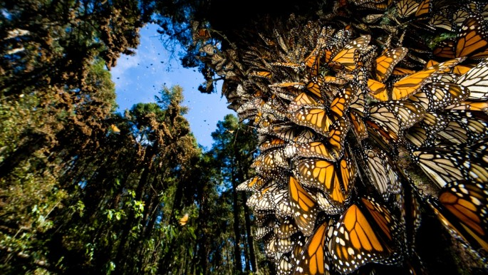
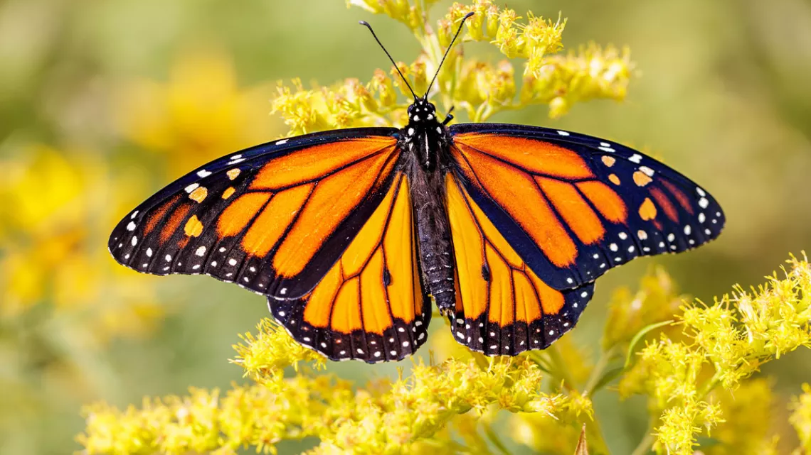

Slide 21
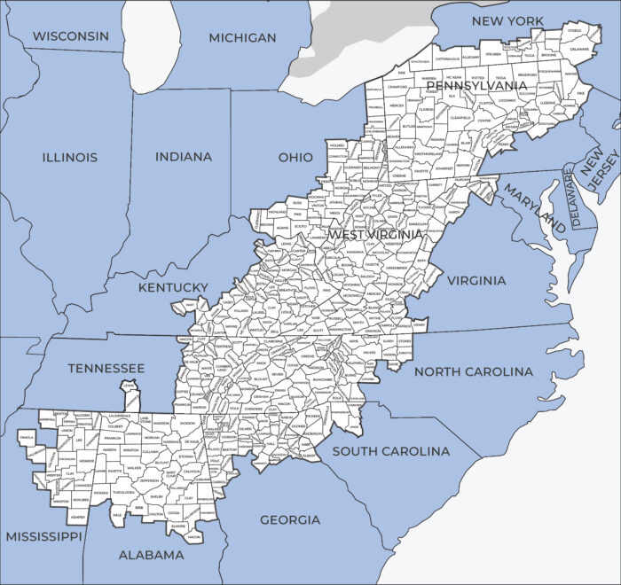
Appalachian Region

Slide 22
Climate Change and Literature

Slide 23
The age of global warming defies both literary fiction and contemporary common sense: the weather events of this time have a very high degree of improbability. Indeed, it has even been proposed that this era should be named the “catastrophozoic” ... It is certain ...that these are not ordinary times: the events that mark them are not easily accommodated in the deliberately prosaic world of serious prose fiction.
But the modern novel, unlike geology, has never been forced to confront the centrality of the improbable: the concealment of its scaffolding of events continues to be essential.
If that is true of a small fluke of chance, consider how much harder a writer would have to work to set up a scene that is wildly improbable even in real life? For example, a scene in which a character is walking down a road at the precise moment when it is hit by an unheard-of weather phenomenon?
To introduce such happenings into a novel is in fact to court eviction from the mansion in which serious fiction has long been in residence; it is to risk banishment to the humbler dwellings that surround the manor house—those generic outhouses that were once known by names such as “the Gothic,” “the romance,” or “the melodrama,” and have now come to be called “fantasy,” “horror,” and “science fiction.”
Amitav Ghosh (2016)
‘It is a tough assignment to show that the changing climate is profoundly altering the way we write, communicate, plan, view imagine’ Malm, Progress..
Notes:
Phenomena such as ocean acidification, climate change, the general effects of incremental forms of ecological degradation across the planet, global overpopulation and resource depletion do not present any obvious or perceptible target for concern or protest at any one place, or often any immediate antagonist perceptible at the normal human scale. The largely benumbed recognition of this reality

Slide 24
Imaginary

Slide 25
Imagination here is understood as a way of seeing, sensing, thinking, and dreaming the formation of knowledge, which creates the conditions for material interventions in and political
sensibilities of the world.
An alternative approach might consider how imagination is actively produced through iterative processes and practices that establish dominant framings of the imagination.
There are two distinct schools of thought here. (1) Imagination as a relational space that is informed by the objects and subjects with which it is entangled. (2) Imagination as a mediator between the positivist world and the human mind.
Kearney suggests that while there is a plurality of terms for the imagination, they all adhere to a basic trait of capturing ‘the human power to connote absence into presence, actuality into possibility, what is into something—other-than-it-is […] What we can say now of the imagination is that rather than being the site of division it is a site of interplay between material
and perceptual worlds, where concepts cohere, forces
pull and attract, and things, discourses, subjects, and
objects are framed, contested, and brought into being.
Yusoff & Gabrys
Climate change… is being reimagined as an
ethical, societal, and cultural problem that poses
new questions and reconfigures the geographic
imaginaries of the world. These new cultures of
climate change can be characterized by three
distinct temporal and spatial imaginative
framings of climate change:
- futurity of climate change.
- adaptation: imagination by degree
- climate practices
Imagination can be thought of as a way of
seeing, or rather a constellation of a way of thinking
and sensing that becomes typified or consolidated in
images and social actions.

Slide 26
Contemporary culture finds it so hard to deal with climate change. Indeed, this is perhaps the most important question ever to confront culture in the broadest sense—for
let us make no mistake: the climate crisis is also a crisis of culture, and thus of the imagination. (2016)

Slide 27
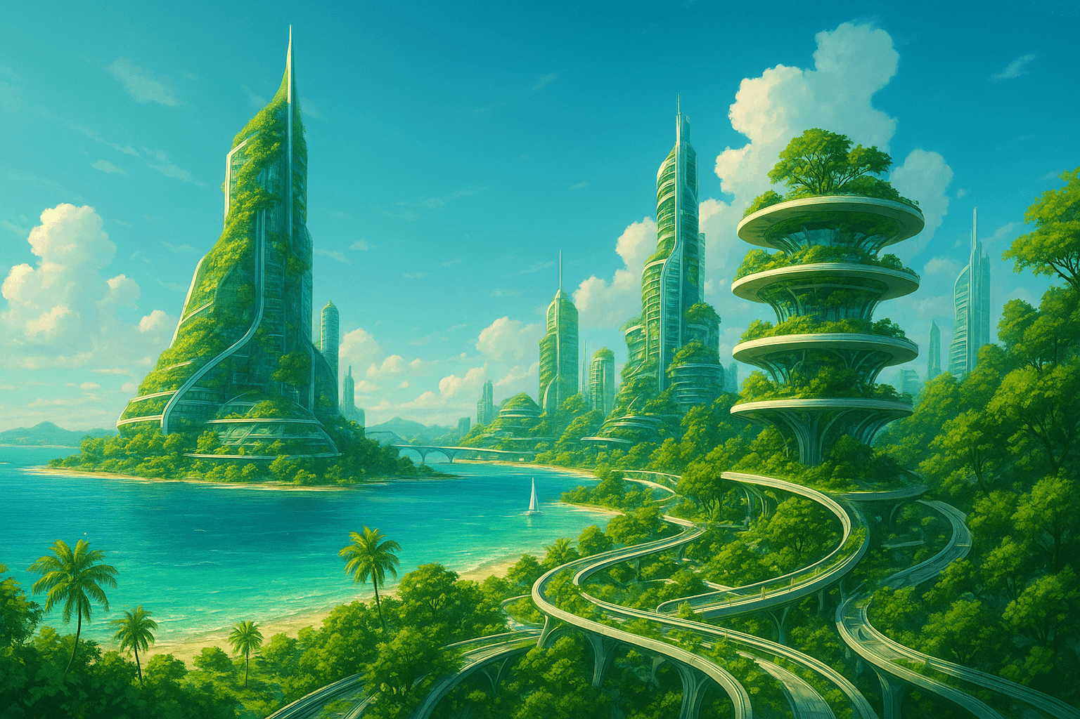
First, there has been a concentration on the futurity of climate change including the arts and techniques of imagination that are bound up with making scenarios, narratives, and contingency plans that project toward or back from uncertain futures. An engagement with the arts of futurity can be seen in the workings of the Intergovernmental Panel on Climate Change (IPCC); the practices of scenario modeling; back-casting and forward-looks that characterize much of the science–policy interface of climate science; and the economics of futures markets. These uncertainties open a generative space of unknowing that has been populated by various ‘visions’ of the future. The arts of this futurity are anticipatory, pre-emptive, and promiscuous.
…..this ‘cultural turn’ in climate change has
seen a critical engagement with the practices of climate
science. Multiple creative practitioners and researchers
are now seeking to expand modes of climate science
production to reconsider the social spaces of climate
interaction at the science-policy-public interface, and
to promote new forms of the coproduction knowledge
between different communities of practice (such
as science–art or art–public collaborations).
Yusoff & Gabrys
Yet within this work, there has been scant attention as to
how futures could be deployed as a cultural and creative
method of environmental imagining and how the arts and
humanities could contribute to future narratives. The
arts and humanities play an important role in thinking
through our representations of environmental change
and give tangible form to the imagination of different
worlds outside of the constraints of the given present….
Arts and humanities scholars and practitioners
in collaboration with scientists can reconsider
how climate futures are imagined.

Slide 28
The age of global warming defies both literary fiction and contemporary common sense: the weather events of this time have a very high degree of improbability. Indeed, it has even been proposed that this era should be named the “catastrophozoic” ... It is certain ...that these are not ordinary times: the events that mark them are not easily accommodated in the deliberately prosaic world of serious prose fiction.
Amitav Ghosh (2016)
Notes:
Phenomena such as ocean acidification, climate change, the general effects of incremental forms of ecological degradation across the planet, global overpopulation and resource depletion do not present any obvious or perceptible target for concern or protest at any one place, or often any immediate antagonist perceptible at the normal human scale. The largely benumbed recognition of this reality

Slide 29
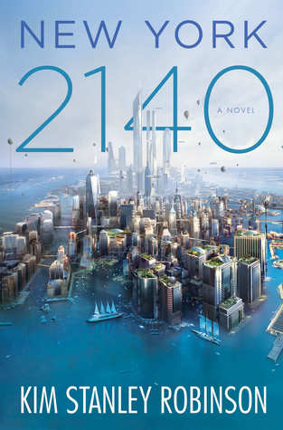
REALISM OR FANTASY?
The flood went up to about Thirtieth. And even though it was fast, it did take two hours. So people just ran north ahead of it. They abandoned whatever they were doing and ran in the streets. We did too. Central Park had millions of people in it, standing there looking at each other….No one could believe it. But it was true. A new day had come. We knew it had happened, because there we were. We knew it would never be the same. Downtown was gone. So that was very strange. People were stunned, you could see it. We stood there looking at each other! No one could believe it but there we were. Everyone was like, well, here we are – it must be real. But it was like a dream.
Kim Stanley Robinson, New York 2140 (2017)
Notes:
We see the same thing here in a novel about adaptation to catastrophe in North American continent, where NYC adapts, yet the entrie scene remains cognitively difficult to grasp – long genre, cautionary tales, tales about denialism and consciousness raising, weird tales of strange climate, offshoring the problem by alienating it, then the speculative fccition and the dystopias – usually of resource-starved worlds, depleted stocks of foods, medicines, turn to authoritarianism, and another way of doing this might be seeing a totally transformed world devoid of humans, - so how about Scotland, in 2563…slide

Slide 30
“Look at the Facts.”
Dellarobia Turnbow, Flight Behaviour, pps: 234-236
“The view out across the valley was puzzling and unreal, like a sci-fi movie.”
Flight Behaviour, pps: 14-22

Slide 31
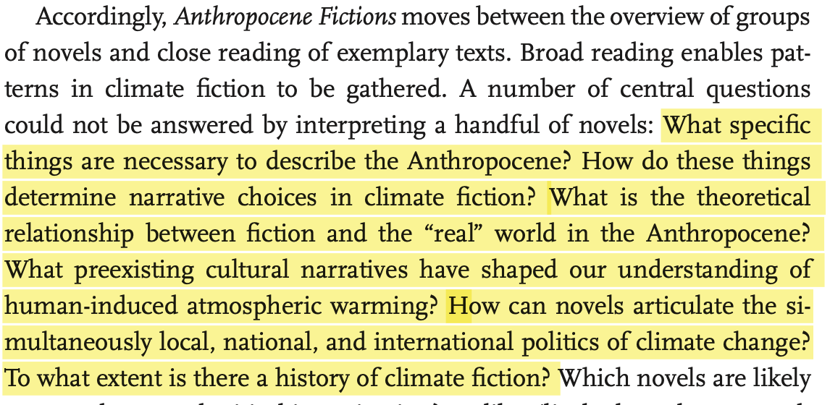

Slide 32
Climate Fictions

Slide 33
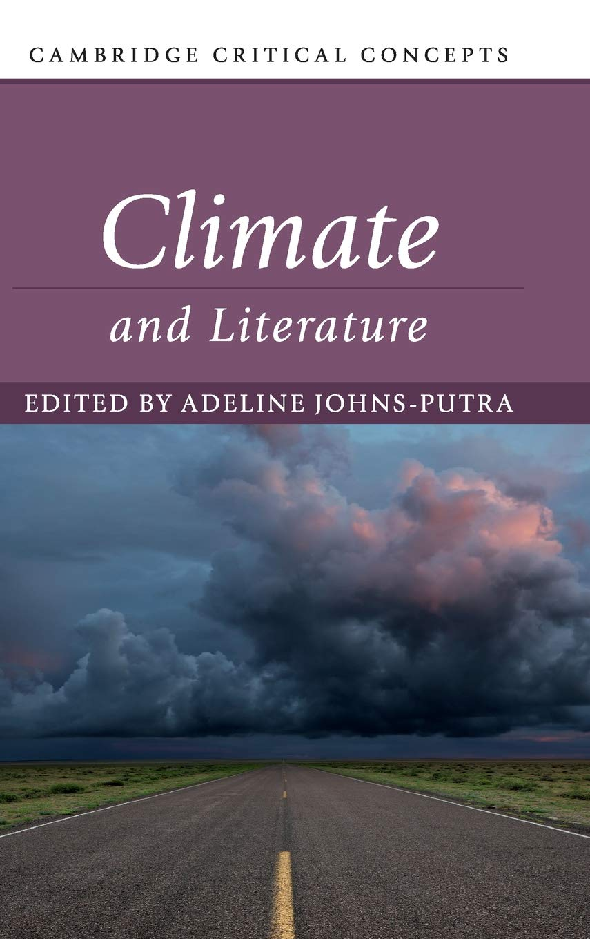
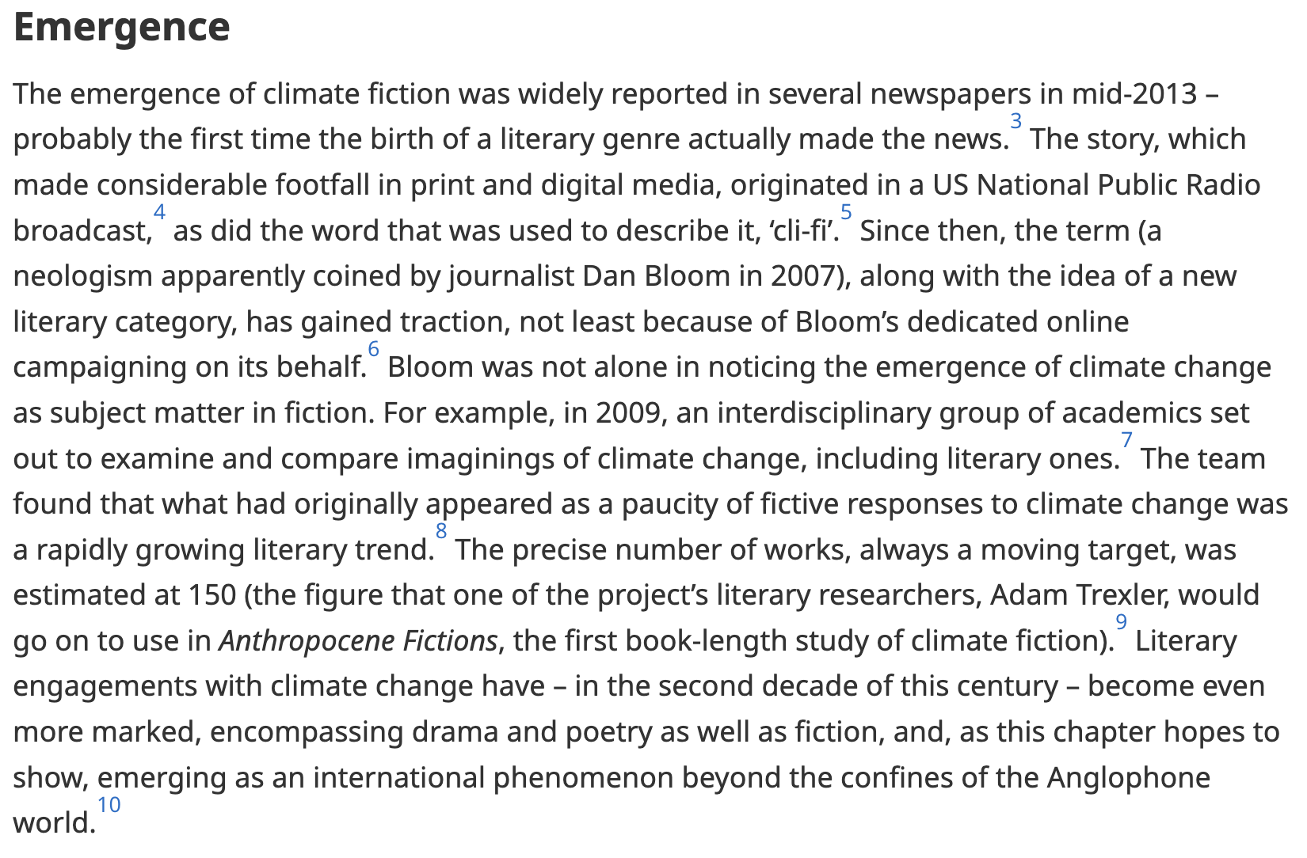

Slide 34


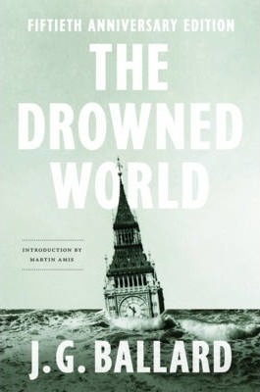

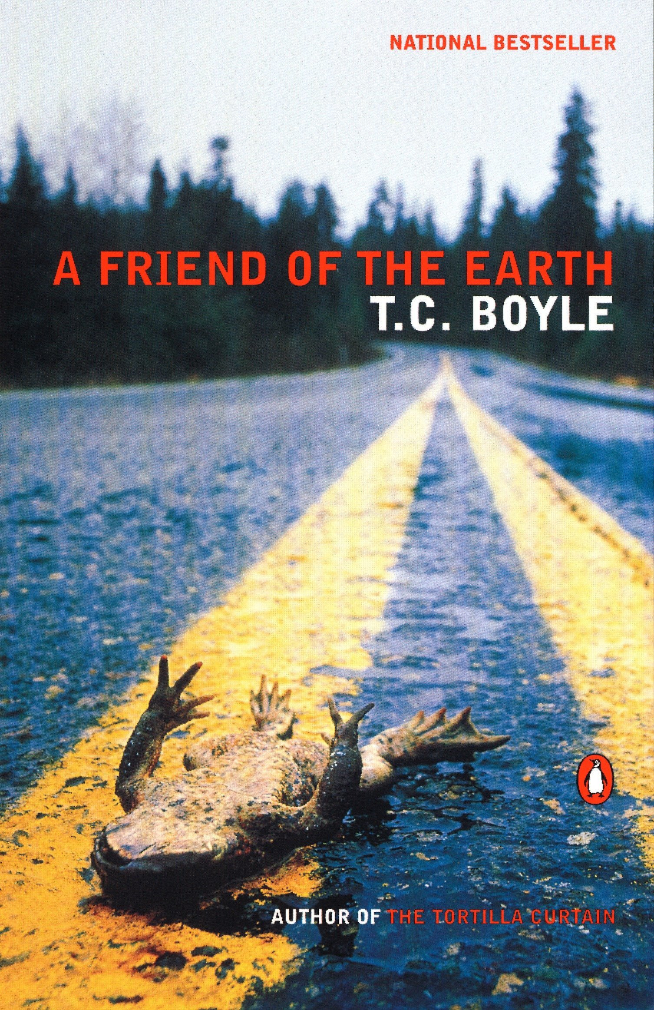
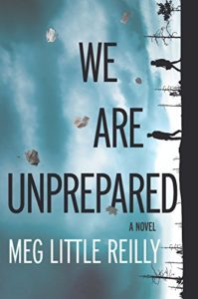

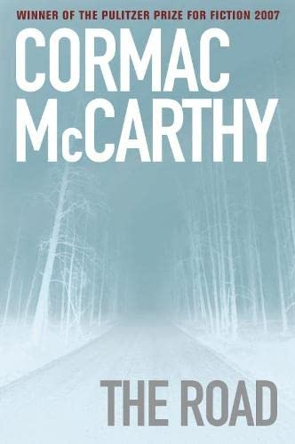
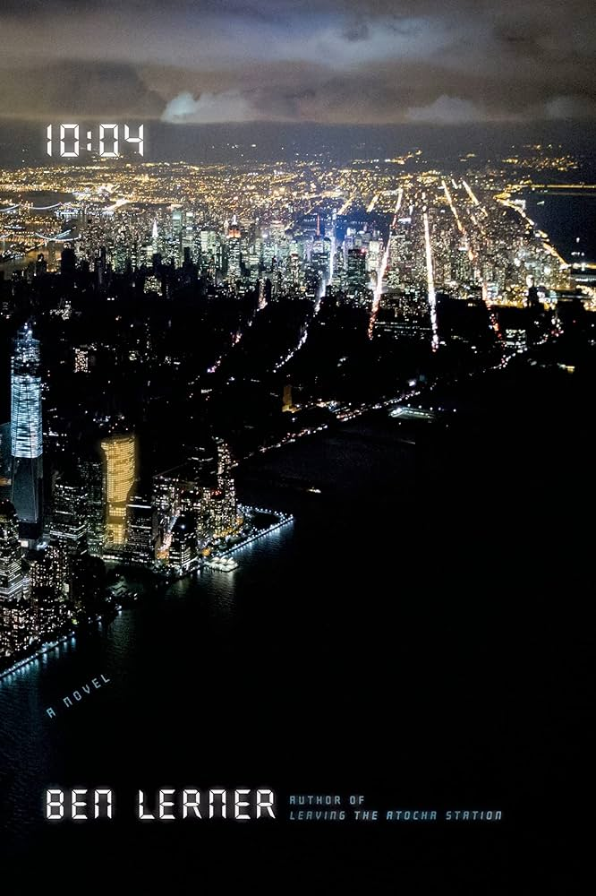

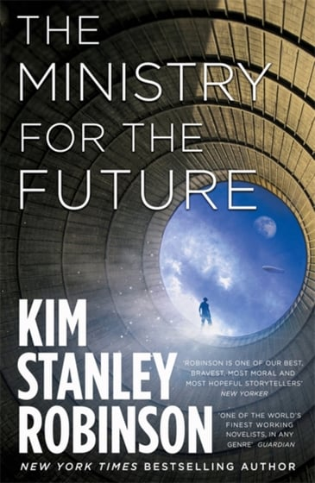






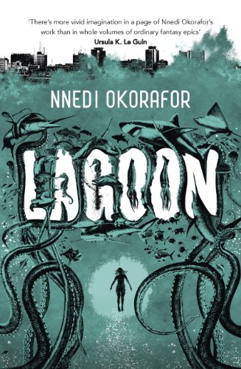
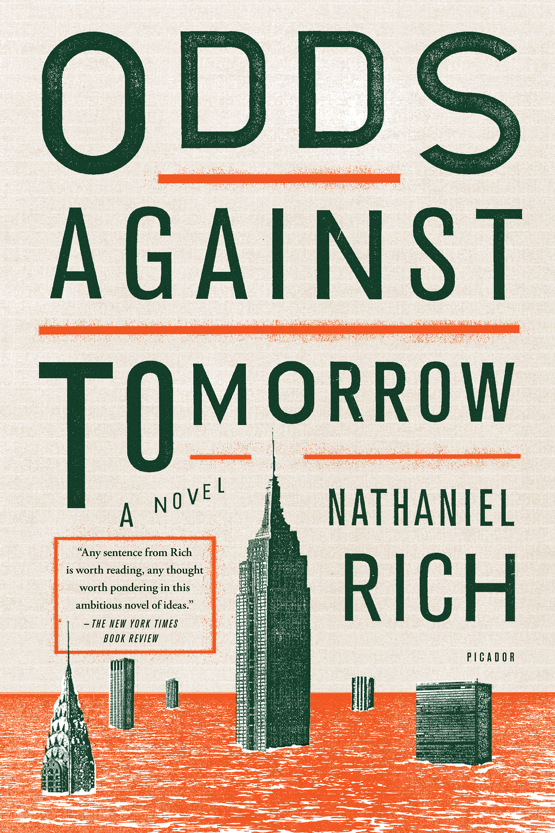
Notes:
YET – there IS A strong idenfiiable strand of climate fiction - ‘clifi’ – what Ghosh resigned to the ‘outhouses’ of culture – there are indeed so many examples of societal meltdown and earth system collapse on our screens that it’s harder to choose one. Predilection for dystopia and apocalypse (end times threats; cautionary tales; extrapolations of the present; also small morality tales within of how to deal wth it and how to be better and perhaps prevent it)
Examples of clifi from all over and through various genres and audicnes, YA fiction to sf to fantasy and the orthodox novel – this fiction is almost always trying to register a massive change and usually involves dystopian worlds, either of adapation to a new and radically transformed climate or a word where an apocalypse is creating dystopian forms of reaction and governance – next slide is benumbing reality in this work….

Slide 35

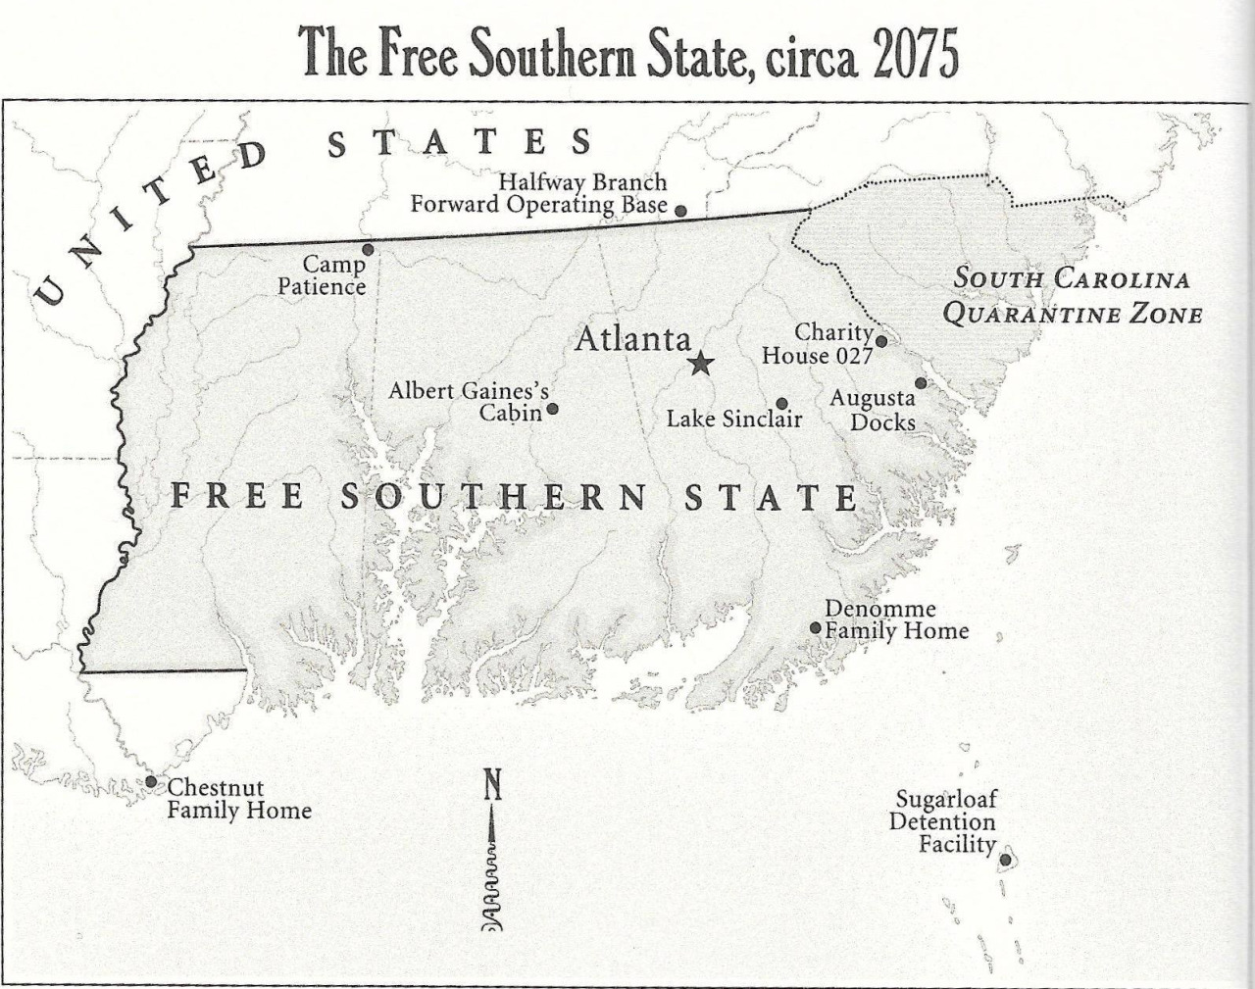


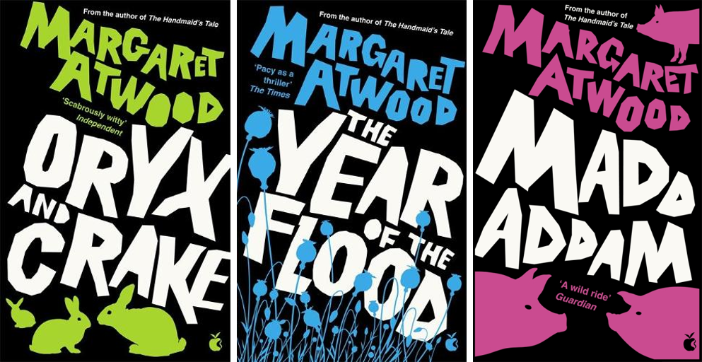

Slide 36
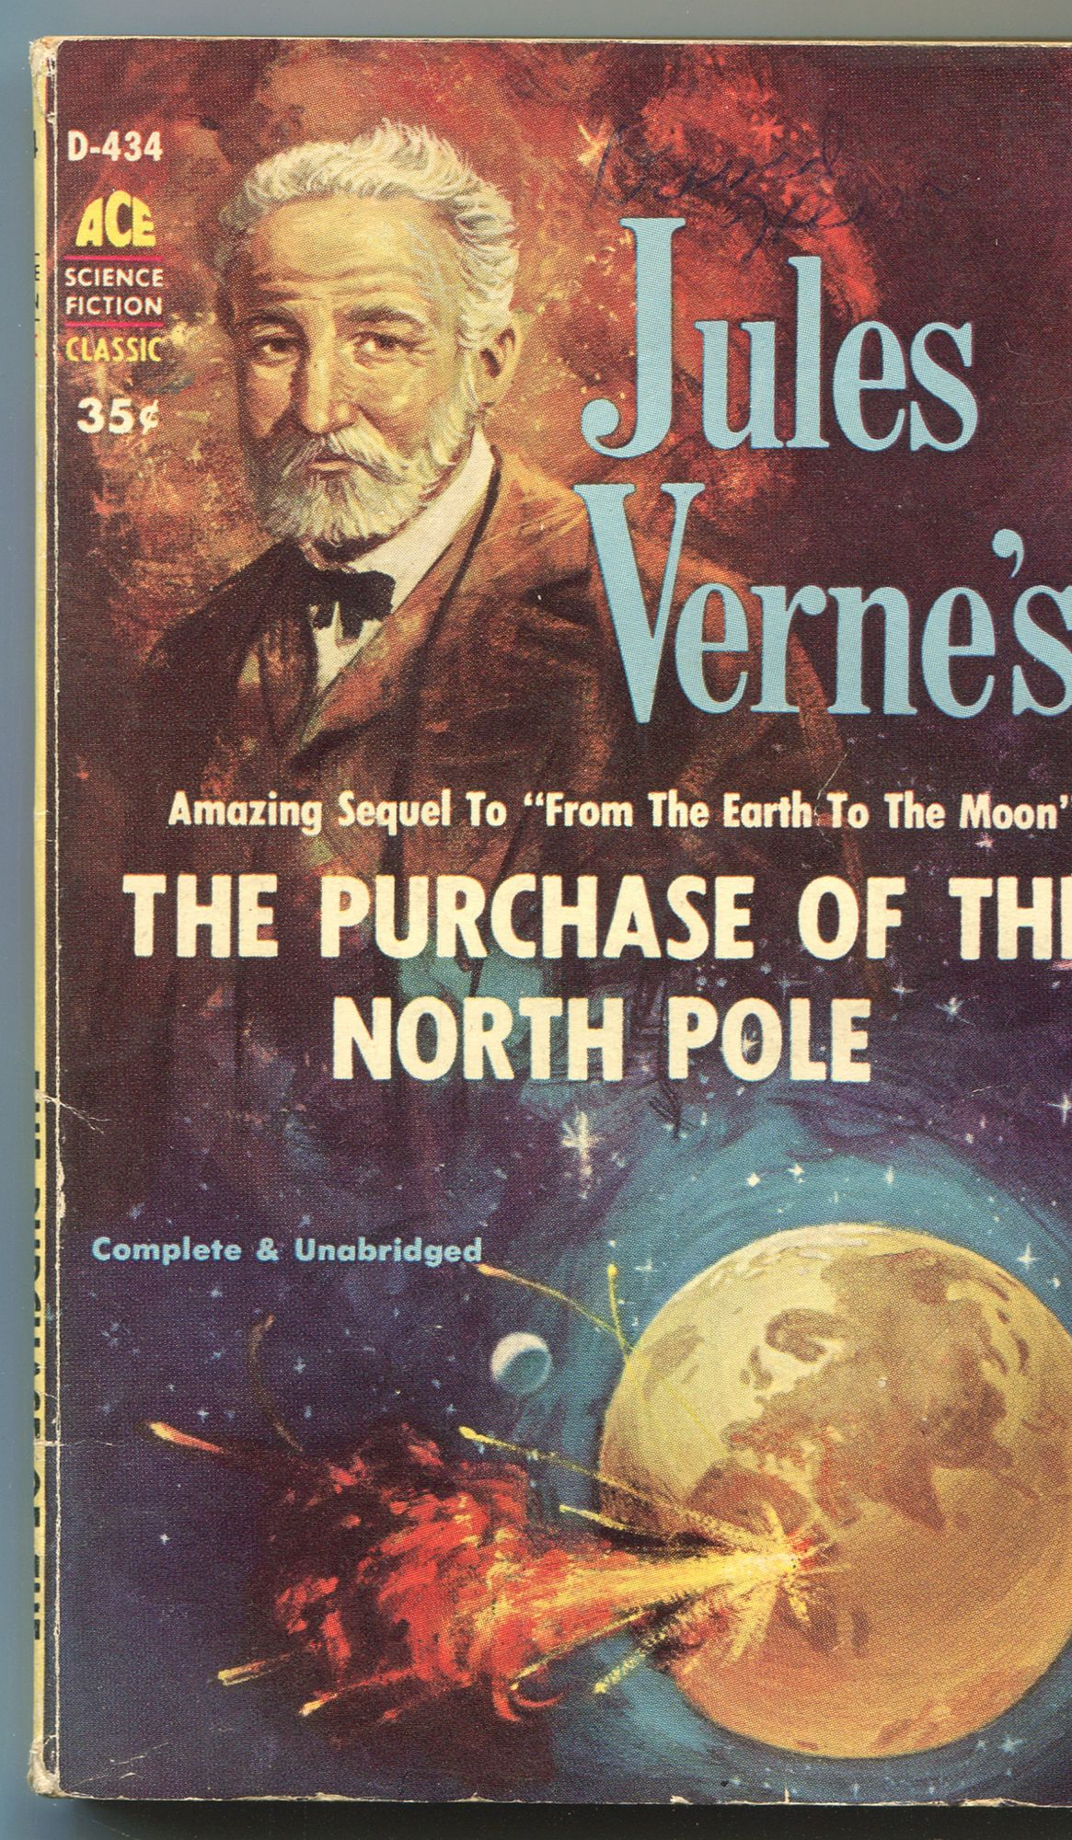
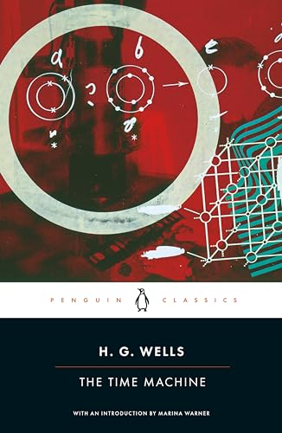
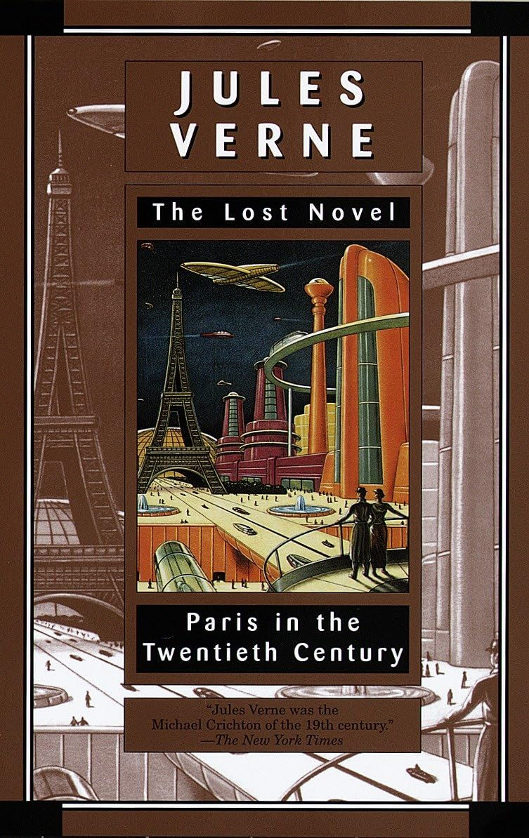

Slide 37



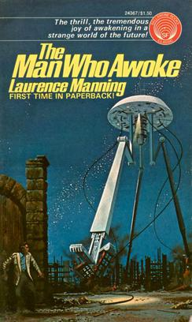
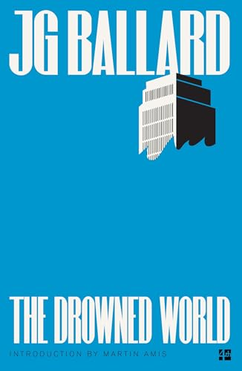


Slide 38


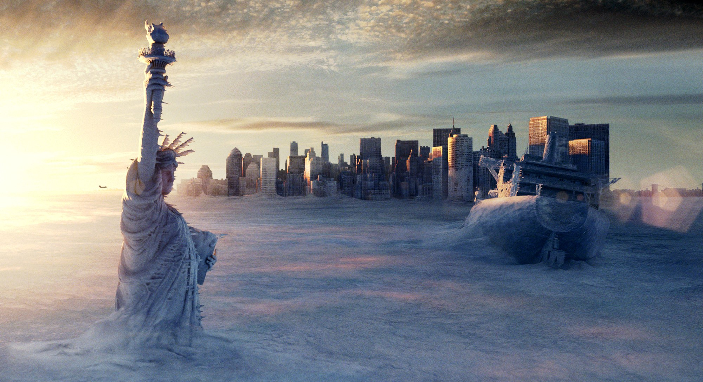
Notes:
collapse, entropy, painful pedestrianism, without maps, following the cracked highway - the bunker episode - Predilection for dystopia and apocalypse (end times threats; cautionary tales; extrapolations of the present; also small morality tales within of how to deal wth it and how to be better and perhaps prevent it)
One vein of thinking is that this seems to be not real at all, difficult to grasp – so maybe bunker thinking is both a natural response and also a fearful/problematic one. other forms of escape and shelter are seen in fagan -

Slide 39
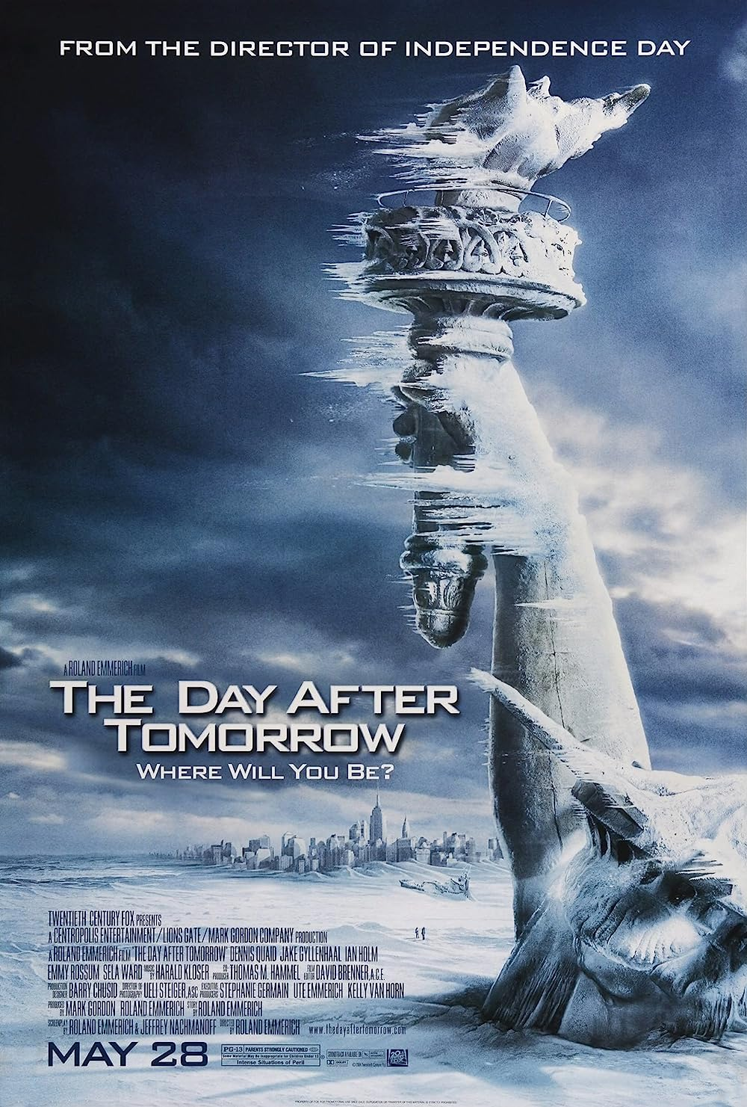
Apocalypse is the single most powerful master
metaphor that the contemporary environmental imagination
has at its disposal. Of no other dimension of
contemporary environmentalism, furthermore, can it
be so unequivocally said that the role of the imagination
is central to the project; for the rhetoric of apocalypticism
implies that the fate of the world hinges on
the arousal of the imagination to a sense of crisis.
Lawrence Buell The Environmental Imagination: Thoreau,
nature writing, and the formation of American Culture (1995)

Slide 40
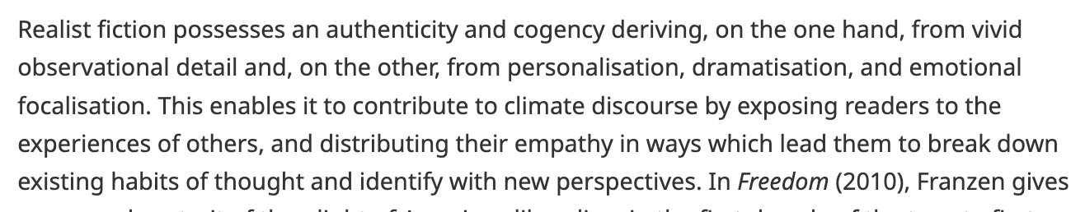

Slide 41
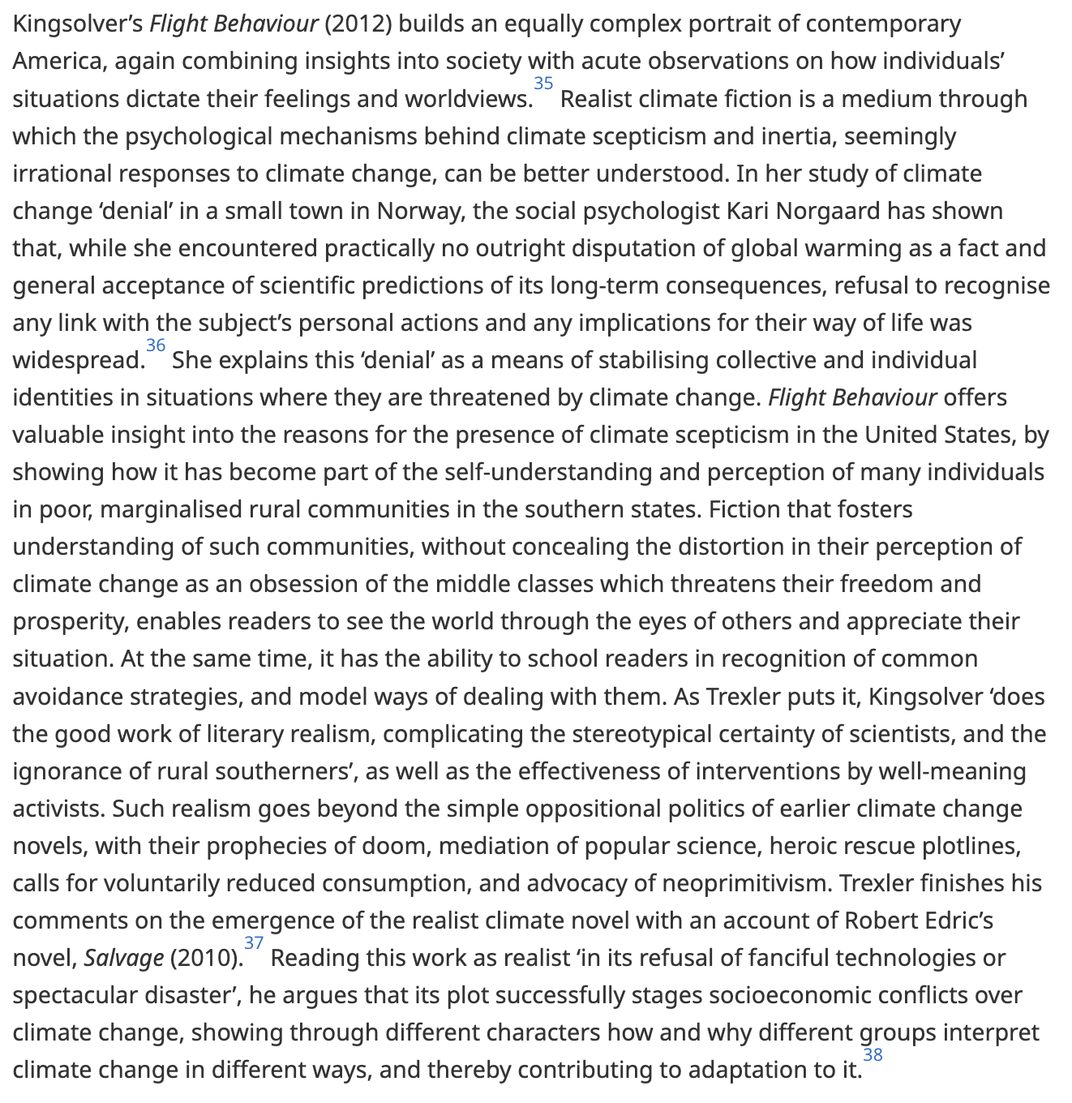

Slide 42
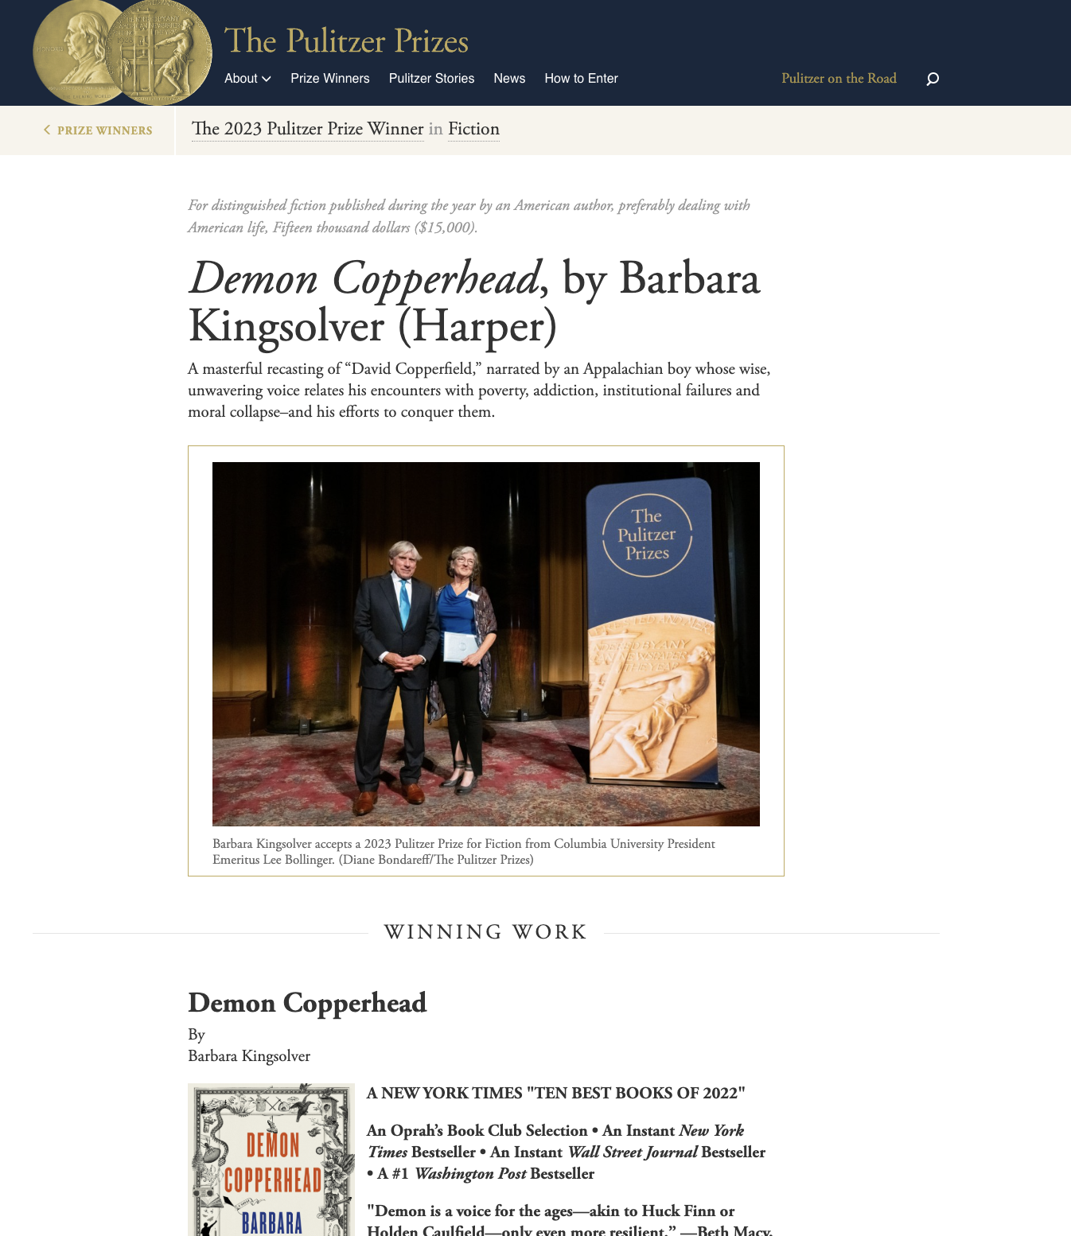
2023

Slide 43



Slide 44




Slide 45

Intro – Close Read

Slide 46
4 THESES
Thesis 1: Anthropogenic Explanations of Climate Change Spell
the Collapse of the Age-old Humanist Distinction between
Natural History and Human History
Thesis 2: The Idea of the Anthropocene, the New Geological
Epoch When Humans Exist as a Geological Force, Severely
Qualifies Humanist Histories of Modernity/Globalization
Thesis 3: The Geological Hypothesis Regarding the
Anthropocene Requires Us to Put Global Histories of Capital in Conversation with the Species History of Humans
Thesis 4: The Cross-Hatching of Species History and the History of Capital Is a Process of Probing the Limits of Historical Understanding
Chakrabarty. “The Climate of History: Four Theses.” Critical Inquiry 35. 2 (2009): 197–222.

Slide 47

The uncountable repetitions of the same act over the past two
centuries form the defeated time now pouring down from the sky.
How can we apprehend that process? Andreas Malm, The Progress of this Storm
Scholars writing on the current climate-change crisis are indeed saying
something significantly different from what environmental historians
have said so far. In unwittingly destroying the artificial but time-honored
distinction between natural and human histories, climate scientists posit
that the human being has become something much larger than the simple
biological agent that he or she always has been. Humans now wield a
geological force. As Oreskes puts it: “To deny that global warming is real is
precisely to deny that humans have become geological agents, changing
the most basic physical processes of the earth.”
In no discussion of freedom in the period since the Enlightenment was
there ever any awareness of the geological agency that human beings were
acquiring at the same time as and through processes closely linked to their
acquisition of freedom. Geological time and the chronology of human
histories remained unrelated. This distance between the two calendars, as
we have seen, is what climate scientists now claim has collapsed. The period
I have mentioned, from 1750 to now, is also the time when human
beings switched from wood and other renewable fuels to large-scale use of
fossil fuel—first coal and then oil and gas. The mansion of modern freedoms
stands on an ever-expanding base of fossil-fuel use. Most of our
freedoms so far have been energy-intensive.
Chakrabarty. “The Climate of History: Four Theses.” Critical Inquiry 35. 2 (2009): 197–222.

Slide 48


Introduction: Contextualising the
Climate Change Novel

Slide 49
Belief
Denial

Slide 50


Slide 51


“Flight Behavior:
Dellarobia’s Bildungsroman”
Wagner-Martin, Linda
Barbara Kingsolver’s World: Nature, Art, and the Twenty-First Century,
Bloomsbury Academic, 2024.

Slide 52


Introduction: Contextualising the
Climate Change Novel

Slide 53



Slide 54
Science

Slide 55


Slide 56
The Beginning and/or The End

Slide 57


Slide 58

And it appears that we are now in an era that will
be defined precisely by events that appear, by our current standards of normalcy, highly improbable: flash floods, hundred-year storms, persistent droughts, spells of unprecedented heat, sudden landslides, raging torrents pouring down from breached glacial lakes, and, yes, freakish tornadoes. Ghosh, The Great Derangement

