Slide 1
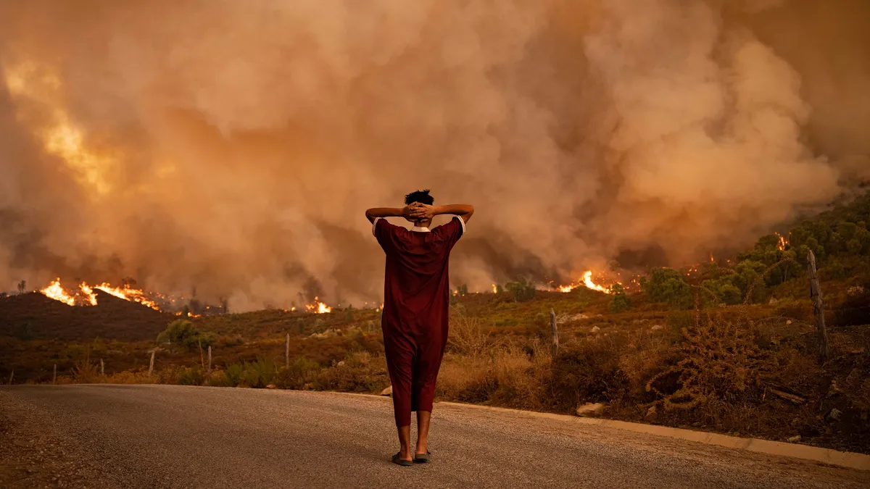
Climate Imaginaries

Slide 2
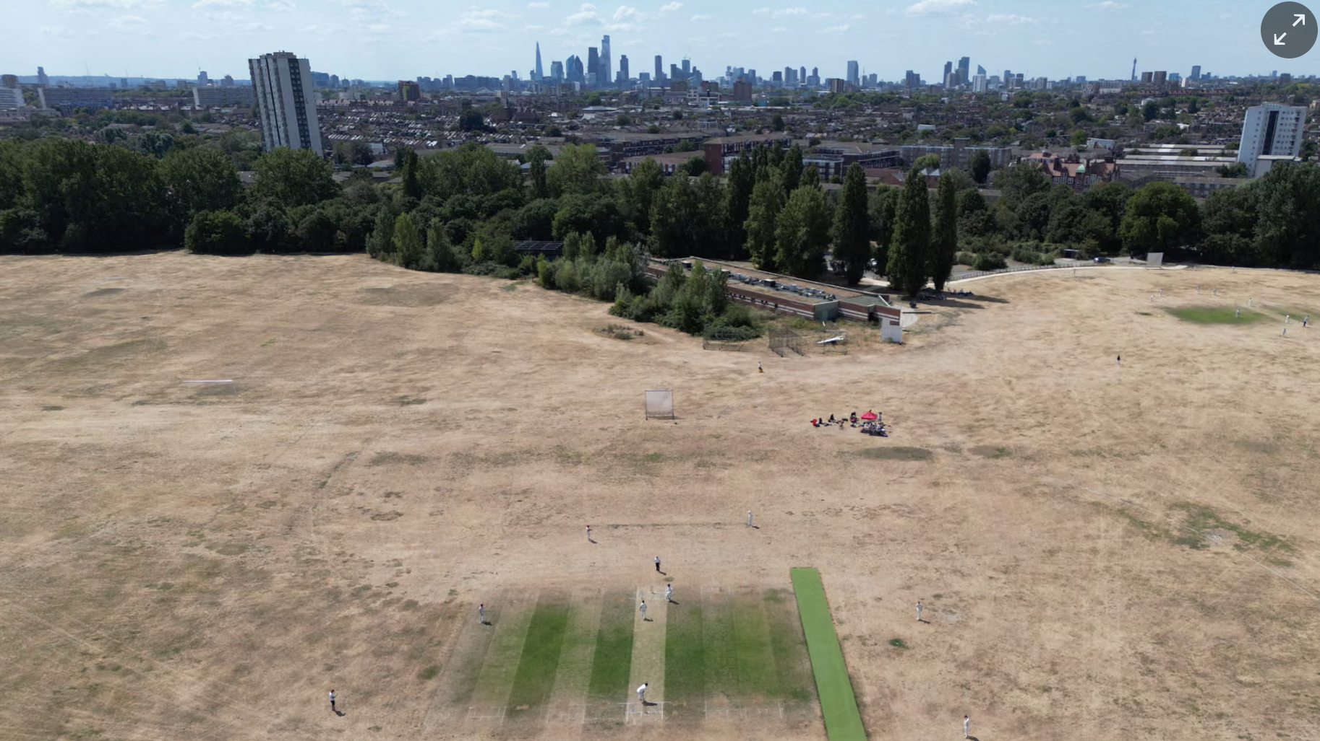

Slide 3
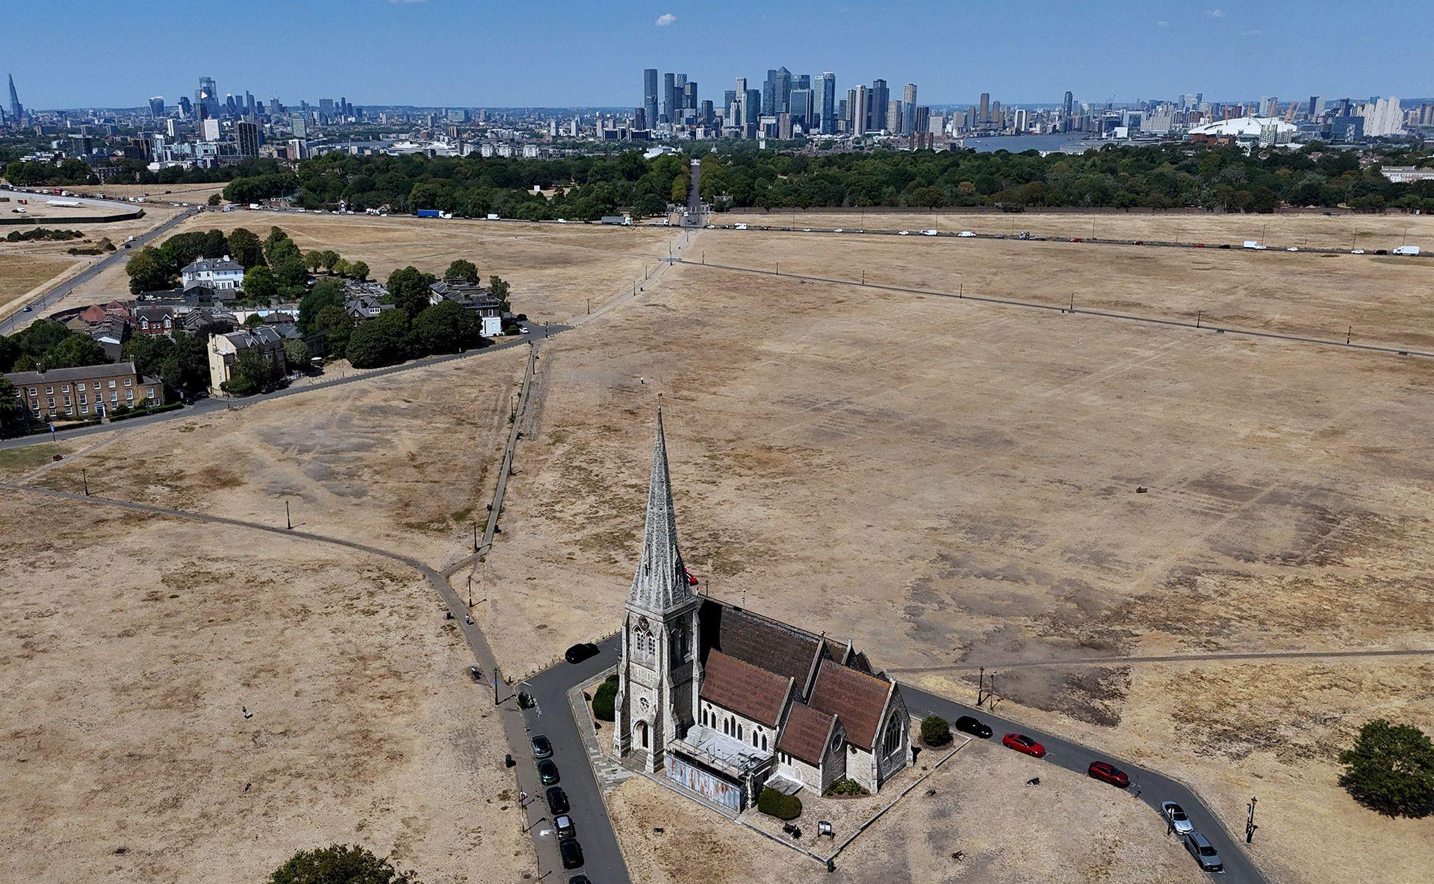

Slide 4
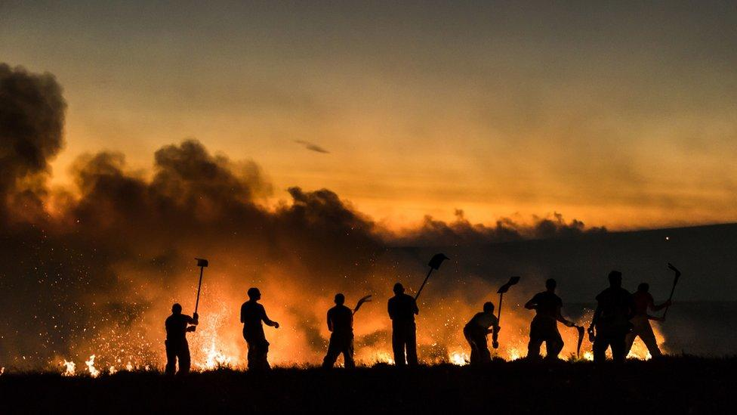

Slide 5
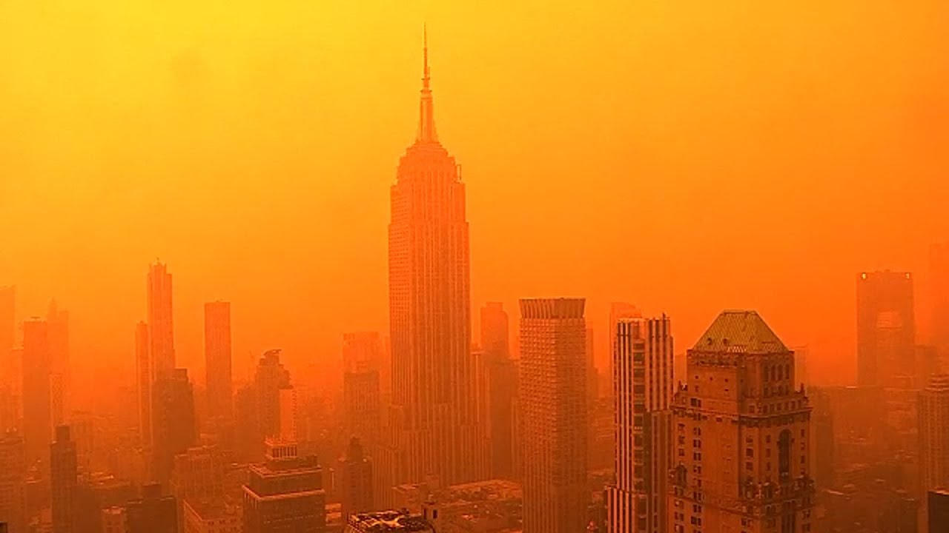

Slide 6
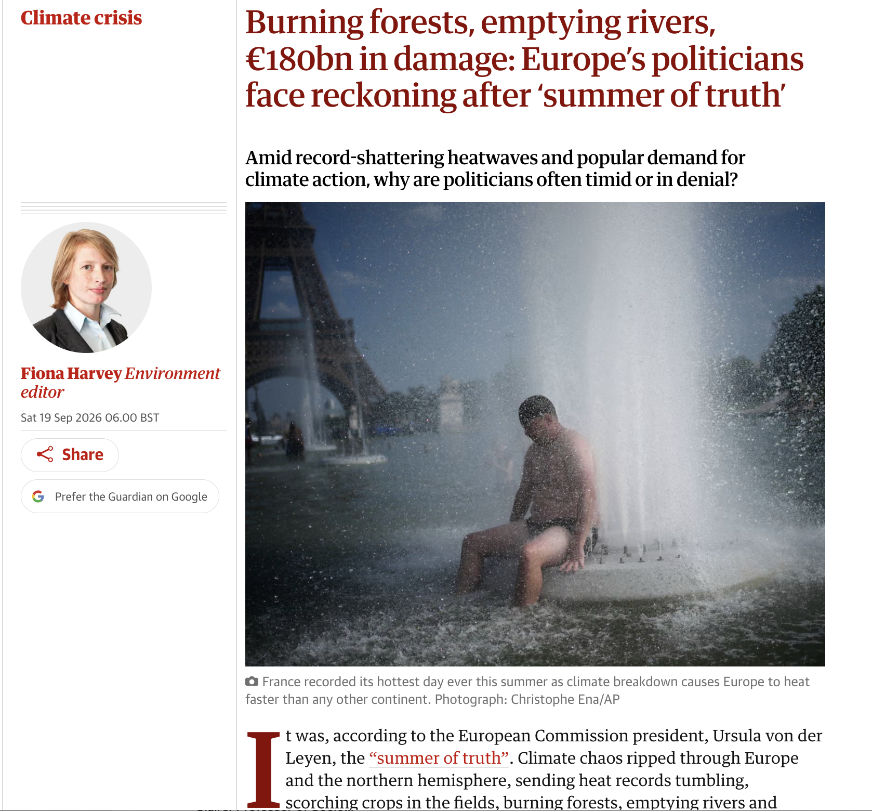

Slide 7
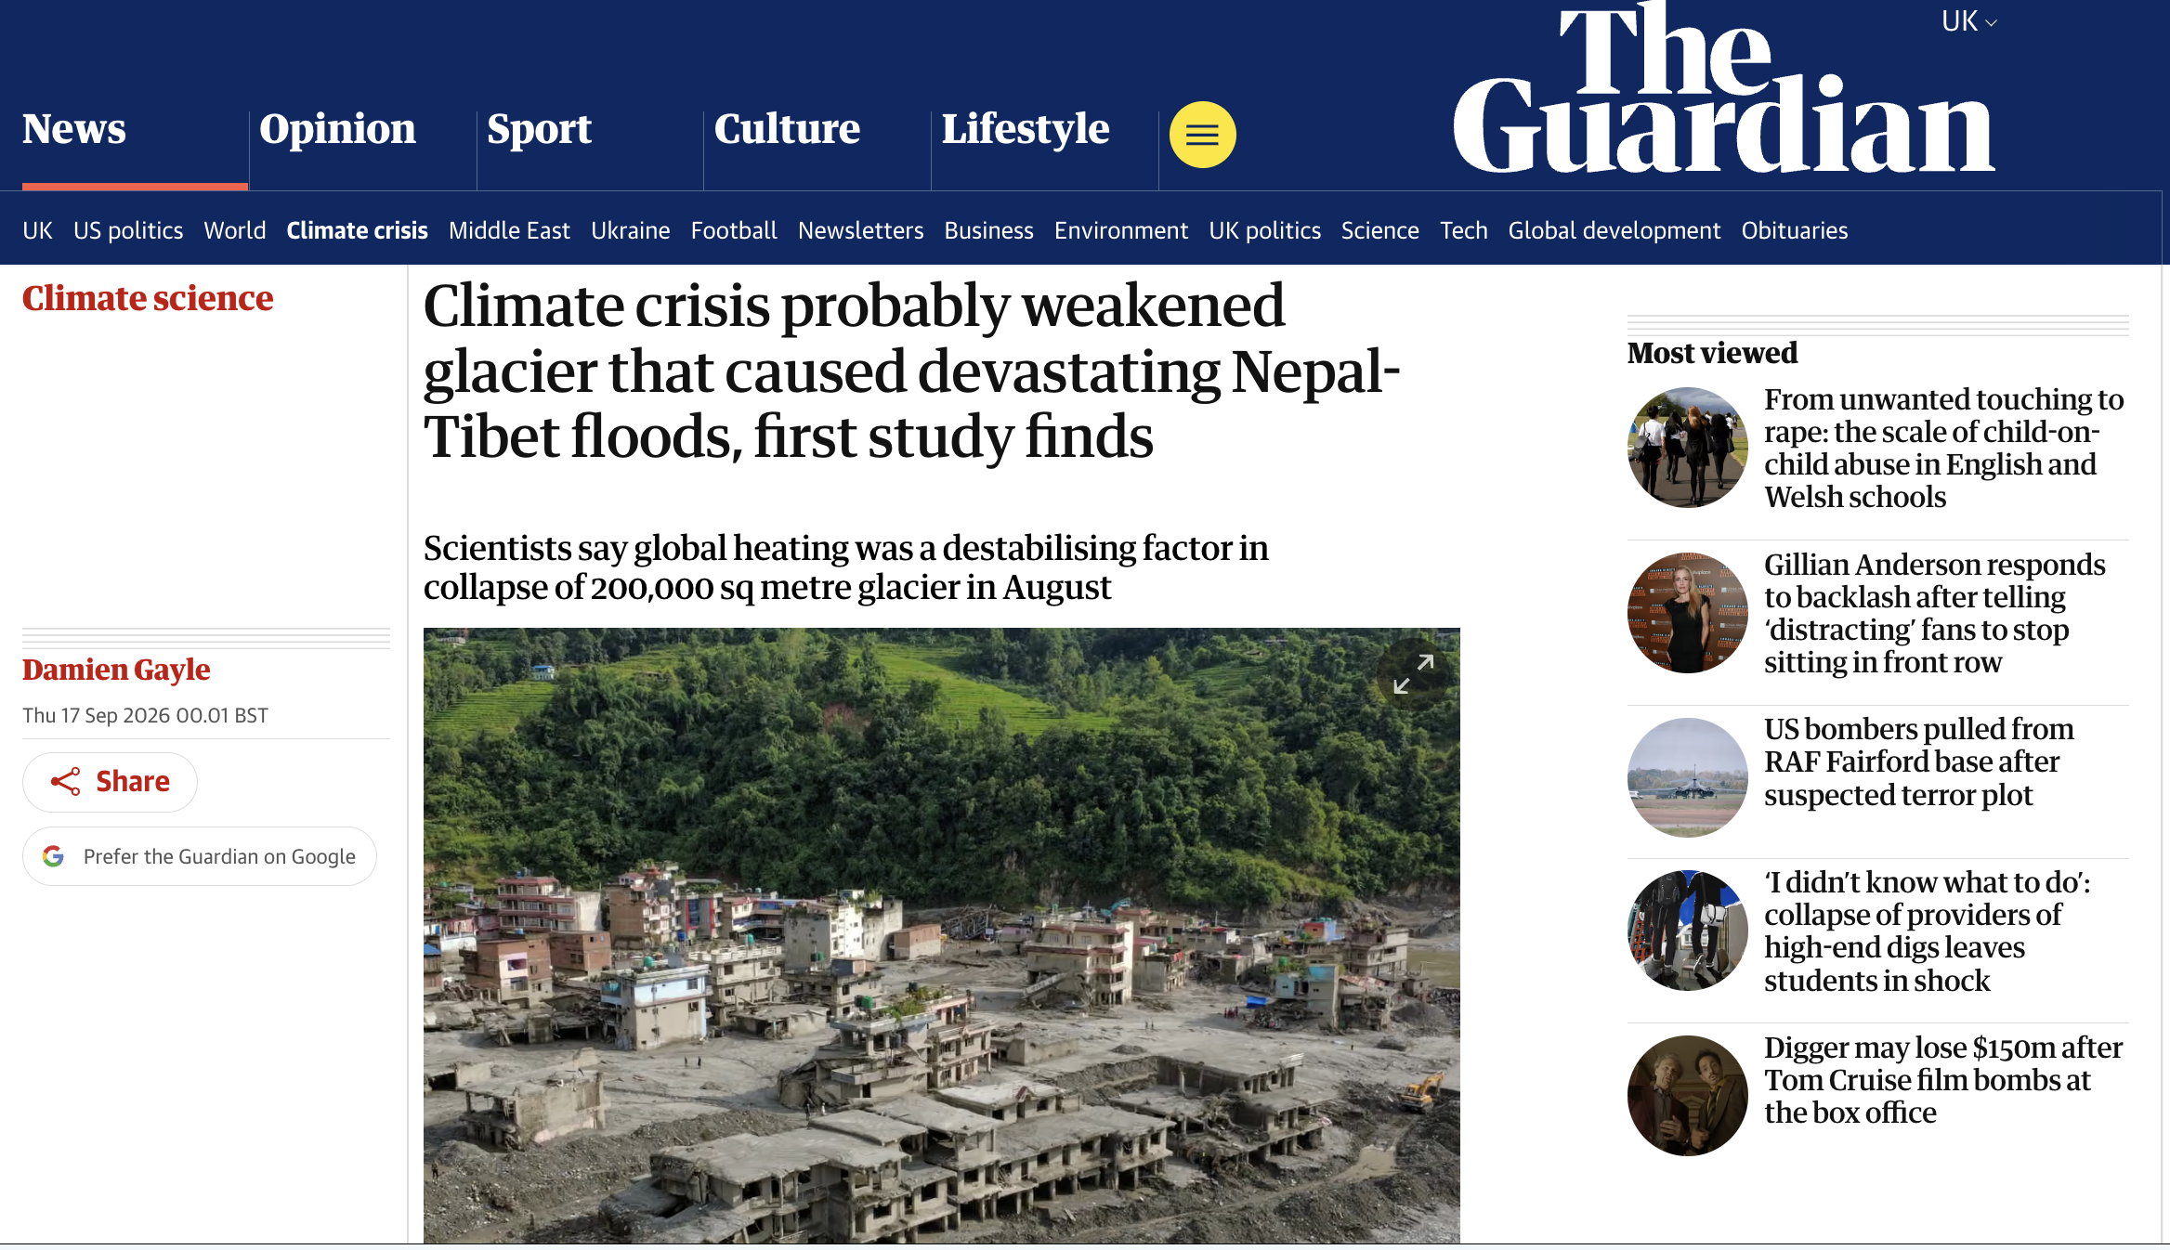

Slide 8
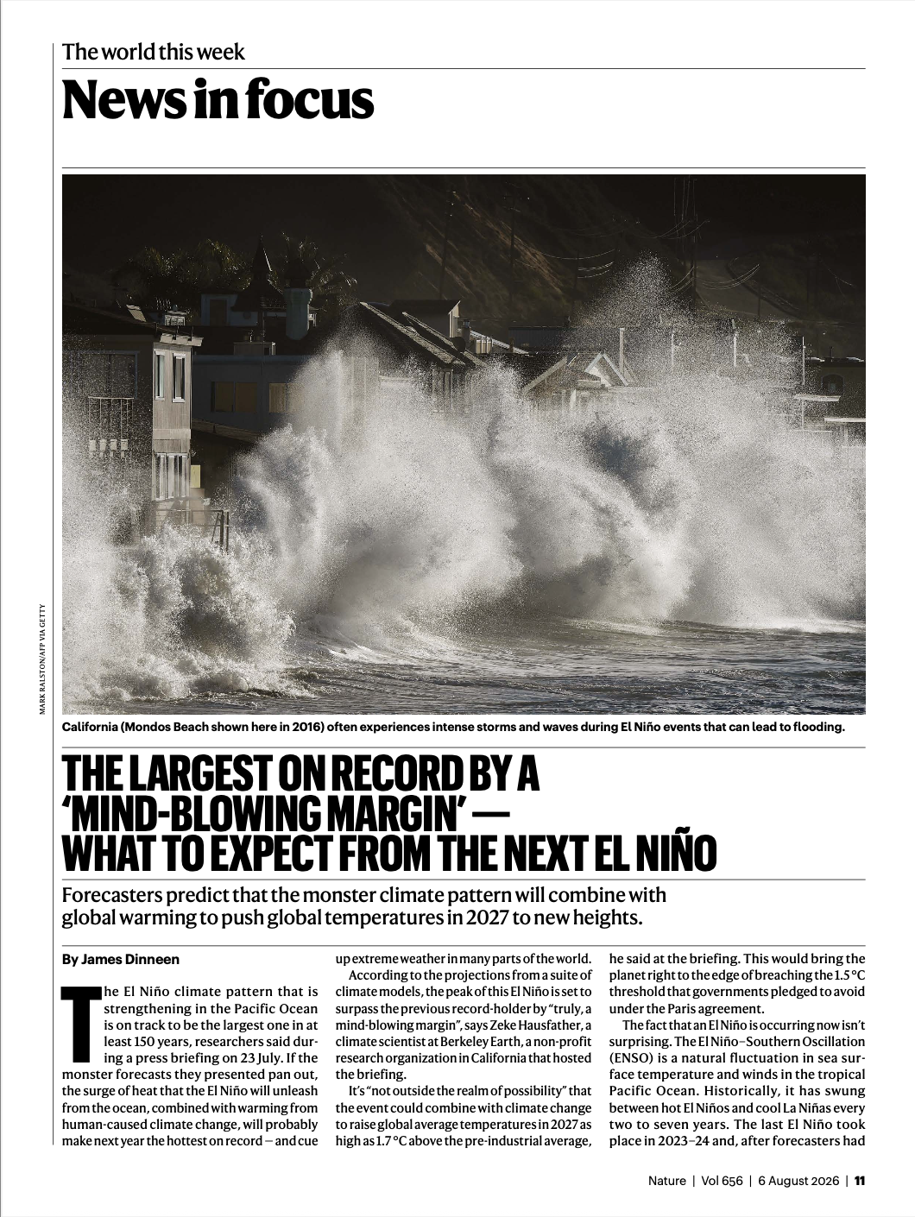
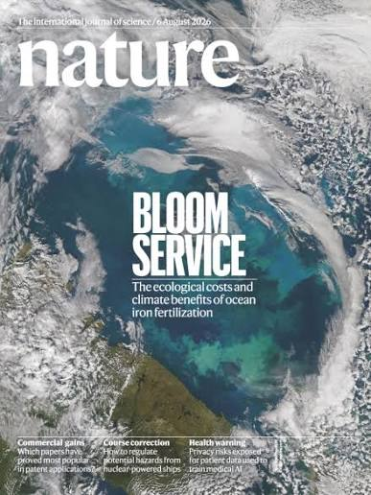

Slide 9
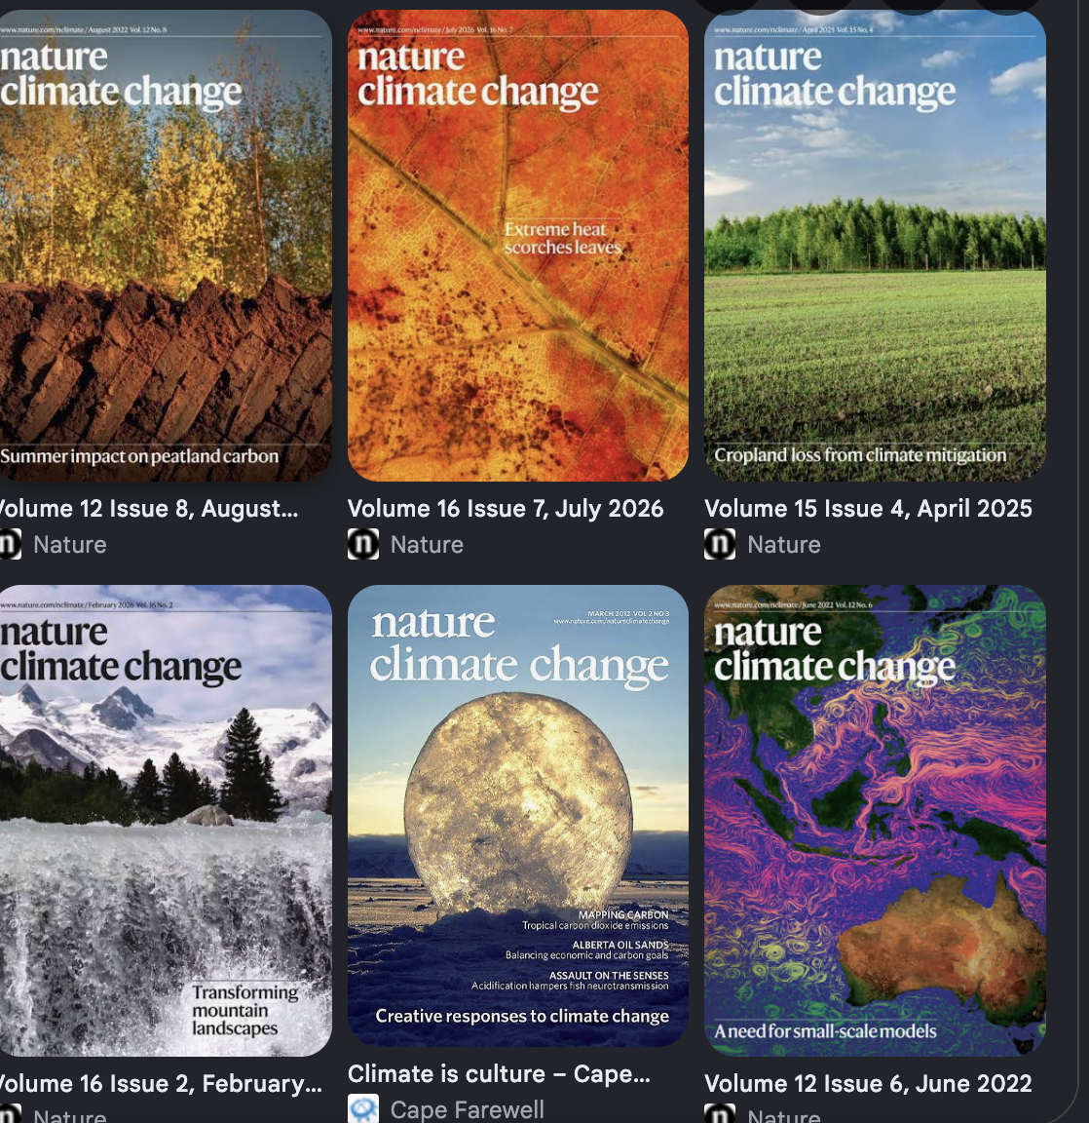

Slide 10
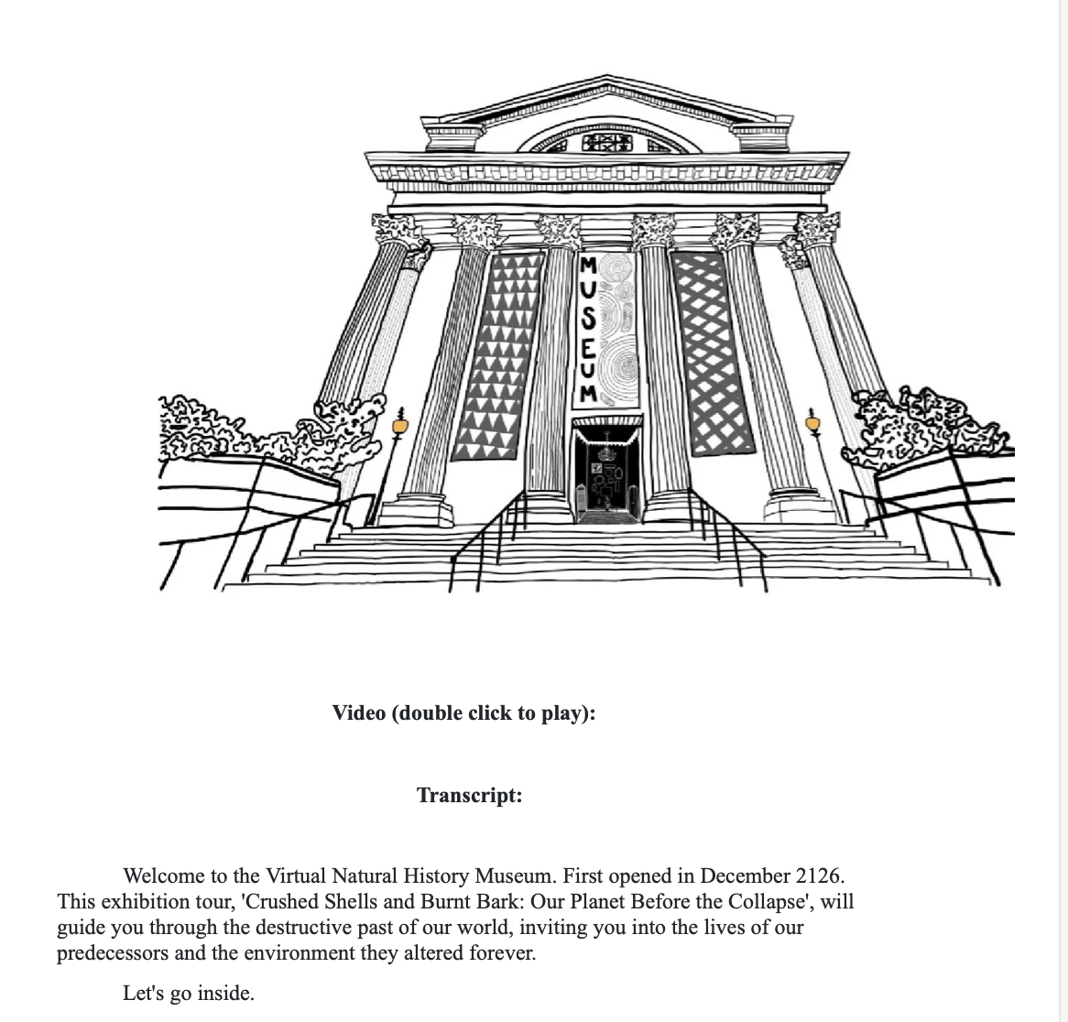
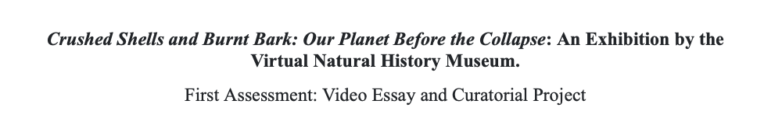

Slide 11
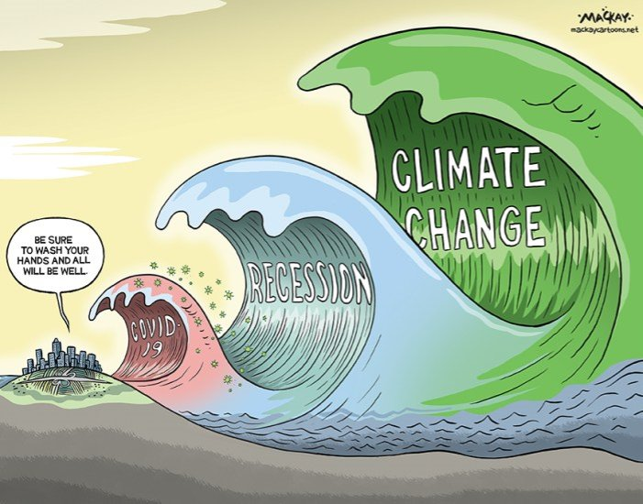

Slide 12
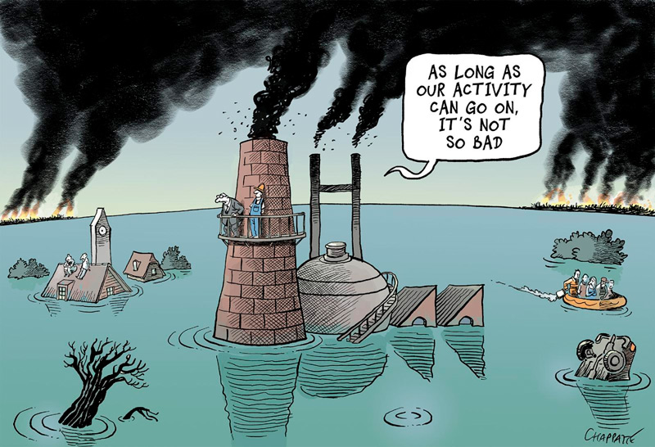

Slide 13
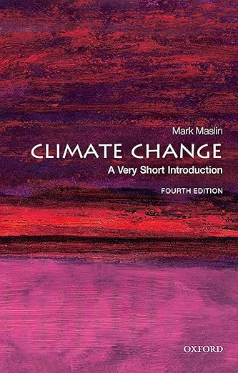
Climate change is one of the four defining challenges of the 21st century, along with environmental degradation, global inequality, and global insecurity. Climate change will continue to increase the temperature of the Earth and raise global sea level. It will increase the frequency of extreme weather events such as droughts, heat waves, floods, and storms threatening the health and livelihoods of billions of people. The severity of these climate change impacts will depend on what we do now to cut greenhouse gas emissions.
CF.P3In the past thirty years, the amount of carbon dioxide emitted through human activity has doubled. This represents a collective failure of the world’s leaders to focus on the climate crisis. (1)
Within 100 years we have put more than one and a half times the amount of carbon into the atmosphere than was emitted over the 4,000 years’ transition from the last ice age to our current interglacial period. (11)
Scientists predict that if we continue on our current carbon emissions pathway we could warm the planet by between 1.5℃ and 4.7 ℃ in the next 80 years. (12)

Slide 14
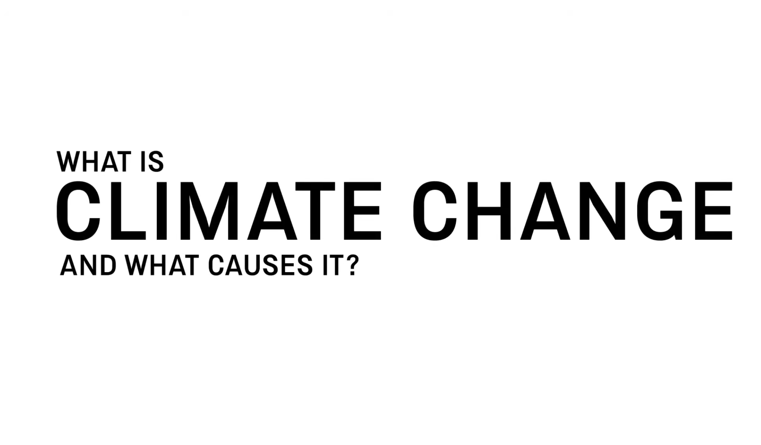

Slide 15
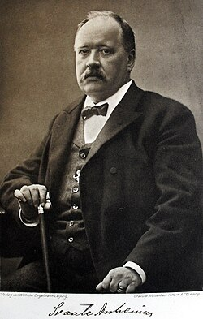
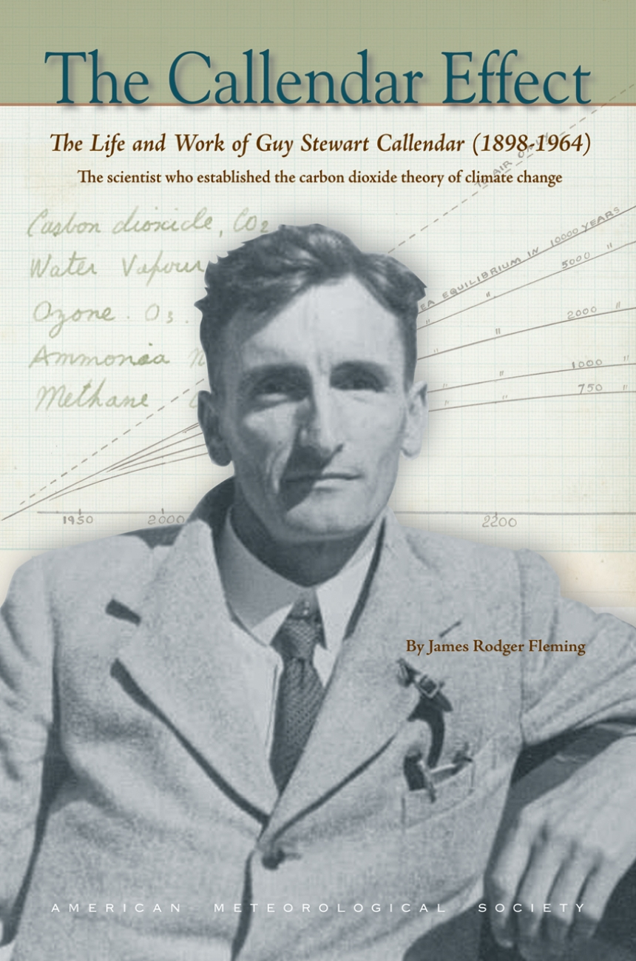
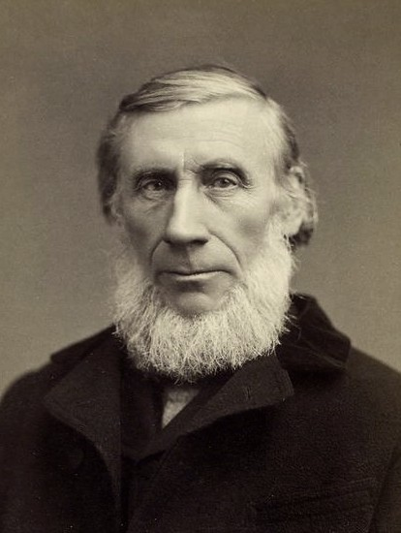
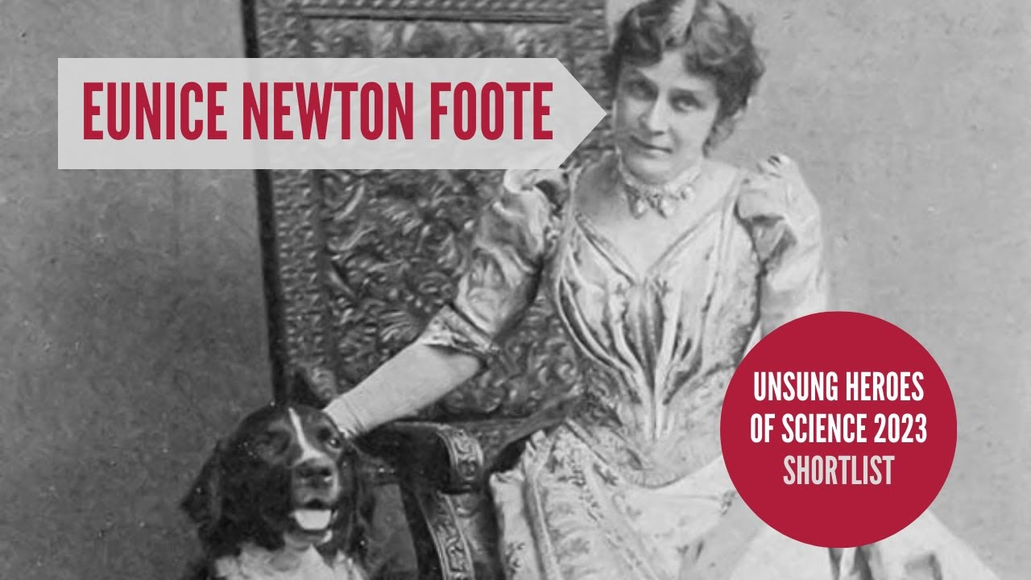
1856 – demonstrated
Greenhouse Effect of C02
John Tyndall, measured
+ demonstrated greenhouse
effect in different gases.
(1859)
Svante Arrhenius
Earth Temp. change in
variation of GhGs
Showed that world was
warming by compiling 147
Temp. records. (1938)

Slide 17

Rachel Carson, Silent Spring (1962)

Slide 19
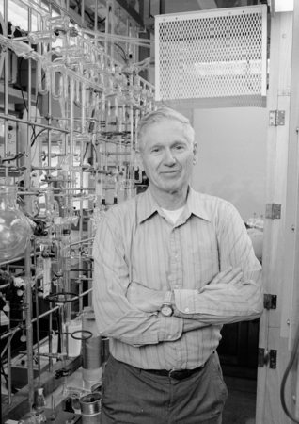
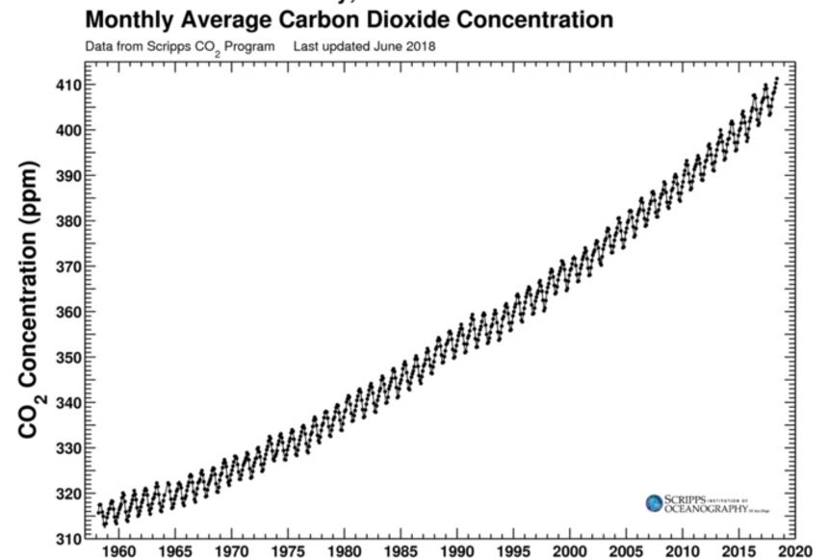
Charles Keeling, of the ‘Keeling Curve’, (1958-)
National Oceanic and Atmospheric Administration (NOOA)

Slide 20
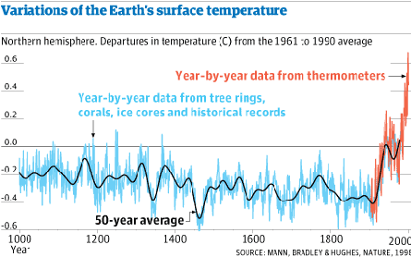

Slide 21
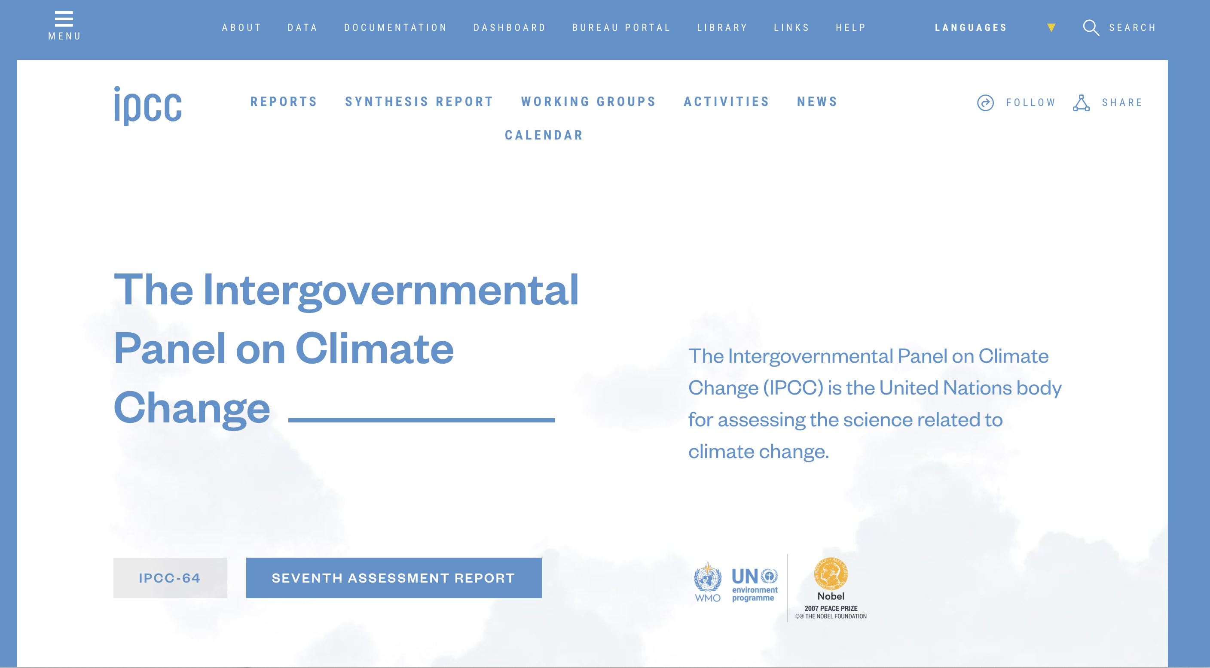

Slide 22
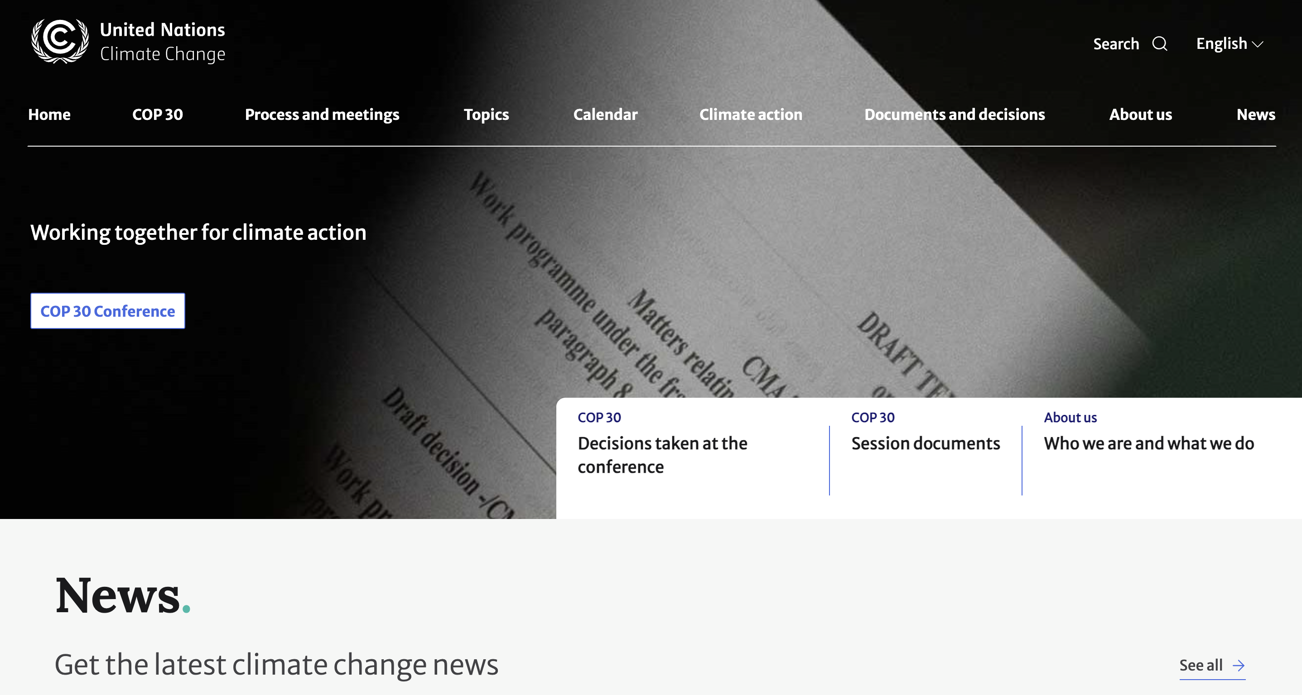

Slide 23
Contemporary culture finds it so hard to deal with climate change. Indeed, this is perhaps the most important question ever to confront culture in the broadest sense—for
let us make no mistake: the climate crisis is also a crisis of culture, and thus of the imagination. (2016)

Slide 24
The age of global warming defies both literary fiction and contemporary common sense: the weather events of this time have a very high degree of improbability. Indeed, it has even been proposed that this era should be named the “catastrophozoic” ... It is certain ...that these are not ordinary times: the events that mark them are not easily accommodated in the deliberately prosaic world of serious prose fiction.
Amitav Ghosh (2016)
Notes:
Phenomena such as ocean acidification, climate change, the general effects of incremental forms of ecological degradation across the planet, global overpopulation and resource depletion do not present any obvious or perceptible target for concern or protest at any one place, or often any immediate antagonist perceptible at the normal human scale. The largely benumbed recognition of this reality

Slide 25
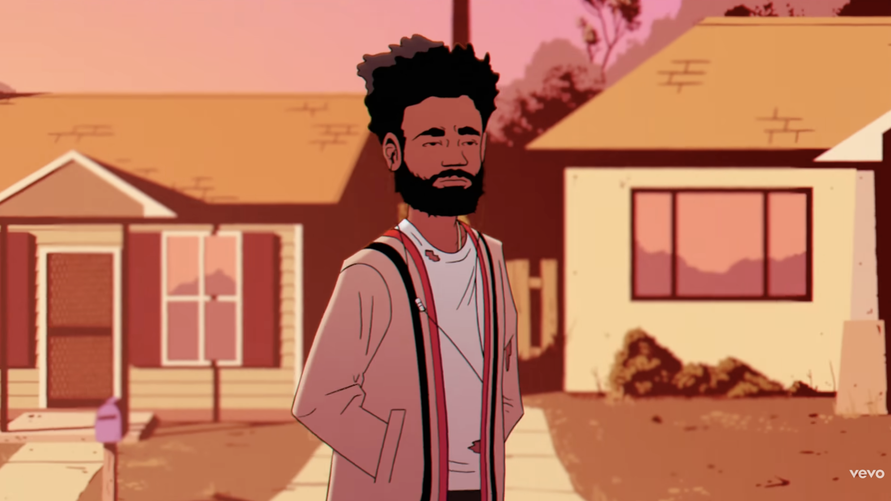

Slide 26
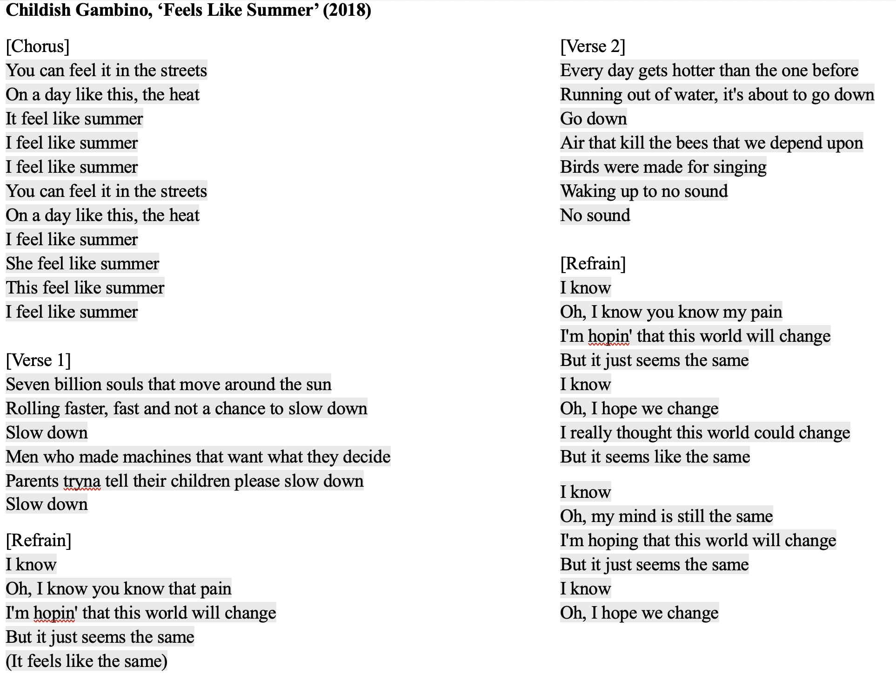

Slide 27
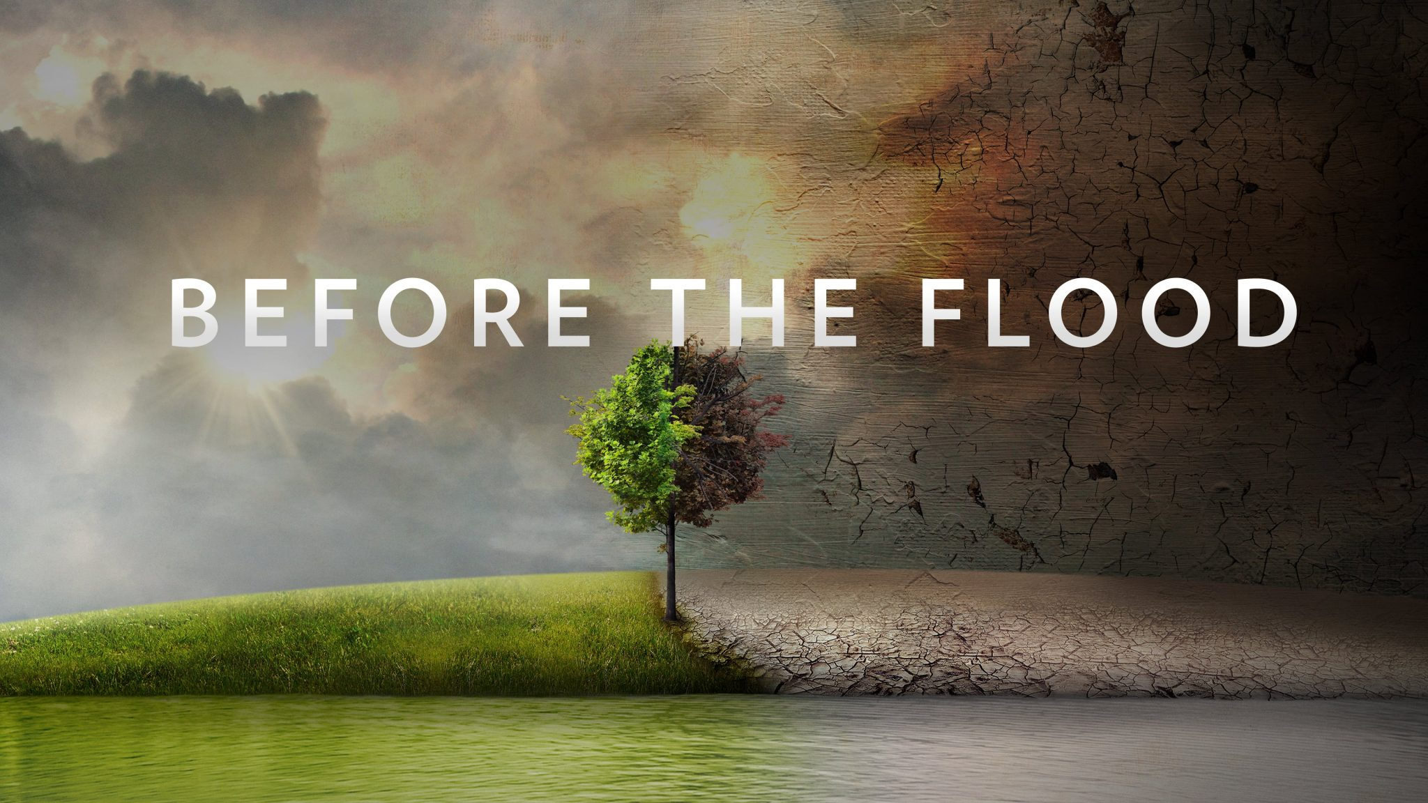
2016

Slide 28
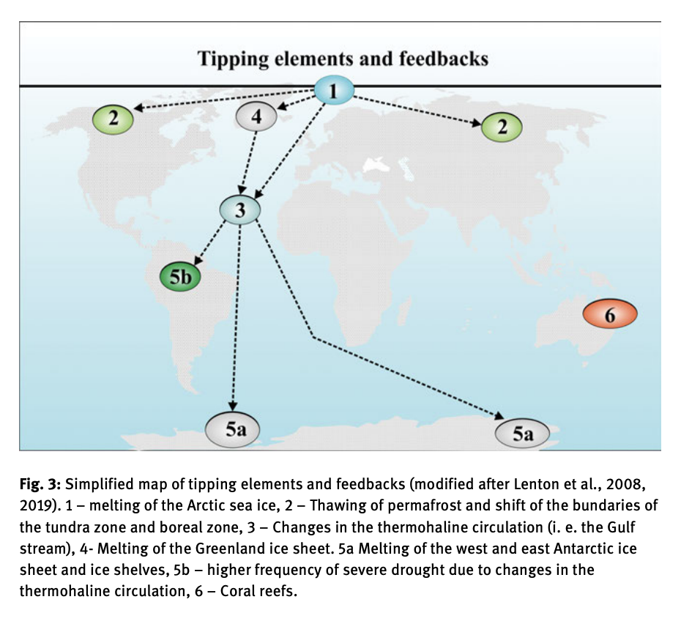

Slide 29
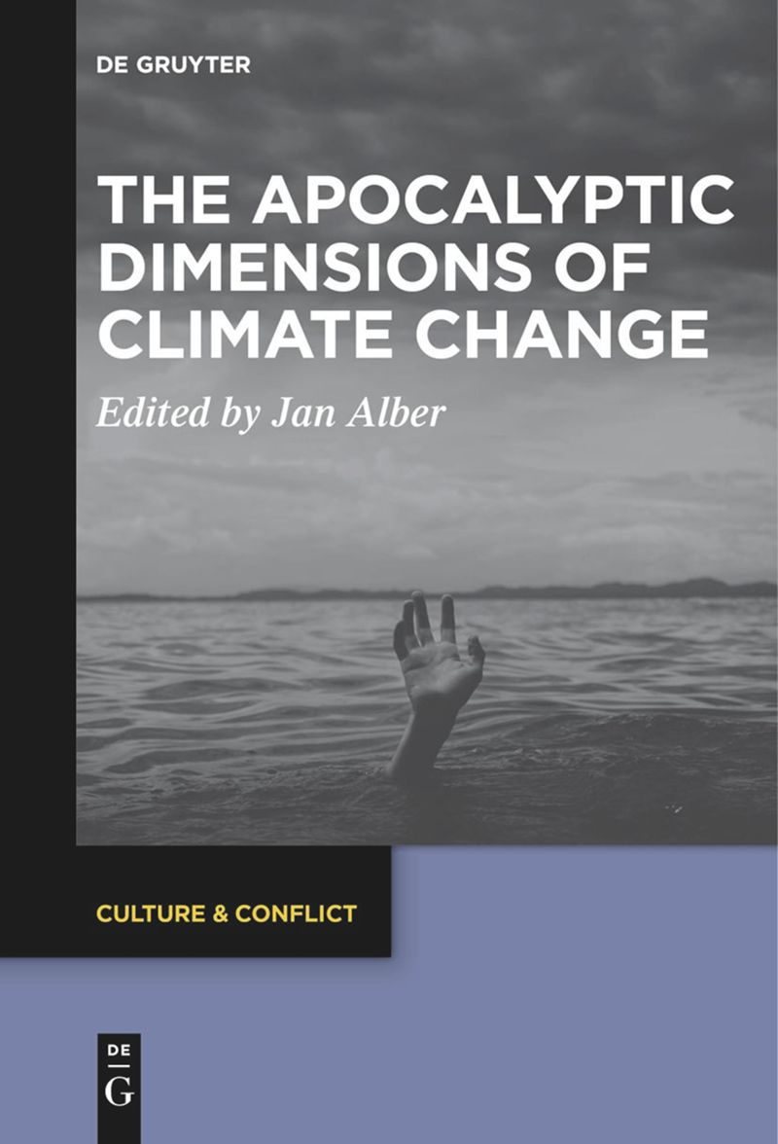
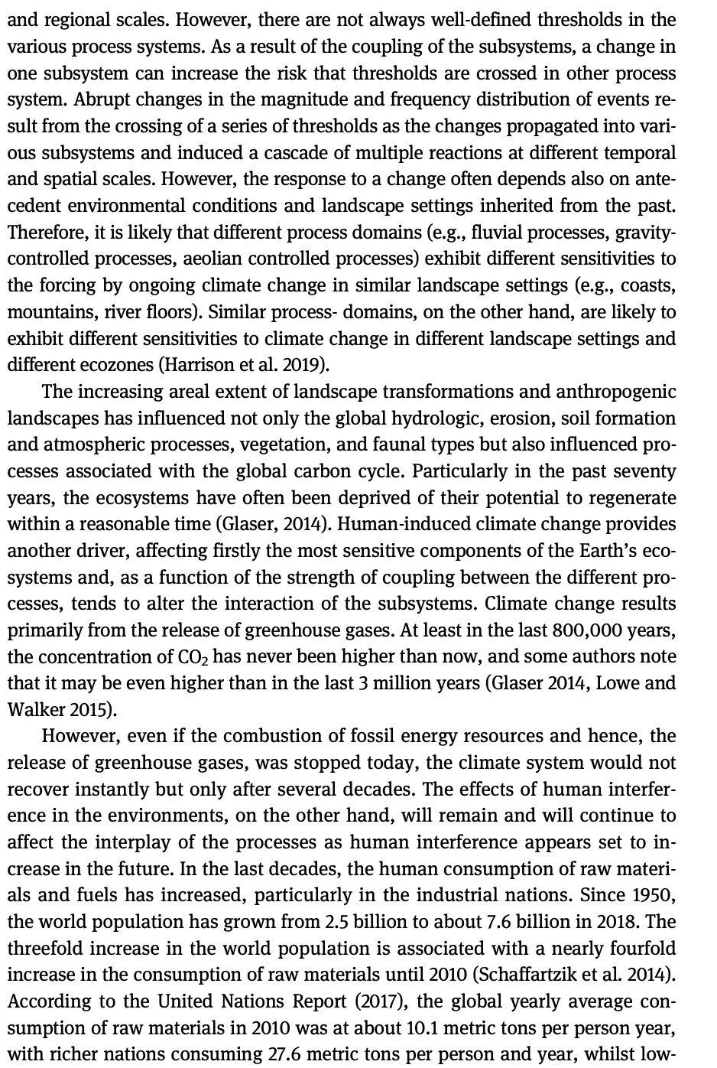
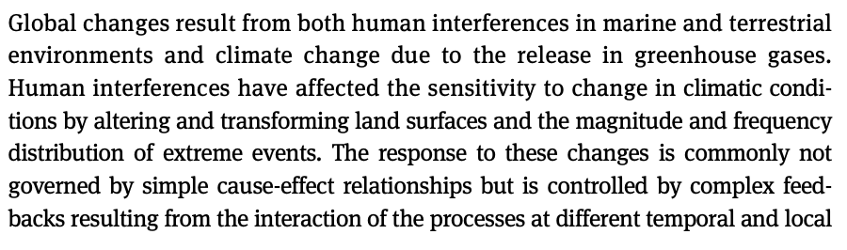
Wolfgang Römer, “Scenarios of Human-Induced Climate and Environmental Changes at Different Spatial and Temporal Scales”(2021)

Slide 30
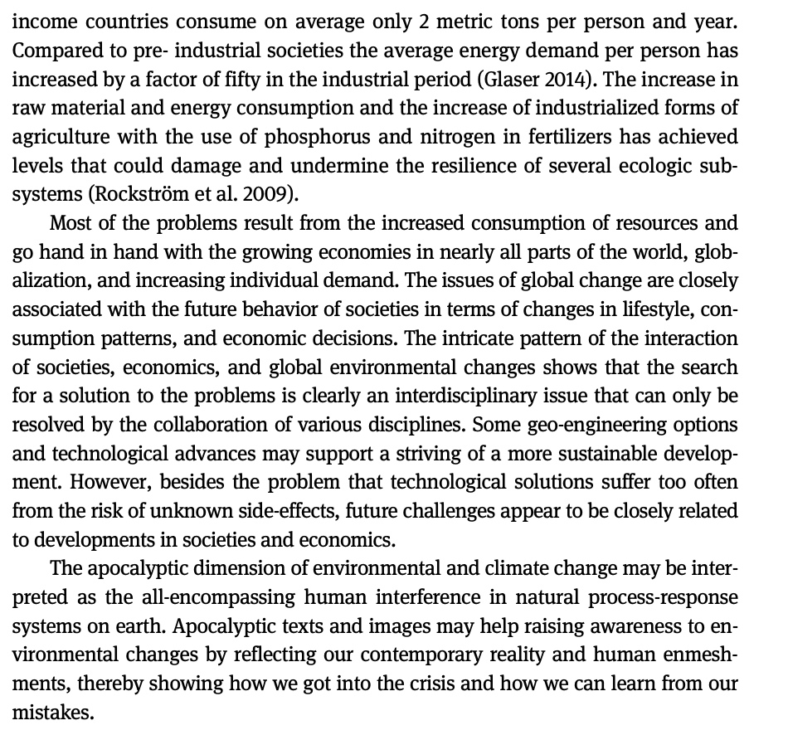
Römer (cont.)

Slide 31
Imaginary

Slide 32
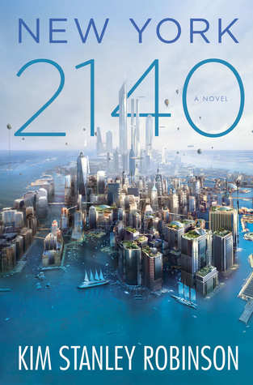
The flood went up to about Thirtieth. And even though it was fast, it did take two hours. So people just ran north ahead of it. They abandoned whatever they were doing and ran in the streets. We did too. Central Park had millions of people in it, standing there looking at each other….No one could believe it. But it was true. A new day had come. We knew it had happened, because there we were. We knew it would never be the same. Downtown was gone. So that was very strange. People were stunned, you could see it. We stood there looking at each other! No one could believe it but there we were. Everyone was like, well, here we are – it must be real. But it was like a dream.
Kim Stanley Robinson, New York 2140 (2017)
Notes:
We see the same thing here in a novel about adaptation to catastrophe in North American continent, where NYC adapts, yet the entrie scene remains cognitively difficult to grasp – long genre, cautionary tales, tales about denialism and consciousness raising, weird tales of strange climate, offshoring the problem by alienating it, then the speculative fccition and the dystopias – usually of resource-starved worlds, depleted stocks of foods, medicines, turn to authoritarianism, and another way of doing this might be seeing a totally transformed world devoid of humans, - so how about Scotland, in 2563…slide

Slide 33
Imagination here is understood as a way of seeing, sensing, thinking, and dreaming the formation of knowledge, which creates the conditions for material interventions in and political
sensibilities of the world.
An alternative approach might consider how imagination is actively produced through iterative processes and practices that establish dominant framings of the imagination.
There are two distinct schools of thought here. (1) Imagination as a relational space that is informed by the objects and subjects with which it is entangled. (2) Imagination as a mediator between the positivist world and the human mind.
Kearney suggests that while there is a plurality of terms for the imagination, they all adhere to a basic trait of capturing ‘the human power to connote absence into presence, actuality into possibility, what is into something—other-than-it-is […] What we can say now of the imagination is that rather than being the site of division it is a site of interplay between material
and perceptual worlds, where concepts cohere, forces
pull and attract, and things, discourses, subjects, and
objects are framed, contested, and brought into being.
Yusoff & Gabrys
Climate change… is being reimagined as an
ethical, societal, and cultural problem that poses
new questions and reconfigures the geographic
imaginaries of the world. These new cultures of
climate change can be characterized by three
distinct temporal and spatial imaginative
framings of climate change:
- futurity of climate change.
- adaptation: imagination by degree
- climate practices
Imagination can be thought of as a way of
seeing, or rather a constellation of a way of thinking
and sensing that becomes typified or consolidated in
images and social actions.

Slide 34
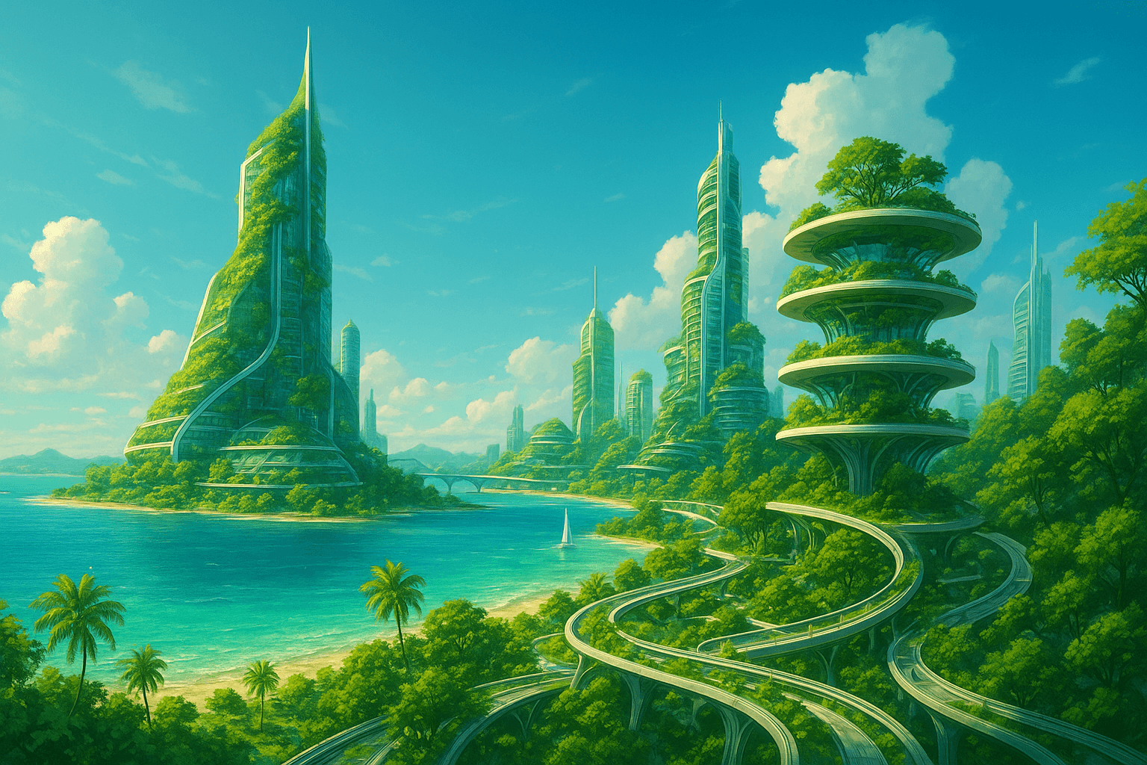
First, there has been a concentration on the futurity of climate change including the arts and techniques of imagination that are bound up with making scenarios, narratives, and contingency plans that project toward or back from uncertain futures. An engagement with the arts of futurity can be seen in the workings of the Intergovernmental Panel on Climate Change (IPCC); the practices of scenario modeling; back-casting and forward-looks that characterize much of the science–policy interface of climate science; and the economics of futures markets. These uncertainties open a generative space of unknowing that has been populated by various ‘visions’ of the future. The arts of this futurity are anticipatory, pre-emptive, and promiscuous.
…..this ‘cultural turn’ in climate change has
seen a critical engagement with the practices of climate
science. Multiple creative practitioners and researchers
are now seeking to expand modes of climate science
production to reconsider the social spaces of climate
interaction at the science-policy-public interface, and
to promote new forms of the coproduction knowledge
between different communities of practice (such
as science–art or art–public collaborations).
Yusoff & Gabrys
Yet within this work, there has been scant attention as to
how futures could be deployed as a cultural and creative
method of environmental imagining and how the arts and
humanities could contribute to future narratives. The
arts and humanities play an important role in thinking
through our representations of environmental change
and give tangible form to the imagination of different
worlds outside of the constraints of the given present….
Arts and humanities scholars and practitioners
in collaboration with scientists can reconsider
how climate futures are imagined.

Slide 35
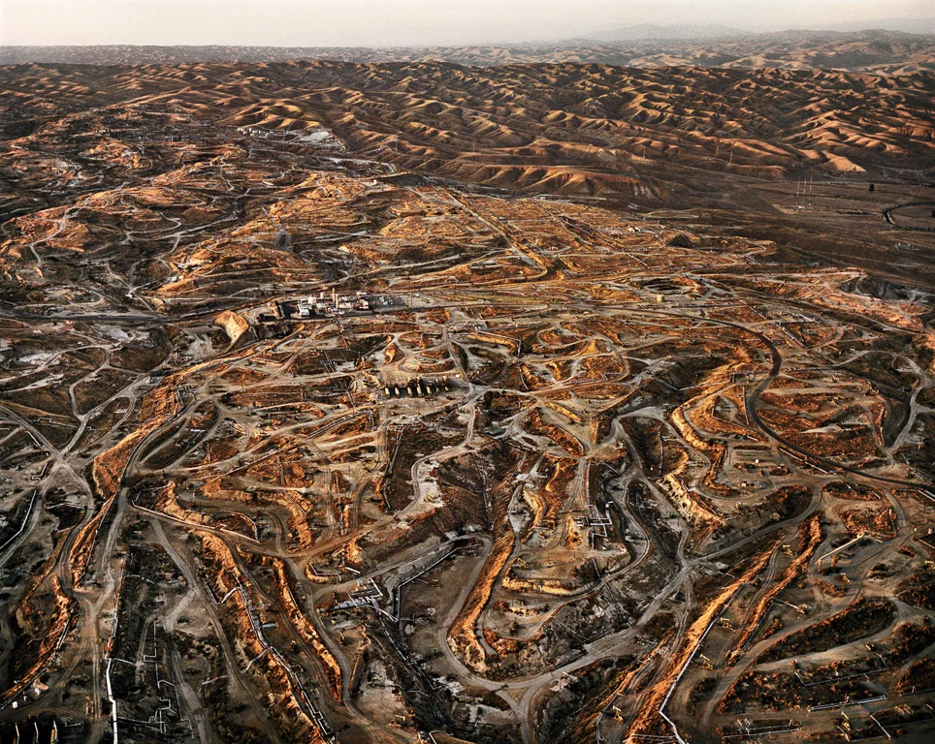
The uncountable repetitions of the same act over the past two
centuries form the defeated time now pouring down from the sky.
How can we apprehend that process? Malm
Scholars writing on the current climate-change crisis are indeed saying
something significantly different from what environmental historians
have said so far. In unwittingly destroying the artificial but time-honored
distinction between natural and human histories, climate scientists posit
that the human being has become something much larger than the simple
biological agent that he or she always has been. Humans now wield a
geological force. As Oreskes puts it: “To deny that global warming is real is
precisely to deny that humans have become geological agents, changing
the most basic physical processes of the earth.”
In no discussion of freedom in the period since the Enlightenment was
there ever any awareness of the geological agency that human beings were
acquiring at the same time as and through processes closely linked to their
acquisition of freedom. Geological time and the chronology of human
histories remained unrelated. This distance between the two calendars, as
we have seen, is what climate scientists now claim has collapsed. The period
I have mentioned, from 1750 to now, is also the time when human
beings switched from wood and other renewable fuels to large-scale use of
fossil fuel—first coal and then oil and gas. The mansion of modern freedoms
stands on an ever-expanding base of fossil-fuel use. Most of our
freedoms so far have been energy-intensive.
Chakrabarty. “The Climate of History: Four Theses.” Critical Inquiry 35. 2 (2009): 197–222.

Slide 36
Climate Fictions

Slide 37

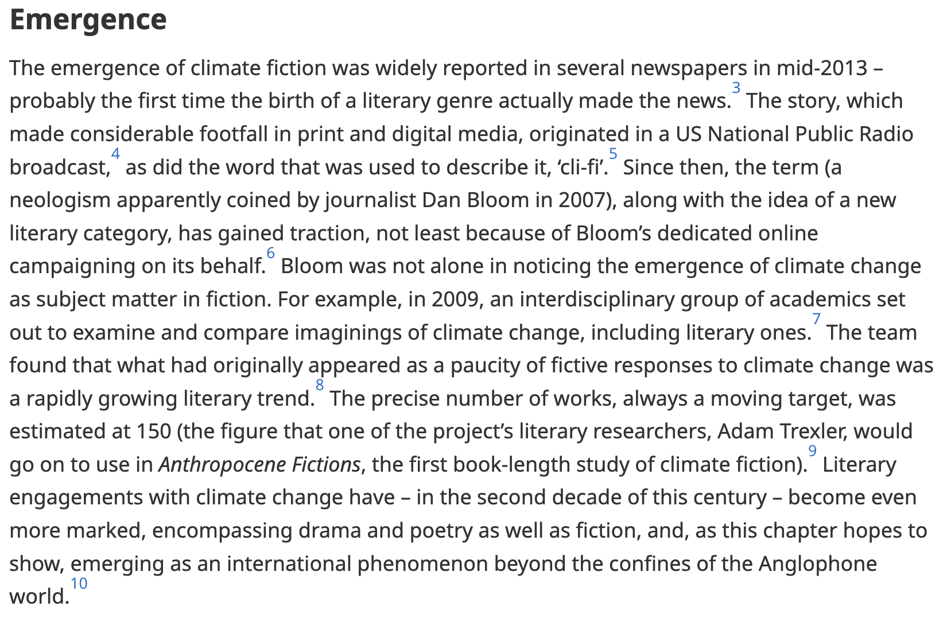

Slide 38


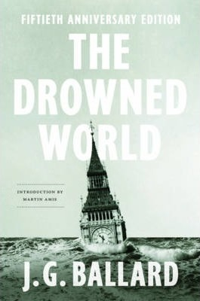

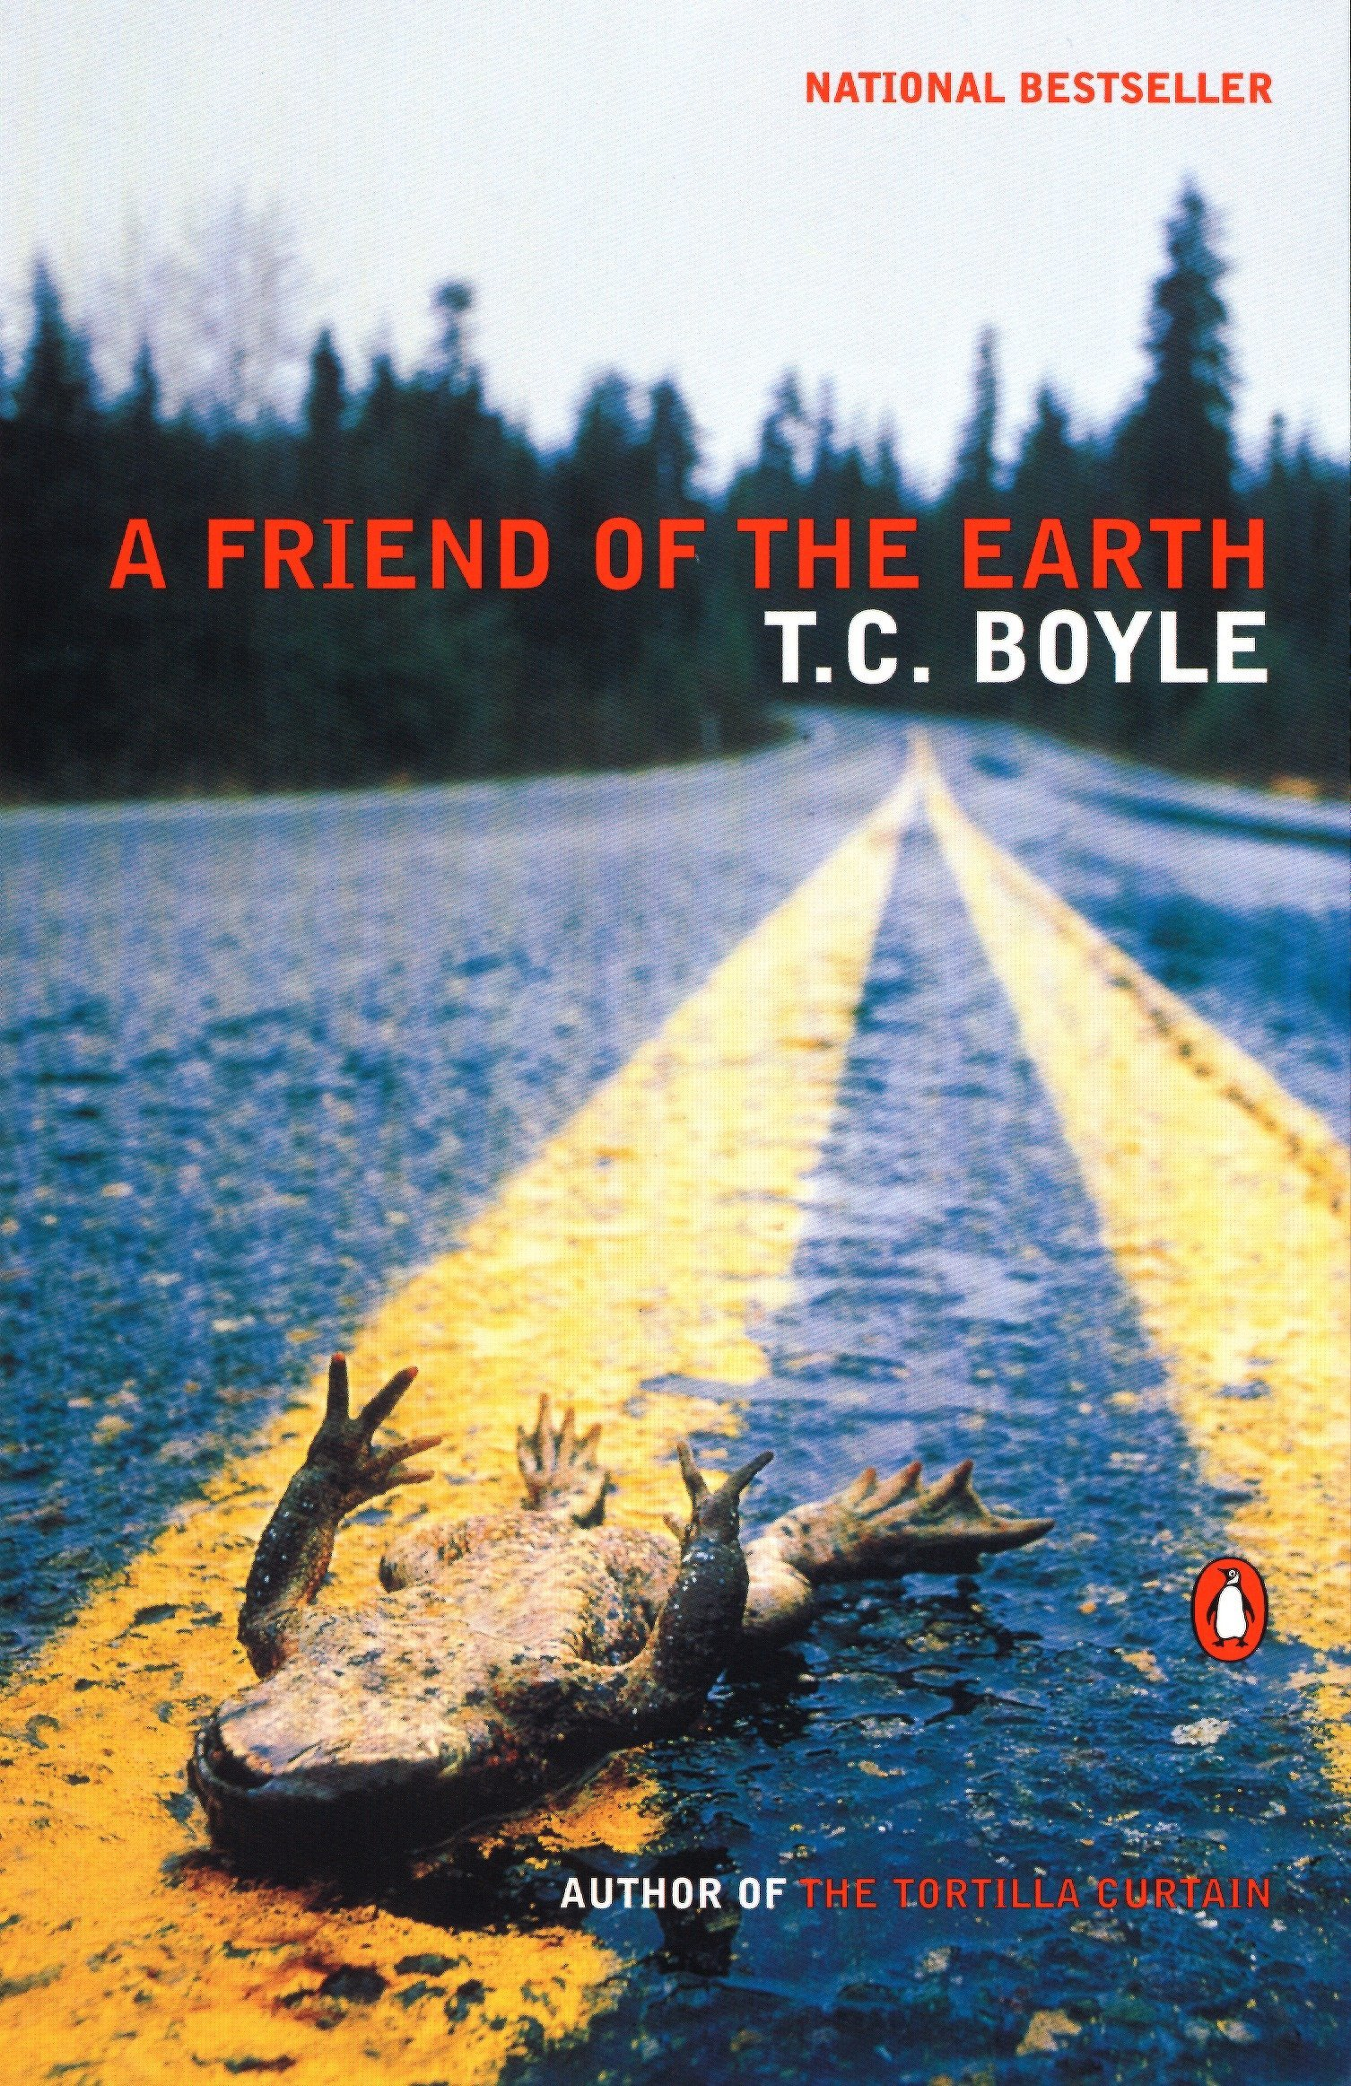
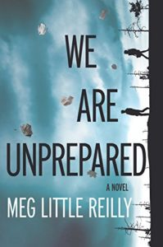


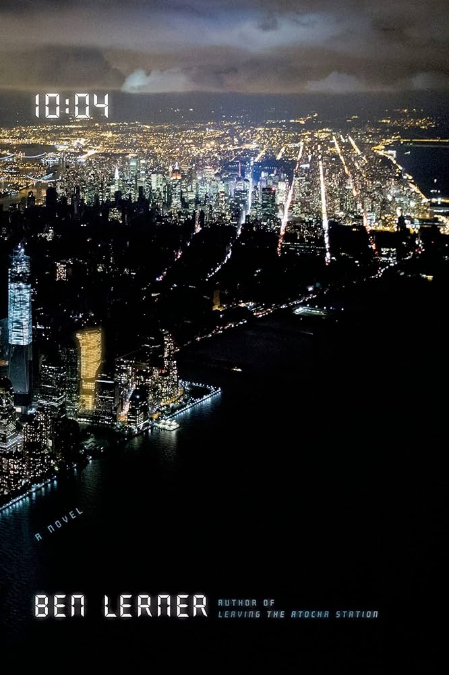

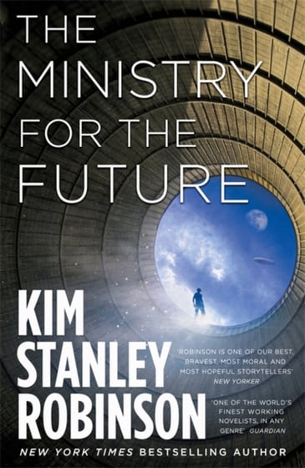







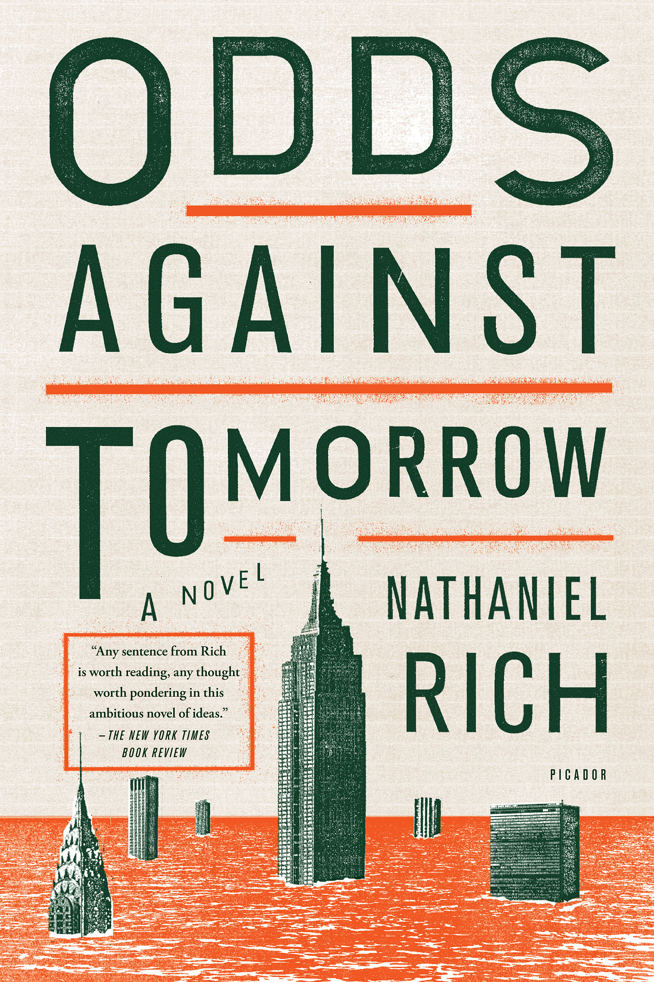
Notes:
YET – there IS A strong idenfiiable strand of climate fiction - ‘clifi’ – what Ghosh resigned to the ‘outhouses’ of culture – there are indeed so many examples of societal meltdown and earth system collapse on our screens that it’s harder to choose one. Predilection for dystopia and apocalypse (end times threats; cautionary tales; extrapolations of the present; also small morality tales within of how to deal wth it and how to be better and perhaps prevent it)
Examples of clifi from all over and through various genres and audicnes, YA fiction to sf to fantasy and the orthodox novel – this fiction is almost always trying to register a massive change and usually involves dystopian worlds, either of adapation to a new and radically transformed climate or a word where an apocalypse is creating dystopian forms of reaction and governance – next slide is benumbing reality in this work….

Slide 39

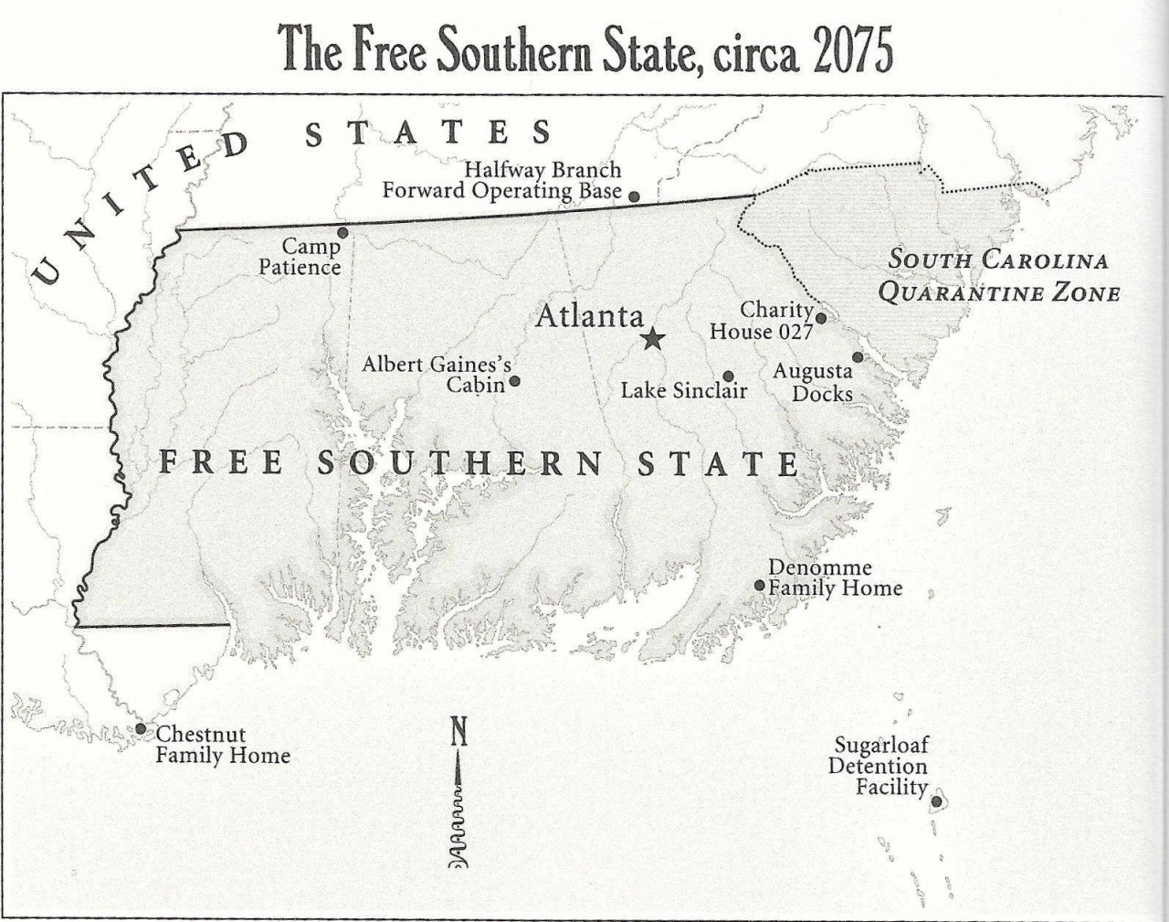




Slide 40
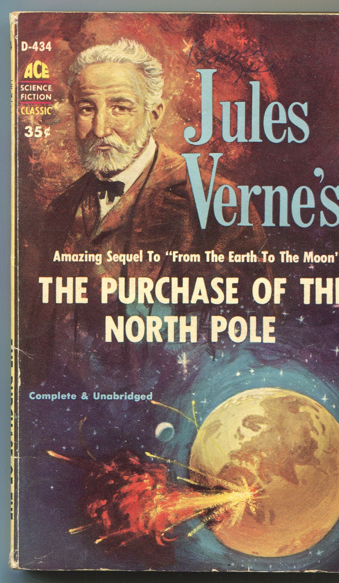

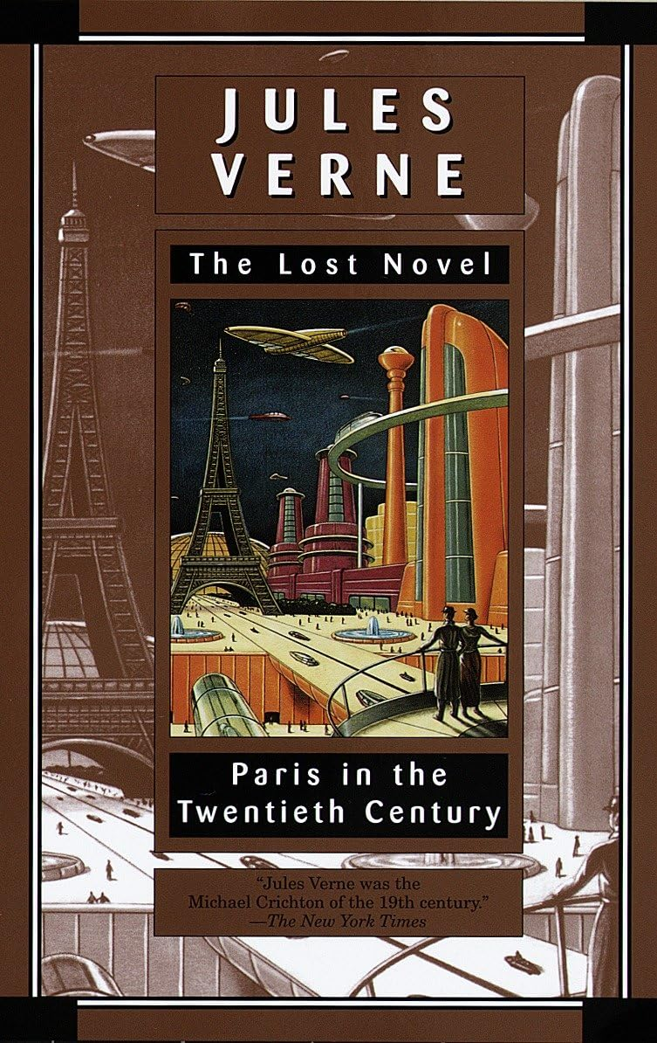

Slide 41



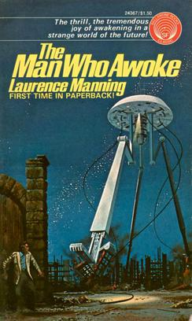
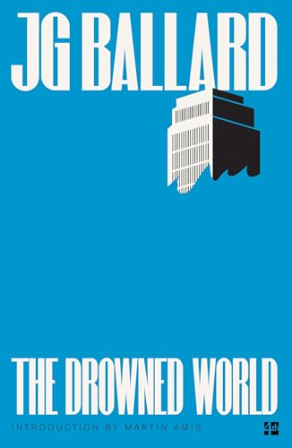


Slide 42


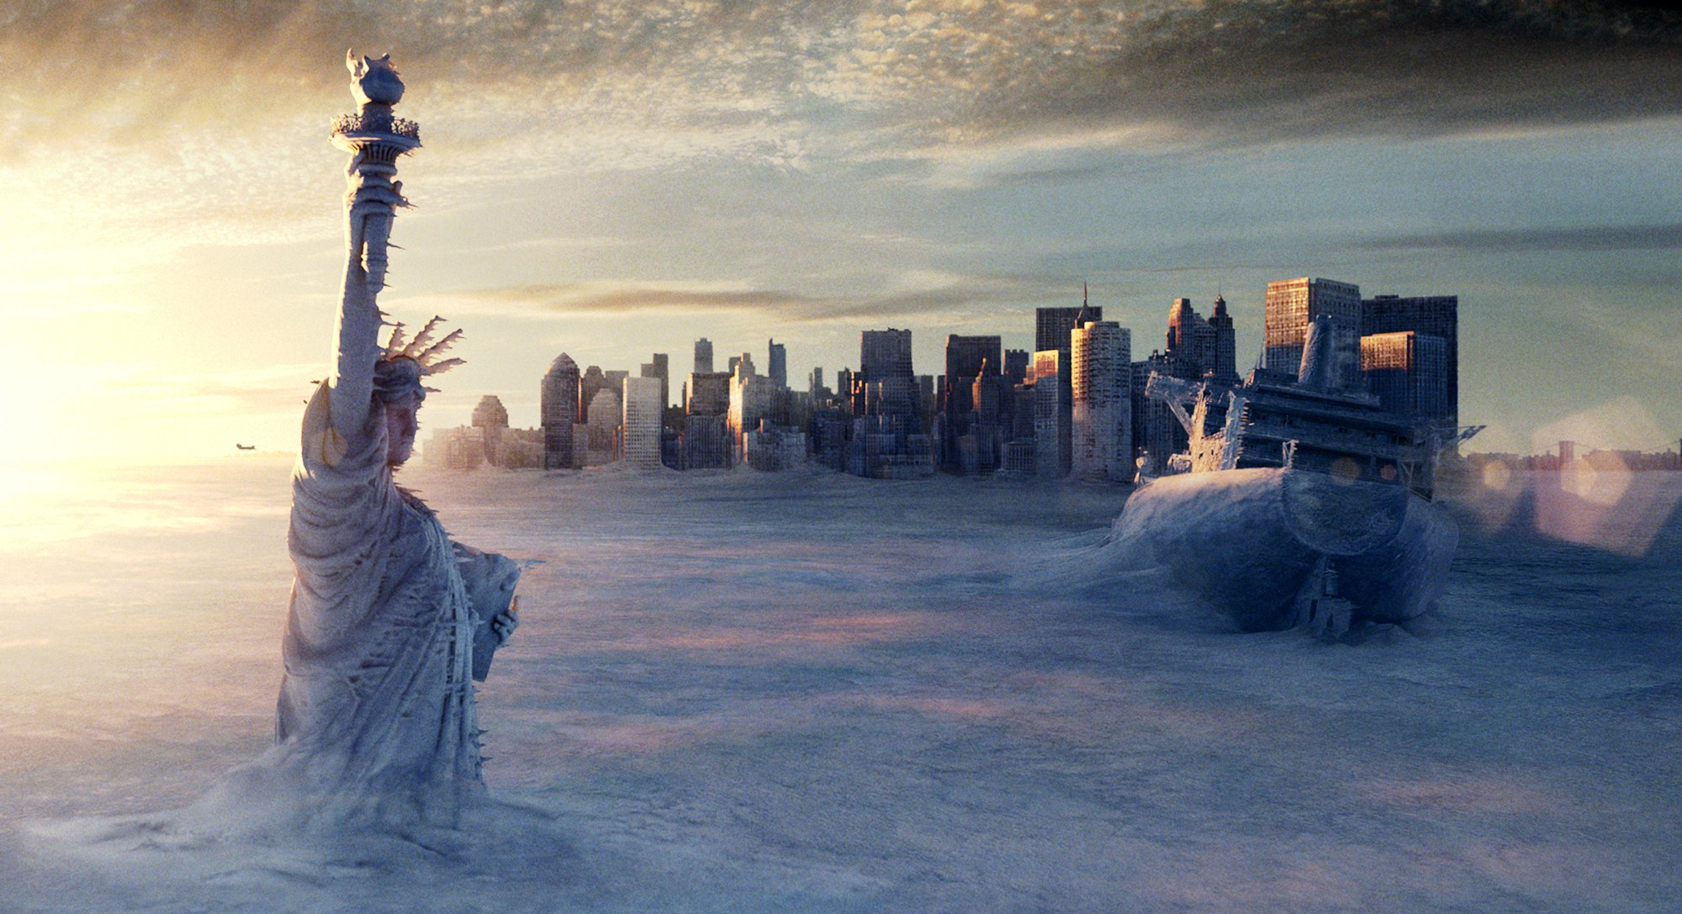
Notes:
collapse, entropy, painful pedestrianism, without maps, following the cracked highway - the bunker episode - Predilection for dystopia and apocalypse (end times threats; cautionary tales; extrapolations of the present; also small morality tales within of how to deal wth it and how to be better and perhaps prevent it)
One vein of thinking is that this seems to be not real at all, difficult to grasp – so maybe bunker thinking is both a natural response and also a fearful/problematic one. other forms of escape and shelter are seen in fagan -

Slide 43
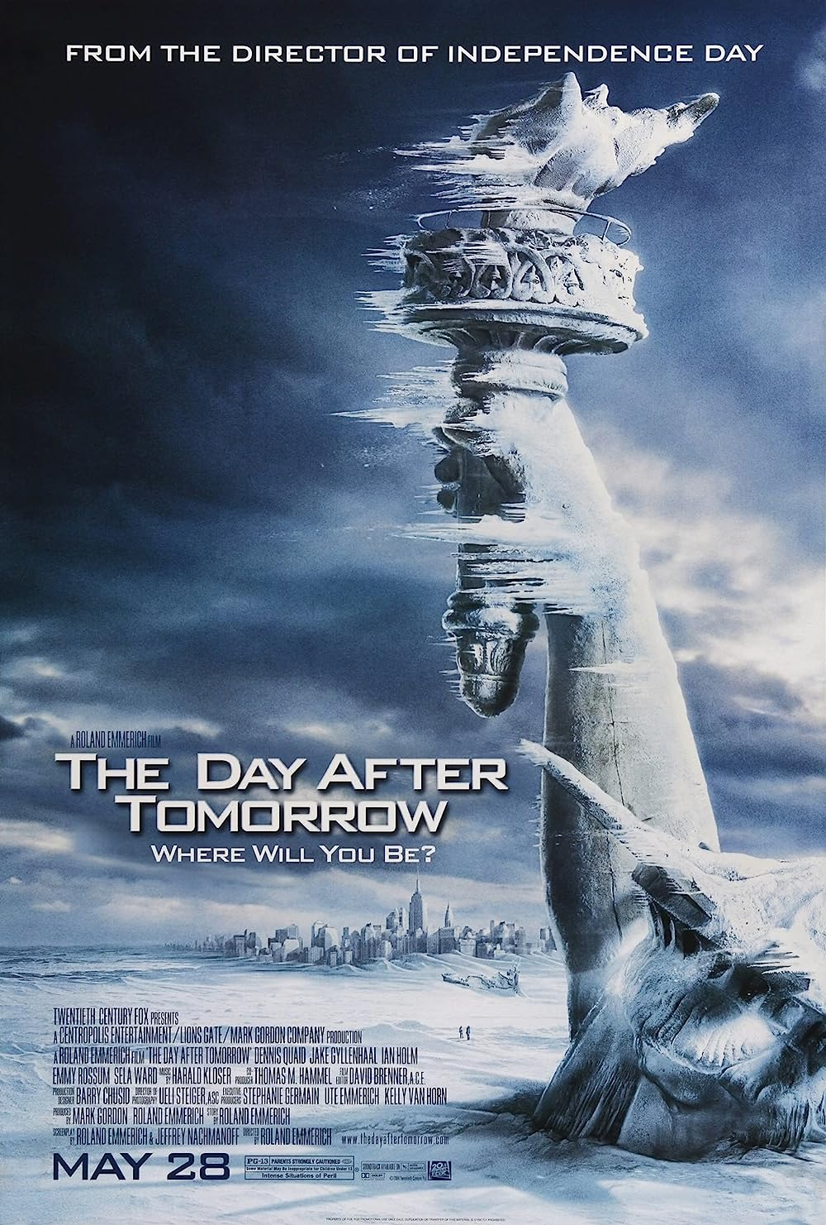
Apocalypse is the single most powerful master
metaphor that the contemporary environmental imagination
has at its disposal. Of no other dimension of
contemporary environmentalism, furthermore, can it
be so unequivocally said that the role of the imagination
is central to the project; for the rhetoric of apocalypticism
implies that the fate of the world hinges on
the arousal of the imagination to a sense of crisis.
Lawrence Buell The Environmental Imagination: Thoreau,
nature writing, and the formation of American Culture (1995)

Slide 44

And it appears that we are now in an era that will
be defined precisely by events that appear, by our current standards of normalcy, highly improbable: flash floods, hundred-year storms, persistent droughts, spells of unprecedented heat, sudden landslides, raging torrents pouring down from breached glacial lakes, and, yes, freakish tornadoes. Ghosh, The Great Derangement

Slide 45
Weird Climate

Slide 46


Slide 47

The twenty-first century has seen an increased awareness of forms of environmental destruction that cannot immediately be seen, localized or, by some, even acknowledged. Phenomena such as ocean acidification, climate change, the general effects of incremental forms of ecological degradation across the planet, global overpopulation and resource depletion do not present any obvious or perceptible target for concern or protest at any one place, or often any immediate antagonist perceptible at the normal human scale. The largely benumbed recognition of this reality has become one feature of life in the so-called Anthropocene, to use the currently still informal term for the epoch at which largely unplanned human impacts on the planet’s basic ecological systems have passed a dangerous, if imponderable, threshold. One major new effort at work in contemporary literary and artistic practice and criticism is to find some way of usefully or authentically engaging such crucial but elusive concerns, precisely when it is acknowledged that they resist representation at the kinds of scale on which most thinking, culture, art and politics operate.
Timothy Clark, from ‘Preface’ to Ecocriticism on the Edge

Slide 48


1935
Notes:
SPRAFF – READ – AND THIS underground withdrawl, and survival instinct after apocalypse runs through cinematic history too – slide la jetee

Slide 49
Leaning on the balcony rail, the slack water ten storeys below reflecting his thin angular shoulders and gaunt profile, Kerans watched one of the countless thermal storms rip through a dump of huge horse-tails lining the creek which led out of the lagoon. Trapped by the surrounding buildings and the inversion layers a hundred feet above the water, pockets of air would heat rapidly, then explode upwards like escaping balloons, leaving behind them a sudden detonating vacuum. For a few seconds the steam clouds hanging over the creek dispersed, and a vicious miniature tornado lashed across the 6o-feet-high plants, toppling them like matchsticks. Then, as abruptly, the storm vanished and the great columnar trunks subsided among one another in the water like sluggish alligators.
Rationalising, Kerans told himself that he had been wise to remain in the hotel—the storms were erupting more and more frequently as the temperature rose—but he knew that his real motive was his acceptance that little now remained to be done. The biological mapping had become a pointless game, the new flora following exactly the emergent lines anticipated twenty years earlier, and he was sure that no-one at Camp Byrd in Northern Greenland bothered to file his reports, let alone read them. (1962)

Slide 50


Slide 51


