Slide 1
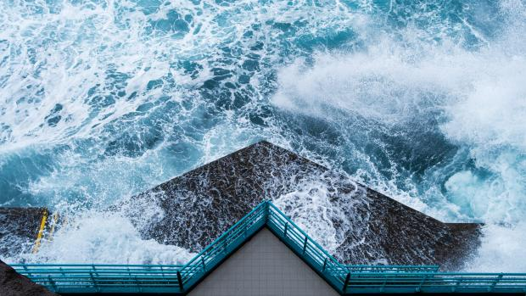
CLIMATE IMAGINARIES WEEK 4 DYSTOPIA/COLLAPSE – THE WALL

Slide 2
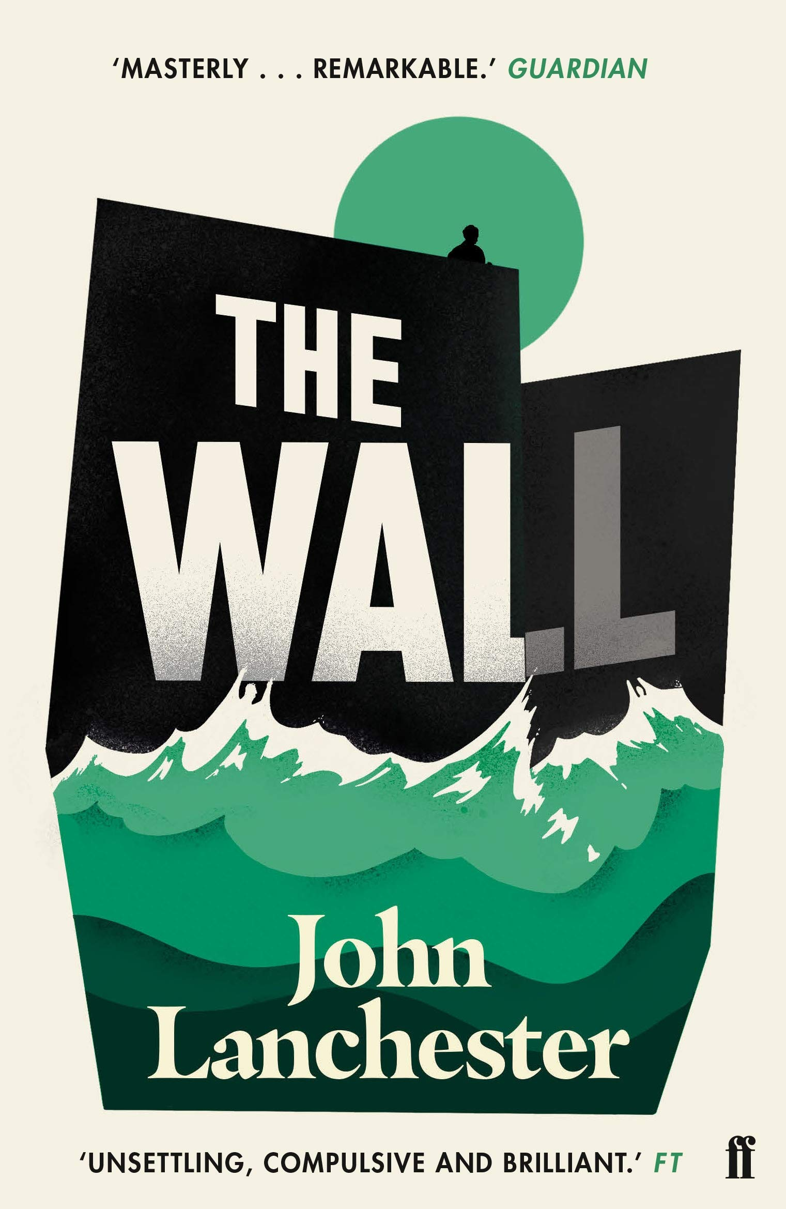
2019

Slide 3


Slide 4
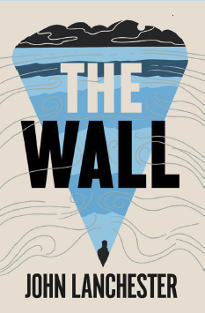
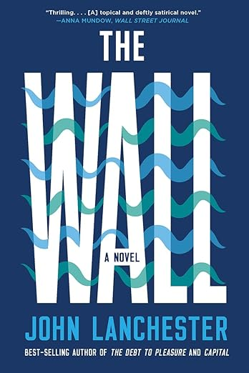


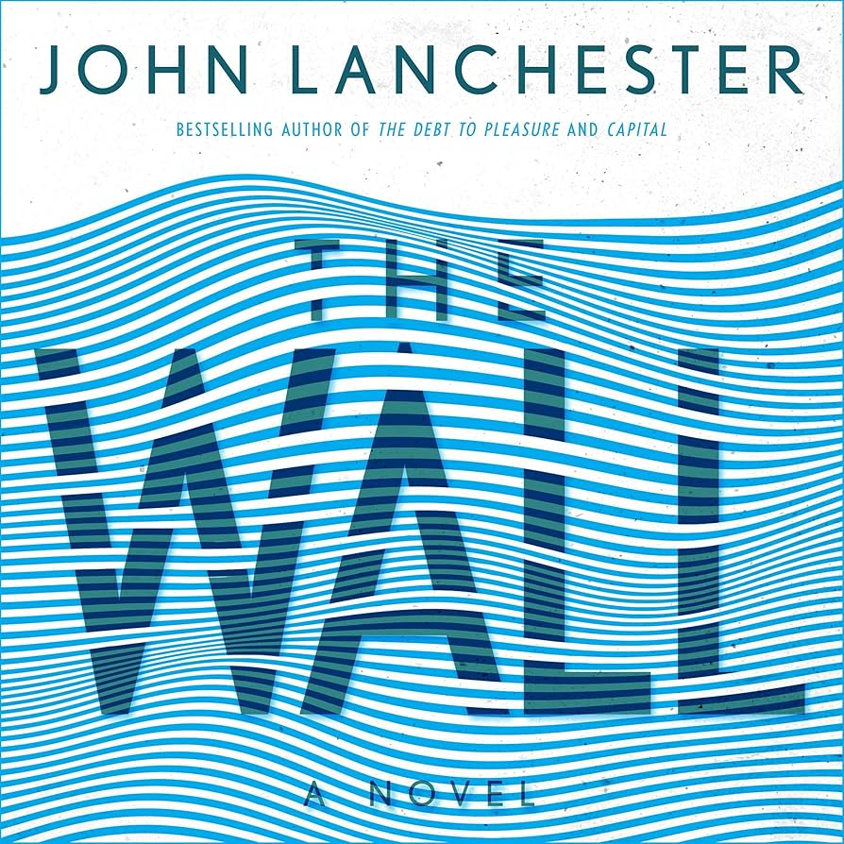

Slide 5
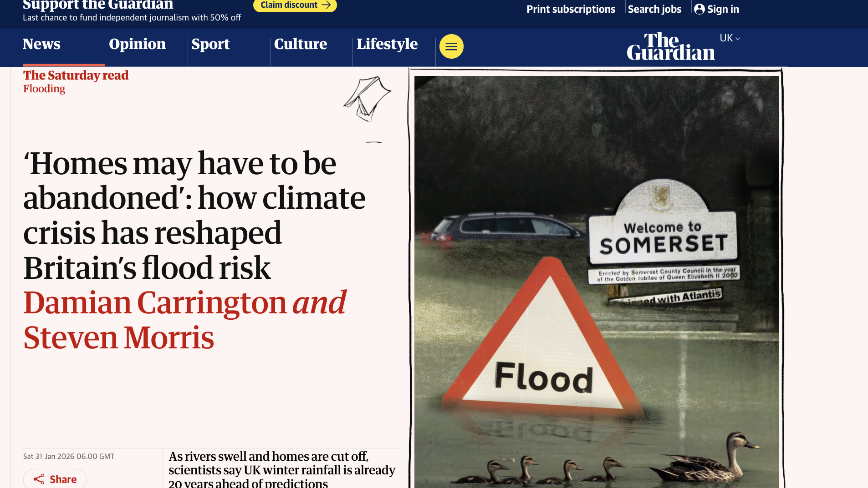

Slide 6
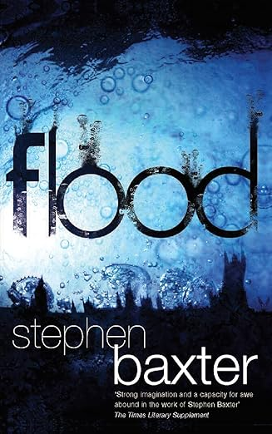
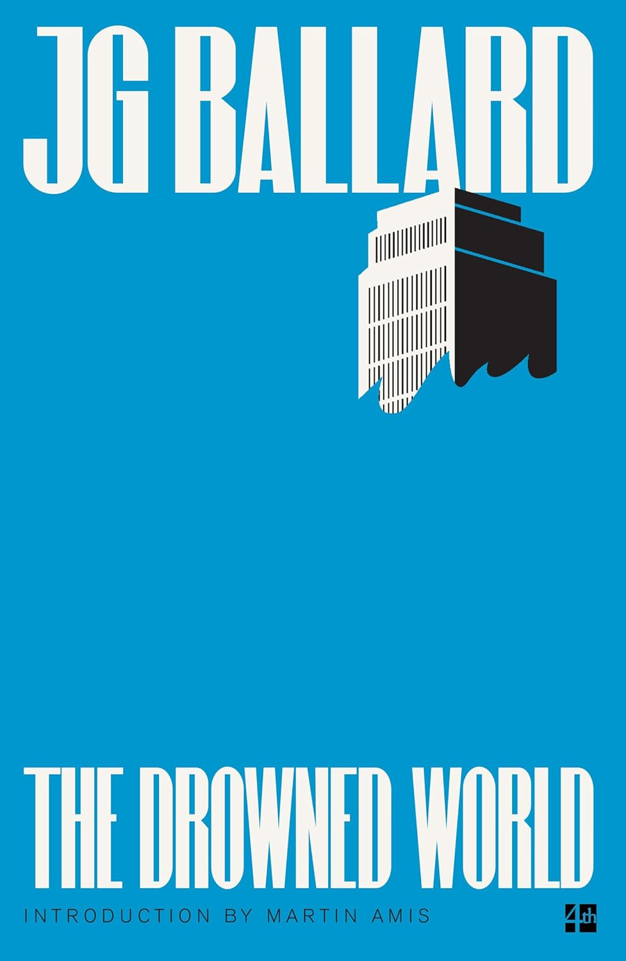
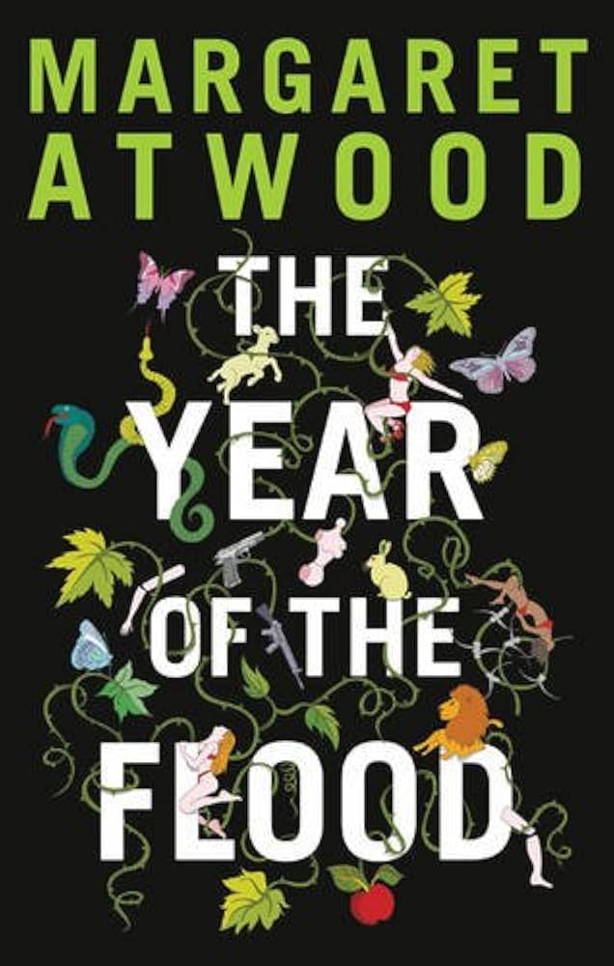
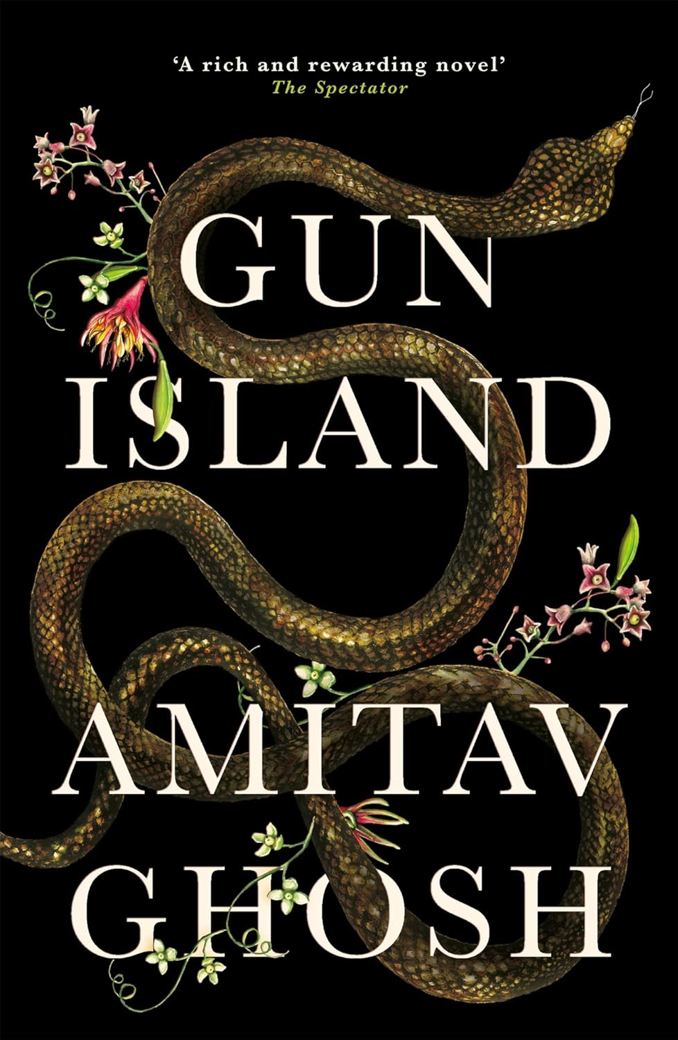
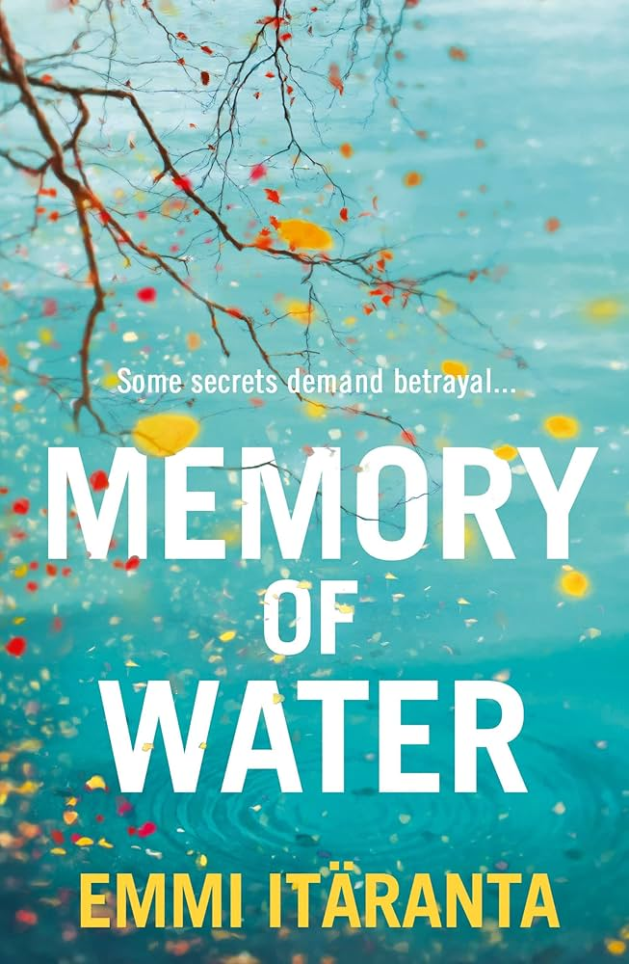
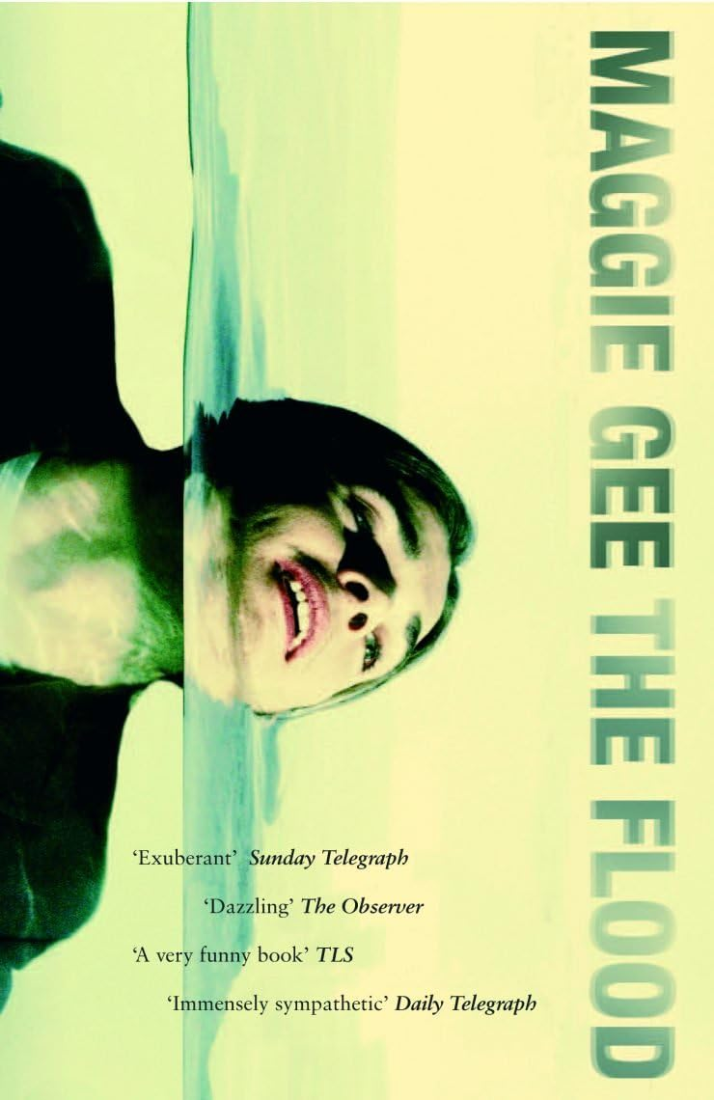
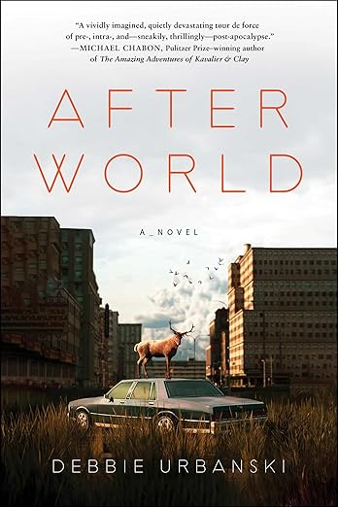


Slide 7
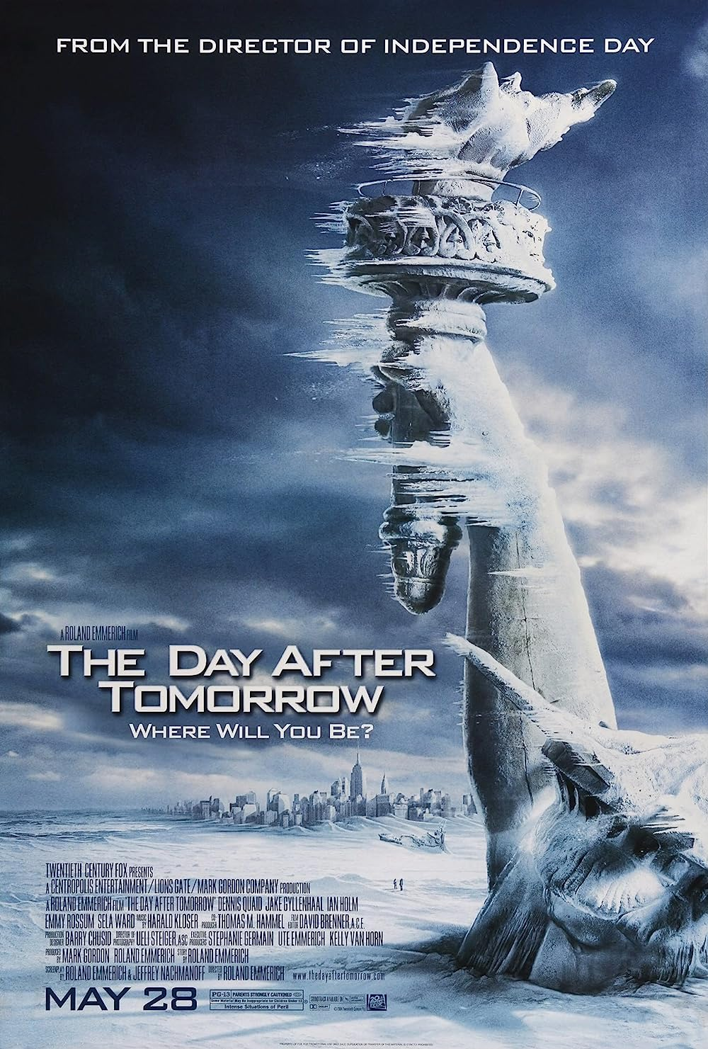
Apocalypse is the single most powerful master
metaphor that the contemporary environmental imagination
has at its disposal. Of no other dimension of
contemporary environmentalism, furthermore, can it
be so unequivocally said that the role of the imagination
is central to the project; for the rhetoric of apocalypticism
implies that the fate of the world hinges on
the arousal of the imagination to a sense of crisis.
Lawrence Buell The Environmental Imagination: Thoreau,
nature writing, and the formation of American Culture (1995)

Slide 8
The age of global warming defies both literary fiction and contemporary common sense: the weather events of this time have a very high degree of improbability. Indeed, it has even been proposed that this era should be named the “catastrophozoic” ... It is certain ...that these are not ordinary times: the events that mark them are not easily accommodated in the deliberately prosaic world of serious prose fiction.
Amitav Ghosh (2016)
Notes:
Phenomena such as ocean acidification, climate change, the general effects of incremental forms of ecological degradation across the planet, global overpopulation and resource depletion do not present any obvious or perceptible target for concern or protest at any one place, or often any immediate antagonist perceptible at the normal human scale. The largely benumbed recognition of this reality

Slide 9
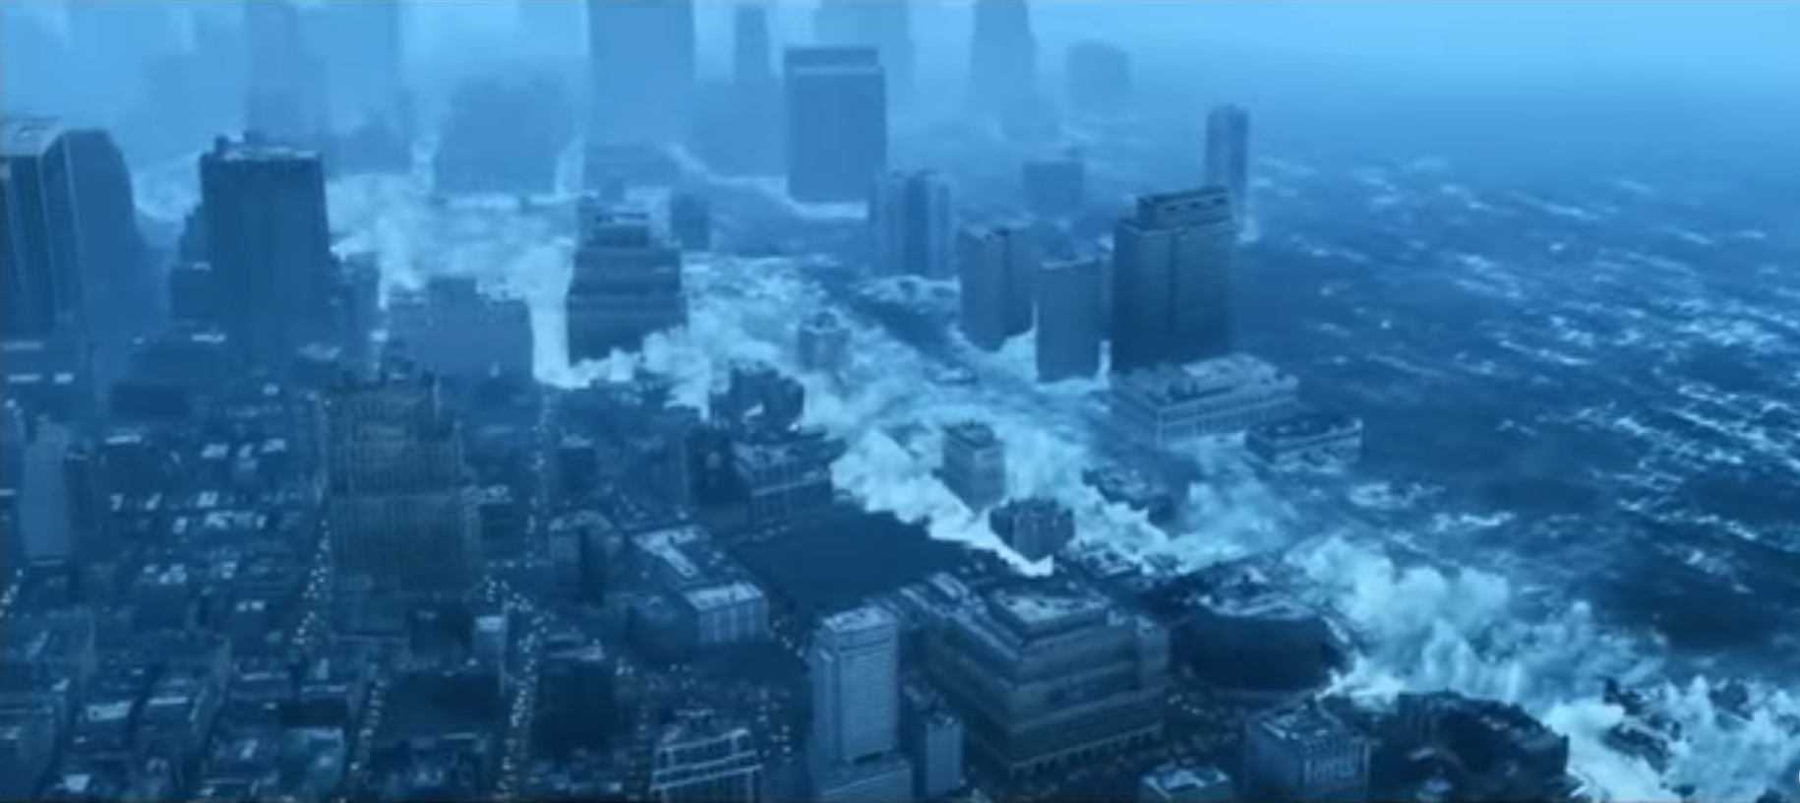
And it appears that we are now in an era that will
be defined precisely by events that appear, by our current standards of normalcy, highly improbable: flash floods, hundred-year storms, persistent droughts, spells of unprecedented heat, sudden landslides, raging torrents pouring down from breached glacial lakes, and, yes, freakish tornadoes. Ghosh, The Great Derangement

Slide 10
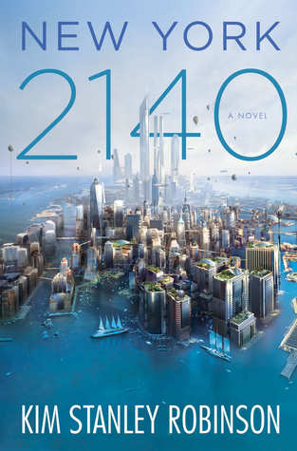
The flood went up to about Thirtieth. And even though it was fast, it did take two hours. So people just ran north ahead of it. They abandoned whatever they were doing and ran in the streets. We did too. Central Park had millions of people in it, standing there looking at each other….No one could believe it. But it was true. A new day had come. We knew it had happened, because there we were. We knew it would never be the same. Downtown was gone. So that was very strange. People were stunned, you could see it. We stood there looking at each other! No one could believe it but there we were. Everyone was like, well, here we are – it must be real. But it was like a dream.
Kim Stanley Robinson, New York 2140 (2017)
Notes:
We see the same thing here in a novel about adaptation to catastrophe in North American continent, where NYC adapts, yet the entrie scene remains cognitively difficult to grasp – long genre, cautionary tales, tales about denialism and consciousness raising, weird tales of strange climate, offshoring the problem by alienating it, then the speculative fccition and the dystopias – usually of resource-starved worlds, depleted stocks of foods, medicines, turn to authoritarianism, and another way of doing this might be seeing a totally transformed world devoid of humans, - so how about Scotland, in 2563…slide

Slide 11
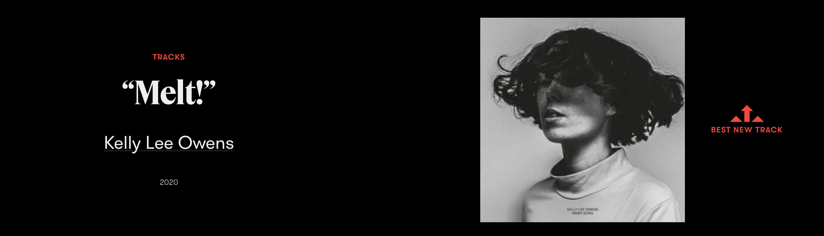

Slide 12
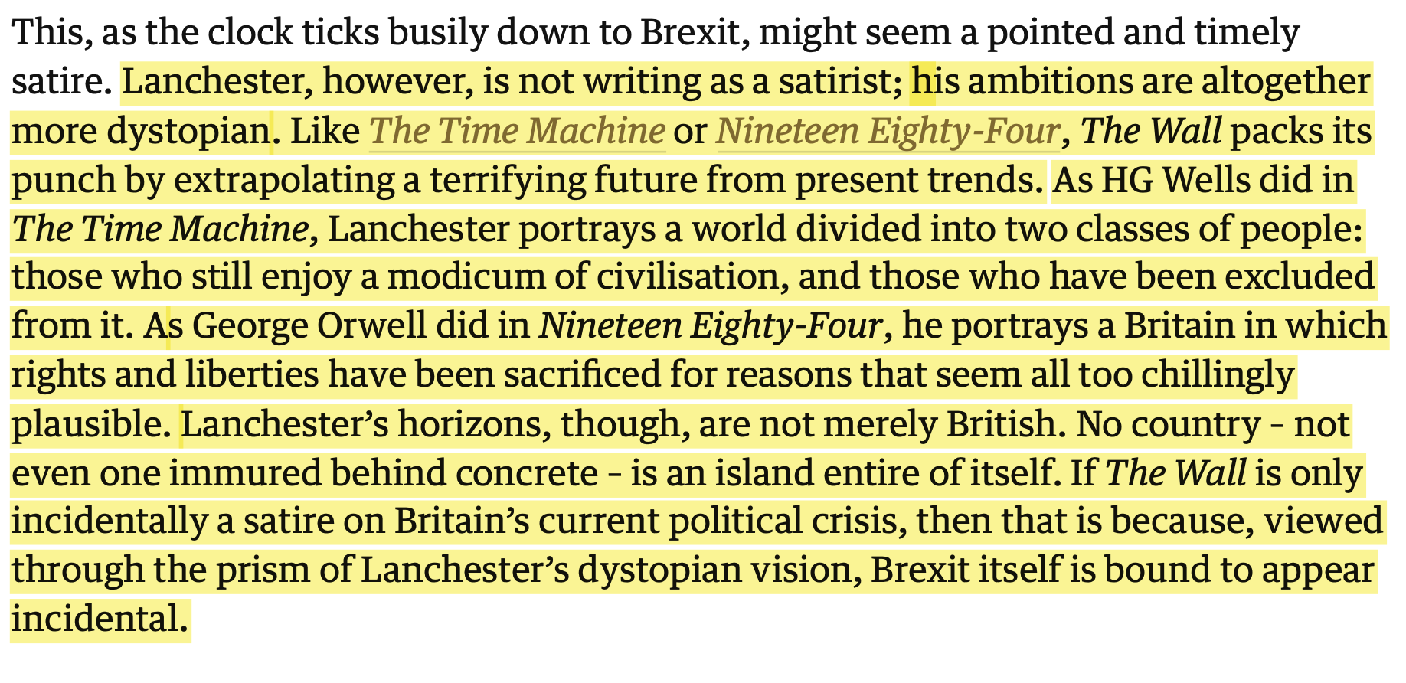
Tom Holland, The Guardian, Sat 19th January 2019.

Slide 13
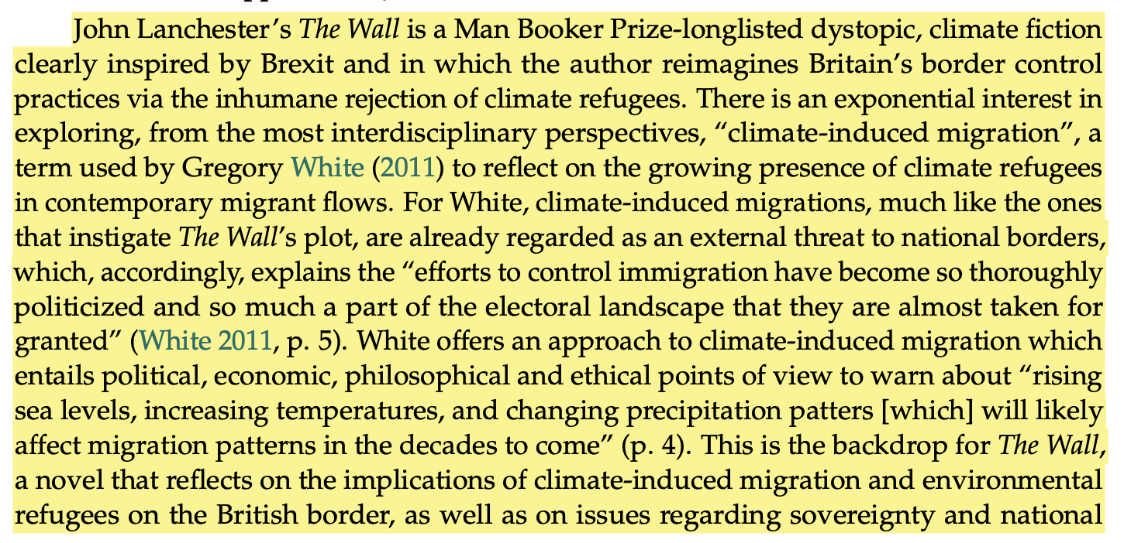
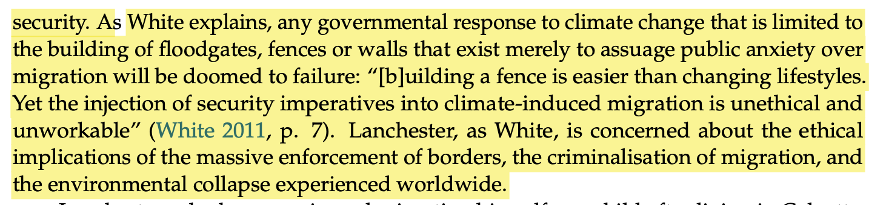
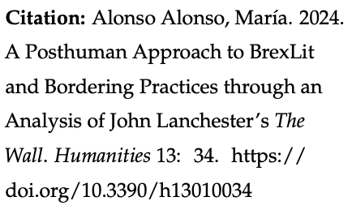

Slide 14
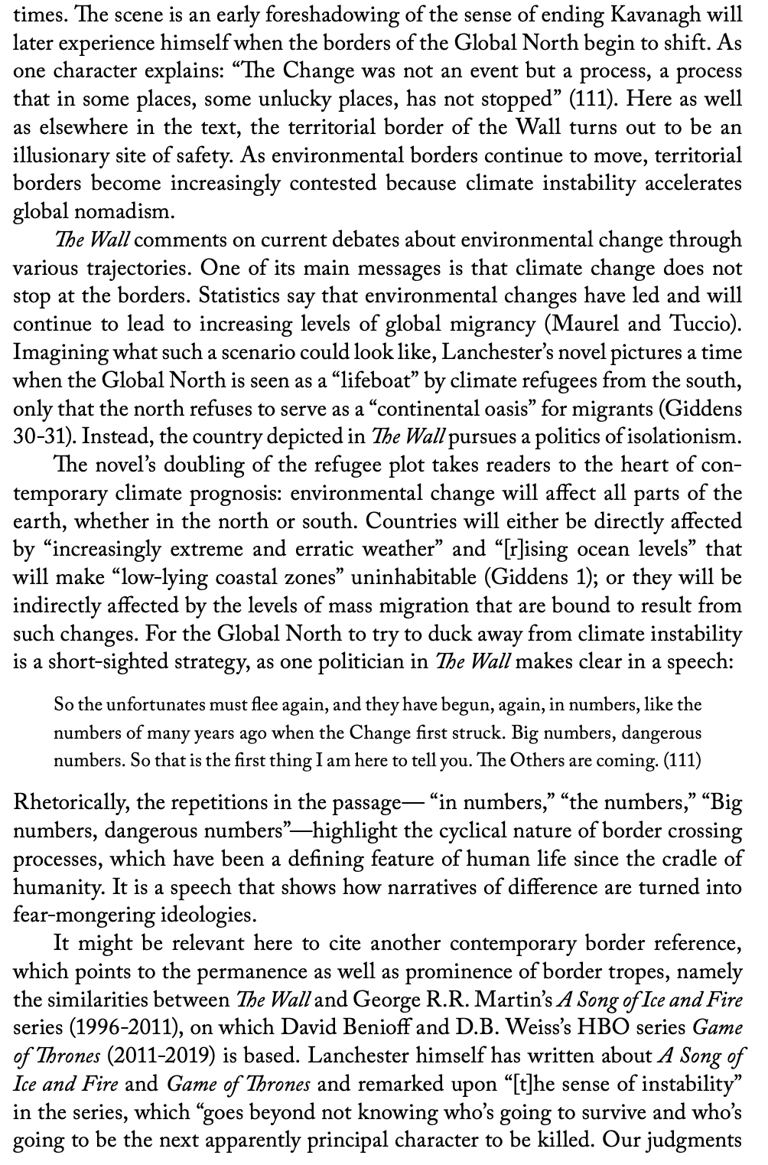

Slide 15
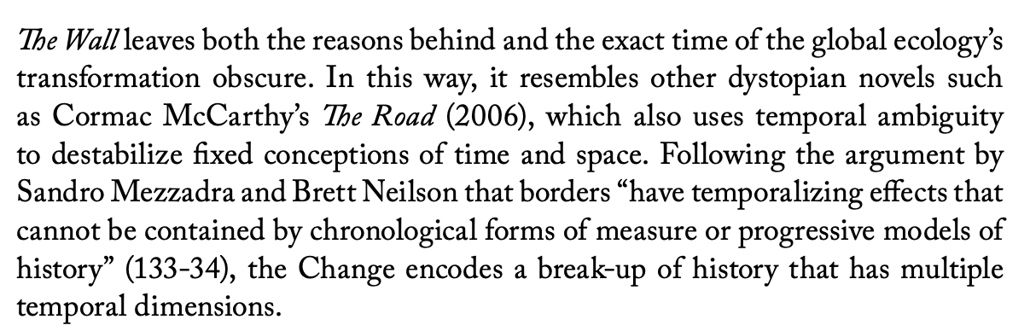
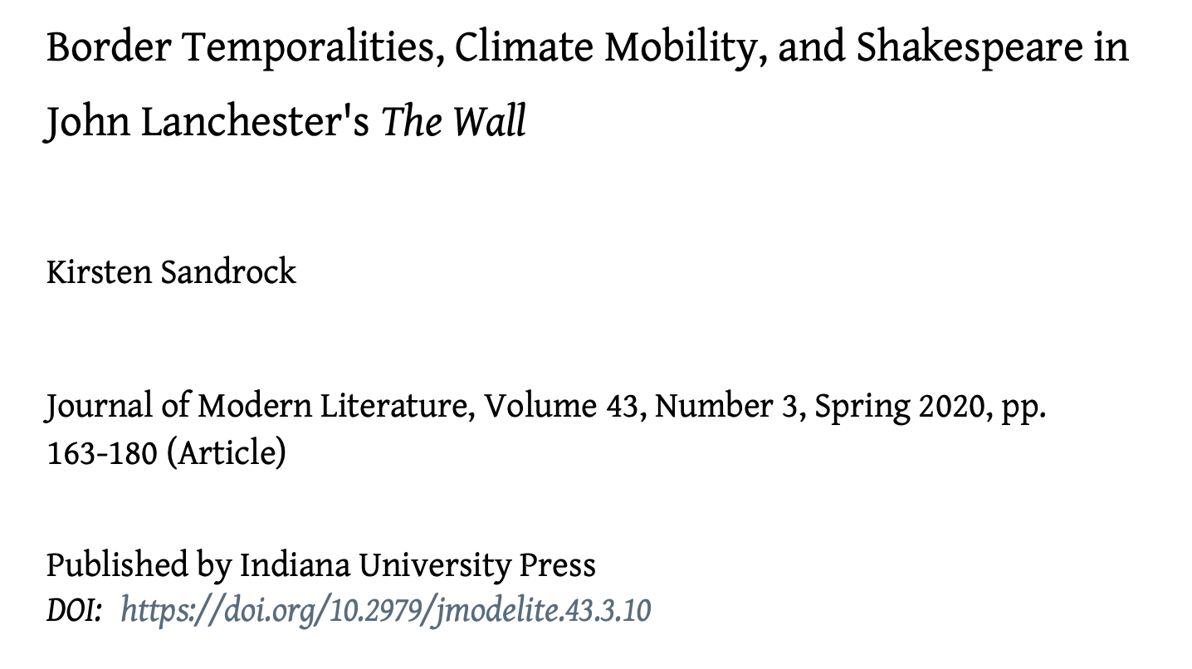

Slide 16
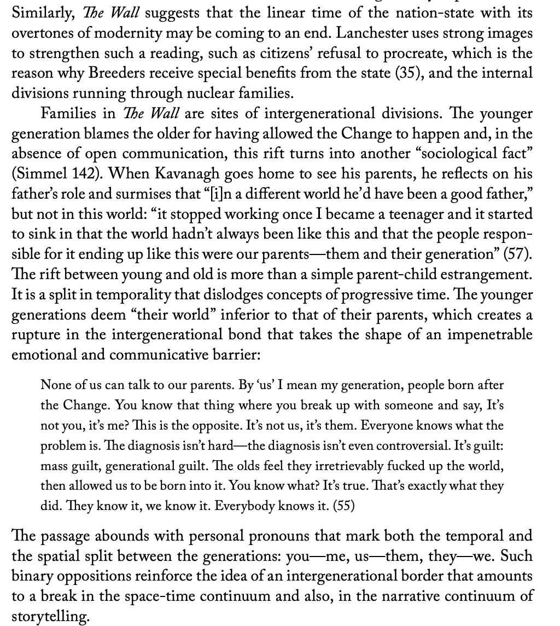

Slide 17
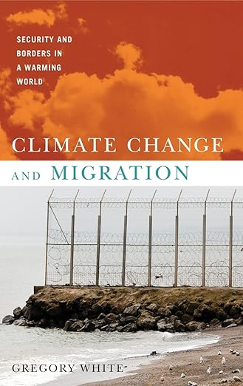
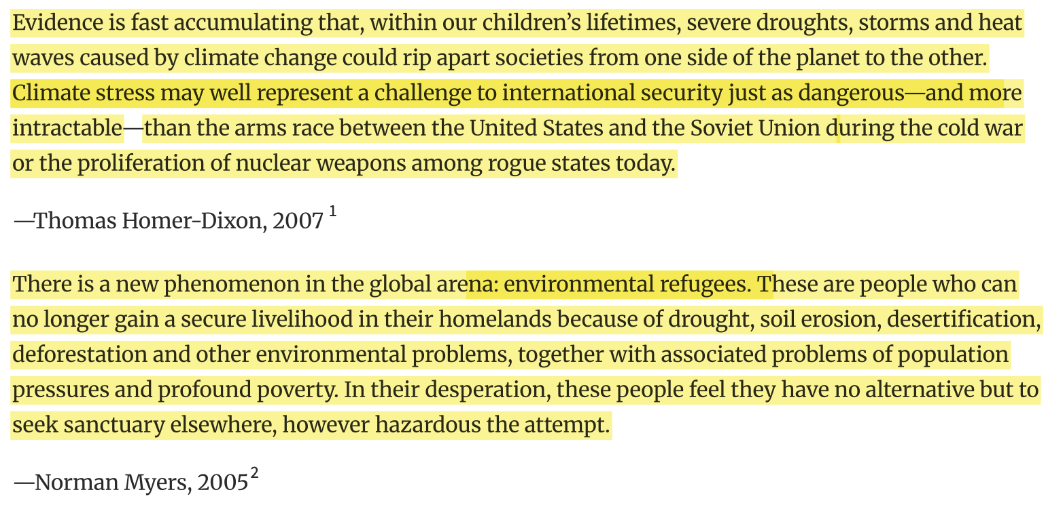
2011

Slide 18
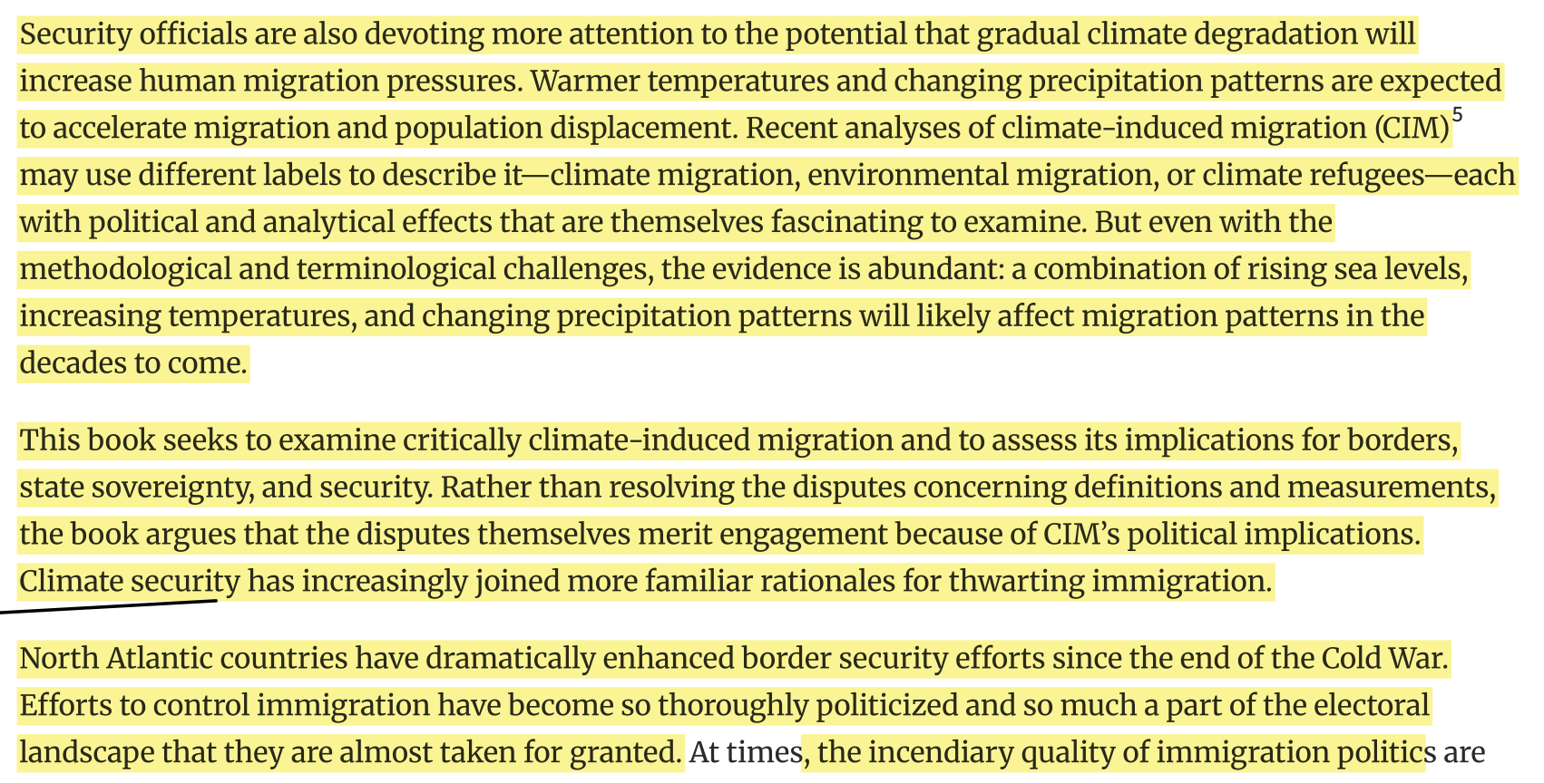

Slide 19
