Slide 1
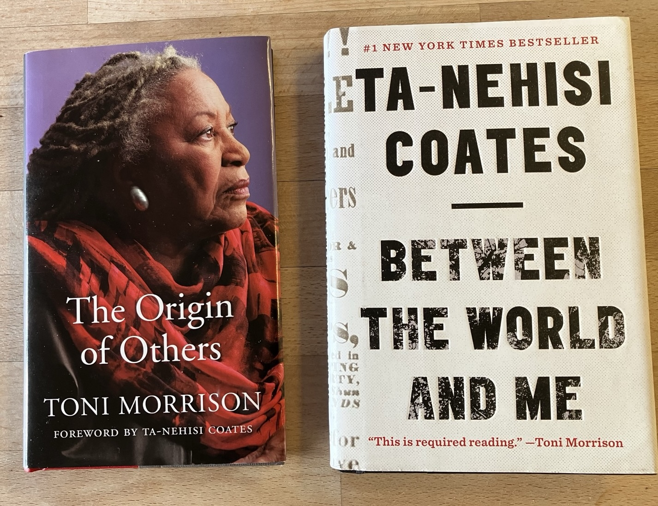

Ghosts, ‘Race’ and the Body: Reading Toni Morrison and Ta-Nehisi Coates’
Paulo de Medeiros,
English & Comparative Literary Studies

Slide 2
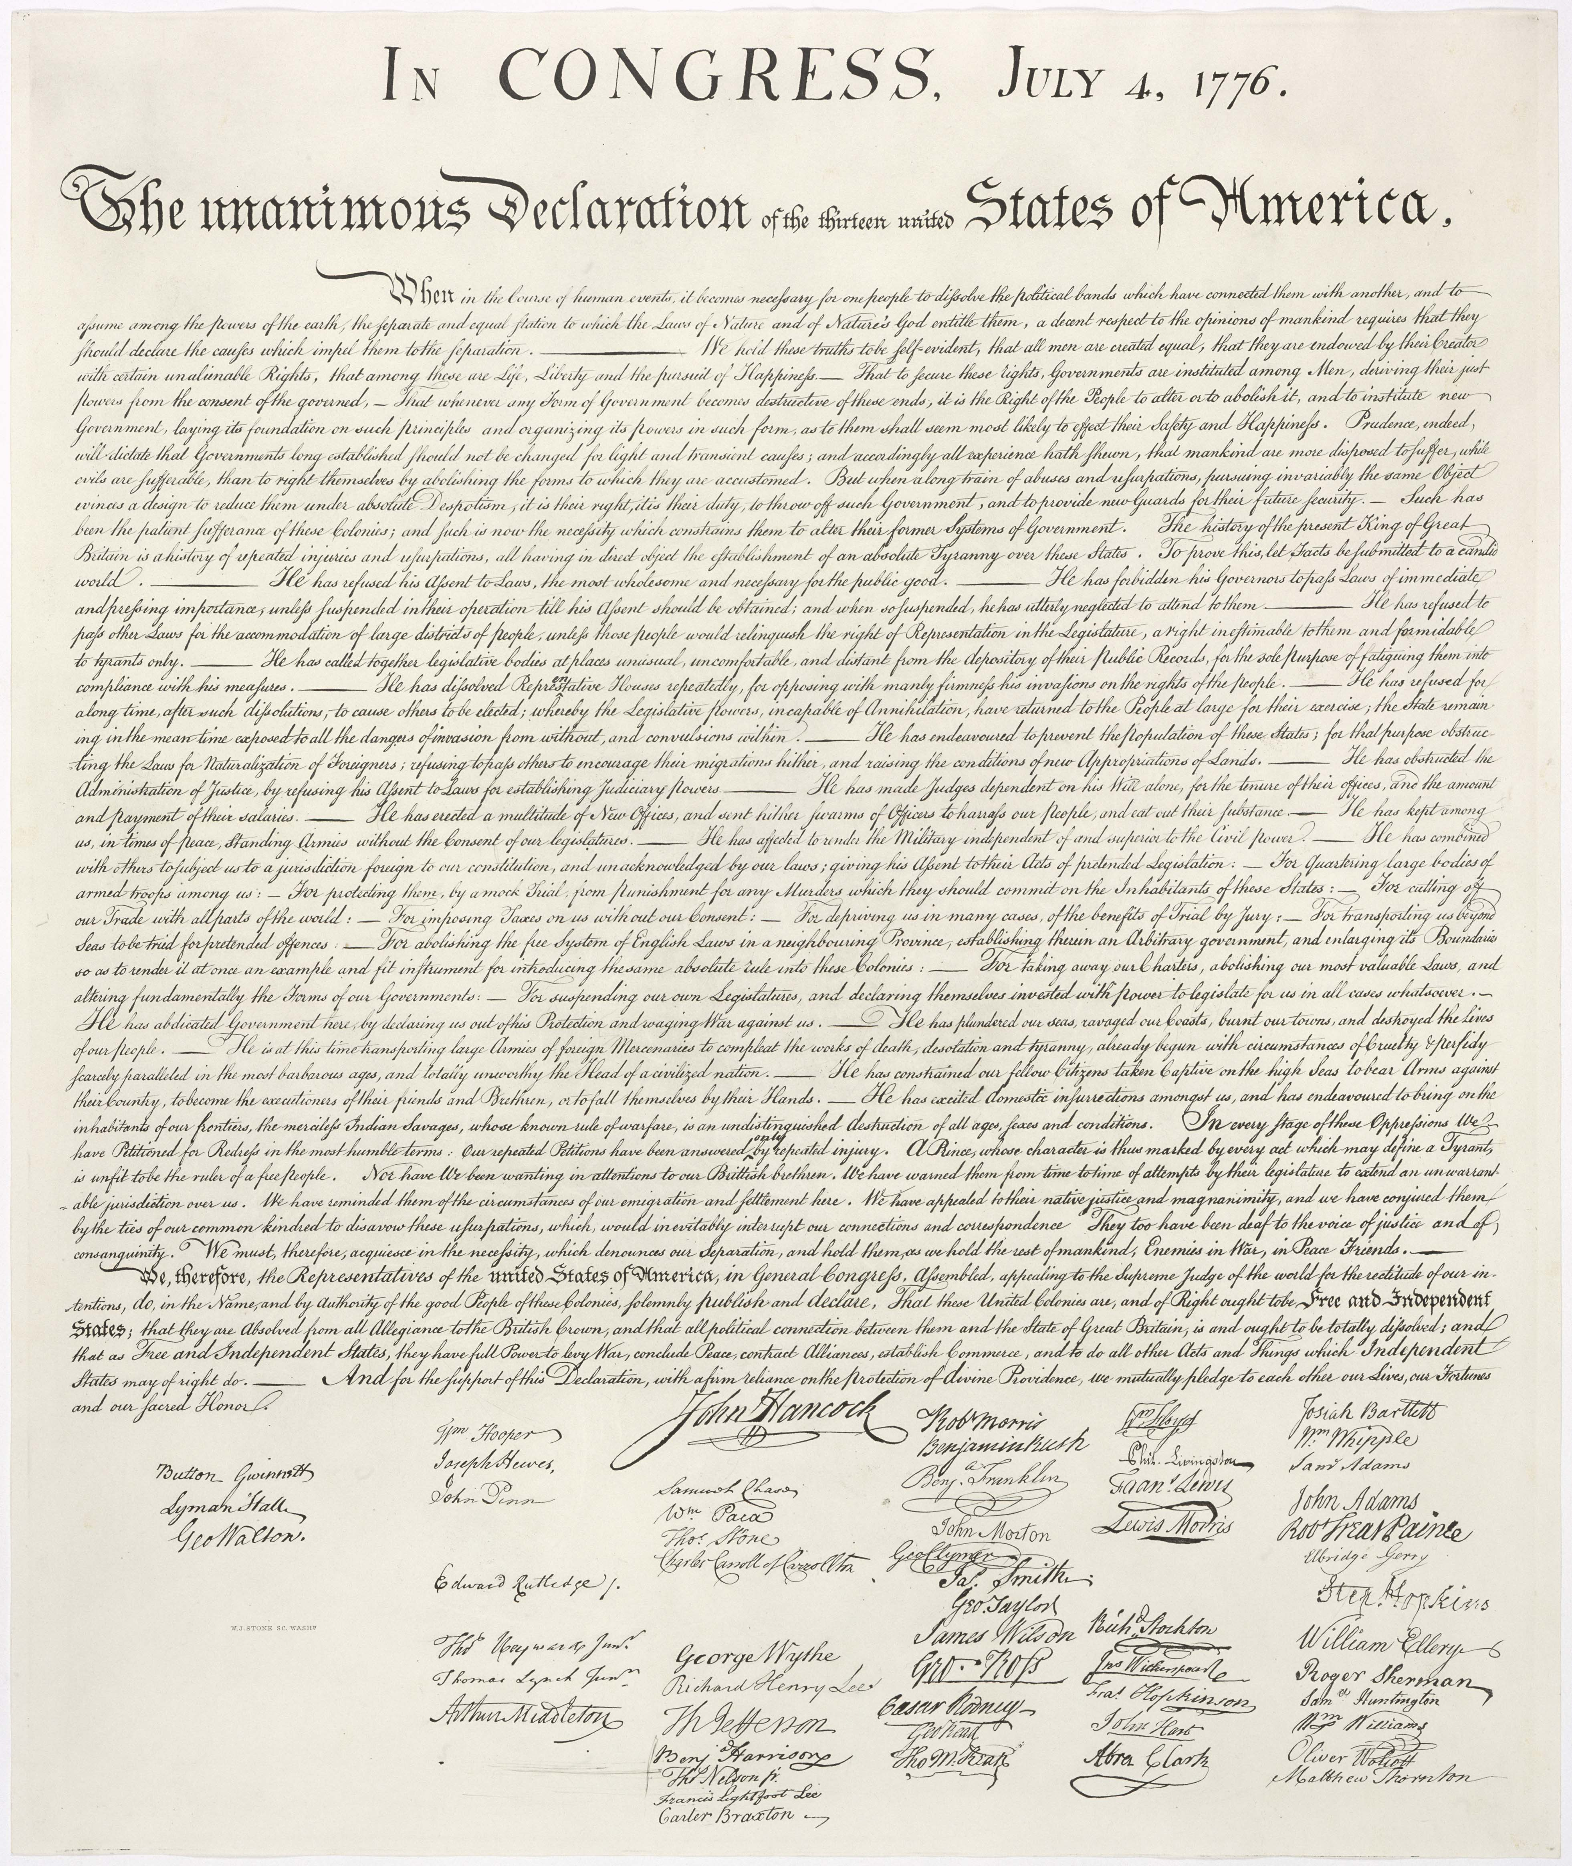

Slide 3
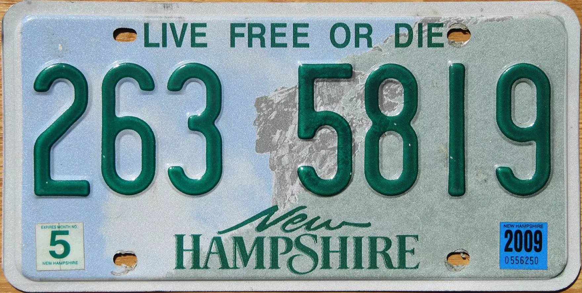

Slide 4
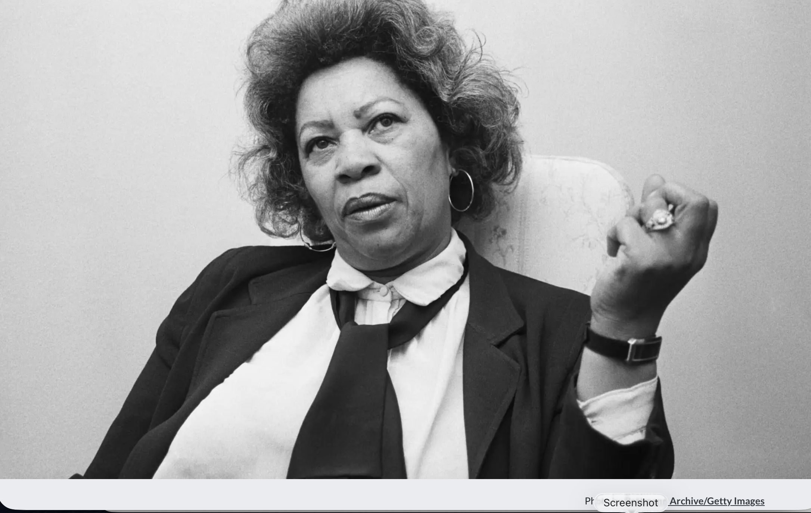

Slide 5
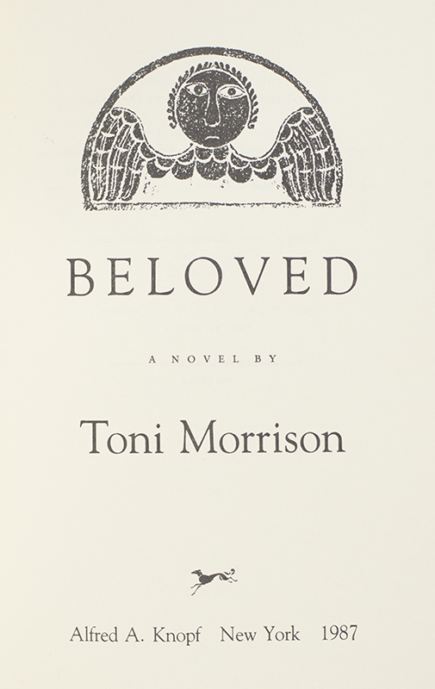

Slide 6
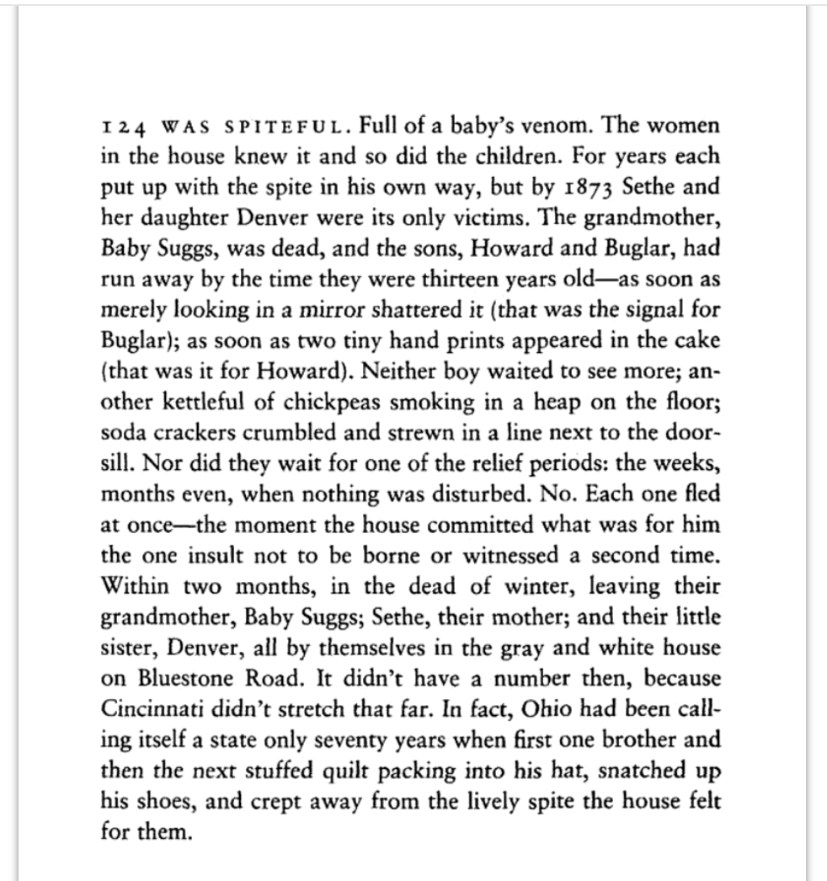

Slide 7
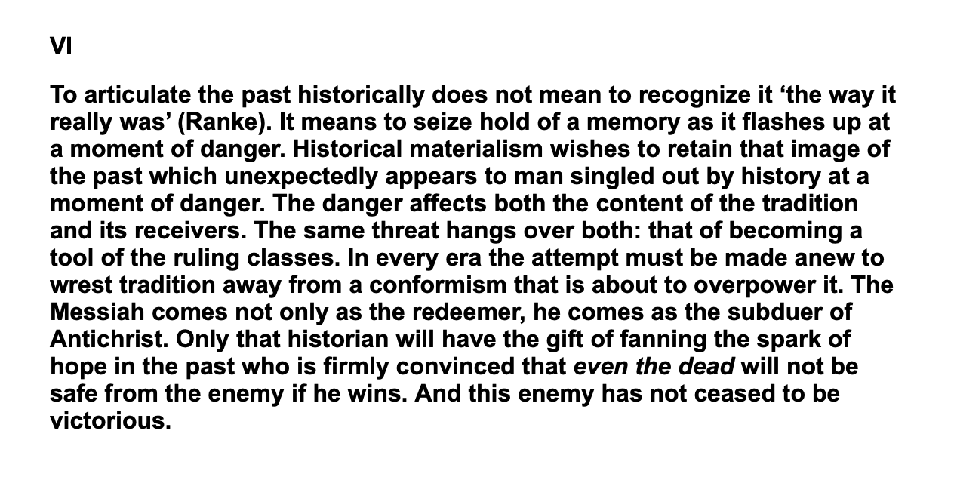

Slide 8
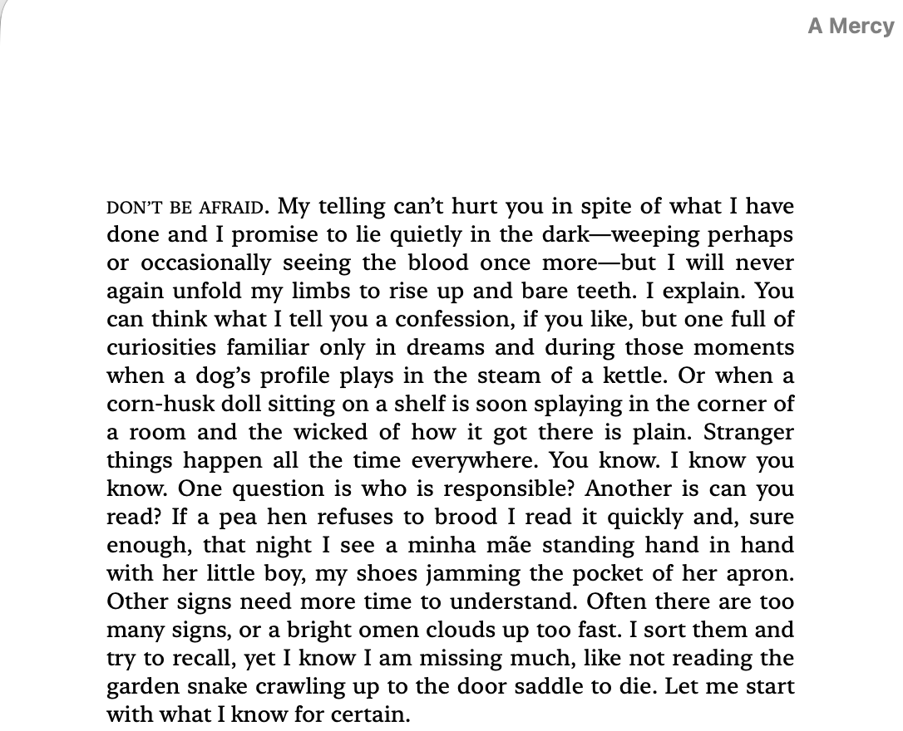


Slide 9
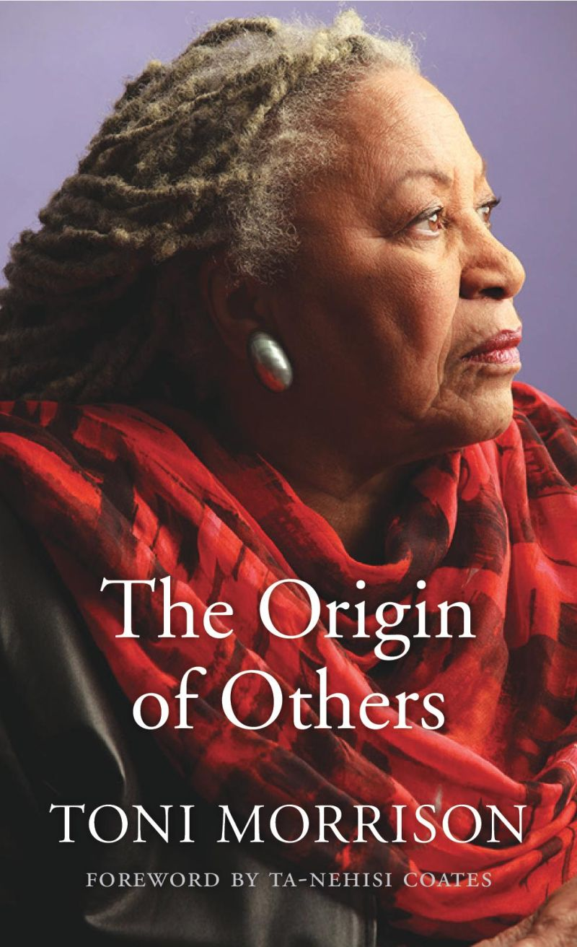

Slide 10
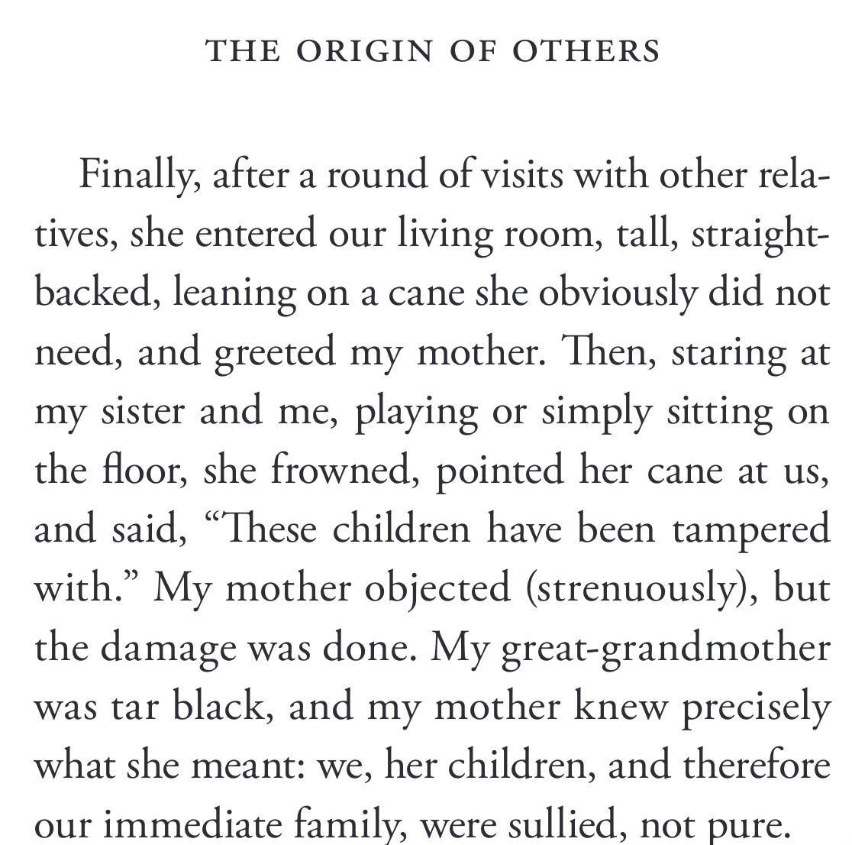

Slide 11
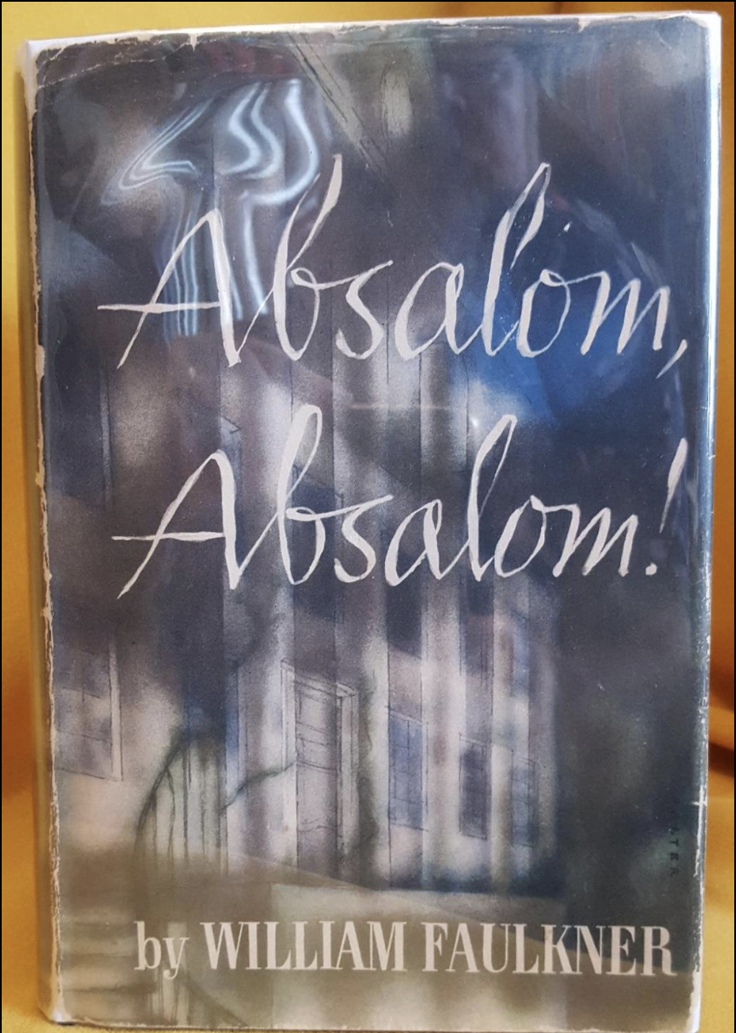
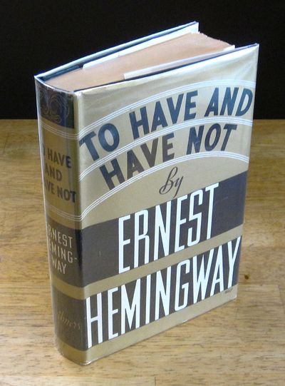

Slide 12
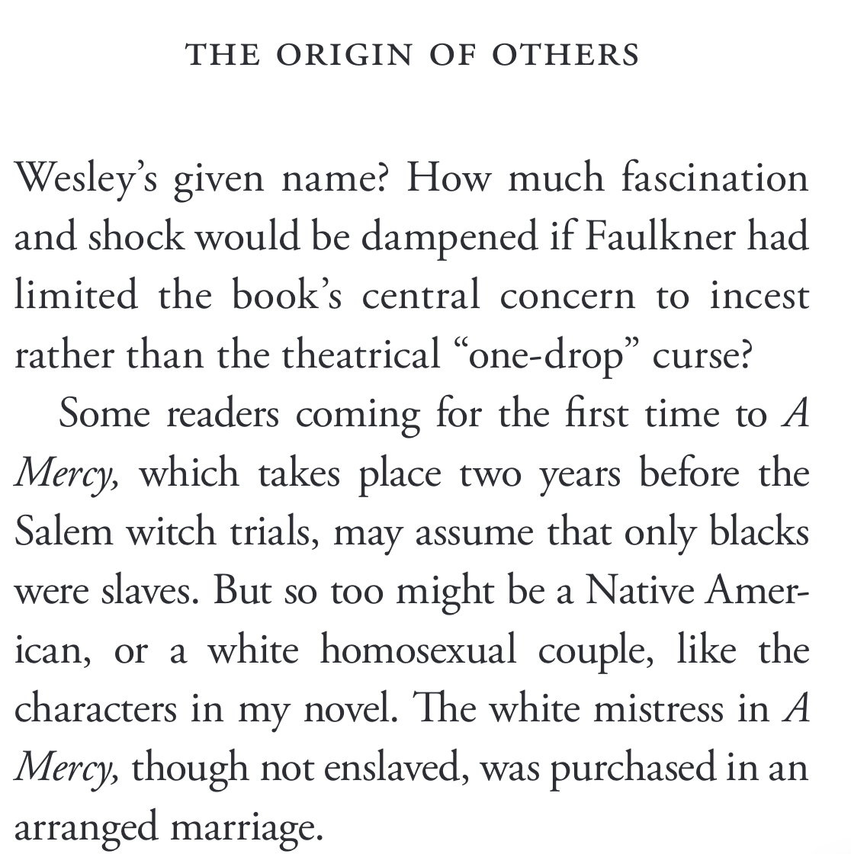
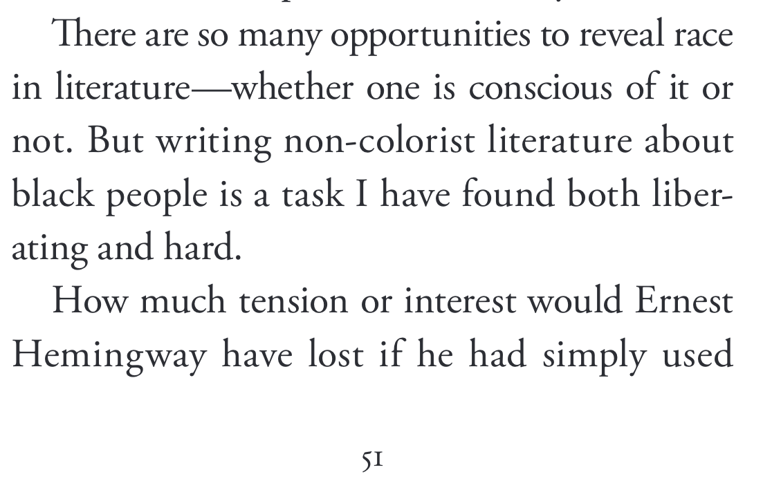

Slide 13
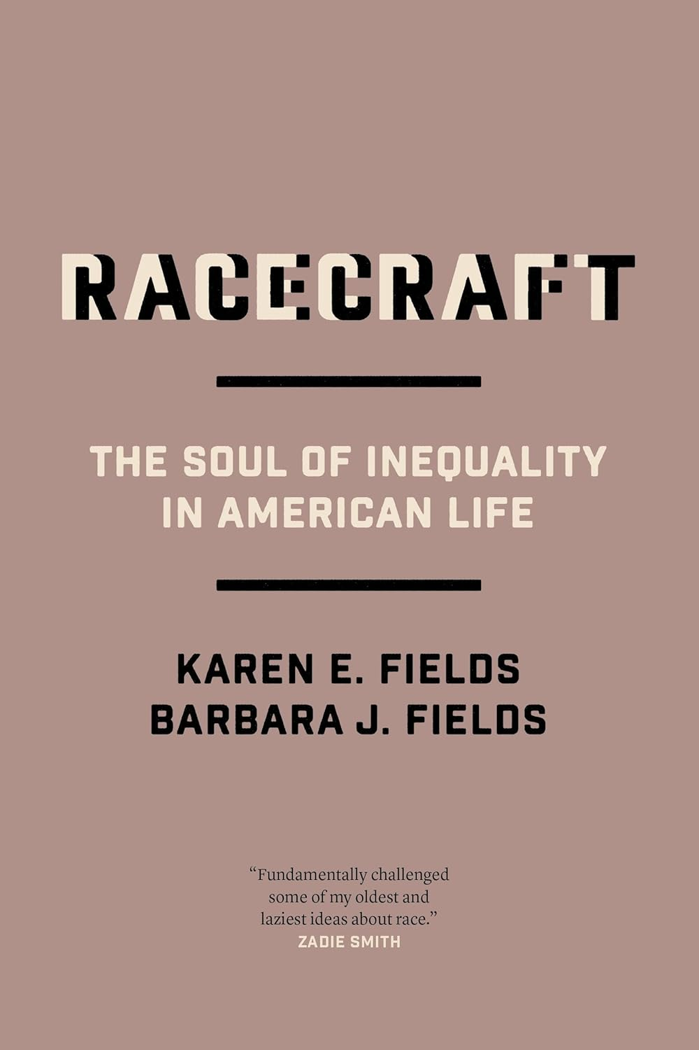
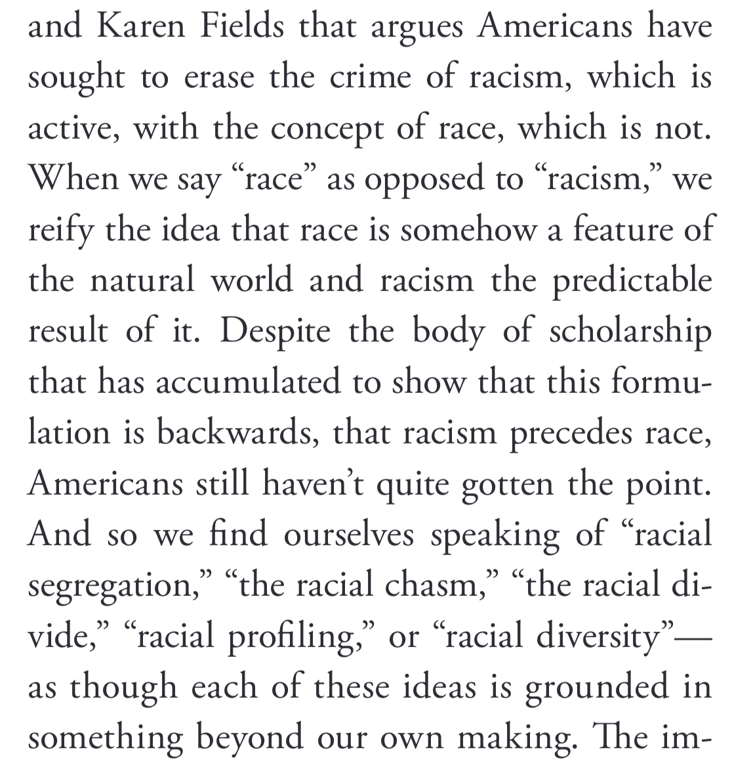

Slide 14
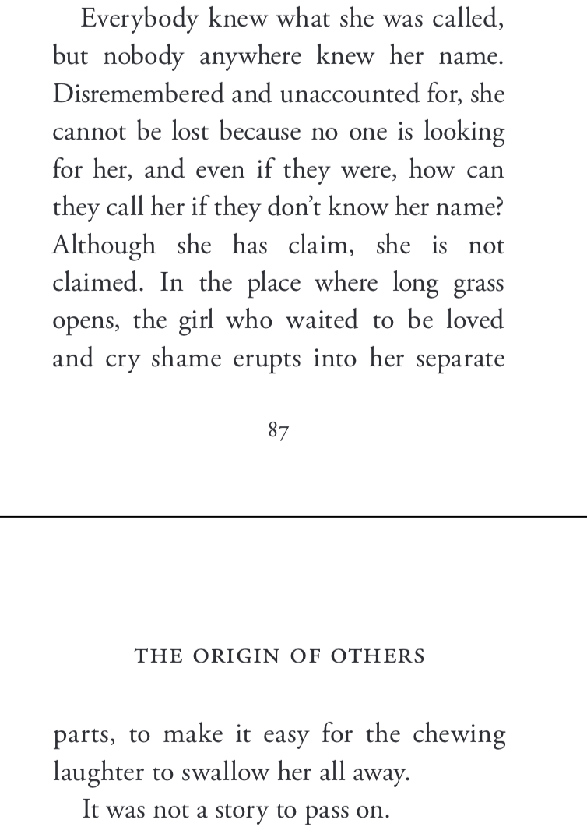
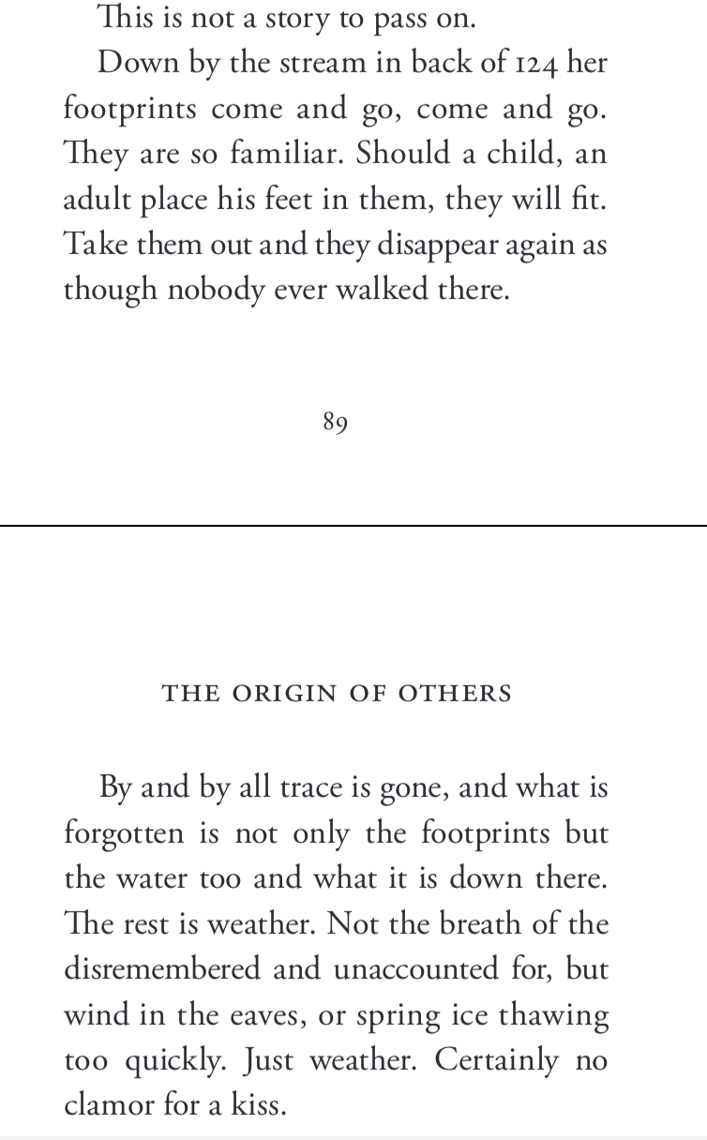
Beloved.

Slide 15
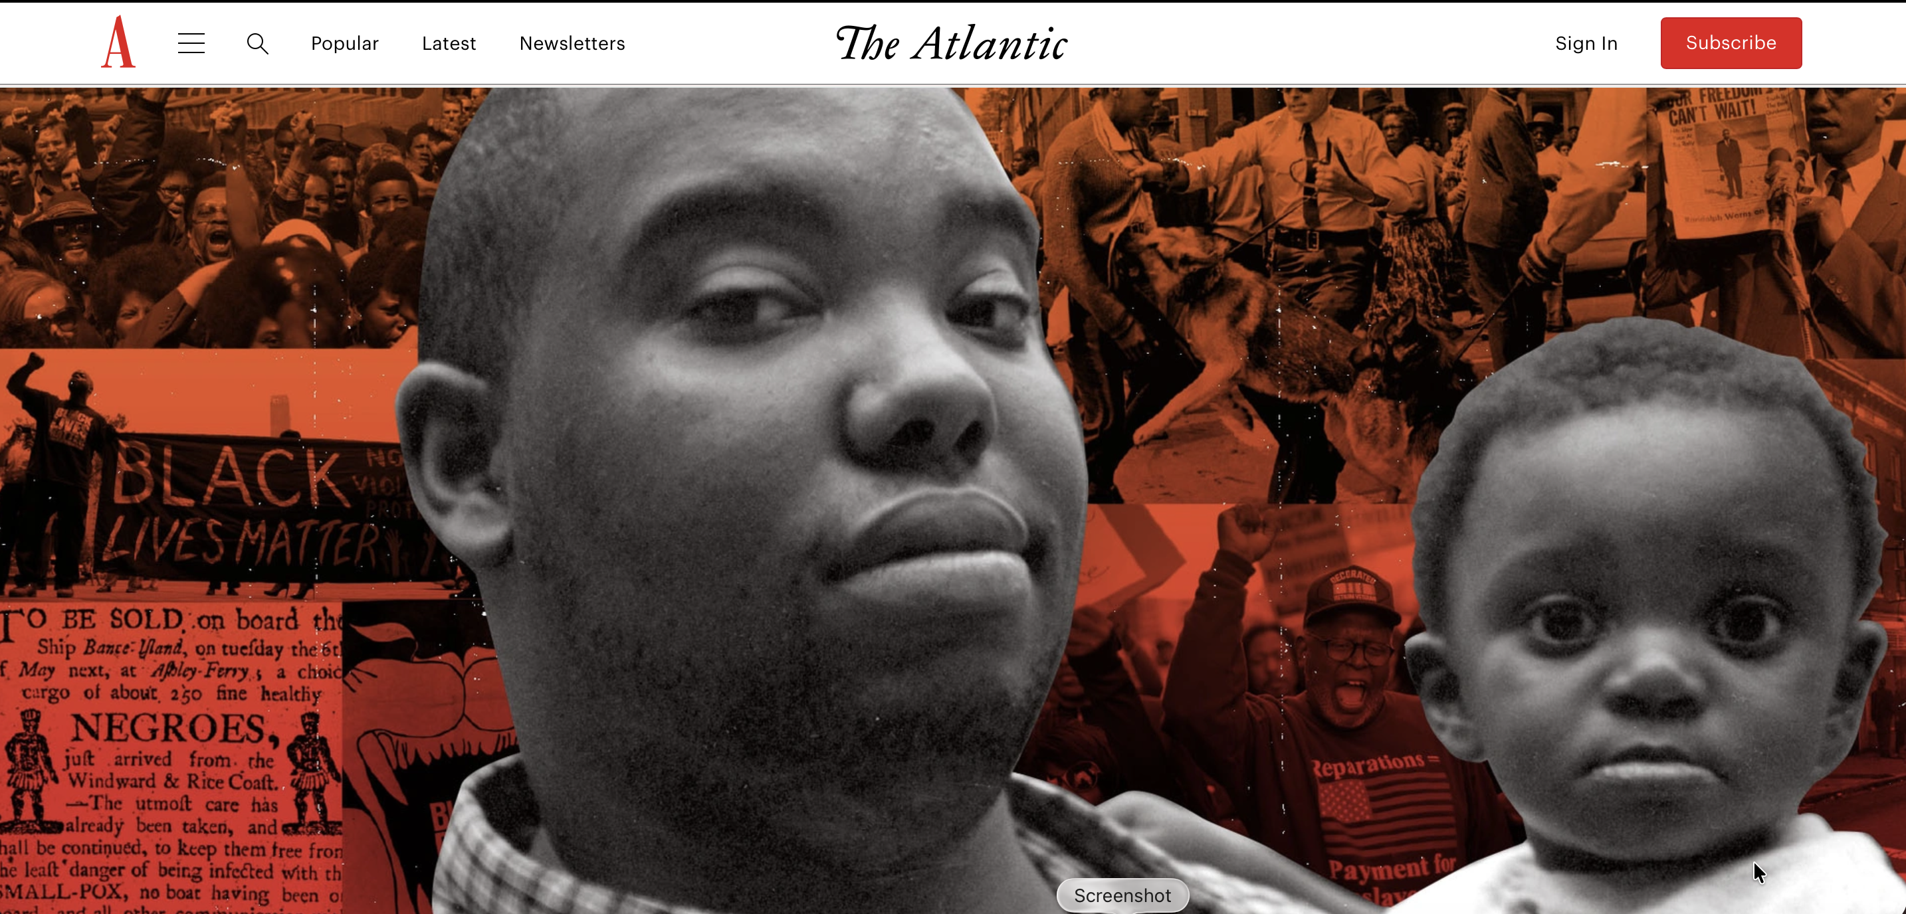

Slide 16
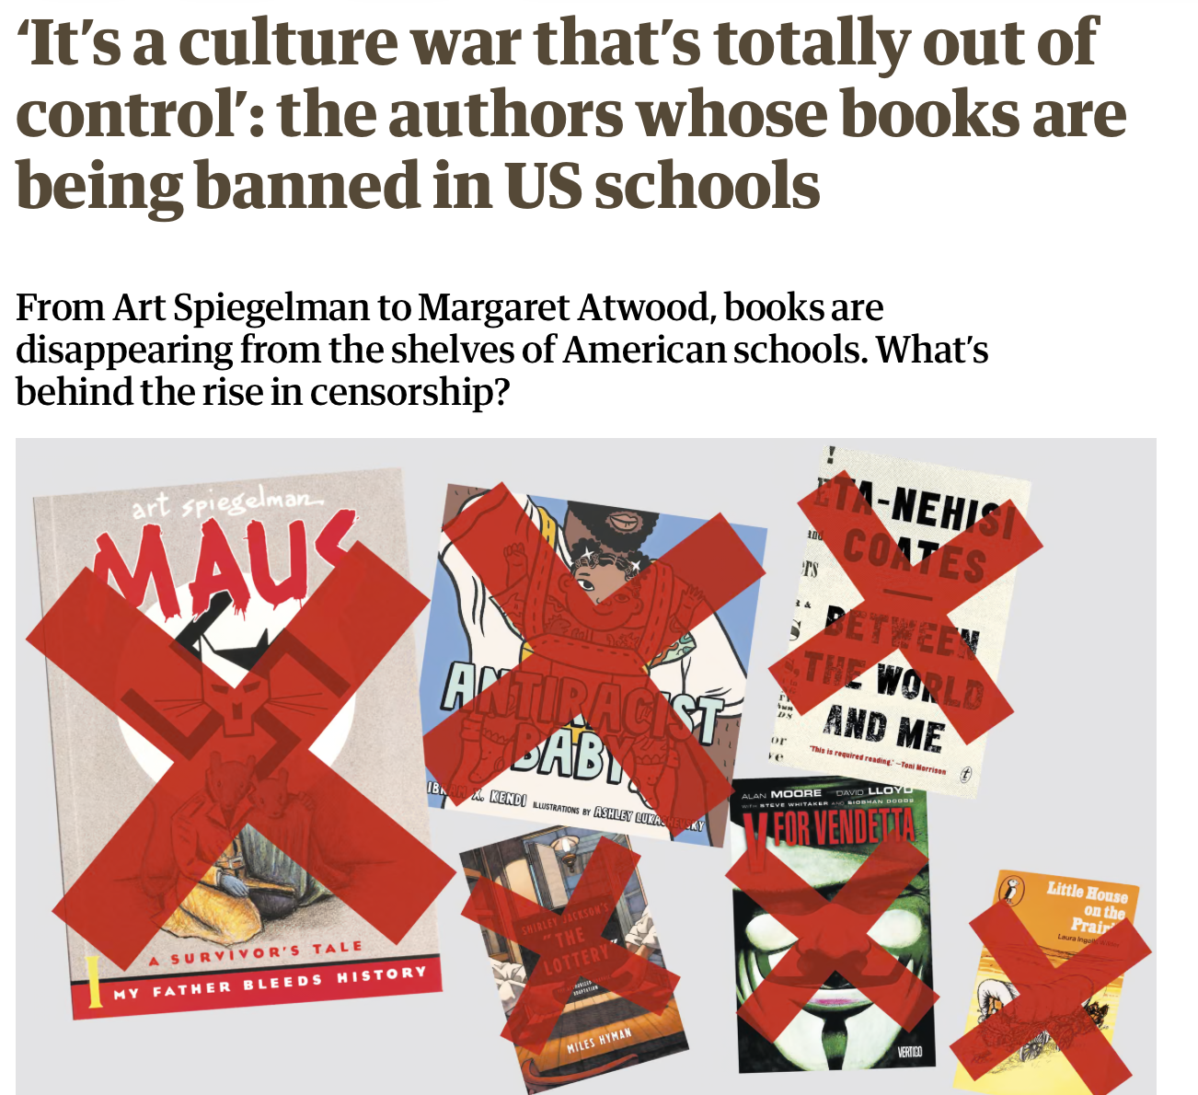
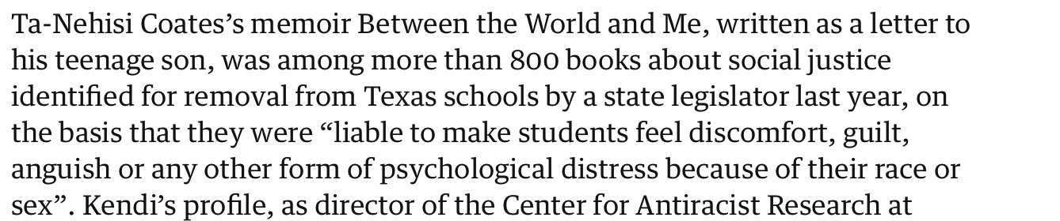

Slide 17
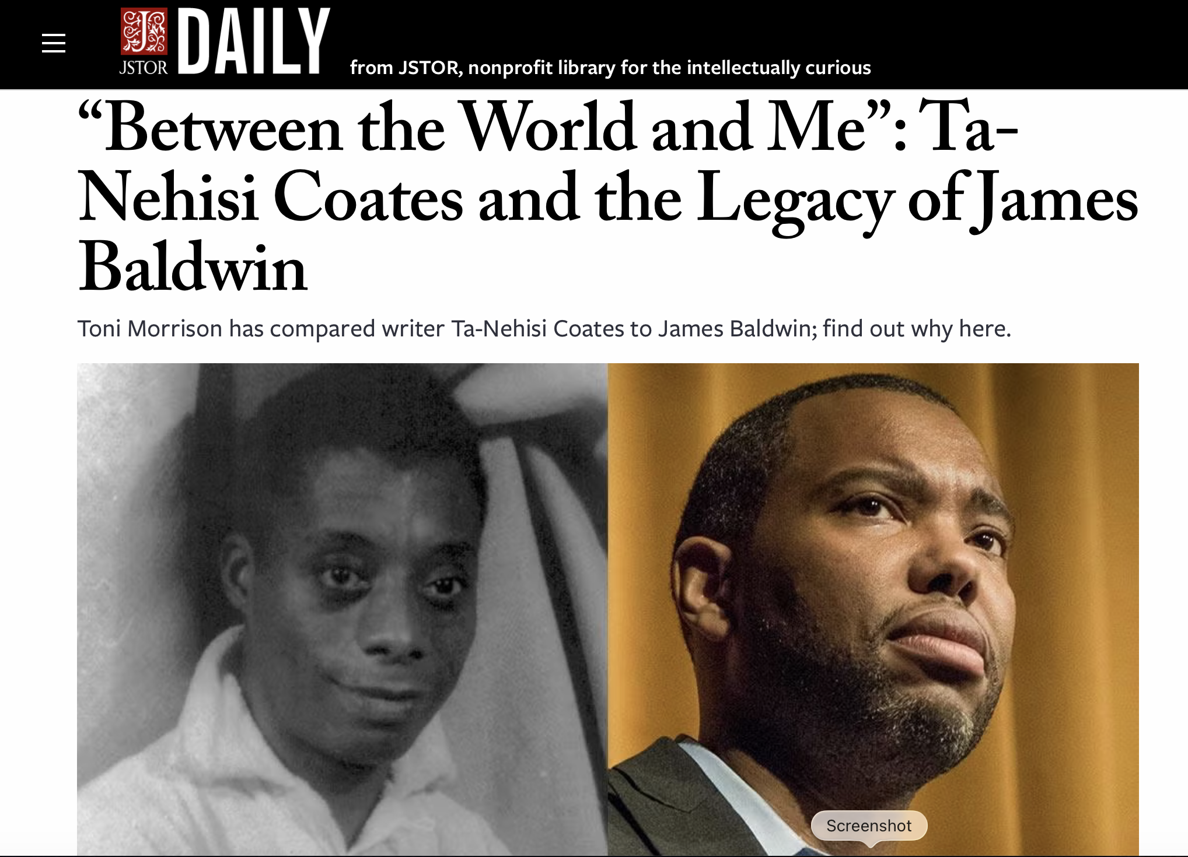

Slide 18
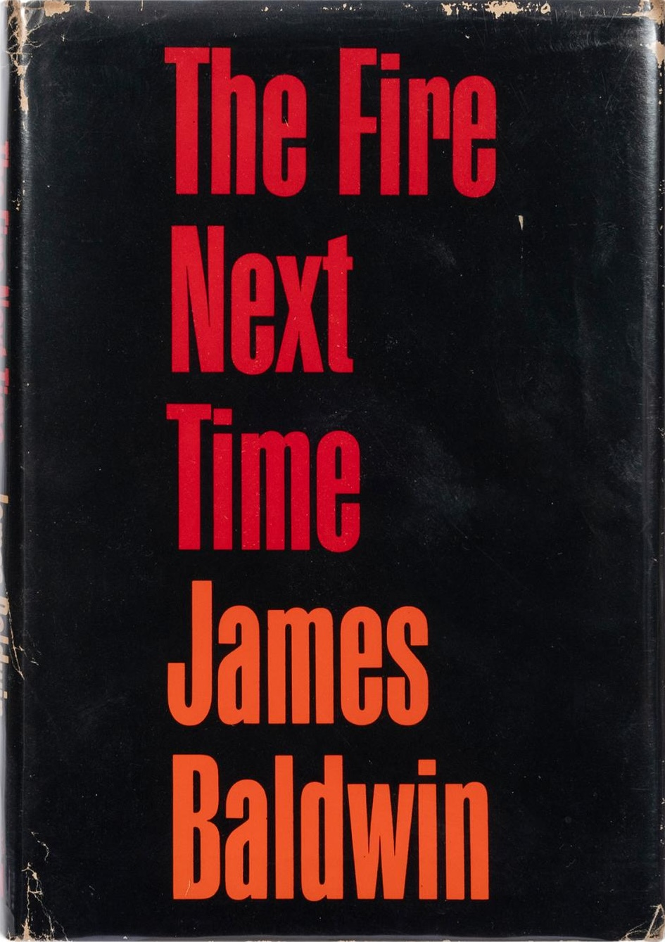

Slide 19
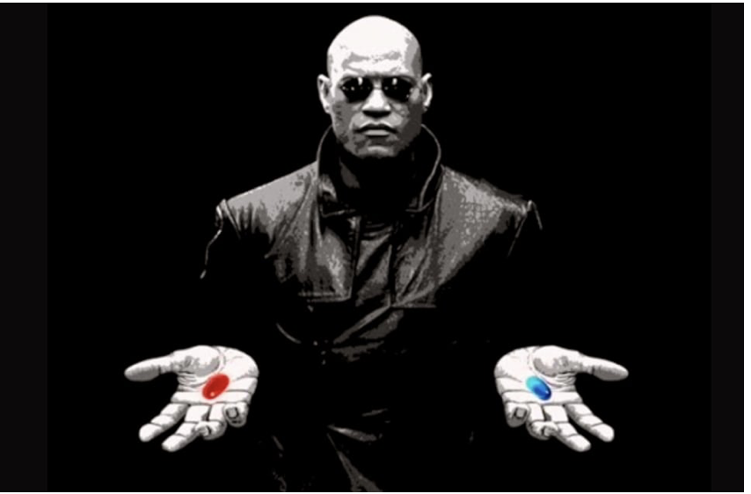

Slide 20
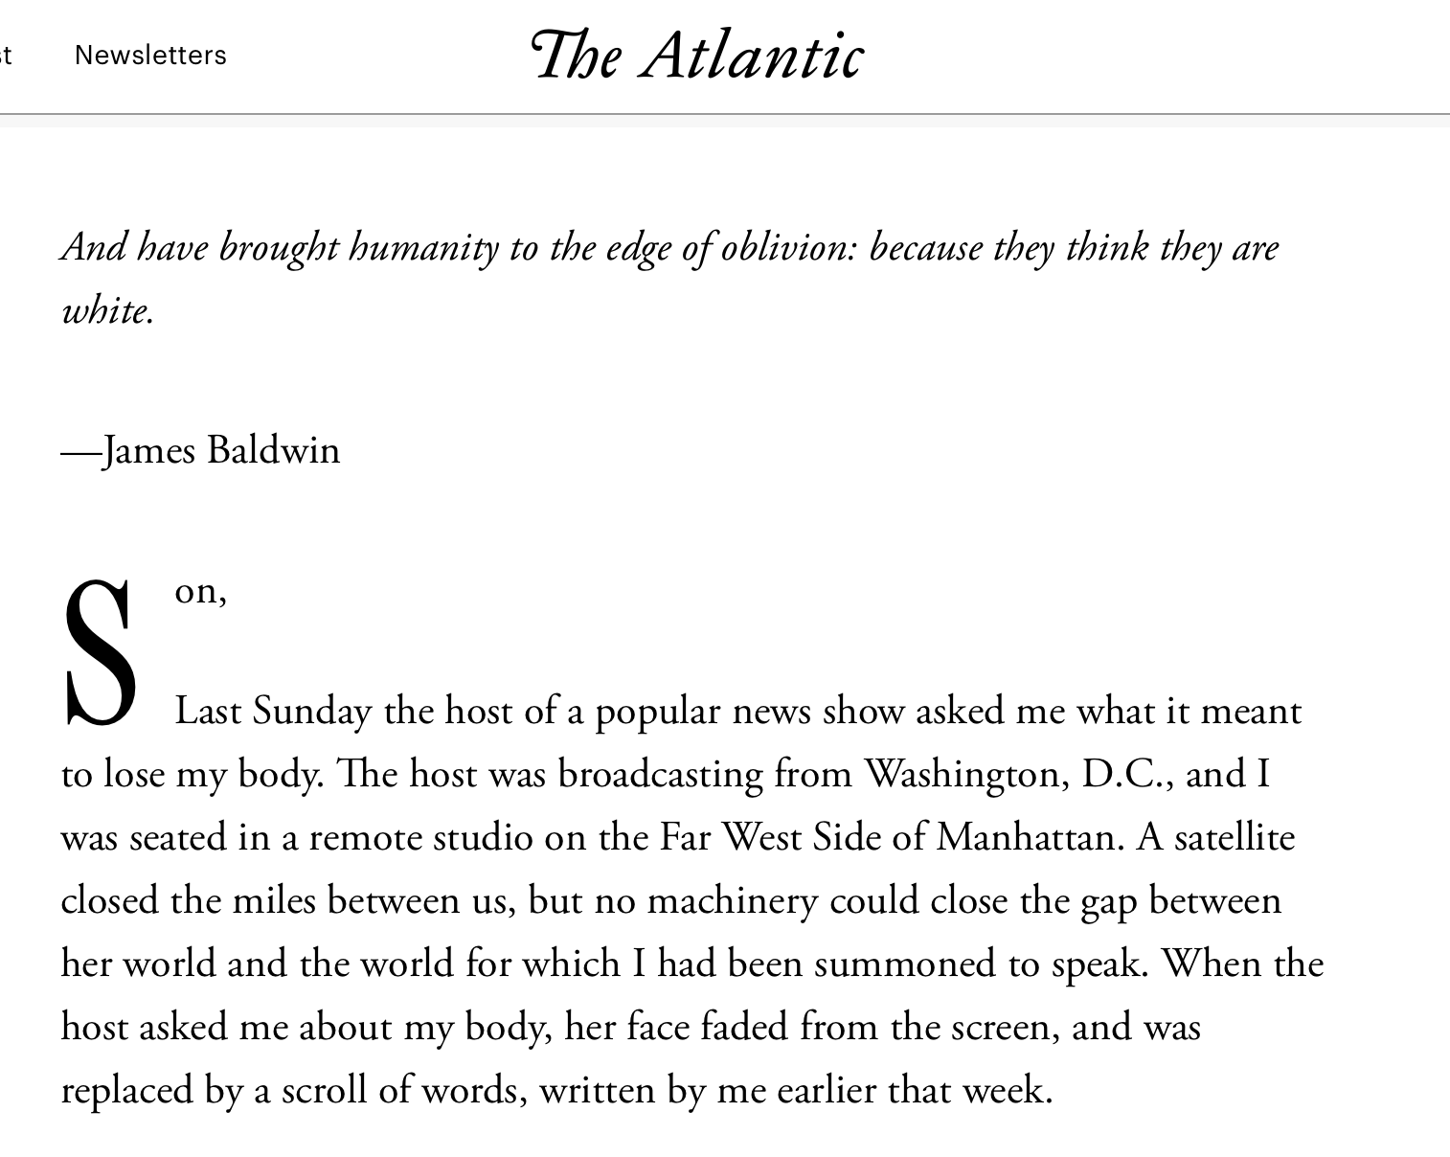

Slide 21
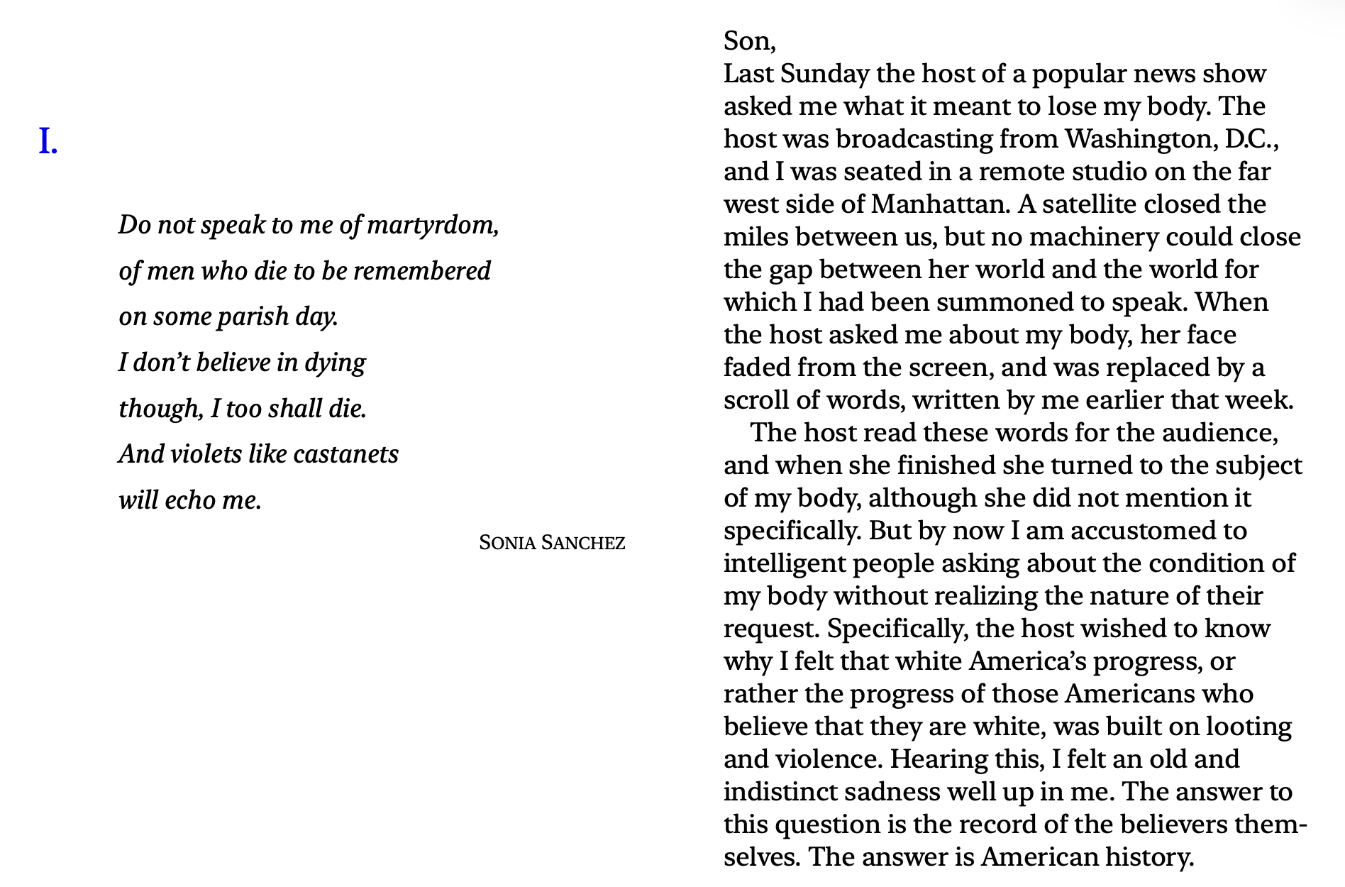

Slide 22


Slide 23
She had never known her father, which put her in the company of the greater number of everyone I'd known. I felt then that these men – these "fathers" — were the greatest of cowards. But I also felt that the galaxy was playing with loaded dice, which ensured an excess of cowards in our ranks. The girl from Chicago understood this too, and she understood something more -t hat all are not equally robbed of their bodies, that the bodies of women are set out for pillage in ways I could never truly know. And she was the kind of black girl who'd been told as a child that she had better be smart because her looks wouldn't save her, and then told as a young woman that she was really pretty for a dark-skinned girl. And so there was, all about her, a knowledge of cosmic injustices, the same knowledge I'd glimpsed all those years ago watching my father reach for his belt, watching the suburban dispatches in my living room, watching the golden-haired boys with their toy trucks and football cards, and dimly perceiving the great barrier between the world and me.

Slide 24
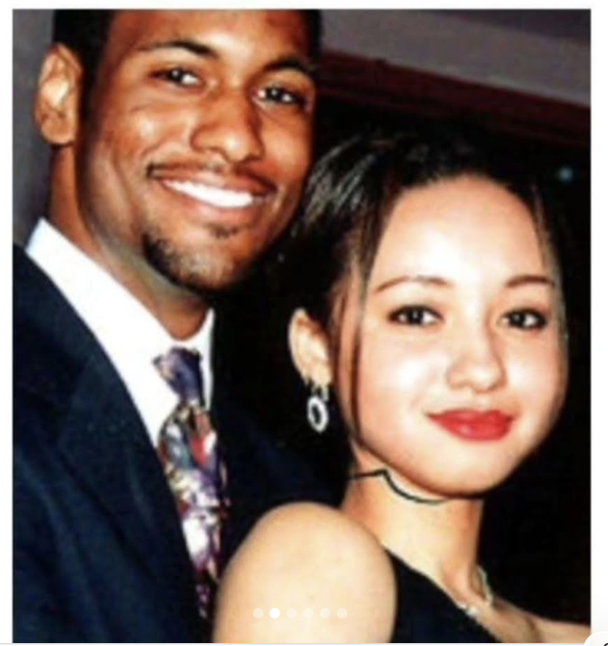

Slide 25
In 1995 racism may wear a new dress, buy a new pair of boots, but neither it nor its succubus twin fascism is new or can make anything new. It can only reproduce the environment chat supports its own health: fear, denial, and an atmosphere in which its victims have lost the will to fight. (…)
When our fears have all been serialized, our creativity censured,
our ideas "marketplaced ," our rights sold, our intelligence sloganized,
our strength downsized , our privacy auctioned; when the theatricality,
the entertainment value, the marketing of life is complete, we will find
ourselves living not in a nation but in a consortium of industries, and
wholly unintelligible to ourselves except for what we see as through
a screen darkly.

