Slide 1
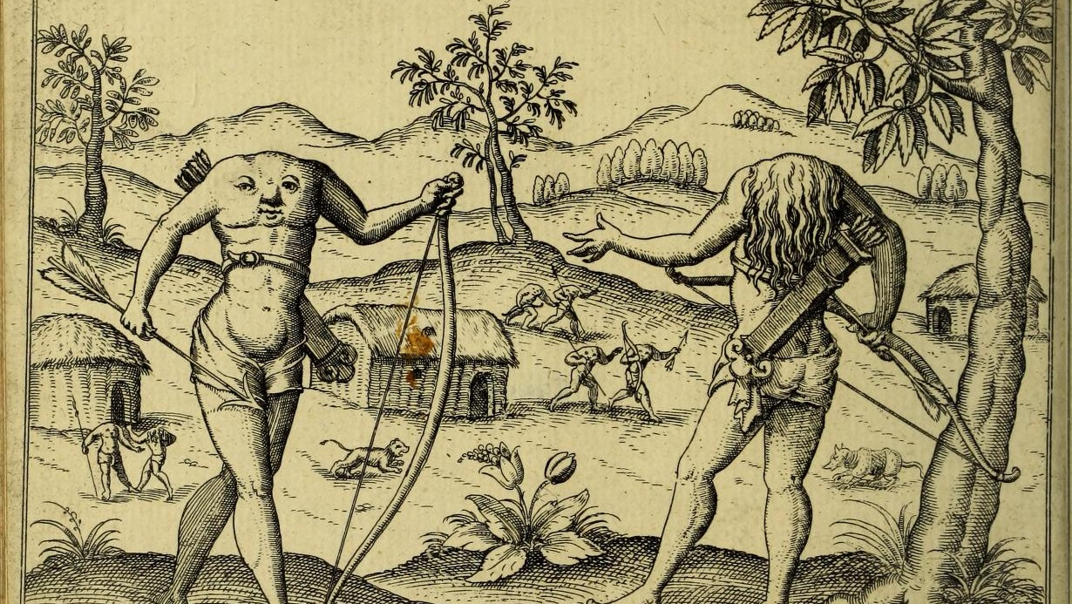
Premodern Race
Natalya Din-Kariuki

Slide 2
Premodern Critical Race Studies
Study of race in the classical, medieval, and early modern periods.
Institutional and disciplinary politics: claims of anachronism, marginalisation and erasure of scholars of colour, and of the field itself.
“When the first scholars of color entered into premodern fields (roughly during the post-Civil Rights era), and when race was introduced as a field of study in premodern history, literature, and culture (most coherently in the1990s), the scholars and the scholarship were often derided for not being rigorous enough: there was not enough evidence to examine race in premodern times; the archives could not support the inquiries; and scholars at the forefront of race studies in later fields claimed that race was a post-Enlightenment phenomena. Yet as those interested in premodern critical race studies persisted what became clear was that the evidence was under-examined, the archives existed but were misread or overlooked, and the race scholars, who flourished in later periods, were taught by pre-modern scholars whose scholarship and pedagogy privileged an unacknowledged white centrality.” – Ayanna Thompson, “Rejected: Introducing the stakes of premodern critical race studies”, Literature Compass 18.10 (2021).
See RaceB4Race: https://acmrs.asu.edu/RaceB4Race

Slide 3
Questions
How did people in premodern periods think about race?
Why is early modernity particularly important for understanding the longer histories of race and racism?
What kinds of genres, forms, and styles did early modern writers employ to set out their theories of race?

Slide 4
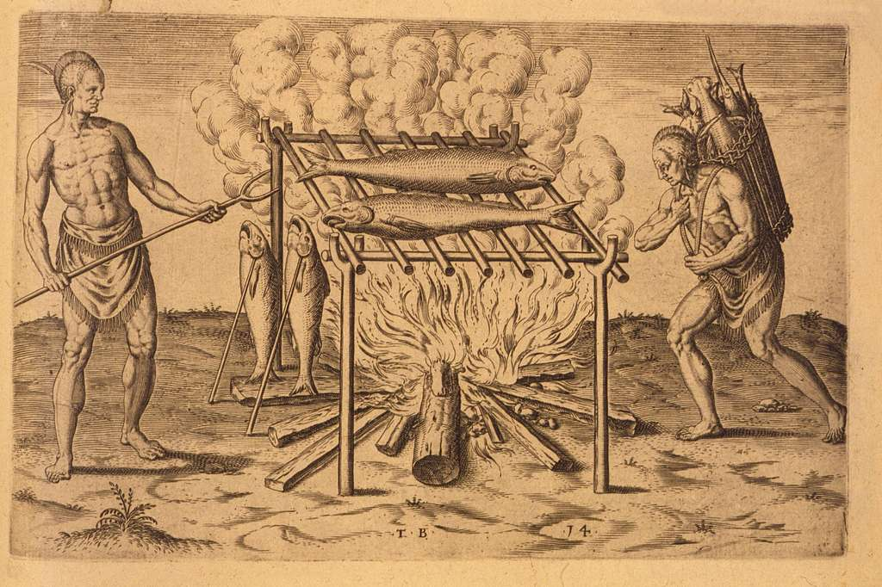
Contexts
Rise of different forms of transcultural encounter, including European ‘voyages of discovery’: international travel; trade, diplomacy.
Expanding practices of colonialism and enslavement.
‘Re-discovery’ of classical texts which dealt with questions of race and human difference, such as the writings of Pliny and Herodotus.
The Bible.
Print culture.

Slide 5
Genres
Travel writing and ethnography. [See Joan-Pau Rubiés, Travellers and Cosmographers: Studies in the History of Early Modern Travel and Ethnology (London; New York: Ashgate, 2007)]
Cosmography, or ‘descriptions of the world’, like George Abbot’s Briefe Description of the Whole Worlde (1599).
Historical writing, like Jean Bodin’s Method for the Easy Comprehension of History (1566).
Sermons and other religious tracts.
Miscellaneous: other writings on the mind, including Juan Huarte’s Examen de ingenious and Burton’s Anatomy of Melancholy.

Slide 6
Circulation
Race is not a biological reality, but a fiction: something made.
Circulation of tropes, images, and ideas of difference.
‘polyvalent mobility’ of race means that ‘racial discourses work through sedimented and familiar cultural representations of difference as they simultaneously tap into and feed the emergence of new ones.’ – Ann Laura Stoler, ‘Racial Histories and Their Regimes of Truth’, in Philomena Essed and David Theo Goldberg, eds., Race Critical Theories: Text and Context (Oxford: Blackwell, 2001), 369-391
‘Racisms have a history of traveling and transforming in their circulation’ – ‘Racial Americanization’, in Karim Murji and John Solomos, eds., Racialization: Studies in Theory and Practice (New York: Oxford University Press, 2005), 87-102.

Slide 7
Travel without travel
On cosmography: ‘she deliuereth us from greate and continuall travailes. For in a pleasaunte house, or warme study, she sheweth vs the hole face of all th’Earthe, withal the corners of the same’. William Cuningham, The Cosmographical Glasse (London, 1559), sig. A6.
Pan-European phenomenon but specifically important in England. ‘the English for the most part do not travel much, but prefer to learn foreign matters and take their pleasures at home’. Thomas Platter, trans. Clare Williams, Thomas Platter’s Travels in England 1599 (London: Jonathan Cape, 1937), 170.

Slide 8
Conceptions of race
Tendency to think about race primarily or exclusively in terms of physical difference, especially skin colour.
But notions of biological difference are socially & culturally constructed.
Wide range of meanings attached to ‘race’, especially in earlier periods.
Theories informed by sources ranging from natural history to the Bible to geographical writings (geohumoralism).

Slide 9
Premodern race
‘After all, “race” is, even today, a confusing word that does not carry a precise set of meanings, but becomes shorthand for various combinations of ethnic, geographic, cultural, class, and religious differences. […] As is the case in the modern world, when we examine early modern notions of racial difference we must consider not only those divisions of humanity that were putatively based on distinctive combinations of physical traits and transmitted through a line of descent, but also the eclectic range of cultural differences that are used to explain, manage, or reorganize relations of power’. Ania Loomba and Jonathan Burton, eds., Race in Early Modern England: A Documentary Companion (London; New York: Palgrave Macmillan, 2007), 2.
‘that race has no singular or stable referent’ because ‘race is a structural relationship for the articulation and management of human differences, rather than a substantive content’. Geraldine Heng, The Invention of Race in the European Middle Ages (Cambridge: Cambridge University Press, 2018), 19.

Slide 10
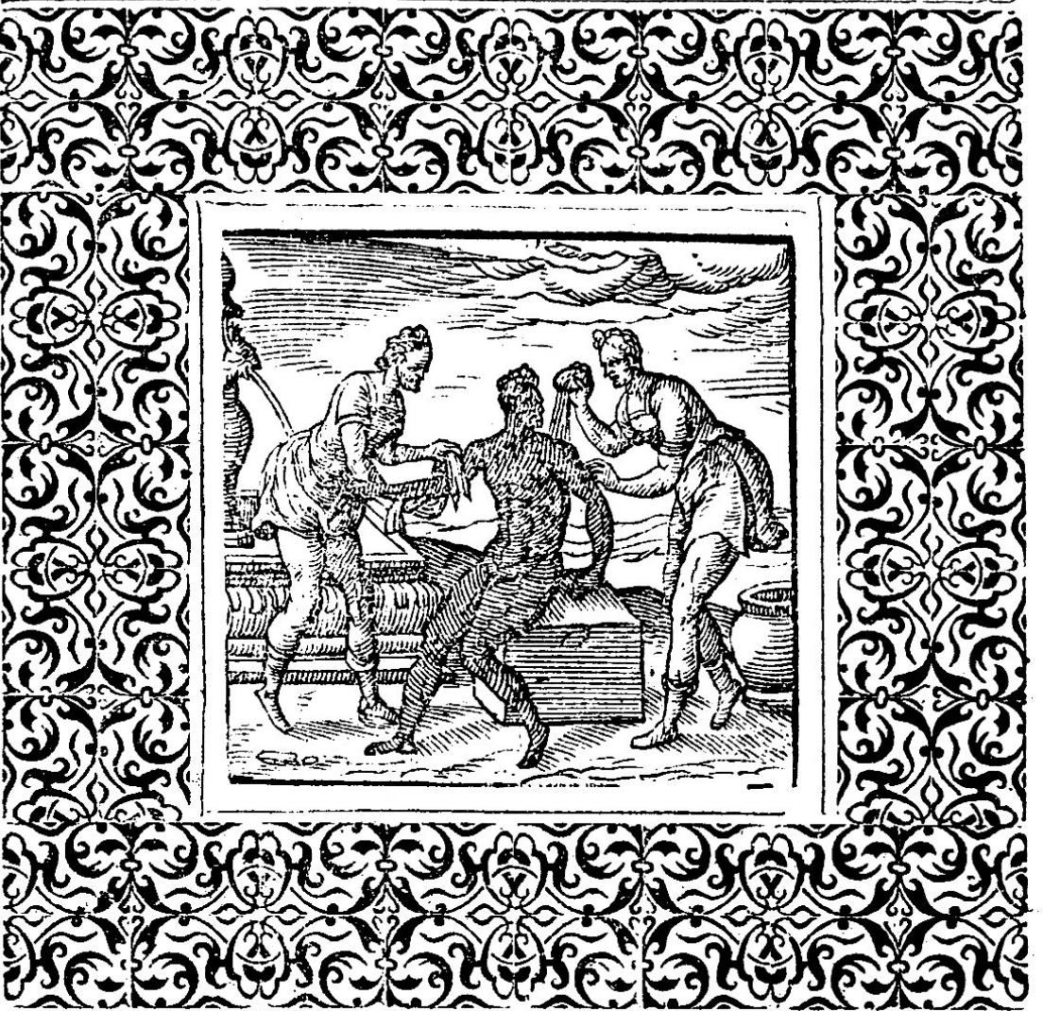
‘wash the Ethiop white’/’wash the blackamor white’
Based on Jeremiah 13.23: ‘Can the blacke More change his skin? Or the leopard his spots? Then may ye also do good, that are accustomed to do evill’ (Geneva Bible, 1560). ‘’Can the Ethiopian change his skin, or the leopard his spots? then may ye also do good, that are accustomed to do evil’ (King James Version, 1611).
Leave of with paine, the blackamore to skowre,
With washing ofte, and wipinge more then due:
For thou shalt finde, that Nature is of powre,
Doe what thou canste, to keepe his former hue:
Thoughe with a forke, wee Nature thruste awaie,
Shee turnes againe, if wee withdrawe our hande:
And thoughe, wee ofte to conquer her assaie,
Yet all in vaine, shee turnes if still we stande:
Then evermore, in what thou doest assaie,
Let reason rule, and doe the thinges thou maie
Geffrey Whitney, A Choice of Emblemes, and other devises (Leiden, 1586), 57.

Slide 11
Blackness in travel writing
‘I my selfe have seene an Ethiopian as blacke as cole brought into Englande, who taking a faire Englishe woman to Wife, begatte a Sonne in all respectes as blacke as the Father was, although England were his native Countrey, [and] an English woman his Mother: whereby it seemeth this blacknesse proceedeth rather of some naturall infection of that man, whiche was so strong, that neyther [the] nature of the Clime, neyther the good complexion of the Mother concurring, coulde any thing alter’.
‘as an example for contempte of Almightie God, and disobedience of parents, God would a sonne shuld be borne, whose name was Chus, who not only it selfe, but all his posteritie after him, should be so blacke [and] lothsome, that it might remaine a spectacle of disobedience to all the World. And of this blacke & cursed Chus came al these blacke Moores which are in Africa [. . .] Thus you see, ye cause of ye Ethiopians blacknesse, is the curse [and] natural infection of bloud, not the distemperature of the clymate.’
George Best, A true discourse of the late voyages of discouerie (London, 1578), 29, 31-32.

Slide 12
Monstrous races
‘Megasthenes writeth that upon diverse mounteines in Ynde, are people with dogges heads, and longe clawes, cladde in hydes of beastes, speaking with no voyce like unto manne, but barking onlye, muche like unto dogges, with mouthes roughe like a grater. [. . .] We rede also that there are in Inde men with one eye and no mo. And certein so notably eared that thei hange downe to their hieles, with suche a largenesse that thei may lye in either of them as upon a pallet: and so harde, that thei maye rende up trees with them. [. . .] It is redde that […] Ther are also that lacke neckes, [and] have their eyes in their shoulders.’ Johann Boemus, trans. William Waterman, The fardle of facions conteining the aunciente maners, customes, and lawes, of the peoples enhabiting the two partes of the earth, called Affrike and Asia (London, 1555), sig. Miii-Miiiv

Slide 13
George Abbot, A briefe description of the whole worlde (1599)
English Clergyman (though he published this before becoming a bishop). How does his religious background shape this text? Post-Reformation debates about worship.
On the people of the East Indies: ‘there are diverse of them who do adore the Sun as their God, and every morning at the rising thereof, do use very superstitious ceremonies, which our merchants, who do trad eto Aleppo do oftentimes see…but in one town […] they found certain Christians dissenting in many things from the Church of Rome, and rather agreeing with the Protestants’ (p. 146 in Loomba and Burton).
See also comparison of splits within Christian Church to the splits in Islamic faith.
Race and religion.

Slide 14
Jean Bodin, Method for the Easy Comprehension of History (1566)
French jurist and philosopher. Why does he include material on race in a work setting out approaches to historical interpretation? Questions about difference and diversity bound up with those of history.
‘I can hardly be persuaded that men are made black from the curse of Chus, as a certain learned man reports.’ (p. 94 in Loomba and Burton).
Geohumoralism.

Slide 15
Juan Huarte, Examen de ingenios. The examination of mens wits... (1594).
Spanish physician. How did his ideas anticipate and provide the foundations for later disciplines such as physiognomy and phrenology?
Connections between physical difference and forms of human intelligence.
On interracial sex: ‘children born of such copulations give token in their manners and conditions that their engendering was not natural’. (p.135 in Loomba and Burton).

Slide 16
Robert Burton, The Anatomy of Melancholy (1621)
English writer. Study of the condition of melancholy.
Copious and digressive. Any connection between his style and his conceptions of race?
Writing on the humours and the mind.

