Slide 1



Race Objects: Introduction
Dr Bushra Mahzabeen

Slide 2
Black Mirror
https://www.youtube.com/watch?v=YE57GER9RXM

Slide 3
Race
“Race” is one of the most troubling and contentious concepts of our times, one of the most powerful and yet one of the most fragile markers of social difference.1 In the last few decades, it has become the subject of intense scholarly attention and debate across various disciplines, even as both scientists and humanists have demonstrated that race is not a natural category but a social construct, or, to adapt Stuart Hall’s words about blackness, “a narrative, a story, a history. Something constructed, told, spoken, not simply found.
Loomba, Ania, and Jonathan Burton, eds. Race in Early Modern England: A Documentary Companion. Palgrave Macmillan, 2007.

Slide 4
Critical Race Theory
The critical race theory (CRT) movement is a collection of activists and scholars engaged in studying and transforming the relationship among race, racism, and power. The movement considers many of the same issues that conventional civil rights and ethnic studies discourses take up but places them in a broader perspective that includes economics, history, setting, group and self- interest, and emotions and the unconscious. Unlike traditional civil rights discourse, which stresses incrementalism and step- by- step progress, critical race theory questions the very foundations of the liberal order, including equality theory, legal reasoning, Enlightenment rationalism, and neutral principles of constitutional law.
Harris, Angela, Jean Stefancic, and Richard Delgado. Critical Race Theory: An iItroduction. NYU Press, 2023.

Slide 5
Microaggression
Think of events that can occur in an ordinary day. A child raises her hand repeatedly in a fourth- grade class; the teacher either recognizes her or does not. A shopper hands a cashier a five- dollar bill to pay for a small item; the clerk either smiles, makes small talk, and deposits change in the shopper’s hand or does not. A woman goes to a new- car lot ready to buy; salespeople stand about talking to each other or all converge trying to help her. A jogger in a park gives a brief acknowledgment to an approaching walker; the walker returns the greeting or walks by silently.
Jean Stefancic, and Richard Delgado. Critical Race Theory: An Introduction. NYU Press, 2023.

Slide 6
Race End Here
“Underpinning my argument is a desire to link the historical and critical study of raciologies and ‘racial’ metaphysics to the new histories of visuality and perception that are being produced, to connect it with some timely critiques of absolute identity and their associated genealogies of subjectivity and, above all, to link it to an understanding of the technoscientific means that have fostered and mediated particular relations with our race-coded selves in the modern past.” (838)
“scientific and biological, historical and cultural, rational and irrational, skin, bone and even blood are no longer primary referents of racial discourse” (845)
Paul Gilroy

Slide 7
North Atlantic Universals
“North Atlantic universals, so defined, even when assisting or addressing content, are therefore not merely descriptive or referential. They do not only describe the world, they offer visions of the world. They appear to refer to things as they exist. But rooted as they are in a particular history, they are evocative of multiple sensibilities, persuasions, and cultural and ideological choices tied to that localized history. In other words, I’m suggesting that the words that can be used to describe the world and the projects themselves as universal must be located.”
Trouillot, Michel-Rolph. "The North Atlantic Universals." Modern World-System in the Longue Duree. Routledge, 2015. 229-237.

Slide 8
Transatlantic Slave Trade
“It played its part in the opening of the Atlantic to European enterprise that occurred during the Age of Reconnaissance. Until the fifteenth century the Mediterranean was the economic center of Europe. Both the source and the destination of the African slaves were unknown to Europe before 1400. A century of exploration broke the sea barriers to West Africa and the Western Hemisphere. In these probings of the unknown, the search for slaves, though not of the first importance, quickened the purpose of princes, captains, and buccaneers.” (2)
Rawley, James A., and Stephen D. Behrendt. The Transatlantic Slave Trade: a history. U of Nebraska Press, 2005.
BBC: https://www.bbc.co.uk/bitesize/articles/zfkfn9q#z3jbvwx

Slide 9
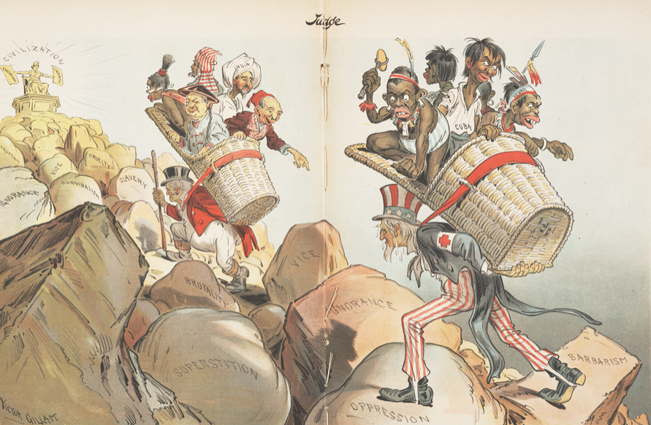
Rudyard Kipling’s “White Man’s Burden”
“Take up the White Man's burden—
Send forth the best ye breed—
Go bind your sons to exile
To serve your captives' need;
To wait in heavy harness
On fluttered folk and wild—
Your new-caught sullen peoples,
Half devil and half child."

Slide 10
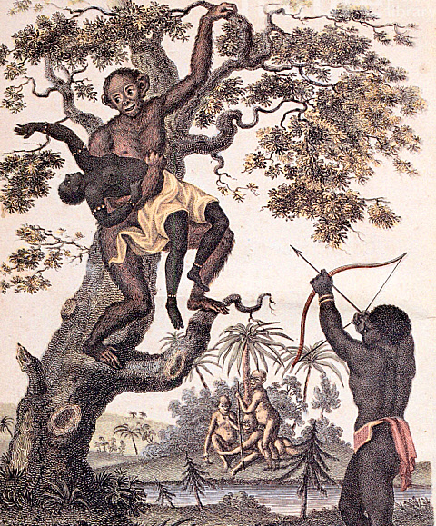
Notes:
“The central, inescapable problem presented in that picture is the suggested kinship between these sub- and anti-human species rather than the fact that their conflictual interrelation is figured through the idea of rape” (Gilroy, 846)

Slide 11
Vio­lence of postcolonial modernity
“The vio­lence of postcolonial modernity mirrors the vio­lence of Eu­ro­pean modernity and colonial direct rule. Its princi­ple manifestation is ethnic cleansing. ­Because the nation-­ state seeks to homogenize its territory, it is well served by ejecting those ­ who would introduce pluralism. Ethnic cleansing can take a variety of forms. These ­ include genocide, whereby the minority population is killed en masse, and population transfer, whereby the minority is removed from the territory or concentrated in a minimal portion of it, away from the majority. Ethnic cleansing unites the examples in this book: the United States, which perpetrated both genocide and population transfer against American Indians; Germany, which perpetrated genocide against Jews and was in turn victimized by Allied population transfers following the Second World War; South Africa, where white settlers forced blacks into tribal homelands known as Bantustans; Sudan, where the British segregated Arabs and Africans into separate homelands; and Palestine, where Zionist settlers forcibly exiled and concentrated non-­Jews, an ongoing pro­cess” (4).
Mamdani, Mahmood. Neither Settler nor Native: The Making and Unmaking of Permanent Minorities, Harvard University Press, 2020.

