Slide 1


Race Objects: Week 10 “Who Belongs Here?: Race and Migration in the UK”
Bushra Mahzabeen

Slide 2

“Promiscuous coition of men and animals took place, wherefore the regions of Africa produce for us so many monsters” (Jean Bodin, 96)
Loomba, Ania, and Jonathan Burton, eds. Race in early modern England: A documentary companion. New York: Palgrave Macmillan, 2007.

Slide 3
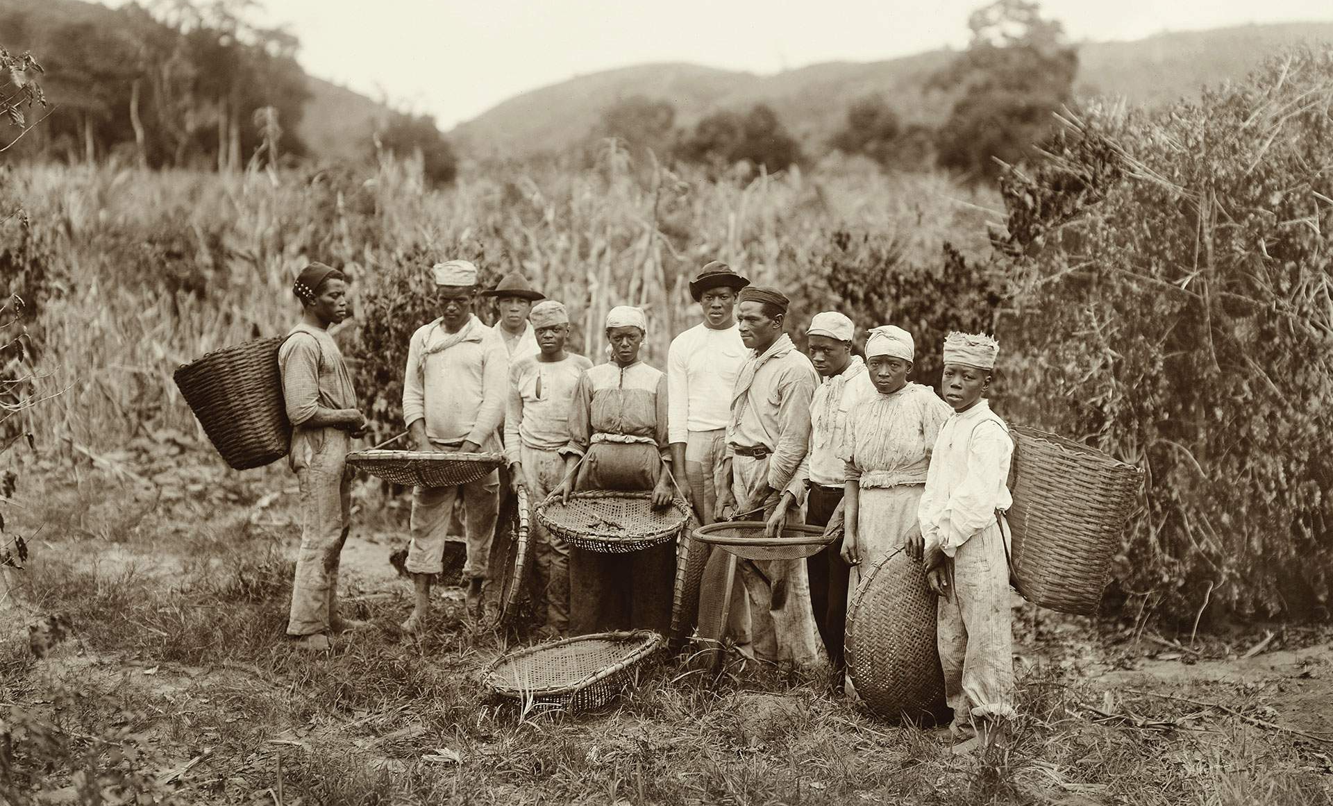
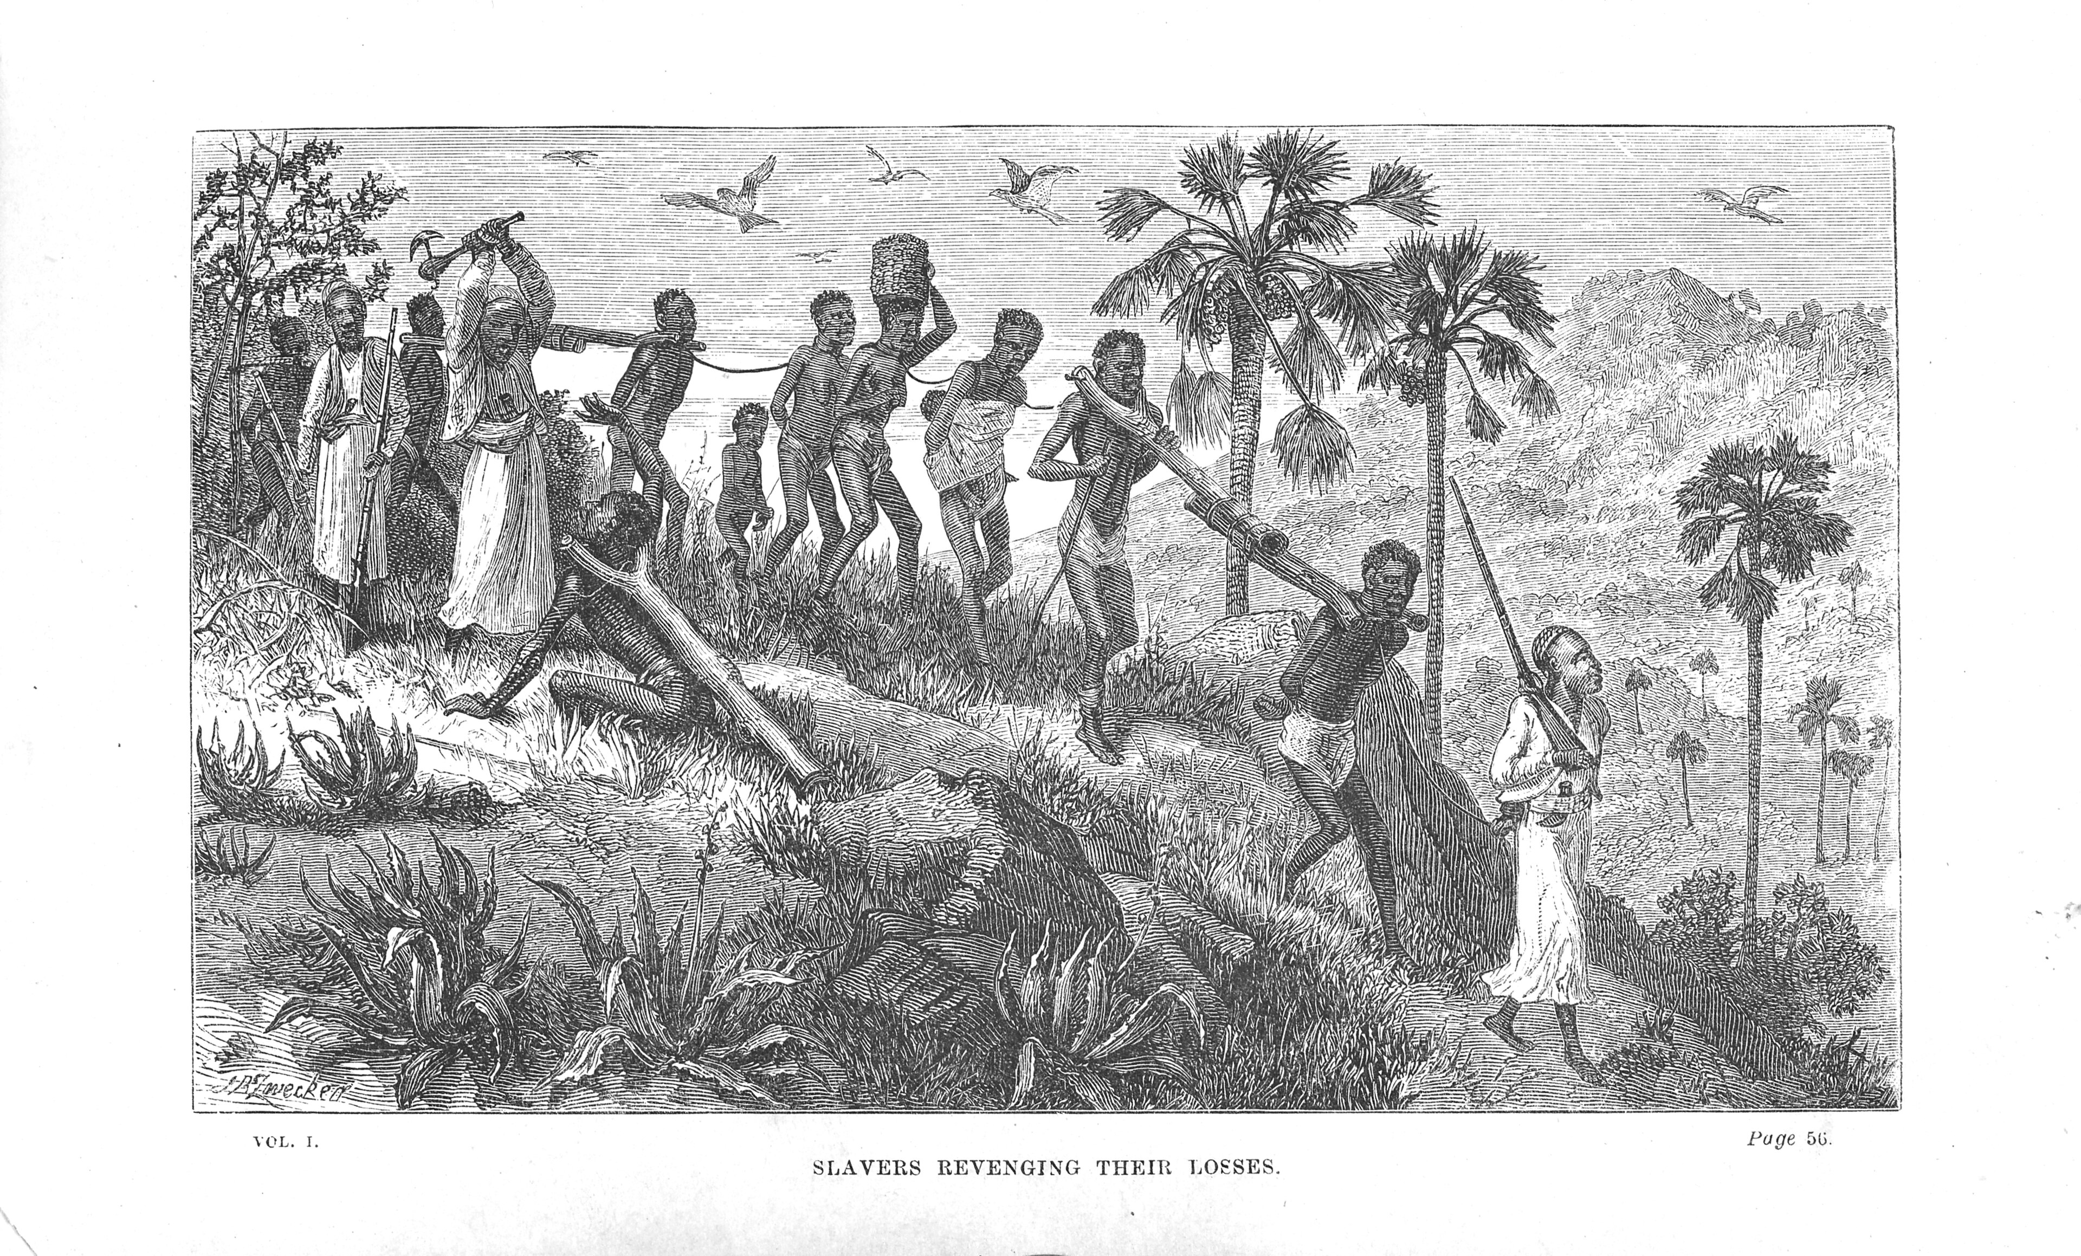
Upper right: https://www.bbc.com/portuguese/resources/idt-sh/lutapelaabolicao
Lower right: Horace Waller: The last journals of David Livingstone in Central Africa, from 1865 to his death. London, 1874.

Slide 4

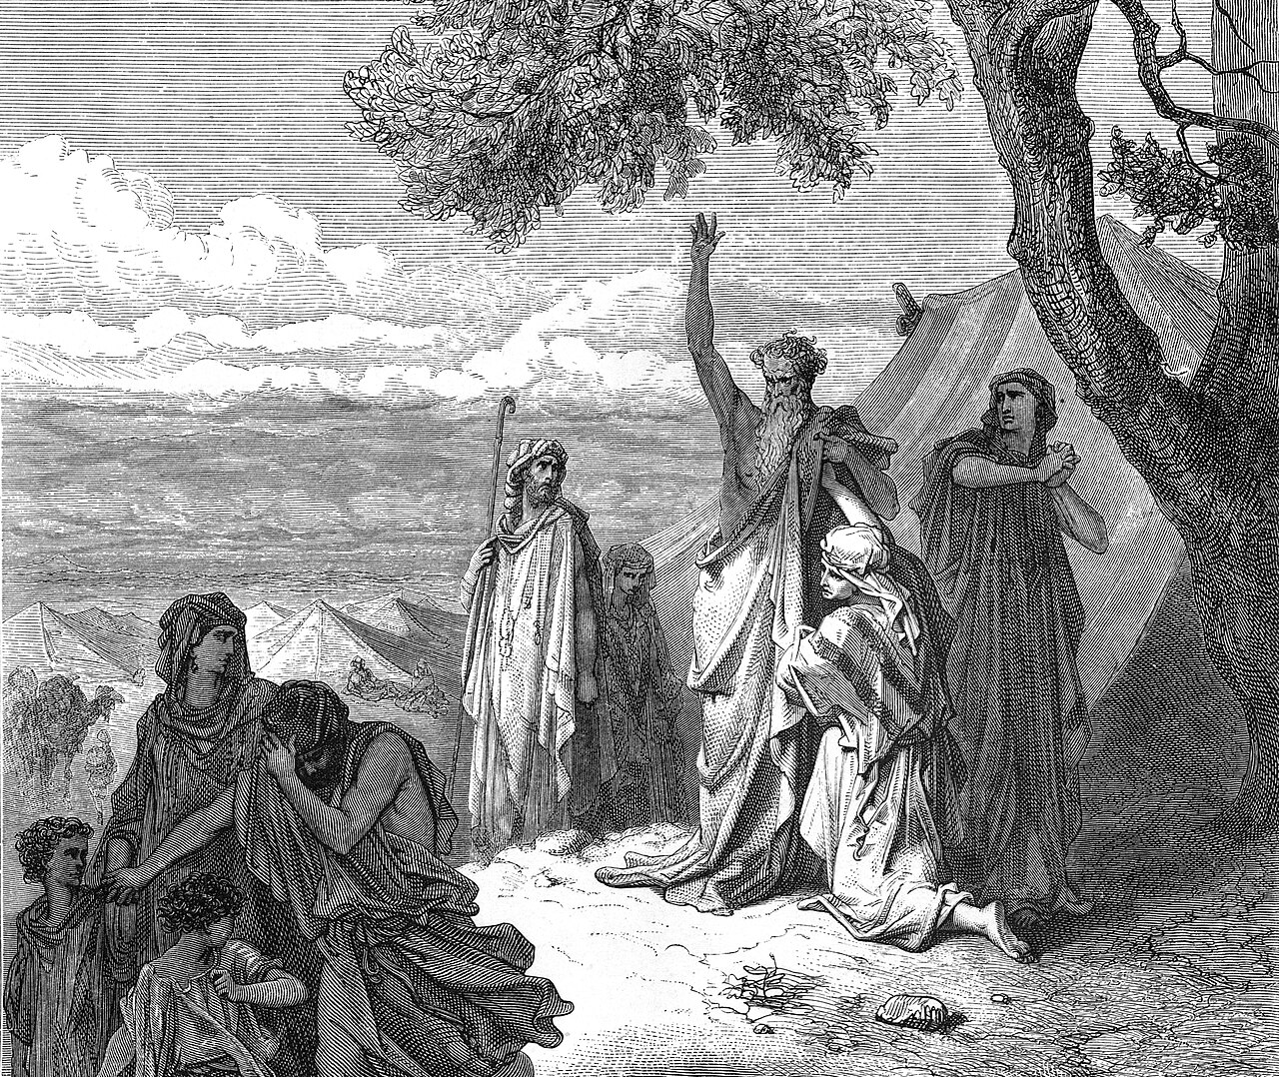
"Noah Curses Ham and Canaan"

Slide 5
“Which good instructions and exhortations notwithstanding, his wicked son Cham disobeyed, and being persuaded that the first child born after the flood (by right and law of nature) should inherit and possess all the dominion of the earth, he, contrary to his father’s commandment, while they were yet in the ark, used company with his wife, and craftily went about, thereby to disinherit the offspring of his other two brethren, for the which wicked and detestable fact, as an example for contempt of Almighty God, and disobedience of parents, God would a son should be born, whose name was Chus, who not only itself, but all his posterity after him, should be so black and loathsome, that it might remain a spectacle of disobedience to all the world. And of this black and cursed Chus came all these black Moores which are in Africa, for after the water was vanished from off the face of the earth, and that the land was dry, Sem chose that part of the land to inhabit in which now is called Asia, and Japhet had that which now is called Europa wherein we dwell, and Africa remained for Cham, and his black son Chus. . .being perhaps a cursed, dry, sandy, and unfruitful ground, fit for such a generation to inhabit in.29 Thus you see, the cause of the Ethiopians’s blackness, is the curse and infection of blood, and not the distemperature of the climate…” (George Best, p. 109-110)
Loomba, Ania, and Jonathan Burton, eds. Race in Early Modern England: A documentary companion. New York: Palgrave Macmillan, 2007.

Slide 6
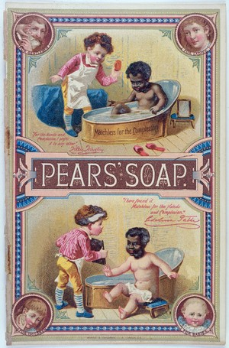
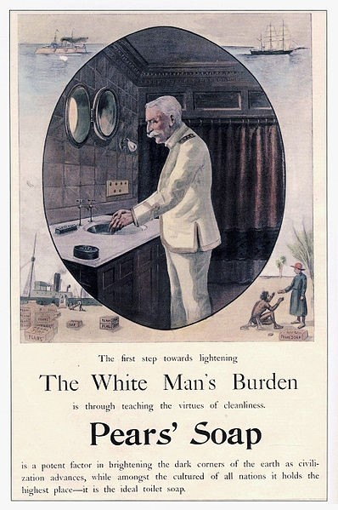

Slide 7


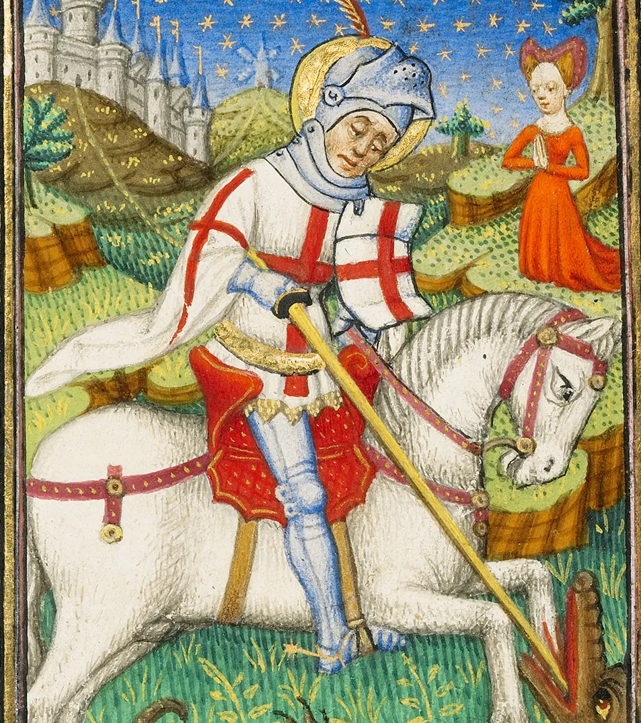
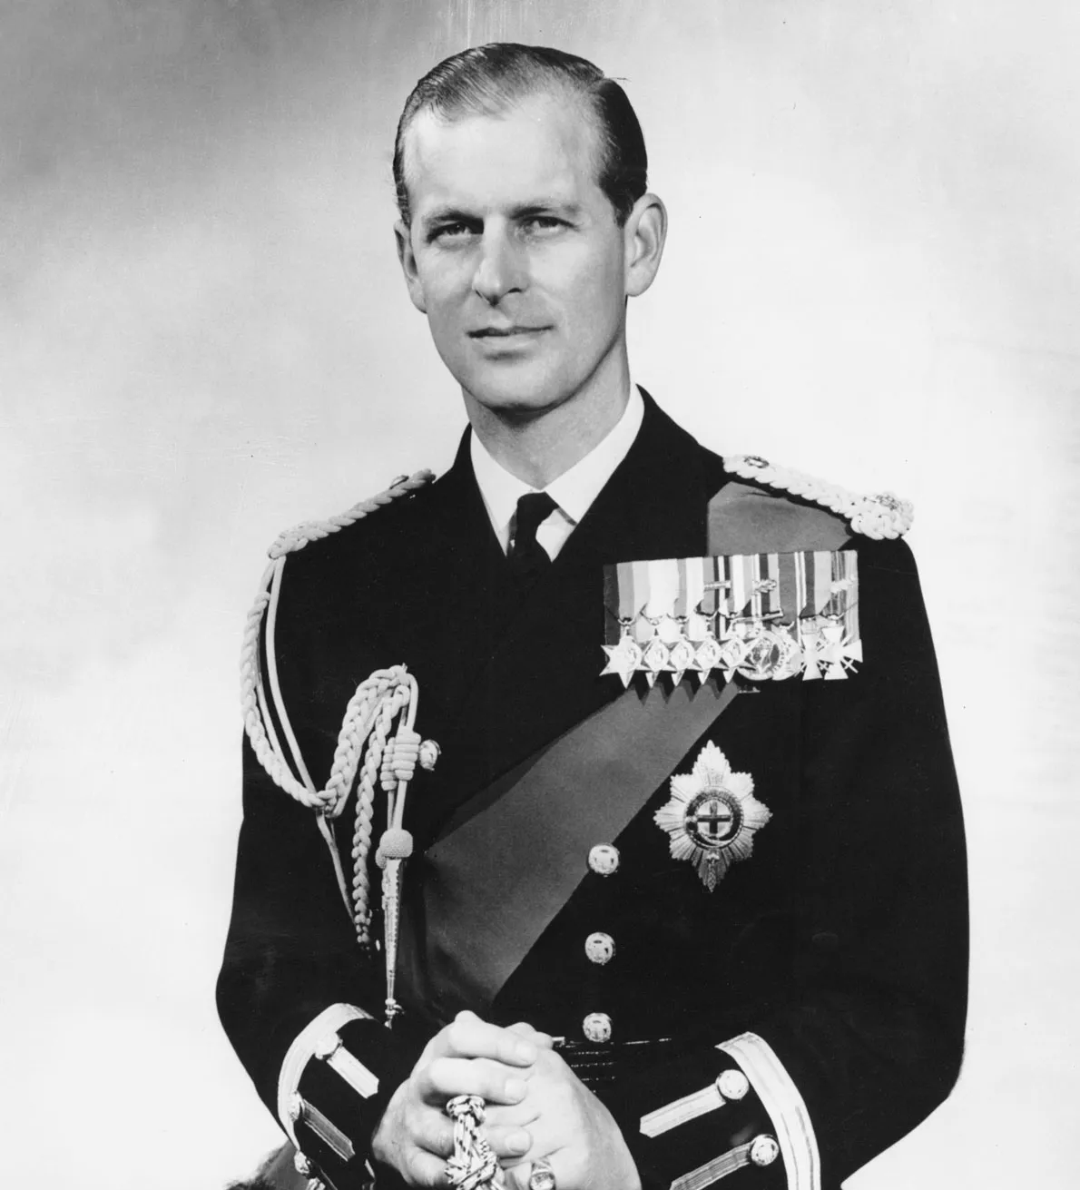



Slide 8

Vevox Poll

Slide 9
How Migration Really Works
In 2015 British Prime Minister David Cameron spoke of a swarm of people coming across the Mediterranean. In the same year, in response to the large-scale arrivals of Syrian refugees in Europe, Dutch Prime Minister Mark Rutte stated that “As we all know from the Roman Empire big empires go down if the borders are not well protected”. Three years later U.S. President Donald Trump warned that “immigration threatens our security in our economy and provides a gateway for terrorism”. In 2022 UK home secretary Suella Braverman referred to growing numbers of boat crossings from France across the English Channel as “an invasion to our southern coast”. (pp. 31)
De Haas, Hein. How migration really works: A factful guide to the most divisive issue in politics. Random House, 2023.

Slide 10
“Consider the European Union’s Schengen visa regime, which is regulated by treaty.96 The European Union’s Visa Regulation maintains two lists of countries: one widely (and at its inception officially) referred to as the Black list containing countries whose nationals require visas to enter and another, the White list, with countries whose nationals do not need a visa.97 A range of factors determine the list to which a given country belongs,98 but the ultimate effect of the categorization is that the nationals on the Black list are presumptively undesirable, and those on the White list are presumptively desirable.99 Nationals of Black listed countries face a structural bar to short-term mobility, which they must overcome on a costly, individualized basis through processes mostly insulated from foundational, liberal due process rights let alone substantive equality protections.” (468)
Achiume, E. Tendayi. "Racial borders." Geo. LJ 110 (2021): 446-448.

Slide 11
“Understanding the Contemporary Race–Migration Nexus”
A recent discourse and content analysis of highly cited works on European migration and ethnic minority scholarship finds that the concepts of race and racism are rarely spoken about … Recognition of racism as a structuring feature of European societies is needed to address how Europe’s migration regimes articulate and are articulated by racialization and coloniality” (Umut Erel et al. 1341).

Slide 12
Although in the 1950s opinion polls in the UK revealed a general preference for ‘coloured’ Commonwealth immigrants over European aliens (Miles 1990, 284), during the early post-war years, European migrant workers were recruited into labour shortage sectors on contracts tying them to their employment. While their working conditions and conditional immigration status marked them as Other, their categorization as white rendered them desirable immigrants in the eyes of government and employers (McDowell 2009). However, the 1960s response to immigration overwhelmingly shifted towards more stringent controls regulating Commonwealth citizens’ arrival (Miles 1990, 284). This disproportionately affected non-white Commonwealth citizens. From the 1960s onwards, political discourse re-cast Commonwealth citizens from fellow subjects to ‘immigrants’. (Umut Erel et al. 1343)

Slide 13

The Good Immigrant edited by Nikesh Shukla, Unbound, 2016.

Slide 14

“A Guide to Being Black”
“With most people, their race is perhaps the only aspect of their identity guaranteed from the moment of conception” – Varaidzo

Slide 15
“My Name is My Name”
“It is there in the white men and women who do not understand, to the point of frustration, why we still walk with the noose of our ancestors around our necks, as we cannot comprehend how they do not carry the indignity of their ancestors tying it there. But tradition is an inescapable trait of our communities – those who cannot rely on land or home for their identity. Our parents, and their parents, and theirs before, have little more to leave us beyond their names, beyond their language. We have inherited the knowledge that community means to remain. When we cannot return to our homes – or are waiting for them to be taken from us again – we must get the hang of how to recreate it elsewhere. It is in the particular smell of rice, or aubergines, the pastry that survived on the windowsills of our mothers’ kitchens”. (Chimene Suleyman 26)

Slide 16

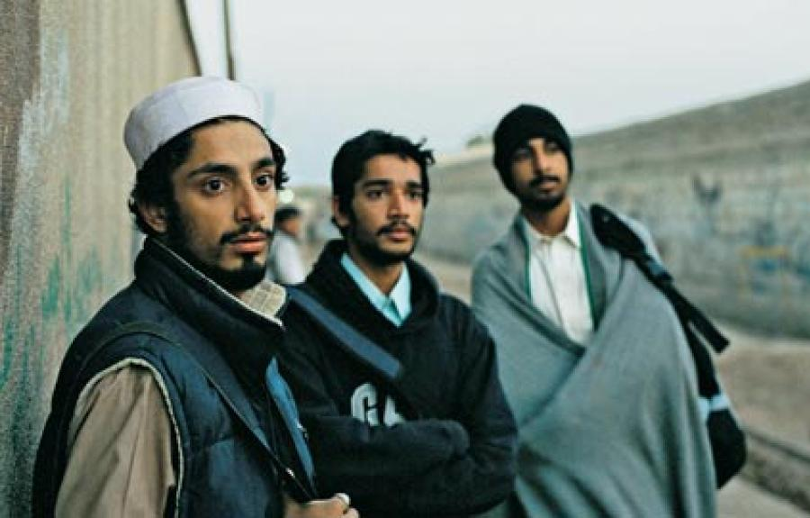
“Airports and Auditions”
Upper right: Riz Ahmed in Rogue One
Lower right: Road to Guantanamo

Slide 17

“Wearing Where You’re at: Immigration and UK Fashion”
“Waiting at the bus stop in South London one day, I was wearing a black turban similar to the style my Egyptian great-grandmother wore. I hardly knew her, but I have always been more comfortable with my head covered, albeit not in a traditionally religion-specific style. When living in Cairo for a few years of my life at various times and whilst exploring aspects of my faith, I have worn hijab, but in London I have always worn a wide variety of head coverings. On this particular turban-wearing day, a white English man came up to me just before I stepped onto the bus, pointed at my head-covering and shouted, ‘All Muslims should die’, before scurrying away to dissolve in the acid of his hatred (hopefully). I am well aware that this is light conversation compared to what Muslim women wearing hijab or niqab have to face every day in this country. But it astounded me, as it always does, that somebody could be driven to such vociferousness by a piece of cloth and the ‘difference’ this might represent.” (Sabrina Mahfouz 148)

Slide 18


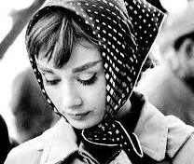

Slide 19

“Shade”
“The universal job of being a writer is to write, to write with empathy, to be brave and honest, to find joy conveying a journey and in sharing your passion. Your ink is replenished by your life experiences, by taking off the mask and using your limitless imagination, by stepping out of the shade and into the light. As a woman may write in the voice of a man, I don’t see why a writer cannot imagine the voice of another shade and culture, that is what imagination is all about. Whatever shade you are, as a writer, you have just one task each day, one battle, and that is you against the blank page. Every writer should have just that in mind, nothing else matters, just that one fight is more than enough to contend with, each and every morning.
You and your pen against the empty page” (Salena Godden 196 )

Slide 20
“the biggest burden facing people of colour in this country is that society deems us bad immigrants – job-stealers, benefit-scroungers, girlfriend-thieves, refugees – until we cross over in their consciousness, through popular culture, winning races, baking good cakes, being conscientious doctors, to become good immigrants.
And we are so tired of that burden.”
The Good Immigrant, edited by Nikesh Shukla, Unbound, 2016.

Slide 21
“All I can do is keep on keeping on, keep sailing my Good Ship.
Human colour is the colour I’m truly interested in, the colour of your humanity. May the size of your heart and the depth of your soul be your currency. Welcome aboard my Good Ship. Let us sail to the colourful island of mixed identity. You can eat from the cooking pot of mixed culture and bathe in the cool shade of being mixed-race. There is no need for a passport. There are no borders. We are all citizens of the world. Whatever shade you are, bring your light, bring your colour, bring your music and your books, your stories and your histories, and climb aboard. United as a people we are a million majestic colours, together we are a glorious stained-glass window. We are building a cathedral of otherness, brick by brick and book by book. Raise your glass of rum, let’s toast to the minorities who are the majority. There is no stopping time, nor the blurring of lines or the blending of shades. With a spirit of hope I leave you now. I drink to our sameness and to our unique differences. This is the twenty-first century and we share this, we live here, in the future. It is a beautiful morning, it is first light on the time of being other, so get out from that shade and feel the warmth of being outside.
You tick: Other.” (Salena Godden)

