Slide 1
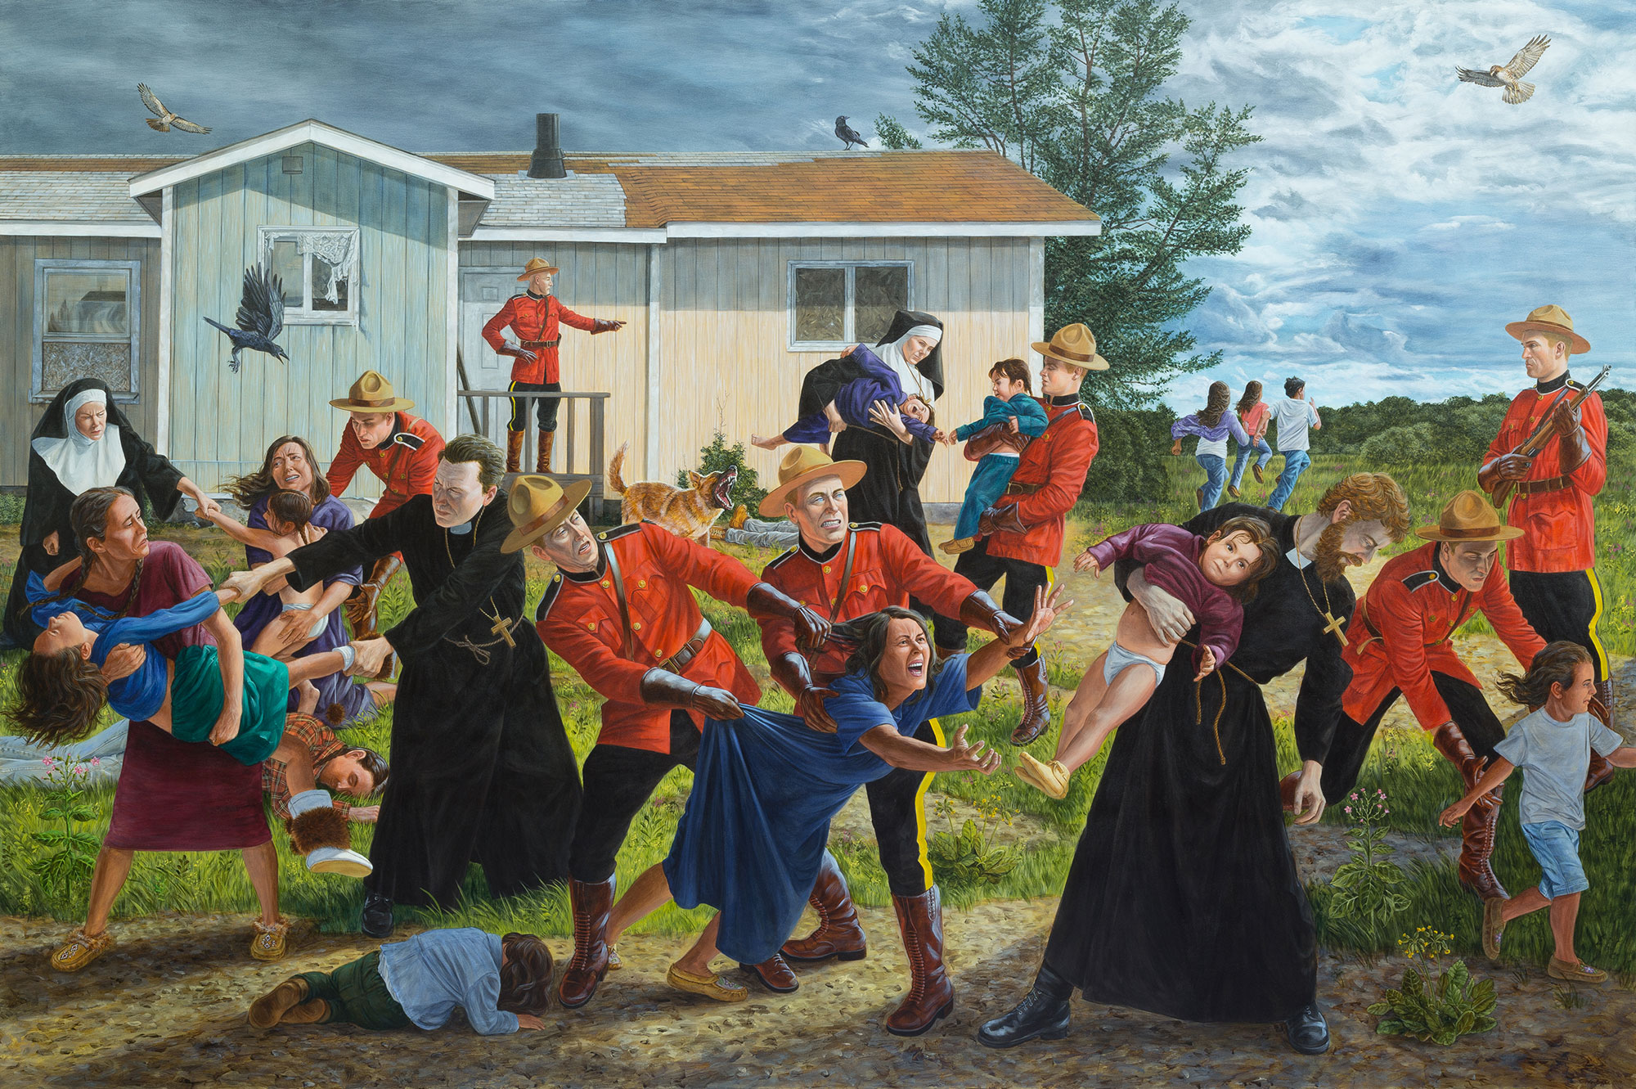
Unsettling the West: White Settler Colonialism and Indigenous Erasure in Canada
Dr. Emily McGiffin
Assistant Professor of World and Postcolonial Literature // emily.mcgiffin@warwick.ac.uk
Image: Kent Monkman, “The Scream.” Artmuseum.utoronto.ca

Slide 2
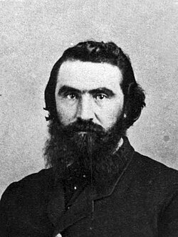
Angus Augustin McKay
First Indigenous Canadian elected to the House of Commons, 1870-1874

Slide 3
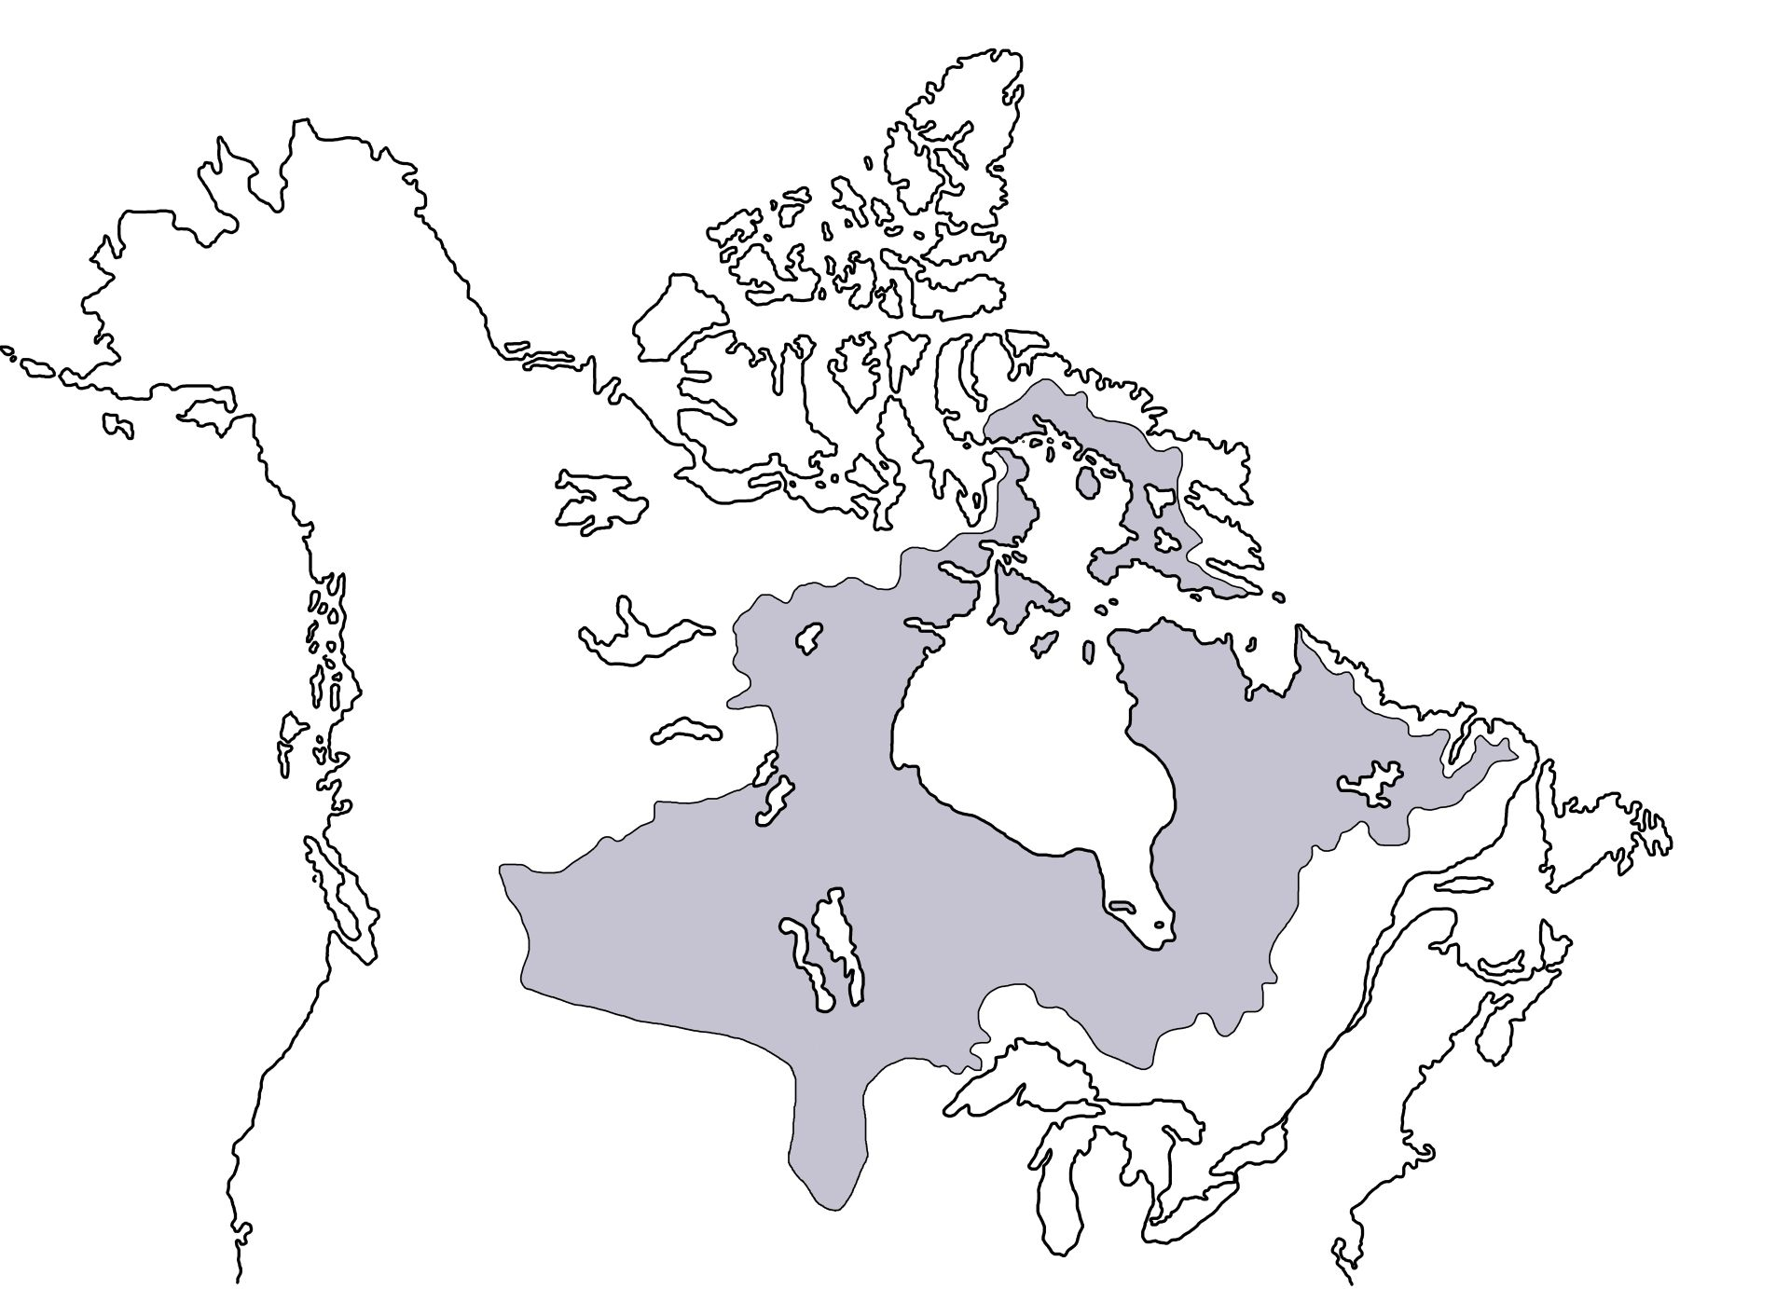
Rough outline of Rupert’s Land (grey area) granted to the Hudson’s Bay Company by King Charles II in 1670
Transferred from the HBC to the newly formed Dominion of Canada in 1869 thanks to a £300,000 loan from the British crown.

Slide 4
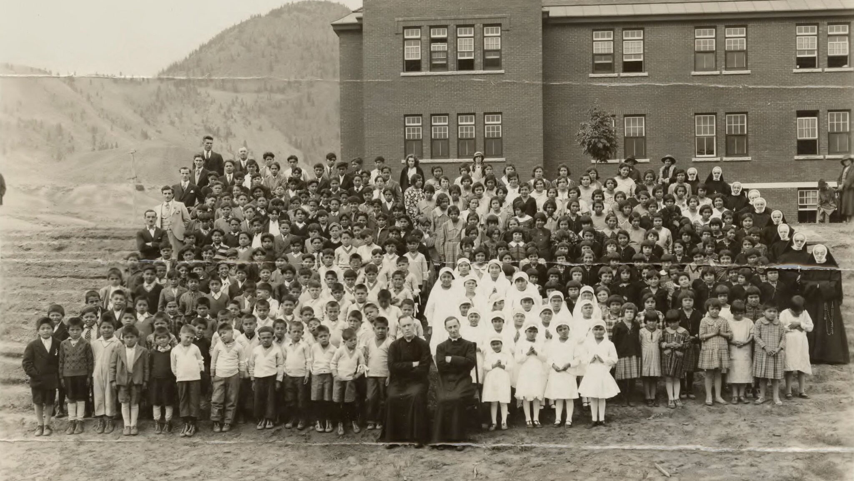
Image: The Kamloops Indian Residential School in 1937. National Centre for Truth and Reconciliation, via EPA, via Shutterstock, via The New York Times

Slide 5

Excerpt from the 2018 film Indian Horse based on Richard Wagamese’s 2012 novel of the same title.

Slide 7


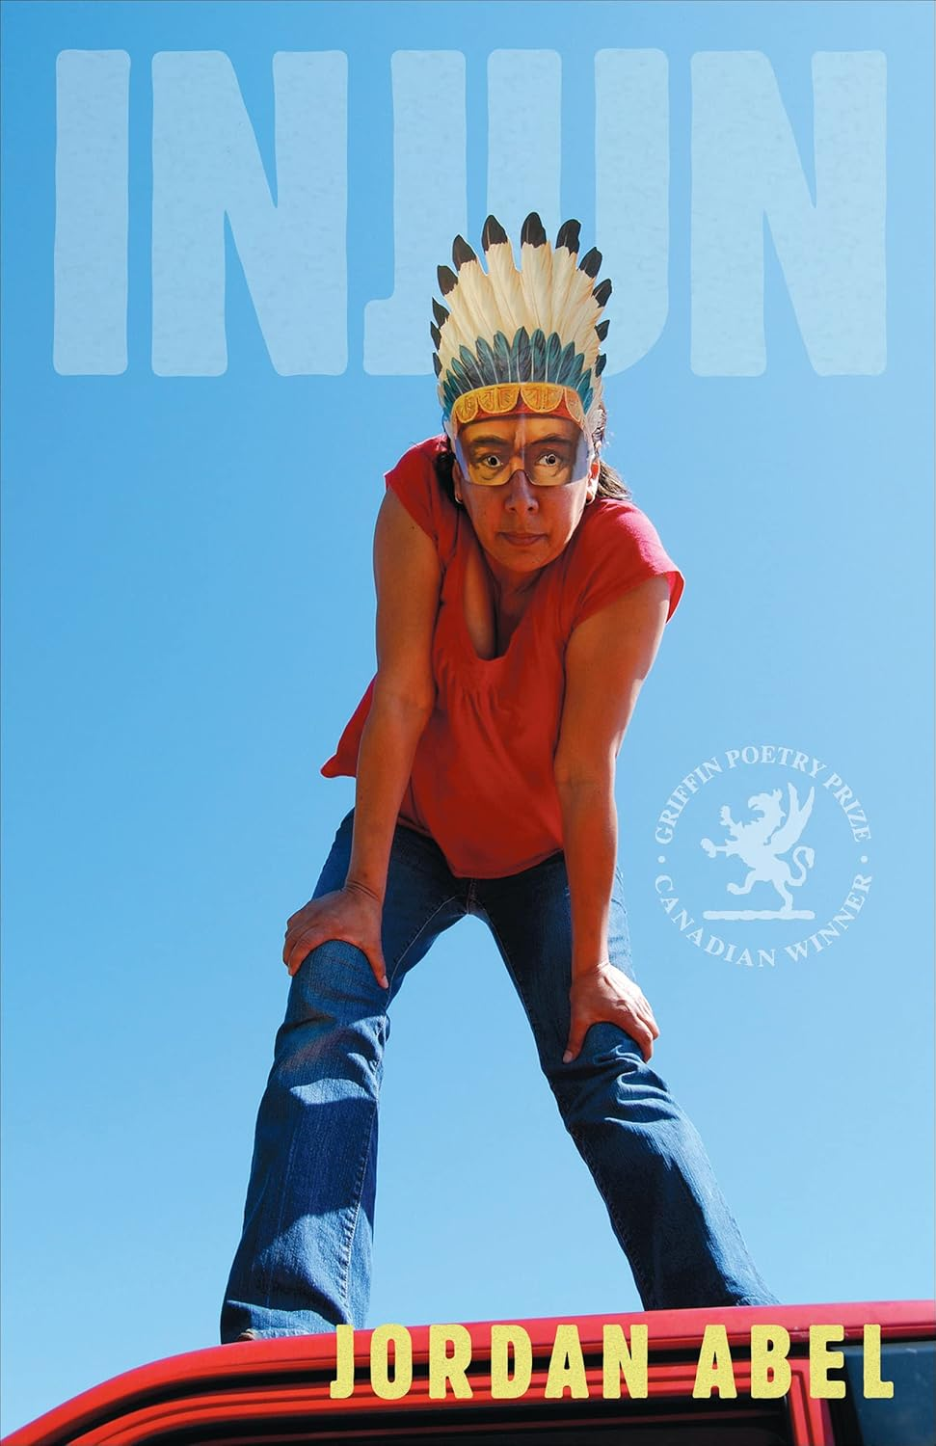




Slide 8
The pole transported to Toronto. To remove this huge totem pole from the Nass, and transfer it to a museum thousands of miles away was not an easy job. Taking it down to the ground and shifting it into the water taxed the ingenuity of a railway engineer and his crew of Indians. It leaned sharply, face forwards, and had it fallen, its carvings would have been damaged. But the work was successfully carried out and after a few days the pole with two others was towed down Portland Canal, on its way south along the coast to Prince Rupert. As it floated in the water, several men could walk on it without feeling a tremor under their feet; it was so large that a few hundred pounds made no difference. When it reached Prince Rupert, it had to be cut, as it lay in the water, into three sections, for the longest railway cars are 50 feet. Nor were all difficulties overcome after the three sections had reached Toronto.

Slide 9
The pole transported to Toronto. To remove this huge totem pole from the Nass, and transfer it to a museum thousands of miles away was not an easy job. Taking it down to the ground and shifting it into the water taxed the ingenuity of a railway engineer and his crew of Indians. It leaned sharply, face forwards, and had it fallen, its carvings would have been damaged. But the work was successfully carried out and after a few days the pole with two others was towed down Portland Canal, on its way south along the coast to Prince Rupert. As it floated in the water, several men could walk on it without feeling a tremor under their feet; it was so large that a few hundred pounds made no difference. When it reached Prince Rupert, it had to be cut, as it lay in the water, into three sections, for the longest railway cars are 50 feet. Nor were all difficulties overcome after the three sections had reached Toronto.

Slide 10
The pole transported to Toronto. To remove this huge totem pole from the Nass, and transfer it to a museum thousands of miles away was not an easy job. Taking it down to the ground and shifting it into the water taxed the ingenuity of a railway engineer and his crew of Indians. It leaned sharply, face forwards, and had it fallen, its carvings would have been damaged. But the work was successfully carried out and after a few days the pole with two others was towed down Portland Canal, on its way south along the coast to Prince Rupert. As it floated in the water, several men could walk on it without feeling a tremor under their feet; it was so large that a few hundred pounds made no difference. When it reached Prince Rupert, it had to be cut, as it lay in the water, into three sections, for the longest railway cars are 50 feet. Nor were all difficulties overcome after the three sections had reached Toronto.

Slide 11
The forest all around was gradually reclaiming its rights after the native villagers had departed many years ago for other haunts, or had died out.

Slide 12
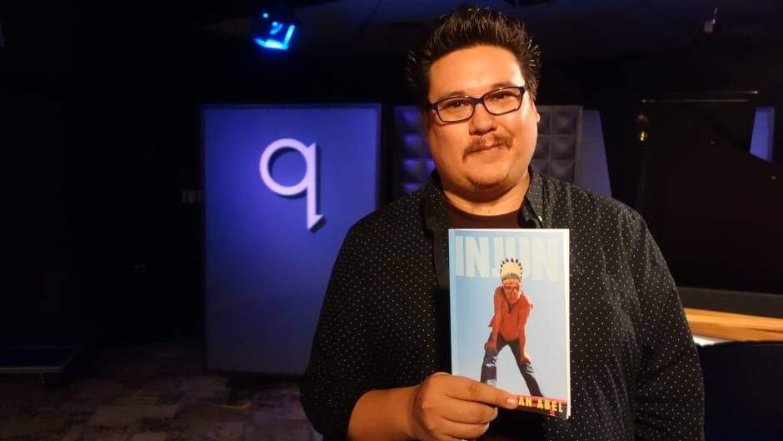

Slide 13
he confessed over a pitch fire
two yards of bright luck
packed through a mangy boil
the antipathy of peaceable hills
going crazy over that injun smell
downwind from the storm
…
a reserve of gas feather camps
dusted straight into the big kill

Slide 14
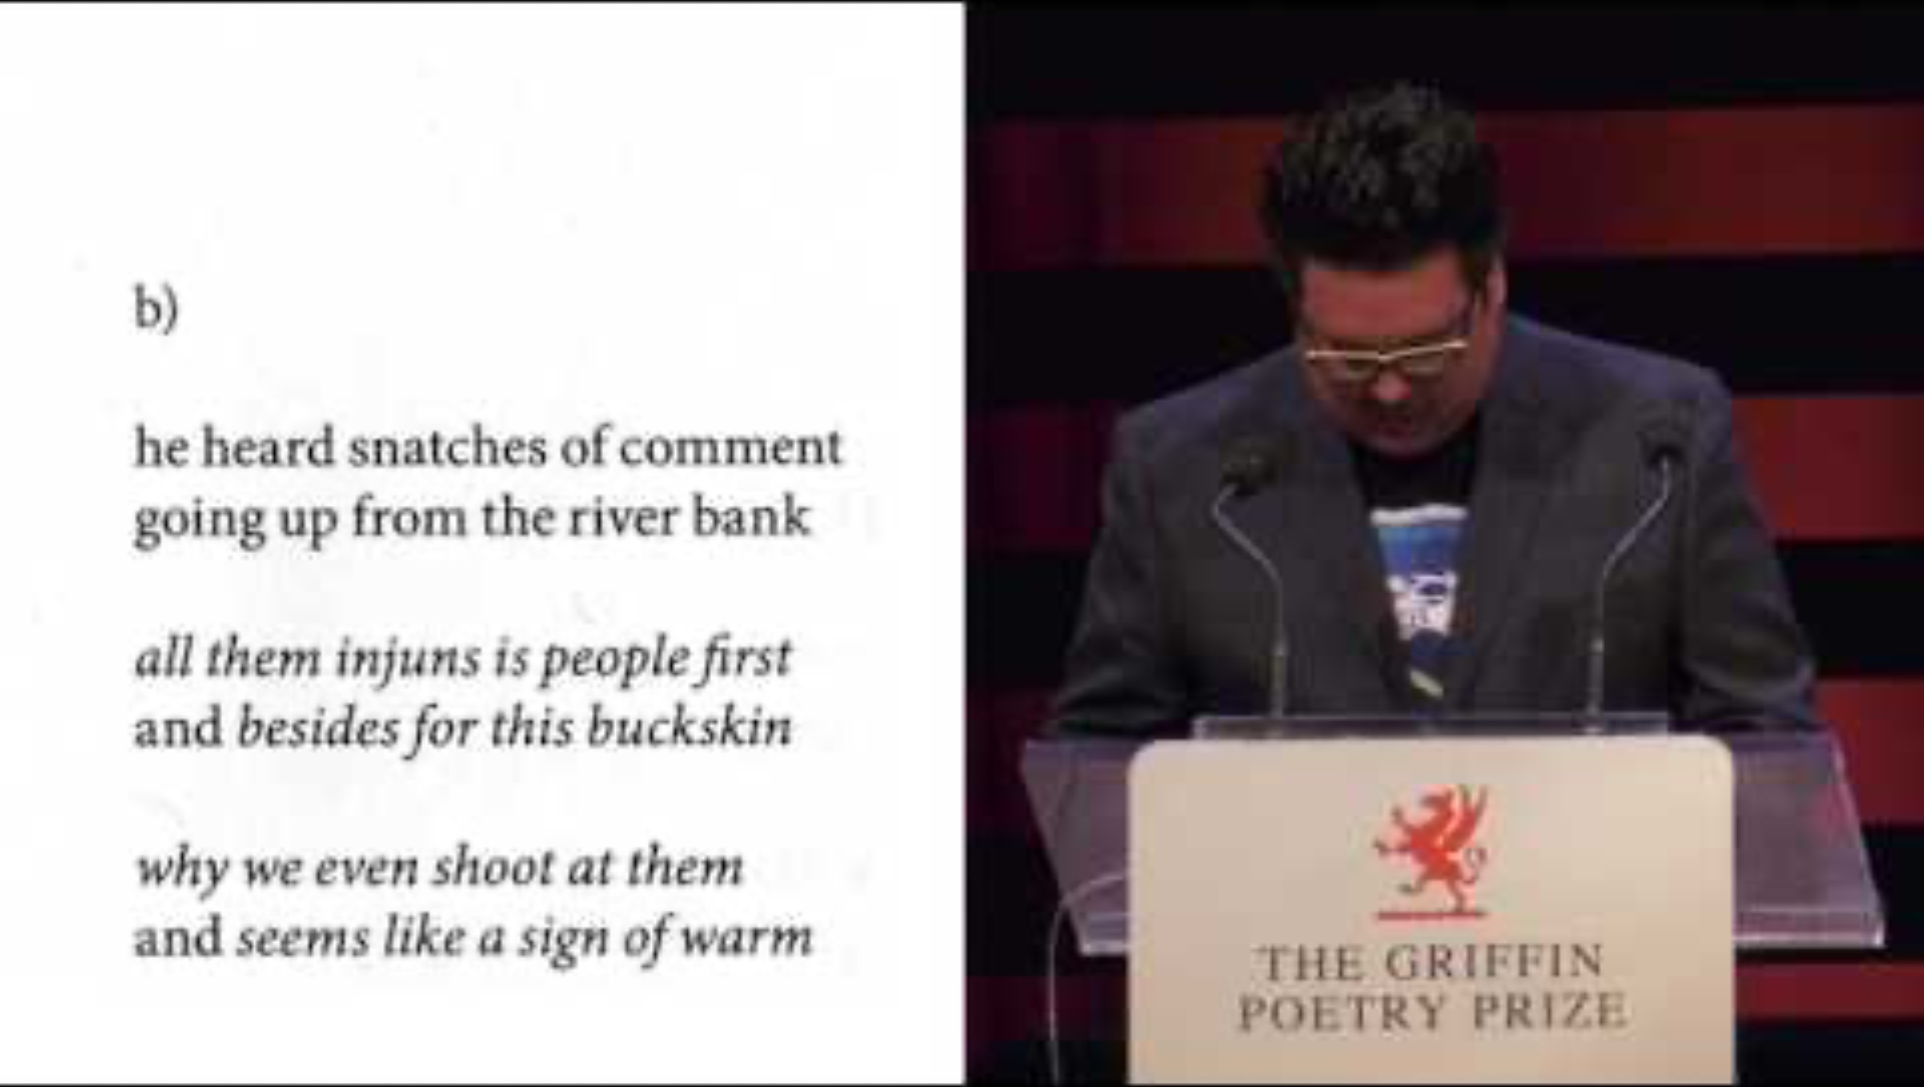

Slide 15
How lonely
I felt, in that vast bush! Ex-
cept for a very few places on the Oule-
out, and the Iroquois towns, the region
was . This was no country
for people to live in, and so far as she
could see it was indeed
From Uninhabited

Slide 16
The boys from the other herds—good men, too—kept shooting them into the water, and inside fifteen minutes’ time we were in the big Territory. Early the next morning I sent one of my boys out on the highest sand dune to around and see wheat they were doing. As we passed out George turned back and apologized to the girls, saying, “He’s a good . He proved himself clear strain that night, the whitest little on the reservation. I had a little experience over east here, on the cut off from the Chisholm trail, a few years ago, that gave me all the I want for some time to come. Well, the Texan wasn’t looking for any particular that day to give six of his own dear horses to. Mr. came up to the fire and professed to be very friendly, shook hands, and spoke quite a number of words in English.
From Injun

Slide 17
