Slide 1
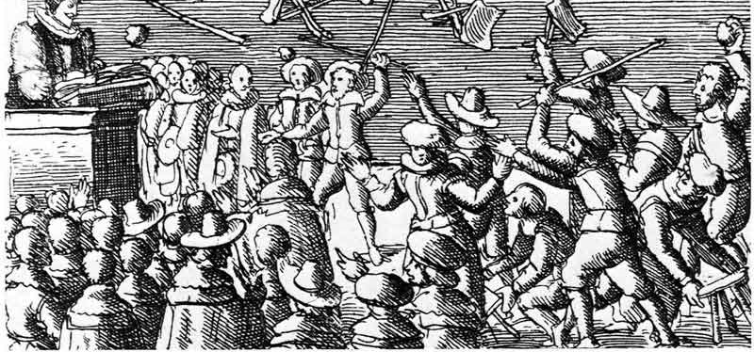
Literature and Revolution 1640-1660
Week 1: England on the Edge
Richard Brome, A Jovial Crew (1641)
Notes:
Introductory lecture

Slide 2
Week 1 Lecture
About the Module
  Housekeeping
  Historical and Critical Contexts
  Aims
2) The Political Context: Britain in 1640-1641
  How do you get from the 1630s to a man with legs for arms?
  Three Problems
  Politics in Parliament and Politics on the Street
3) Brome, A Jovial Crew (1641)
  Background, Performance and Publication
  A Jovial Crew in 1641: Escapist Fantasy or Political Critique?
  A Jovial Crew in 1652: Printed Drama and the Preservation of the Pre-Civil War Past
Notes:
Outline of lecture: Housekeeping (module website; formative assessment; summative assessment, including different wordcount for different year groups; deadlines). Contexts to cover broad overview of how the period has been discussed and why it’s interesting. Aims to cover questions we want to address.
Second two parts start to home in on the first week’s reading firstly by providing a sense of the context of the 1630s and the early 1640s and then by turning to Brome’s play and why looking at it is an interesting window on the political debates of the period.

Slide 3
Module Housekeeping
Module Website: EN2K5/EN3K5 Literature and Revolution, 1640-1660.
Critical Reading:
The Oxford Handbook of Literature and the English Revolution: https://encore.lib.warwick.ac.uk/iii/encore/record/C__Rb2672281__SKnoppers%2C%20Laura__P0%2C4__Orightresult__U__X3?lang=eng&suite=cobalt
Deadlines:
formative commentary (750 words) due in Term 1, Week 5; submitted directly to me either in person or on email.
summative essay due 26th April 2027 (Term 3, Week 1), submitted through Tabula. Intermediate students (3000 words); Finalists (4000 words).
Visiting Students: if you are a full-year student, please follow the same assessment pattern as home students. If you are here for part of the year, please submit your 2000-word essays through Tabula by 12 noon on Tuesday of Week 12 (22nd December).

Slide 4
Week 1 Lecture
About the Module
  Housekeeping
  Historical and Critical Contexts
  Aims
2) The Political Context: Britain in 1640-1641
  How do you get from the 1630s to a man with legs for arms?
  Three Problems
  Politics in Parliament and Politics on the Street
3) Brome, A Jovial Crew (1641)
  Background, Performance and Publication
  A Jovial Crew in 1641: Escapist Fantasy or Political Critique?
  A Jovial Crew in 1652: Printed Drama and the Preservation of the Pre-Civil War Past

Slide 5
The Civil Wars 1640-60: overview of key historical events
1642-51: Civil Wars between Parliamentarians and Royalists
1649: execution of the reigning monarch, Charles I
1649-53: a republican government is established and rules in England (Scotland at this point remains an independent nation and crowned the dead king’s son, Charles Stuart, in 1651).
1653-59: the protectoral government is established, first under Oliver Cromwell (1653-58) and then his son, Richard Cromwell (until 1659).
1660: after a short period of republican government from May 1659 to early 1660, the Stuart monarchy is restored in May 1660 and Charles I’s son, Charles II, takes the throne.
Notes:
Constitutional issues: Personal Rule in 1630s; Parliament’s increasing confidence to assert its power. Religious issues: church innovations in the 1630s led by Laud; perception that Charles’s court was too close to Catholicism, especially because of the power of his Catholic wife.
This is a bare and straightforward timeline that is designed to help orientate our contextualising of the module set texts.

Slide 6
The Civil Wars 1640-60: overview of key historical events
1641/2: Brome, A Jovial Crew performed
1642-51: Civil Wars between Parliamentarians and Royalists
1644: Milton, Aereopagitica
1649: execution of the reigning monarch, Charles I
1649: publication of Anne Bradstreet’s The Tenth Muse; many of the poems on the execution of the king are circulating in manuscript.
1649-53: a republican government is established and rules in England (Scotland at this point remains an independent nation and crowned the dead king’s son, Charles Stuart, in 1651).
1649: Coppe, A Fiery Flying Roll
1650: Winstanley, The True Levellers’ Standard
c. 1651: Marvell, “An Horatian Ode”
1653-59: the protectoral government is established, first under Oliver Cromwell (1653-58) and then his son, Richard Cromwell (until 1659).
1654: Trapnel, The Cry of a Stone
1655: Waller’s panegyric on Cromwell and Hutchinson’s verse response
1660: after a short period of republican government from May 1659 to early 1660, the Stuart monarchy is restored in May 1660 and Charles I’s son, Charles II, takes the throne.
1660: Dryden, Astraea Redux and Hutchinson’s Elegies (1660 and after)
Notes:
So, this is where our primary texts sit within that bare chronological outline.
Point is that social, political and religious change leads to generic and formal innovations that might have been impossible prior to 1642.

Slide 7
1640-1660: Social and Cultural Changes
Public theatres close in 1642 and re-open in 1660.
Lapse in censorship. Licensing Act lapses briefly in 1641.
Widening of print culture.
An expanding literate class of readers.
New meeting spaces emerge where printed literature could be read or heard (e.g. ale houses and coffee houses, churches, in the street).

Slide 8
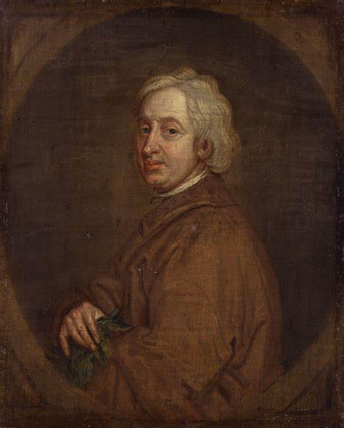
The Civil Wars in Cultural History
“And though the fury of a Civil War, and Power, for twenty years together, abandon'd to a barbarous race of men, Enemies of all good Learning, had buried the Muses under the ruines of Monarchy; yet with the restoration of our happiness, we see reviv'd Poesie lifting up its head, & already shaking off the rubbish which lay so heavy on it.”
John Dryden, from An Essay of Dramatique Poesie (1668)
Notes:
Dryden arguing that the period of Civil War and so-called ‘Interregnum’ was a period of cultural backwardness and barbarism; he insists that cultural regeneration and royal restoration must go hand in hand.

Slide 9
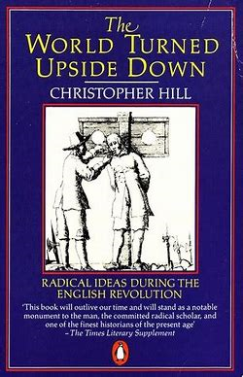
The Civil Wars in Cultural History
“What was new in the seventeenth century was the idea that the world might be permanently turned upside down: that the dream of…the kingdom of heaven might be attainable on earth now.” (Hill, p. 17)
Hill’s work was an influence on literary critics who have focused on the literature of political and religious radicalism in the mid century (e.g. Nigel Smith, David Norbrook, Sharon Achinstein, David Loewenstein).
Notes:
Critical history of the period – origins of democracy? Old view but some modern proponents (Zaret) – history from below (Hill) sought to retrieve neglected voices – influence of this history from below on literary criticism on the 1990s – present – potential ways of nuancing this approach (e.g. McDowell – the elite education of the radical writers).

Slide 10
Key Questions for the Module
In what ways does war and revolution affect writing?
How does revolution instigate generic and formal literary experimentation?
How does the writing produced in a period of conflict articulate different political and religious viewpoints?

Slide 11
Week 1 Lecture
About the Module
  Housekeeping
  Historical and Critical Contexts
  Aims
2) The Political Context: Britain in 1640-1641
  How do you get from the 1630s to a man with legs for arms?
  Three Problems
  Politics in Parliament and Politics on the Street
3) Brome, A Jovial Crew (1641)
  Background, Performance and Publication
  A Jovial Crew in 1641: Escapist Fantasy or Political Critique?
  A Jovial Crew in 1652: Printed Drama and the Preservation of the Pre-Civil War Past

Slide 12
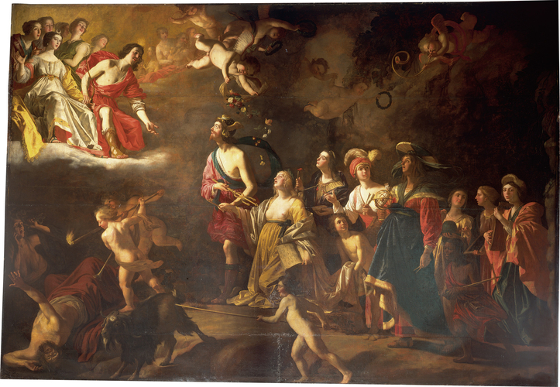
Apollo and Diana, Gerrit van Honthorst (c. 1628)
Royal Collection Trust / © Her Majesty Queen Elizabeth II 2019
Notes:
Look at portrait: illustrates the shaping of many masques.
Mythological basis (here Apollo and Diana)
inserts major royal actors into the key parts (here, Charles and his wife HM are the deities); they therefore appear as forces of divine power.
Power dynamics illustrated in the positions of the people: monarchs above, courtiers below.
Force of unrest being cojoled out into the corner of the painting: masques are frequently dramatizing the banishing of forces of evil by (usually royal) forces of good. Antimasque and masque.

Slide 13
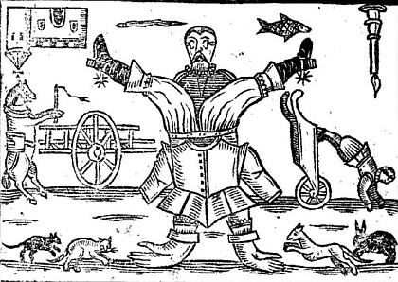
Notes:
Compare it to this – this is an image from 1645. Front cover of the poem The World Turned Upside Down by John Taylor (so-called ‘Water Poet’ – see monograph by Bernard Capp).
A body turned on its head; a world where everything is in reverse.
Contention - could this image have existed prior to the 1640s? Could it have existed in a society where the king and queen were at the top of a cultural and ideological hierarchy? A conflict between the crown and Parliament creates new ways of imagining the world.
But what made that change happen?

Slide 14
Historical Context 1640-41: Three Political Problems
Ship Money
  Can the crown claim emergency powers of taxation and the right to define what counts as an emergency without consulting Parliament?
Church Governance
  Were the unpopular innovations launched by William Laud in the 1630s a sign of the deterioration of the national Protestant Church of England?
The Scottish Prayer Book
  Charles attempts to impose a new Laudian prayer-book in Scottish churches, which leads to protests that escalate into rebellion and war.

Slide 15
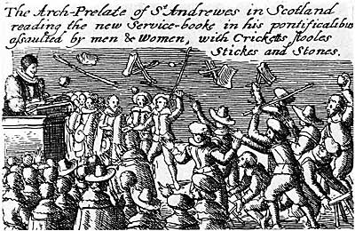
Notes:
Prayer book riots in 1638.

Slide 16
Historical Context: 1640-41
Short Parliament (called late 1639, sat April 1640).
Long Parliament (meets November 1640; sits for 13 years).
  Emergence of a coherent opposition to Charles and his associates (The Junto).
  Development of a royalist group who seek to defend to king.
London street politics
  Charles’ supporters in the Lords are attacked.
  An underground printing presses publish several radical pamphlets calling for major reformation in religion (see Braddick, God’ Fury, England’s Fire, Ch. 4).

Slide 17
Week 1 Lecture
About the Module
  Housekeeping
  Historical and Critical Contexts
  Aims
2) The Political Context: Britain in 1640-1641
  How do you get from the 1630s to a man with legs for arms?
  Three Problems
  Politics in Parliament and Politics on the Street
3) Brome, A Jovial Crew (1641)
  Background, Performance and Publication
  A Jovial Crew in 1641: Escapist Fantasy or Political Critique?
  A Jovial Crew in 1652: Printed Drama and the Preservation of the Pre-Civil War Past
Notes:
Now turn to Brome and to this week’s play.

Slide 18
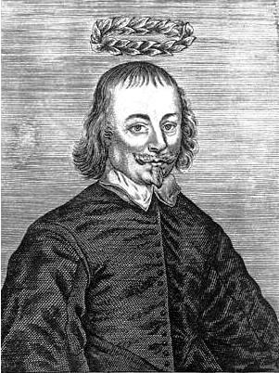
Richard Brome: A Jovial Crew
Brome was a major dramatist of the 1630s. For his other work and discussions of his dramatic technique see the edition of his work at https://www.dhi.ac.uk/brome/.
A Jovial Crew was probably written around 1640 and performed in London in 1641-2.
A Jovial Crew was probably being performed at roughly the same time that the theatres were closed even if it may not have been the last play to be performed on the public London stage.
The play was not printed until 1652. It was revived in 1661 when the theatres were re-opened.

Slide 19
The Civil Wars 1640-60: overview of key historical events (with A Jovial Crew added)
1641/2: Brome, A Jovial Crew performed
1642-51: Civil Wars between Parliamentarians and Royalists
1644: Milton, Aereopagitica
1649: execution of the reigning monarch, Charles I
1649: publication of Anne Bradstreet’s The Tenth Muse; many of the poems on the execution of the king are circulating in manuscript.
1649-53: a republican government is established and rules in England (Scotland at this point remains an independent nation and crowned the dead king’s son, Charles Stuart, in 1651).
1649: Coppe, A Fiery Flying Roll
1650: Winstanley, The True Levellers’ Standard
c. 1651: Marvell, “An Horatian Ode”
1652: publication of A Jovial Crew, with Brome’s preface and the dedicatory poems most added (most likely composed in early 1650s but the dating isn’t certain).
1653-59: the protectoral government is established, first under Oliver Cromwell (1653-58) and then his son, Richard Cromwell (until 1659).
1654: Trapnel, The Cry of a Stone
1655: Waller’s panegyric on Cromwell and Hutchinson’s verse response
1660: after a short period of republican government from May 1659 to early 1660, the Stuart monarchy is restored in May 1660 and Charles I’s son, Charles II, takes the throne.
1660: Dryden, Astraea Redux and Hutchinson’s Elegies (1660 and after)
1661: A Jovial Crew revived at the reopened theatres.
Notes:
So, this is where our primary texts sit within that bare chronological outline.

Slide 20
The Closure of the Theatres
After debates during the summer of 1642, Parliament issued an order on 3rd September that all stage plays be suppressed and a week later all the public theatres in London were forced to close.
Theatre historians disagree as to why this ordinance was issued. Two representative examples are:
Martin Butler, Theatre and Crisis, 1632-1642 (CUP, 1984)
Butler argues that it only makes sense as a response to a series of “collisions between the authorities and the playhouses” (136). Butler thus goes on to read A Jovial Crew as “a sharp rebuke to the court” (270).
Martin Wiggins, Drama and the Transfer of Power in Renaissance England (OUP, 2012)
Wiggins argues that it was the result of neither fundamentalist anti-theatrical ideology nor suppression of political criticism. The plays being performed, he argues, were ‘supine’ and if they recommend anything at all it is ‘quietism’. This is a reading he applies to A Jovial Crew with its story of order restored through the revelation and forgiveness of Oldrents’ past misdemeanours.
Rather, Wiggins uncovers evidence that Parliament listened to a sermon preaching the wrath of God upon a disobedient nation just before they debated the issue of the theatres and that its wording is echoed in the ordinance. It was contingency not ideology that closed the theatres.

Slide 21
Beggar Commonwealths
“Early modern drama rarely engaged with the concrete realities of a life of destitution and beggary. The stage beggars…are instead evidence of the ways in which the figure of the beggar was deployed in early modern literature in an emblematic way in order to facilitate discussion of social and political issues. Stage beggars were scarcely directly related to their real-life analogues. Instead, representations of this nature enabled dramatists to practise a particular kind of social investigation.”
…
“Brome's play is interested, like so many of his dramas, in offering the audience a skewed reflection of their own situation, part mirror, part inversion. This is frequently the way in which 'beggars' commonwealths' operate on the early modern stage: as a means of discussing the society back home, be it in the court or city.”
Sanders, ‘Beggar’s Commonwealth’s and the Pre-Civil War Stage’ The Modern Language Review 97 (2002)

Slide 22
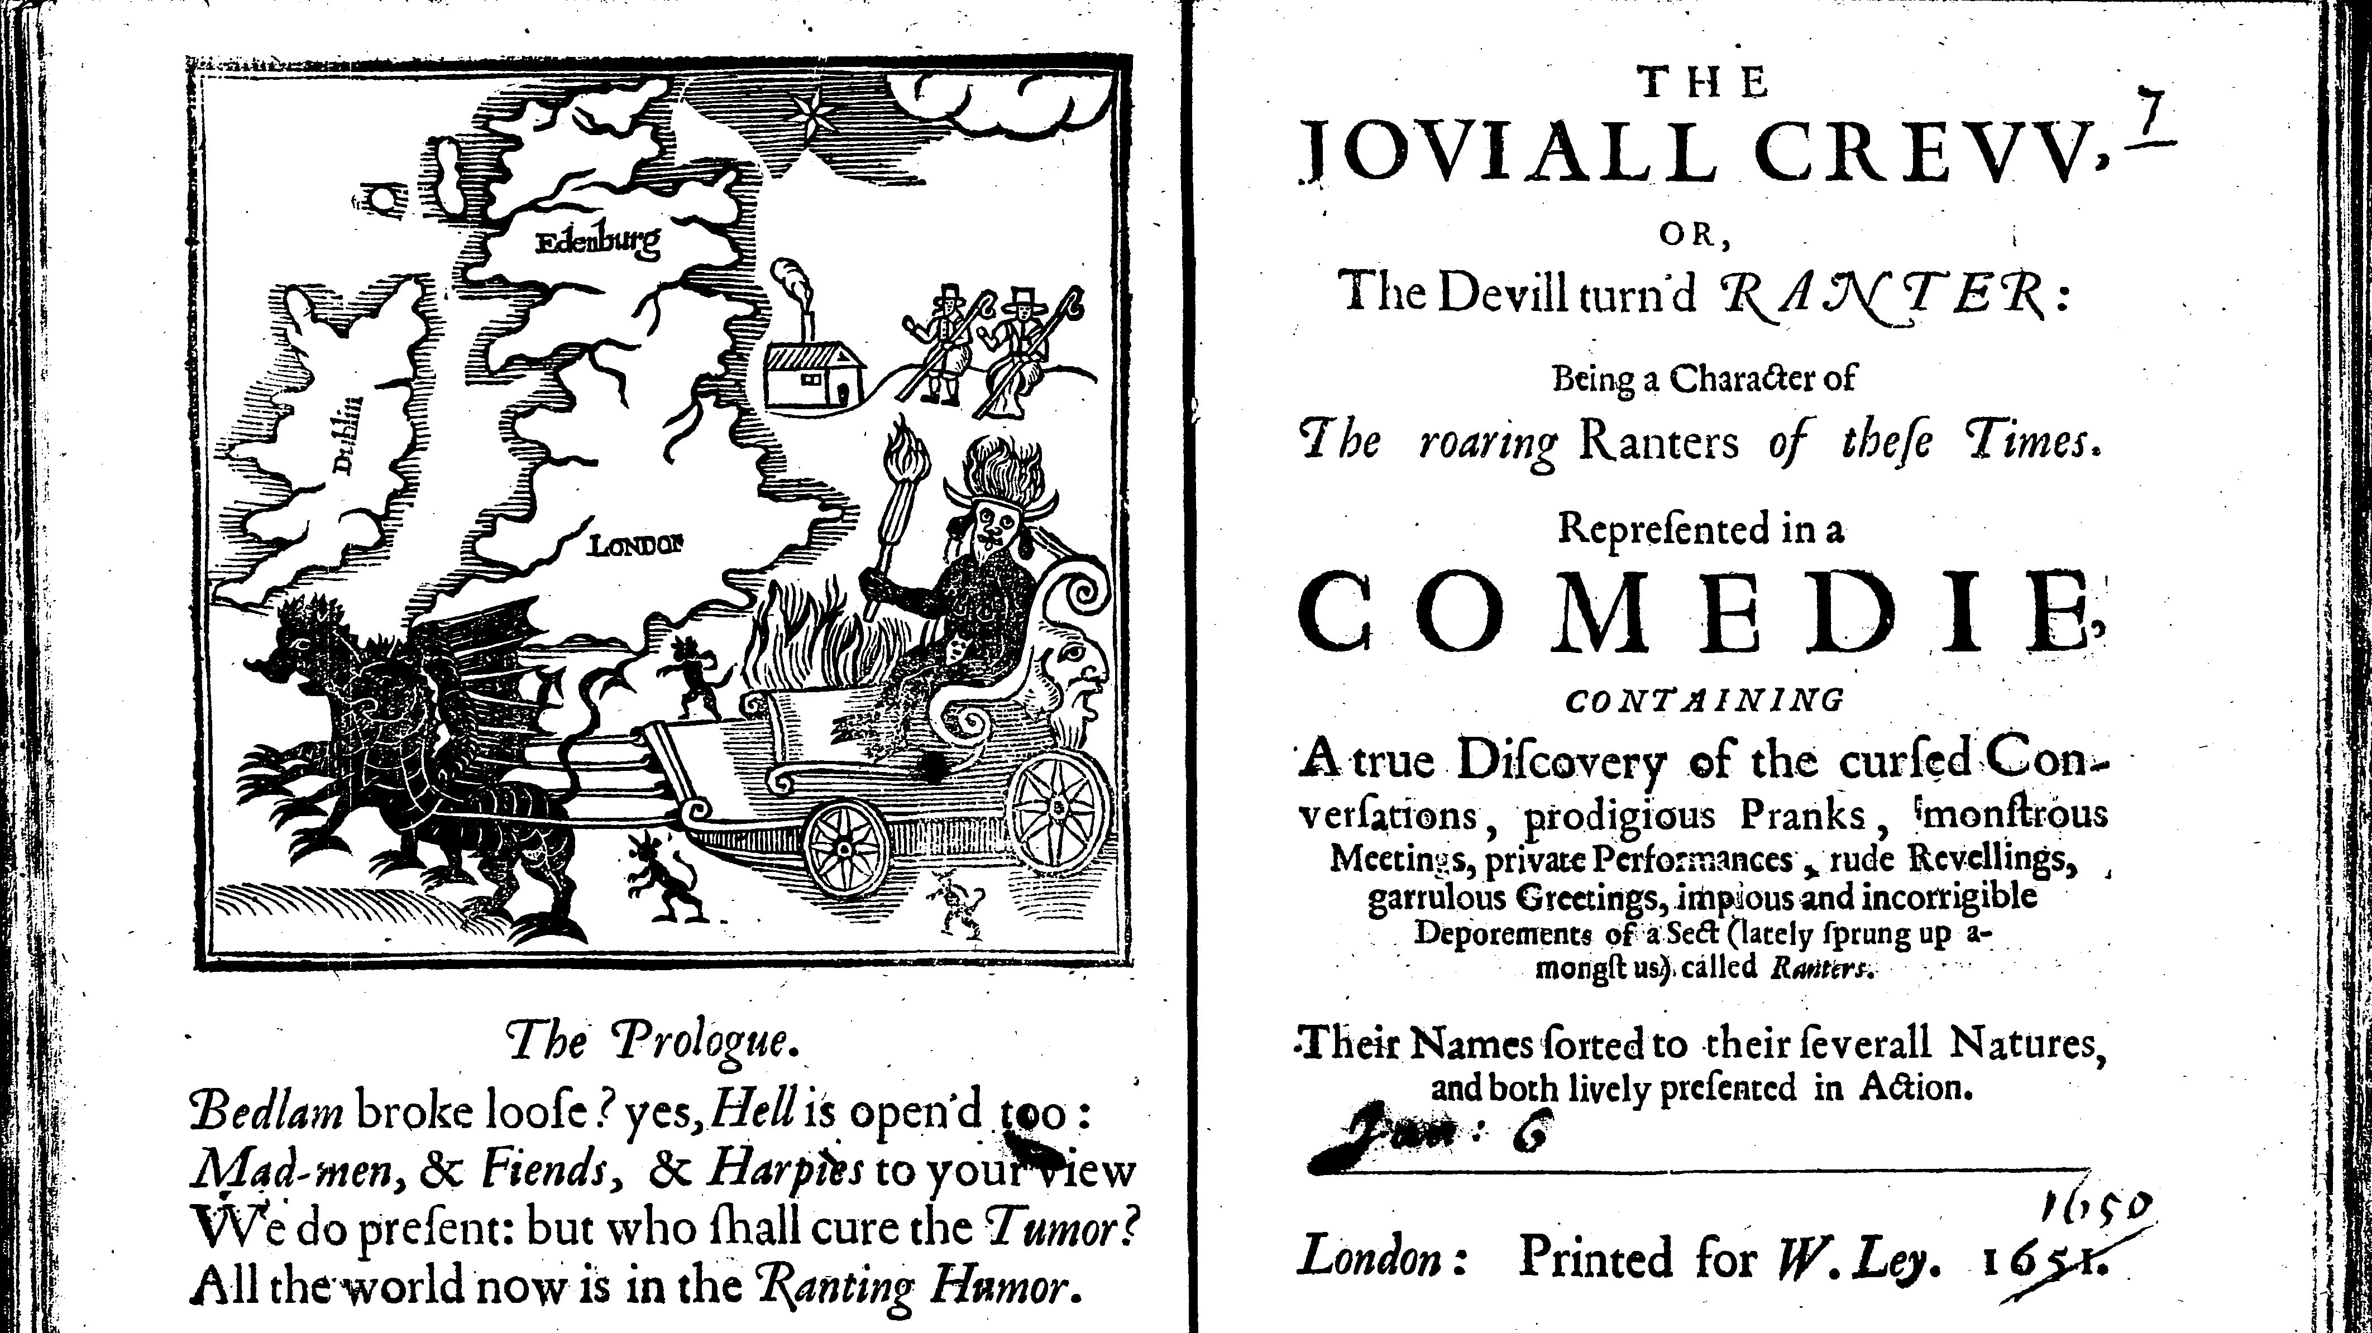
Notes:
1651 pamphlet – beggars as scary religious radicals sweeping over the country

Slide 23
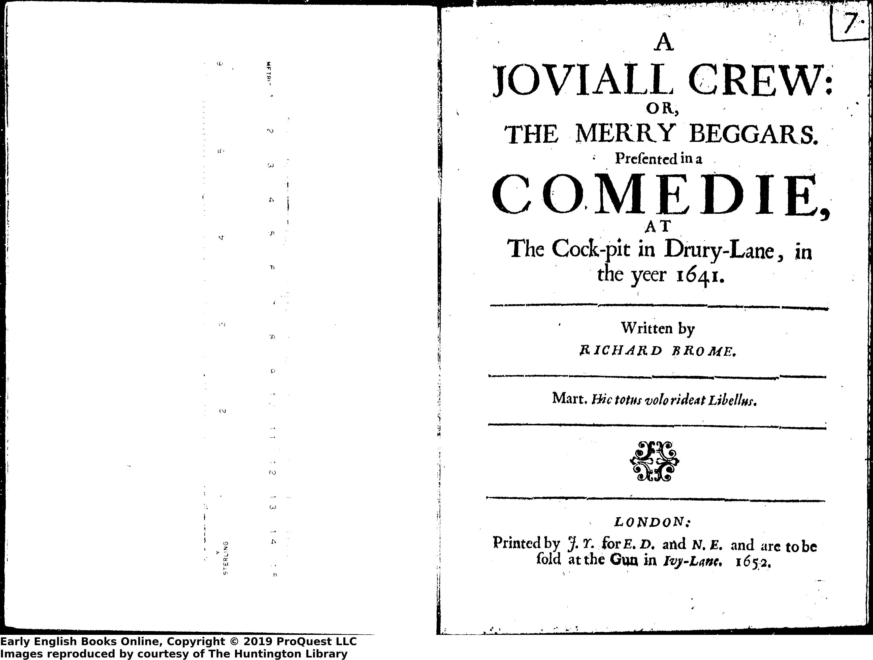
Notes:
Note the typographical similarities between the title pages – was the print publication of the play an attempt to capitalise on the pamphlet?

Slide 24
The 1652 Preface: Brome to Thomas Stanley
“All the arguments I can use to induce you to take notice of this thing of nothing is that it had the luck to tumble last of all in the epidemical ruin of the scene, and now limps hither with a wooden leg to beg an alms at your hands. I will wind up all with a use of exhortation, that since the times conspire to make us all beggars, let us make ourselves merry; which (if I am not mistaken) this drives at.”
Notes:
Printing early c17 drama in the period when the theatres were closed was a way of trying to keep hold of some imagined antebellum golden age when pleasure, entertainment, and joy were present. Does the play’s emphasis on joy and laughter (e.g. the daughters in Act 2) become a kind of resistance to what royalists would have perceived as puritan philistinism?

