Slide 1
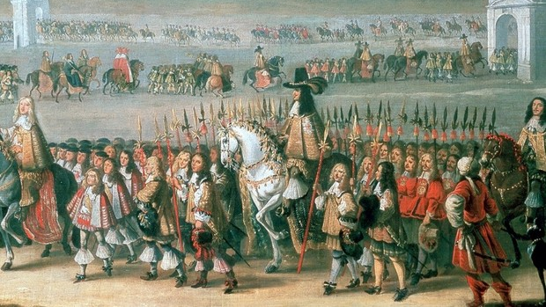
Literature and Revolution: Week 10
The Restoration, Dryden, and Hutchinson

Slide 2
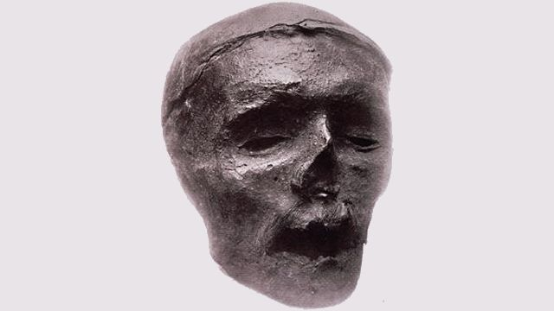
The Curious Case of Cromwell’s Head
This day the Parliament voted that the bodies of Oliver, Ireton, Bradshaw, &c., should be taken up out of their graves in the Abbey, and drawn to the gallows, and there hanged and buried under it: which (methinks) do trouble me that a man of so great courage as he was, should have that dishonour, though otherwise he might deserve it enough.
Samuel Pepys, Diary, 4 December 1660

Slide 3
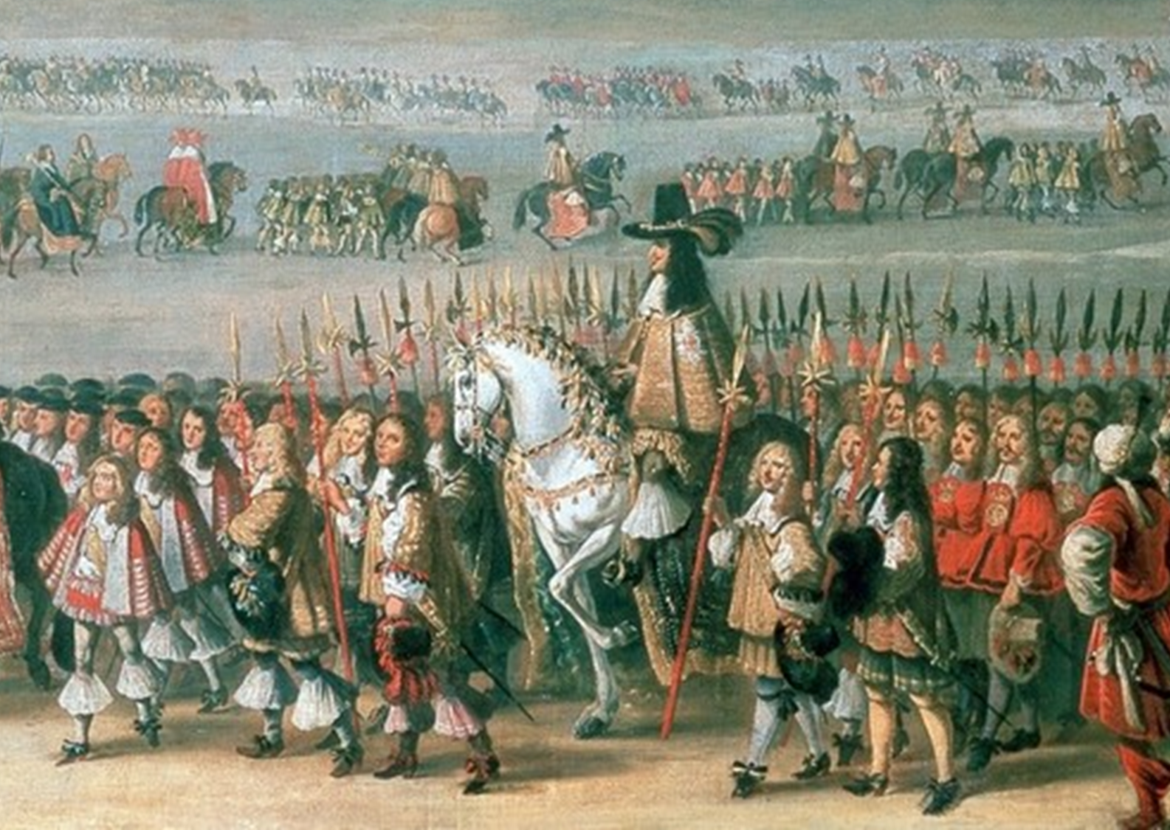
[G]ot on shore when the King did, who was received…with all imaginable love and respect at his entrance upon the land of Dover. Infinite the crowd of people and the horsemen, citizens, and noblemen of all sorts…The shouting and joy expressed by all is past imagination.
Samuel Pepys, Diary, 25 May 1660

Slide 4
“The start of another story of another world”?
Robert Wilcher, The Writing of Royalism (Cambridge, 2000), p. 348

Slide 5
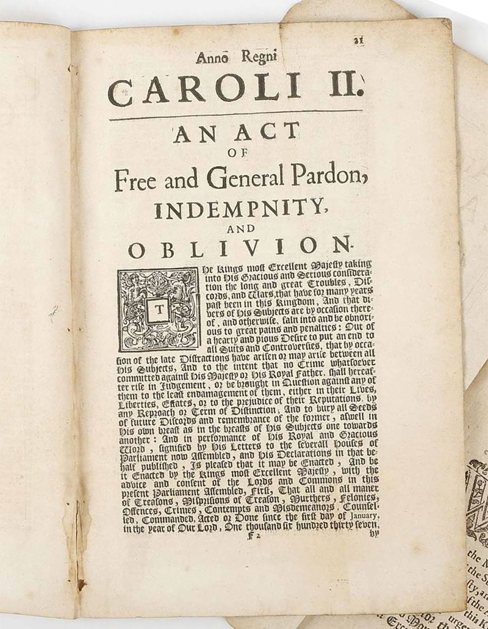
Title page of An Act of Free and General Pardon, Indemnity, and Oblivion (1660) in which Charles II offered indemnity to crimes of the previous two decades so as “to bury all Seeds of future Discords and remembrance of the former, as well in his own breast as in the breasts of his Subjects one towards another.”

Slide 6
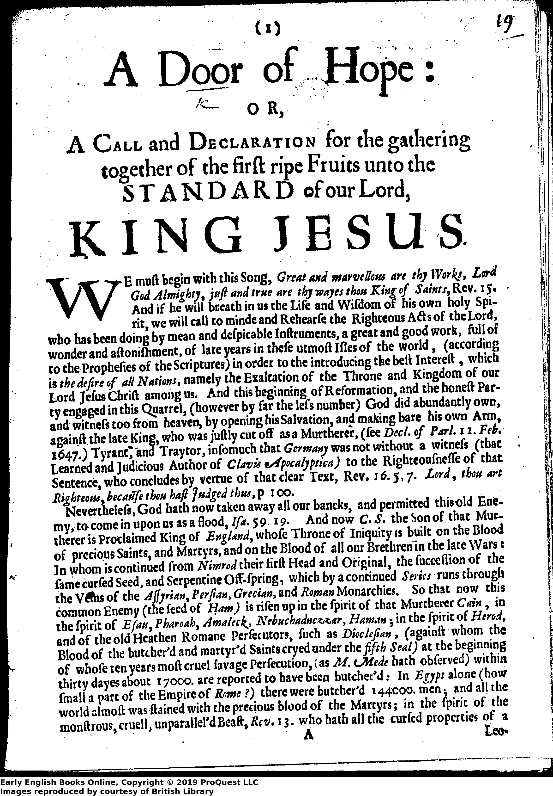
The Threat of Radicalism in 1660?
“And now C.S. [Charles Stuart] The Son of that Murtherer is Proclaimed King of England, whose Throne of Iniquity is built on the Blood of precious Saints, and Martyrs, and on the Blood of all our Brethren in the late Wars.” (A Door of Hope, p.1)

Slide 7
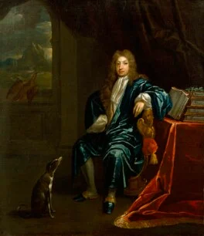
John Dryden’s Early Career
1649: “Upon the Death of Lord Hastings”: an elegy for the aristocrat, Hastings, printed in the volume Lachrymae Musarem.
1650: “To his friend, John Hoddesdon”.
from 1657: worked for the Cromwellian Protectorate in the same department as Andrew Marvell and John Milton.
1659: Heroique Stanzas: an elegy on the death of Oliver Cromwell.
1660, February: “To…Sir Robert Howard”.
1660, June: Astraea Redux: a panegyric on the restoration of the monarchy.
James Maubert’s portrait of John Dryden, c.1700 © National Portait Gallery, London

Slide 8
And wars like mists that rise against the sun
Made him but greater seem, not greater grown.
Heroique Stanzas, lines 23-24
“…the implications of the analogy are perhaps more critical of Oliver's established reputation than a brisk reading might register: his martial achievements are compared to mists raised by the sun shining on the morning dew, which are merely an effect of a pre‐existent, enduring greatness, not the material of that greatness. The implication of this analogy—helped along by the analogy's likening of wars to nebulous matter—is that the reader should look beyond the martial successes celebrated by other elegies for the important objects of praise.”
Edward Holberton, Poetry and the Cromwellian Protectorate (Oxford, 2009), p. 199.

Slide 9
John Dryden’s Early Career
1649: “Upon the Death of Lord Hastings”: an elegy for the aristocrat, Hastings, printed in the volume Lachrymae Musarem.
1650: “To his friend, John Hoddesdon”.
from 1657: worked for the Cromwellian Protectorate in the same department as Andrew Marvell and John Milton.
1659: Heroique Stanzas: an elegy on the death of Oliver Cromwell.
1660, February: “To…Sir Robert Howard”.
1660, June: Astraea Redux: a panegyric on the restoration of the monarchy.
James Maubert’s portrait of John Dryden, c.1700 © National Portait Gallery, London

Slide 10
Panegyric in 1660
“You bring such Clemency, as shews you have | More Pardons, than your Angel-Father gave.” (William Davenant, Poem Upon His Sacred Majesty’s Most Happy Return).
“the joyful London meets | The Princely York, himself alone a freight; | The Swift-sure groans beneath Great Gloc’sters weight.” (Dryden, Astraea Redux).
“But since them | A sad and long Parenthesis hath been | ‘Twixt us and Regal-splendour” (William Fairebrother, To the King’s Most Sacred Majesty).
Gerald MacLean’s online anthology of Restoration poems is here: The Return of the King : An Anthology of English Poems Commemorating the Restoration of Charles II / edited by Gerald MacLean

Slide 11
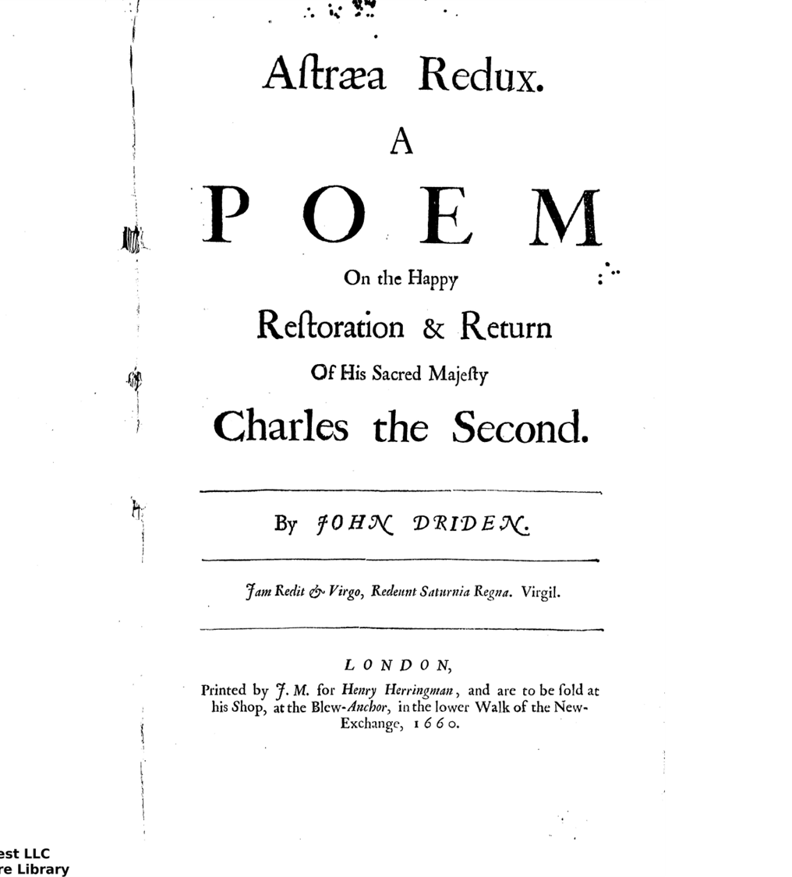
Title: Astraea Redux: A Poem on the Happy Restoration and Return of his Sacred Majesty Charles the Second
Epigraph: Iam Redit & Virgo, Redeunt Saturnia Regna. Virgil.
[Now the Virgin [Astraea] returns, the kingdom of Saturn returns]
The opening lines:
Now with a general Peace the World was blest,
While ours, a World divided from the rest,
A dreadful quiet felt

Slide 12
Fictions of Restoration?
Yet as wise Artists mix their colours so
That by degrees they from each other go,
Black steals unheeded from the neighb’ring white
Without offending the well cous’ned sight:
So on us stole our blessed change; while we
Th’ effect did feel but scarce the manner see.
Astraea Redux, lines 125-130

Slide 13
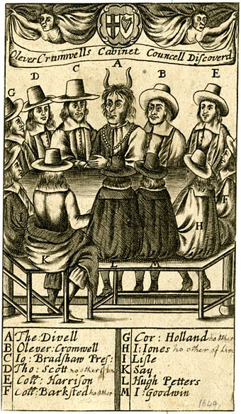
The Act of Indemnity and Oblivion exempted 33 people who had been involved in the trial of Charles I.
The trial of the regicides who were imprisoned took place in October 1660 (left is a print from 1660 showing some of these figures as agents of the devil).
John Hutchinson, Lucy Hutchinson’s husband, had signed the death warrant of Charles I but did not face trial. He did, however, die in prison.

Slide 14
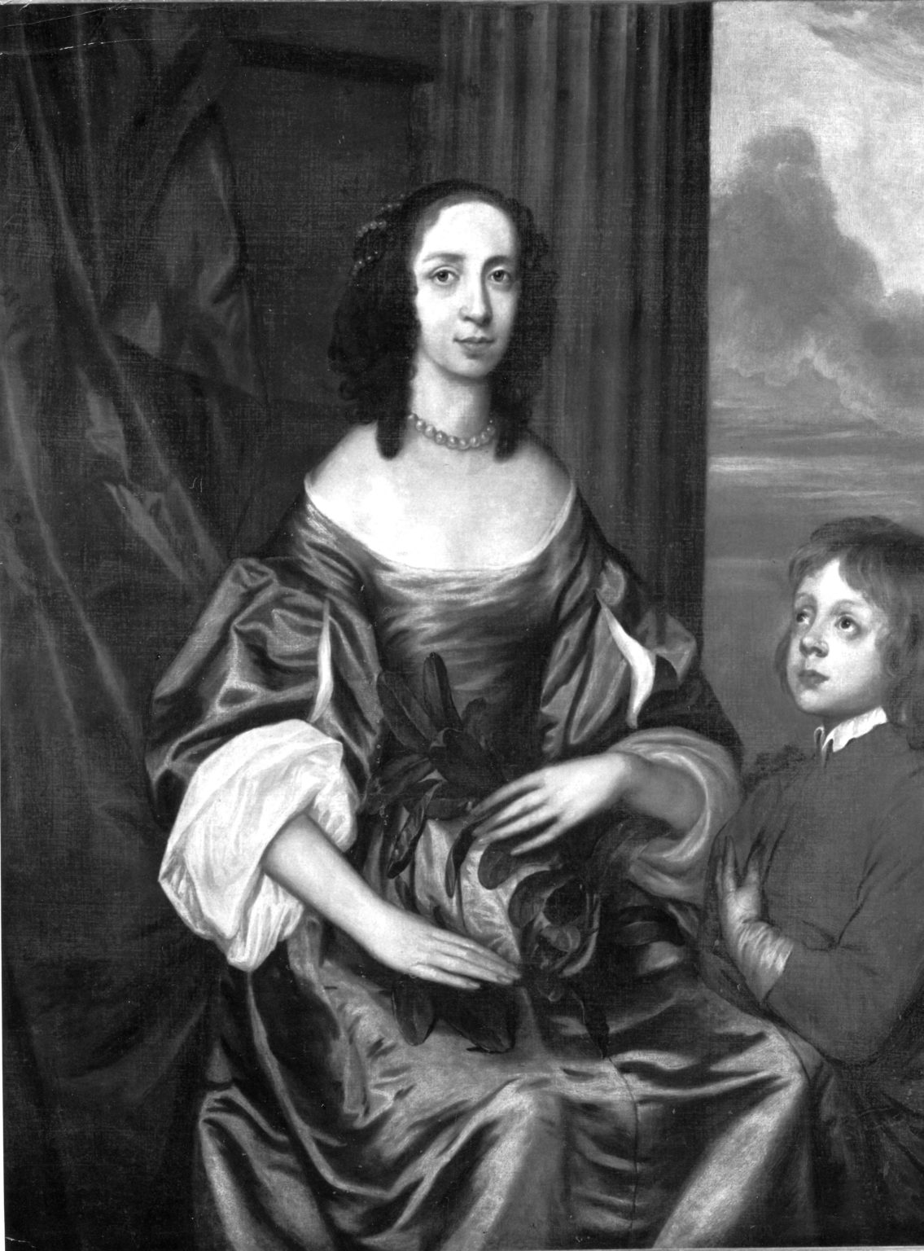
Lucy Hutchinson’s elegies were written in the 1660s after the death of John Hutchinson.
John Hutchinson was a commander in the Parliamentarian army during the Civil Wars.
Like Lucy, he opposed Cromwell’s accession to the Protectorate.
Charged with plotting against the new regime in 1663, he died in prison in Kent.

Slide 15
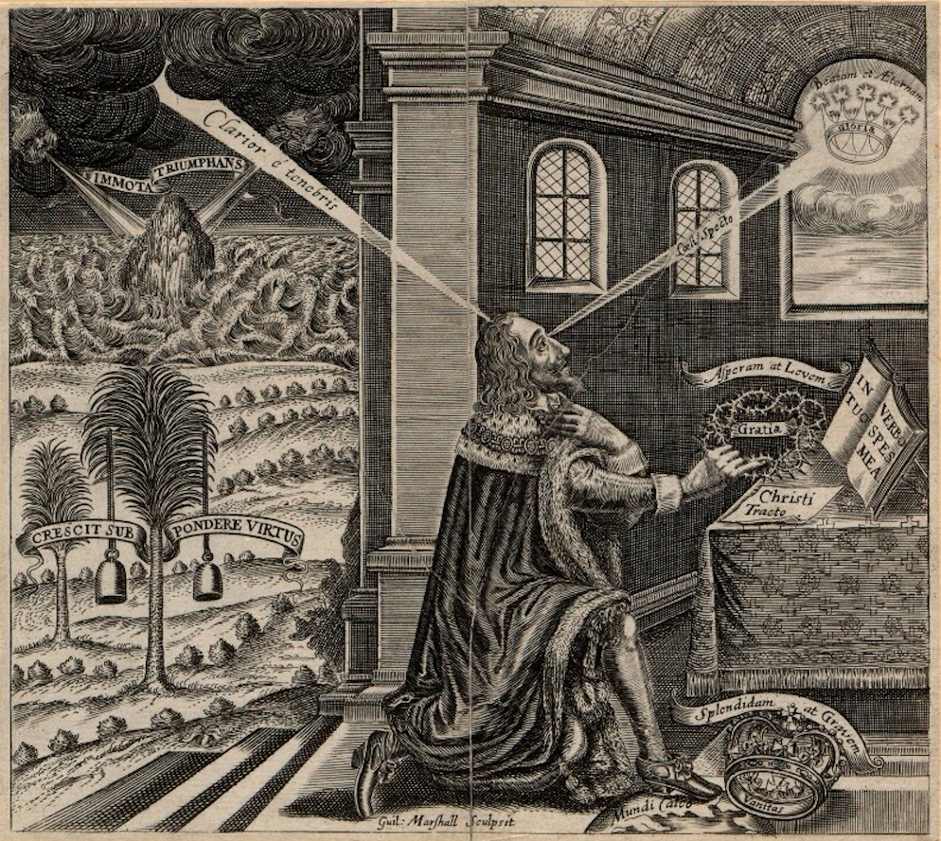
In prison’s exile, solitude, disgrace
And death itself beheld a lovely face;
On God alone he fixed his steadfast look
Till God into himself his creature took
Who all things else with God-like eyes now viewed
And, seeing them in God, saw they were good. (Elegy 1)
“Hutchinson’s elegies respond to the king’s image both as shameful and as capable of eliciting pity and that they use it to frame representations not only of her dead husband but also of her own widowed grief”
Hero Chalmers, “Lucy Hutchinson and the Image of the Imprisoned King” in Scott-Baumann, Clarke, and Ross eds. The Oxford Handbook of Early Modern Women’s Writing (Oxford, 2022), p. 581

Slide 16
Bright day star look not at me;
Thou canst not in thy circuit see
A spectacle of greater woe
[…]
Let me and my just griefs alone;
Go guild the tyrant’s bloody throne,
Cast lustre on the strumpet’s face,
Reveal their glories in full grace
And let the great ones by thy light
Act crimes, which used to black the night.
Elegy 2, lines 1-3; 15-20

