Slide 1

Literature and Revolution: Week 5
Republican and Protectoral Poetry and Poetics
Critical Frameworks
The Republic and Republican Sublimity: Marvell, ‘An Horatian Ode’
The Protectorate and Protectoral Augustanism: Waller’s Panegyric to Cromwell
Anti-Cromwellian Visual and Literary Satire

Slide 2
Critical Debates
Did the English Republic or the Cromwellian Protectorate manage to create an image or aesthetic that was distinct from the court-centred royalist aesthetics that had been in existence before the execution of the king?

Slide 3
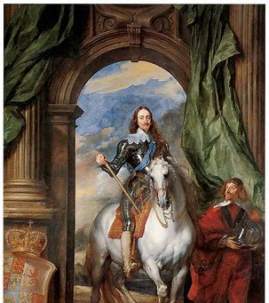
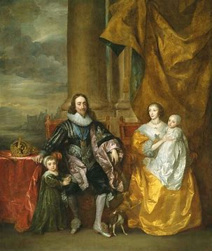

Slide 4
Critical Debates
“Both revisionist work in history and a focus on republicanism in literary studies have tended to assimilate Cromwell to monarchy. Yet a panoramic view of popular print images of Cromwell shows a more complex and shifting picture, including the bold revision of monarchical forms, the persistence of non-monarchical images…and the paradoxical role of royalist print in producing Cromwell as a populist figure” (Laura Knoppers, Constructing Cromwell (Cambridge, 2000), p. 8).
“If the origin of the Protectorate lay in the failure to construct republican discourses and images, the course and legacy of the Protectorate saw the cultural revalidation of monarchical forms and, ultimately, the reconstitution of a regal polity. Where, in the late 1640s, it was Cromwell’s name that appeared alongside that of the king, by the late 1650s he was widely heralded as king in all but name.” (Kevin Sharpe, Image Wars (New Haven and London, 2010), p, 467).

Slide 5
The English Republic (1649-1653)
‘And whereas it is and has been found by experience that the office of a king in this nation and Ireland, and to have the power thereof in any single person, is unnecessary, burdensome and dangerous to the liberty, safety and public interest of the people […] be it therefore enacted and ordained by this present Parliament that the office of a king in this nation shall not henceforth reside in or be exercised by any one single person’.
“An Act for the Abolishing of the Kingly Office” (17 March 1649)

Slide 6
Early Modern Republicanism
Support for forms of government without a king. Yes, but much else besides...
Preoccupied by the origins and exercise of power (cf. slides from Week 4 on Leveller ideas about political consent).
Two important distinctions:
  between rule imposed from above and that derived from consent
  between rule by one person and the rule of law
Early Modern republicanism does see monarchy as suspect, but it also, in theory at least, provides for the possibility of a virtuous monarch who rules with consent and according to the law.

Slide 7
Early Modern Republicanism
Virtue and virtú
In classical philosophy of Aristotle, ‘virtue’ is to demonstrate excellence in a specific skill or task.
Striving for virtue is the most important of tasks because it can lead to the good life (eudaimonia).
Eudaimonia can only best be achieved within the context of political community.
Thus, the pursuit of eudaimonia through the exercise of virtue is linked to the citizen’s public-life as part of a polity.

Slide 8
Early Modern Republicanism
Virtue and virtú
In the Renaissance philosophy of Machiavelli we see a key shift from ‘virtue’ as demonstrable excellence linked to the citizen’s actions in the political community to ‘virtú’ as the quality that allows for a political leader to exercise excellent statecraft.
Excellent statecraft, Machiavelli contends, might mean acting courageously but it probably also means acting ruthlessly and even cruelly.
Machiavellian virtú is a counterbalance to fortuna: fortuna is linked with the irrational and unpredictable; virtú dominates fortuna.
Virtú is thus focused less on the citizen’s responsibility in a state than on the leader’s maintenance of order in the state.

Slide 9
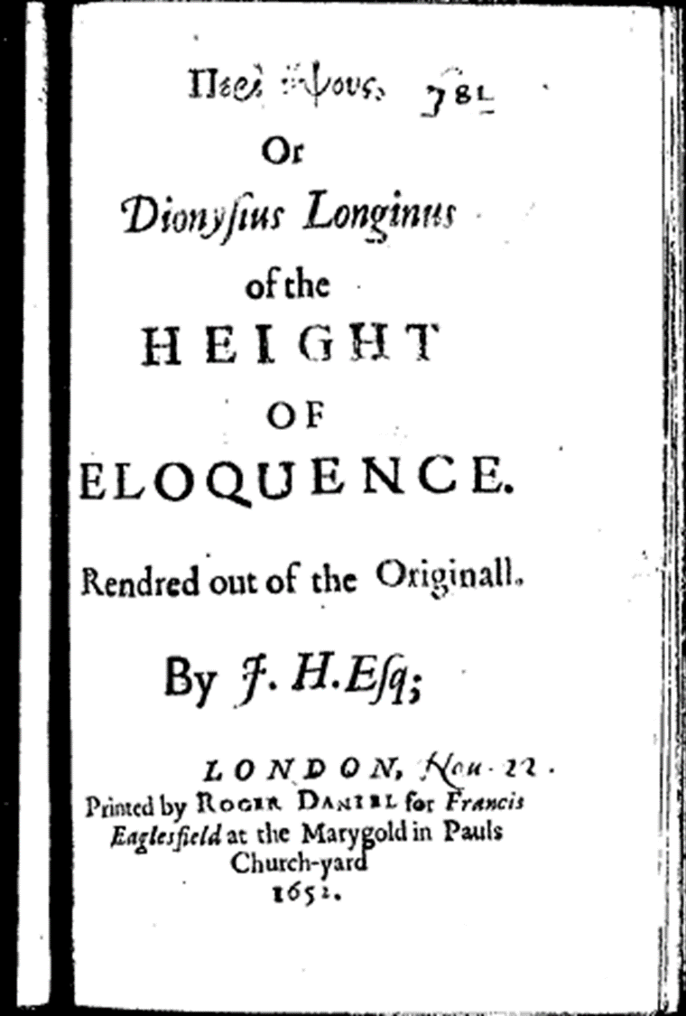
Republican Poetics: The Sublime
John Hall, whom Milton knew, translated Longinus’ treatise on the sublime in 1652. He recommends five parts of sublime eloquence:
vastness of thought
fierce and transporting passion
variation of figures of speech
elaborate elocution
nobility and beauty of disposition

Slide 10
Marvell, ‘An Horatian Ode’
So restless Cromwell could not cease
In the inglorious arts of peace,
But through adventurous war
Urgèd his active star:
And like the three-fork’d lightning, first
Breaking the clouds where it was nurst,
Did thorough his own Side
His fiery way divide (ll. 9-16)

Slide 11
The Instrument of Government
“…as touching the frame and constitution of the Government established…we shall have Triennial Parliaments, and the first to begin on the third of September next, and so from three years to three years. That Parliaments shall be chosen by the People, according to certain Qualifications set down in the said Parchment; That the time of their sitting shall be for five months. That such Laws as shall be agreed on in Parliament shall be presented to the Lord Protector for his assent; which if it be not obtained within 20 days, then those Bills shall pass notwithstanding, and become Laws in ful force and vertue. Strict provision is made also for the succession of Parliaments, the management of Elections, and of Returns to be made by the several Sheriffs of the persons elected. That the Lord Protector shall govern with the advice and consent of his Councel, the number of whom shall not be less than 13. and not exceed 21. This is the form of Government in general” (Mercurius Politicus 184, Dec. 1653)

Slide 12
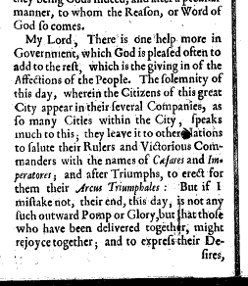
Account of a speech delivered at Oliver Cromwell’s investiture as Lord Protector (February 1654)
Is this a ‘royal’ ceremony?
‘In this account…Cromwell was not a Caesar but a new kind of ruler, whose power drew upon the consent of the people.’ (Laura Knoppers, Constructing Cromwell, p. 78).

Slide 13
Marvell, The First Anniversary (1655)
’Tis he the force of scatter’d Time contracts,
And in one Year the Work of Ages acts:
While heavy Monarchs make a wide Return,
Longer, and more Malignant then Saturn:
And though they all Platonique years should raign,
In the same Posture would be found again.
Their earthly Projects under ground they lay,
More slow and brittle then the China clay:
Well may they strive to leave them to their Son,
For one Thing never was by one King don.

Slide 14
Marvell, The First Anniversary (1655)
He seems a king by long succession born,
And yet the same to be a king does scorn.
Abroad a king he seems, and something more,
At home a subject on the equal floor.
O could I once him with our title see,
So should I hope that he might die as we.
But let them write his praise that love him best,
It grieves me sore to have thus much confessed’ (ll. 387-394)
Notes:
.

Slide 15
Waller and ‘Protectoral Augustanism’
[38]
This Caesar found, and this ungratefull Age
With losing him, went back to blood and rage:
Mistaken Brutus thought to break their Yoak,
But cut the bond of Union with that stroak.
[39]
That Sun once set, a thousand meaner Starres
Gave a dimme Light to Violence and Warres,
To such a Tempest as now threatens all,
Did not your mighty Arme prevent the fall.
“In a kind of rhetorical sleight of hand, Waller manages to make Cromwell the true heir of the Roman emperors and of the Stuarts” (David Norbrook, Writing the English Republic, p. 306).

Slide 16
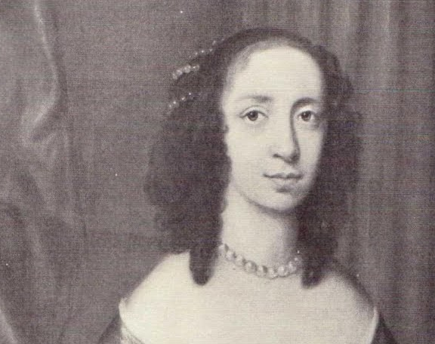
Lucy Hutchinson (1620-81)
Republican and Puritan writer.
Her prose life of her husband, John Hutchinson – Memoirs of the Life of Colonel Hutchinson – defends her regicide husband and chronicles the history of the Civil Wars from a republican perspective.
Her manuscript verse response to Waller’s poem on Cromwell was discovered in the mid 1990s.
Questions to think about when reading this response: how does Hutchinson satirise Waller’s style? What does she think about Cromwell?

Slide 17
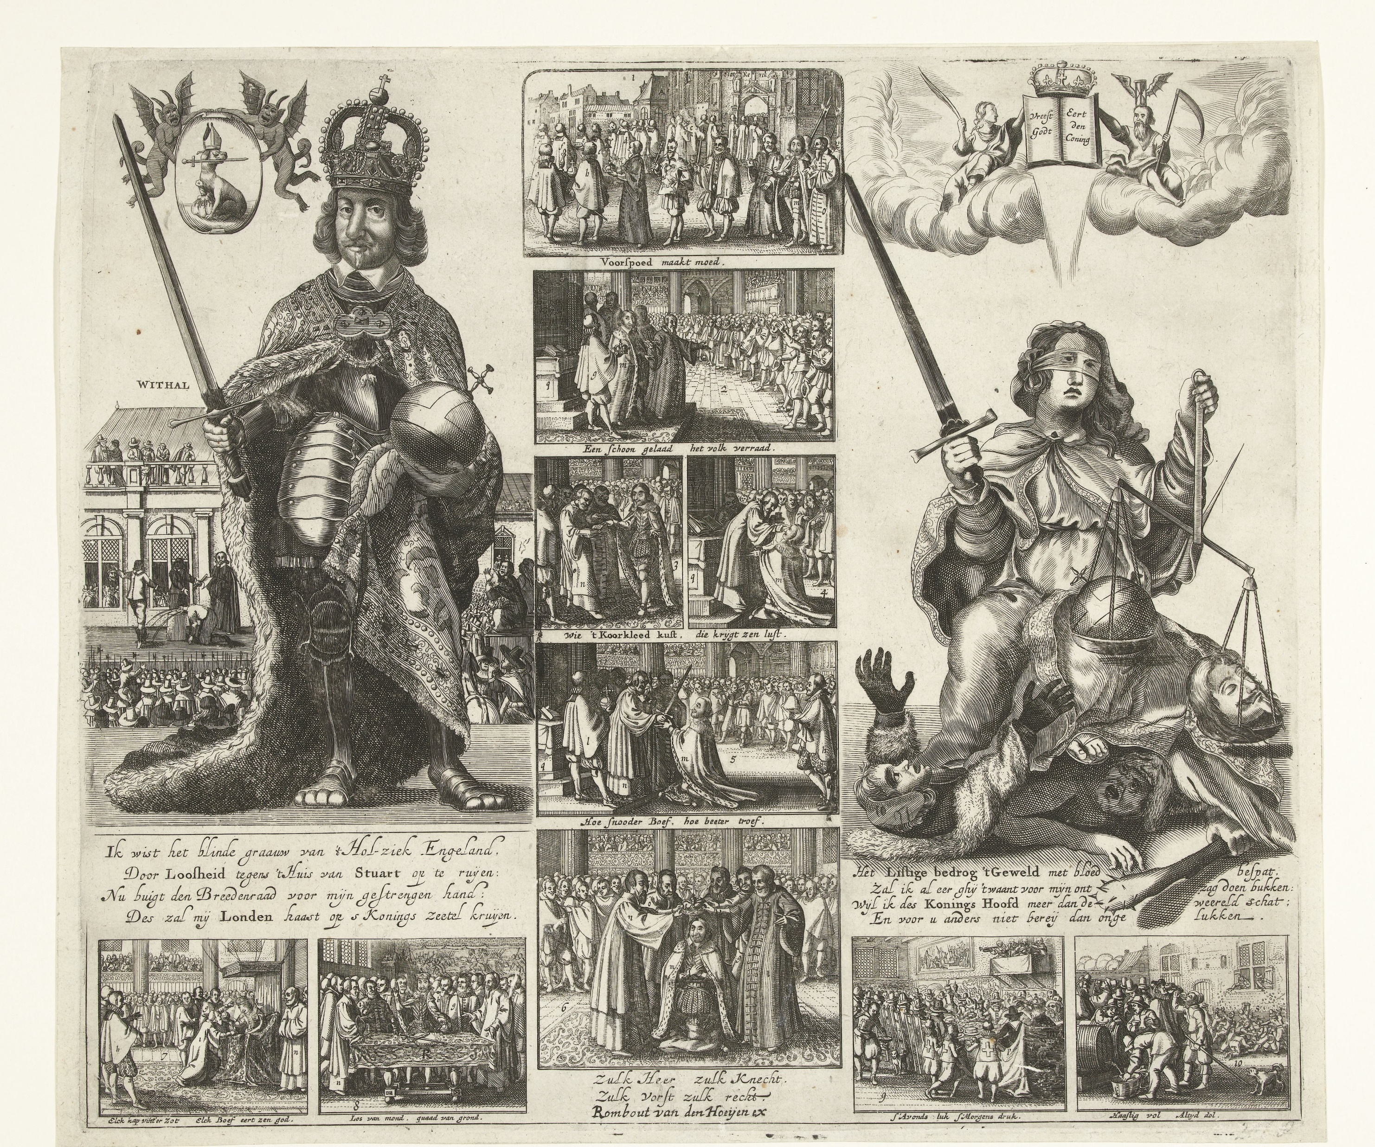
Romeyne de Hooghe, The Coronation of Oliver Cromwell (1649)

Slide 18
‘Cromwell’s Coronation’
Oliver, Oliver, take up thy Crown,
For now thou hast made three Kingdoms thine own;
Call thee a Conclave of thy own creation,
To ride us to ruine, who dare thee oppose:
Whilst we thy good people are at thy Devotion,
To fall down and worship thy terrible Nose. (ll. 1-6)

Slide 19
